Slide 1
: neutrino astronomy and more
Piotr Kalaczyński, pkalaczynski@camk.edu.pl
The 6th Young Astronomers Meeting at CAMK-PAN
08.03.2024

Slide 2
Outline
2
Analyses
Introduction
Summary
KM3NeT

Slide 3
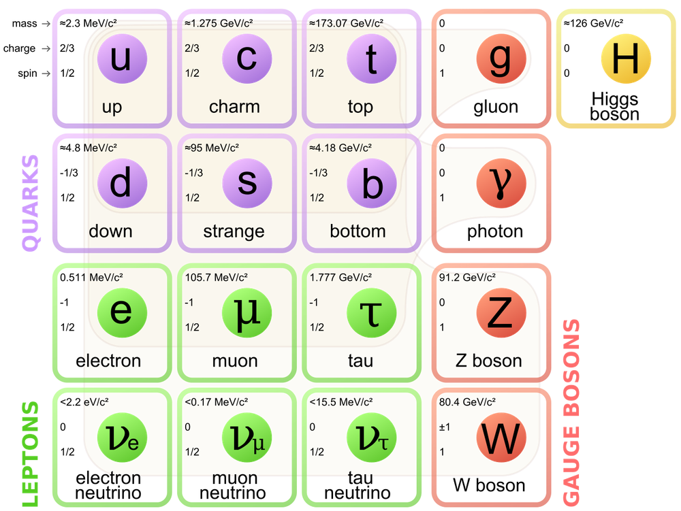
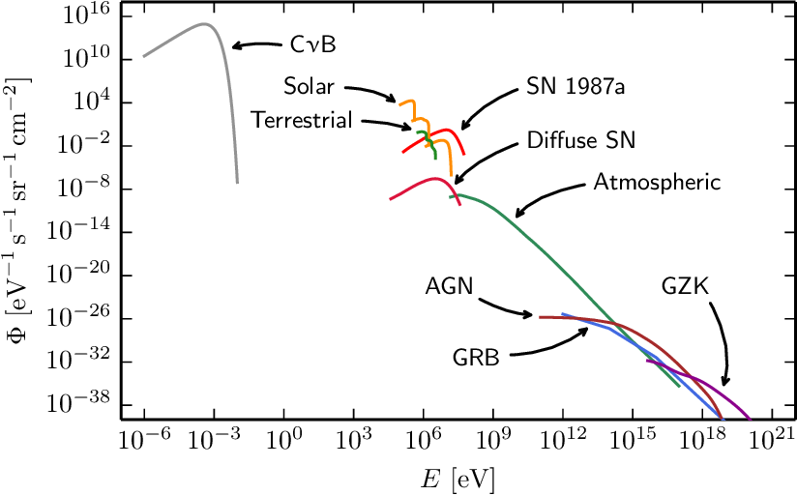
Neutrino sources
3
KM3NeT $E$ scale

Slide 4
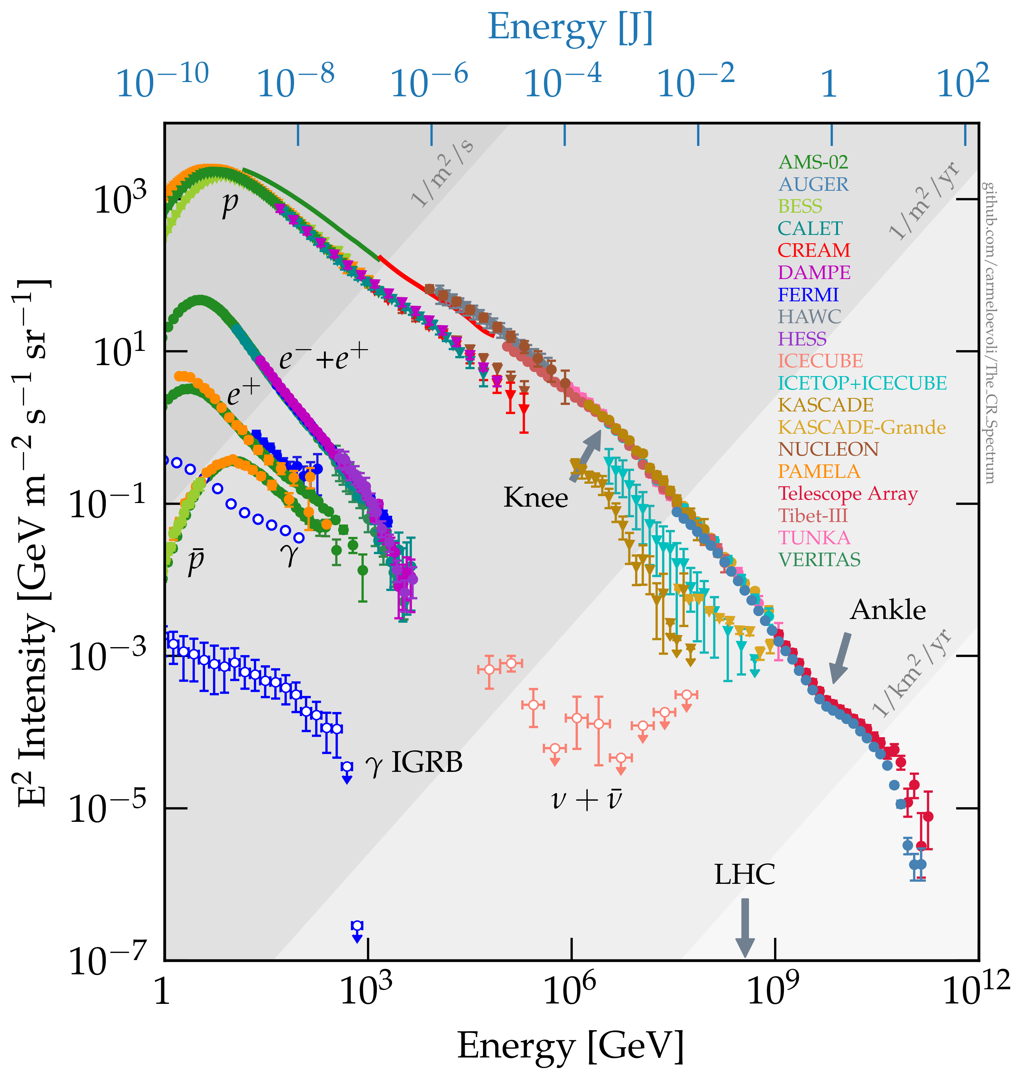
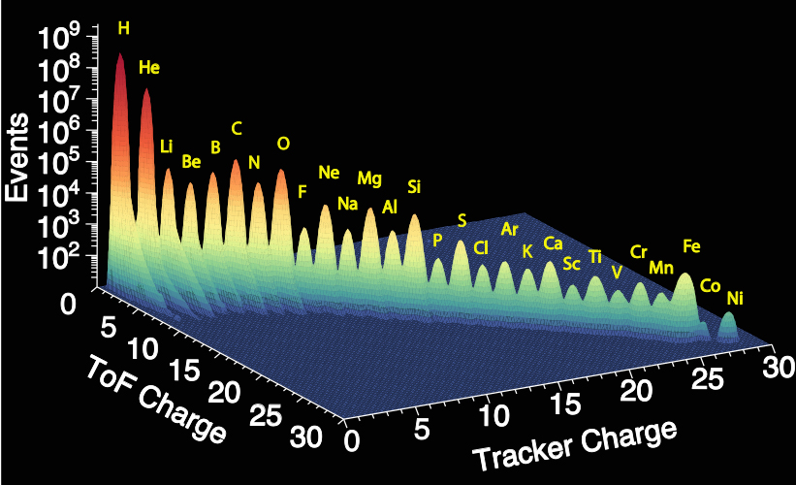
Cosmic rays
4
Cosmic Rays (CR):
High-Energy particles & nuclei arriving at Earth from outer space
First discovered by Victor Hess in 1912 (Nobel prize in 1936)
Quite a few measurements since then, e.g.:
https://doi.org/10.1016/j.physrep.2020.09.003

Slide 5
Outline
5
Analyses
Introduction
Summary
KM3NeT

Slide 6
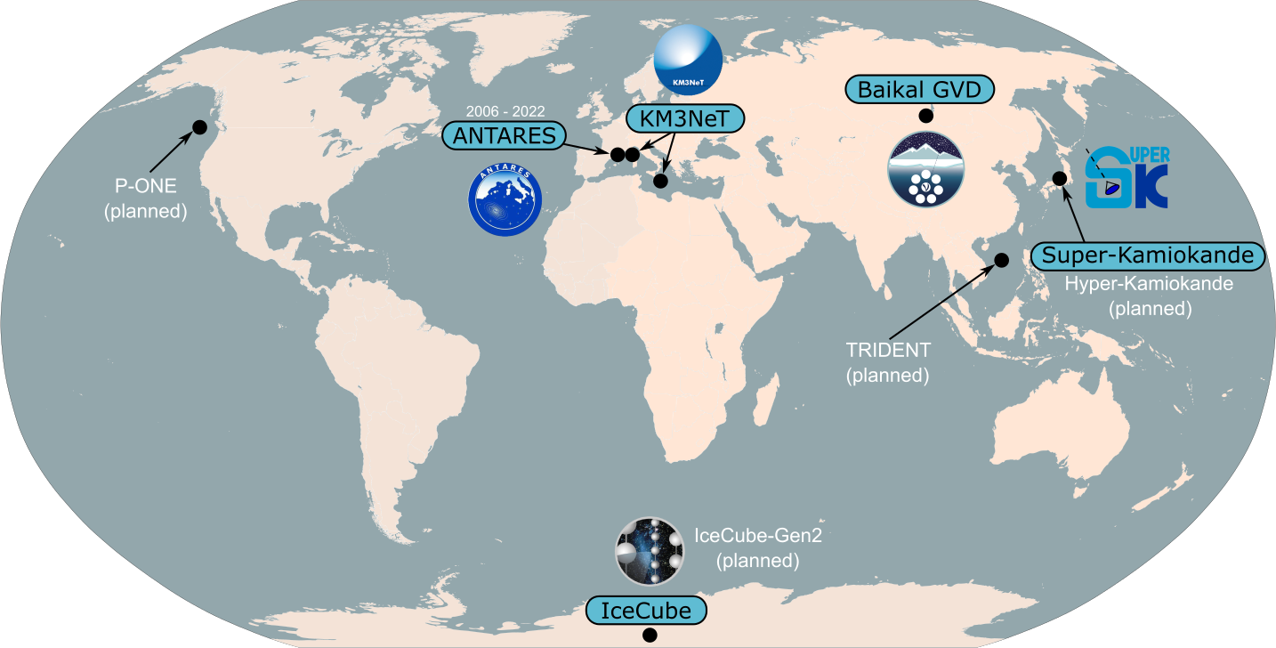
Water Cherenkov $ν$ telescopes
6

Slide 7
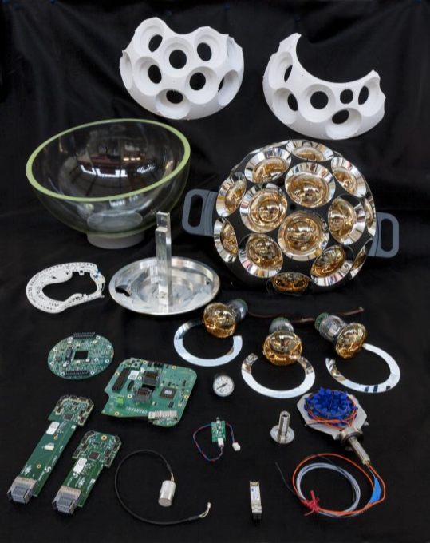
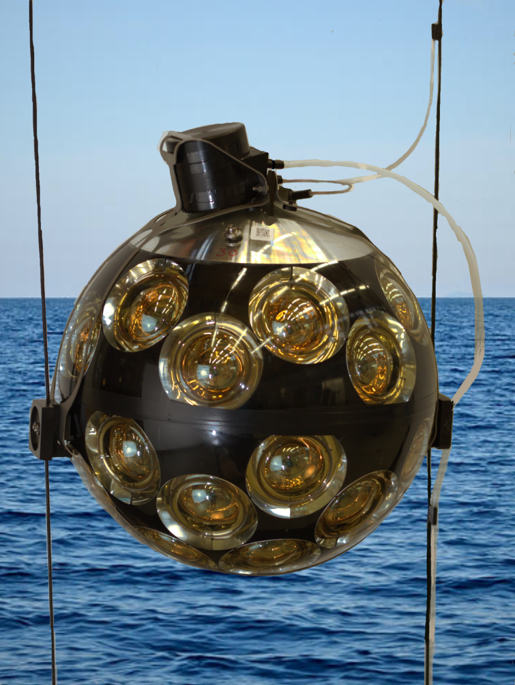
Detector design summary
7
DOM: 71 unique components
1 DOM:
31 PMTs
1 string (DU):
18 DOMs
1 building block:
115 DUs
DOM production:(@Nikhef)
Preparation for deployment:
String deployment:
More at:
youtube.com/KM3NeTneutrino

Slide 8
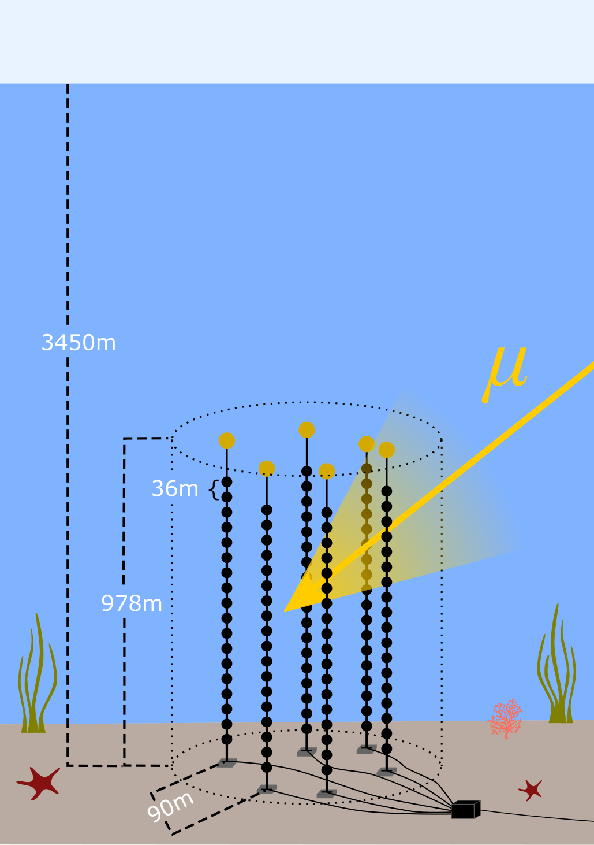
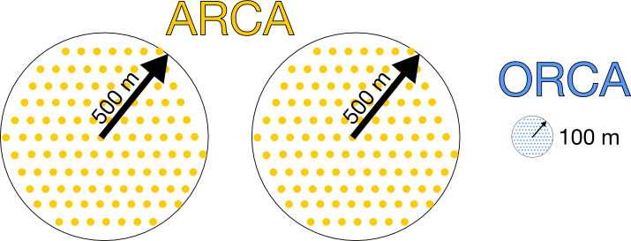
Detectors: details
8
Detector | ARCA | ORCA
Depth | $$3.5 km$$ | $$2.45 km$$
Volume | $$1 km^{3} (1Gton)$$ | $$0.007 km^{3} (7Mton)$$
# strings | 28 / 2x115 | 16 / 115
Topic | Astroparticle RCA* | Oscillation RCA*
Goal | $$ν_{astro}$$ | $m_{ν}$hierarchy
ARCA6
(ARCA with 6 strings)
*RCA : Research with Cosmics in the Abyss

Slide 9
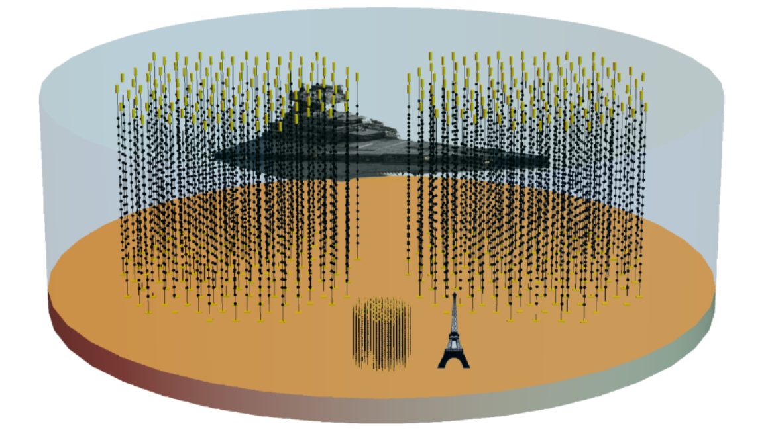
Detector size comparison
9
ARCA2x115
Credit: Joao Coelho
YES, the imperial star destroyer
IS up to scale!
ORCA115
https://www.pngegg.com/en/png-sujmc

Slide 10
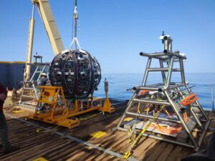
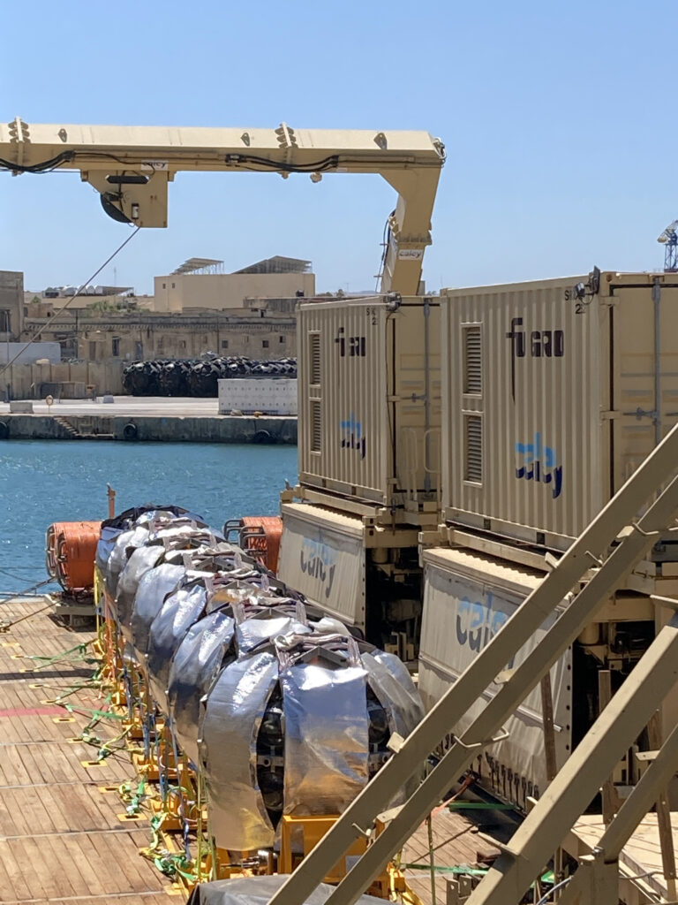
Current status & history
10
ARCA timeline
ORCA timeline
Dec 2015: first strings
…
Sep 2023: +10 strings
Currently: ARCA28!
…
Summer 2024: next deployment
…
2032(?): ARCA2x115
Dec 2017: first strings
…
Apr 2023: +3 strings
Currently: ORCA16!
…
Dec 2023: next deployment
…
2030(?): ORCA115
more details
more details
For more follow us at:
https://www.km3net.org

Slide 11
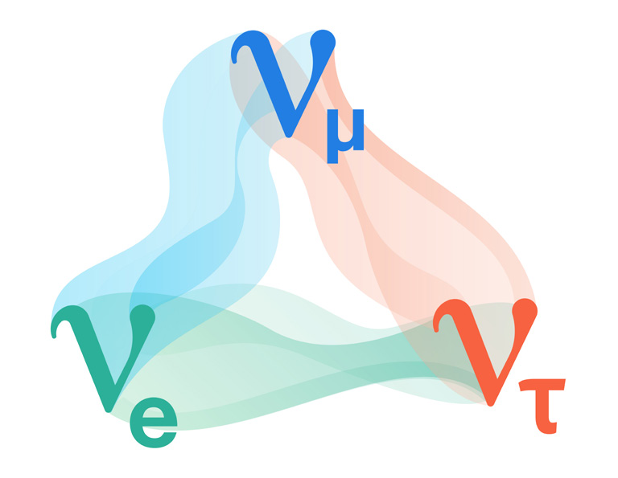
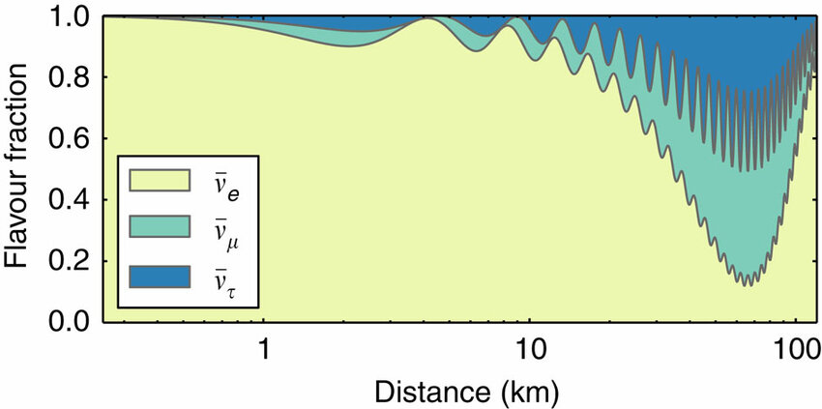
Outline
11
Analyses
Introduction
Summary
KM3NeT
Osci
Astro
CR & other
https://sanfordlab.org/article/why-dune-searching-origin-matter
Interactions of neutrinos:
gravitational
weak
$ν$ oscillations
DOI: 10.1038/ncomms7935

Slide 12
Neutrino oscillation parameter fit
12
ORCA6
$$\sin^{2}{ θ_{23}=0.51\begin{matrix}+0.06 \\ −0.07\end{matrix}}$$
$$Δm_{31}^{2}{ =\left(2.14\begin{matrix}+0.36 \\ −0.25\end{matrix}\right)⋅{10}^{−3} eV^{2}}$$
Best fit
Preference for normal ordering (NO): $−2\log\left(\frac{L_{NO}}{L_{IO}}\right)=0.9$
PoS(ICRC2023)996

Slide 13
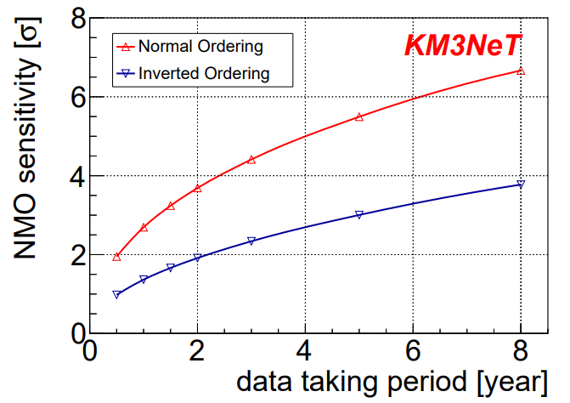
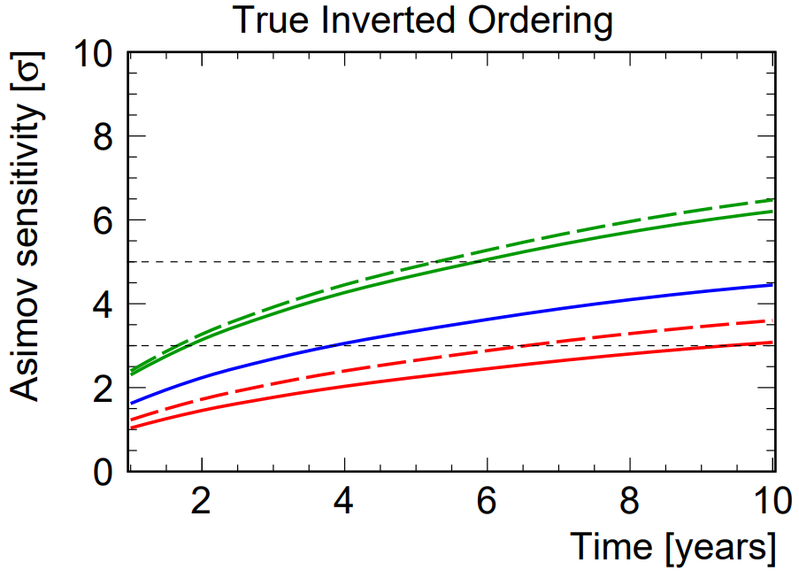
Neutrino Mass Ordering (NMO) sensitivity
13
ORCA115
ORCA115 + JUNO
Eur. Phys. J. C 82, 26 (2022)
JINST 16 C11007 (2021)
Possibly world-first to determine NMO!

Slide 14
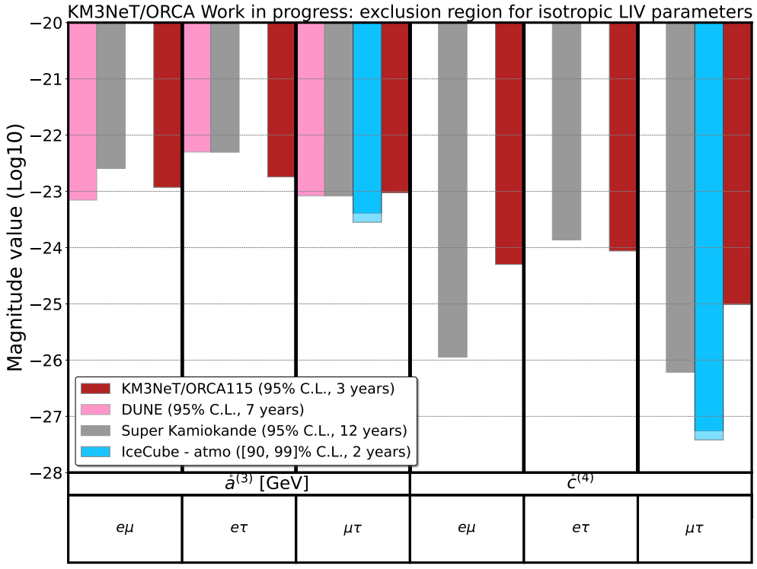
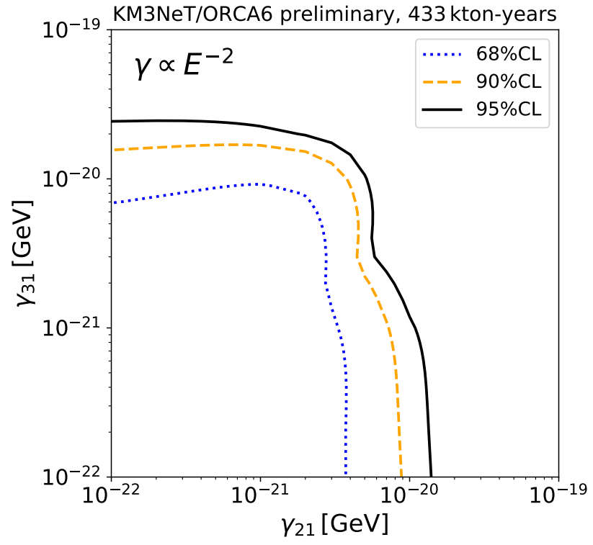
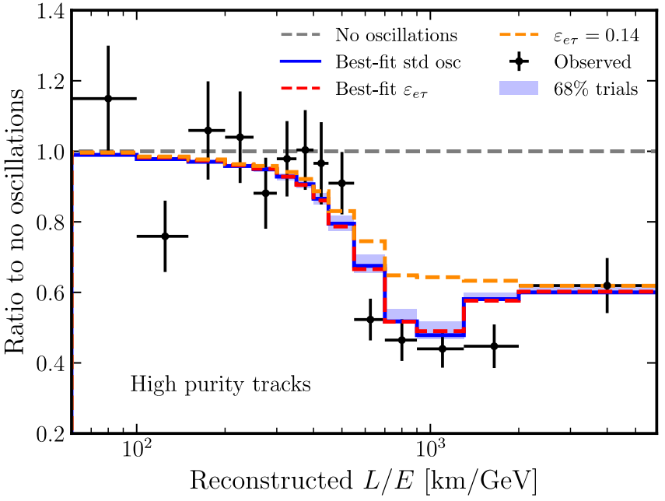
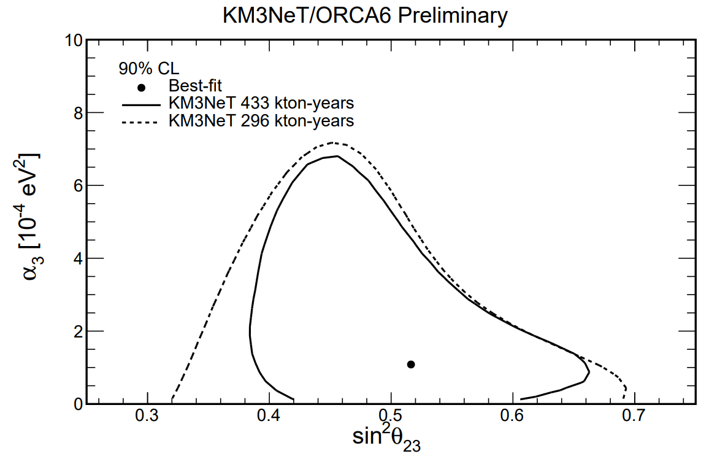
There’s more …
14
Only selected analyses covered.
See backup and arXiv:2309.05016 for more!
Other osci topics include:
Lorentz Invariance Violation [PoS(ICRC2023)1086]
Quantum decoherence [PoS(ICRC2023)1025]
Non-Standard Interactions [PoS(ICRC2023)998]
Invisible neutrino decay [PoS(ICRC2023)997]
…

Slide 15
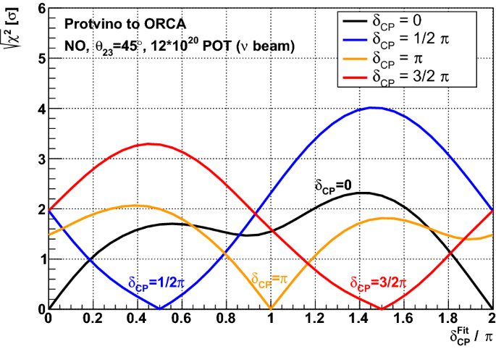
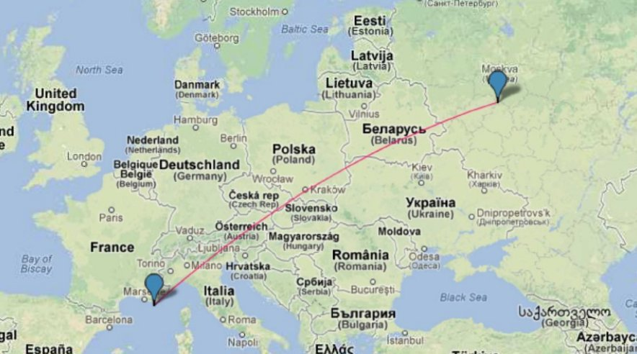
Neutrino oscillations
15
Current Osci open tasks (aka potential theses):
Impact of High QE PMT performance on NMO sensitivity
Systematic uncertainty study for ORCA6 (and larger configs)
Study of systematic correlations
Reconstruction of Bjorken-y
Identification of neutral current (NC) events
Some more ideas:
Neutrino beam to ARCA/ORCA? (proposed Protvino to ORCA (P2O) obviously not happening any time soon …)
Sensitivity to $δ_{CP}$
…
your ideas?
https://doi.org/10.1140/epjc/s10052-019-7259-5

Slide 16
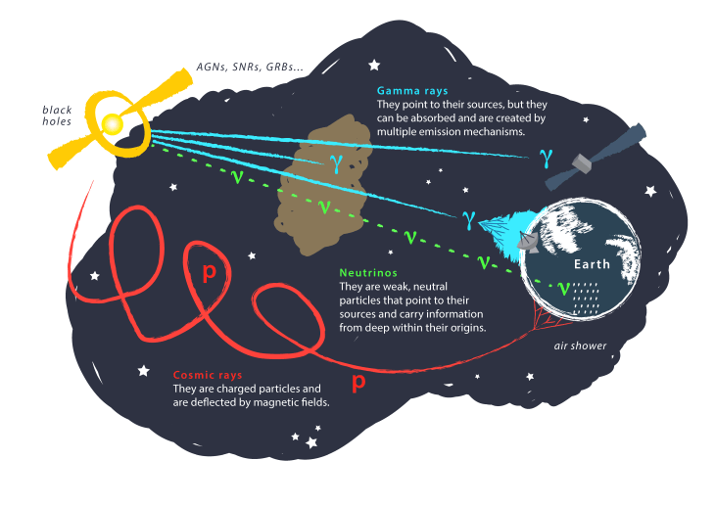
Outline
16
Analyses
Introduction
Summary
KM3NeT
Osci
Astro
CR & other
Image: Juan Antonio Aguilar and Jamie Yang. IceCube/WIPAC

Slide 17
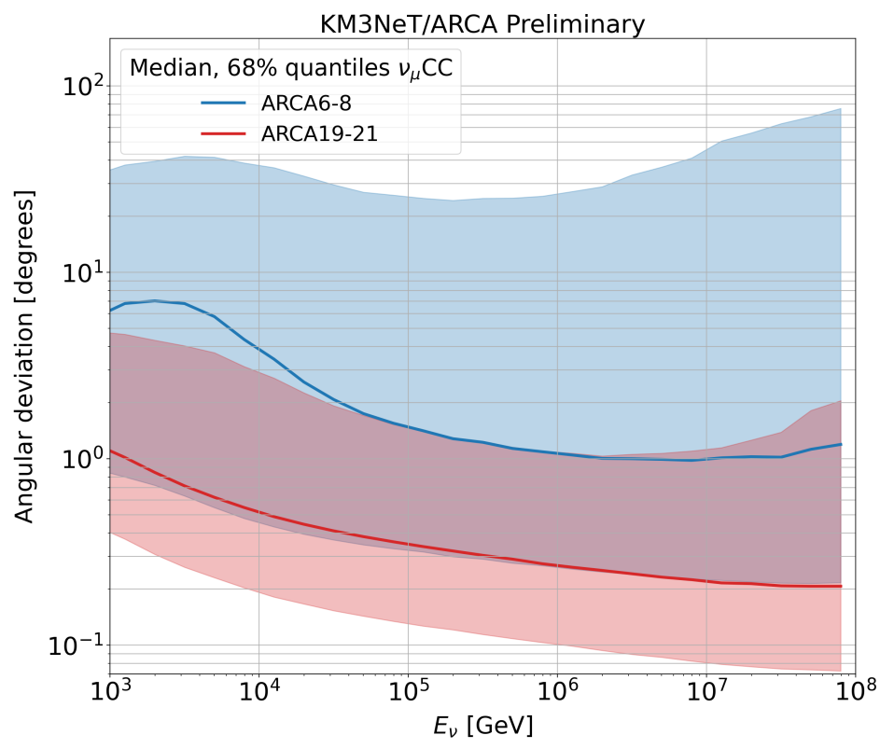
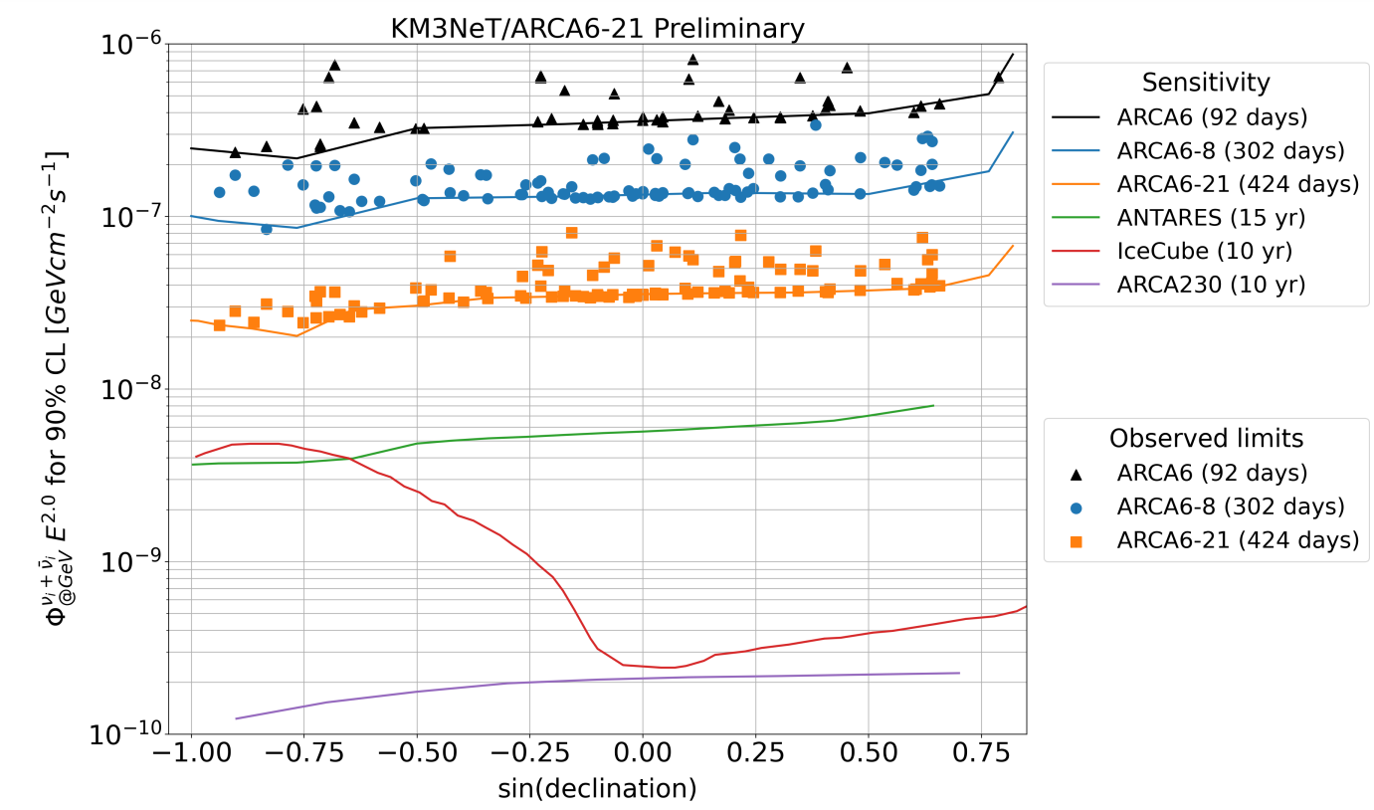
Point source sensitivity
17
Some details:
$t$-integrated PS search
101 candidate sources
Detector: ARCA6-21
Livetime: 424d (May-Sep 2021)
$Δψ\sim 1°$ (for $E^{−2}$)
Results:
No significant excess [expected]
Limits not (yet) competitive [expected]
Best source: Centaurus A ($p=0.02$) (radio galaxy; yellow arrow)
PoS(ICRC2023)1018

Slide 18
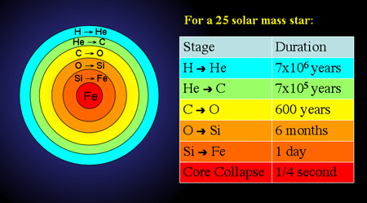
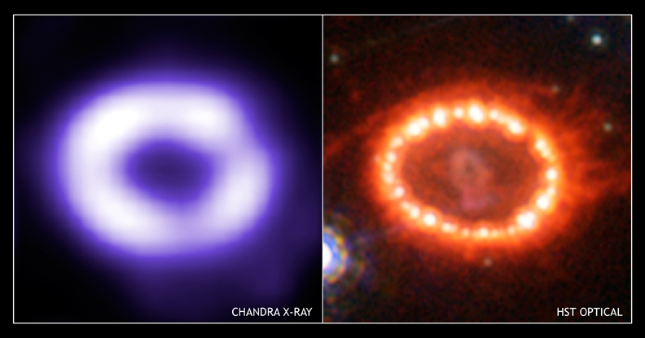
Sensitivity to supernovae
18
Explosion mechanism not fully understood but we know:
99% of $E_{grav}→ν$ when $γ$ cannot escape
CCSN* produce MeV $ν$’s
First and only observation: 24$ν$ from SN1987A
JINST 16 C09034 (2021)
*core-collapse supernova (type II)

Slide 19
Sensitivity to supernovae
19
Explosion mechanism not fully understood but we know:
99% of $E_{grav}→ν$ when $γ$ cannot escape
CCSN* produce MeV $ν$’s
2 ways to detect a SN:
• measure the $ν$’s
• background rate
KM3NeT $E_{ν}$ threshold few GeV
JINST 16 C09034 (2021)
*core-collapse supernova (type II)

Slide 20
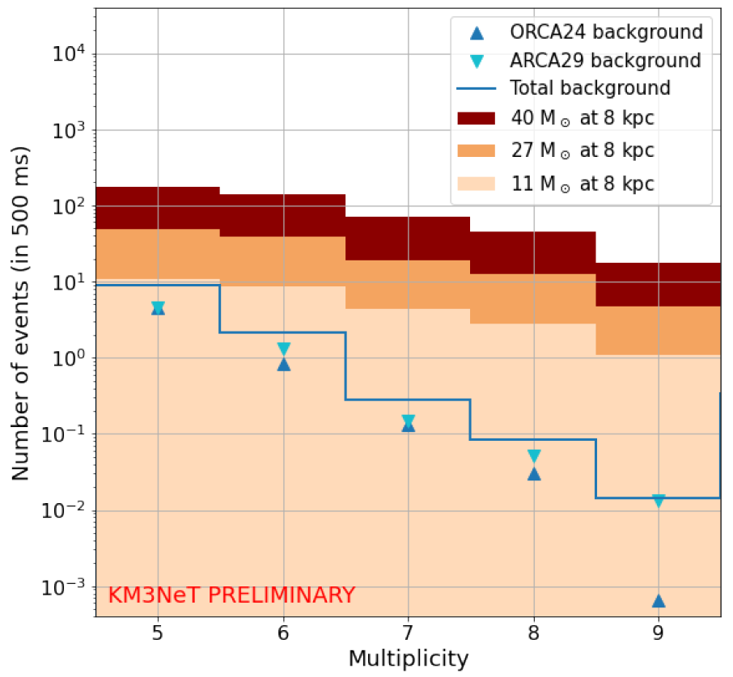
Sensitivity to supernovae
20
Explosion mechanism not fully understood but we know:
99% of $E_{grav}→ν$ when $γ$ cannot escape
CCSN* produce MeV $ν$’s
2 ways to detect a SN:
• measure the $ν$’s
• background rate
with BDT cuts
PoS(ICRC2023)1160
(number of hit PMTs on a DOM)
JINST 16 C09034 (2021)
*core-collapse supernova (type II)

Slide 21
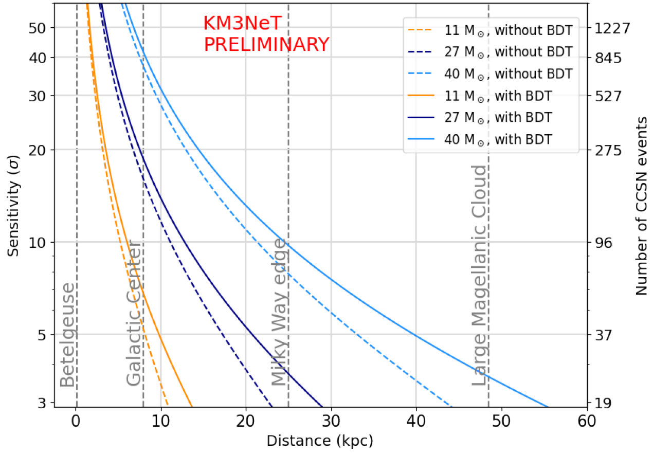
Sensitivity to supernovae
21
Explosion mechanism not fully understood but we know:
99% of $E_{grav}→ν$ when $γ$ cannot escape
CCSN* produce MeV $ν$’s
ARCA115 + ORCA115
2 ways to detect a SN:
• measure the $ν$’s
• background rate
with BDT cuts
PoS(ICRC2023)1160
Status:
SN alert system in place
Part of the SNEWS network
So far no SN detection
(number of hit PMTs on a DOM)
*core-collapse supernova (type II)

Slide 22
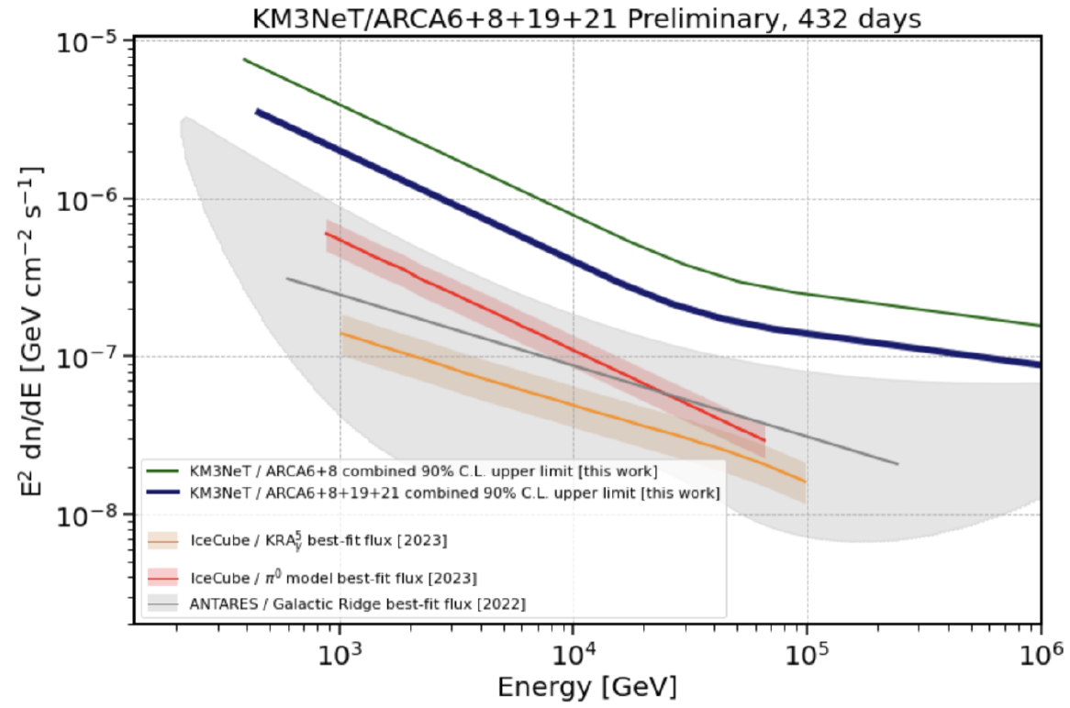
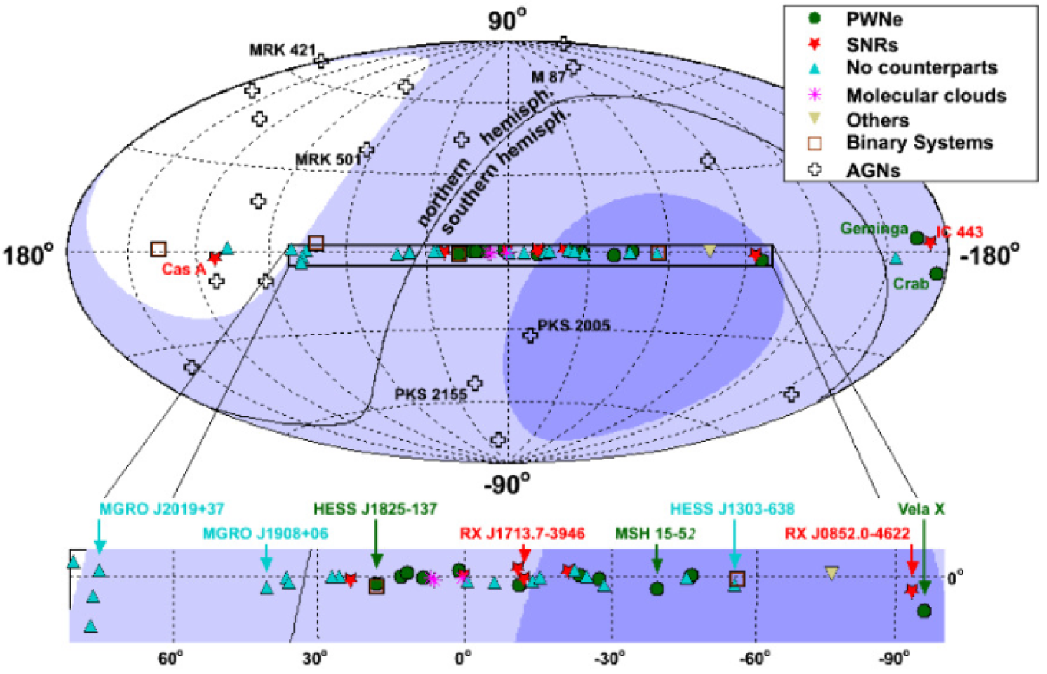
Galactic ridge
22
Sources in the galactic centre → high-energy CRs
CR + interstellar medium → $ν$’s!
PoS(ICRC2023)1190
detector: ARCA6-21
livetime: 432d
assumed spectrum: $φ=φ_{0}⋅E^{−Γ_{ν}}$, $Γ_{ν}:2.2−2.8$
method: ON/OFF technique:
ON region: galactic ridge $(|L_{gal} | <30°$, $|B_{gal} | <2°$)
12 OFF regions: time-shifting the ON region (avoiding the Fermi Bubbles)

Slide 23
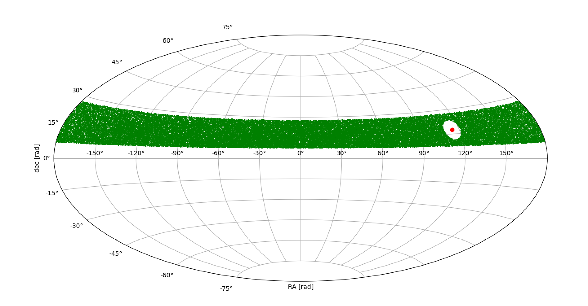
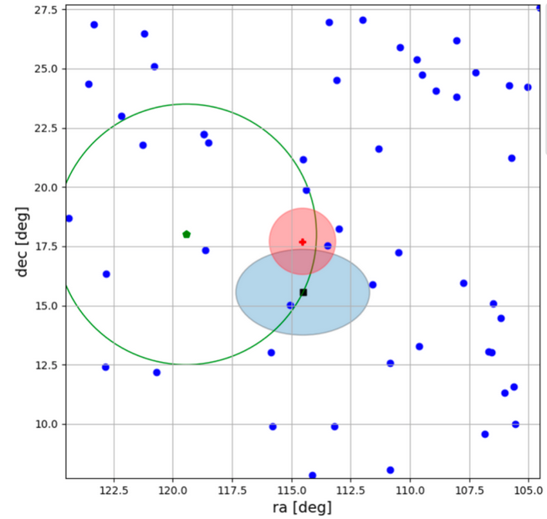
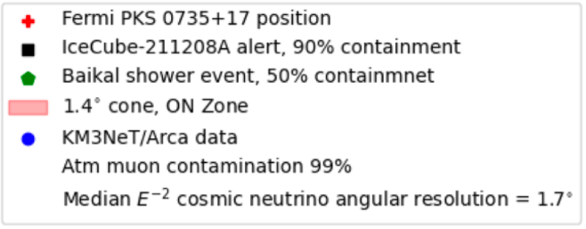
Follow-up observations
23
Method: ON/OFF technique
ON region: cone centered on the source position
OFF region: declination band centered at the source’s position (but with ON region subtracted). The solid angle is rescaled to be able to compare with the ON region.
Example for PKS 0735+17 blazar:
Original detection | Alert(s) | Object name | Events in ON region
Fermi | - | GRB 221009A | 0
LIGO/Virgo | - | O3 run (55 events) | 0
IceCube | IC211208A | PKS 0735+17 | 1*
IceCube | IC220205B | PKS 1741-03 | 0
IceCube | IC220225A | PKS 0215+15 | 0
IceCube | IC220304A | TXS 0310+022 | 0
PoS(ICRC2023)1521
detector: ARCA8, ORCA10
assumed spectrum:
$φ=φ_{0}⋅E^{−2}$ (all alerts)
selection:
upgoing track-like events
*No significant discovery, only 1 $ν_{μ}$ candidate with $E\sim 18TeV$ ($p=0.14$)
[expected]
Poster P0739 @Neutrino2022

Slide 24
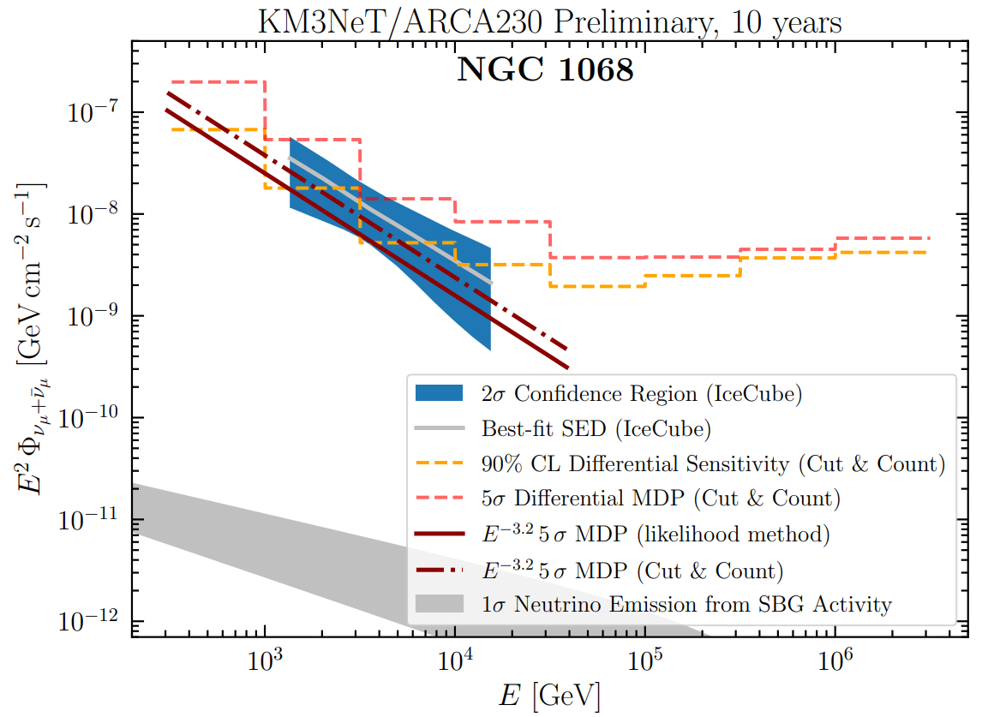
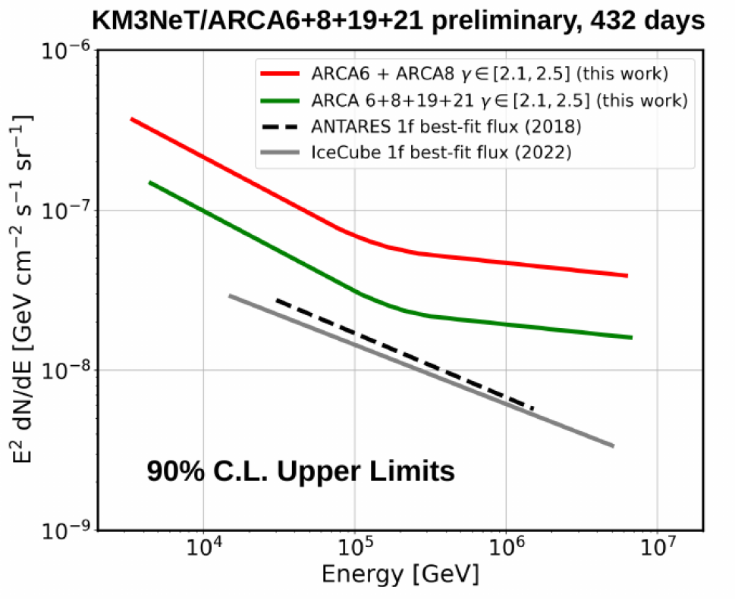
Again, there’s even more …
24
Only selected analyses were covered.
See backup and arXiv:2309.05016 for more!
Other astro topics include:
Microquasar flares [PoS(ICRC2023)1505]
Diffuse neutrino flux [PoS(ICRC2023)1195]
Starburst galaxies [PoS(ICRC2023)1150]
…

Slide 25
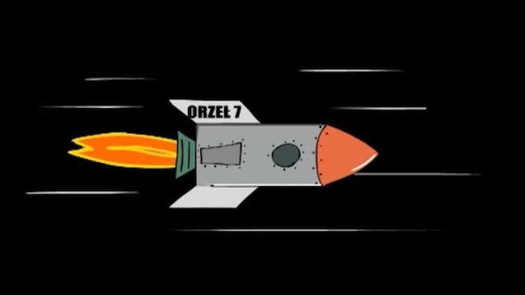
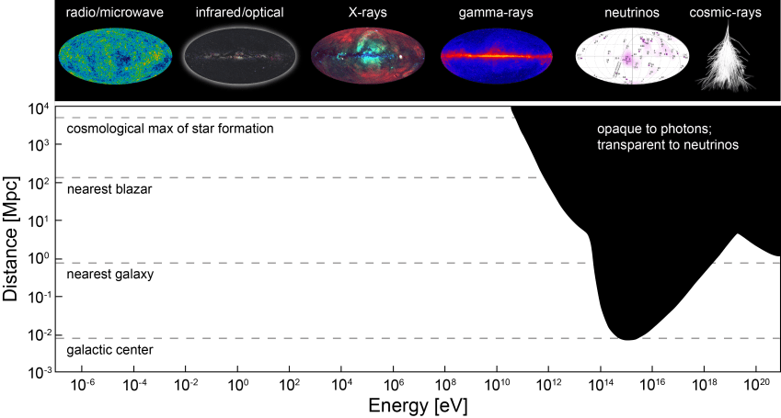
Neutrino Astronomy
25
you never know what may lurk in the outer space …
Current Astro open tasks (aka potential theses):
Online monitoring, transient events, alert follow-ups
Cosmic tau neutrino search
ARCA 6-21 stacking analysis
Some more ideas:
Search for point sources: angular auto- and/or cross-correlation analysis
Neutrino emission from UHE catalogs, e.g. LHAASO
Blazar Flares
Fermi Bubbles
…
your ideas?
https://icecube.wisc.edu/science/research/

Slide 26
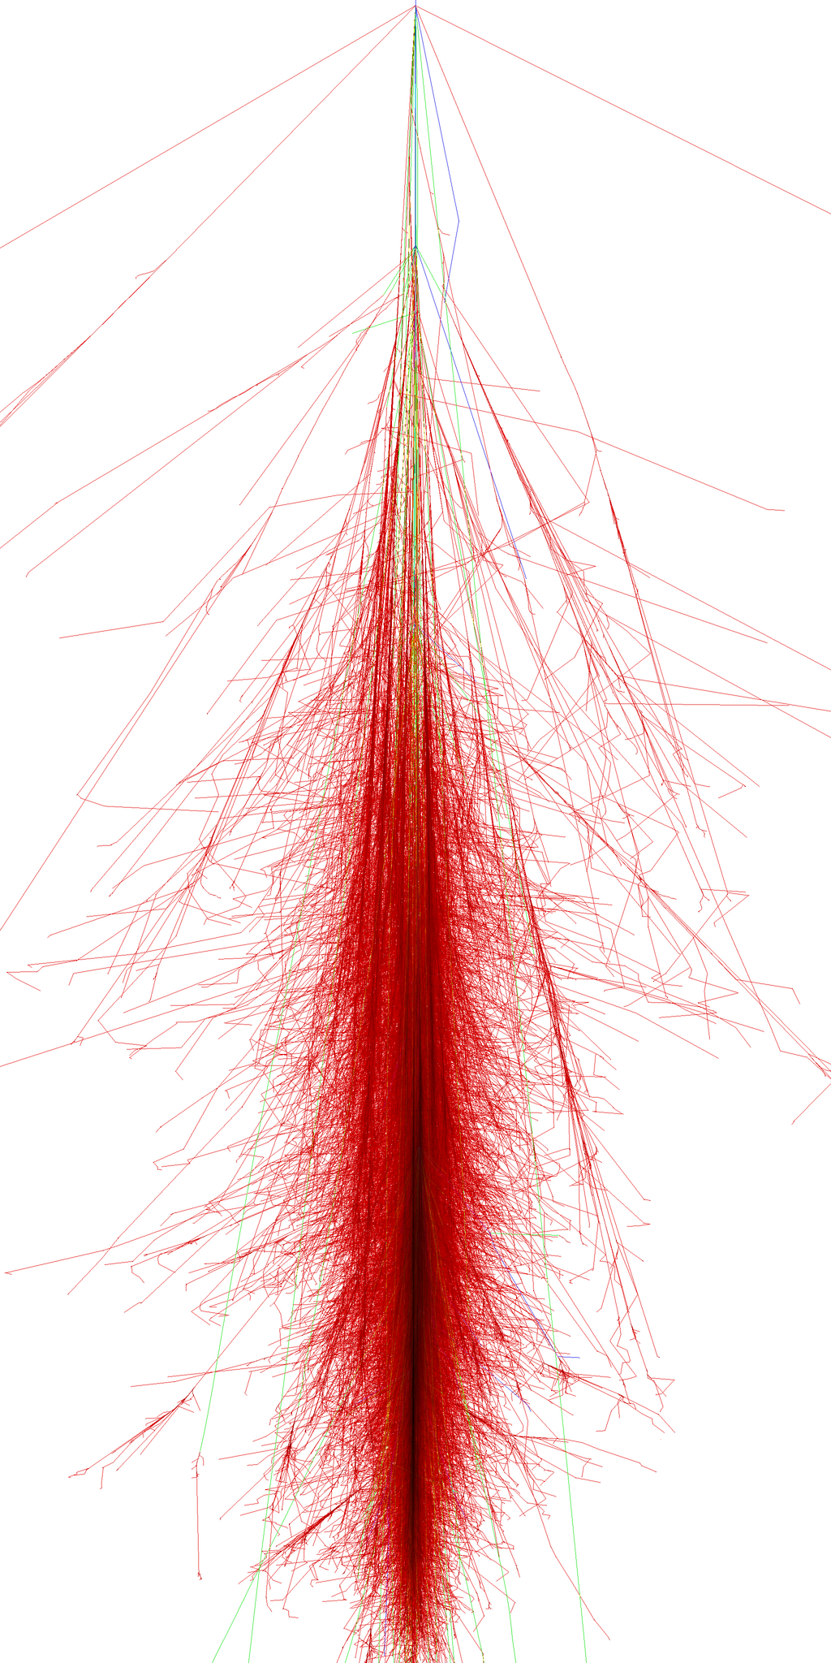
Outline
26
Analyses
Introduction
Summary
KM3NeT
Osci
Astro
CR & other

Slide 27
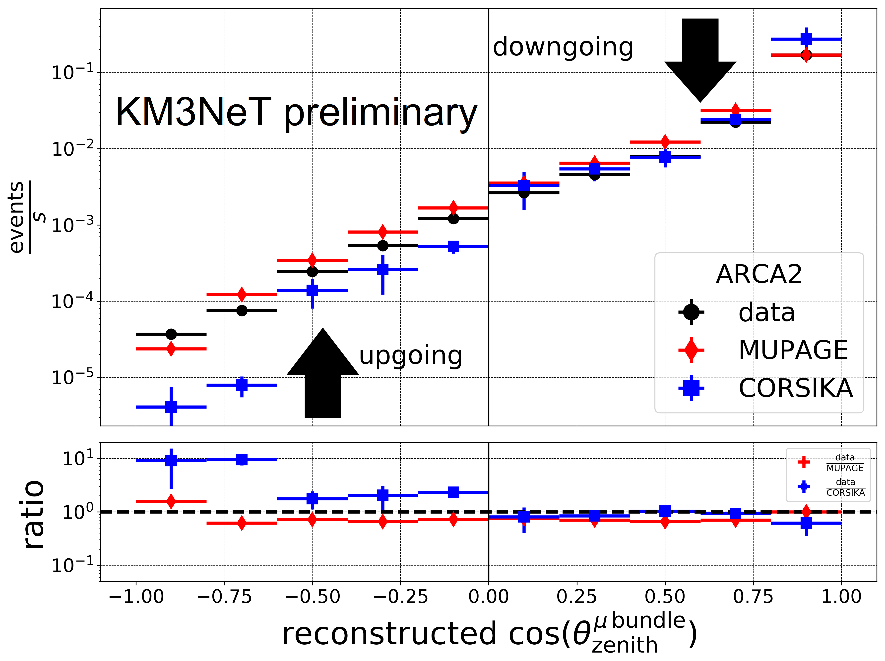
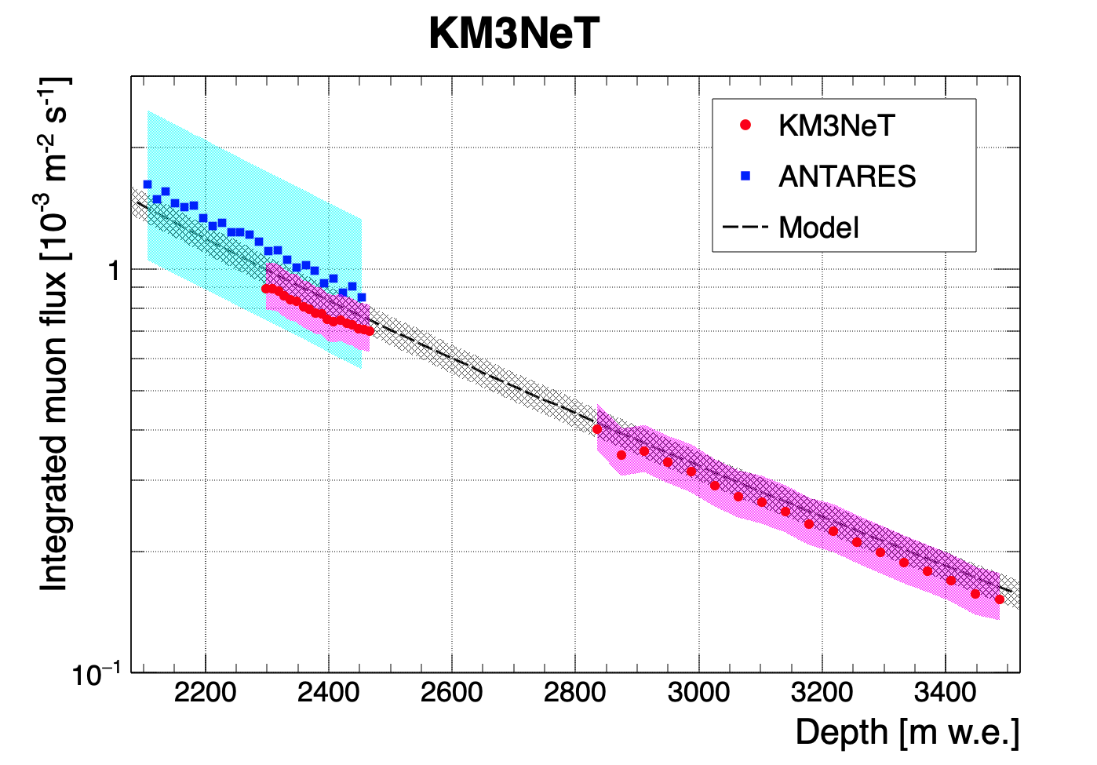
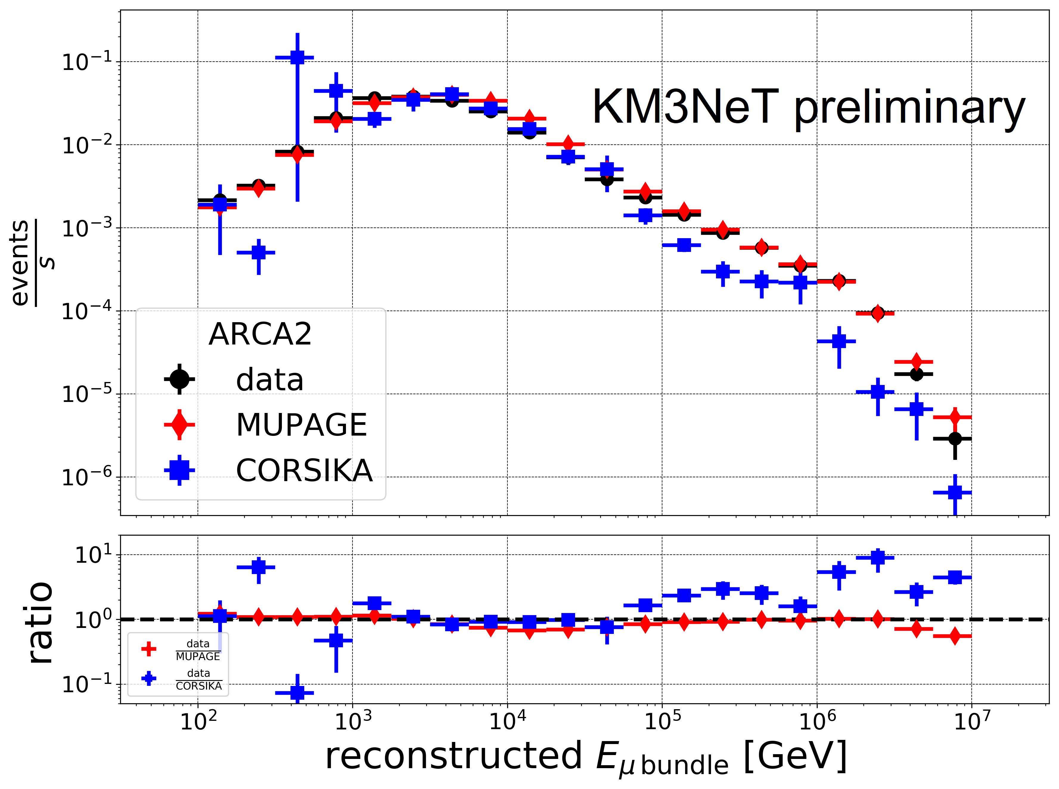
Cosmic Ray muon flux
27
Results based on the very first data!
Eur. Phys. J. C 80, 99 (2020)
PoS(ICRC2021)1112
ORCA1
ARCA2
Model: E.V. Bugaev et al., Phys. Rev. D 58 (1998) 054001

Slide 28
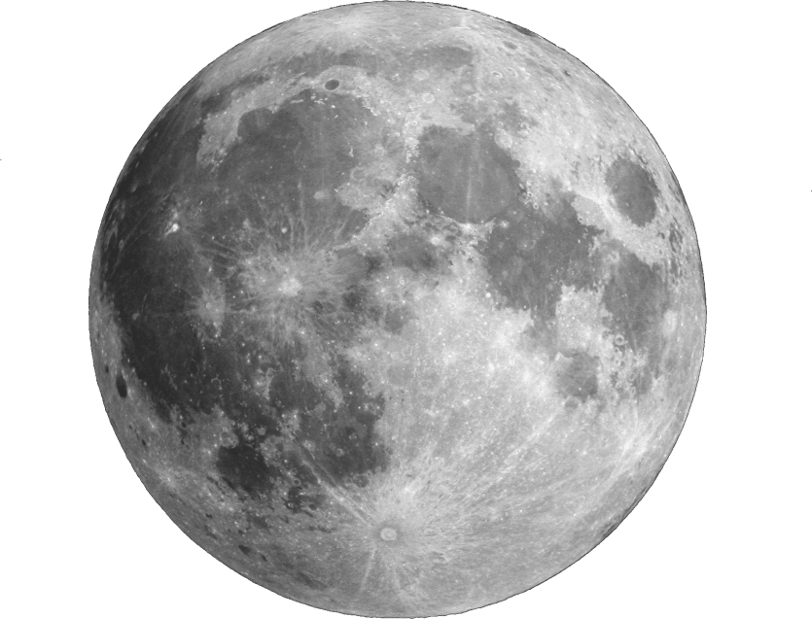
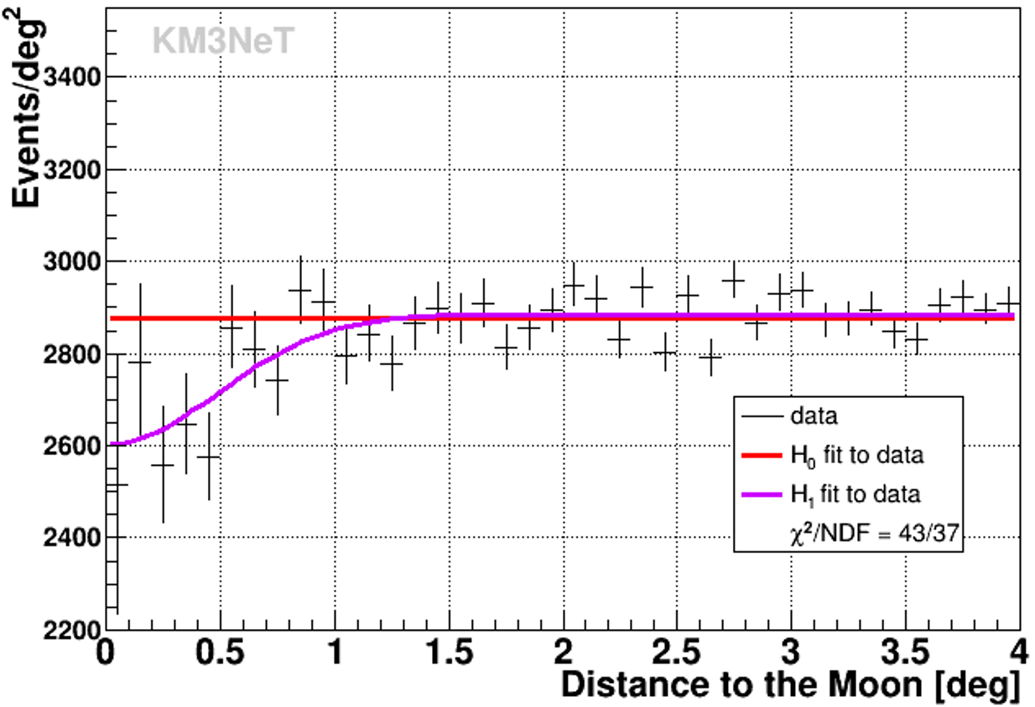
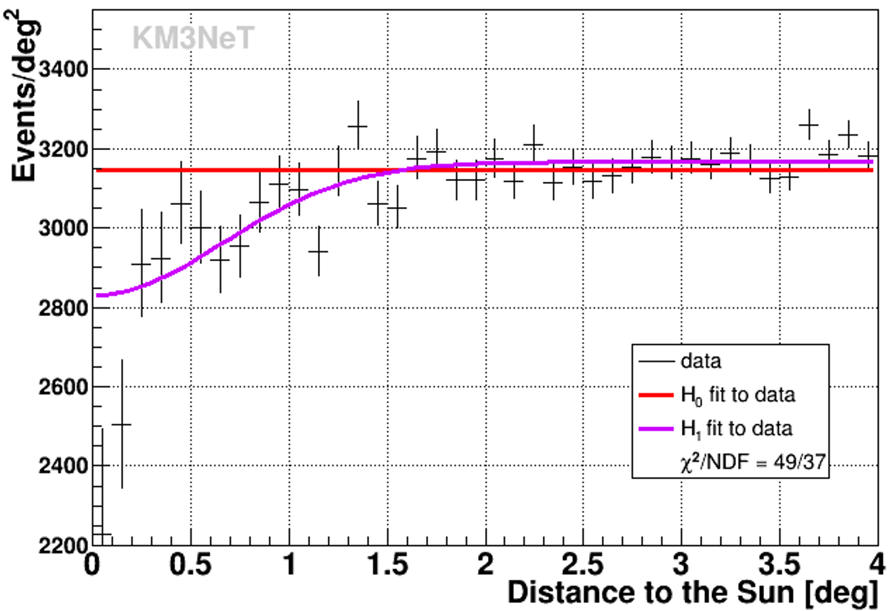
Cosmic Ray muons: Moon & Sun shadow
28
Moon shadow
Cosmic Rays
Eur.Phys.J.C 83 (2023) 4, 344
ORCA6
Livetime: 499.3d (11/02/2020 - 18/11/2021)
analysis for ARCA underway
https://www.amnh.org/explore/ology/earth/what-is-earth
https://toppng.com/show_download/170855/moon-transparent-png-full-moon/large
Moon
Sun

Slide 29
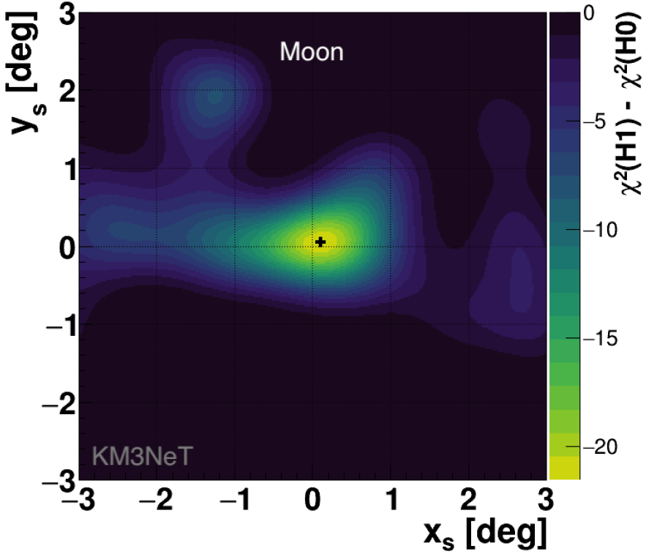
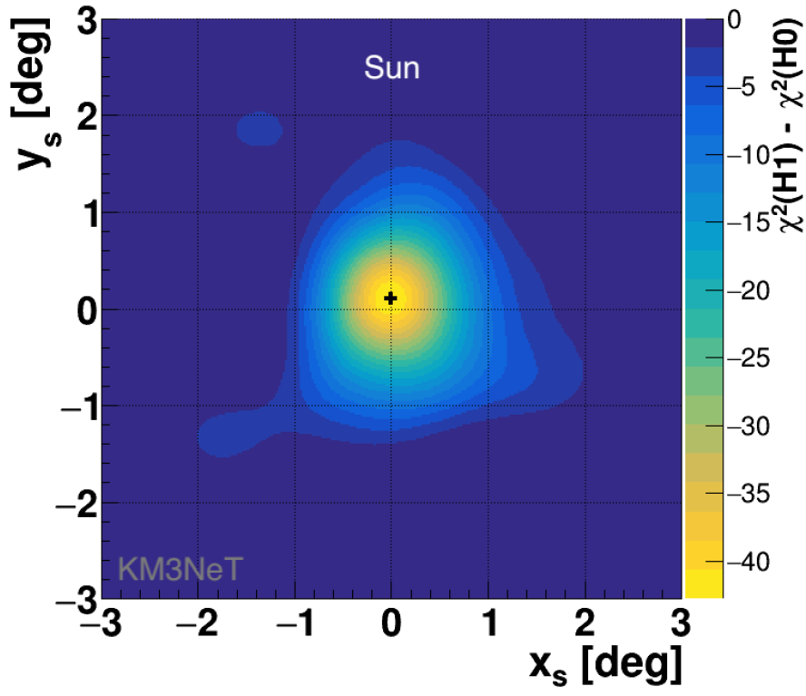
Cosmic Ray muons: Moon & Sun shadow
29
Moon shadow
Cosmic Rays
Eur.Phys.J.C 83 (2023) 4, 344
ORCA6
Livetime: 499.3d (11/02/2020 - 18/11/2021)
analysis for ARCA underway
https://www.amnh.org/explore/ology/earth/what-is-earth
https://toppng.com/show_download/170855/moon-transparent-png-full-moon/large
Signif.: $4.2σ$
Signif.: $6.2σ$

Slide 30
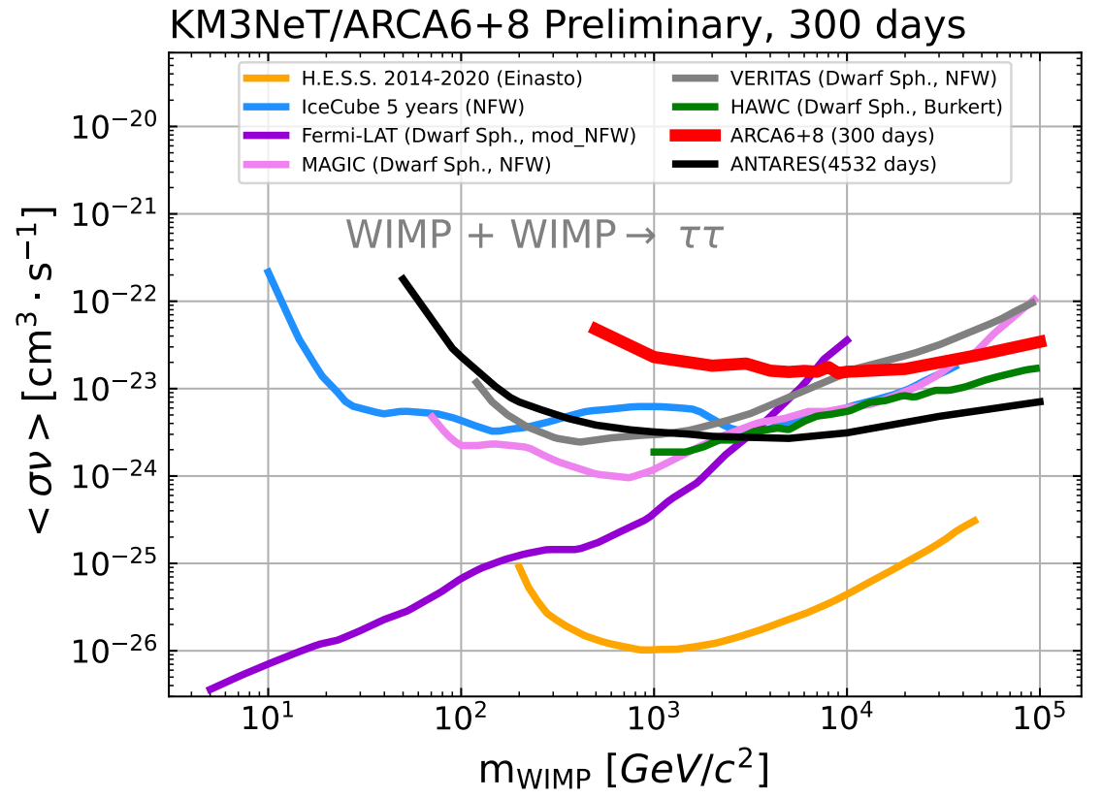
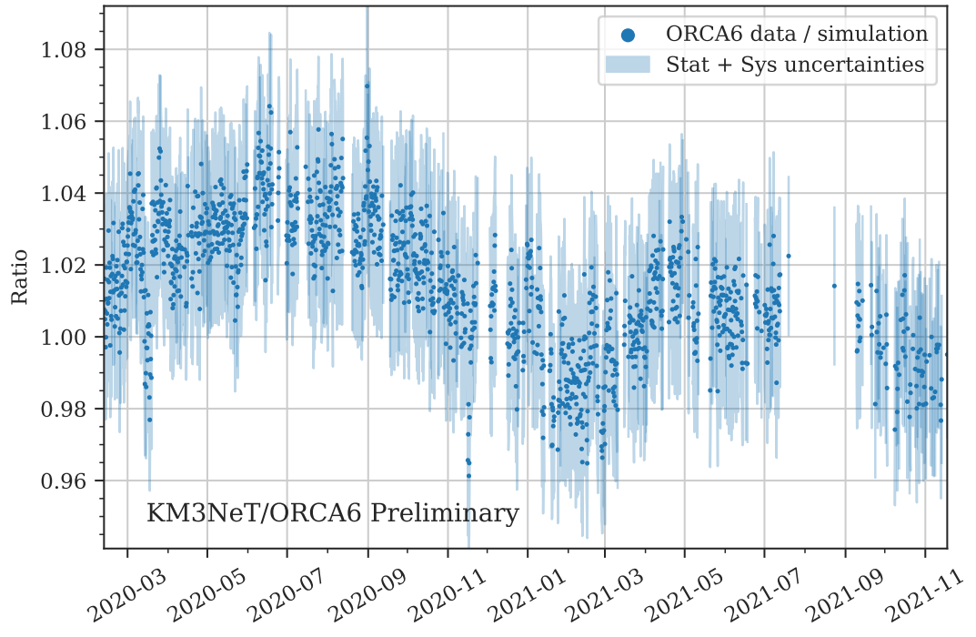
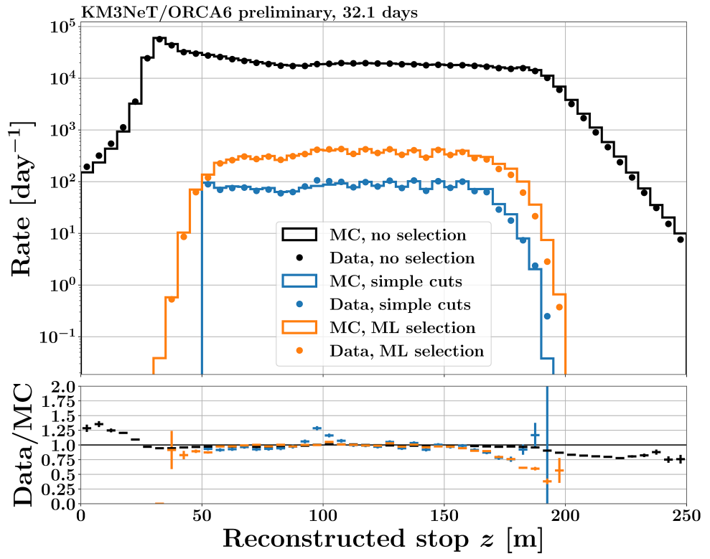
Obviously we again have more …
30
Only selected analyses were covered.
See backup and arXiv:2309.05016 for more!
Other topics include:
Dark matter [PoS(ICRC2023)1377, 1382, 1406]
Stopping muons [PoS(ICRC2023)203]
Seasonal dependence of muon flux [PoS(ICRC2023)355]
…

Slide 31
Cosmic ray physics
31
Current CR open tasks (aka potential theses):
Development of framework to fit primary cosmic ray spectrum and composition
Self-veto: coincident atmospheric muon and atmospheric neutrino events
Combined fit of CR observables with other experiments
CORSIKA 8
Multi-muon reconstruction (events with >1 muon)
Time-coincident events (overlapping air showers)
Study of the detector response with stopping muons
Investigation of the MUPAGE (fast muon simulation code) parameterization
PoS(ICRC2021)284
Some more:
sea surface detectors for KM3NeT? (analogous to IceCube’s IceTop)
correlation between KM3NeT data & earthquakes
measurement of the Earth’s radius with cosmic ray muons (probably not the most precise, but nobody tried that so far)
…
your ideas?
Bull.Am.Astron.Soc. 51 131

Slide 32
Outline
32
Analyses
Introduction
Summary
KM3NeT

Slide 33
Summary
33
To sum up:
KM3NeT currently under construction: ARCA28 & ORCA16 (completion around 2032 and 2030)
Rich physics programme
Valuable results already with intermediate configurations
Plenty of possibilities to get involved (I did not even mention DM & Exotics, acoustics etc.)
Thank you for your attention!
Any Questions?
Interested in a thesis in KM3NeT? Write to us at: pkalaczynski@camk.edu.pl gawron@camk.edu.pl artur.ukleja@ncbj.gov.pl

Slide 34
Backup
34

Slide 35
Cherenkov radiation
35
Supersonic jetplane:
In a nutshell: EM equivalent of a sonic boom shockwave
$$n$$
charged particle
$$\cos{θ_{Cher}}=\frac{c}{u∙n}$$
https://www.quora.com/Can-a-pilot-hear-his-own-sonic-boom-when-he-slows-down-the-plane
e.g. in water, $θ_{Cher}≈41°$

Slide 36
Cherenkov source examples
36
Extensive Air Showers
Nuclear reactors
and neutrino interactions!
eso.org
https://www.flickr.com/photos/35734278@N05/3954062594/

Slide 37
The KM3NeT Collaboration
37
Numbers:
47 groups
20 countries
4 continents
2 detectors
ORCA
Legend:
group
observer
member
ARCA

Slide 38
Light sensors
38
Digital Optical Module (DOM) acrylic glass sphere with:
31 3” PMTs,
readout electronics,
pressure gauge,
acoustic sensonrs,
...
Photomultiplier Tube (PMT)
converts light into electric signal
2022 JINST 17 P0703
JATIS 7(1), 016001 (2021)
JINST13 (2018) P05035

Slide 39
DOM arrangement
39
Detection Unit (DU):
vertical string with 18 DOMs
Eur. Phys. J. C 76 (2016) 76:54
Naming:
ORCA6 ↔ ORCA with 6 strings
ARCA2 ↔ ARCA with 2 strings
etc.
2020 JINST 15 P11027

Slide 40
DOM arrangement
40
Detection Unit (DU):
vertical string with 18 DOMs
Eur. Phys. J. C 76 (2016) 76:54
Naming:
ORCA6 ↔ ORCA with 6 strings
ARCA2 ↔ ARCA with 2 strings
etc.
2020 JINST 15 P11027

Slide 41
Tau appearance
41
https://icecube.wisc.edu/news/research/2019/01/atmospheric-tau-neutrino-appearance-in-icecube/
PoS(ICRC2023)1107
ORCA6 vs others
ORCA6

Slide 42
Follow-up observations
42
Method: ON/OFF technique
Original detection | Alert(s) | Object name | Events in ON region
Fermi | - | GRB 221009A | 0
LIGO/Virgo | - | O3 run (55 events) | 0
IceCube | IC211208A | PKS 0735+17 | 1*
IceCube | IC220205B | PKS 1741-03 | 0
IceCube | IC220225A | PKS 0215+15 | 0
IceCube | IC220304A | TXS 0310+022 | 0
detector: ORCA4, ORCA6
assumed spectrum:
$φ=φ_{0}⋅E^{−2}$
selection:
upgoing track-like events
PoS(ICRC2023)1506
ORCA +ANTARES
(only events fully above the detector horizons at the time of the alert)
90% UL on total 𝐸 emitted in $ν$’s:

Slide 43
Follow-up observations
43
Method: ON/OFF technique
Original detection | Alert(s) | Object name | Events in ON region
Fermi | - | GRB 221009A | 0
LIGO/Virgo | - | O3 run (55 events) | 0
IceCube | IC211208A | PKS 0735+17 | 1*
IceCube | IC220205B | PKS 1741-03 | 0
IceCube | IC220225A | PKS 0215+15 | 0
IceCube | IC220304A | TXS 0310+022 | 0
detector: ARCA21, ORCA10
assumed spectrum:
$φ=φ_{0}⋅E^{−2}$
selection:
upgoing track-like events
PoS(ICRC2023)1503

Slide 44
Event topologies
44
Direction
Shape
Examples of basic event topologies:
Classes based on combinations of:
ARCA6

Slide 45
CCSN: time resolution
45
JINST 16 C09034 (2021)

Slide 46
SN alert system
46
PoS(ICRC2023)1223

Slide 47
Non-standard interactions (NSI)
47

Slide 48
Non-standard interactions (NSI)
48
PoS(ICRC2023)998
ORCA6

Slide 49
Atmospheric neutrino flux
49
detector: ORCA6
livetime: 555.7d
method: spectrum unfolding
PoS(ICRC2023)1093

Slide 50
Extensive Air Showers (EAS)
50
EAS:
Caused by primary CR
Typically start at $h\sim 30−40km$
3 main components:
electromagnetic (EM)
hadronic
muonic

Slide 51
EAS simulations in KM3NeT
51
We have 2 options:
MUPAGE (atmospheric MUons from PArametric formulas: a fast GEnerator for neutrino telescopes)
developed for ANTARES
fast muon MC generator
based on parametric formulas and MACRO measurements
parameters can be freely tuned
CORSIKA (COsmic Ray SImulations for KAscade)
developed for KASCADE
full simulation of air showers
customizable (models, primaries, etc.)

Slide 52
KM3NeT muon simulation chain
52
Workflow of KM3NeT muon simulations:
simulated particles
direction of processing
Here:
sea – sea surface above the km3net detectors
can – cyllindrical volume around the detector
light – simulation of the photon emission inside the can (including the environmental background)
trigger – applying a set of trigger conditions to events, e.g. 3DMuon, tailored to select primarily muon tracks
reconstruction – applying reconstruction algorithms to obtain distributions of observables, e.g. energy, direction

Slide 53
Muon bundles
53
Muon bundle:
Important characteristics:
$E_{bundle}=\sum{E_{μ}}$ rather bad standard reco
(designed for single
muon events)
$\cos{θ_{zenith}}=\frac{\sum{\cos{θ_{zenith}}}}{N_{μ}}$ good standard reco
multiplicity: $N_{μ}$ no standard reco
bunch of muons coming from a single EAS

Slide 54
gSeaGen
54
git.km3net.de/opensource/gseagen
gSeaGen
Tech stack:
C++
ROOT
PERL
PROPOSAL (github.com/tudo-astroparticlephysics/PROPOSAL)
Code for propagating muons and/or neutrinos to neutrino telescopes. Developed for KM3NeT, but applicable to other experiments.
My involvement in this project:
Implementation of CORSIKA shower processing
Speed, memory & storage optimization
Rework of the geometry: no more flat Earth!
Code maintenance
Current devs:
Carla Distefano
Alfonso Andres Garcia Soto
Piotr Kalaczyński
Johannes Schumann
Rodrigo Garcia
Andrey Romanov
paper on this work under collaboration review …

Slide 55
Sky coverage
55
Galactic sources expected at 1-10 TeV:
Field of view with horizontal tracks
The Earth is opaque for $ν$’s at highest energies
golden channel: horizontal tracks (atm. $μ$’s are suppressed, but the $ν$’s make it)

Slide 56
Angular resolution
56
Tracks ( CC: $ν_{μ}$, $ν_{τ}$ ($τ→μ$) )
Cascades ( NC: $ν_{e,μ,τ}$, CC: $ν_{e}$, $ν_{τ}$ ($τ↛μ$) )
Double Cascades
($ν_{τ}$ - only)
JINST 16 C09021
PoS(ICRC2021)1089
PoS(ICRC2021)1089

Slide 57
Angular resolution comparison
57
Expected KM3NeT/ARCA resolution drawn on optical skymap around blazar TXS 0506+056:
(first identified HE $ν_{cosmic}$ source by IceCube)
ARCA & ANTARES resolutions are
added to the original plot from
SCIENCE 13 Jul 2018 Vol 361, Issue 6398

Slide 58
Point & extended source sensitivity
58
Poster P0745 @Neutrino2022

Slide 59
Diffuse $ν$ flux
59
With assumption of $ν$ flux parameters as measured by IceCube:
PoS(ICRC2021)1077
JINST 16 C09034 (2021)

Slide 60
Starburst Galaxies
60
Result for complete ARCA (2x115=230 strings)
Differential sensitivity to diffuse $ν$ flux coming from Starburst Galaxies (SBGs):
event distributions after selection:
JINST 16 C12016
KM3NeT Preliminary
KM3NeT Preliminary

Slide 61
Dark Matter from Galactic Centre
61
$$\left\langle σv\right\rangle =\frac{4π}{J_{int}}⋅\frac{n_{sig}}{A⋅t_{live}}⋅M_{χ}^{2}$$
$A$ – acceptance
$t_{live}$ – livetime
$J_{int}$ – geometry factor depending on the source shape
$M_{χ}$ – mass of the DM particle
$n_{sig}$ – number of distinguishable signal events
Sensitivity for ARCA2x115 (230 strings)
Sensitivity to $ν$ coming from DM annihilation in the Galactic Centre computed by performing pseudo-experiments (injecting different signals into background skymaps)
JINST 16 C09006

Slide 62
Dark Matter from Galactic Centre
62
$$\left\langle σv\right\rangle =\frac{4π}{J_{int}}⋅\frac{n_{sig}}{A⋅t_{live}}⋅M_{χ}^{2}$$
$A$ – acceptance
$t_{live}$ – livetime
$J_{int}$ – geometry factor depending on the source shape
$M_{χ}$ – mass of the DM particle
$n_{sig}$ – number of distinguishable signal events
Result for ARCA6
Sensitivity to $ν$ coming from DM annihilation in the Galactic Centre computed by performing pseudo-experiments (injecting different signals into background skymaps)
Poster P0549 @Neutrino2022

Slide 63
KM3NeT + CTA
63
KM3NeT: $ν$ data (10y)
CTA:
Imaging-Air-Cherenkov telescope (IACT)
$γ$-ray data (200h)
$20TeV<E<few 100TeV$
We compare 2 emission scenarios
Hadronic: $γ+ν$ (inverse compton model)
Leptonic: only $γ$ (pion decay model)
Tested on 4 sources:
Vela X (shown in plots)
RX J1713.7-3946
HESS J1908+063
Westerlund1
Results:
Poster P0519 @Neutrino2022

Slide 64
Galactic neutrino sources
64
Astropar. Phys. 111, 100–110 (2019)
$Φ_{0}$ - expected neutrino flux

Slide 65
KM3NeT muon simulation chain
65
My work:
Running CORSIKA:
Test productions
Mini-prods for systematic studies
First mass prod
gSeaGen development:
Implementation of CORSIKA processing
Improvements in the propagation routine:
Speed-up: for EeV 1w -> 40min
Earth’s curvature
Statistics optimization: muon range tolerance margin, possibility to retry propagation etc.
More in the publication [under review]: “gSeaGen code by KM3NeT: an efficient tool to propagate muons simulated with CORSIKA” (to be submitted to: Comp. Phys. Comm.)
Reconstruction of new observables
KM3NeT CR muon simulation chain:
μ,ν, other
Stage
simulated particles
μ
CORSIKA
sea
git.km3net.de/opensource/gseagen
MUPAGE
gSeaGen
detector
dane
JSirene
light
JTE
trigger
My reco
JMuon
reconstruction
Here:
sea – sea surface above the KM3NeT detectors
can – cyllindrical volume around the detector
light – simulation of the $γ$ emission inside the can (including the environmental bgd)
trigger – preselection of interesting events by applying trigger conditions
reconstruction – reconstruction of observables, like energy, direction etc.

Slide 66
Reconstruction of multiplicity
66
Example of reco results: muon multiplicity for ARCA115
Analogical results for ARCA6, ORCA115 i ORCA6 (and for 2 other observables)
2D: reco vs true
1D histograms
A115
A115

Slide 67
Sensitivities vs time
67
Comments:
Sensitivity limited by systematics
Should improve by the time we complete the construction
IceCube uncertainty: various CR models
full analysis covered in my PhD thesis:
https://bip.ncbj.gov.pl/attachments/download/258
My simulation
My reco
My analysis

Slide 68
ML reco: general overview
68
features weights
targets
Read data
Workflow of the reconstruction:
Data extraction
Scale weights
(in case the training performs better with scaled weights; depends on the model and target)
Preprocessing
feature/
model/
target/
method/
selection
$$x_{scaled} =\frac{\left(x −x_{mean}\right)}{x_{std}}$$
one common scaling
Training
Validation
Scale features
Model tuning
64%
20%
16%
Final result
Train data
Validation data
Test data

Slide 69
ML reco: features used for reconstruction
69
In total: 46 features (+4 targets)
Example for ARCA115
(the same was done for ARCA6,
ORCA115 and ORCA6)

Slide 70
ML reco: feature clustering
70
Cluster distance cutoff is arbitrary
Clusters are marked by different colors
Example for ARCA115
(the same was done for ARCA6,
ORCA115 and ORCA6)

Slide 71
Bundle energy reco: best ML model selection
71
Performance comparison on a fraction (50k events) of the training dataset:
Best performance
The (weighted) Pearson correlation coefficient:
The (weighted) R2-score, called the coefficient of determination:

Slide 72
Bundle energy reco: best ML model selection
72
Speed comparison on a fraction (50k events) of the training dataset:
LightGBM:
not the fastest, but still very decent
+ it turned out to scale up very well (entire dataset is orders of magnitude larger)
These times were obtained running with 20 CPU cores in parallel

Slide 73
Bundle energy reco: learning inspection
73
Here we see why 50k events were fine for testing (but e.g. 5k would not be)
50k events

Slide 74
Bundle energy reco: basic comparison with JMuon
74
Here I just compare LightGBM (no tuning whatsoever) and JMuon reco
(non-ML reco)
JMuon
LightGBM

Slide 75
Bundle energy reco: basic result in 1D
75
Comparison in 1D:
Clearly even untuned ML approach
reproduces the distribution much closer

Slide 76
Bundle energy reco: feature importance
76
Colors here are not random!
They match the feature clustering
The idea:
Try to select only the most important feature
in each cluster

Slide 77
Bundle energy reco: feature selection
77
I considered 4 options:
All features
Features with importance>0 & only the most important one from each cluster
The most important feature only
Features with importance>0
1. All features
2. importance>0 & clustering

Slide 78
Bundle energy reco: feature selection
78
I considered 4 options:
All features
Features with importance>0 & only the most important one from each cluster
The most important feature only
Features with importance>0
3. 3DMUON_3DSHOWER_trig_hits only
4. importance>0

Slide 79
ML reco: general overview
79
Workflow of the reconstruction:
Data extraction
Preprocessing
feature/
model/
target/
method/
selection
Training
Validation
Model tuning
Final result

Slide 80
Multiplicity reco: muon selection check
80
Example of ARCA6, for which the effect is the most pronounced
All muons
Selected muons

Slide 81
Multiplicity reco: final results
81
Analogical results obtained for ARCA115, ORCA115 and ORCA6
Example of the results for ARCA6:
2D: pred vs true
1D histograms
A6
A6

Slide 82
Definition of the test
82
Poisson formula for BGD with non-negligible uncertainty:
ref1
ref2
ref3
TS: $q_{0}=\left\{\begin{matrix}2⋅\left[N_{TOTAL}⋅\ln\left(\frac{N_{TOTAL}⋅\left(N_{BGD}+σ_{BGD}^{2}\right)}{N_{BGD}^{2}+N_{TOTAL}⋅σ_{BGD}^{2}}\right)−\frac{N_{TOTAL}^{2}}{σ_{BGD}^{2}}⋅\ln\left(1+\frac{σ_{BGD}^{2}⋅\left({N_{TOTAL}−N}_{BGD}\right)}{N_{BGD}⋅\left(N_{BGD}+σ_{BGD}^{2}\right)}\right)\right] & for N_{TOTAL}≥N_{BGD} \\ 0 & for N_{TOTAL}<N_{BGD}\end{matrix}\right.$ Significance: $Z=\sqrt{q_{0}}$
Critical $Z$: $5σ$
systematic uncertainties are included:
$$σ_{BGD}=\sqrt{{\left(σ_{BGD}^{stat}\right)}^{2}+{\left(σ_{BGD}^{syst}\right)}^{2}}$$

Slide 83
Prompt and conv parent particles
83
Note: 1 parent conventional → the muon is conventional.
The colours here only tell you if particles have short or
long livetimes (if applicable).
Most muons originate from $π^{±}$ and $K^{±}$, as expected.
The most important prompt mother particles for muons
are light vector mesons ($η,ρ,ω$), not $D$ mesons (also expected).
If mother is a muon or grandmother is the same nucleus as the primary, it means that there were just less interactions between shower start and muon creation.
NB: particles & antiparticles are counted together! (and so are all nuclei, including hydrogen)

Slide 84
Muon arrival time
84
Proton events
arrival time: time between the first interaction of the primary and the muon crossing the can boundary
Iron events
Conclusion here is that prompt is not really evident from arrival times on event-by-event basis (which is a bummer, because this could have been measurable)

Slide 85
Muon energy share
85
I use ORCA115 to boost the statistics
Prompt muons indeed tend to carry a larger portion of the total primary energy
The wiggles are coming from the contributions of different primaries

Slide 86
Muon production point
86
I use ORCA115 to boost the statistics
Prompt muons indeed are more
often produced close to the 1st interaction

