Slide 1
Studying High-Mass Star Forming Regions: Dust Continuum Emission
Mohna Rebecca
MSc Physics(Astrophysics)
With the guidance of
Prof. Bhaswati Mookerjea,
Department of Astronomy and Astrophysics,
Tata Institute of Fundamental Research (TIFR)
The 6th Young Astronomers Meeting
CAMK-PAN
Warsaw, 6-8 March 2024

Slide 2
Table of contents
01
02
Introduction
Methodology
Results & Discussions
03
04
Conclusion & Future Scope

Slide 3
01
Introduction

Slide 4
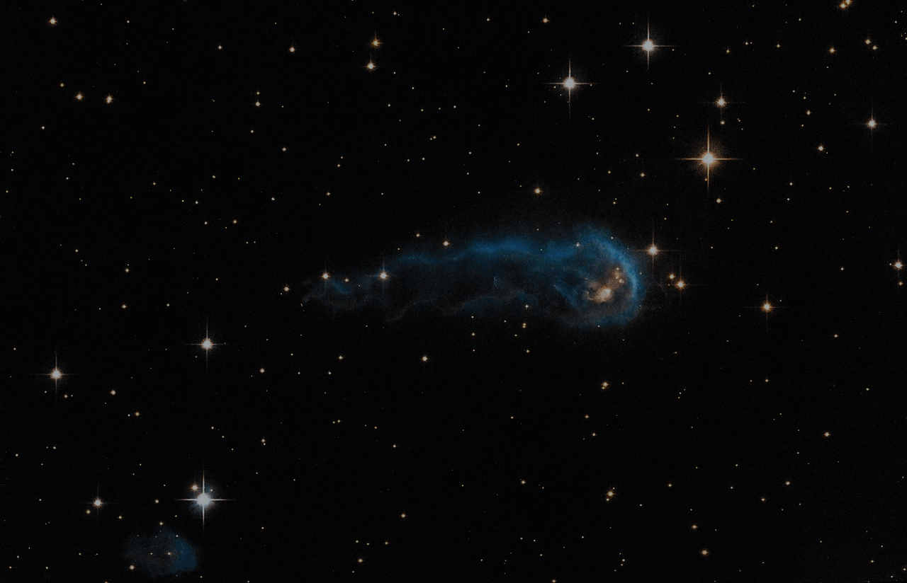
Star Formation
The dense (${10}^{6} cm^{−3}$), large molecular clouds (~1pc) containing neutral, cold (~10K) gas and dust in the Interstellar Medium (ISM) are predominantly the sites of star formation.
The processes involving star formation are different for low and high-mass stars.

Slide 5
Objective of the research
In this project we aimed to develop a tool to determine dust temperature and column density maps using multi-wavelength dust continuum observations of high-mass star forming region.

Slide 6
02
Methodology

Slide 7
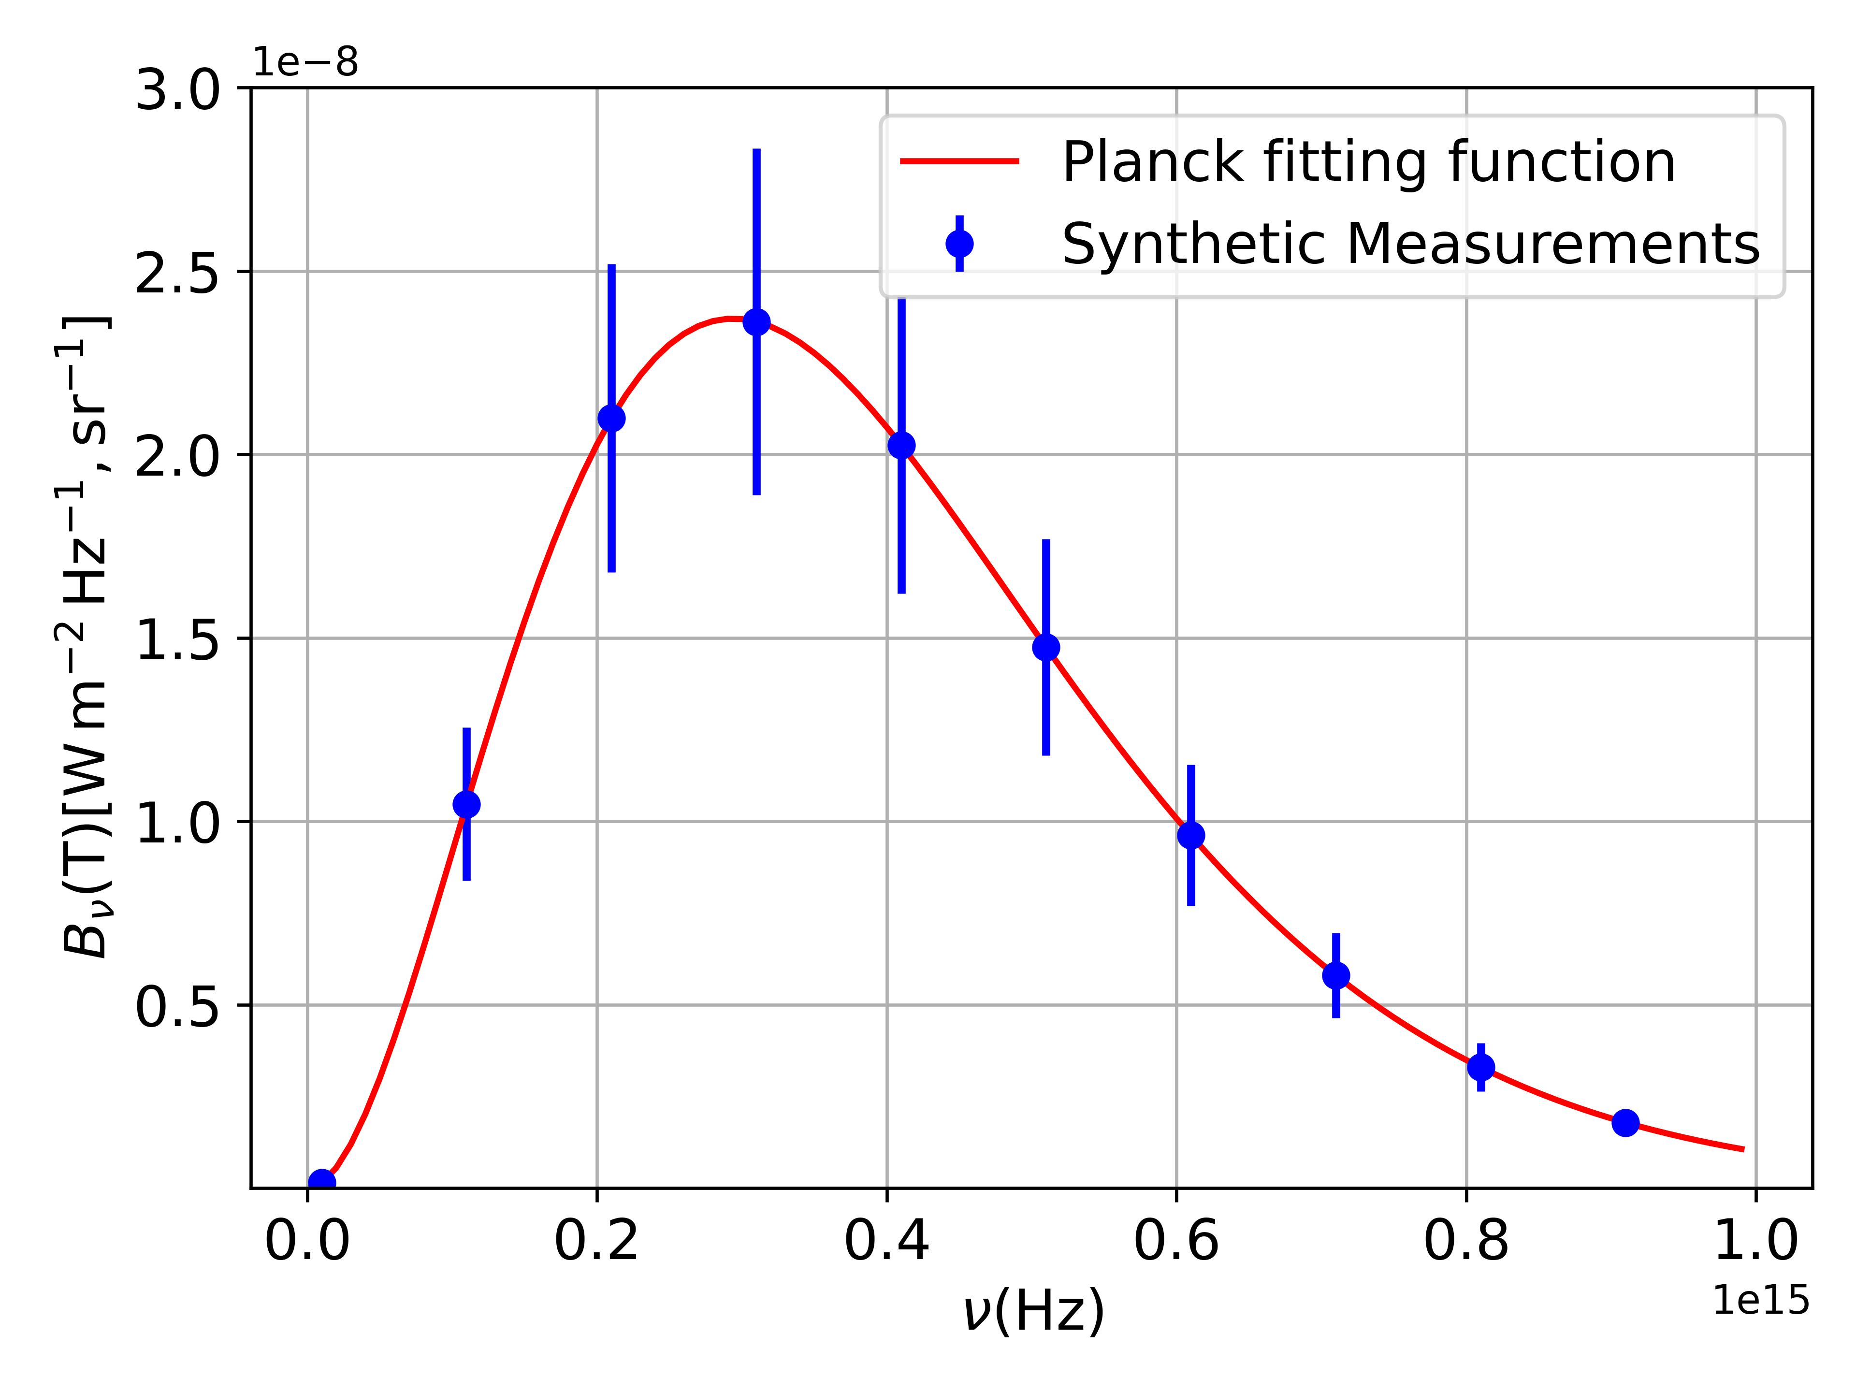
Tools developed to Perform Curve-Fitting
Blackbody Function
The Blackbody function with respect to frequency has the form:
$I_{ν}=B_{ν}\left(T\right)=\frac{2hν^{3}}{c^{2}}{\left\{e^{\left[\frac{hν}{kT}\right]} −1 \right\}}^{−1} −(1)$
Synthetic measurements were generated by sampling the blackbody profile for T = 5000K at 10 selected frequencies and assumed an uncertainty of 20% in the intensity at each of these frequencies.
A curve fitting routine was developed to obtain the best fit estimate of temperature. The temperature derived from the curve fitting routine is 5000 + 60K. Result of the fitting routine is shown in Figure 2.
Figure 2: Result of fitting of a blackbody curve to the synthetic measurements assuming an uncertainty of 20%.

Slide 8
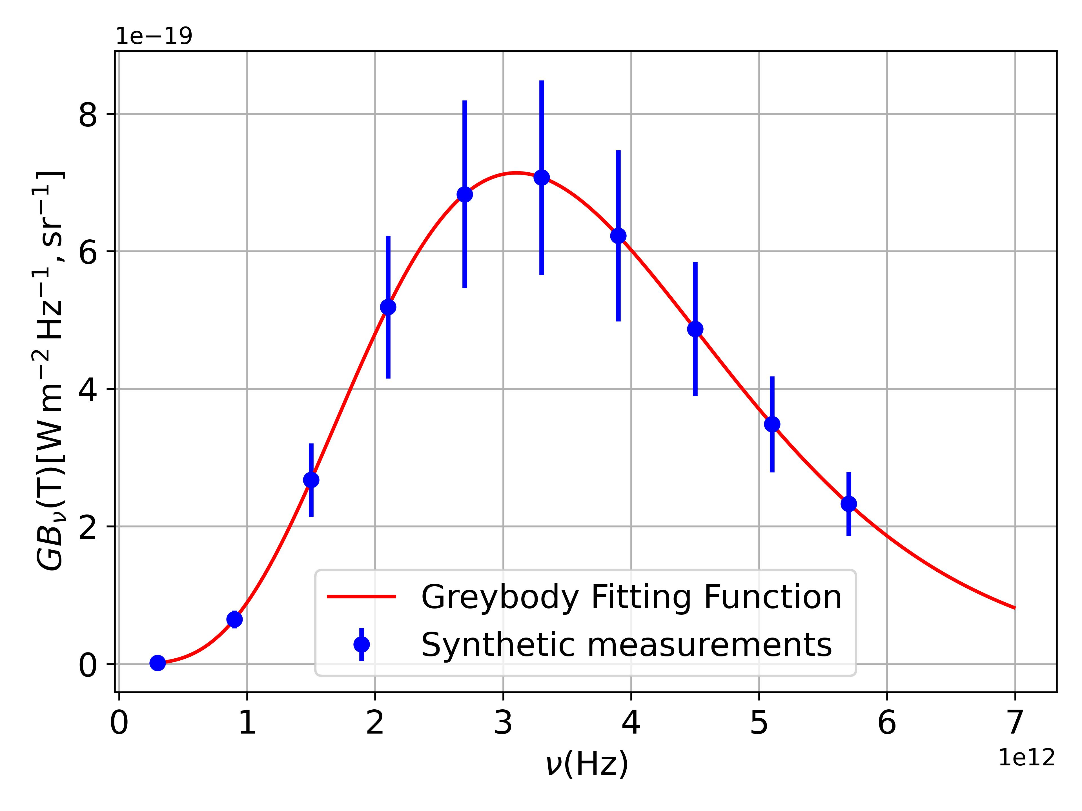
Greybody Function
A procedure similar to what was applied for blackbody fitting was performed to sample the greybody function for T = 30K and N = 5 x ${10}^{22} cm^{−2}$ at 10 selected frequencies. Uncertainty of 20% was assumed in the intensity at each these frequencies.
A curve fitting routine was written to fit these synthetic measurements with a greybody curve to obtain the best fit estimate of temperature and column density.
The temperature and column density derived from the curve fitting routine are 30 + 5.5K and (5 + 0.7) x ${10}^{22} cm^{−2}.$ The curve-fitting results are presented in the following plots.
Figure 3: Result of fitting of a greybody curve to the synthetic measurements assuming an uncertainty of 20%.

Slide 9
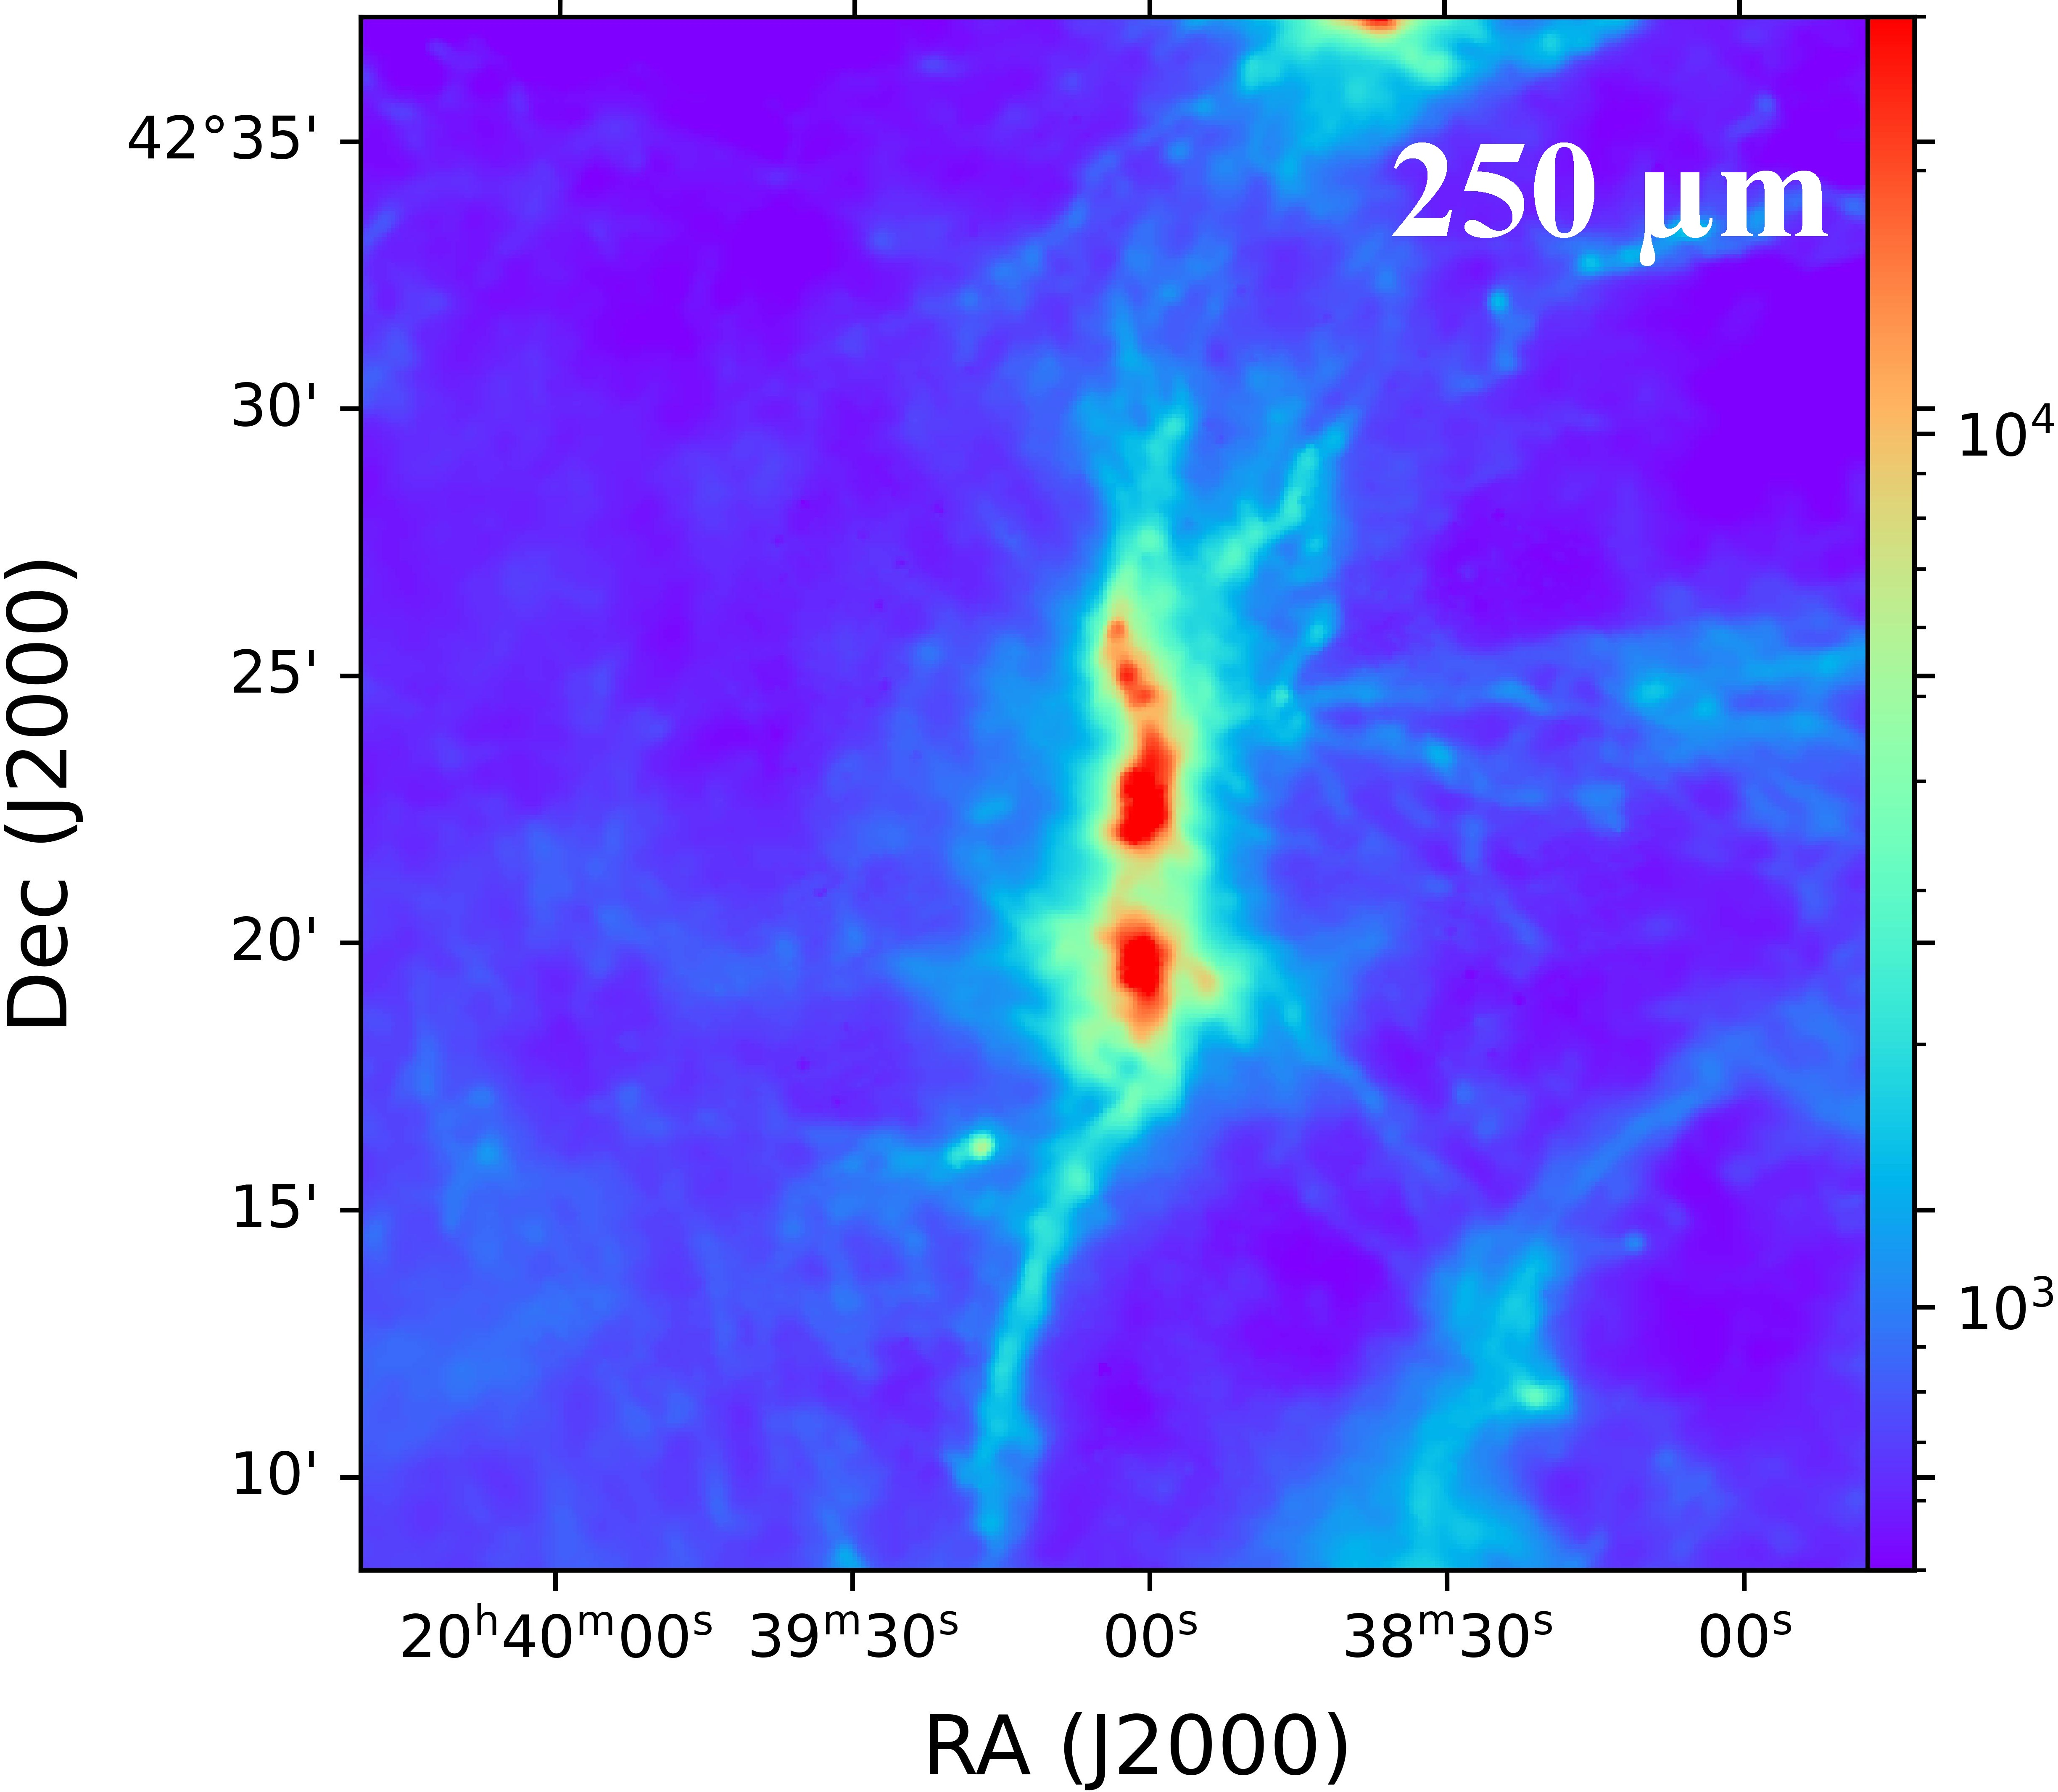
The source : DR21(OH)
DR21(OH) is a cluster of massive star forming core located in the Cygnus X molecular cloud complex located at a distance of 1.5kpc.
It is a massive dense core (~9000$M_{ʘ}$) present in the filamentary structures of an elongated massive gas structure connected by a number of filaments.
In the southern end, the DR21 ridge inhabits a massive clump and in the northern end, a filamentary structure.
Towards the northern end, the filament-like structure has a string of Massive Dense Clouds (MDCs), the most massive one of which is the object of our interest, namely DR21(OH).
Figure 4: Dust emission by DR21(OH) at 250 µm.

Slide 10
Creation of cut-outs of area 1800’’ x 1800’’ around the position of DR21(OH).
Smoothening of all maps to a common resolution of the 350µm image (${23}_{.}^{′′}9$).
Extraction of DR21(OH) continuum images from the Herschel Space Observatory.
Method
Construction of the line-of-sight-averaged molecular hydrogen column density and dust temperature maps.
Carrying out a pixel-to-pixel greybody fit of intensities measured at 160, 250 and 350µm.
Sampling all maps on the same grid as 350µm image.

Slide 11
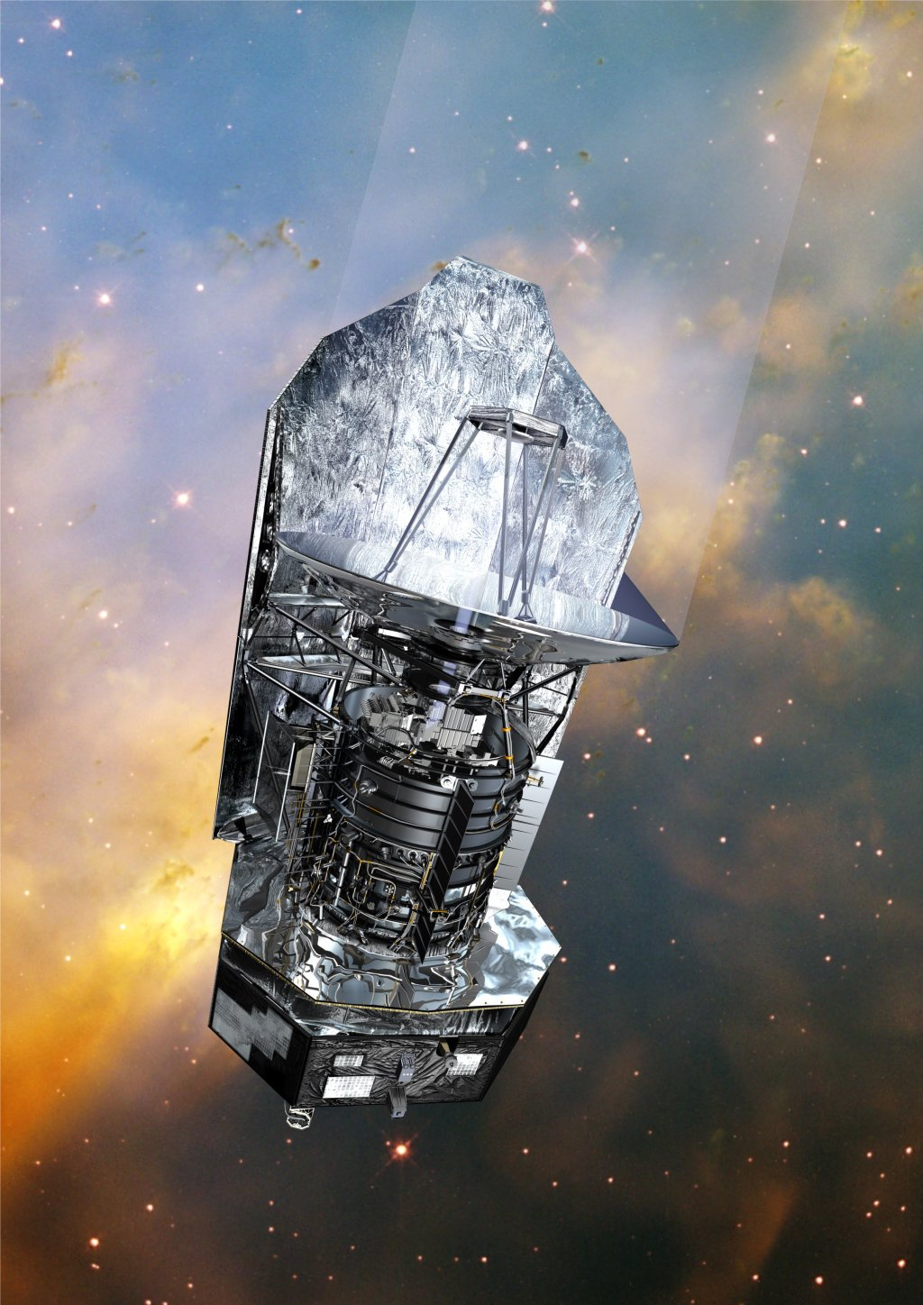
Herschel Hi-Gal Survey
Data was acquired from the Herschel Space Observatory to study the star forming region DR21(OH). In this project, we make use of the far-infrared observations of the telescope and download the continuum images from Herschel Science Archive.
The survey was carried out with the help of two instruments, namely Photodetector Array Camera Spectrometer (PACS) and Spectral and Photometric Imaging Receiver (SPIRE) covering a range of wavelengths from 70 – 500µm.
Figure 5: Herschel Space Telescope
Credits : Max-Planck-Institut für Astronomie

Slide 12
Continuum Data
Table 1: Information about the multi-wavelength continuum maps
Wavelength ($μm)$ | Pixel Size ($′′$) | Beam Sizes ($′′$)
70 | 3.19 | 5.6
160 | 3.19 | 10.7
250 | 4.8 | 17.6
350 | 5.7 | 23.9
500 | 10.7 | 35.2
The co-ordinates of the source under study, i.e., DR21(OH) $α_{J200}={20}^{h}{39}^{m}{01}_{.}^{s}01, δ_{J200}= +42°{22}^{′}{50}_{.}^{′′}2$) were acquired using SIMBAD. Using co-ordinates of the source, Herschel Science Archive was used to acquire the continuum maps of a region of radius 5$′$ containing DR21(OH).
The continuum maps for the source were downloaded at five wavelengths; 70 and 160$μm$ PACS (Level-2.5) and 250, 350 and 500$μm$ SPIRE (Level-3) with pixel and beam sizes represented in the table given.

Slide 13
Pre-Processing Of Continuum Images
01
02
Reprojection
Cropping the FITS Images
The maps were re-projected in order to place the source DR21(OH) at the center of the maps at 70, 160, 250, 350 and 500$μm$.
Information about the FITS files was accessed using their header information, using which the maps were re-projected.
After re-projecting the continuum maps, they were required to cover equal area around the source DR21(OH).
Using header information, it was possible to map one pixel to its equivalent area in the sky. This information was utilized to extract an area of ${1800}^{′′}×1800′′$around the position of the source DR21(OH).

Slide 14
03
Smoothening to a Common Resolution
For performing greybody fitting the resolution of all the maps needed to be smoothed out to a common value.
This was achieved with the help of a Convolution Kernel that would smooth the images to a required common resolution. The convolution kernels for 250 and 160$μm$ were available on Astronomy Convolution Kernel Repository. The Convolution was performed using the required kernels.

Slide 15
04
Regridding
The convolved 160 and 250$μm$ maps sampled to the common grid of 350$μm$ in order to have a common pixel size, which is crucial for pixel-by-pixel greybody fitting.
Python library reproject was used for this purpose.
Since the unit of flux values measured from PACS ($Jypx^{−1}$) and SPIRE ($MJy{sr}^{−1}$) were different and the greybody fitting is performed pixel-wise, the flux values at 250 and 350$μm$ were converted to $Jypx^{−1}$.

Slide 16
05
Pixel-by-Pixel Greybody Fitting
The far-infrared emission arises from dust. This emission can be approximated by a greybody function or a modified blackbody function, described in the form:
$F_{ν}= ΩB_{ν}\left(T_{d}\right)\left(1 −e^{−τ_{ν}}\right), − (2)$
Where, $τ_{ν}= µm_{H}κ_{ν}N\left(H_{2}\right)$
$B_{ν}\left(T_{d}\right)$ - Blackbody function at temperature $T_{d}$ .
$Ω$ - Solid angle subtended by the source
$m_{H}$ - Mass of the hydrogen atom
$µ$ - Mean molecular weight
$κ_{ν}$ - Dust opacity
$N\left(H_{2}\right)$ - Molecular hydrogen column density
The dust opacity is calculated as:
$κ_{ν}=0.1 {\left(\frac{ν}{1000GHz}\right)}^{β}$ , $β$ – dust emissivity index

Slide 17
05
Pixel-by-Pixel Greybody Fitting
Adequate measurements of $F_{ν}$ at different frequencies will allow us to determine dust temperature and column density of the dust under observation.
In order to study the dust properties, we shall construct the line-of-sight averaged molecular hydrogen column density and dust temperature maps of this region.
The dust temperature and column density maps are created by carrying out a pixel-to-pixel greybody fit of flux measured at 160, 250 and 350$μm$ using the equation of greybody model discussed earlier. The solid angle in the equation of greybody is taken to be the common pixel size in radians.

Slide 18
03
Results & Discussions

Slide 19
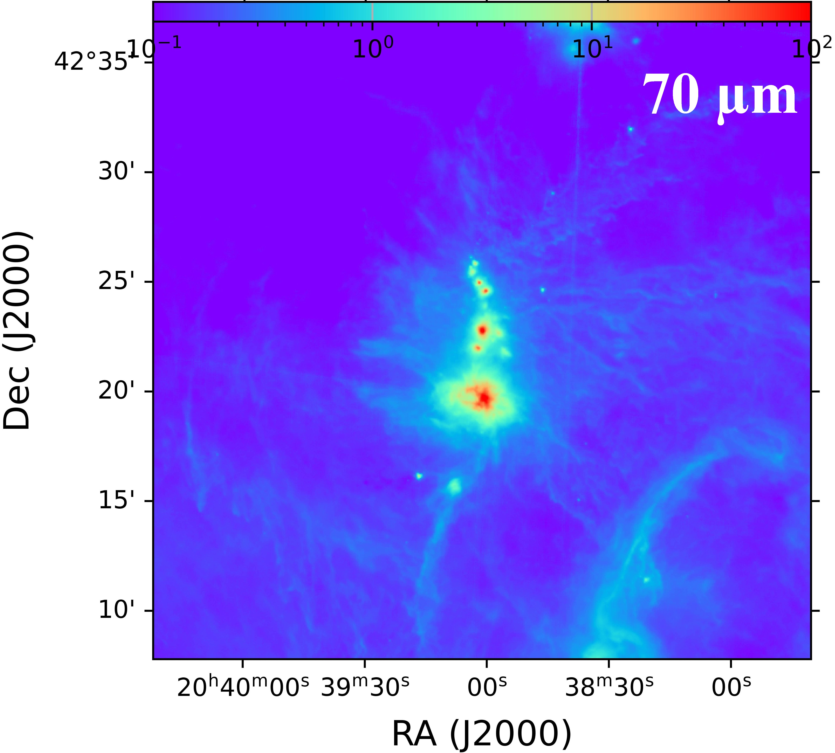
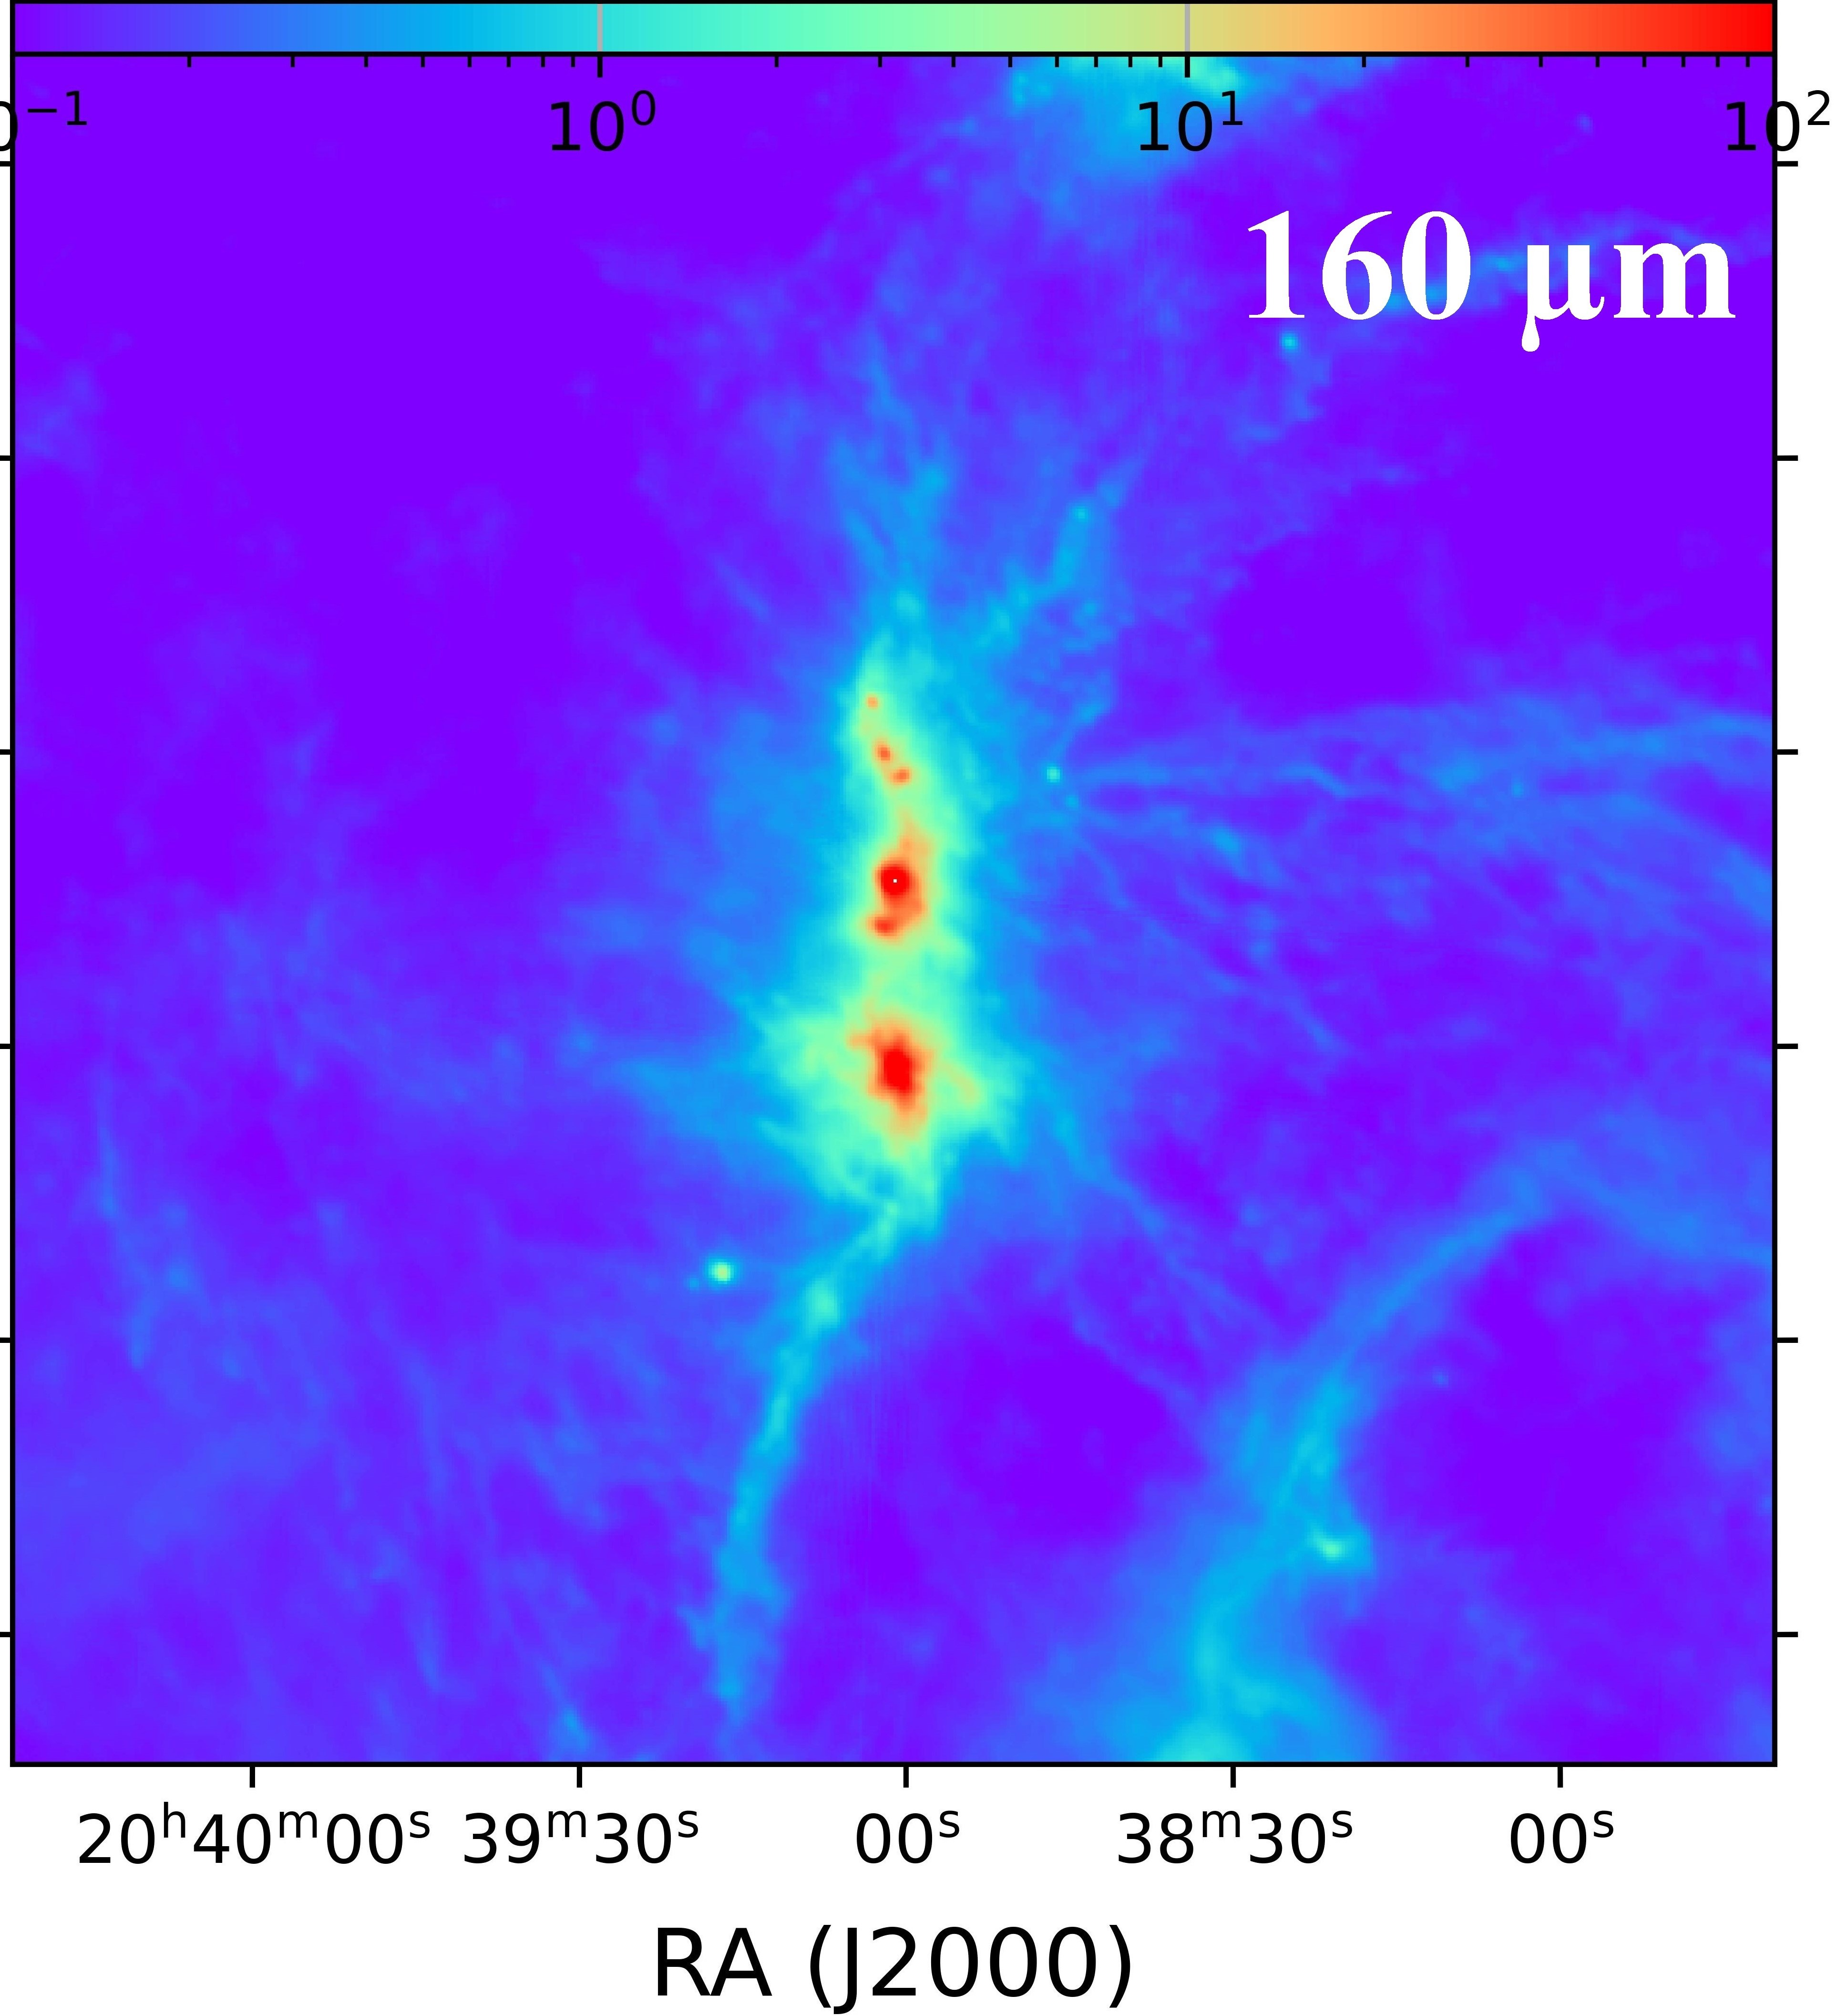
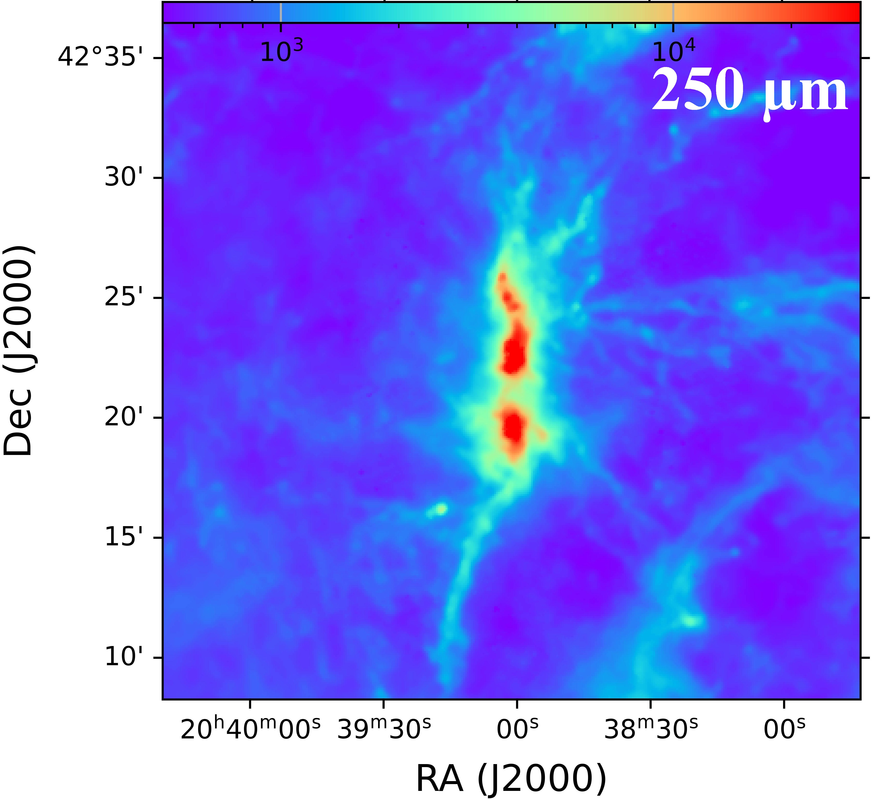
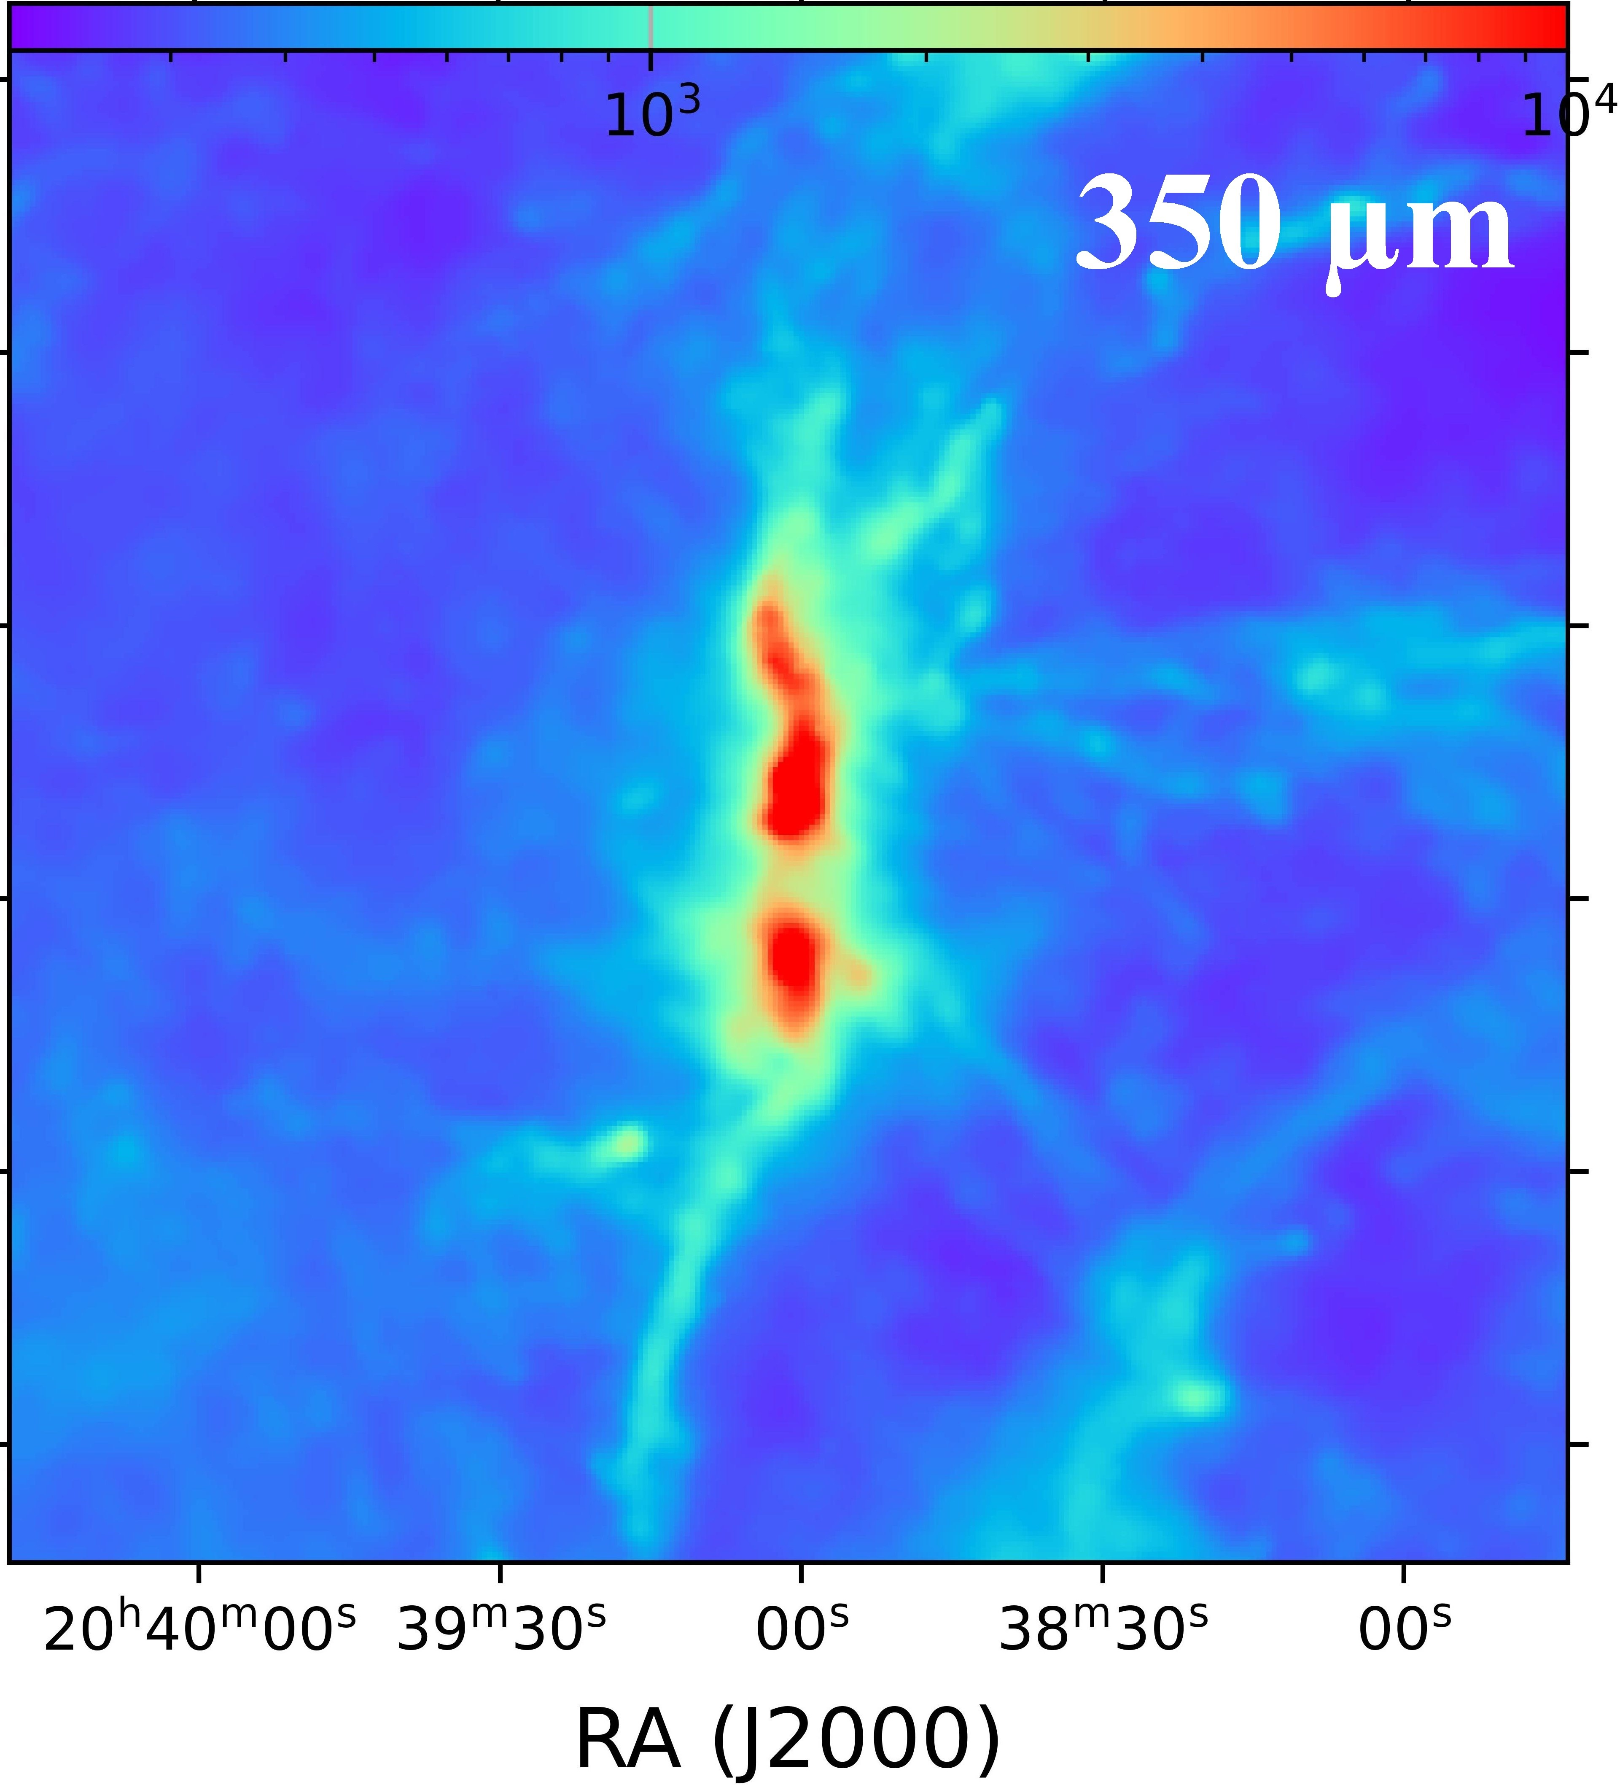
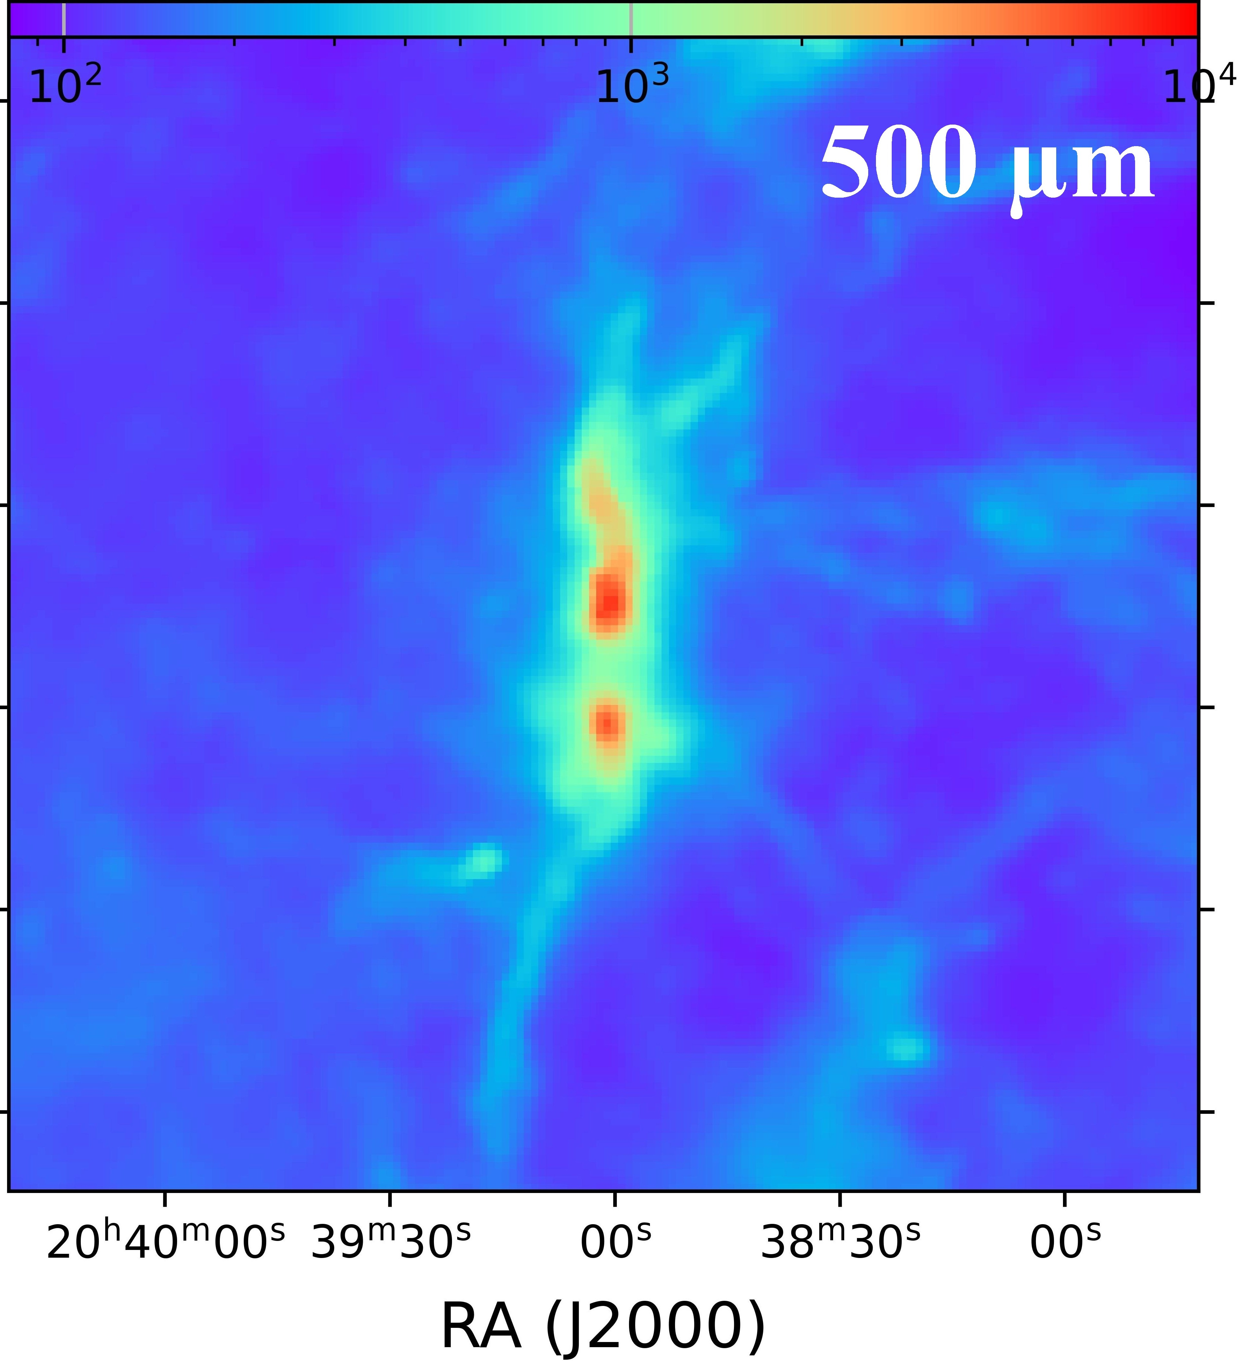
Dust Continuum Maps
DR21(OH)
At least two massive HFS present in the DR21 ridge.
DR21 clump
Filaments are connecting the two massive star forming regions.
Figure 6: Distribution of dust emission towards DR21(OH) region 70 and 160 µm from Herschel PACS and 250, 350 and 500 µm from Herschel SPIRE.
Notes:
70 and 160 micron maps have better resolution
Filaments connecting the two regions, and are meeting together

Slide 20
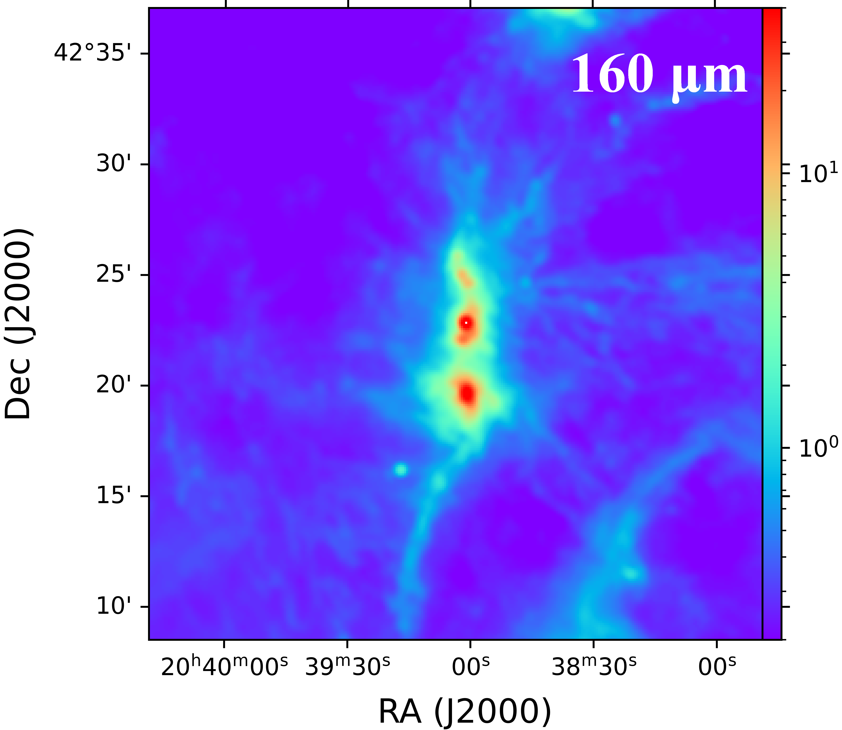
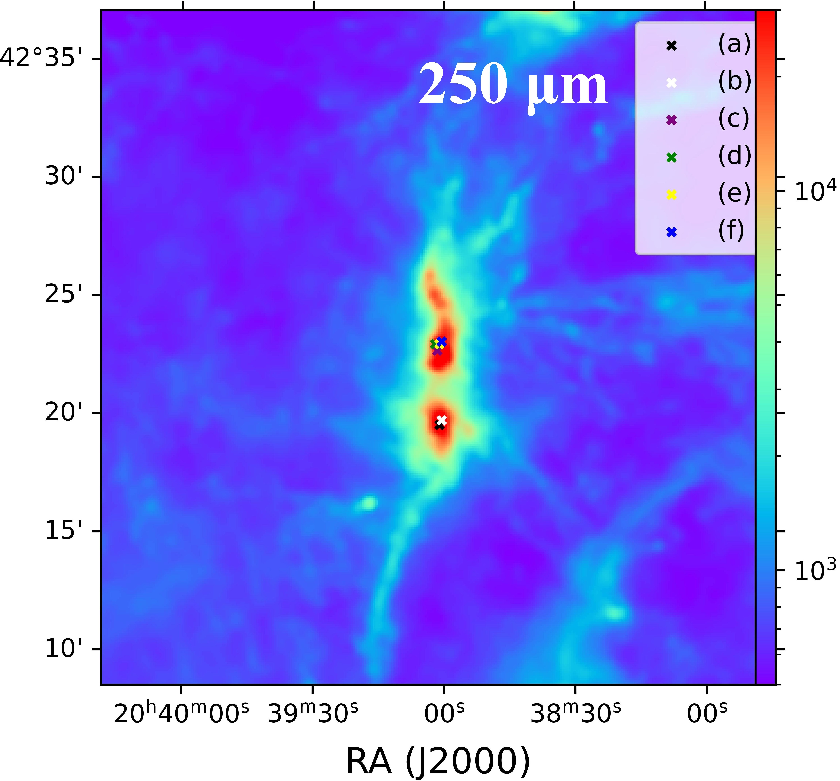
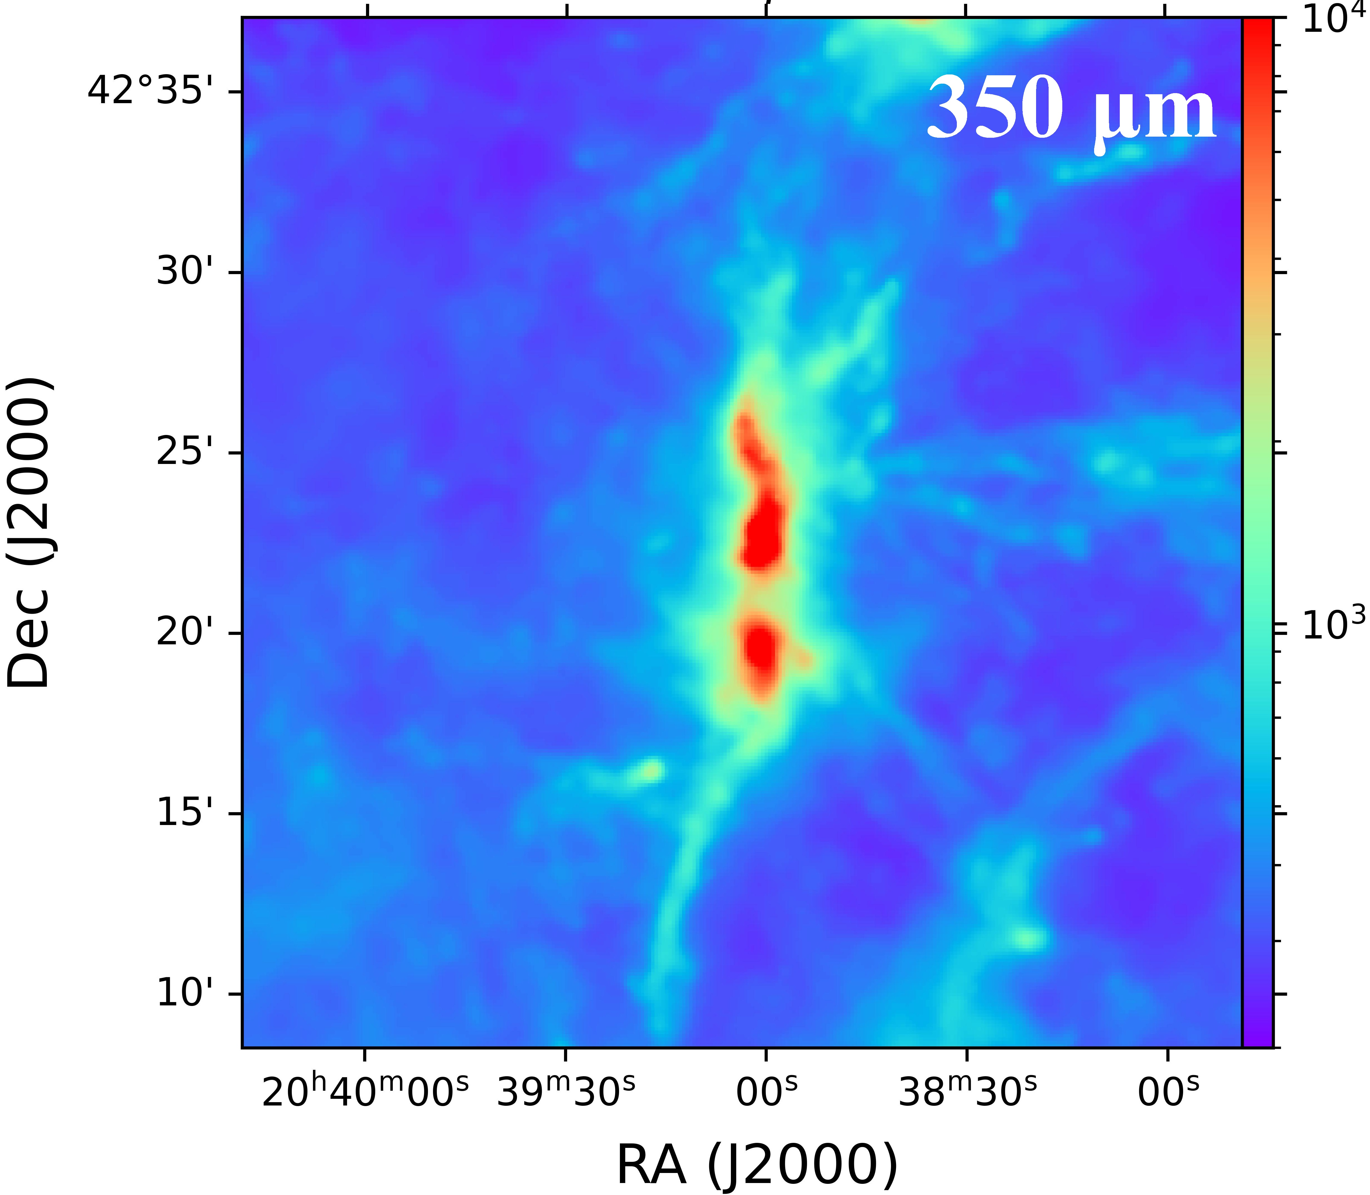
Convolved and Regridded Maps
Figure 7: DR21(OH) region: Processed continuum images at (a)$160μm$ (b)$250μm$ to the common resolution ${23}_{.}^{′′}9$ and pixel size $({5.7}^{′′})$ of $350μm$ (c). The markers in the map at 250$μm$ (b) represent the positions at which SED fits were obtained. Information about these positions are provided in the following table and their SED fits are represented in Figure 8.

Slide 21
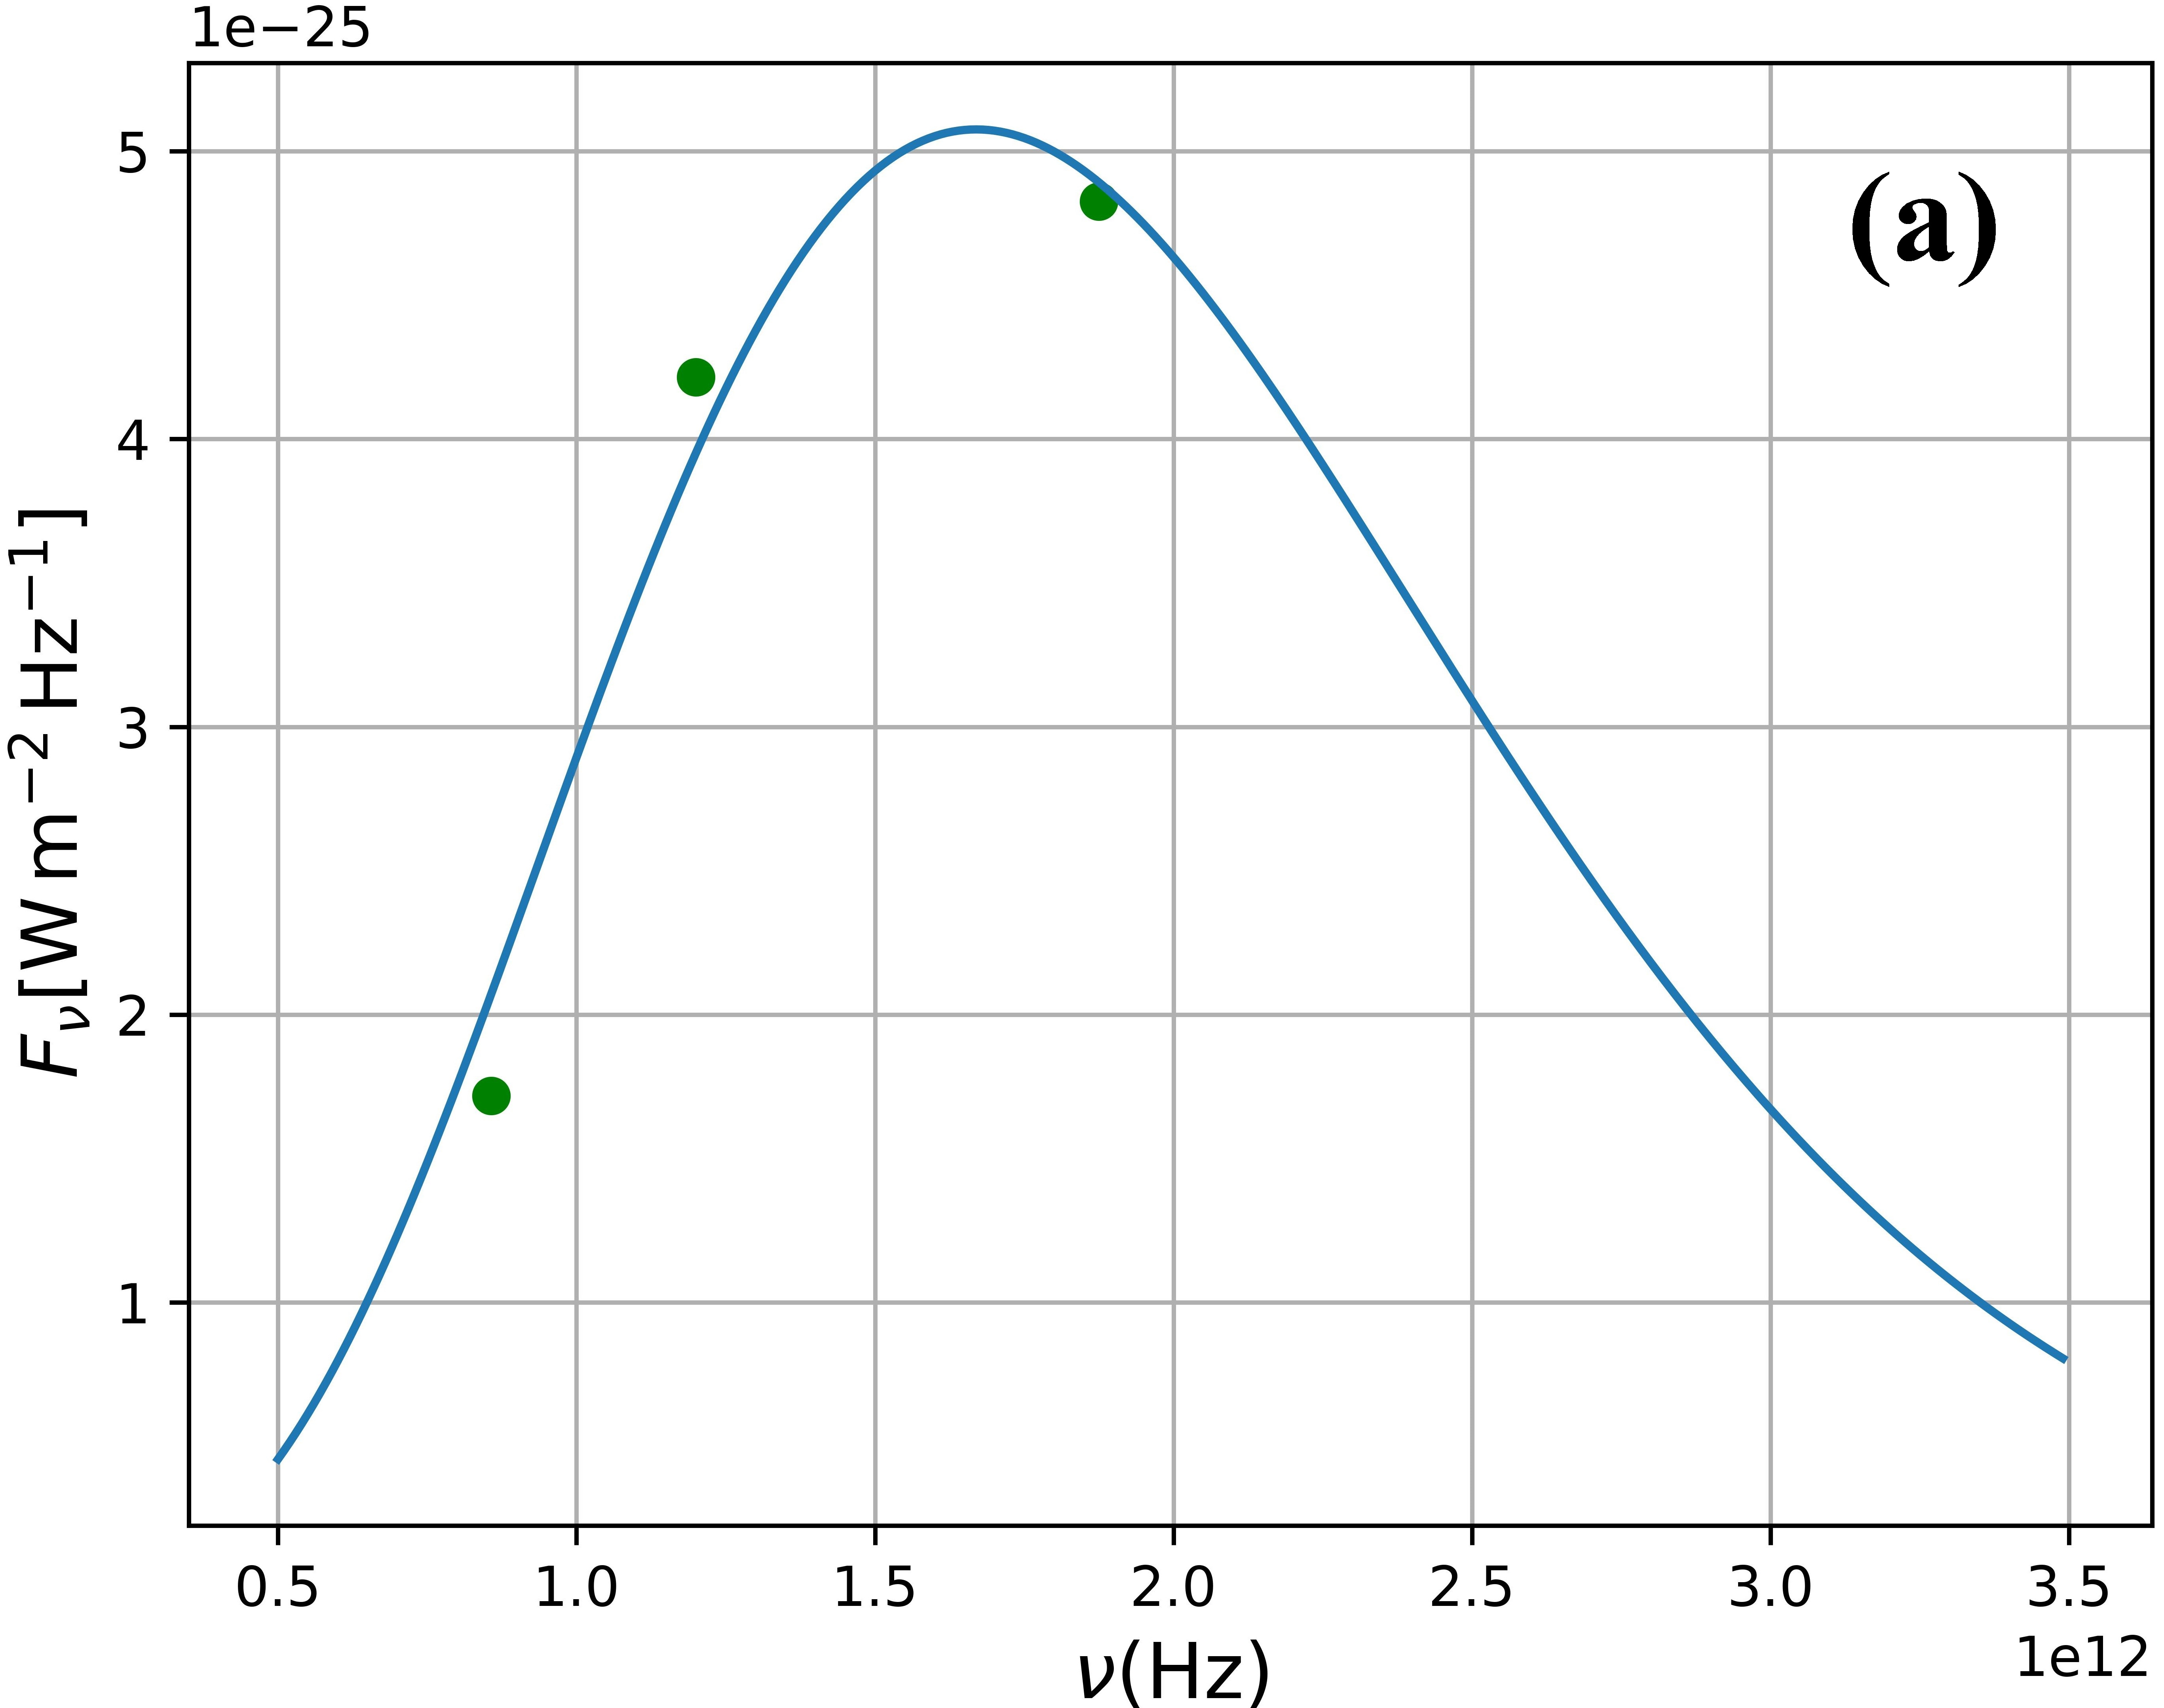
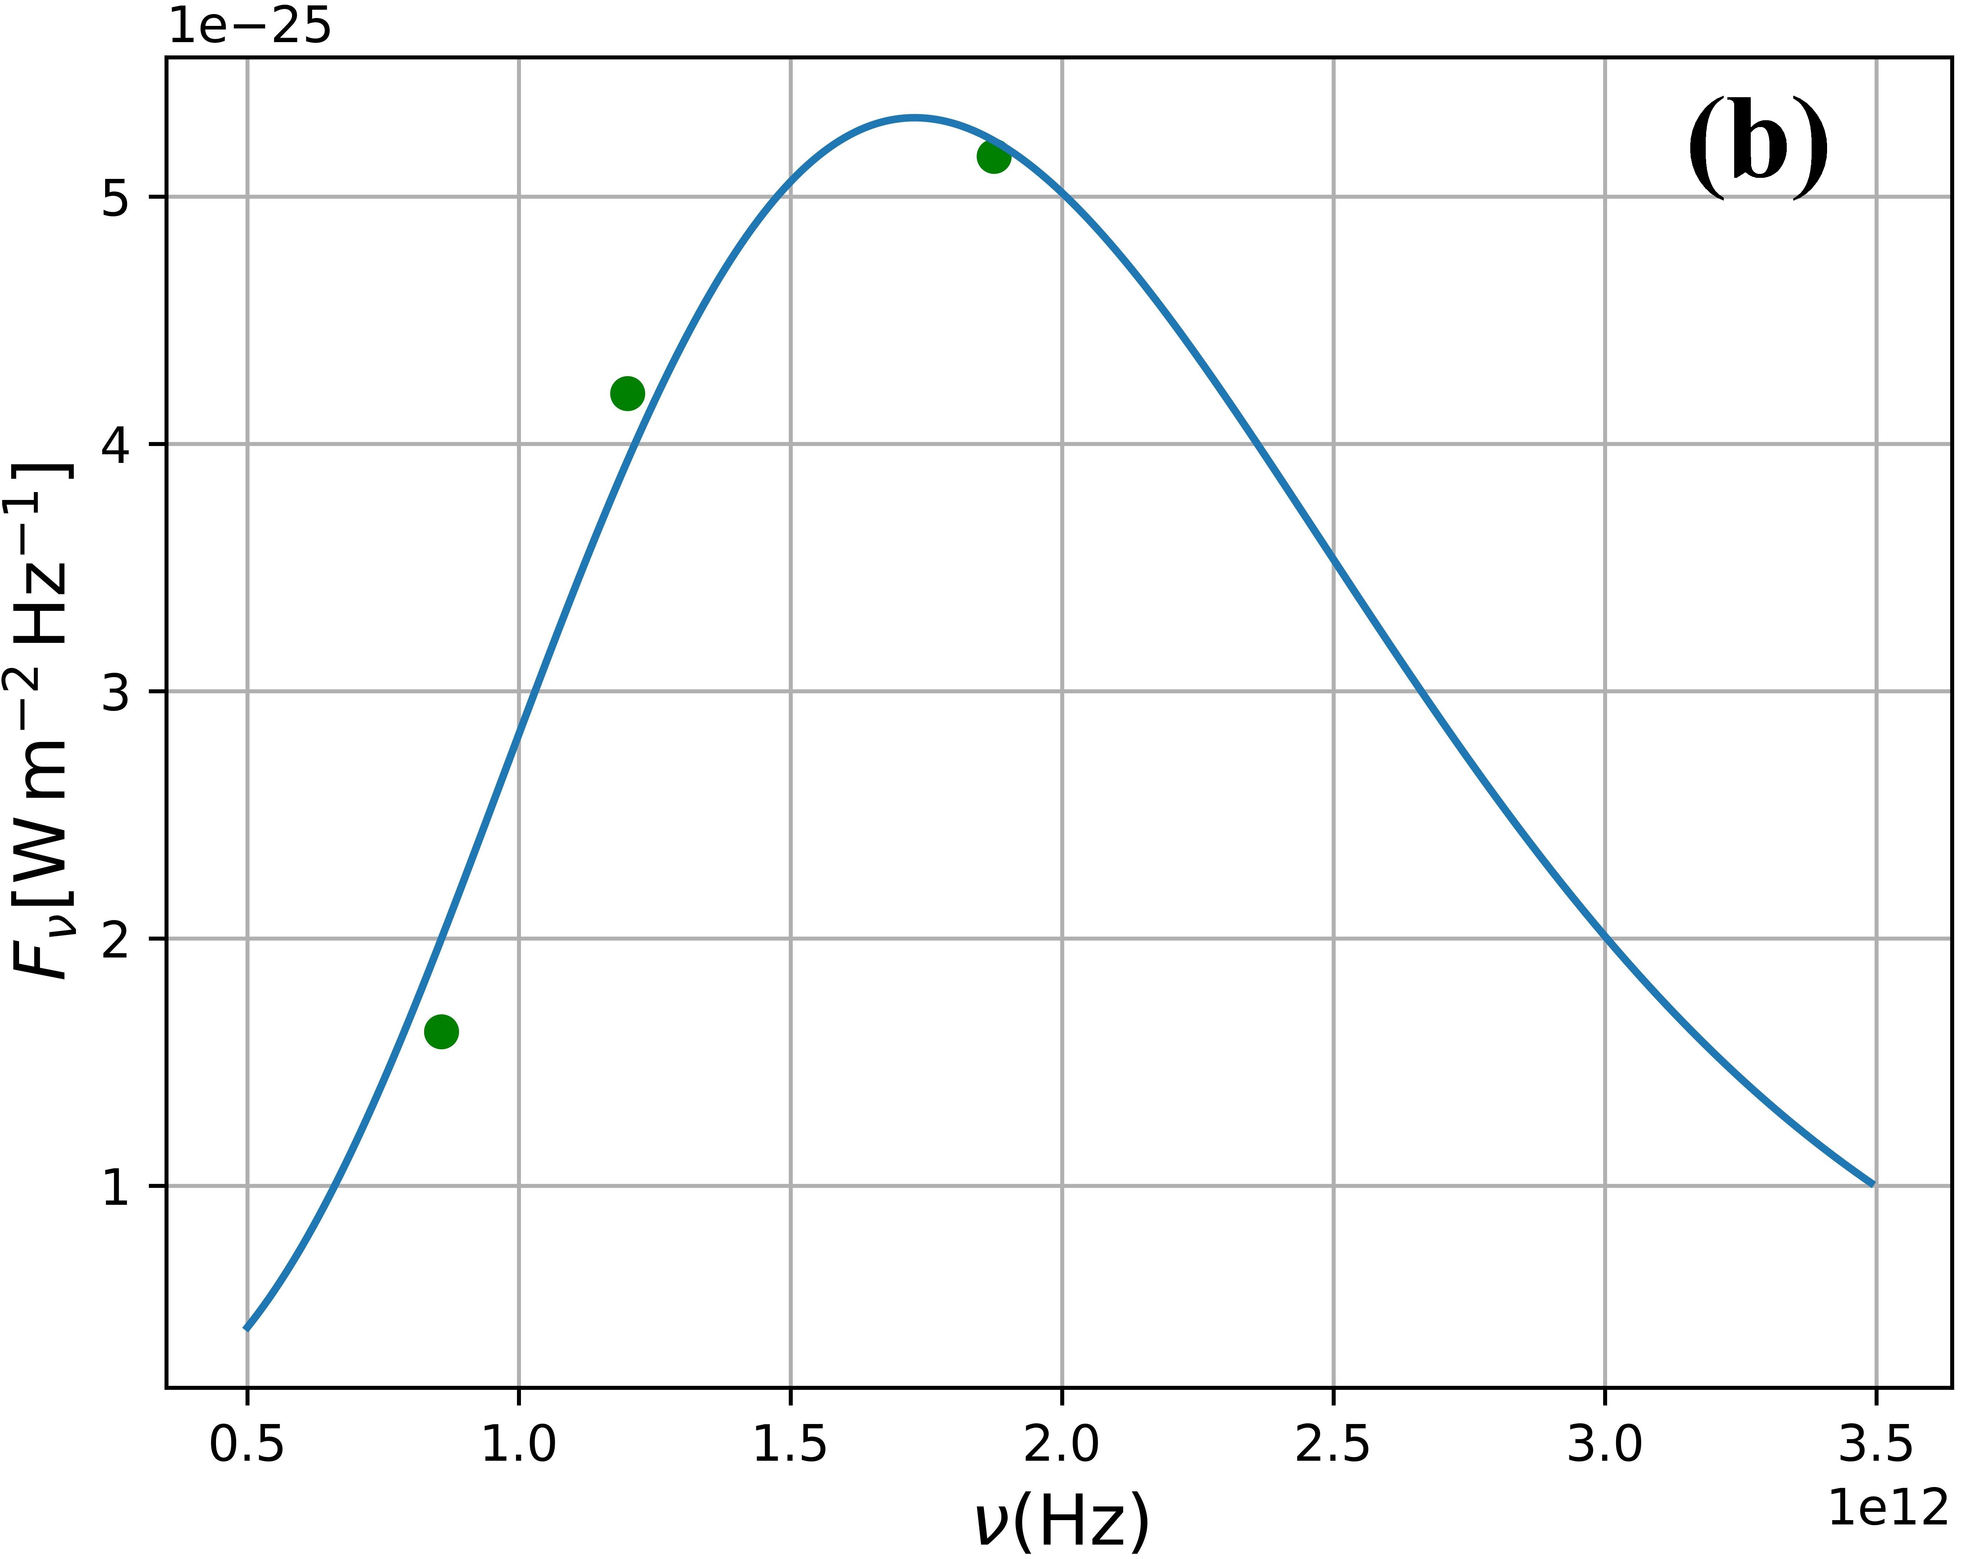
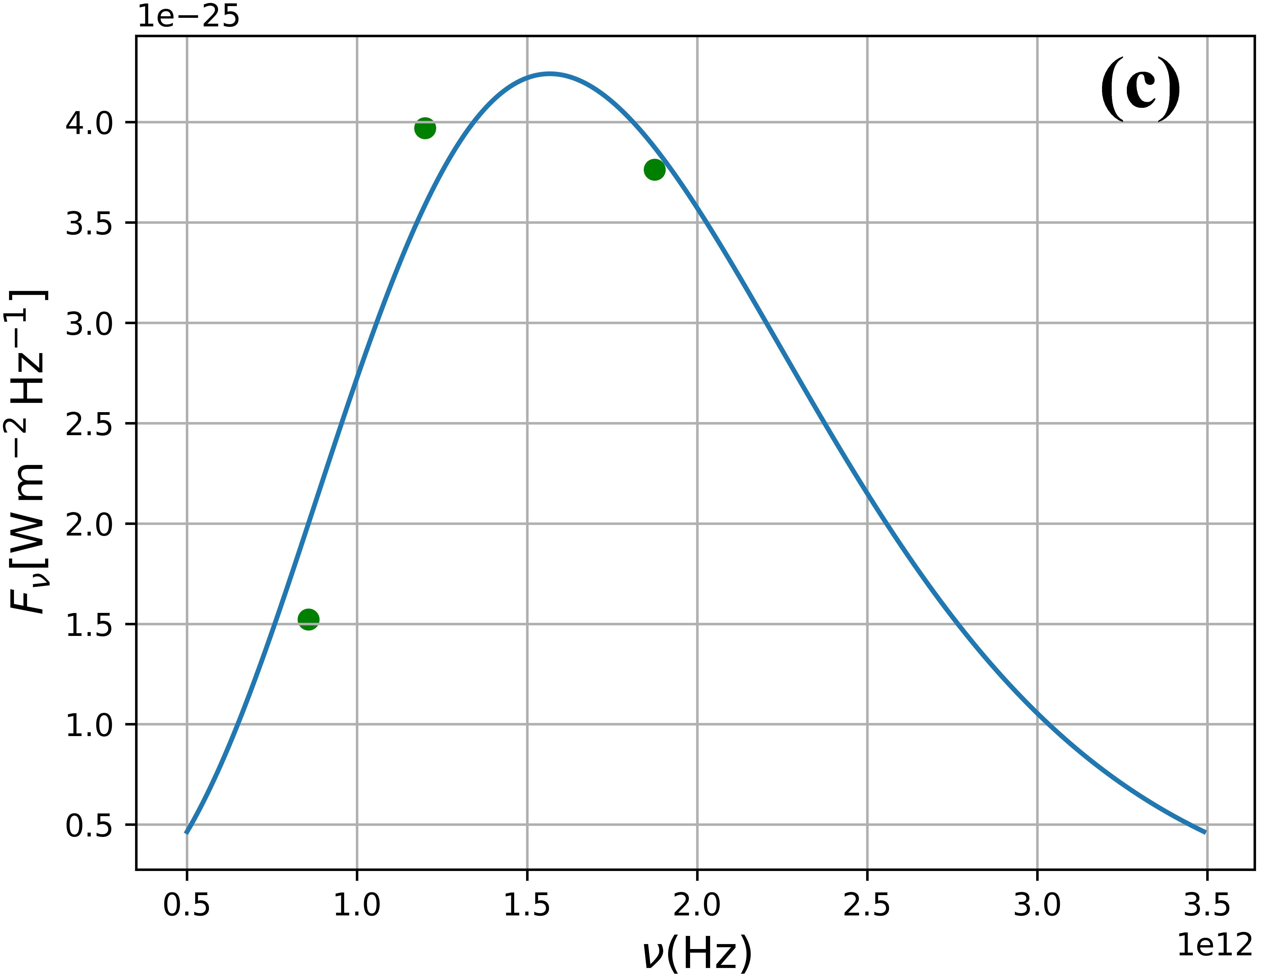
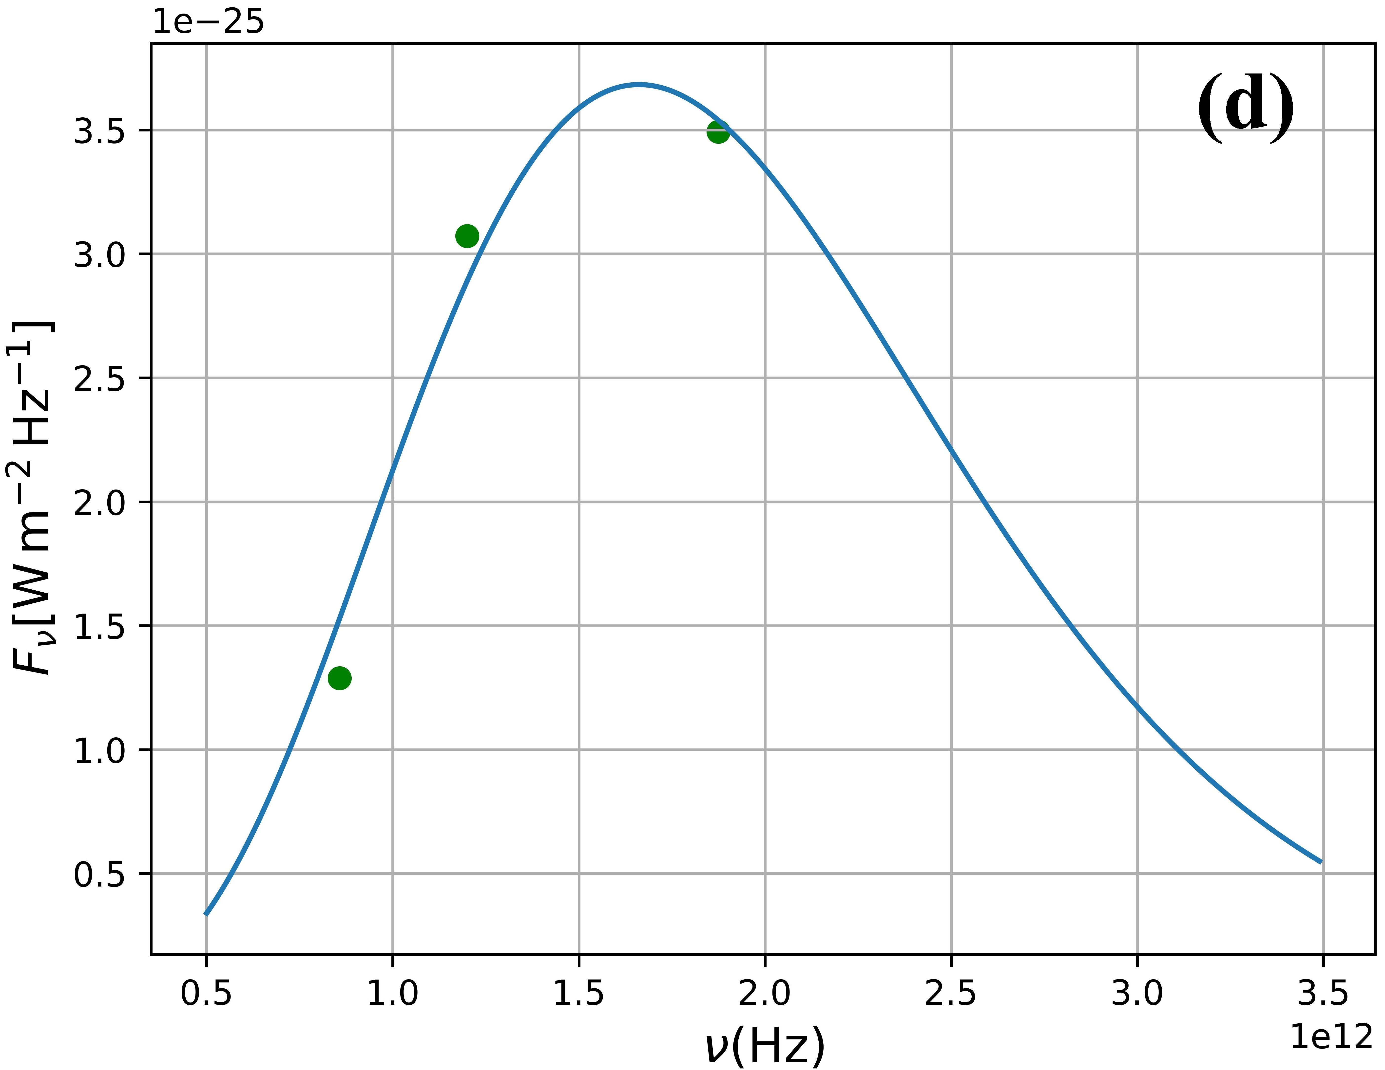
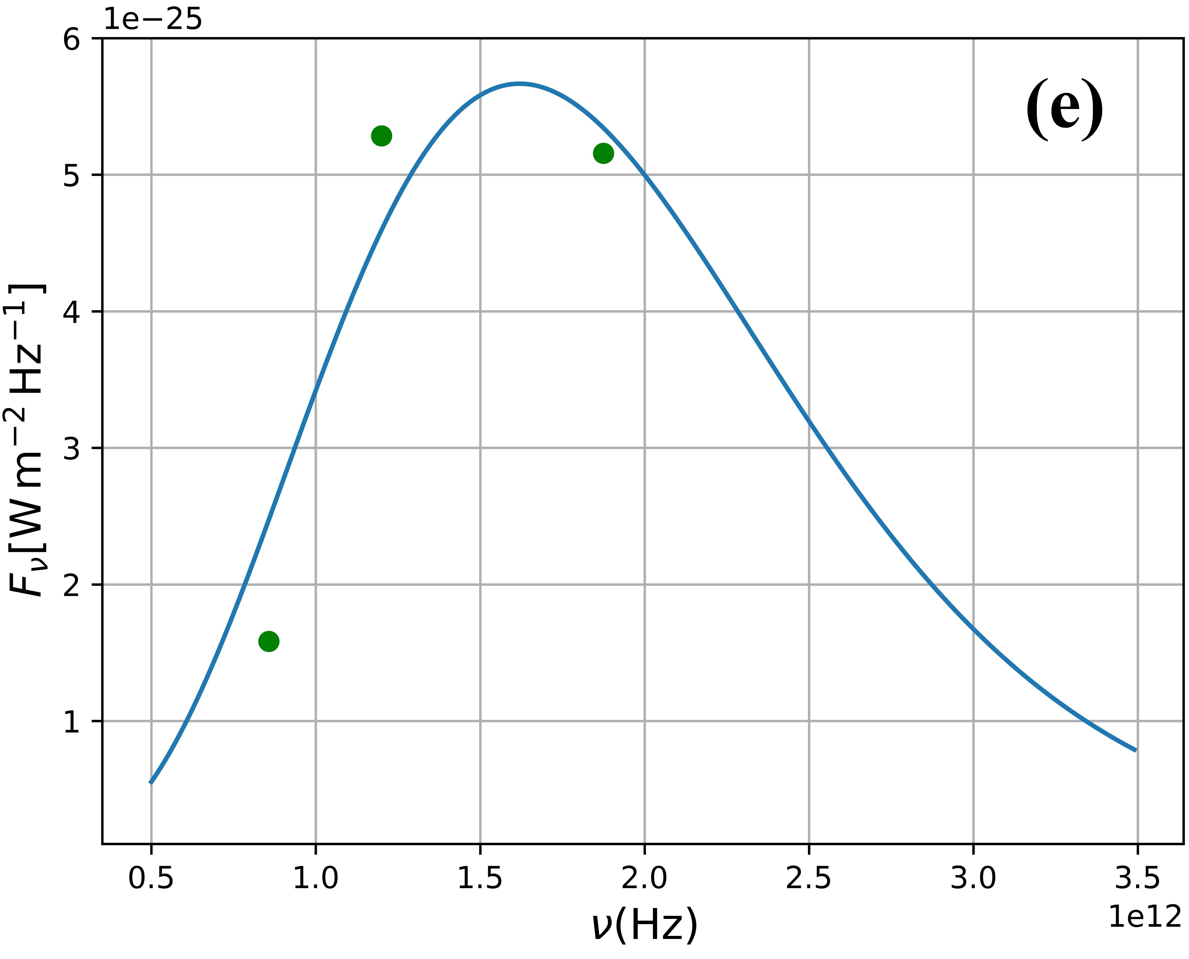
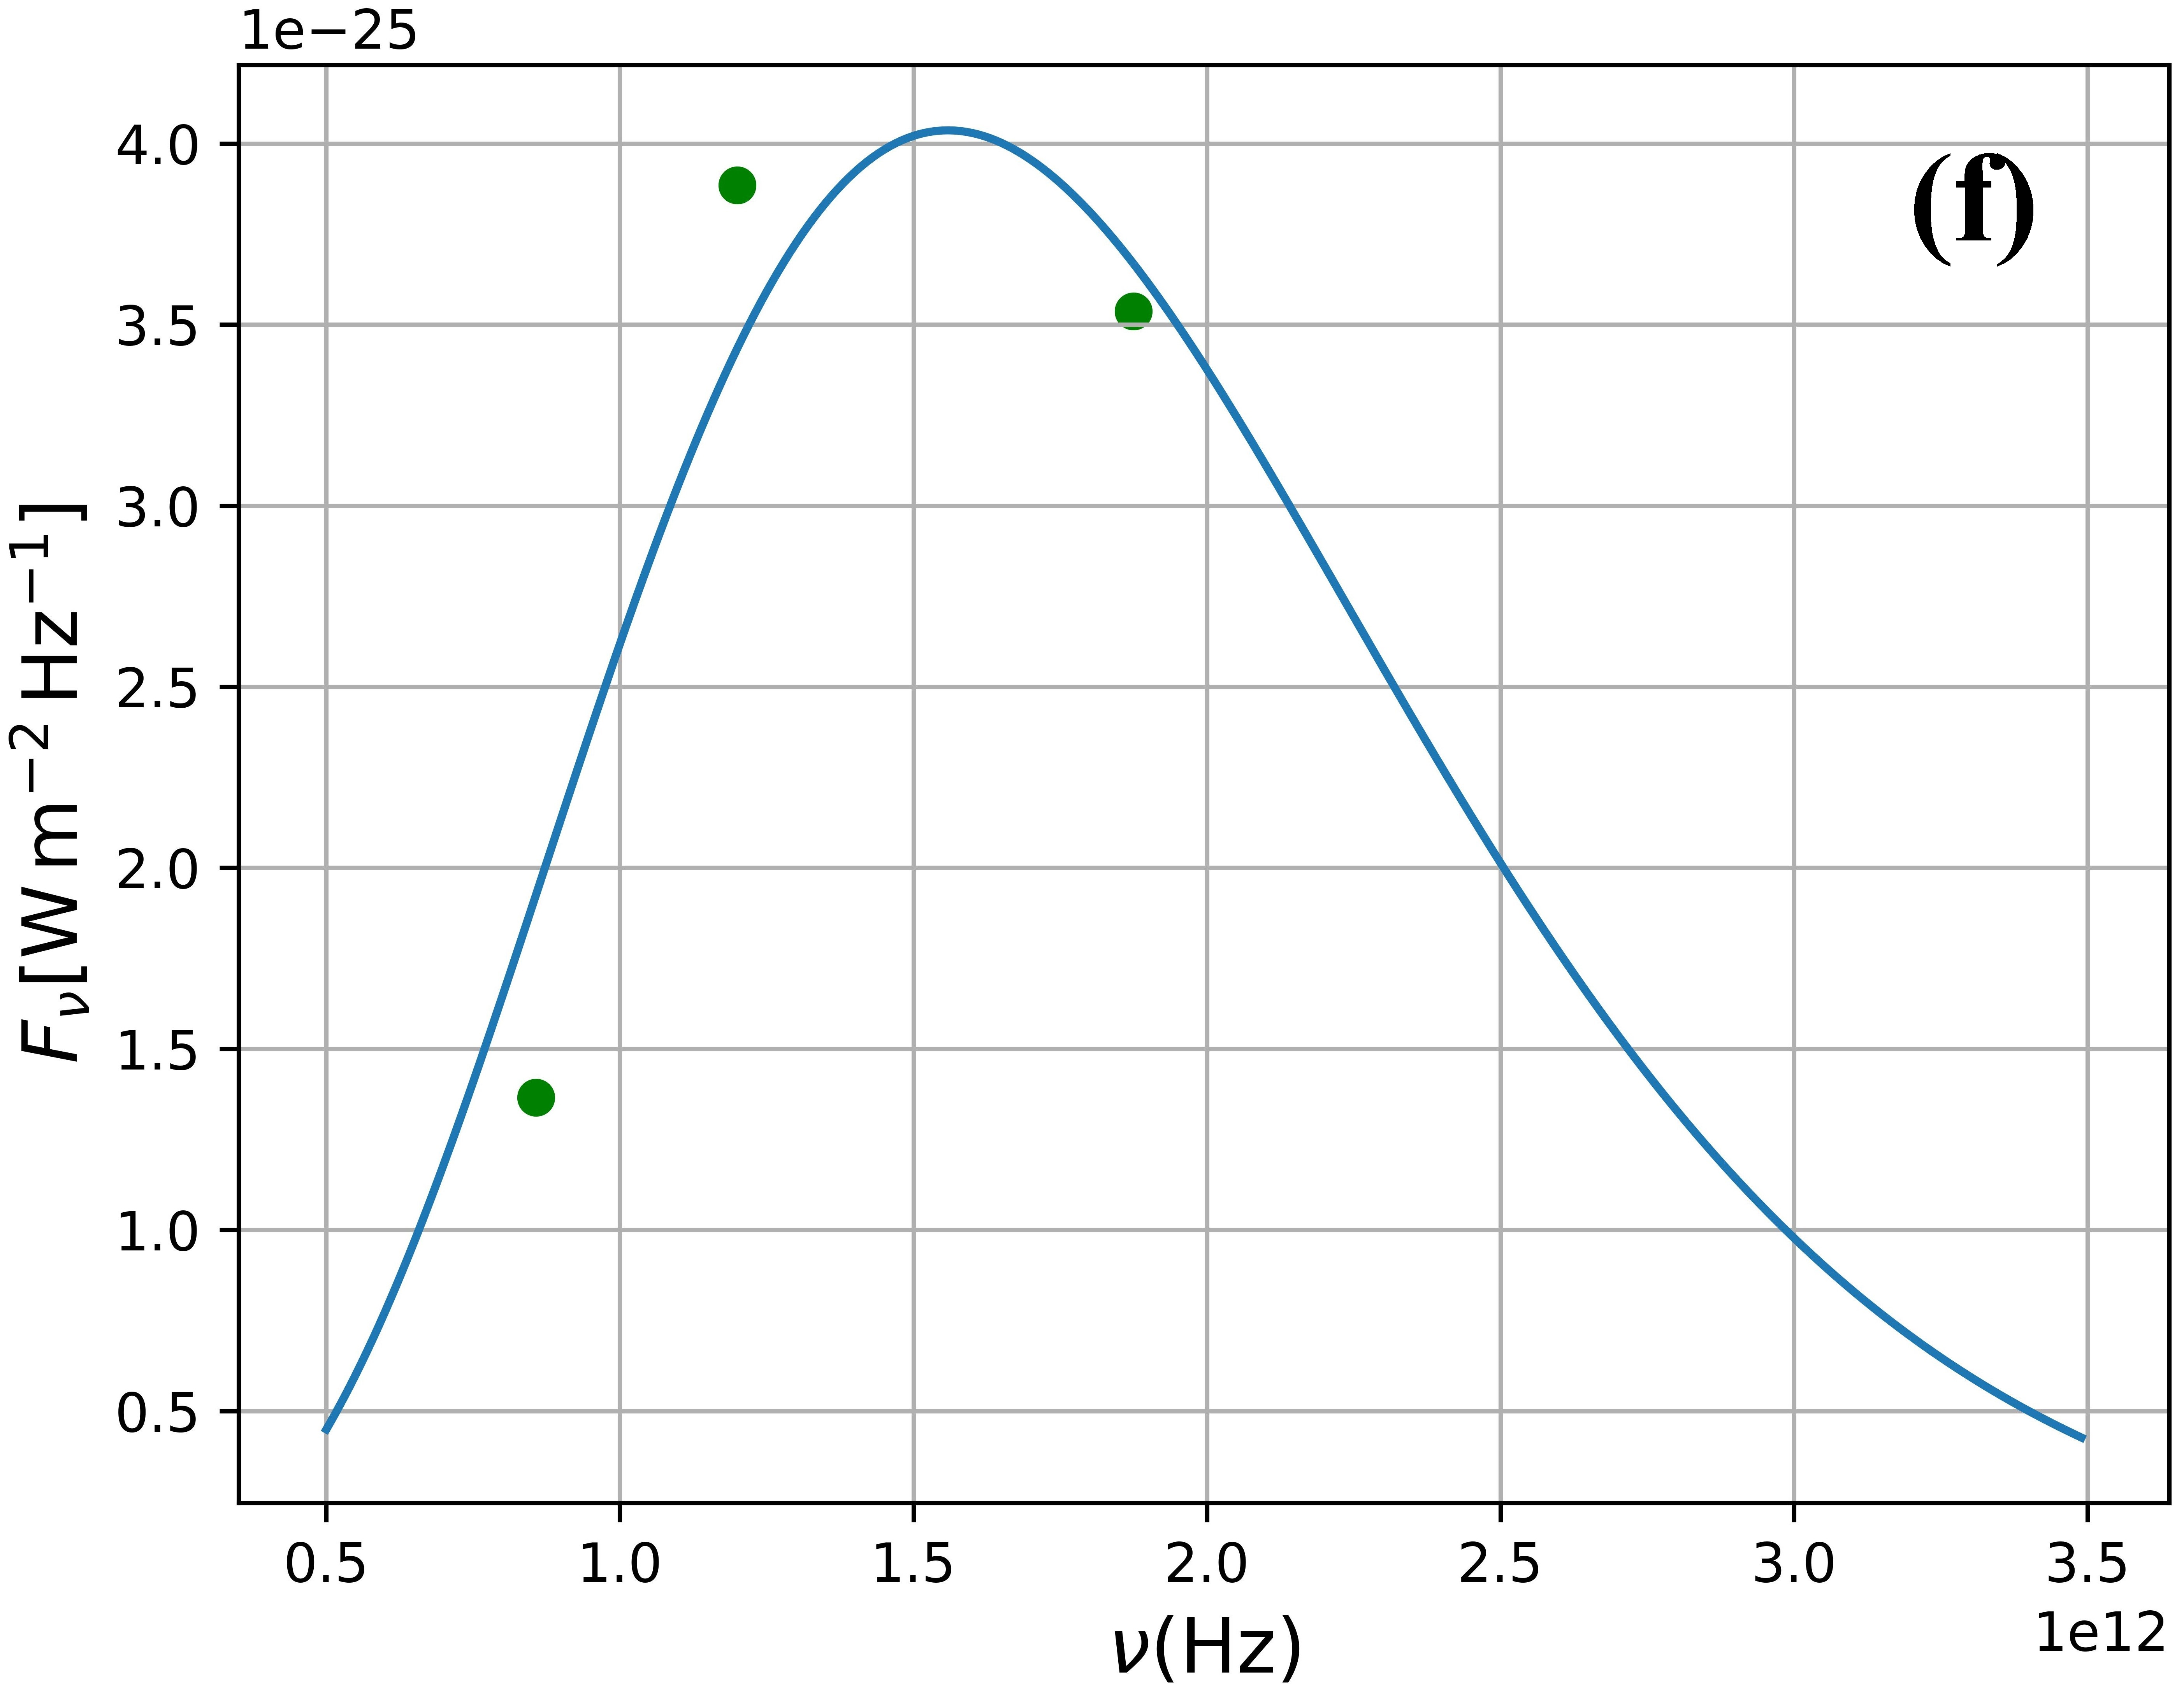
Figure 8: Spectral Energy Distributions (SEDs) of six positions around DR21(OH).

Slide 22
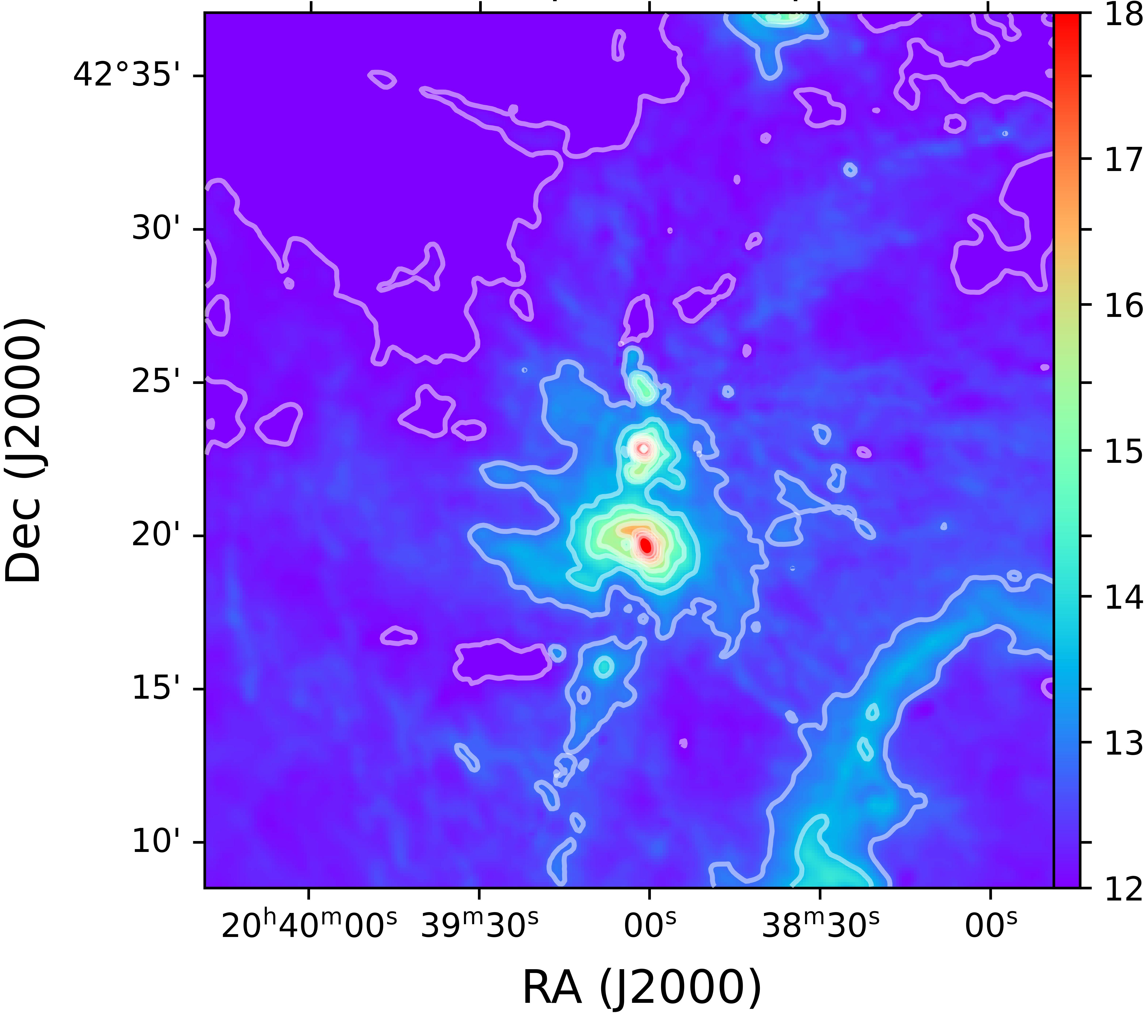
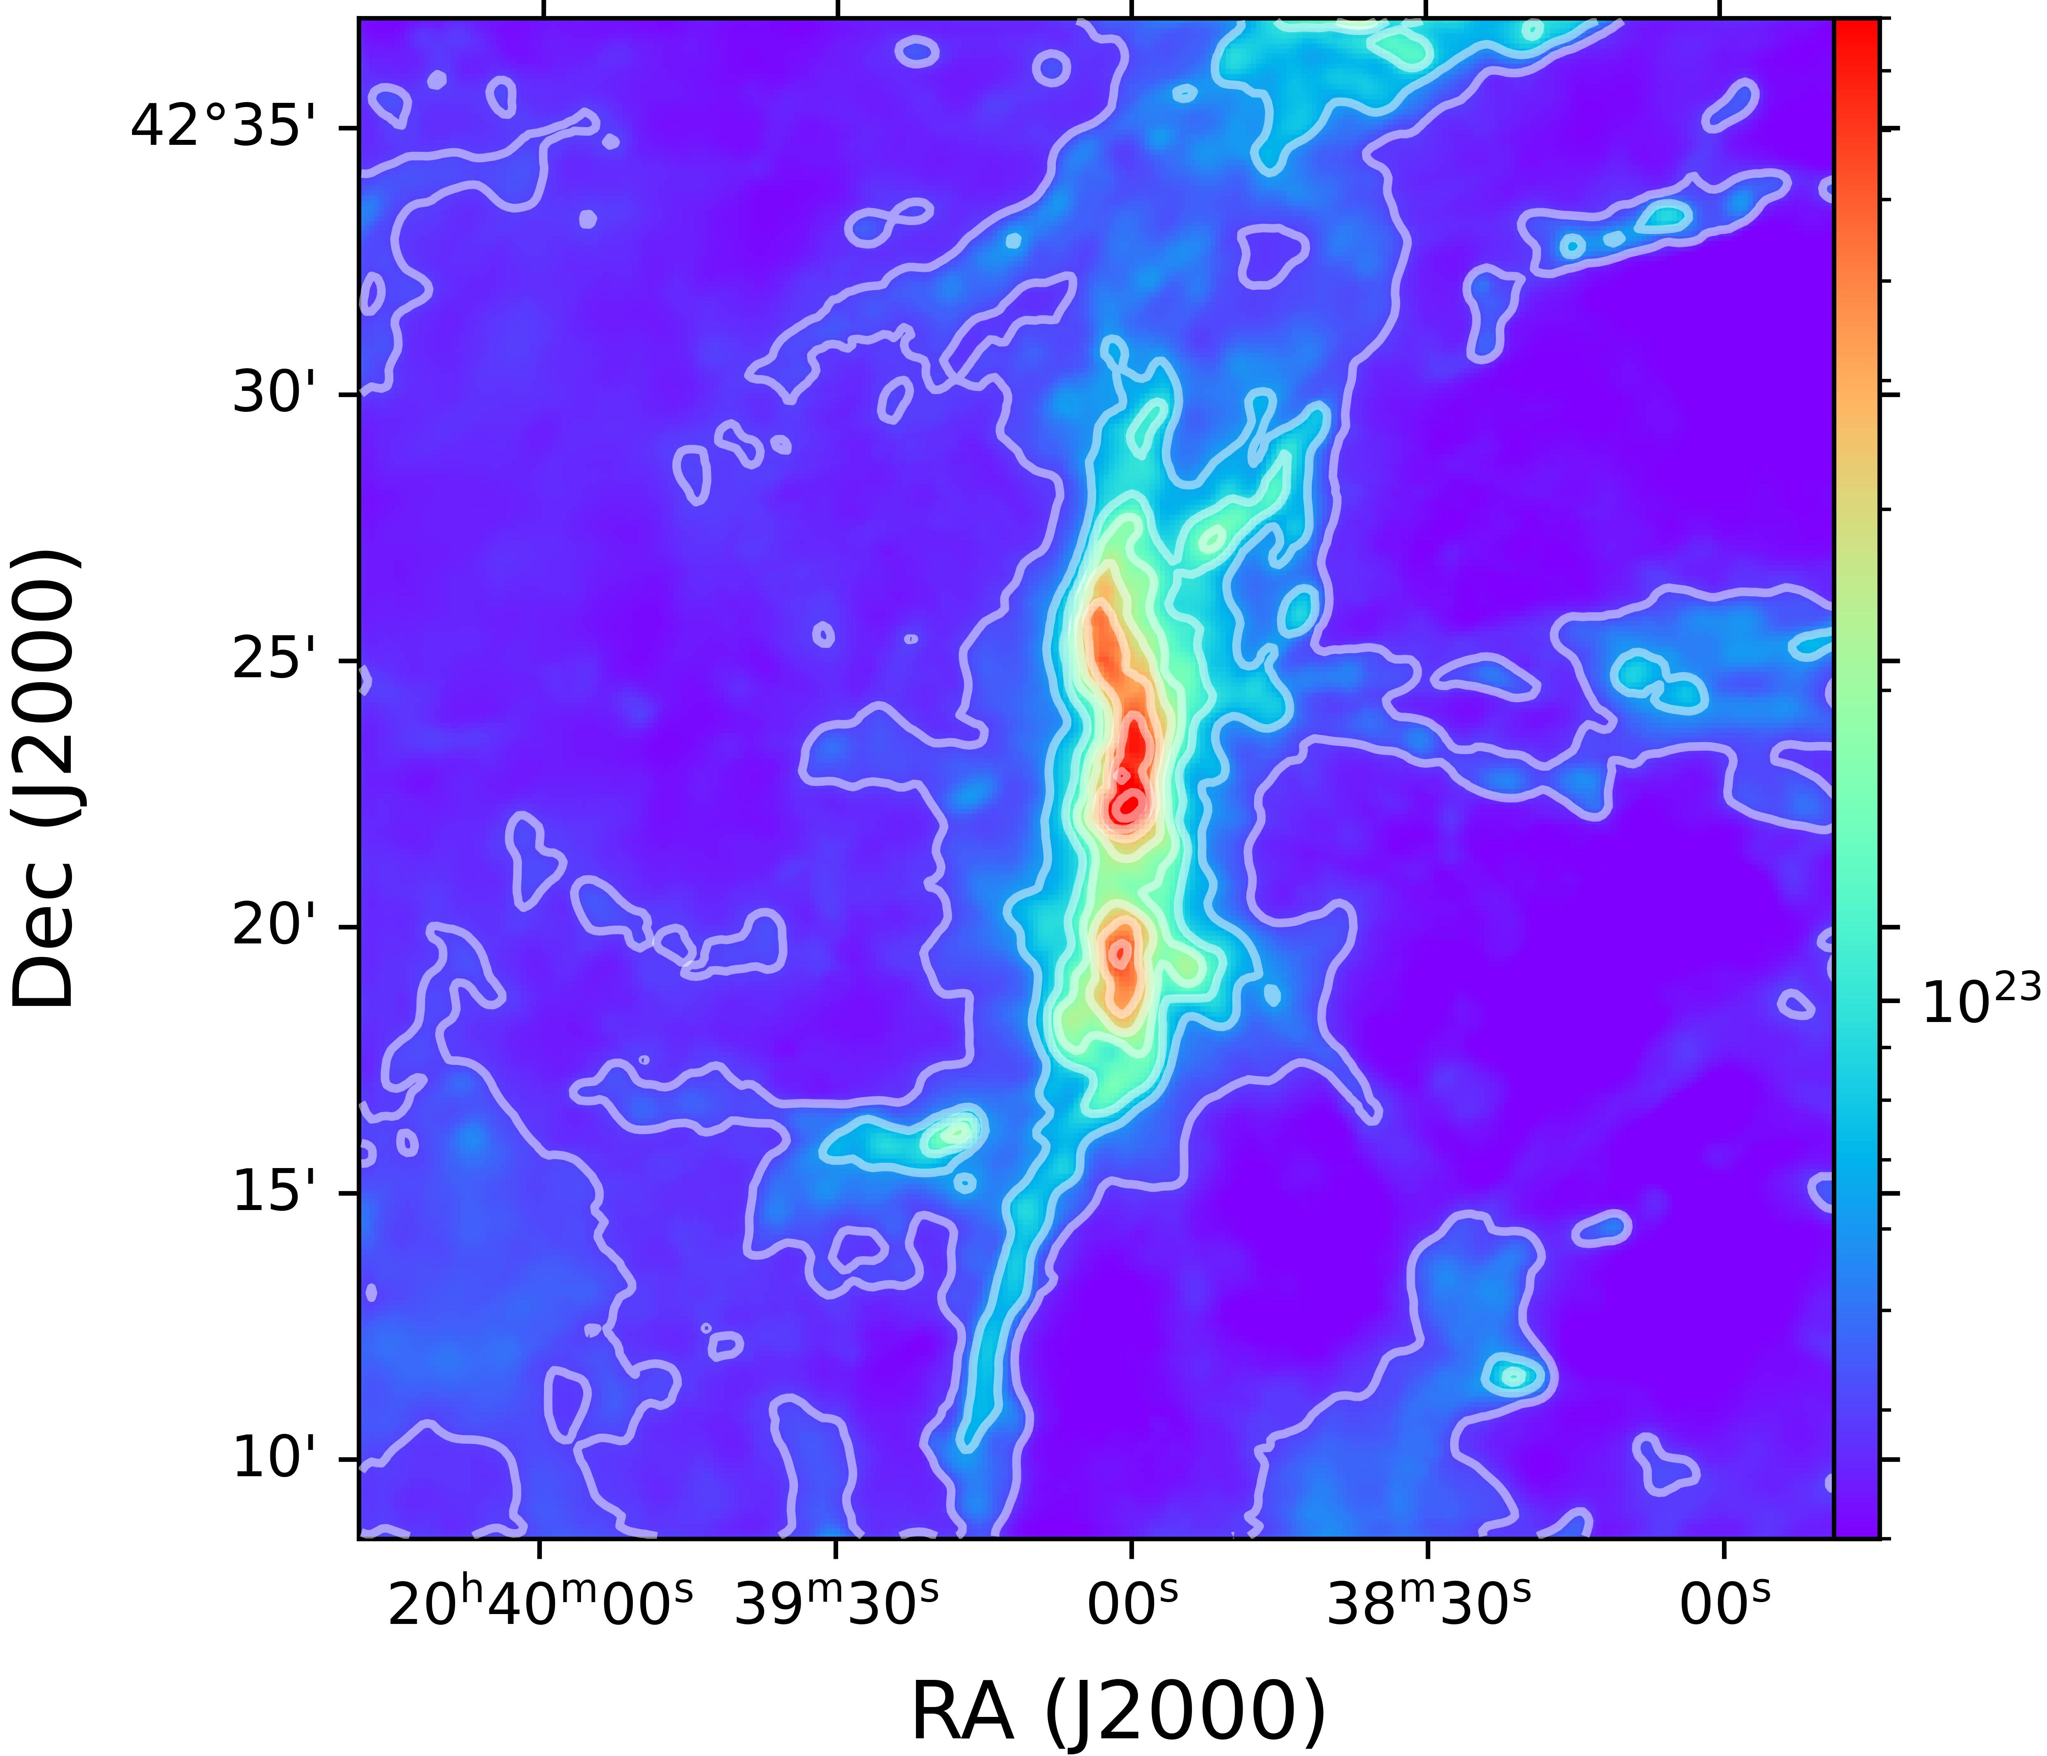
Maps of Dust Temperature and Column Density
The region has temperatures in the range of 11-19K.
$N\left(H_{2}\right)$ values lie in the range of $3 ×{10}^{22} {cm}^{−2} to 1 ×{10}^{24} {cm}^{−2}$
The temperature in the immediate surroundings of the DR21(OH) region spans from $\sim 16−19K$
Around DR21(OH), $N\left(H_{2}\right)$ values lie in the range $7 ×{10}^{23}−1 ×{10}^{24} {cm}^{−2}$
(a)
(b)
Figure 9: (a) Dust temperature map and (b) Column density map derived from the pixel-by-pixel greybody curve-fitting routine in Python. They have pixel size $5.7′′$ and resolution of ${23}_{.}^{′′}9.$ The contour levels in the dust temperature map correspond to the range 12 to 19K with a step size of 0.8K, with a total of $\sim 9$ samples. The contours in the column density map are from ${10}^{22} −{10}^{24} {cm}^{−2}$, with a total of ${10}^{11}$ samples.

Slide 23
04
Conclusion & Future Scope

Slide 24
Summary
The northern and southern parts of DR21 ridge are clearly observed in the cropped maps having a common area of ${1800}^{′′}×{1800}^{′′}.$
Continuum maps at 160 and 250$μm$ smoothed to a common angular resolution.
01
02
03
04
05
Multiple dense clouds seen in the northern DR21 ridge at 70 and 160$μm$, most massive being DR21(OH).
160 and 250$μm$ convolved maps regridded to have common pixel size.
Dust emission of DR21(OH) region at 70, 160, 250, 350 and 500$μm$ shows presence of filamentary structures around the source.

Slide 25
The values of column density obtained are comparable to the Cao values, although the temperature values obtained are slightly low compared to the Cao values.
Temperature observed to be the highest in the regions surrounding the source $\sim 19K$, following a gradual decrease in the outer regions.
06
07
08
09
10
The column density obtained for regions surrounding the source $\sim 7 ×{10}^{23} {cm}^{−2}$ to ${10}^{24} cm^{−2}$, showing the same trend as temperature.
The values obtained for column density and temperature from our fitting output indicate that DR21(OH) is undergoing high-mass star formation.
Pixel-by-pixel fitting performed on the convolved and regridded maps using greybody function.

Slide 26
Future Scope
Maps of dust $T_{dust}$and $N\left(H_{2}\right)$ of any number of star-forming sources can be derived.
More physical properties of a source using these maps of column density and dust temperature can be found.
The column density maps are useful to identify filaments and potential sites of star formation. Several algorithms are available for identifying such structures.
As a next step of this work, use of techniques such as ‘filfinder’ will be used to identify and characterize the filaments in DR21(OH).
The procedures implemented can be used to study other filamentary molecular clouds that are also sites of low- and high-mass star formation.

Slide 27
Thank You!
Does anyone have any questions?
email4rmohna@gmail.com

