Slide 1


Scholarships and financial aids
for studies and research in France
& the PHC Polonium
Prof. Dr. hab. Jean-Luc Schneider
Attaché for Science and Higher Education
French Embassy in Poland / French Institute of Poland

Slide 2
Studies in France: funding
France Excellence scholarships
Master 2: 1 to 10 months of studies in France (€860 / month)
France Excellence Europa: Master 1 & 2 (€6850 / semester)
PhD: co-tutelle or co-direction → 3 stays of 4 months maximum
per year (€1690 / month)
→ https://www.pologne.campusfrance.org/fr

Slide 3

Excellence Eiffel Scholarship
Master level: up to 2 years (€1181 / month)
Engineering school: up to 3 years (€1181 / month)
PhD level: up to 1 year (€1700 / month)
All citizenships
Pre-selection by the French universities and engineering schools
Information:
https://www.campusfrance.org/fr/le-programme-de-bourses-eiffel

Slide 4


Erasmus Mundus Joint Masters scholarships
Students at master's level from all over the world can apply;
Erasmus Mundus Joint Masters: high-level and integrated Master programmes;
Either a joint degree or multiple degrees;
1 to 2 academic years (60, 90 or 120 ECTS credits);
The scholarship covers travel and living costs;
At least 2 study periods in 2 countries (different from the country of residence);
Information:
https://erasmus-plus.ec.europa.eu/opportunities/individuals/students/erasmus-mundus-joint-masters-scholarships

Slide 5
Research stays in France
High-level scientific stay: young and confirmed researchers
→1 to 3 months of scientific stay in France (€1704 / month)
Short time research stays (some days): invitation / mission
In France : €140 per night + €20 per meal + roundtrip flight
In Poland : €114 per night + €31 per meal + roundtrip flight
    https://www.pologne.campusfrance.org/fr
    contact me for the short time research stays
(jean-luc.schneider@diplomatie.gouv.fr)

Slide 6




Hubert Curien Partnership (PHC) “POLONIUM”
→ French-Polish partnership
→ https://www.campusfrance.org/fr/polonium

Slide 7

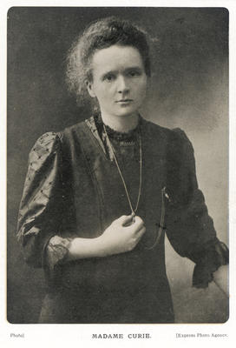
The PHC Polonium
Two collaborating French and Polish teams working on a joint research project during 2 years;
20 projects selected each year;
French and Polish independent selection comitees;
The program provides money for researchers travels and stays in both France and Poland
Information:

Slide 8
To conclude: useful information
Campus France: https://www.campusfrance.org/en
Campus France Poland: https://www.pologne.campusfrance.org/fr
jean-luc.schneider@diplomatie.gouv.fr

Slide 9
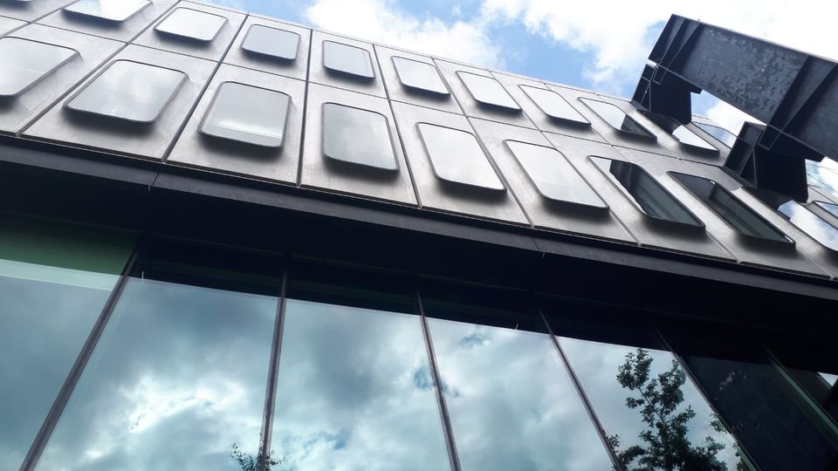
Thank you
Dziękuję bardzo

