Slide 1



Particle Astrophysics Science and Technology Centre
https://astrocent.camk.edu.pl/
Leszek Roszkowski

Slide 2
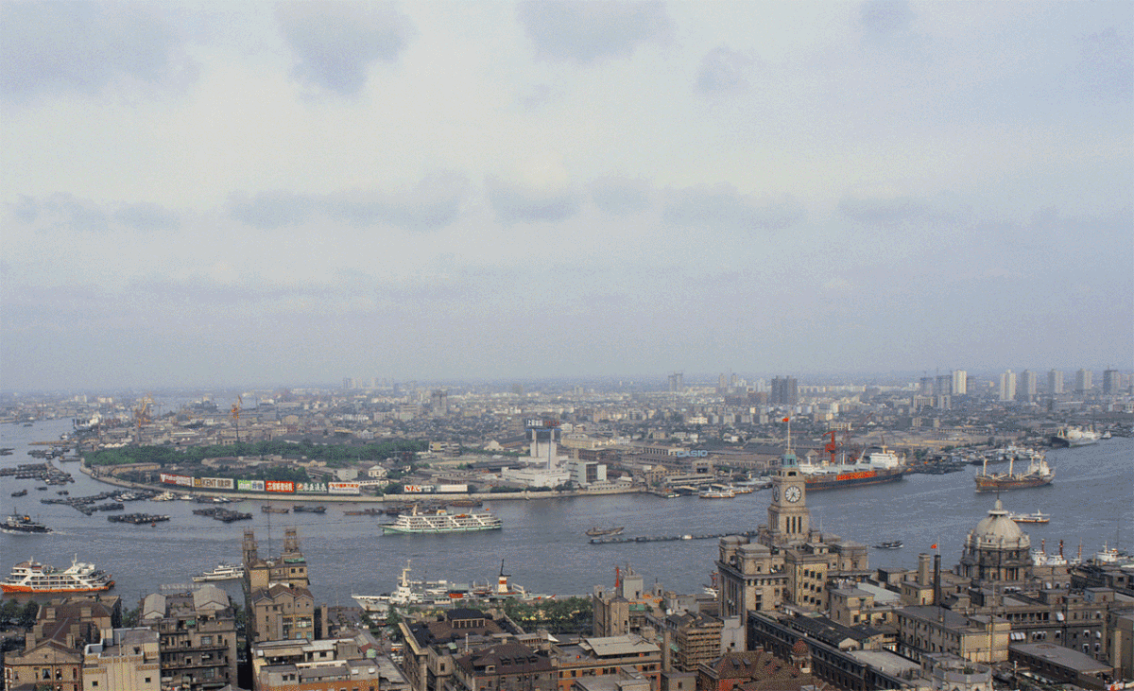
Vision

Slide 3
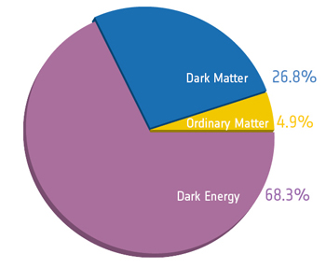
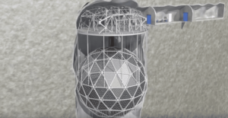
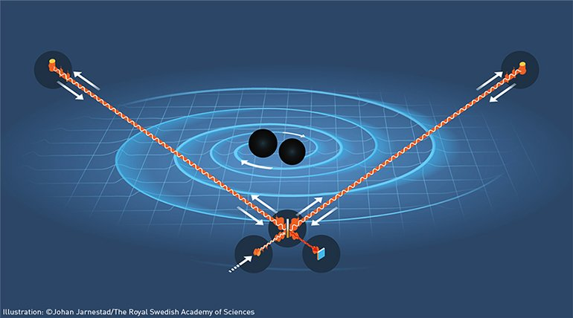
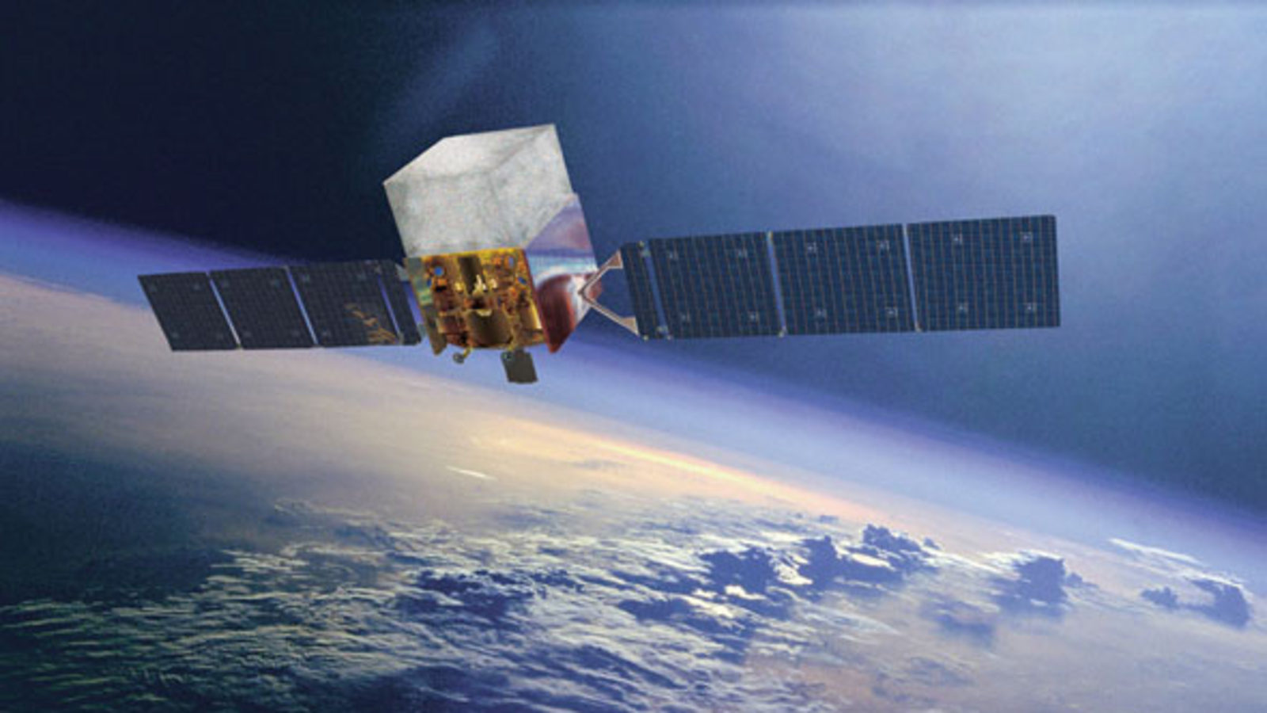
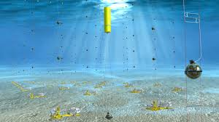
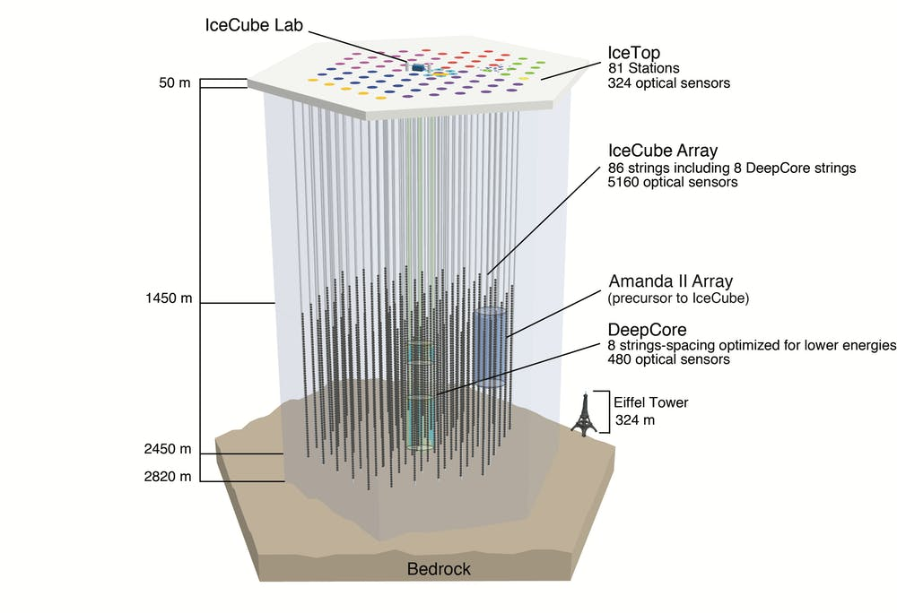
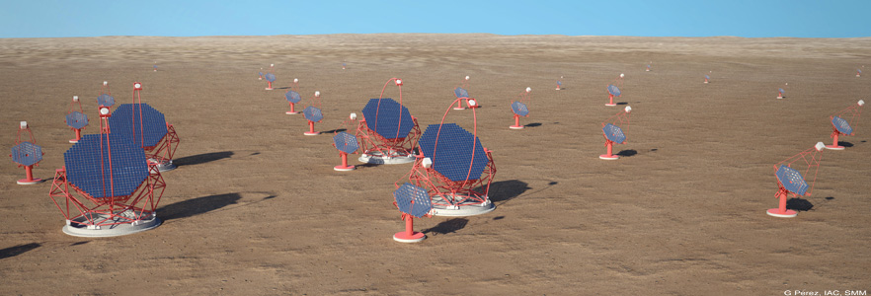
Particle astrophysics
Study of elementary particles in the invisible Universe
9 Nobel prizes so far
Fruitful cooperation of:
Fascinating, frontline, highly promising
science (with bright future), and
Innovative, cutting-edge technologies
Dark matter
Gravitational waves
Neutrinos
…
Technological requirements:
Extremely sensitive
Prepared for long-term use
Work in extreme conditions
Own/limited power supply
Sturdy, no/little option for repair
Process huge amount of data, online
Requires inventing new solutions
Affordable
…
Gravitational waves:
Nobel Prize 2017
Need teams of scientists, engineers,
software programmers
Need innovative R+D

Slide 4
AstroCeNT
Particle Astrophysics Science and Technology Centre
International Research Agenda: new centre of excellence
Funding: 38 MPLN (8.3 MEuro) for 5 years (1 July ‘18 – 30 June ‘23)
Autonomous department of CAMK PAN
source: FNP
(EU structural
funds)
31 December ’23
Main objectives:
Studies of the invisible Universe (gravitational waves, dark matter,
  neutrinos…)
Ultra-sensitive instruments to detect extremely faint signals
  Seismic sensors, modules of silicon photomultipliers (SiPMs), …
Big data collection and processing
Applications to hi-tech industry and medicine (e.g., PET)
…
Big
science
Innovative
technologies

Slide 5
AstroCeNT and new technologies
Data
Science
SiPM
Quantum Computing
Environmental
sensors
Medical Physics
AstroCeNT
Stavros Katsanevas
Chair of ISC (2018-22)

Slide 6
Main research directions, collaborations and partners
Large experimental collaborations:
Dark matter:
DarkSide, DEAP-3600
Global Argon Dark Matter
Collaboration (ARGO) - future
Technology for science and industry:
Silicon Photo Multiplier (SiPM) systems
systems of seismic sensors
data acquisition and large data set processing
quantum computing and artificial intelligence
Liquid Argon PET
main roadmap directions (APPEC)
Gravitational waves/seismic noise:
Advanced VIRGO/LIGO,
Einstein Telescope - future
Neutrinos:
KM3Net (observer)
Hyper-Kamiokande (joined 2021)
Main scientific partners:
APC
European Gravitational Observatory
Princeton University
Gran Sasso Science Institute
+ TUM, …. (via DarkWave)
National Centre for Nuclear Research
Warsaw University of Technology
University of Warsaw
Strategic partner APC
growing collaboration in large
international experiments: Virgo (GW),
DarkSide (DM), KM3Net (neutrino), …
Joint (cotutelle) student
plan to expand KM3Net and other
collaboration involvement
Notes:
HK: Ziembicki: deputy leader of HK Electronics group
McDonald Institute in Canada:
Student/visitor exchange programme (on hold due to covid)

Slide 7
International Scientific Committee
CAMK Director
APC-AstroCeNT
Executive Commitee
Management Board
Director of Astrocent
&
Director for Scientific Affairs
Administration
Office
HR
Technology broker
Public procurement
Information and promotion
Finances
Research Board
Commercialisation Board
CAMK administration & accounting
Research groups
I | II | III | IV | V | VI
SiPM Systems for Astroparticle Physics and Medical Physics | Seismic Sensors | Electronics and Data Acquisition and Processing | Ultrapure SiPMs and Associated Readout Electronics | Scientific Computing & Information Technology | Particle Astrophysics
Decision making
Institutional support
Merit support
Administration support

Slide 8
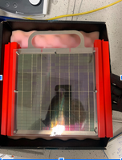
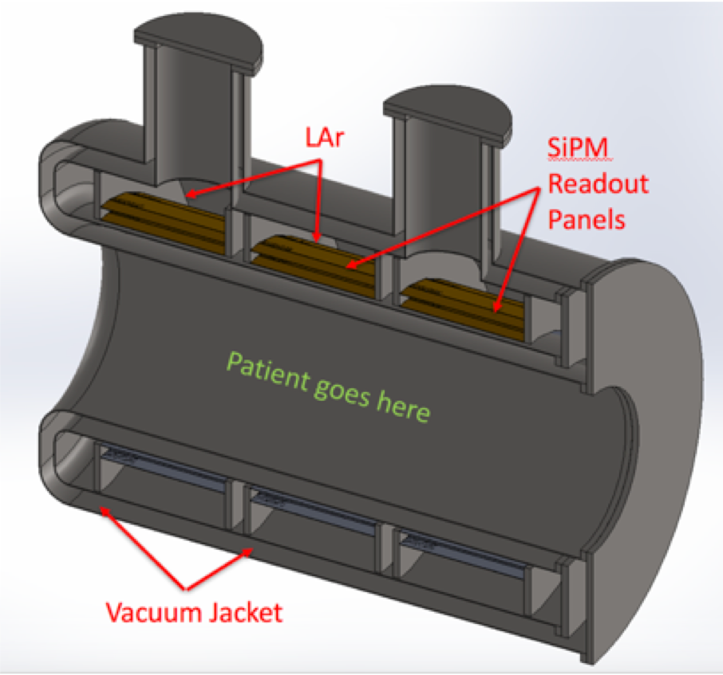
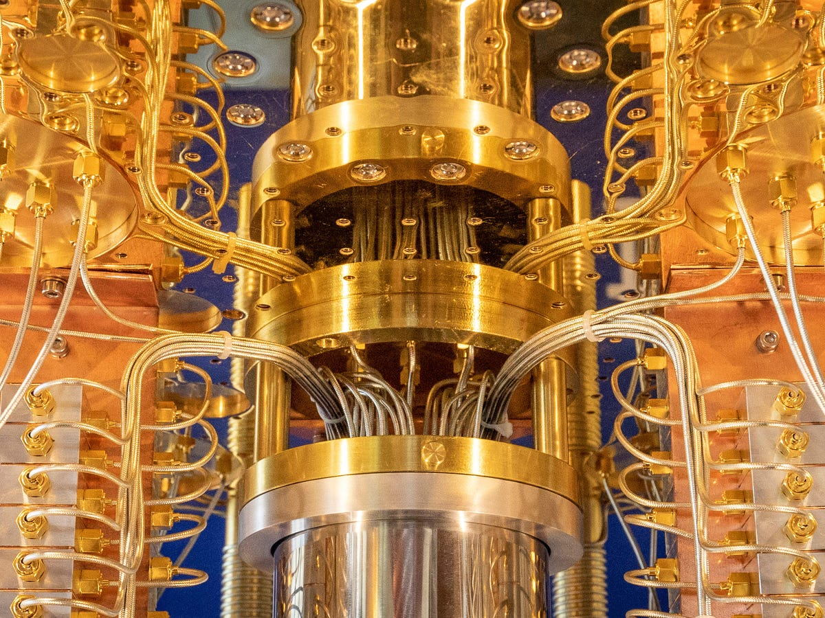
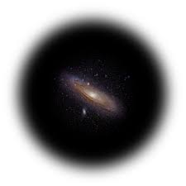
Astrocent Research Groups and main activities
Group 1: SiPM Systems for Astroparticle Physics and Medical Physics
Leader: Dr Marcin Kuźniak, prof. CAMK
  Dark matter experiments: DEAP-3600 (running), DarkSide-20k (under construction)
  Light detection and collection (wavelength shifters and photosensors) in cryogenic dark matter and neutrino detectors)* in LAr, synergy with DUNE
Group 2: Seismic Sensors
Leader: Prof. Tomasz Bulik
  seismic and environmental sensors for gravitational wave detectors (Virgo, ET) and for industry
Group 3: Electronics and Data Acquisition and Processing
Leader: Dr Mariusz Suchenek
  autonomous seismic sensors for GW detectors and for industry
  Seismic data acquisition and processing
Group 4: Ultrapure SiPMs and Associated Readout Electronics
Leader: Dr Masayuki Wada
  Ultrapure photodetectors (DM search DarkSide, neutrinoless double beta decay)
  Liquid Argon PET scanner (Princeton U, …)
Group 5: Scientific Computing and Information Technology
Leader: Prof. Piotr Gawron
  Application of deep neural networks for GW data analysis
  Bayesian modelling of events from dark matter detectors (DEAP-3600)
Dark matter:
1/4 of the Universe
Group 6: Particle Astrophysics
Leader: Prof. Leszek Roszkowski
  Dark matter theory of relevance to experiments
  New physics beyond the Standard Model
  Non-standard models of the Big Bang

Slide 9
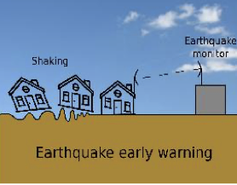
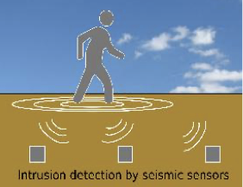
Next generation of sensors
(Autonomous, without communication and synchronization cables)
Developed from research on gravitational wave detection
Characterized by their low cost (~8x relative to commercial products),
low power consumption and high sensitivity
Two technologies fully worked out by Gp 3 (led by M. Suchenek):
Autonomous Seismic Sensor
Acoustic Infrasound Sensor
patent applications pending approval
48 units produced (NCN MINIATURA grant) for research
commercialisation pending signing contract with Ergo Plus Polska
Autonomous Seismic
Sensor
190 units produced (NCN MINIATURA grant) for The European
Gravitational Observatory
Acoustic Infrasound Sensor
Potential applications beyond science with commercialisation prospects:
perimeter defence, surveillance
wind farm monitoring
Large constructions (e.g., skyscrapers) and health diagnostics
exploration of geothermal deposits, soil testing in mining industry
earthquake monitoring
…
(For more info, see poster)
seismic sensors can tell the origin of vibrations
(vehicles, people, animals,…) and their location
Notes:
seismic sensor: compared to Innoseis Sensor Technology, infrasound sensors: GRAS

Slide 10
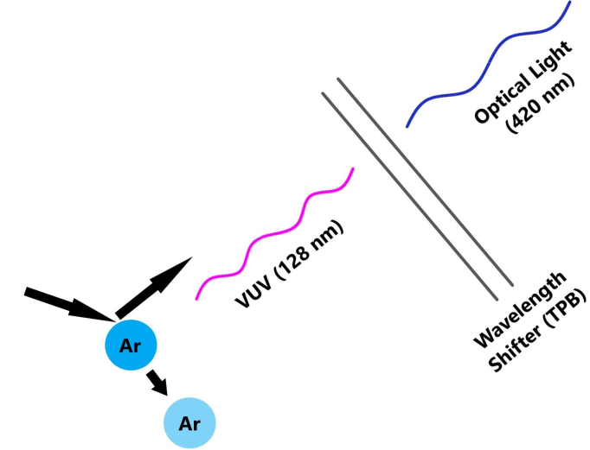
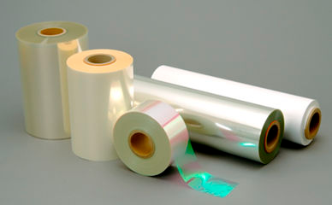

Spinoff from dark matter searches for photovoltaics, etc
In liquid argon based detectors of dark matter and neutrinos it is necessary to convert ultraviolet scintillation light (at 128 nm) to visible light, which can be efficiently registered
Visible light
(420 nm)
Wavelength shifter (WLS)
M. Kuźniak et al (Gp1) at AstroCeNT developed
scalable large format polymeric reflector
and WLS films, as well as tailored WLS
Potential applications:
photovoltaics: increased cell efficiency
environmentally-friendly alternative to current fluors
radiation counters and dosimetry
…
Cooperation with Roltec Sp. z o.o., Polish
producer of thin-film CIGS photovoltaic cells
(For more info, see poster)

Slide 11

AstroCeNT -- some highlights
including 20 postdocs, 8 technicians,
6 PhD students + several internships (ug students)
+ 5 long-term visitors
… up and flying…
Set up from scratch into an internationally recognised research centre
  Research groups created following basically assumed schedule
  Interdisciplinary (physics, engineering, programming,…)
Currently 41 researchers from 10 countries, 5 continents
Member of 7 large international experimental collaborations
MoUs with SNOLab and McDonald Institute (Canada)
Several grants, notably 3yr EU Twinning grant (900kEuro) and Hyper Kamiokande (~8M PLN, our contribution to the world biggest and most advanced neutrino detector)
Three technological innovations: one utility model granted, two patents pending
Collaboration with research and industrial partners established and growing
  Two formal agreements signed, one in preparation
Co-operation with our strategic partner APC flourishing
Strong support from International Scientific Committee
PR, visits and public talks by Nobel Prize Laureates and other VIPs, promotional film
…
Notes:
Welcome
Happy that AC is up and running – my dream, plus a bit of work and perseverance
Joint effort of many people: leaders, support staff, headquarters, Stavros and other ISC members – thanks
Thanks to FNP team
Thanks go to the evaluators. Your comments will help us do better
AC is known internationally and we want to make it to improve

Slide 12
Gender composition of AstroCeNT
Women in decision-making positions
50%
ISC OF ASTROCENT
19%
Prof. Roxanne Guenette – the University of Manchester, UK
Dr Federica Petricca – Max Planck Institute, Germany
Prof. Silvia Pascoli – University of Bologna, Italy
Administration
Office and R&D support
ASTROCENT TEAM
Dr Marta Borowiec – Director for Scientific Affairs
17%
  All
AstroCeNT team
NCAC PAS: GENDER EQUALITY PLAN (2023-2026): LINK
  Researchers
A strategic document aimed at increasing awareness of existing biases and differences in the treatment of men and women, and enabling all employees and doctoral students to have equal opportunities for scientific and personal development.
Group leaders, postdocs, students

Slide 13
AstroCeNT in numbers
GROUP LEADERS
POSTDOCS
PHD STUDENTS
TECHNICIANS
STUDENTS
LONG-TERM VISITING SCIENTISTS
6
24
6
11
12
5
PATENTS
PUBLICATIONS
TRAVELS
CONFERENCES
AND SYMPOSIA
HONORARY MEMBERSHIPS
1#
~150
~300
~150
3*
* T. Bulik elected to Polish Academy of Sciences
  (corresponding member)
L. Roszkowski elected to:
  European Academy of Sciences and Arts
  Copernican Academy
# - plus two pending

Slide 14
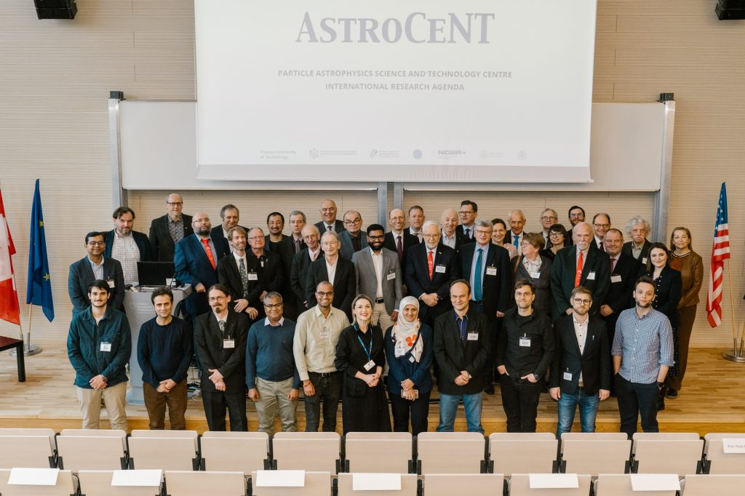
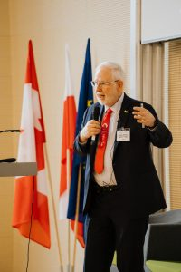
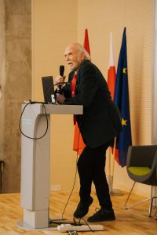
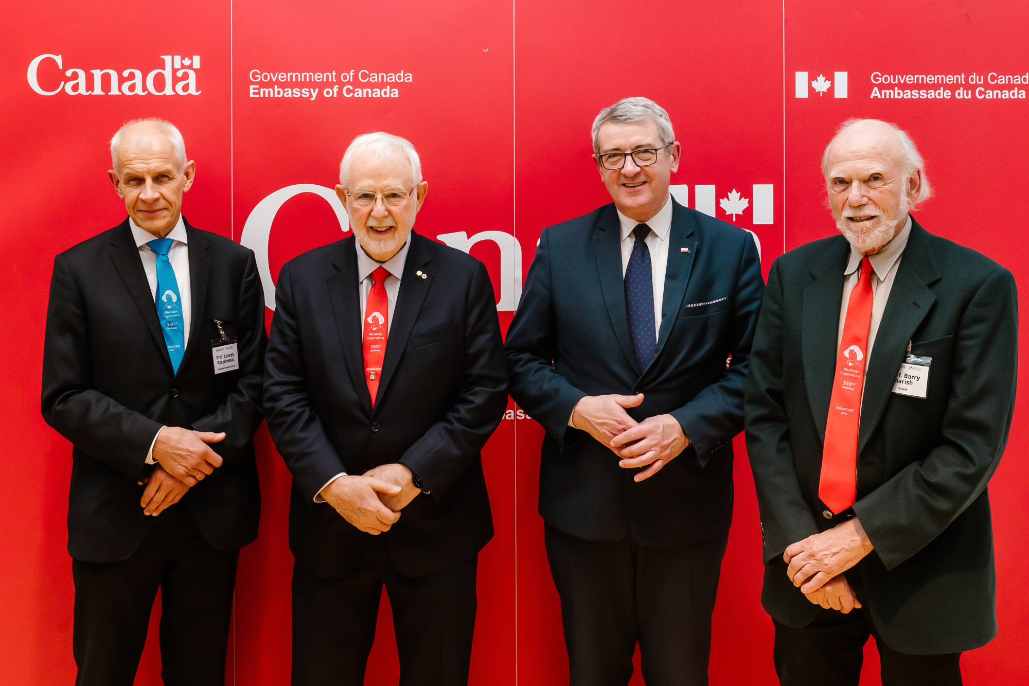
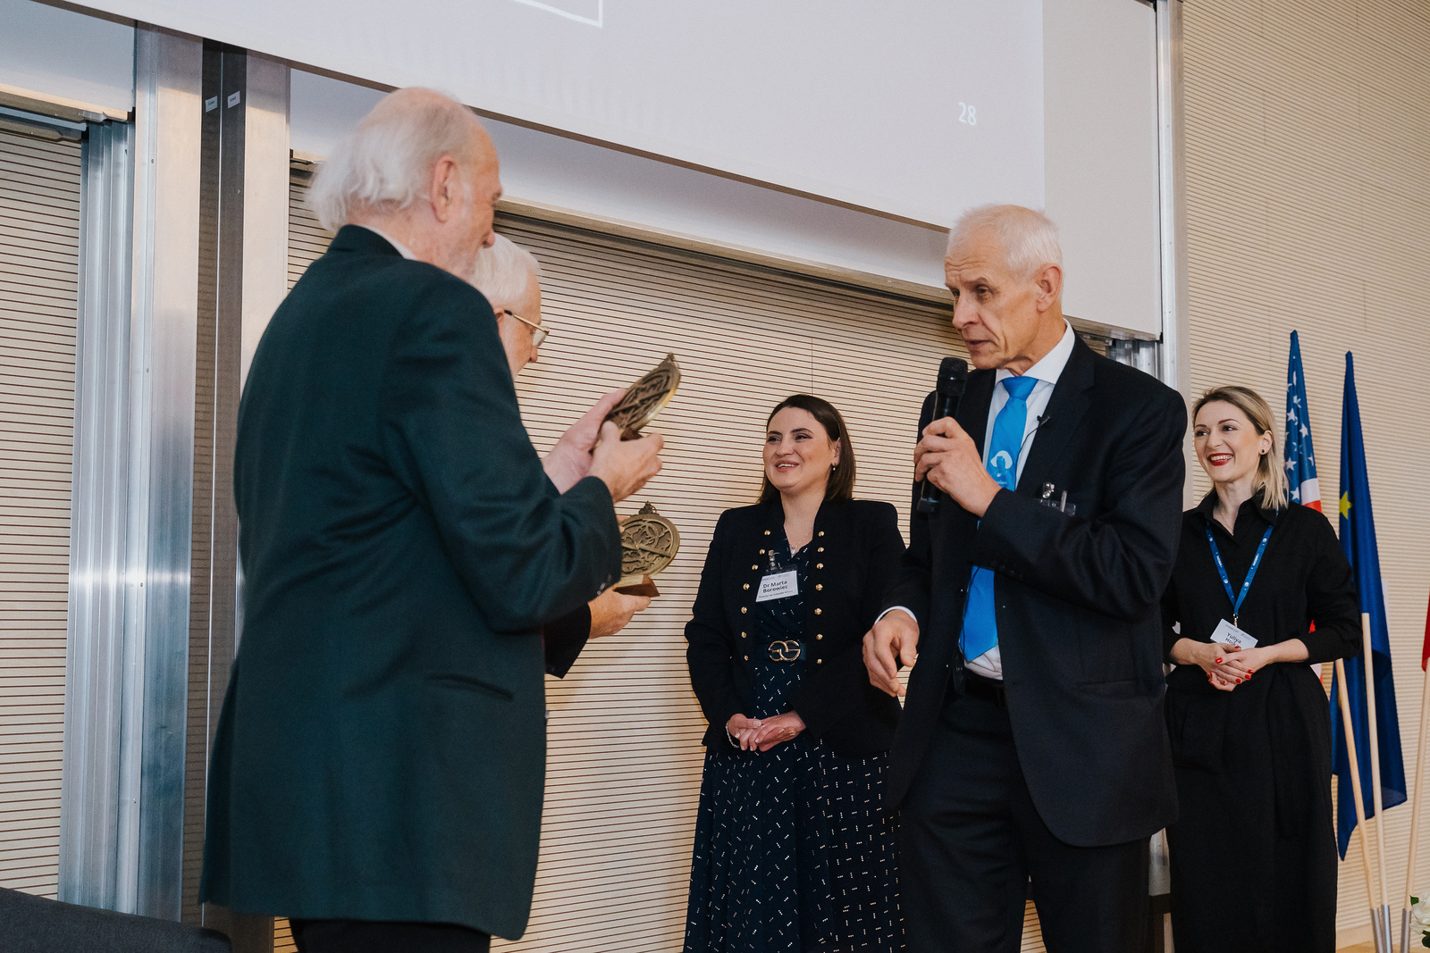
Public talks by Nobel laureates
Art McDonald and Barry Barish
(22 Feb. 2023)

Slide 15
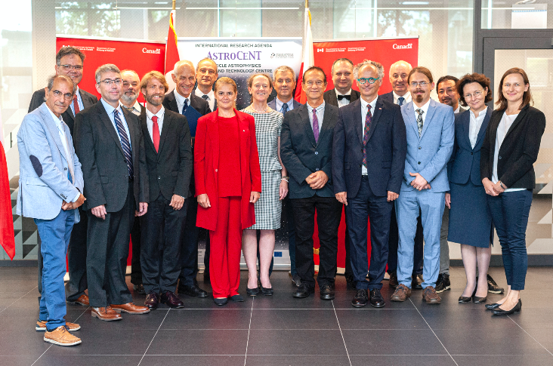
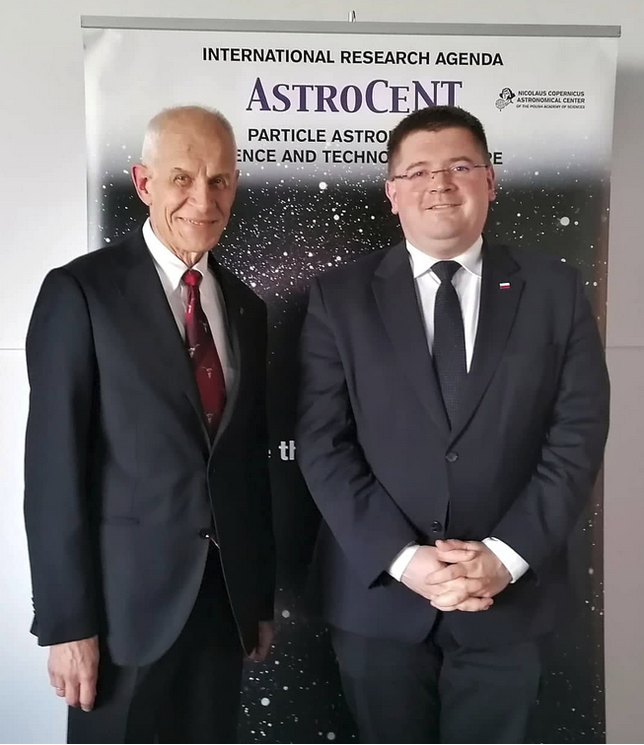
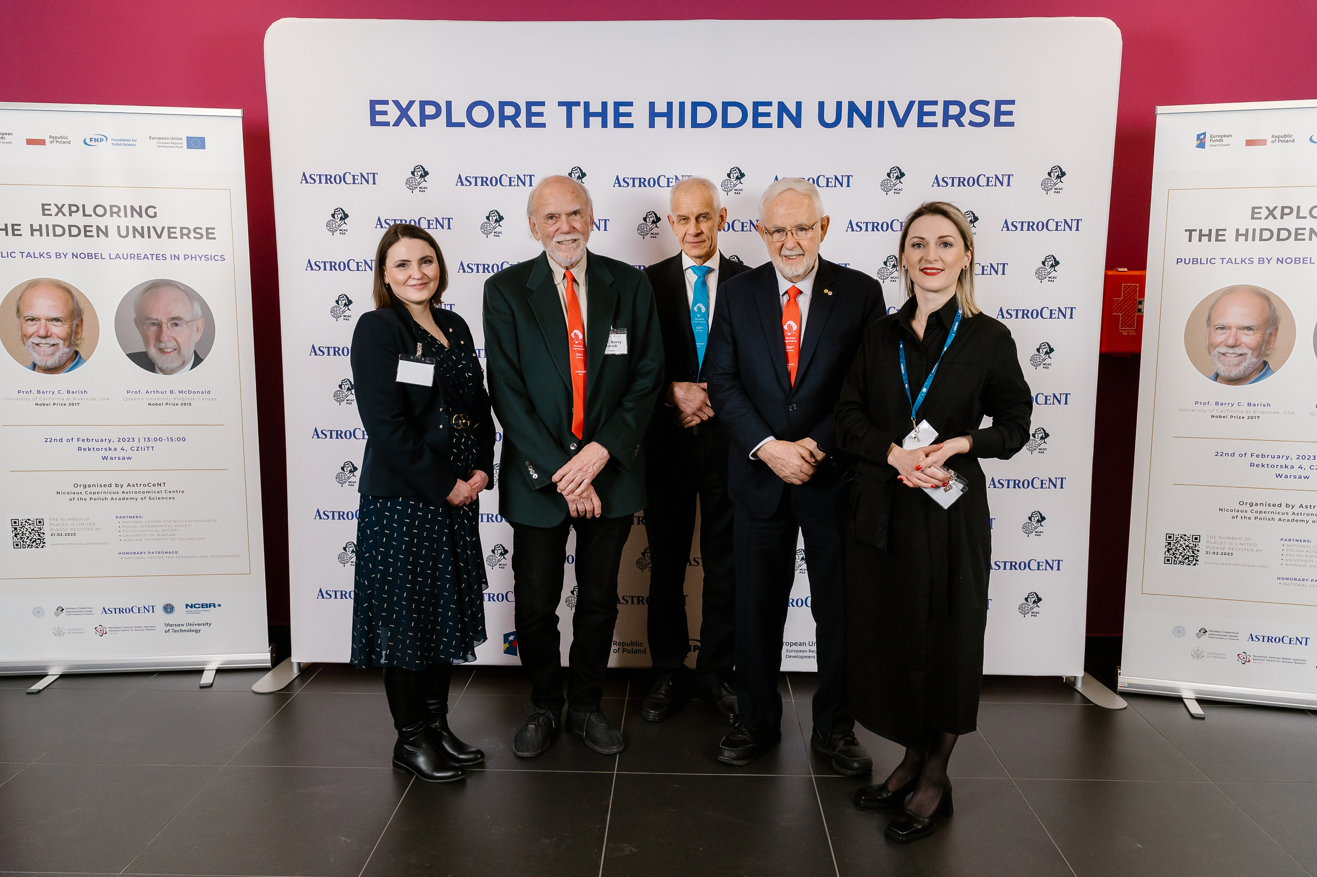
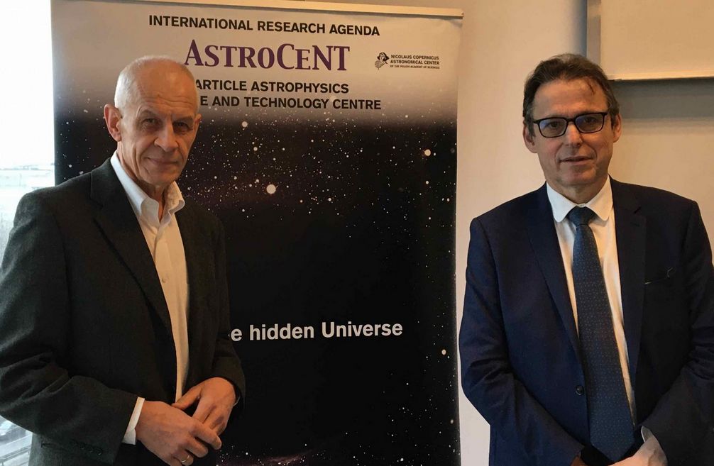
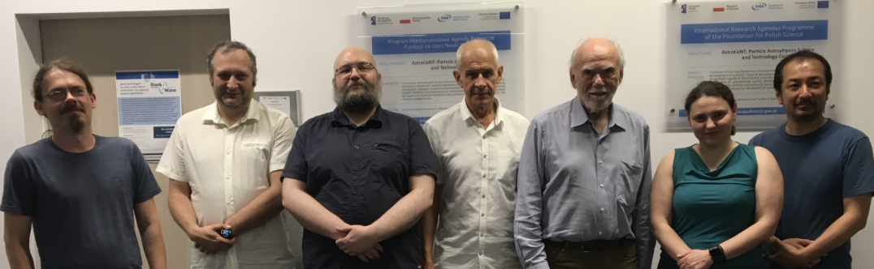
Some events and PR activities
20-21 May ‘19: 4th biennial conference ``Particle Astrophysics in Poland”
  Special session devoted to Astrocent:
  keynote talk by Dr Art McDonald, a 2015 Nobel Prize in Physics winner,
  several VIPs, attended incl. ambassadors of France and Italy & president of INFN
  Astrocent announced to join DEAP-3600, DarkSide and GADMC/ARGO
2 September ‘19: visit of Governor General
of Canada and meeting with FNP &
government officials and ISC representatives
1 June 2022: visit of Vice Minister of Education and Science, Dr T. Rzymkowski
22 February 2023: Visit of
B. Barish and A. McDonald
21 February 2020: visit of
the President of CNRS,
Prof. Alain Schuhl
23 June 2023: Visit of B. Barish
Conference LIDINE—2022
hosted by Astrocent
on 20-23 September
(local chair: M. Kuźniak)
Notes:
Deap collab meeting

Slide 16
Grants and other income – partial list
Title | PI | Source and scheme | Amount | Period | Remarks
AstroCeNT: Particle Astrophysics Science and Technology Centre | LR | FNP, Int. Research Agenda | 38 MPLN | 07/18- 06/23 | Main IRA grant
Dark matter search with liquid argon | LR | IN2P3-COPIN | 24 person-days | 01/20-12/20 | Scientific exchange with APC, LPNHE Paris and CPPM Marseille
Novel technologies for dark matter search and frontier astroparticle physics experiments (DarkWave) | MK | Horizon 2020-WIDESPREAD-2018-2020 | 880 kEUR | 07/20-06/23 | Consortium DarkWave: AstroCeNT (coordinator), APC, GSSI, TUM, INFN. Support for scientific exchange and equipment
Development of the Most Sensitive Dark Matter Detector with Liquid Argon | MW | NCN, Sonata BIS | 2852 kPLN | Nov 22 – Oct 25 | 2 postdocs, 2 PhD students, equipment
PROBES of new physics and technological advancements from particle and gravitational wave physics experiments. (Europe - USA- Asia) | LR | Horizon 2020, MCSA-RISE 2020 | 2 189 600 Euro (total), 32 200 Euro (CAMK) | March 2022 - Feb 2024 (CAMK) | EU consortium grant CAMK: Scientific exchange and trainings for 7 person/months
LUMI-QPI | PG | EuroHPCJU | 225 kEUR | Q2 2023-Q2 2028 | To provide a European-wide quantum computing environment integrated with the EuroHPC infrastructure
EuroQHPC-Integration | PG | EU | 449,828 Eur (total), ~0.5 Meuro (CAMK) | 2024, 4 yrs, submitted | Linked to LUMI-QPI
Hyper-Kamiokande | MZ | MEiN | 67 596 799,26 PLN (total), 8 985 964,47 PLN (CAMK) | Dec 2022 - Nov 2027 | 1 technician, international neutrino detector construction project
Methods for the reconstruction of signals from seismic detector networks | MC | NCN, Miniatura-6 | 48 048,00 PLN | Aug 2022 – July 2023 | Materials, small equipment and services
Environmental Noise Studies with Infrasound Microphone Array | MS | NCN, Miniatura-6 | 49 742,00 PLN | Aug 2022 – July 2023 | Materials, small equipment and services
Development of the Most Sensitive Dark Matter Detector with Liquid Argon | MW | NCN, Sonata-Bis 11 | 2 852 105,00 PLN (614 kEUR) | Dec 2022 – Dec 2025 | Funds for laboratory equipment, cosnumables, travels and remuneration (2 postdocs, 2 PhDs and technician)
The feasibility study of constructing a tonne-scale dual-phase argon detector for light dark matter searches | MW | NCN, Sheng-3 | 687 066,00 PLN (148 kEUR) | 36 months SUBMITTED | Project in cooperation with Institute of High Energy Physics, Chinese Academy of Science laboratory equipment, cosnumables, travels and remuneration
Search for dark matter with liquid argon detectors | MK | NCN, OPUS-24 | 2 151 300,00 PLN (463 kEUR) | 36 months granted | Funds for laboratory equipment, cleanroom rental costs, cosnumables, travels and remuneration (PI + co-investigator, postdoc, 1 PhD)
Astrocent Plus: Particle Astrophysics Science and Technology Centre | LR | EU | 15 MEuro | Q3 2024 (?) – 6 years | Teaming for Excellence, Passed to 2nd stage, in preparation
Astrocent: Particle Astrophysics Science and Technology Centre | MK | FNP | 30 MPLN | Q1 2024 (?) – 5yrs, submitted | IRA competition grant, pending decision
16

Slide 17
End of Project in sight
Budget spending on track
expected underspent at ~110-150 kPLN (0,3% - 0,4%)
All grant indicators already exceeded initially declared values
Two patents pending approval and one granted (utility model)
Co-operation with industry developed (groups 1, 3, 5)
…
2 formal co-operation agreements signed, one being prepared

Slide 18
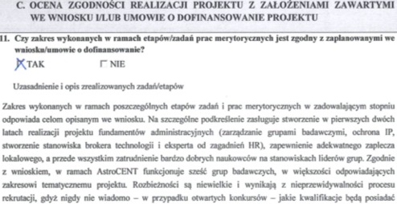
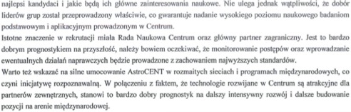
Audyt NCBR / Audit of National Centre for Research and Development
15 October 2020
Część formalna: bez żadnych korekt
Część merytoryczna (15.10.20):
What deserves special emphasis is the creation of administrative foundations
in the first two years of the project (management of research groups, IP protection,
creation of the position of a technology broker and HR expert), ...
and, above all, the employment of very good scientists as group leaders.
the selection of leaders was carried out properly, which guarantees a high scientific
level of fundamental and applied research conducted at the Center.
It is also worth pointing out the strong presence of AstroCeNT in various international
networks and programs, which makes the initiative recognizable. Combined with the fact
that the technologies developed at the Center are attractive to external partners,
this is a very good forecast for further intensive development and further building of
the position in the international arena.

Slide 19
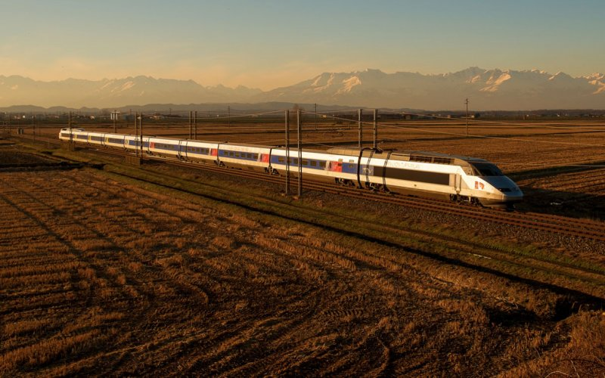
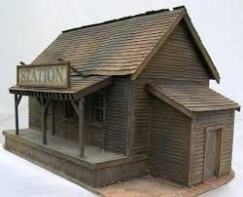
Biggest achievements…
?

Slide 20
Thank you

Slide 21
Backup

Slide 22
Group 4 (M. Wada):

