Slide 1
What surfaces in the operation of noble liquid dual-phase detectors
"If in the first act you have hung a pistol on the wall, then in the following one it should be fired” Anton Chekhov
Sergey Pereverzev
LLNL
LLNL-PRES-839901-DRAFT
LIDINE 2022, September 21-23

Slide 2
Noble liquid dual-phase TPC: reliable, versatile technique but beware: energy /charge accumulation and releases
Dual-phase detector
Past and present:
Xenon 10, Xenon 100, Xenon 1ton, LUX, LZ, Xenon N ton, …
Ar detectors: DarkSide50
Future:
Larger Ar detectors: DUNE, and more
Large Xe detector Darwin , and more
Low background detectors: LBECA, and more
Searches for non-elastic scattering, including Migdal effect
we need to understand details:
Suppression of EXCESS low-energy background
Understanding of scaling: backgrounds, purity, electric breakdowns
Reconstruction and analysis of multi-vertex events
Photo-multipliers (PMTs)
Anode grid
Gas “secondary”
HV
Extraction grid
Liquid “primary”
Radiation
HV
e⁻
e⁻
e⁻
Photo-multipliers
Cathode grid
No revisions of the model since 1990 –ies…
Do we understand electron extraction processes, dynamics of surface-bound non-extracted electrons, EXCESS backgrounds, and scaling of backgrounds?

Slide 3
RED1 (Russian Emission Detector): S3 events, short dwelling time of unextracted elections on the surface
D.Y. Akimov et al., Observation of delayed electron emission in a two-phase liquid xenon detector. JINST 11, C03007 (2016).
An S2 signal and the following S3; seven PMTs waveforms in
different colors; S2 signal is distorted due to saturation.
Distance between the initial interaction and the following S3 vs. drift time.
position of an initial signal reconstructed by S1 (blue) or S2 (magenta). The points encircled by black ellipses -events with S3 at x > -5mm (outside “hot spot”)
The data are fitted with a linear function d = v_{drt} in red.
Reconstructed positions of initial signals and S3. The outer solid line - edge of the sensitive volume; dashed lines - PMTs; red stars- reconstructed positions of S3 after single vertex events; initial interactions reconstructed by S2 (magenta stars) or by S1 (blue stars).

Slide 4
Muon track (not-single-vertex) unextracted electron cloud motion reconstruction: electron emission between S2 & S3
D.Y. Akimov et al., Observation of delayed electron emission in a two-phase liquid xenon detector. JINST 11, C03007 (2016).
Spatio-temporal reconstruction of one muon event: a-projection onto the horizontal plane, b—projection onto the vertical plane to which the x-axis belongs. The magenta cross represents muon effective position and time; the green cross represents S3 position and time; red dots correspond to subinterval positions and times (red circles represent position reconstruction uncertainty); a blue line connecting magenta and green crosses – a hypothetical drifting path of trapped electrons.
A muon S2 signal and the following S3, the sum of waveforms from all seven PMTs (dark blue). The inset -the part of the time interval between S2 and S3 with intensive electron emission signals on it; different colors -different PMTs (baselines shifted for clarity). The amplitude of the S2 is distorted due to saturation.
Unextracted Electron cloud drift time is below ~ 100 us
Unextracted electron cloud drift fast to the perimeter of active region. Some emission of unextracted electrons on the way-mechanism of this emission into gas not clear (S3- instability under anode holder ring? )

Slide 5
The large ionization events in LUX detector: e-bursts, unextracted electrons dwelling time and “immobility”
D. S. Akerib et al., Investigation of background electron emission in the LUX detector. Phys. Rev. D 102, 092004 (2020) Analysys of Jungke Xu
LUX waveform over one second. one 2.3 MeV gamma ray interacts here; background electrons are observed to follow the S1 and S2 pulses. insets - zoomed-the S1-S2 event and an electron cluster (\e-burst") and single electron (SE) pulses and photoelectron (PHE) pulses.
Time delay of e-bursts from preceding S2s for top (red) and bottom (blue) interactions in LUX ; The X position difference between e-bursts and preceding S2s as a function of the time delay.
Unextracted electron cloud “freeze at place;” several charged surface instabilities can show up at the S2 location with up to 50 ms delays (possibly suppressed multi-electron emission events rate, single electrons high/present)

Slide 6
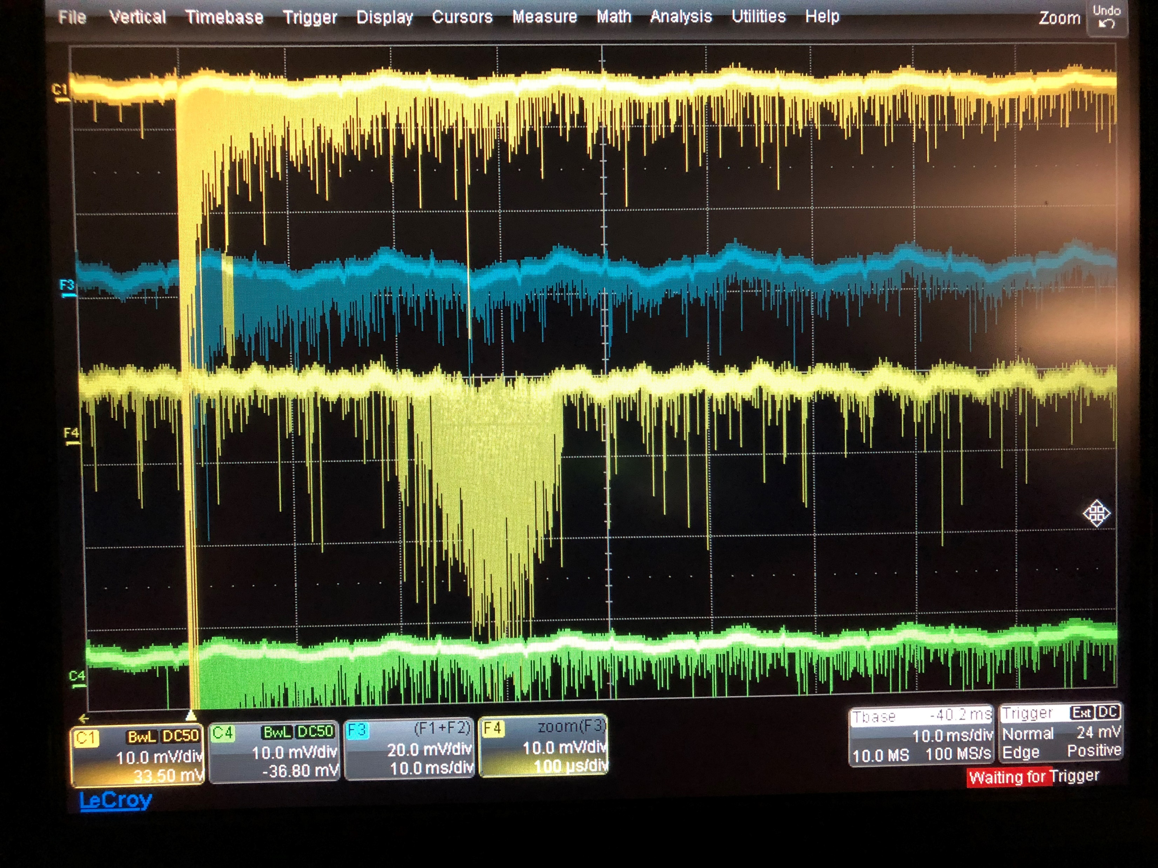
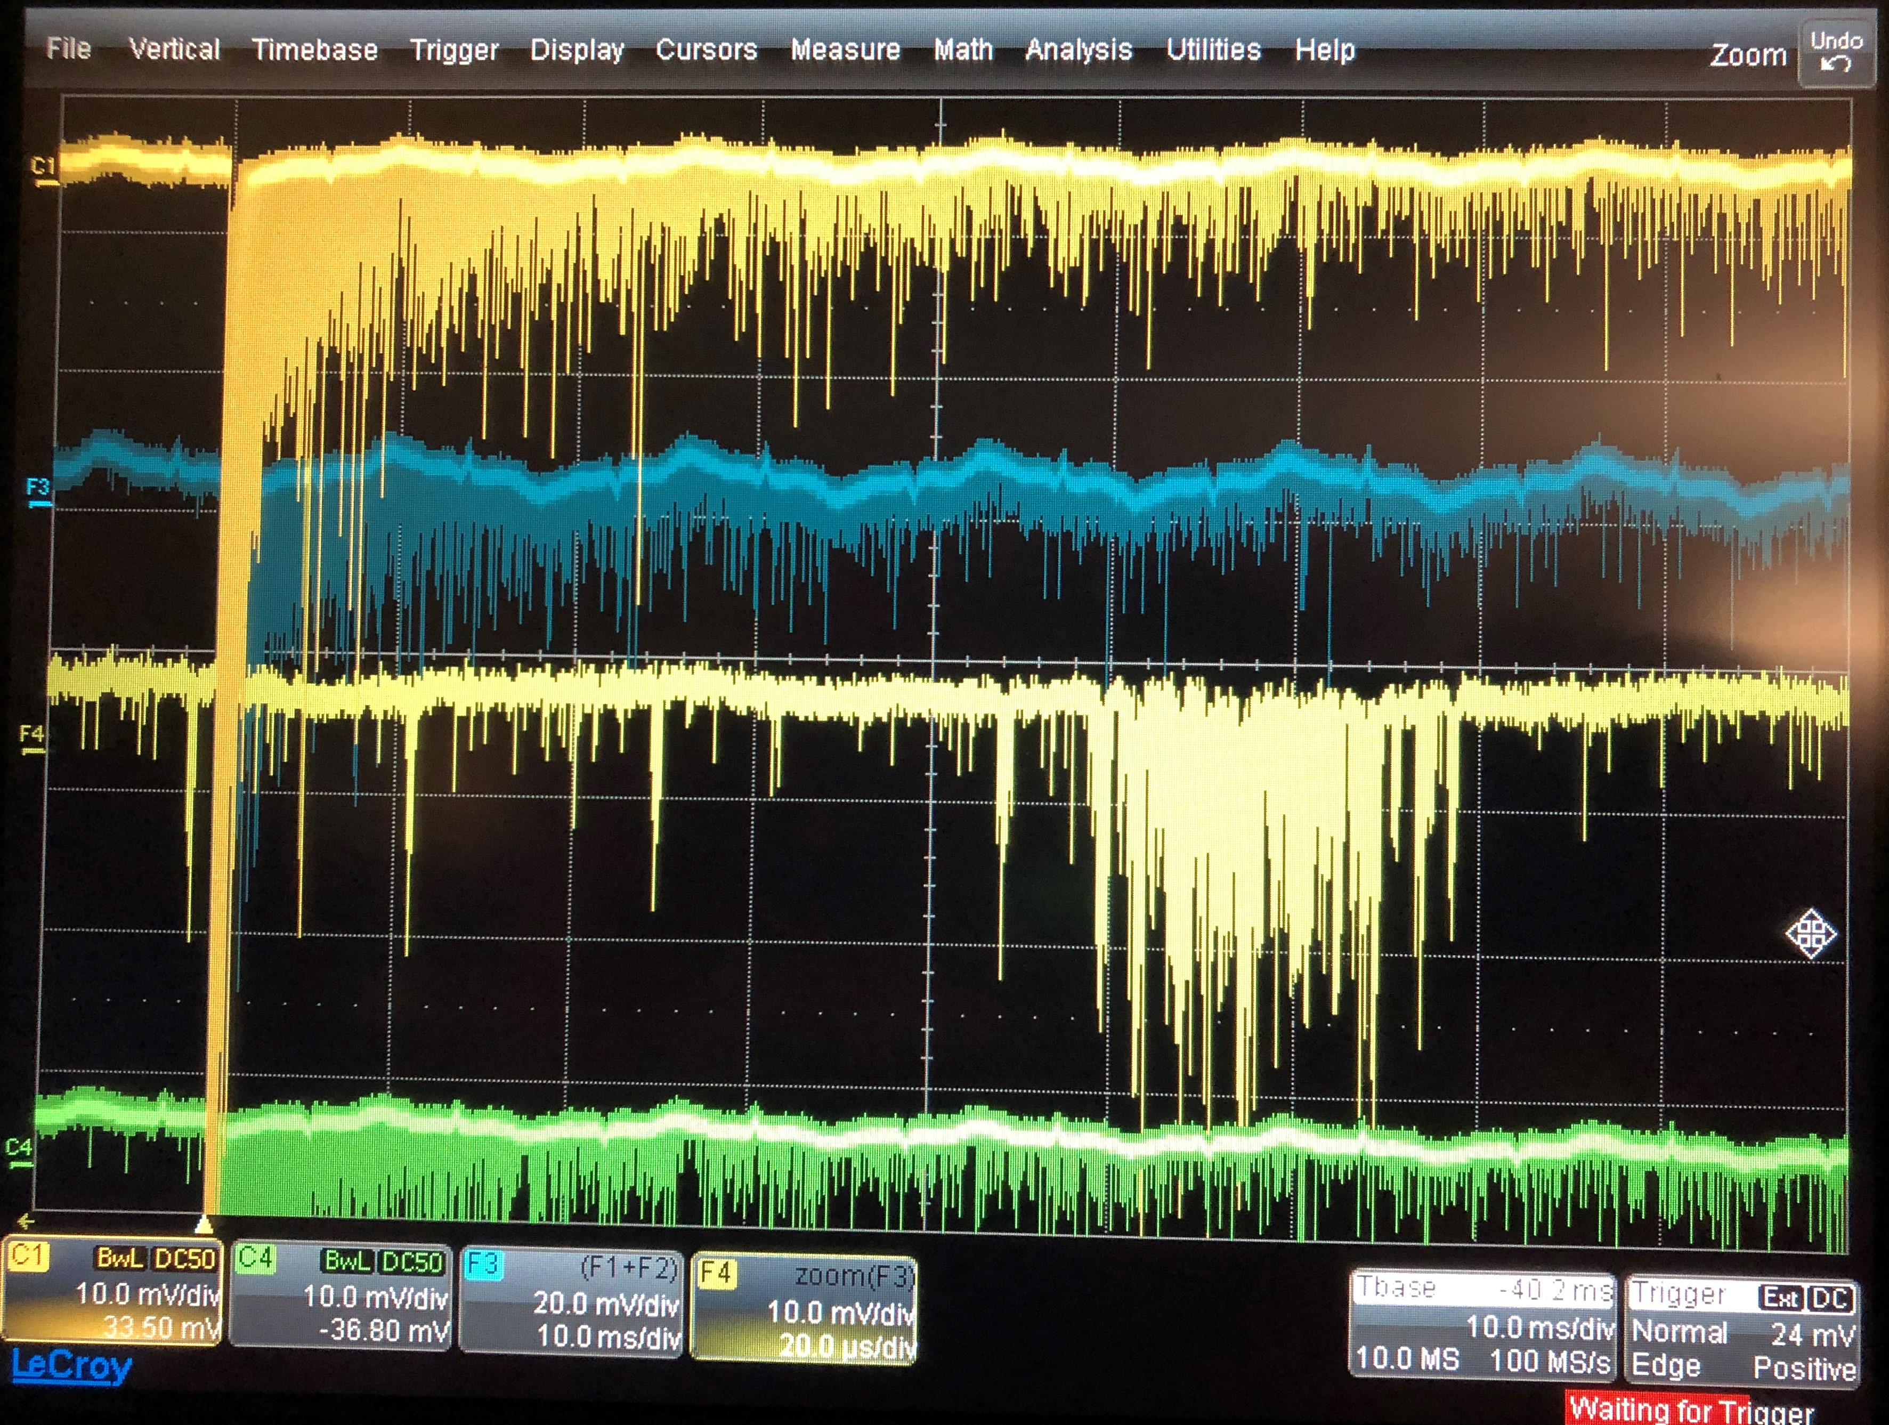
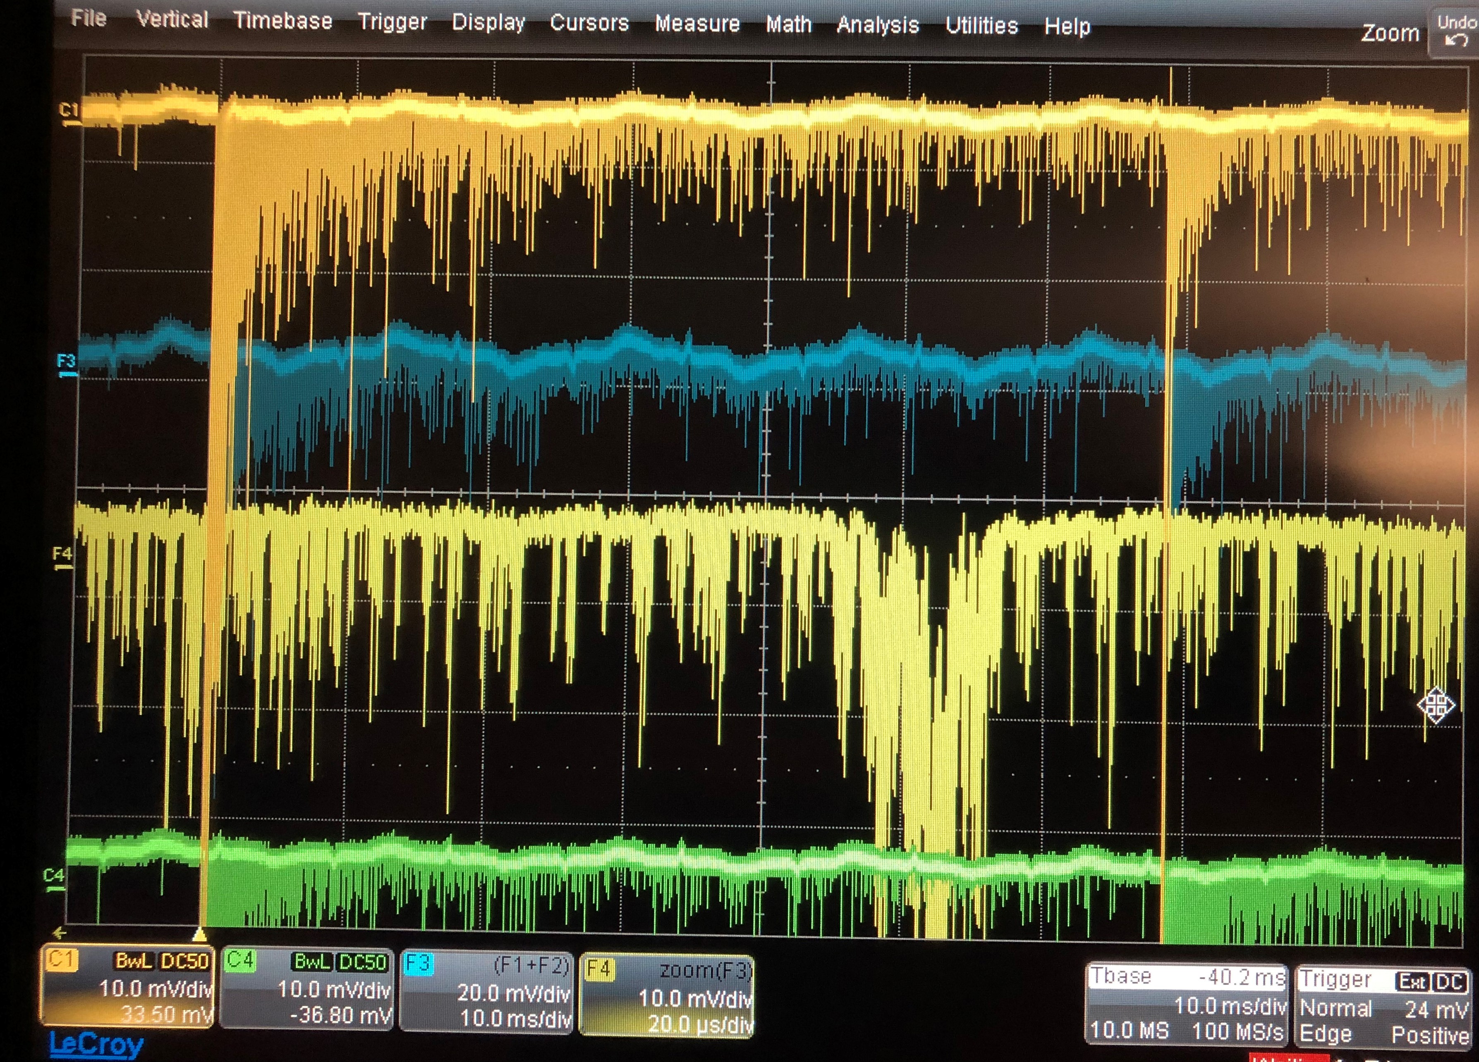
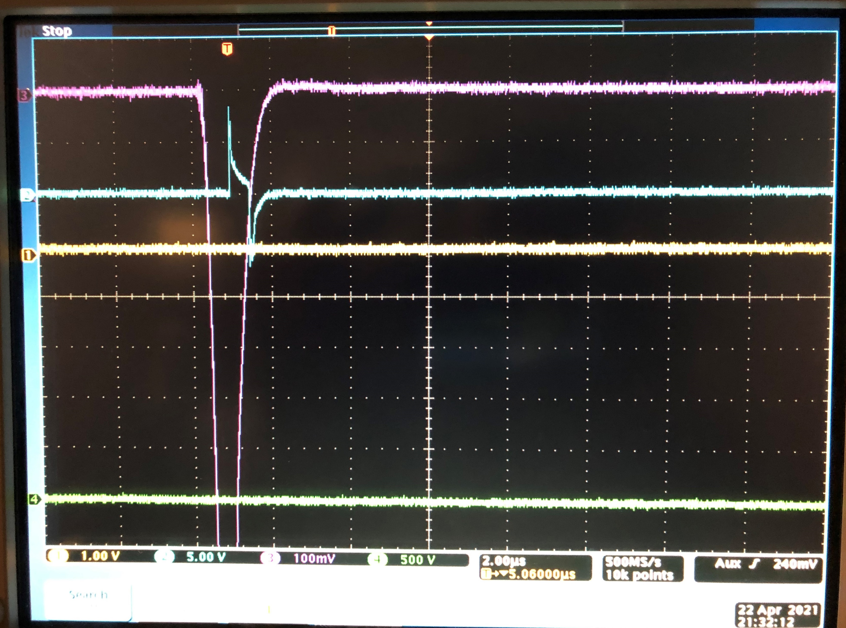
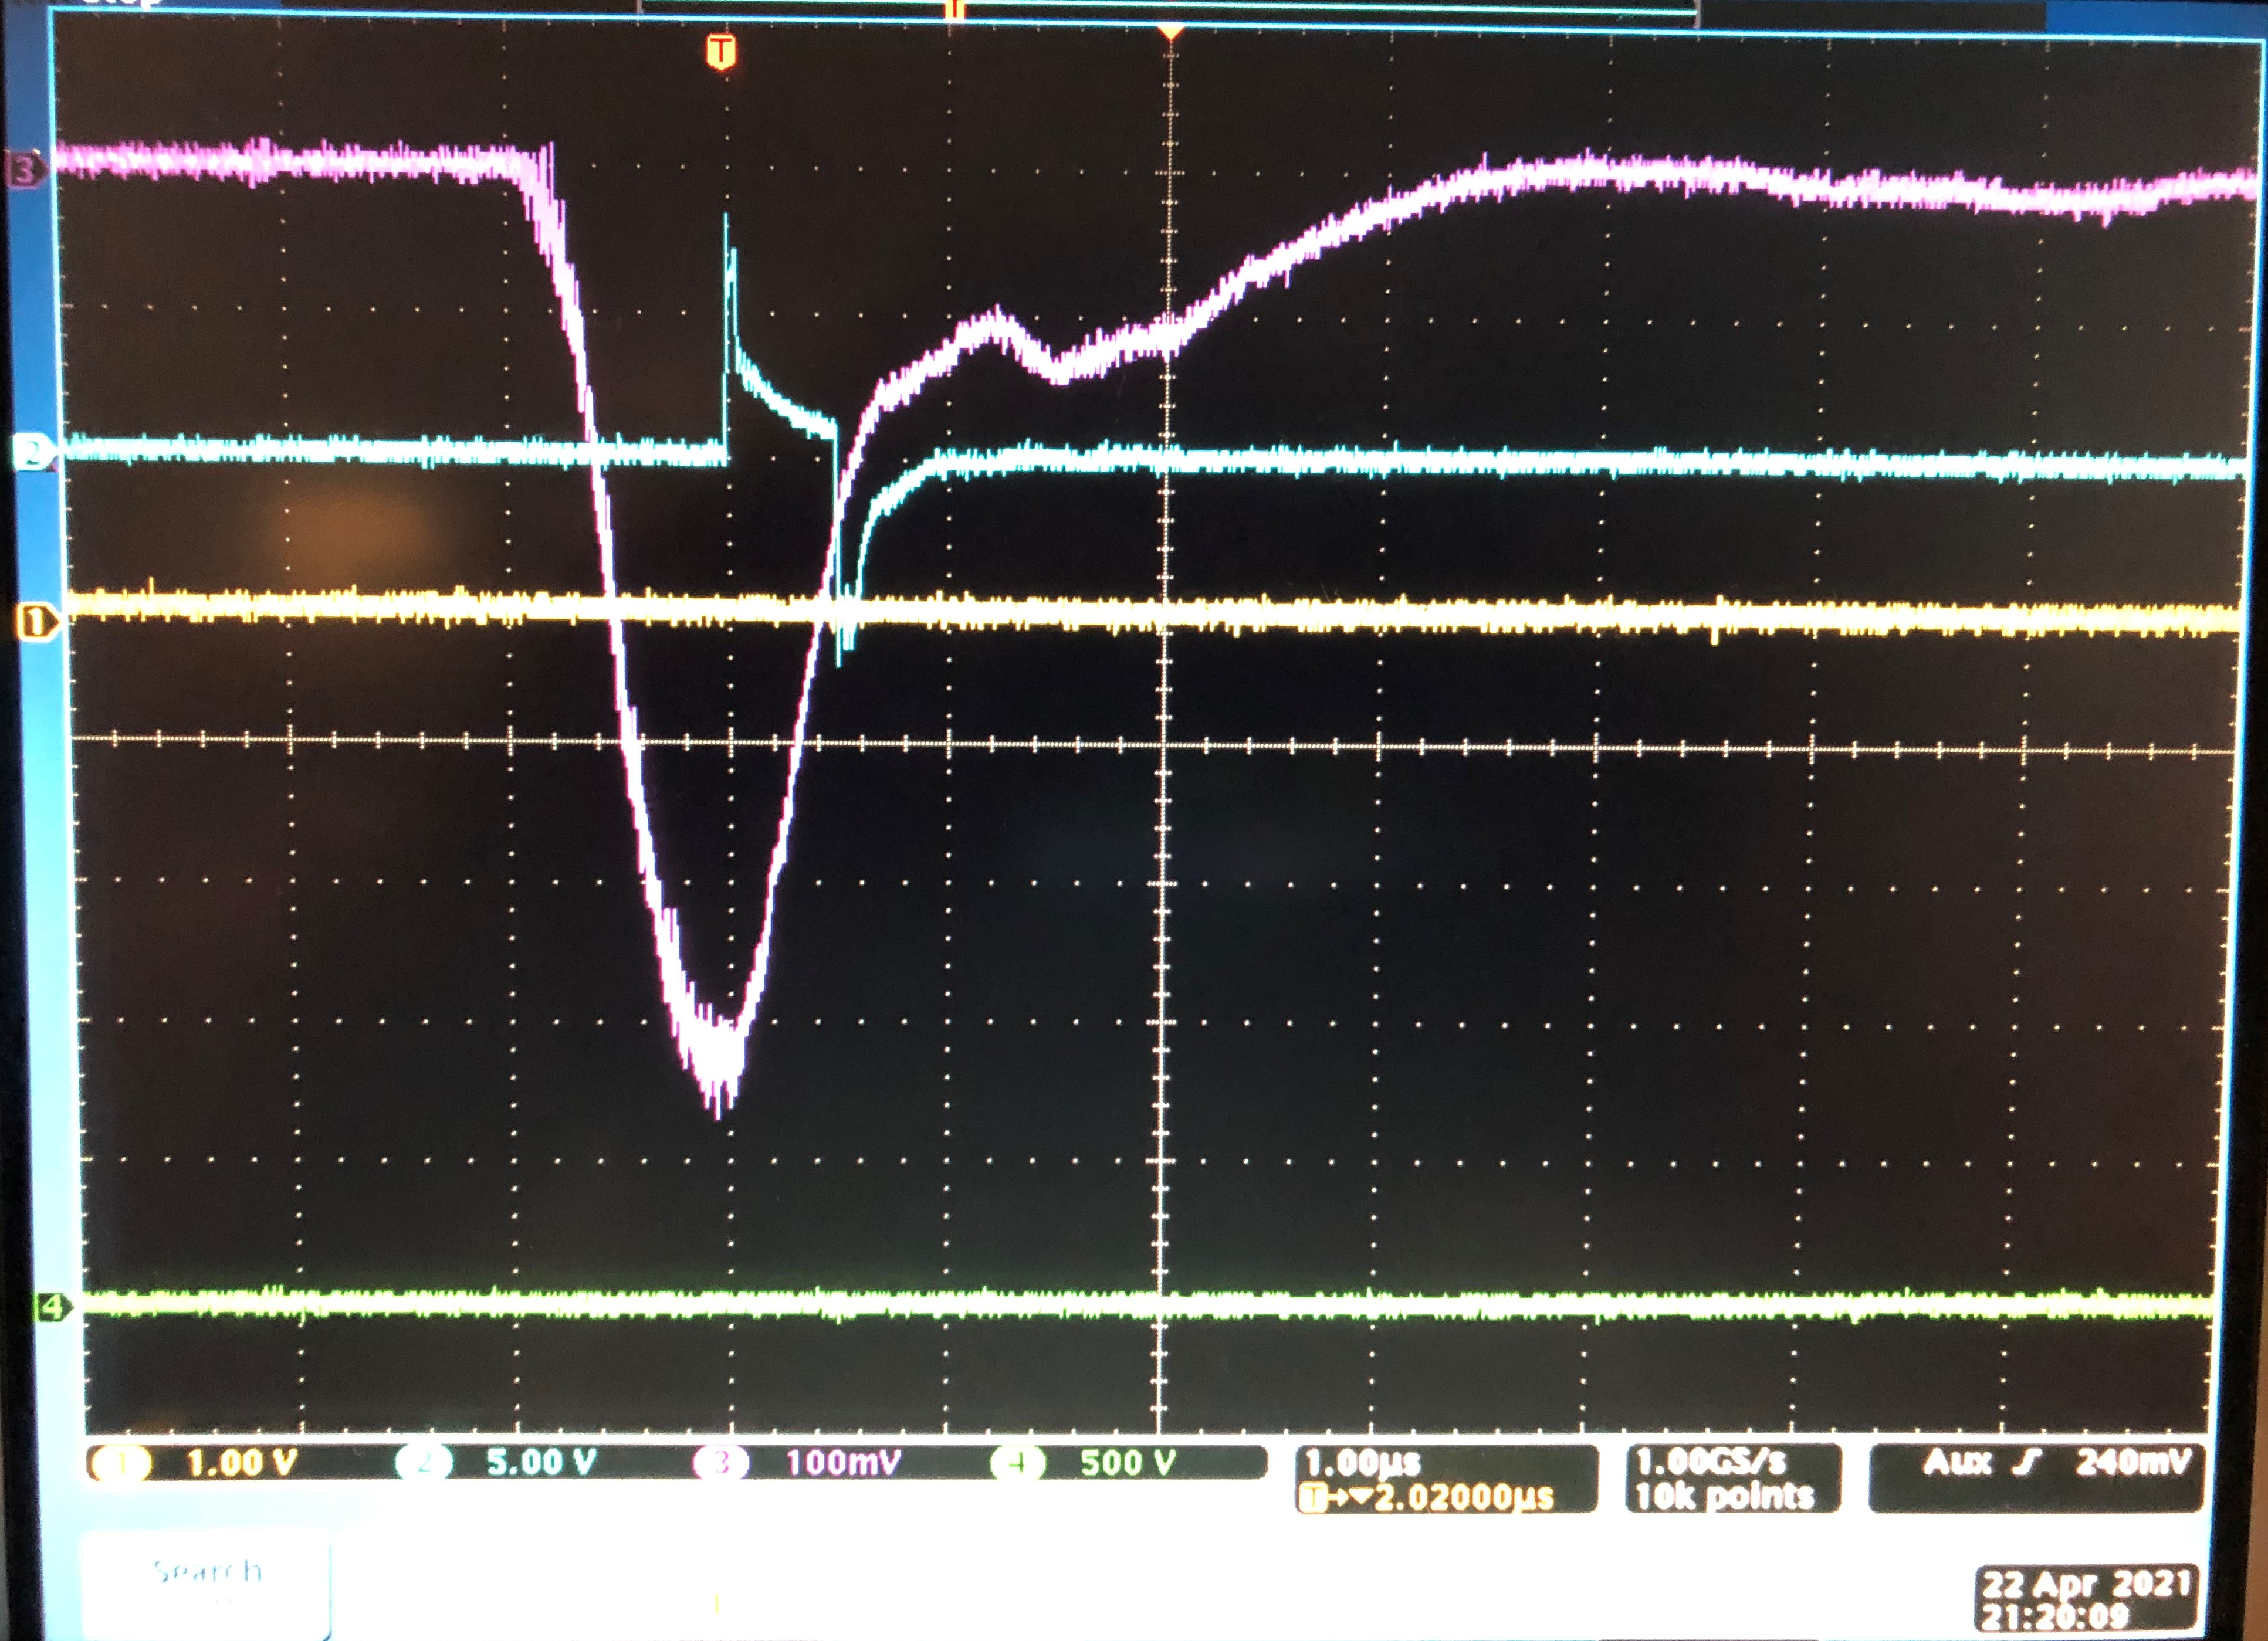
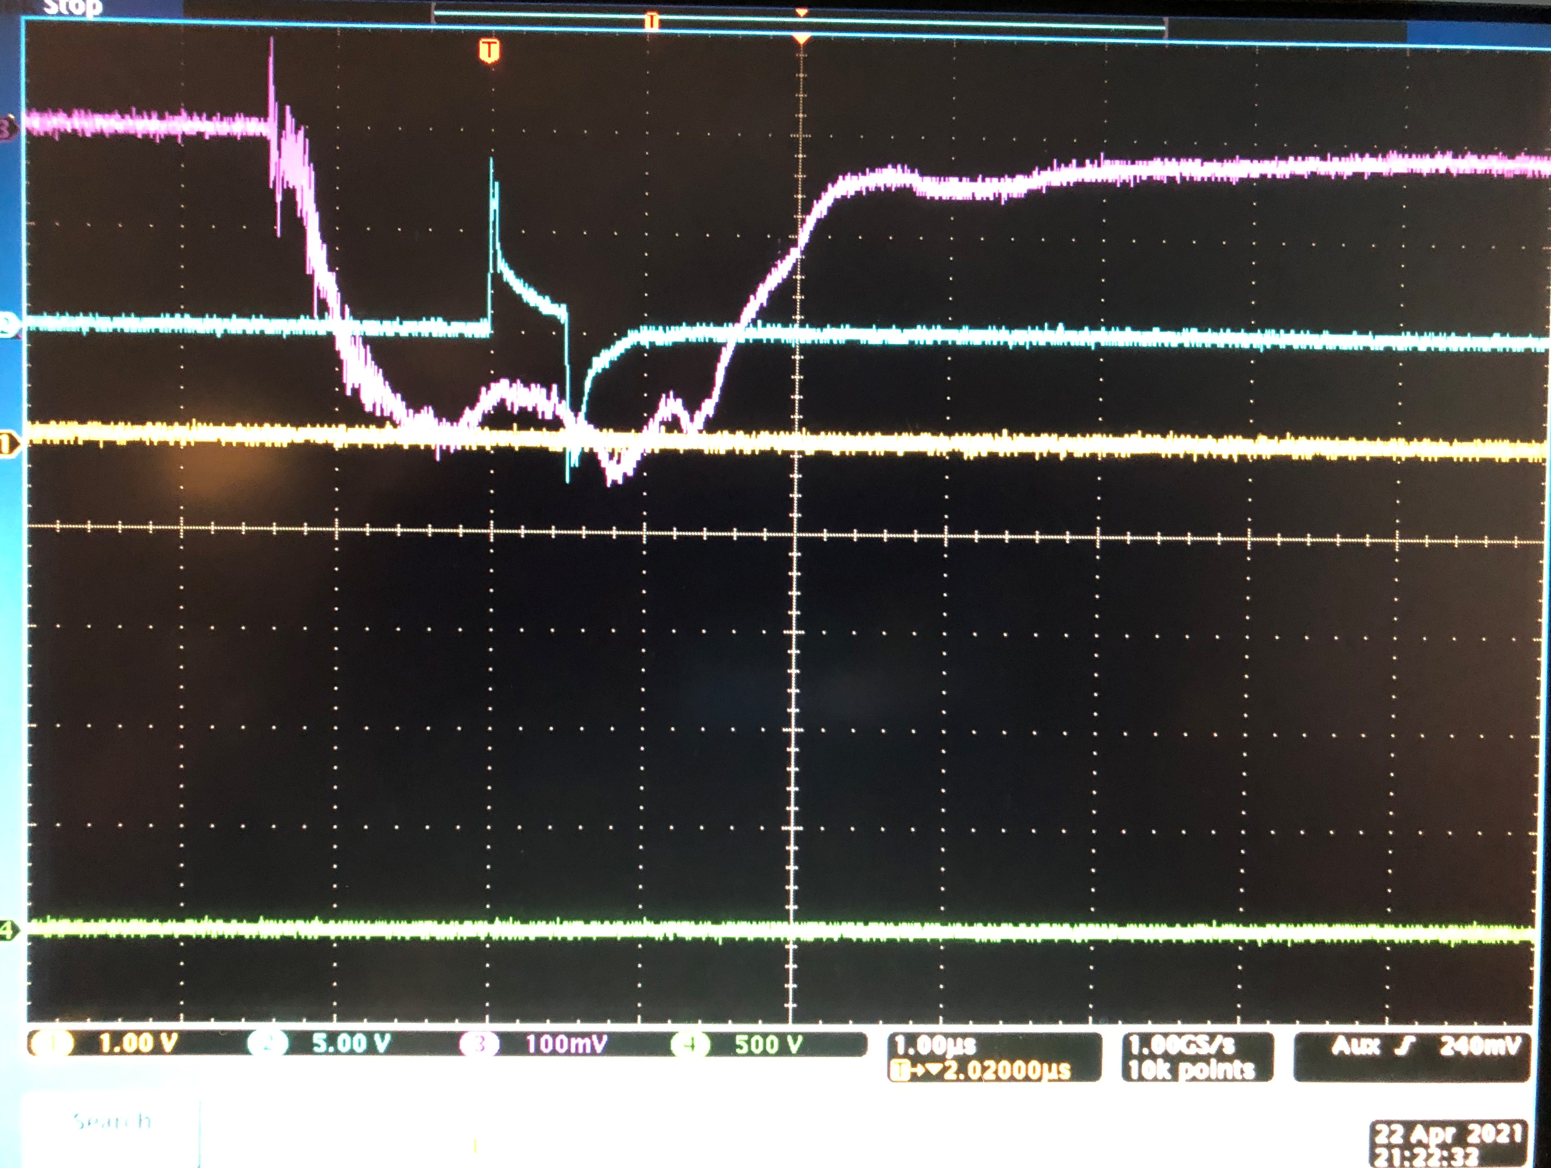
E-bursts in XeNu: up to 20 ms after S2 anticorrelation of E-burst with single-vertex events
10 ms/div
100 us/div
20 us/div
Blue line (f3) sum or 4 top PMT; 100 ms/div; f4- zoom into f3 (note total length of event in 100 ms)
2us/div
1us/div
Pink- bottom PMT (low voltage); anti-correlationn: E-trains: not present for short S2, present for long S2 (multi-vertex, muons)
Several E-burst possible after strong S2 events with up to 20 ms delay, but no E-bursts after single-vertex events (interference of waves caused by extraction?)

Slide 7
No barrier for surface-bound electrons to leave
to the wall in RED1, ZEPLINIII, RED100
D.Y. Akimov et al., The ZEPLIN-III dark matter detector: Instrument design, manufacture and commissioning. Astroparticle Physics, V. 27, pp.46-60, (2007)
RED1
Metal anode grid holder touch liquid surface in RED1, ZEPLIN III
S3 were present only when
gas between anode ring and
charged liquid surface
(D. Akimov, private communication)
ZEPLINIII
Electric field line tangential to the liquid surface at the perimeter- electrons are driven out
In RED1, ZEPLINII (and RED100)- surface electrons can escape to the metal electrode touching surface- no E-bursts;
Hypothesis: S3 and E-bursts - charged surface instability in high field

Slide 8
LUX: electrodes and grid holders embedded in PTFE- difficulty for electrons to leave area under anode
Only small openings/windows in PTFE are left in LUX where surface-bound electrons can leave an active area
(see next slide)

Slide 9
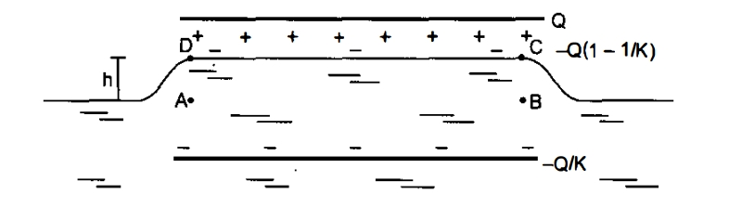
Electrons cannot leave freely area under the anode through opening in the PTFE wall in front of copper weir reservoir: liquid level rise in electric field makes a potential barrier for surface electrons in LUX and XeNu
LUX
h ≈ E₀²ε₀(κ_{e} - 1)/(ρg)
E₀=V/d
XeNu
The liquid level will rise in electric field
h
h
Observation of the liquid level rise under the anode is mentioning in Alexander Bolozdynya book on emission detectors
d
h~ 0.12 mm for 10 kV applied to 10 mm space in between grids
A liquid surface is a surface of the constant electrochemical potential for Xe atoms, but not for electrons;
up to 100 V potential barrier (much larger than T) for surface electrons in LUX and XeNu (and other detectors)

Slide 10
Hypothesis1: e-bursts are charged liquid surface instabilities Example: charged He surface in an inhomogeneous electric field; instability development in time
Static deformation of the free surface of superfluid He (Taylor cone) due to the trapped charge (a) Negative charge rapped; (b) positive charge. T = 2.1 K.
P. Moroshkin, P. Leiderer,
Phys. Rev .E (2017 )
Time dependence of the height of the Taylor cone
corresponding to the video recording. The dashed line shows the undisturbed liquid level.
Frames of a fast video recording of the charge escape from the Taylor cone. Upin = −390 V, Uplate ≈ +900 V (ramp from +800 to +1800 V), T = 2.1 K, single-frame time ≈0.19 ms; time t = t0 corresponds to the beginning of the jet emission.

Slide 11
Hypothesis2: electrons can form an immobile rigid charged crust on the liquid under the Anode (hillock crystal);
Example: Wigner crystallization on liquid He, or solid H₂
From P. Leiderer revue paper (1992).
A typical scheme of the measuring cell.
Formation of a dimple lattice on a ⁴He
surface (T=3.5 K) charged with electrons from
above. The image plane in (b) was chosen such that local maxima appear bright; in (c) bright areas correspond to the center of the dimples). The distance between adjacent rows of dimples is close to the wavelength of the soft ripplons, 0.24 cm here
From Yu. Monarkha, Appl. Phys. Review 021319 (2019)
WC pinning on the defects:
The resistance of WC on the surface of helium film covering a rough solid substrate, as a function of temperature for ne=2x10² cm⁻² ² and D =380 A. Inset - dependence of the resistance on the low-frequency excitation voltage at n= =5x10⁹ cm⁻², d =320A, T= 690 mK.
The surface relief of liquid ³He, induced by a fixed WC (solid line) and a crystal, moving at high velocity (dashed line).
Picture will be reversed for Xe and Ar: a “hillock crystal” instead of a “dimple crystal” on He

Slide 12
Discussion
The accumulation of unextracted electrons can result in
false signals originated at the surface
suppression of electrons extraction from real small events by “charged crust” (are few-electrons evens suppressed in the LUX or LZ?)
Electron extraction can cause surface waves (momentum transfer from drifting electron cloud to liquid)
wave interference in multi-vertex events nucleates charged surface instabilities?
reconstruction of multi-vertex events distorted by the interaction of surface electrons and waves
Decreasing rate of single-electron emission after significant events is not a “reliable measure” of the remaining unextracted electron density
We discuss here not yet confirmed models and assumptions, but if confirmed, these models will strongly affect detector design and results interpretation
When one is looking for rare low-energy events, rare condensed-matter and chemical events need to be accounted, which required advanced condensed matter physics consideration
All discussed models/assumption can be experimentally verified by methods uses in helium physics
Moreover, suppression of unwanted effects is possible

Slide 13
Conclusions
Present insufficient understanding of liquid surface- electrons effects produces serious uncertainties for HEP experiments (light dark matter particles, CEvNS)
Interdisciplinary research efforts/projects would be beneficial: to combine ideas and tools of high energy /particle physics and condensed matter physics /low temperature/helium physics
Note: Excess backgrounds in many low-energy threshold detector types can be understood using Prigogine’s ideas about systems with energy flow, energy accumulation and unsteady releases. Interactions in between states bearing excess energy leads to formation o dissipative generation of complexity; avalanche –like energy releases (Self-Organized Criticality theory). see: S. Pereverzev, "Detecting low-energy interactions and the effects of energy accumulation in materials", Phys. Rev. D 105, 063002 (2022). https://arxiv.org/abs/2107.14397
When looking for rare low-energy events … there are many of guns, pistols and landmines hanging on the walls …

Slide 14
Disclaimer
This document was prepared as an account of work sponsored by an agency of the United States government. Neither the United States government nor Lawrence Livermore National Security, LLC, nor any of their employees makes any warranty, expressed or implied, or assumes any legal liability or responsibility for the accuracy, completeness, or usefulness of any information, apparatus, product, or process disclosed, or represents that its use would not infringe privately owned rights. Reference herein to any specific commercial product, process, or service by trade name, trademark, manufacturer, or otherwise does not necessarily constitute or imply its endorsement, recommendation, or favoring by the United States government or Lawrence Livermore National Security, LLC. The views and opinions of authors expressed herein do not necessarily state or reflect those of the United States government or Lawrence Livermore National Security, LLC, and shall not be used for advertising or product endorsement purposes.

