Slide 1




GRRMHD simulation of sub-Eddington accretion discs
Debora Lančová
The Nicolaus Copernicus Astronomical Center of the Polish Academy of Sciences
Institute of Physics, Silesian University in Opava, Czech Republic
Feb. 3rd 2026 CAMK Annual Meeting, Warsaw

Slide 2
The puffy disc
Sub-Eddington, radiation-pressure dominated (mass accretion rate in range 0.4-1.5 of Eddington limit)
Stabilised by magnetic pressure
Geometrically thick photosphere
Stellar mass non-rotating black hole
High soft state of microquasars
Very different from analytical models
Lančová+2019, 2023; Wielgus+2022;

Slide 3
Puffy vs analytical models
Observable surface at almost 45°
Inner edge located under the ISCO
Lower surface density (magnetic pressure)
Lower central temperature (strong advection cooling)
Universal behaviour of viscous ɑ in simulations
Lančová+ in prep., Abramowicz+ in prep.

Slide 4
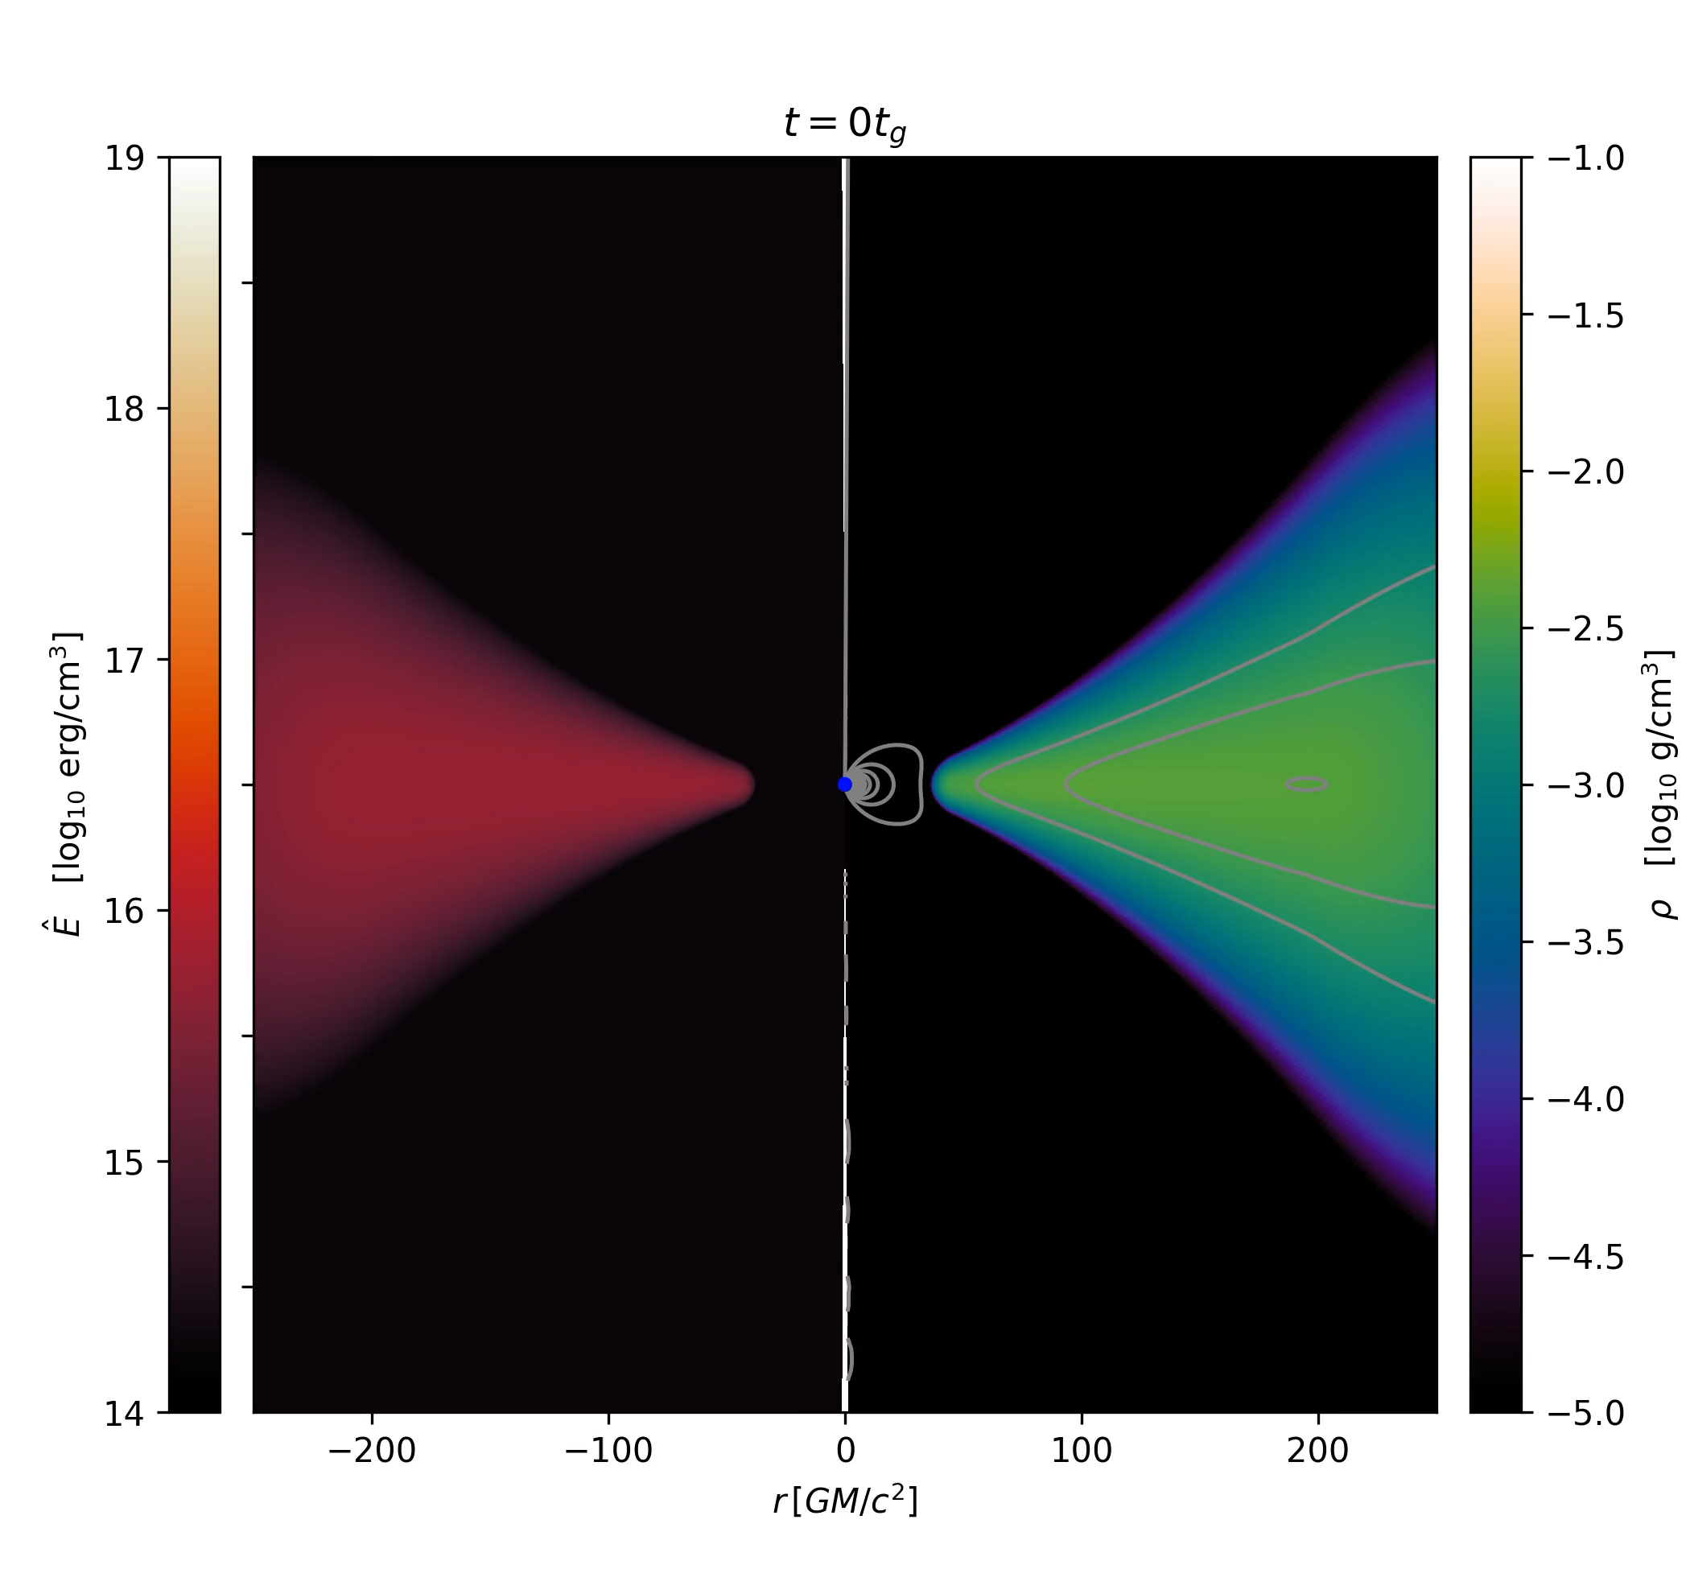
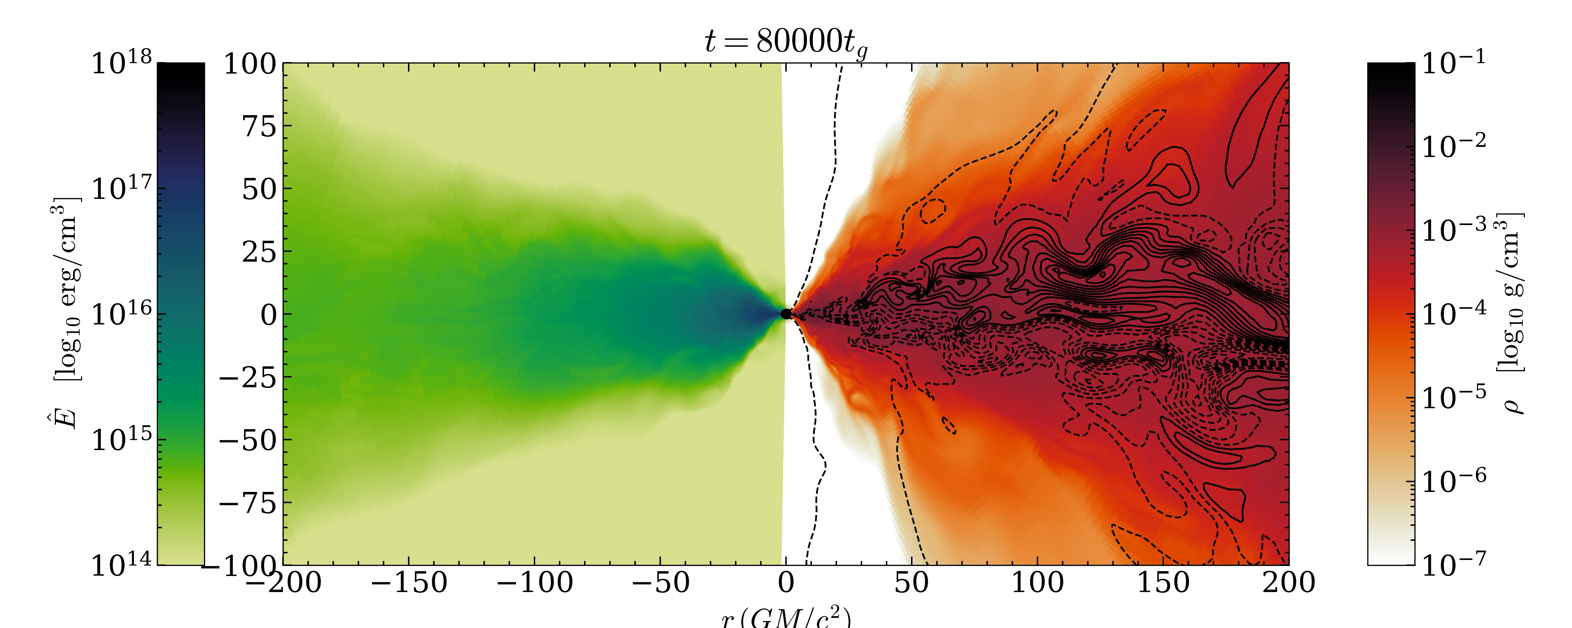
Accretion on a compact star and black hole
Accretion on a compact star with dipolar magnetic field
Varying compactness and surface magnetic field strength
Comparison to BH accretion with increasing spin
Kayanikhoo+ in prep.

Slide 5
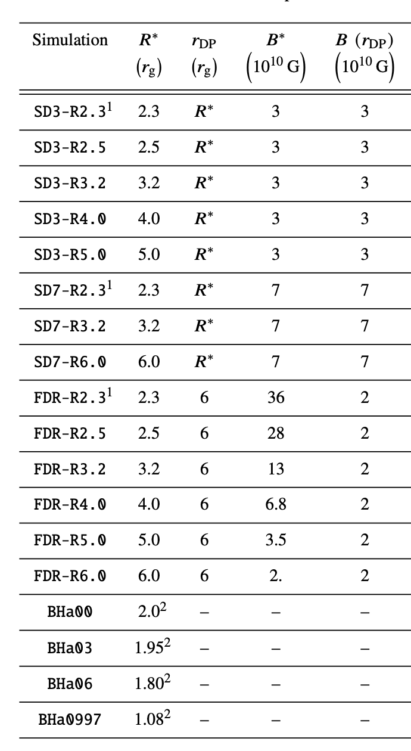

Slide 6
Thank you for your attention!

