Slide 1

DRD1 6rd Collaboration Meeting Closeout
Anna, Beatrice, Eraldo, Leszek, Maxim, Piotr
1

Slide 2
Highlights from the CB Meeting on 9.10.2025
• Election results endorsed:
– Anna Colaleo – CB Chair (2026–2027)
– Eraldo Oliveri, Maxim Titov – Spokespersons (2026–2027)
• Common Project (CP) results:
– 1st CP approved: Development of Prepreg with Controllable Resistivity.
– Next call: Dec 2025 → results June/July 2026.
New membership:
approved the procedure for accepting new institutions,
• New membership requests:
– CSIC–Valencia, University of Warsaw will be submitted at next CB

Slide 3
Highlights from the CB Meeting on 9.10.2025
Work Package endorsement procedure:
– Internal Referees endorsed: T. Lux (WP1), P. Colas (WP2), G. Iaselli (WP3), N. Tomida (WP4), A. White (WP5), M. Abbrescia (WP6), G. Charles (WP7), M. Tytgat (WP8), A. Breskin (WP9).
– Process initiated: first six WPs (1, 2, 4, 7, 8, 9) ready for review and approval.
Resource:
– 2025 Common Resources expenditure approved
– 2026 provisional budget approved
– Resources Board: 1st meeting in two weeks to approve the WP endorsement procedure and 2025-2026 budget.
Next DRD1 Collaboration Weeks:
– Feb 23–27 2026, plus proposal for June/July (outside CERN) and Fall 2026
– The CB confirmed the interest in organizing Collaboration Week outside CERN
Concern about potential low participation due to the dense calendar of community events in 2026.
Institutions interested in hosting will be promptly invited to express their availability — both for 2026 and 2027 — so that the CB can evaluate attendance and plan accordingly.

Slide 4
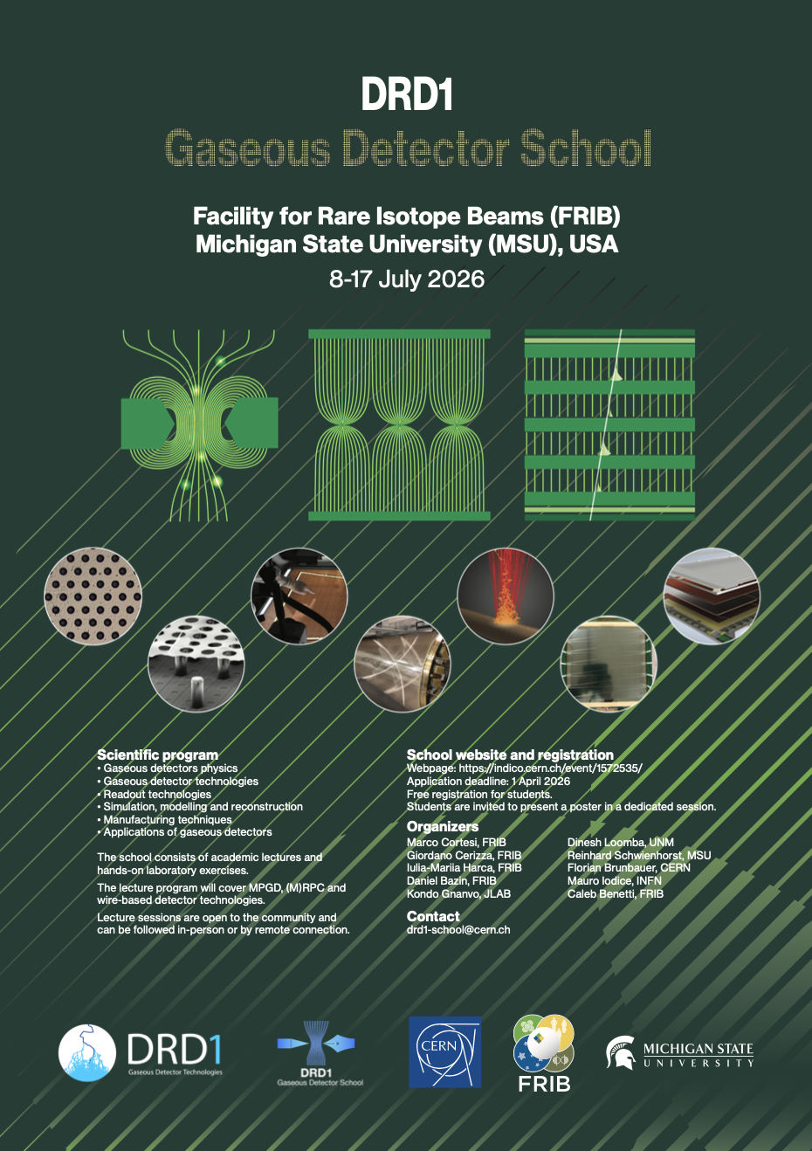
Highlights from the CB Meeting on 9.10.2025
CB appreciated the strong engagement in training and education activities
DRD1 Summer Student Program 2025
Six projects hosted at CERN (June–September 2025).
➔ The CB expressed appreciation for the quality of the projects and student participation.
New project proposals open in January 2026 for the next edition.
DRD1 School 2025 – Bonn (Germany)
First DRD1 Gaseous Detector School organized outside CERN (Sept 17–24, 2025).
24 students from 12 countries took part; excellent feedback from both students and tutors.
➔ The CB congratulated the organizers and lecturers for the success and strong community involvement.
Next school: FRIB, Michigan State University (July 8–17, 2026).
Call for 2027 DRD1 School Host
Institutions interested in hosting the 2027 DRD1 School are invited to contact Florian M. Brunbauer and Mauro Iodice or WG8 conveners (DRD1-WG8-convenors@cern.ch).

Slide 5
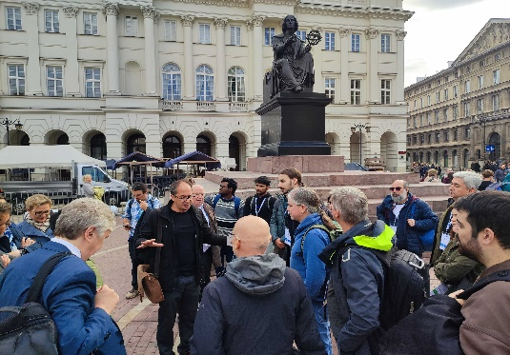
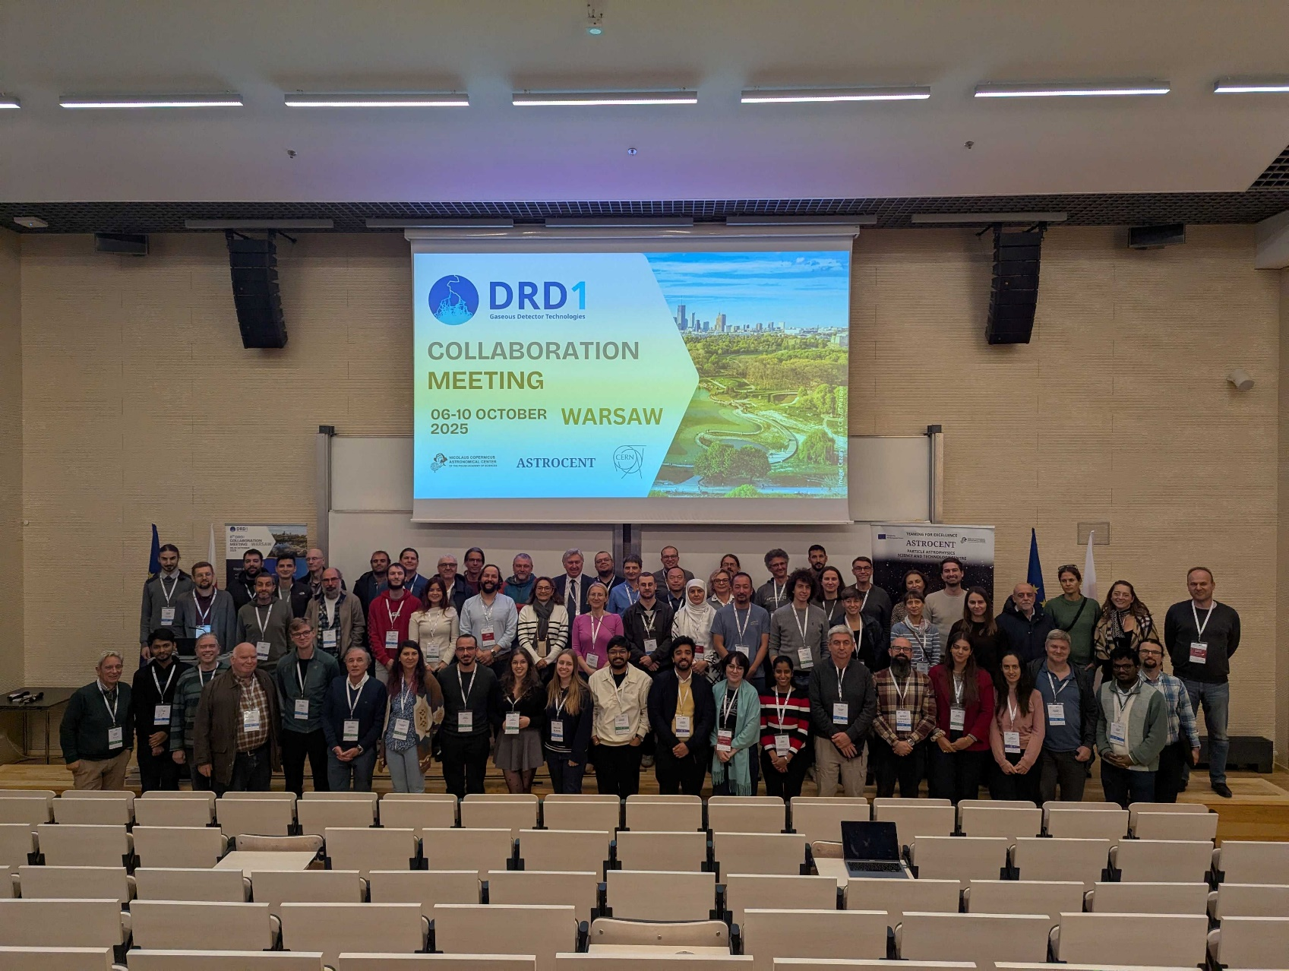


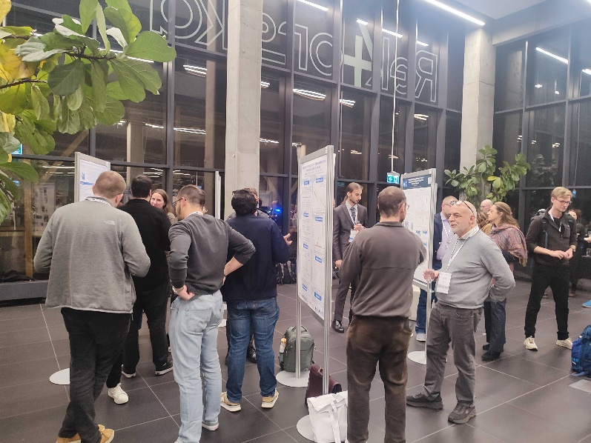
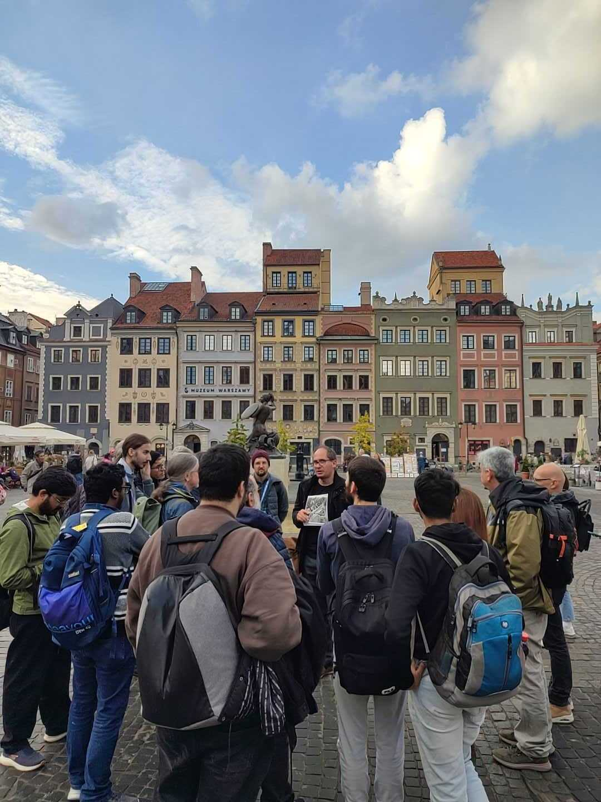
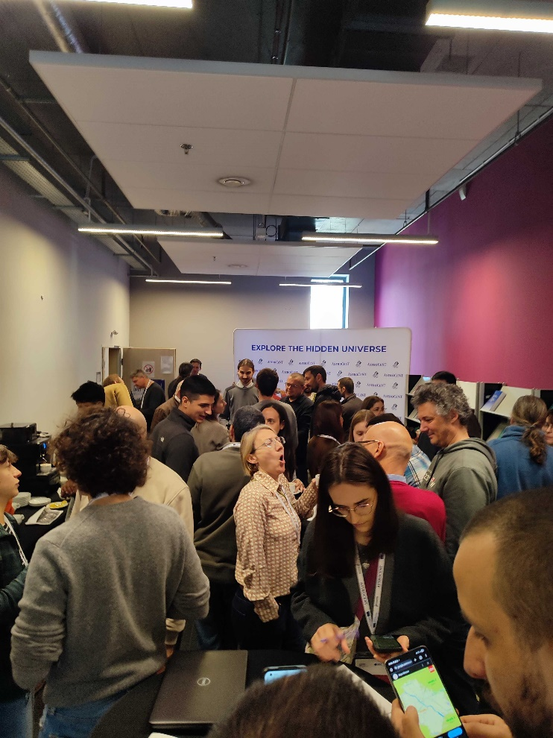
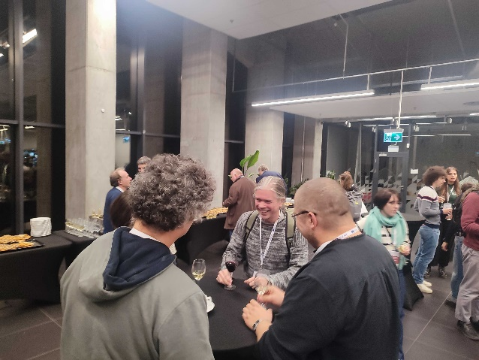
💙 A warm thank to the Astrocent & CAMK PAN team
for the excellent organization, hospitality, throughout the DRD1 Week in Warsaw!
5

