Slide 1
Performance of C-μRGroove in magnetic field
Qixuan Huang
On behalf of USTC-MPGD Group
6rd DRD1-WG2, 7/10/2025

Slide 2
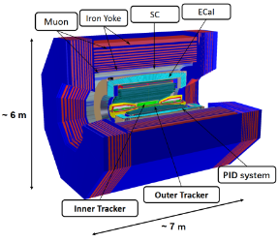
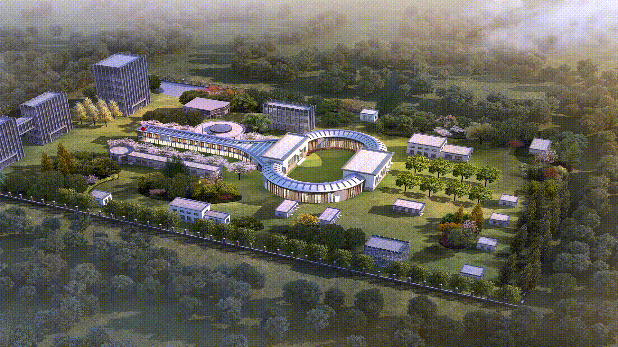
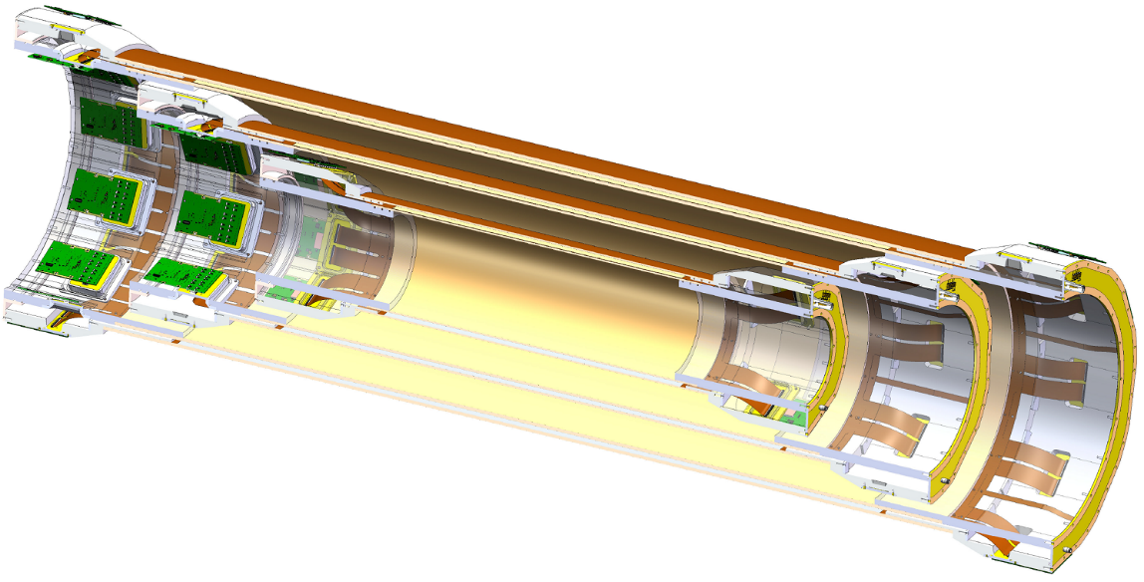
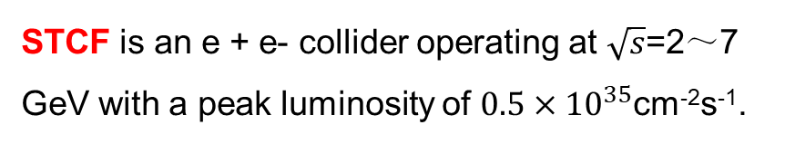
Super Tau-Charm Facility
Track detection under extremely high luminosity requires the ITK performance includes:
Ultra-Low Material Budget (<0.3%X₀)
Good Spatial resolution (<100μm)
Handle high occupancy operated in μ-TPC mode
……
STCF is an e + e- collider operating at $\sqrt{s}$=2～7 GeV with a peak luminosity of $0.5×{10}^{35}$cm⁻²s⁻¹.
Damping Ring
150 m
Collider Ring
1000m
Detector
Possible Solutions：
3-layers Cylindrical MPGDs

Slide 3
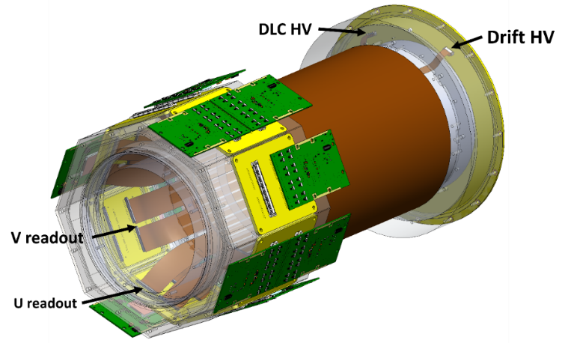
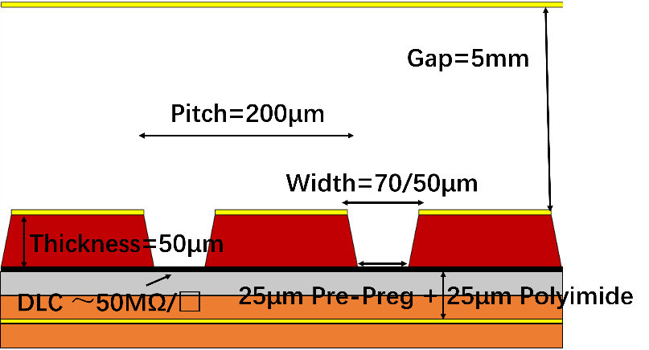
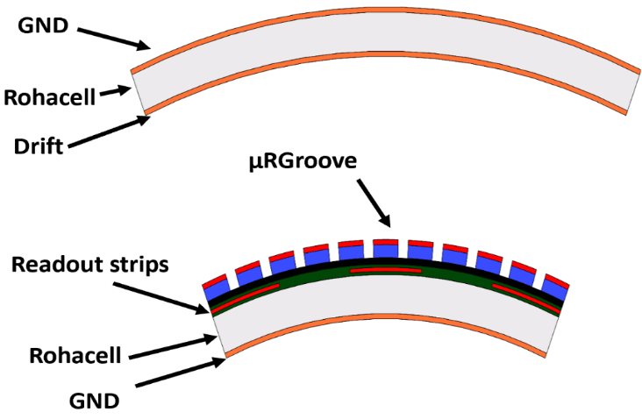
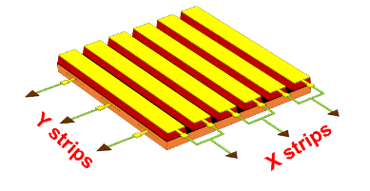
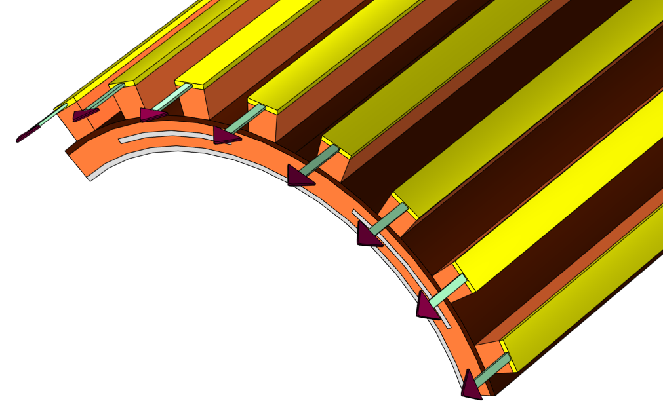
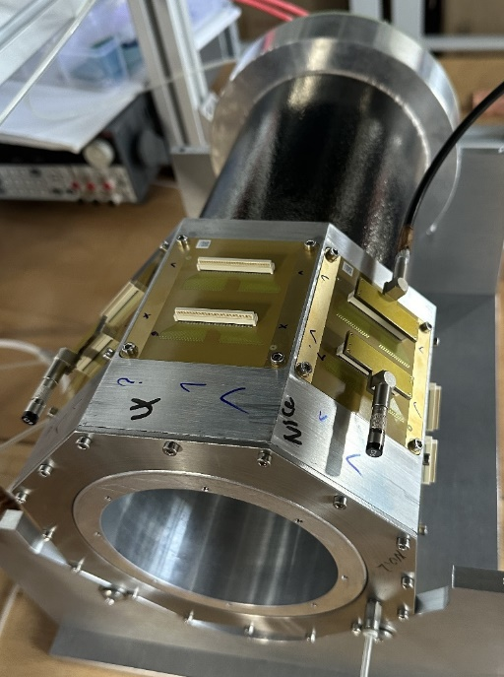
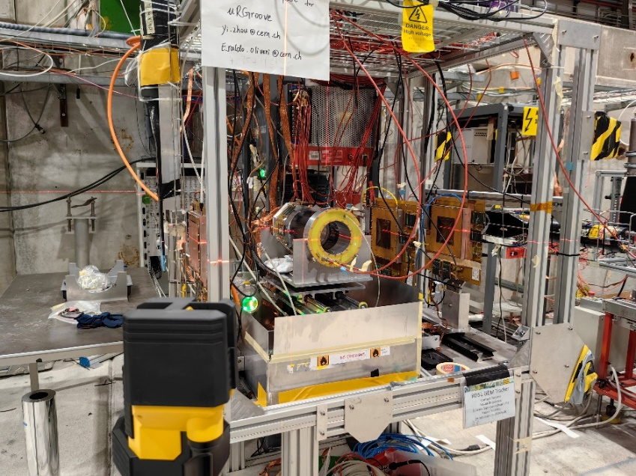
Cylindrical μRGroove
1st C- μRGroove prototype:
Size of active area: D=131.0mm, L=100.0mm;
Spatial resolution without magnetic field：
<100μm for perpendicular tracks
<120μm for Oblique incident tracks
Prototype
C-μRGroove
Next, Test detector performance in magnetic field

Slide 4
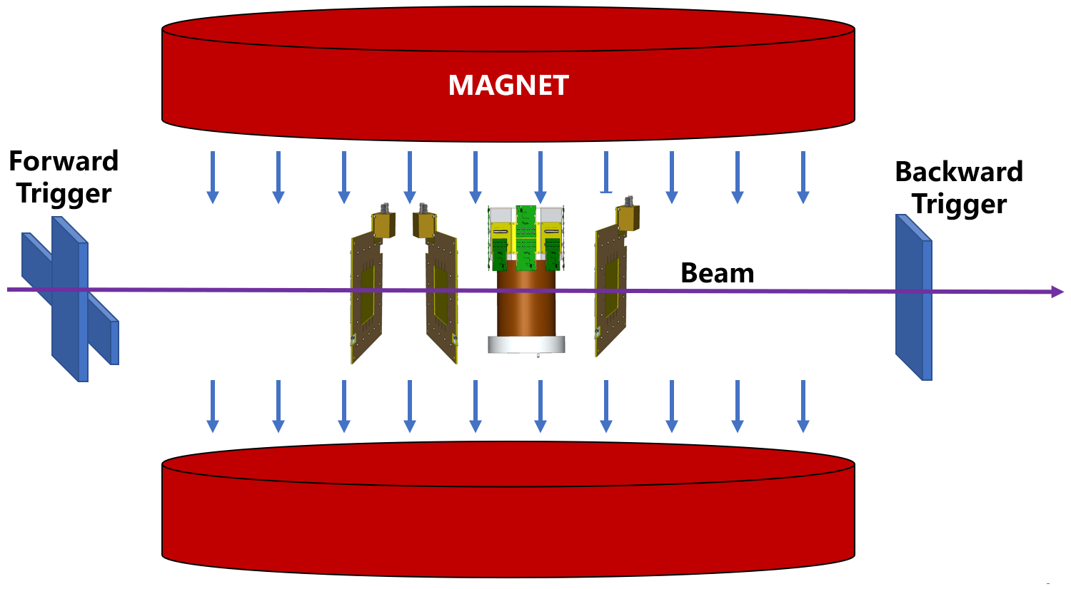
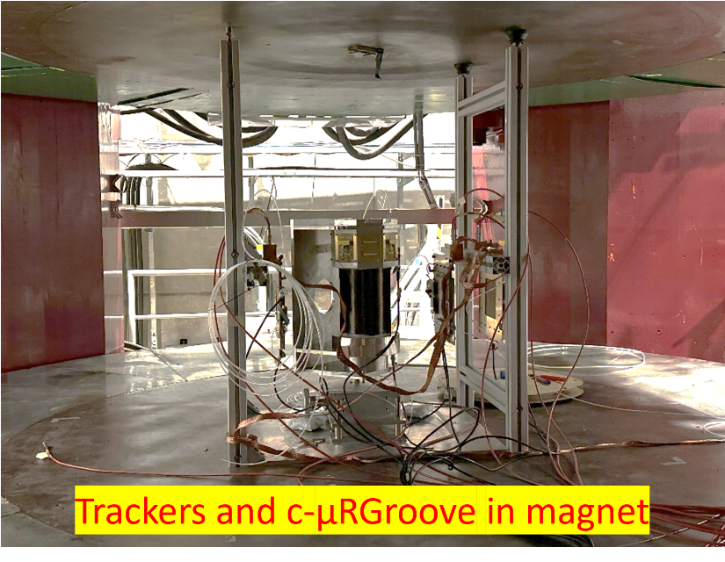
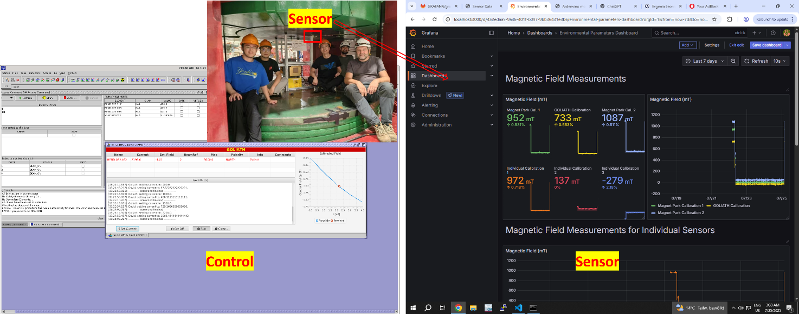
Experiment setup
Goliath magnet at SPS-H4, B = 1T
Trackers: μRGroove, Ar/iC₄H₁₀(98/2), 3kV/cm drift field, Lorentz angle: ~6°
C-μRGroove: Ar/CF₄/CO₂(45/40/15), 0.5kV/cm drift field, Lorentz angle: ~22°
APV25 + SRS + mmDAQ
2025. 07

Slide 5
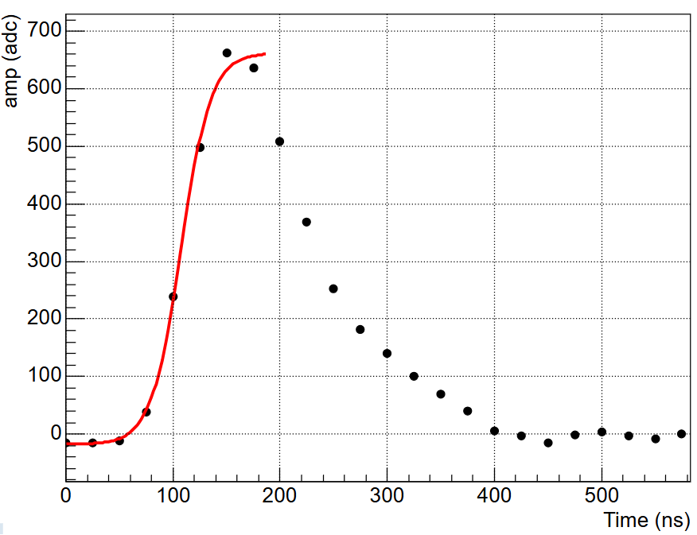
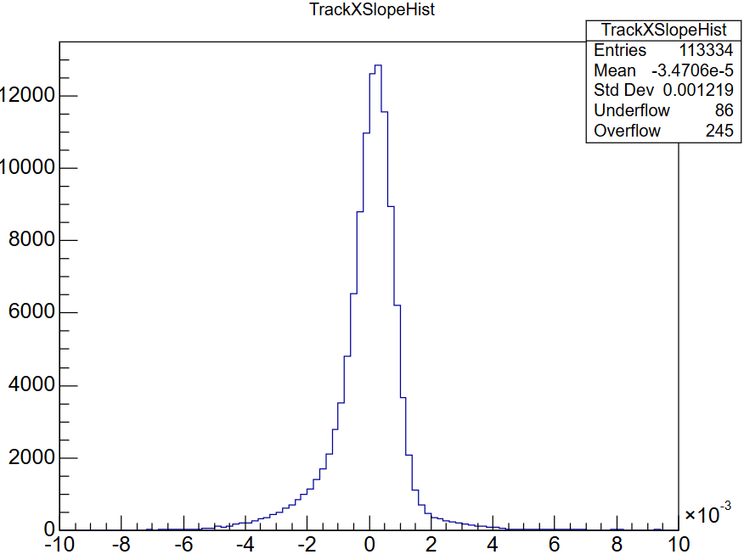
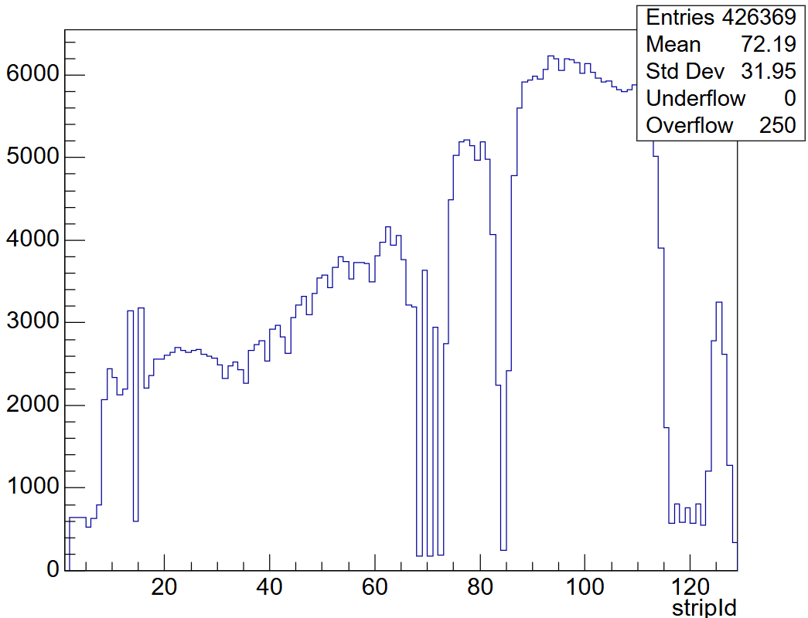
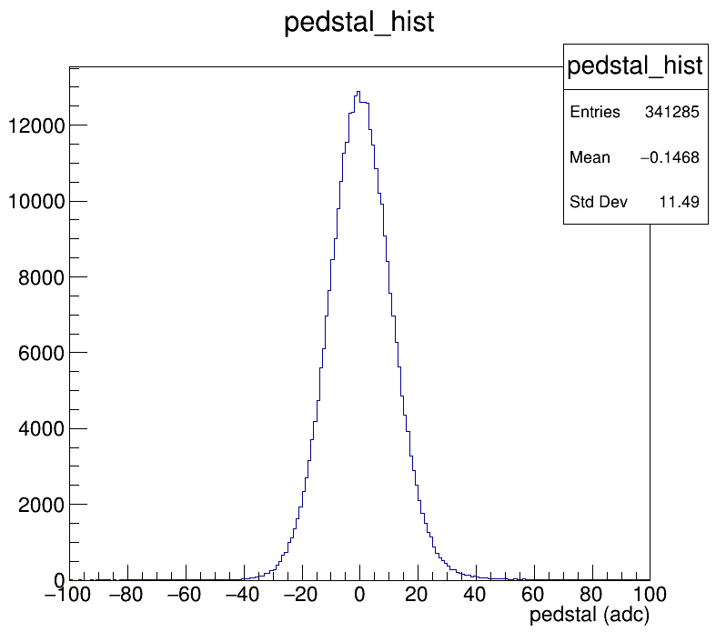
Analysis Workflow of Raw Data
Track Slope
HitID for C-μRGroove
Beam Analysis Workflow
Waveform Process: extract charge and time with fit the leading edge
Clustering: group neighboring fired strips, allow one missing strip
Event Selection: allow only one hit per tracker, keep tracks with χ² < 10
DUT Matching: get hit point and find nearest cluster in the DUT
Reconstruct
~12 Adc

Slide 6
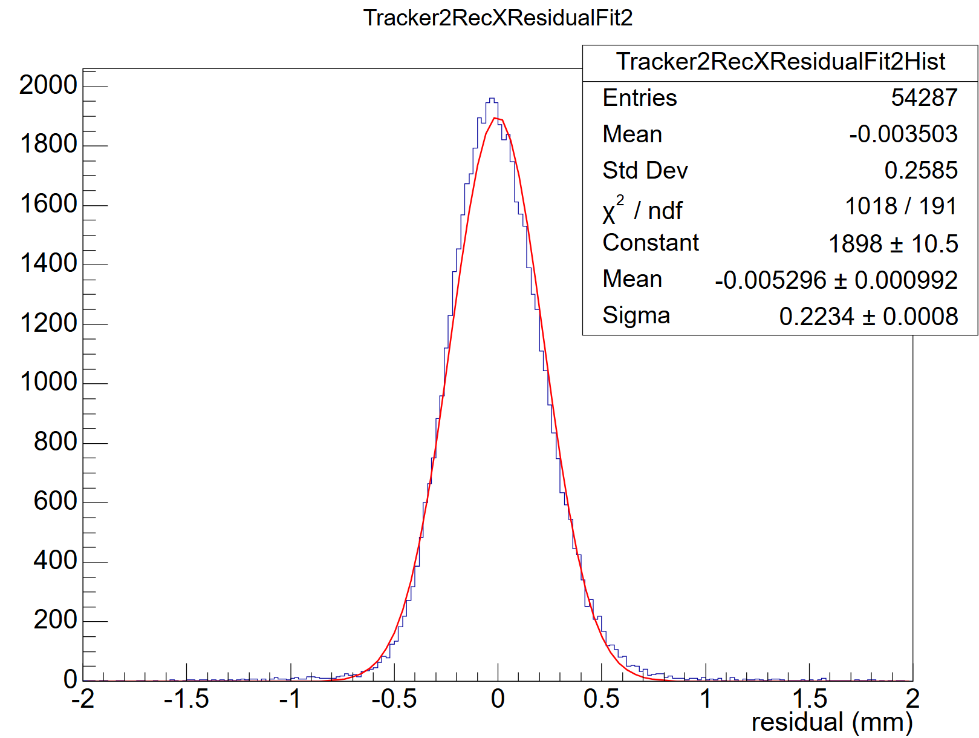
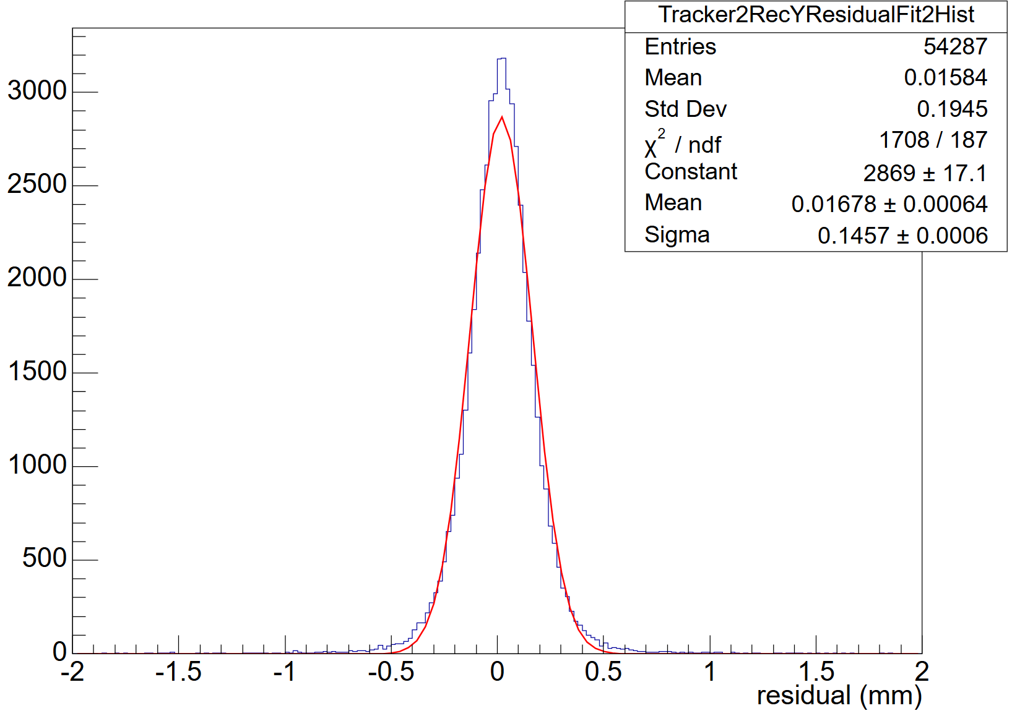

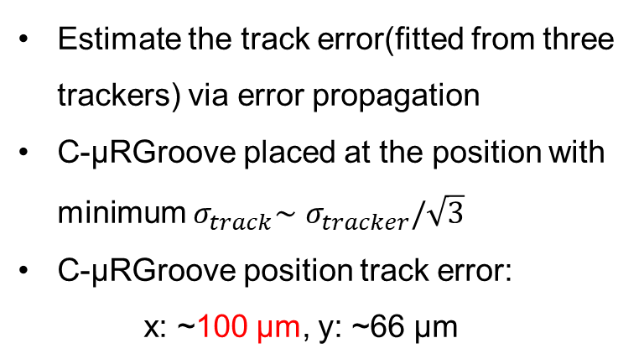








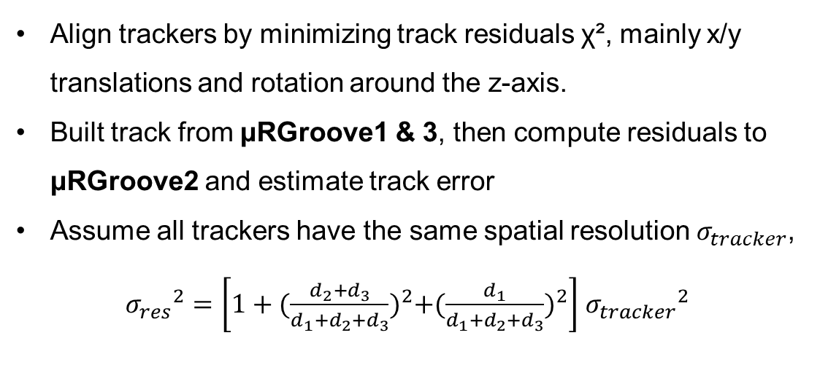



Tracking System in magnetic field
Align trackers by minimizing track residuals χ², mainly x/y translations and rotation around the z-axis.
Built track from μRGroove1 & 3, then compute residuals to μRGroove2 and estimate track error
Assume all trackers have the same spatial resolution $σ_{tracker}$,
${σ_{res}}^{2}=\left[1+{(\frac{d_{2}+d_{3}}{{d_{1}+d}_{2}+d_{3}})}^{2}+{(\frac{d_{1}}{{d_{1}+d}_{2}+d_{3}})}^{2}\right]$ ${σ_{tracker}}^{2}$
$$315 mm$$
$$155 mm$$
$$140 mm$$
$$d_{3}$$
$$d_{2}$$
$$d_{1}$$
$$x$$
C-μRGroove
$$z$$
μRGroove3
μRGroove2
μRGroove1
Estimate the track error(fitted from three trackers) via error propagation
C-μRGroove placed at the position with minimum $σ_{track}\sim$ $σ_{tracker}/\sqrt{3}$
C-μRGroove position track error:
x: ~100 μm, y: ~66 μm
$$x$$
$$y$$
$$σ_{res}=223 μm$$
$$σ_{res}=146 μm$$

Slide 7
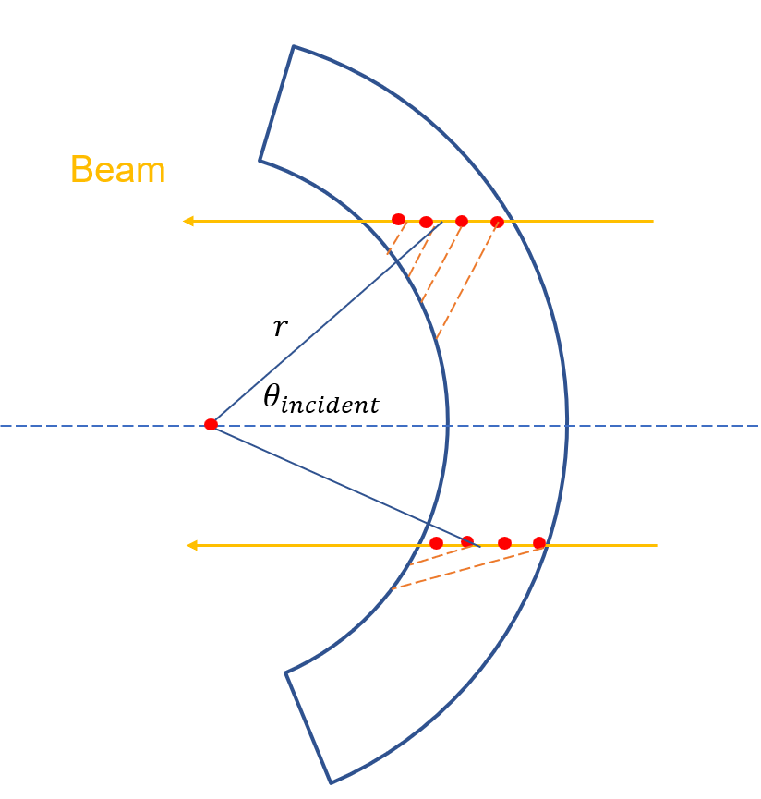
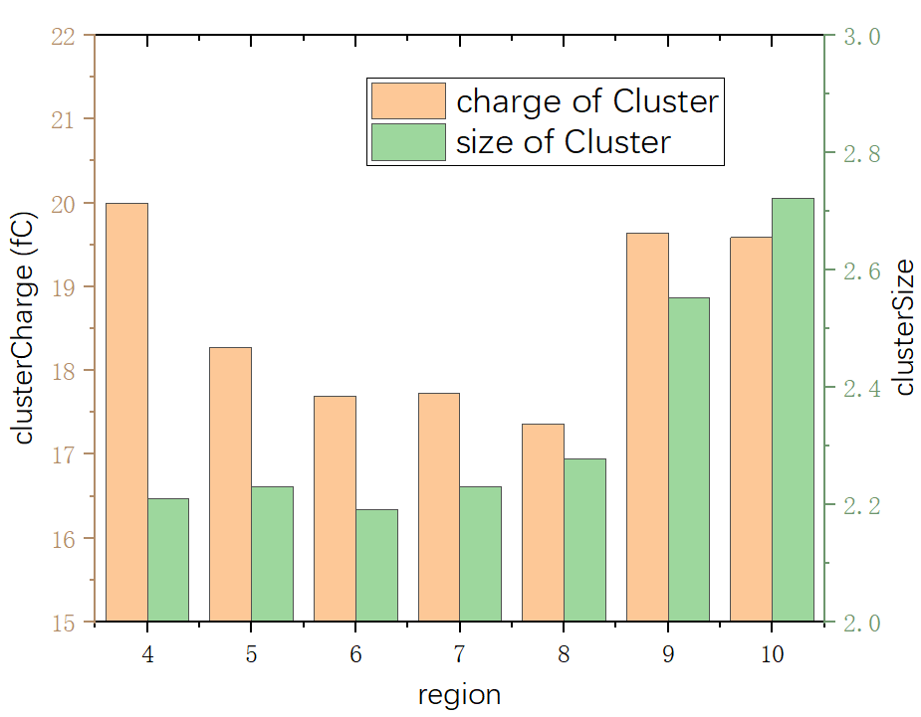
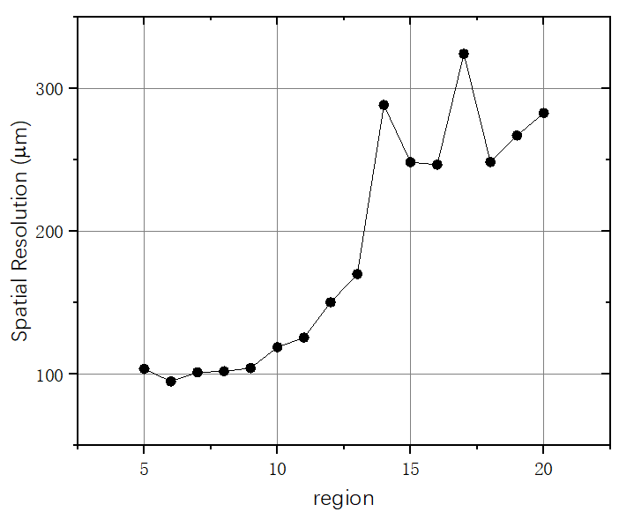

Spatial resolution @B = 0T
charge centroid Residual RMS
$$\sqrt{{95}^{2}−{66}^{2}}≈70 μm$$
Mid pos
Maybe wrinkle
region
2
1
Divide the cylindrical surface into regions along the arc per 2°
The center hard to determine accurately, but 2° error does not matter
Different hit positions lead to different incident angles through the cylindrical detector
Test the detector performance and determine the center position at B=0 T

Slide 8
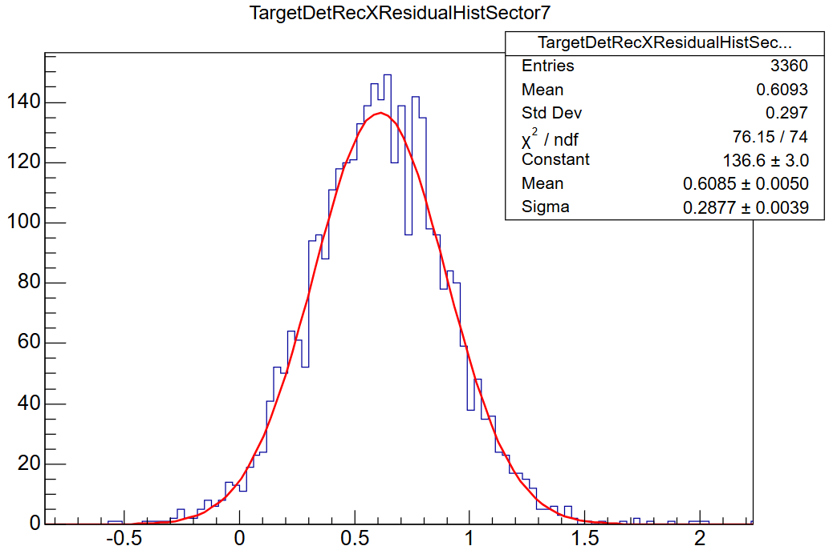
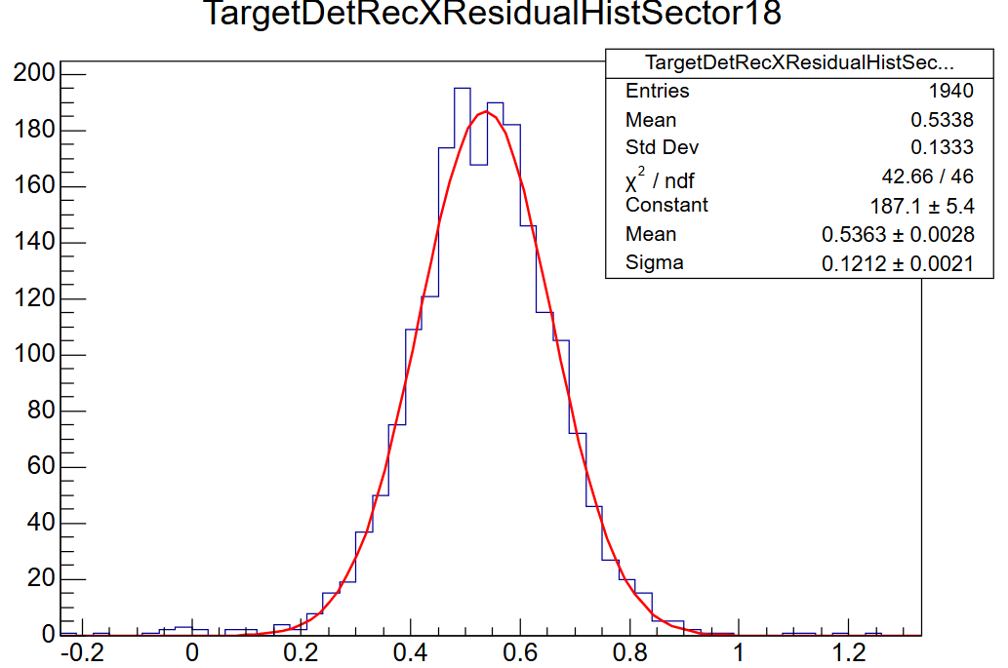
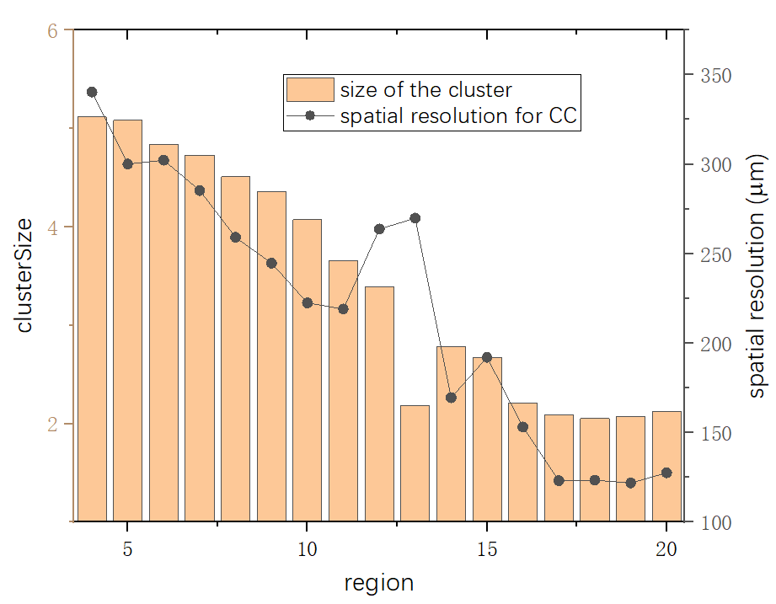
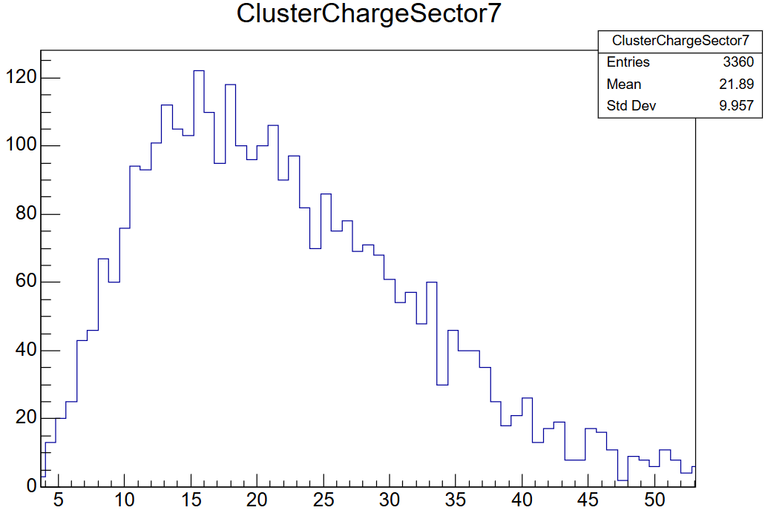
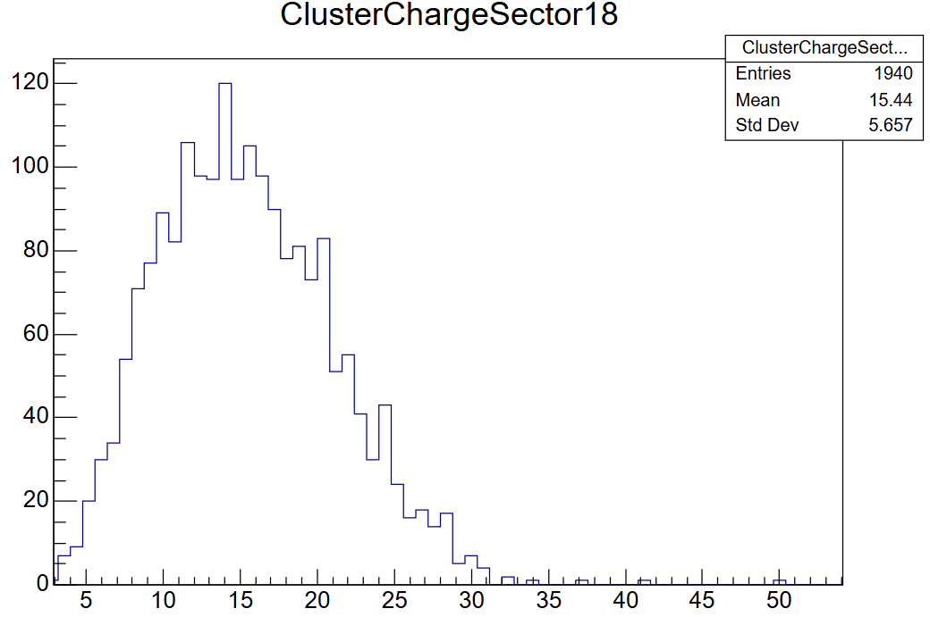



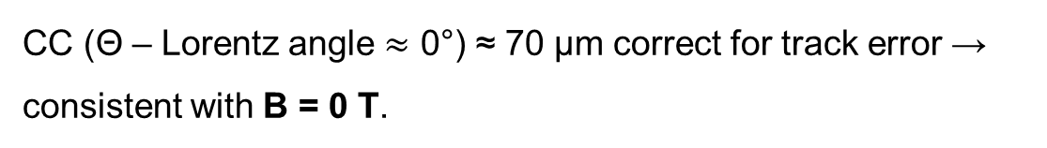

Charge-centroid @B = 1T
288 $μm$
121 $μm$
$$incident angle≈0°$$
$$incident angle−Lorentz≈0°$$
CC (Θ – Lorentz angle $≈$ 0°) ≈ 70 μm correct for track error → consistent with B = 0 T.

Slide 9
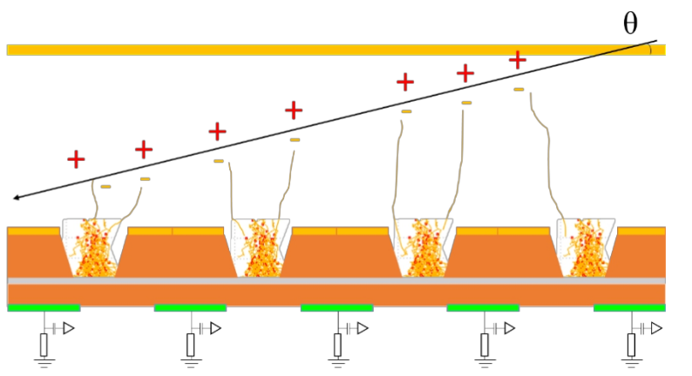
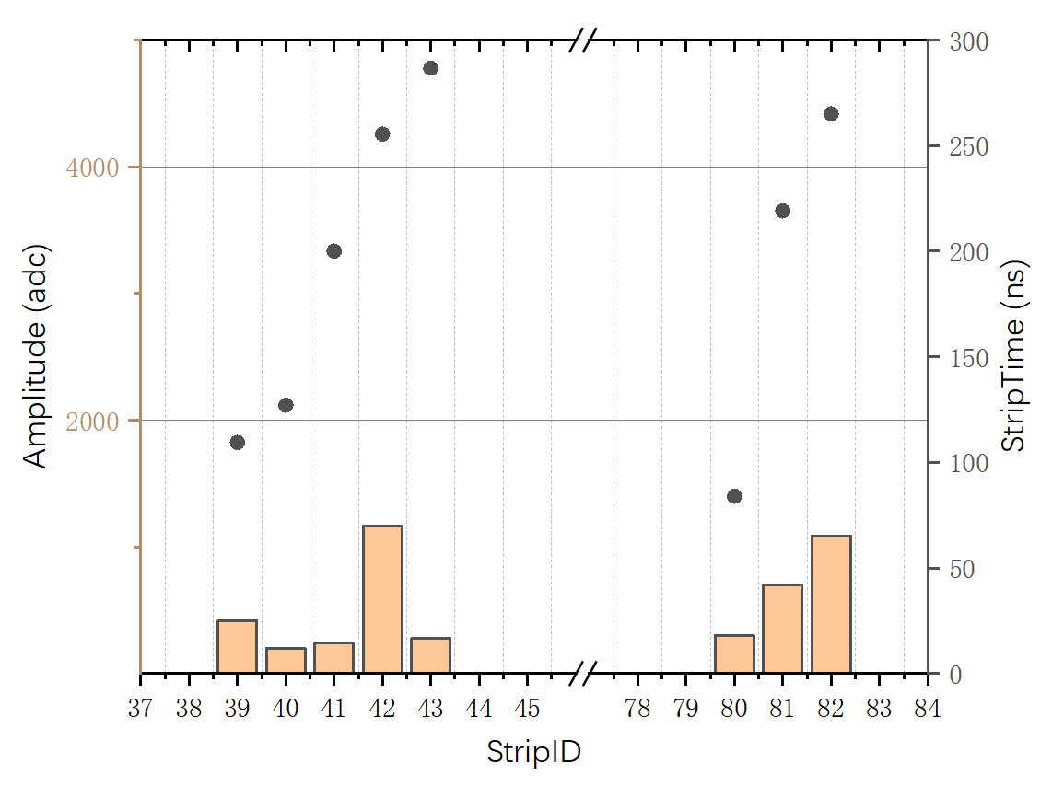
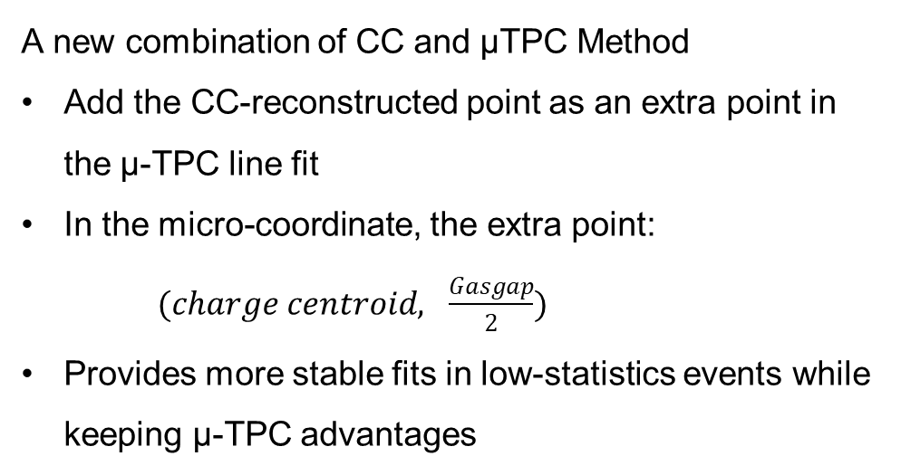
The micro-TPC mode
The time information of the hits can be used with the drift velocity to reconstruct
For large incident angles or with magnetic field, micro-TPC is stronger than the charge centroid
A new combination of CC and μTPC Method
Add the CC-reconstructed point as an extra point in the μ-TPC line fit
In the micro-coordinate, the extra point: $(charge centroid, \frac{Gasgap}{2})$
Provides more stable fits in low-statistics events while keeping μ-TPC advantages

Slide 10
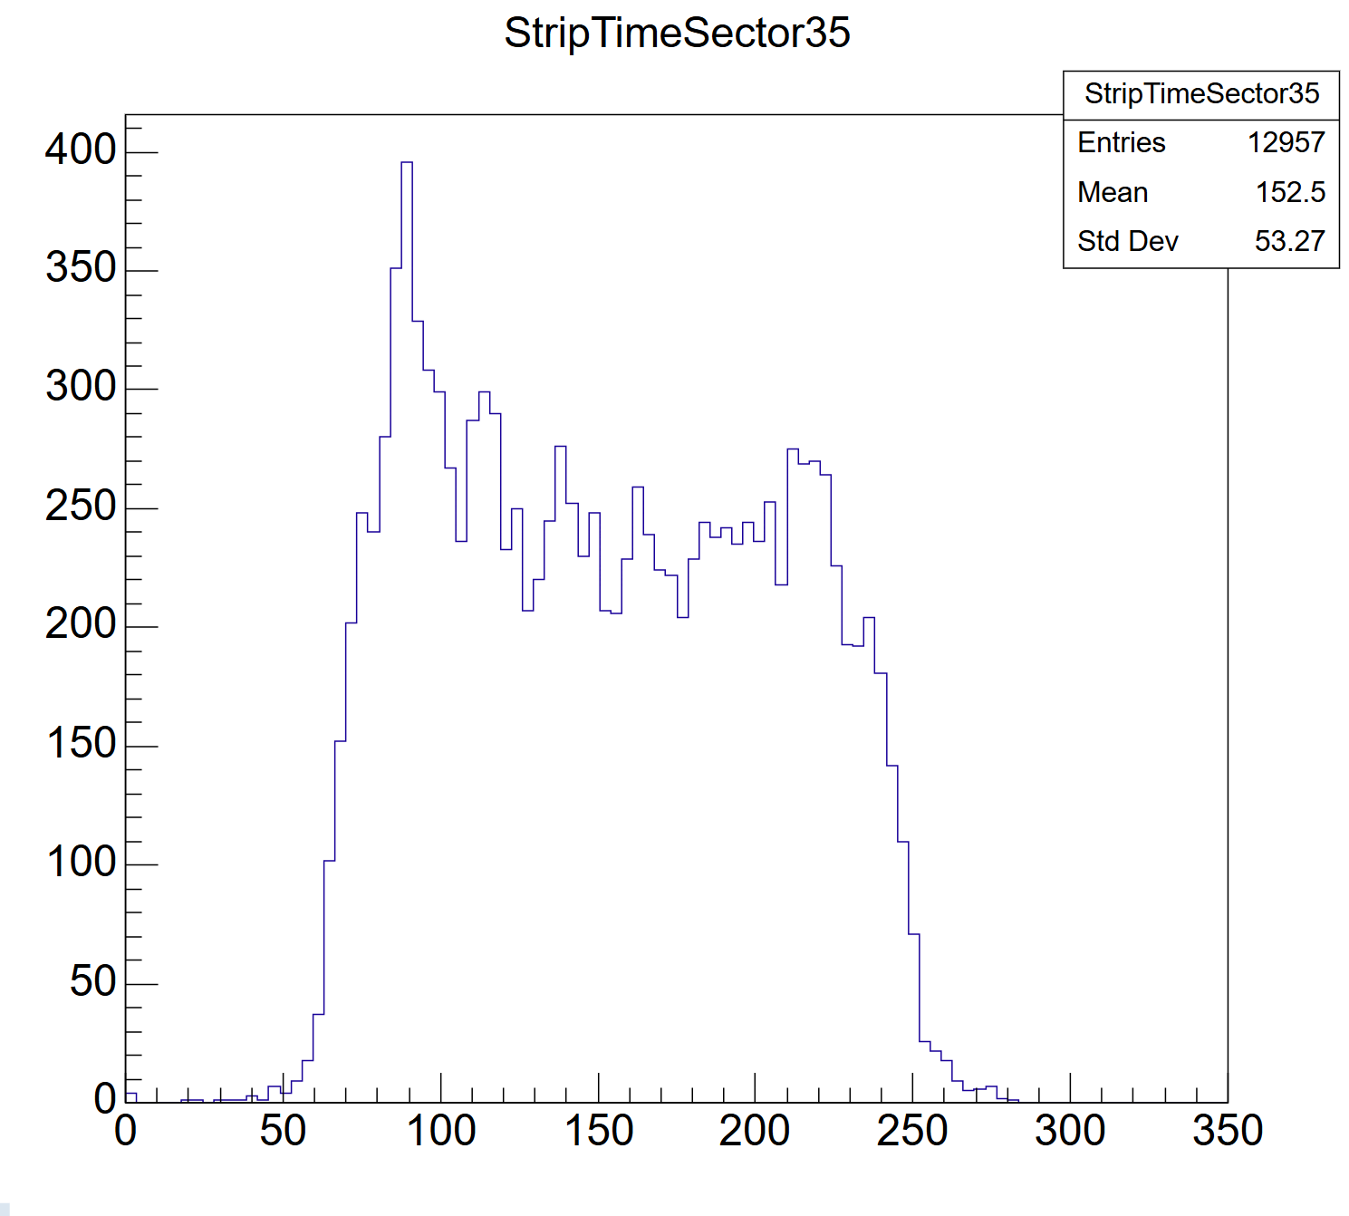
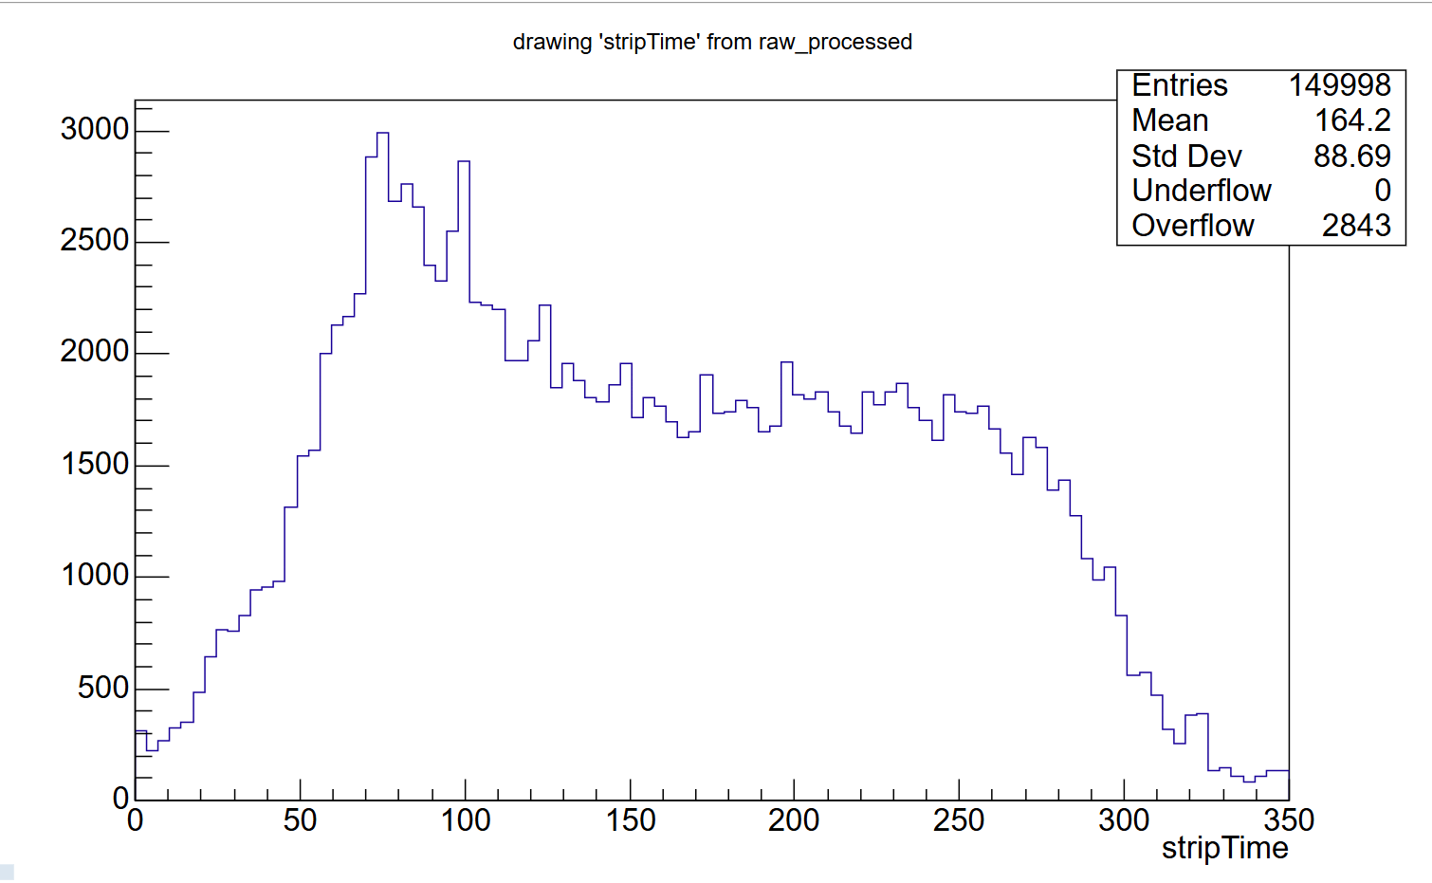
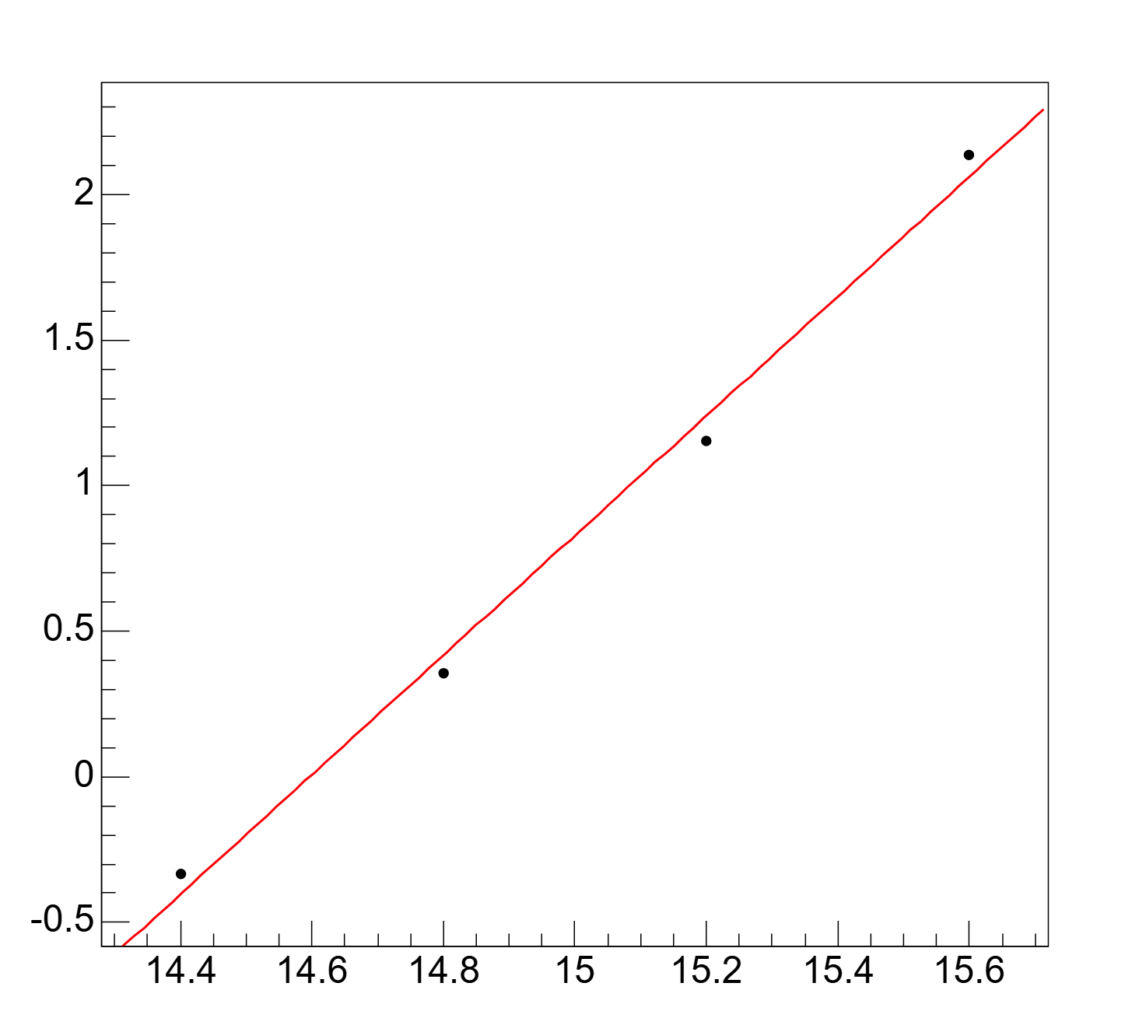
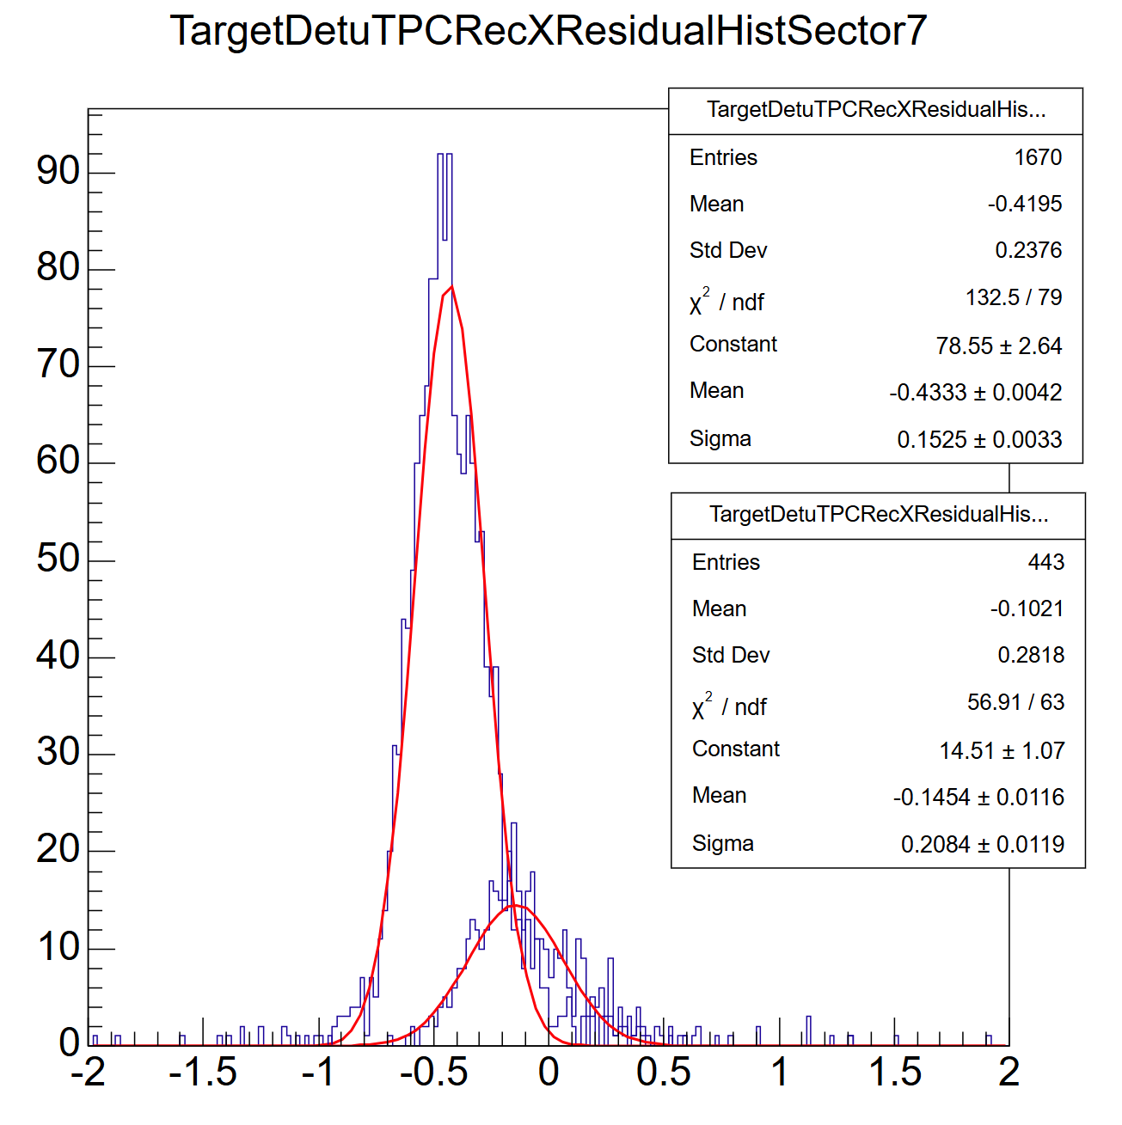
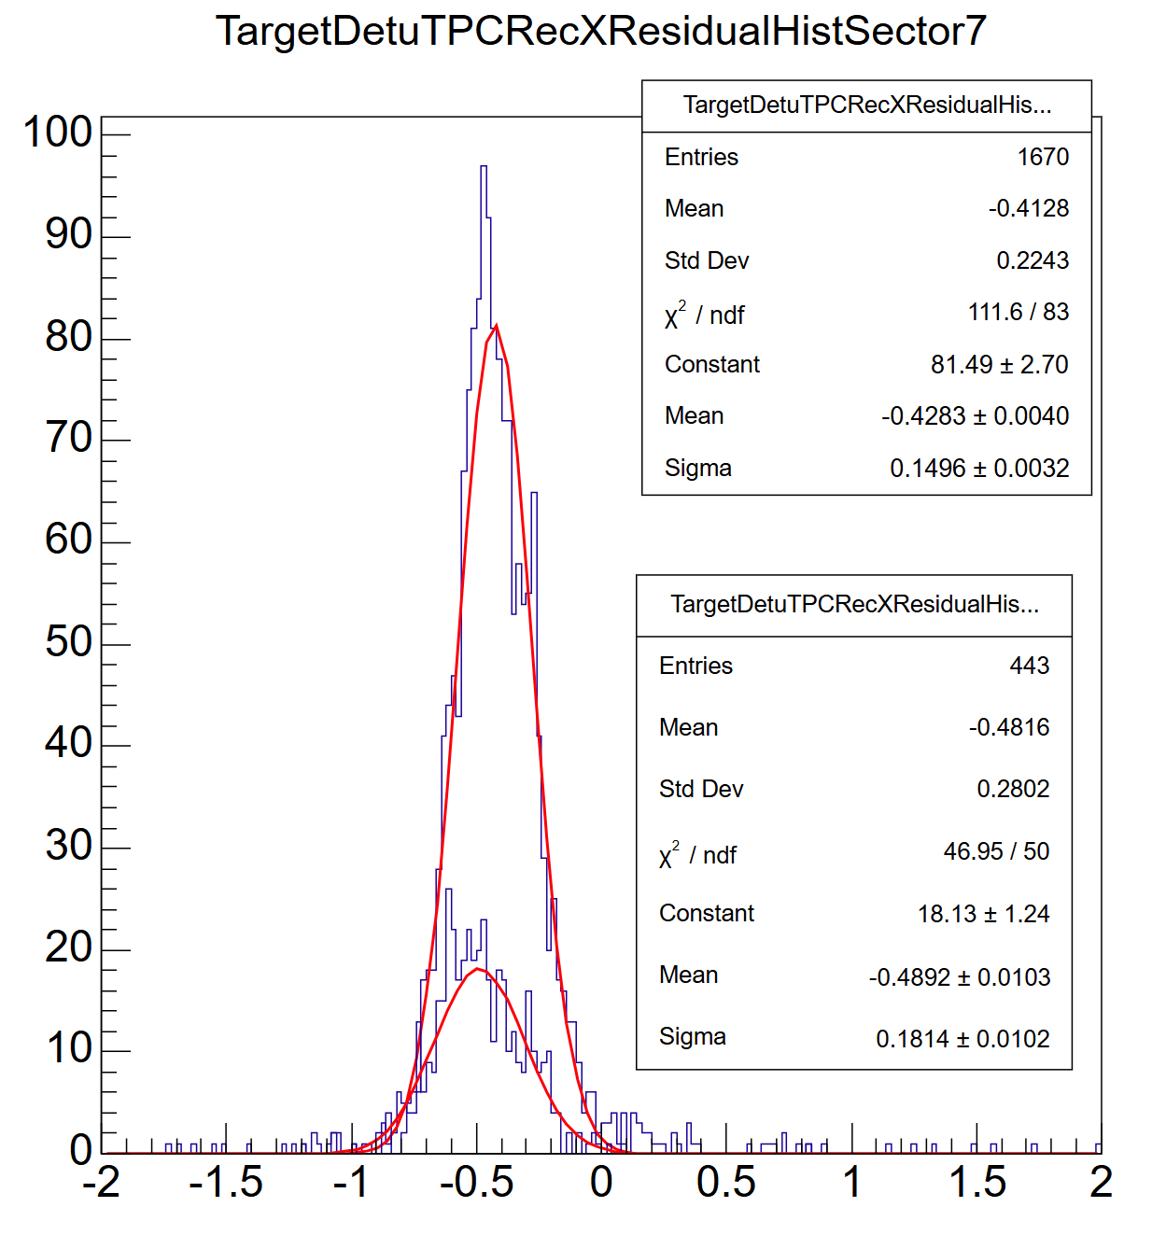
Time shift correction in magnetic field
0 T
1 T
Origin residual distribution
corrected distribution
Observed abnormal events, Indicates a timing shift affecting all points
Applying a global time offset to points during abnormal events

Slide 11
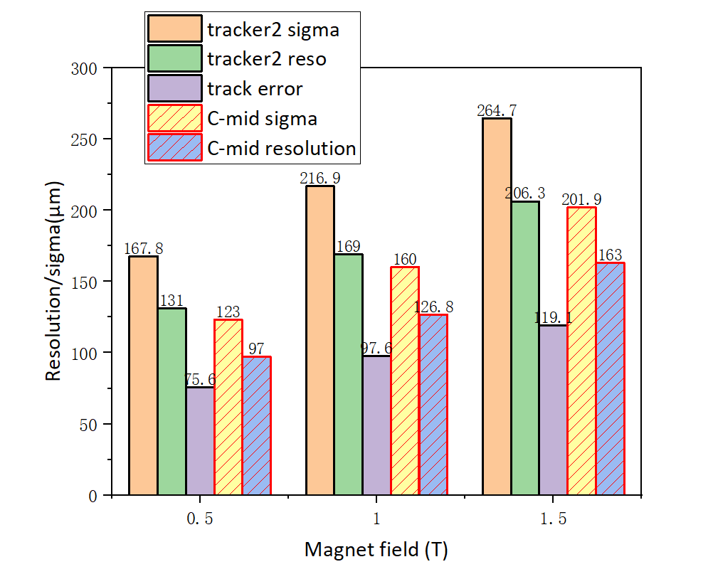
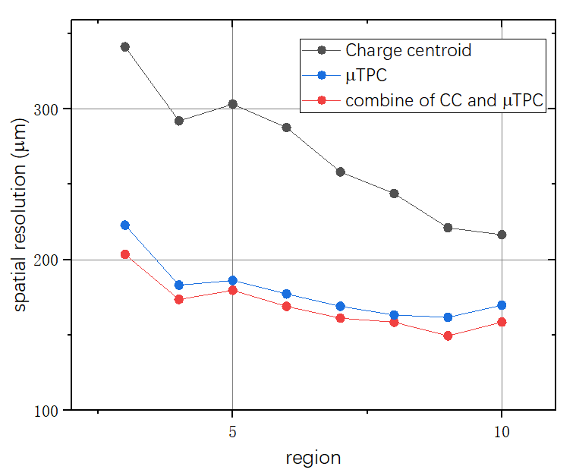
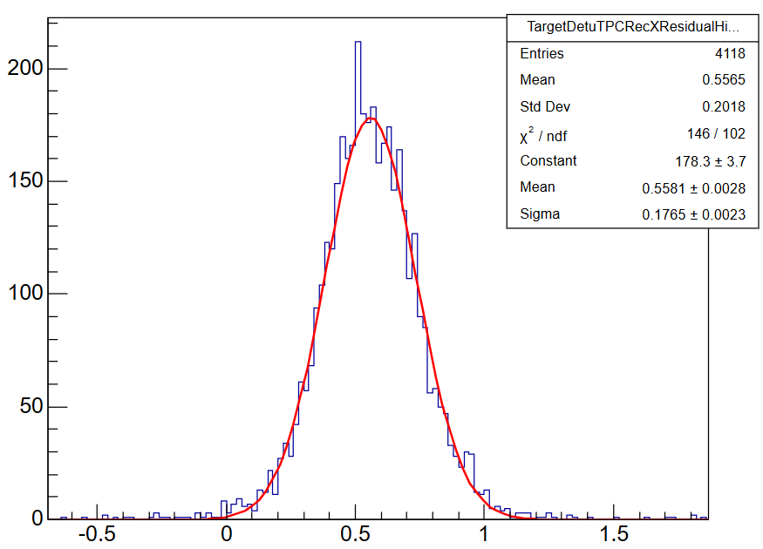
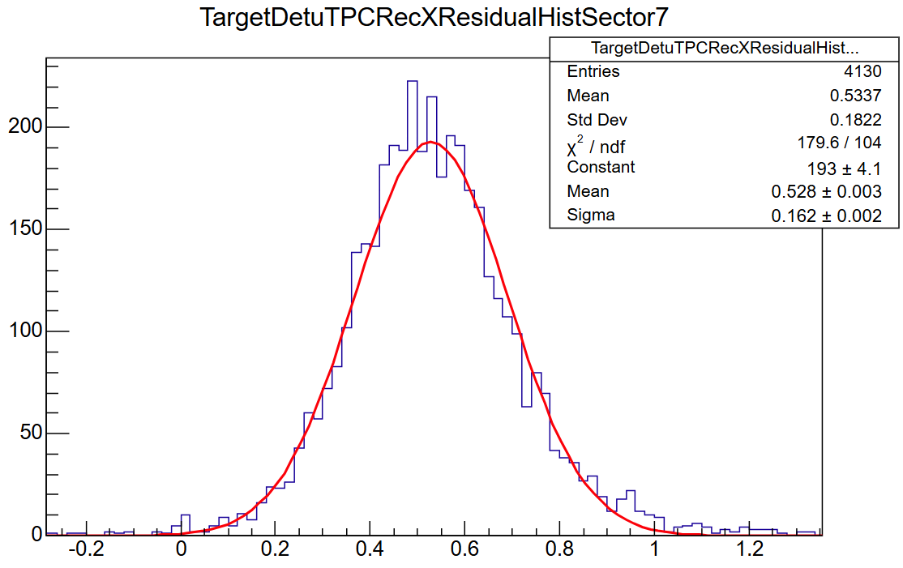
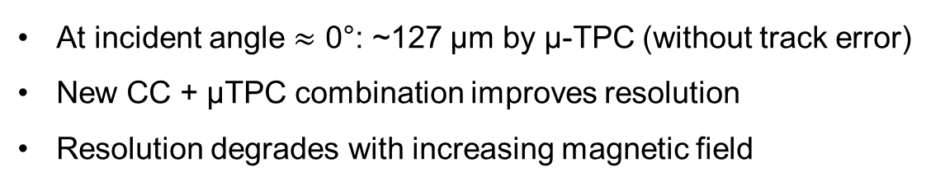


Result in magnetic field
Micro-TPC
176 $μm$
Combine of CC and Micro-TPC
At incident angle $≈$ 0°: ~127 μm by μ-TPC (without track error)
New CC + μTPC combination improves resolution
Resolution degrades with increasing magnetic field
162 $μm$

Slide 12
Summary
Validation in Magnetic Field
Verified detector performance at B = 1 T
At normal incidence: <130 μm spatial resolution achieved
Proposed a new combination method, which further improves resolution

