Slide 1
Neutron Detectors
TPC readout with GridPix
Group 6
Victoria Bashu¹, Diego Rodas², Giorgio Canezin³, Maximilian Spors⁴
The Australian National University, Canberra, Australia
AstroCeNT, CAMK PAN, Warsaw, Poland
Laboratory of Instrumentation and Experimental Particle Physics, Coimbra, Portugal
University of Bonn, Germany
6th DRD1 Collaboration Meeting
October 10th, 2025
Notes:
‹#›

Slide 2
Outline
Neutron Detectors
TPC and GridPix Basics
Experimental Setup
Results
Conclusions
‹#›
Notes:
‹#›

Slide 3
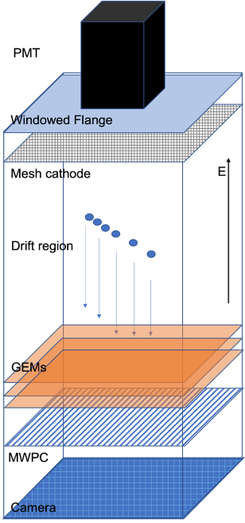
TPC and GridPix Basics
Neutron Detectors
Time Projection Chamber
Components: A TPC consists of a large conversion and drift volume made of only gas, and a segmented readout plane;
Working principle: Incoming particles passing or converting into charge particles ionize the molecules or atoms, the electrons drift to the readout plane;
Key Features: Provides 3D tracking and particle identification by measuring the drift time and charge deposition (dE/dx).
‹#›
Notes:
‹#›

Slide 4
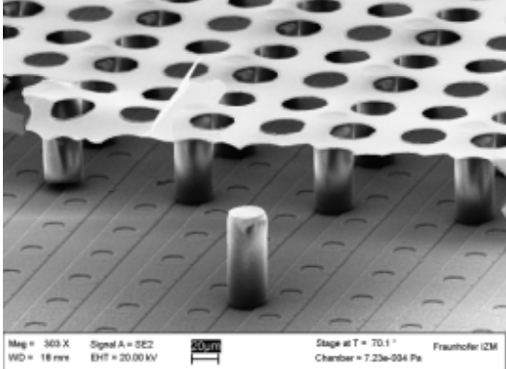
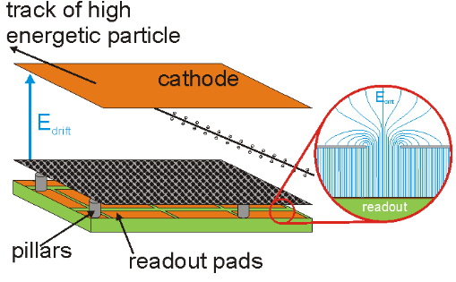
TPC and GridPix Basics
Neutron Detectors
GridPix
Components: Combination of a highly pixelated readout ASIC and an integrated Micromegas Grid (InGrid);
Working principle: Primary electron from the drift region enters a hole, gas amplification takes place and the complete avalanche is collected by a single pixel;
Key Features: Provides excellent spatial and energy resolutions.
Source: DRD1 Lab book, DRD1 School 2025
‹#›
Source: Jochen Kaminski
Notes:
‹#›

Slide 5
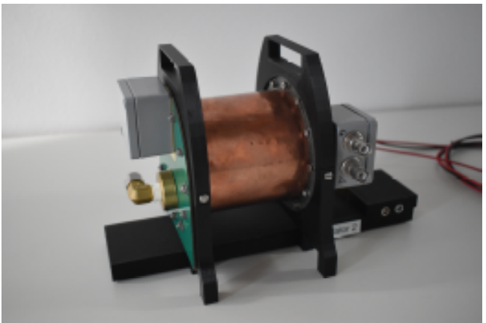
Experimental Setup
Neutron Detectors
CLassroom Experiment On PArticle TRAcking (CLEOPATRA detector)
The maximum drift length is 10 cm and the inner diameter of the drift volume is 8 cm,
The anode side is equipped with 4 GridPix detectors, which are read out with the Scalable Readout System (SRS)
Cosmic ray and radioactive source measurements
CLEOPATRA detector
‹#›
Notes:
‹#›
Schematic and do transition

Slide 6
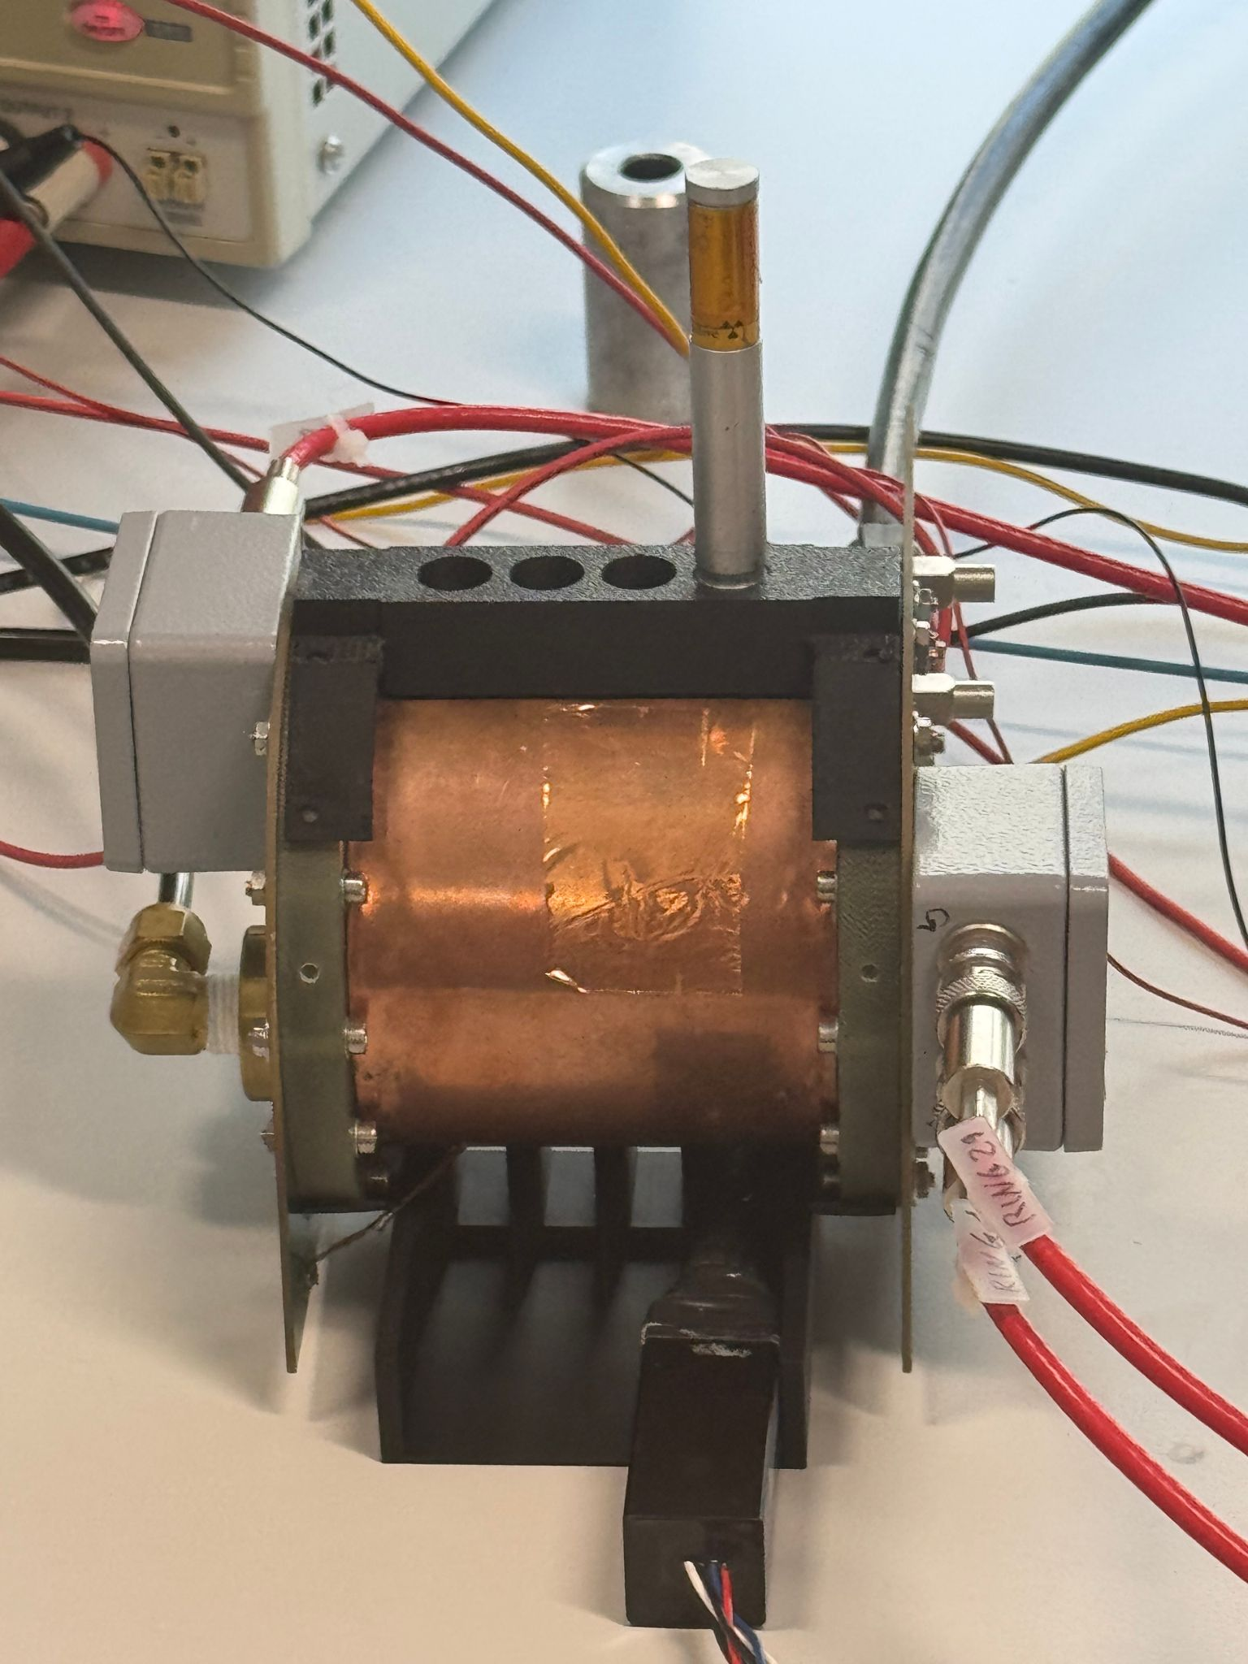
Experimental Setup
Neutron Detectors
Cosmic ray measurements
Scintillator surrounding the drift volume to trigger from the Cosmic rays
Cosmic rays
Radioactive source
scintillator
Scintillator for trigger
Cosmic ray set up
Setup with radioactive source
‹#›
Notes:
‹#›
Schematic and do transition

Slide 7
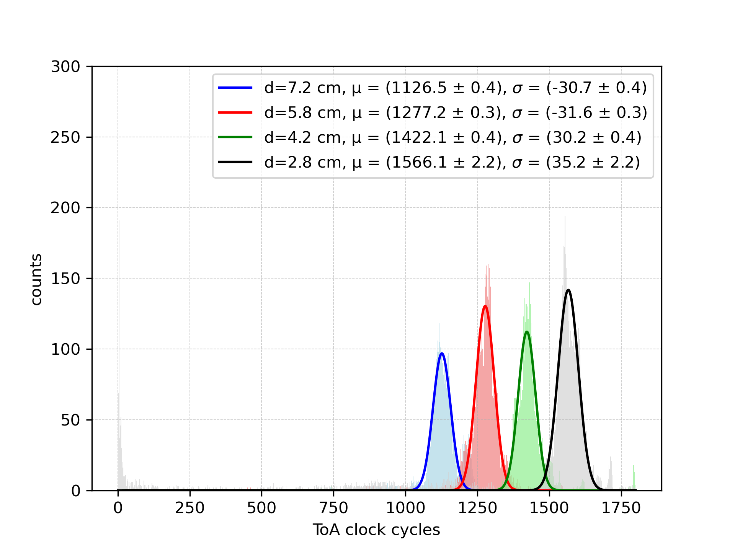
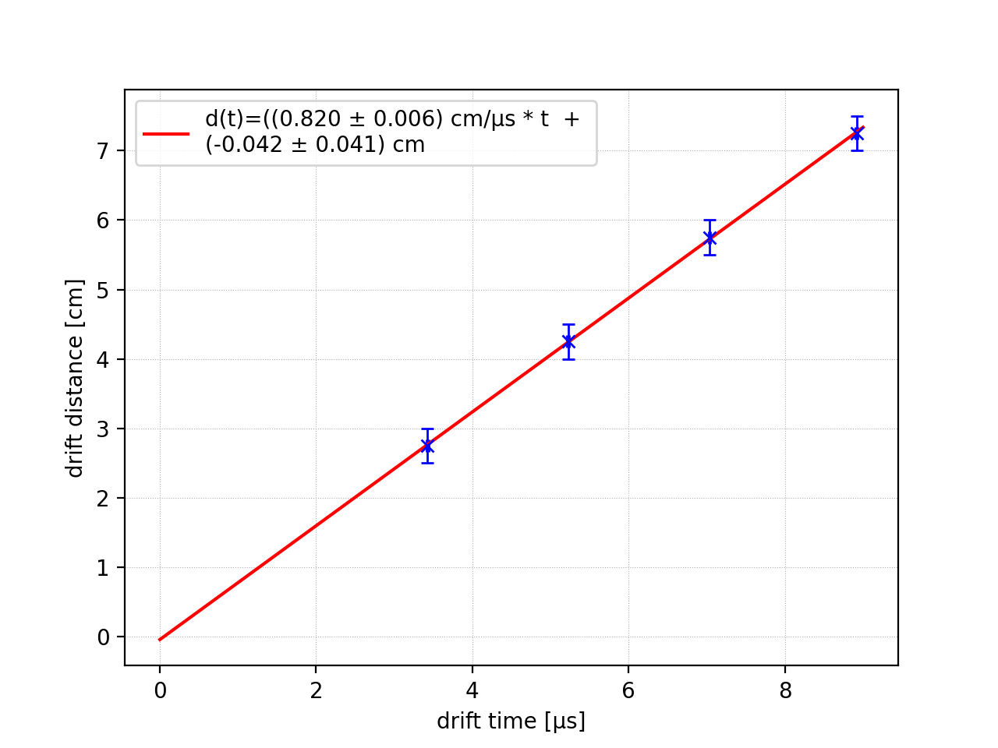
Results
Neutron Detectors
Drift velocity measurements with radioactive source Ar:CO2 82:18
Big thanks to Jochen Kaminski and Jan Glowcz
‹#›
Notes:
‹#›

Slide 8
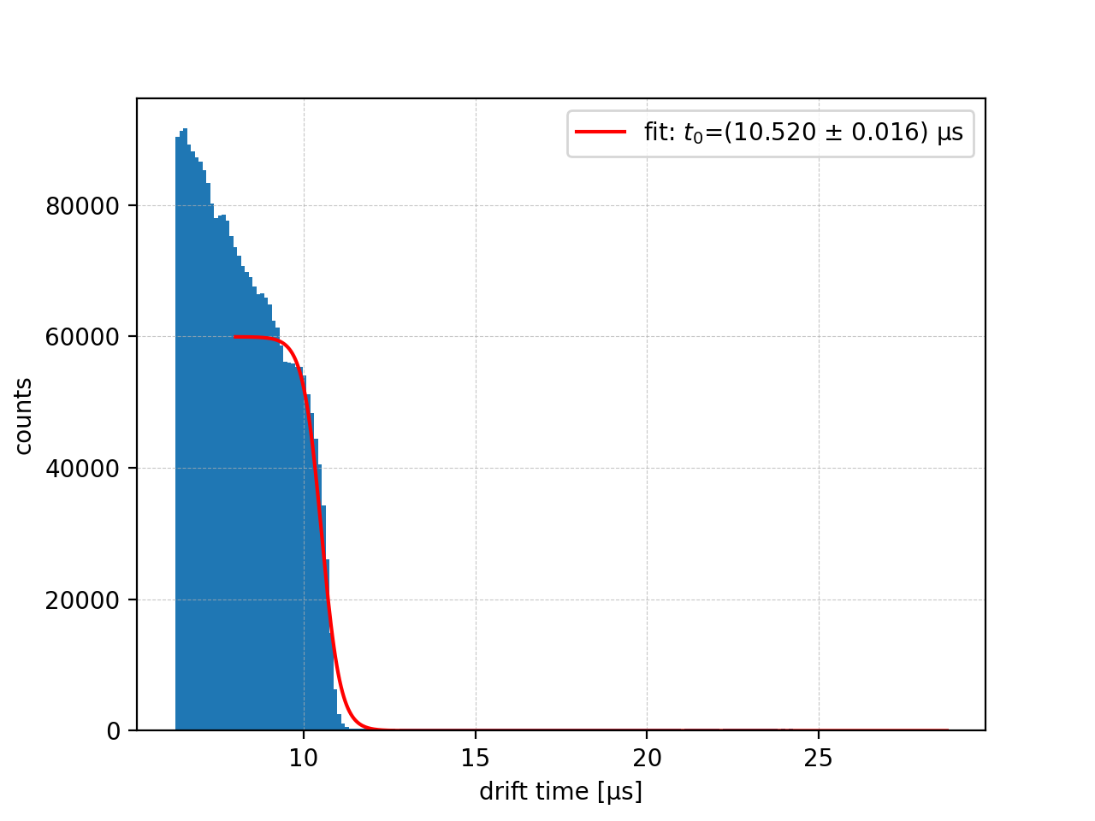

Results
Neutron Detectors
Drift velocity from cosmic ray
Fit S-curve to find maximum drift time
Start fit at t> 8 µs to exclude distorted regions
Reasons:
Electron attachment (<1000 ppm Water present)
Trigger inefficiencies for larger track
‹#›
Notes:
‹#›

Slide 9
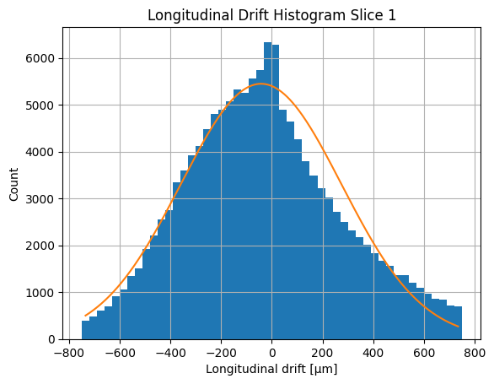
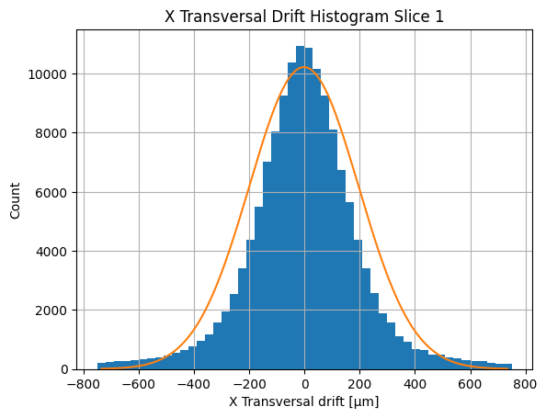
Results
Neutron Detectors
Diffusion constants with cosmic ray dataset
Difference between drift time and time of arrival from the trigger
Pixel hit distance from the central cosmic ray track that is found by a track finding algorithm
‹#›
Notes:
‹#›

Slide 10
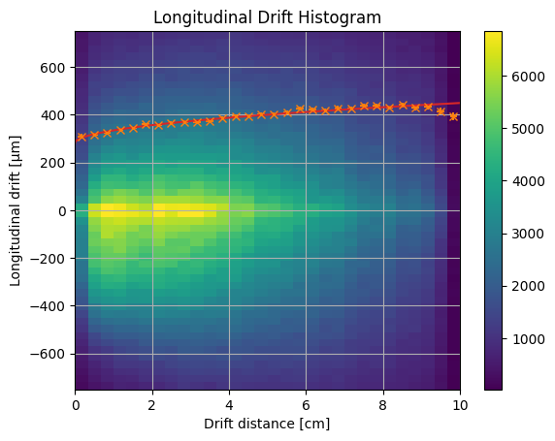

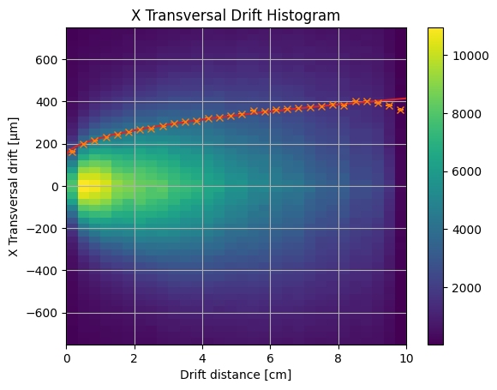


Results
Neutron Detectors
Diffusion constants
Charge distribution centered around 0
Orange points: spread of the gaussian of the corresponding slice (1D fit)
Readout pixel pitch 55 micron
‹#›
Notes:
‹#›

Slide 11
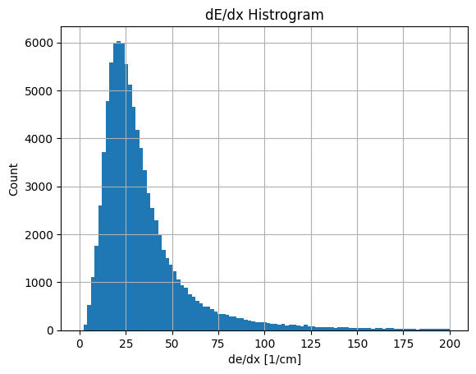
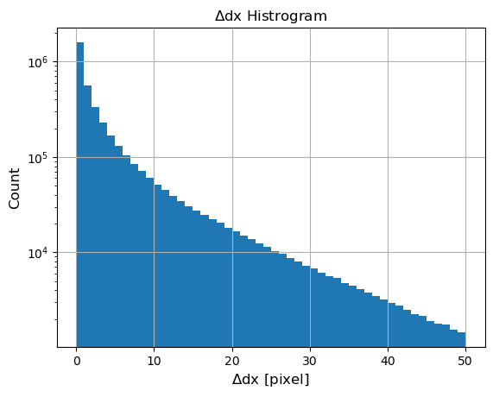
Results
Neutron Detectors
Pixel hits distances with respect to the central track
Energy resolution
Energy deposition has Landau distribution and not Polya as the amplification fluctuation is taken out by being able to count the primary ionised electrons from the track
Another way of viewing the spread of pixel hits from the central track
Closer to the track has most of the pixel hits
‹#›
Notes:
‹#›

Slide 12
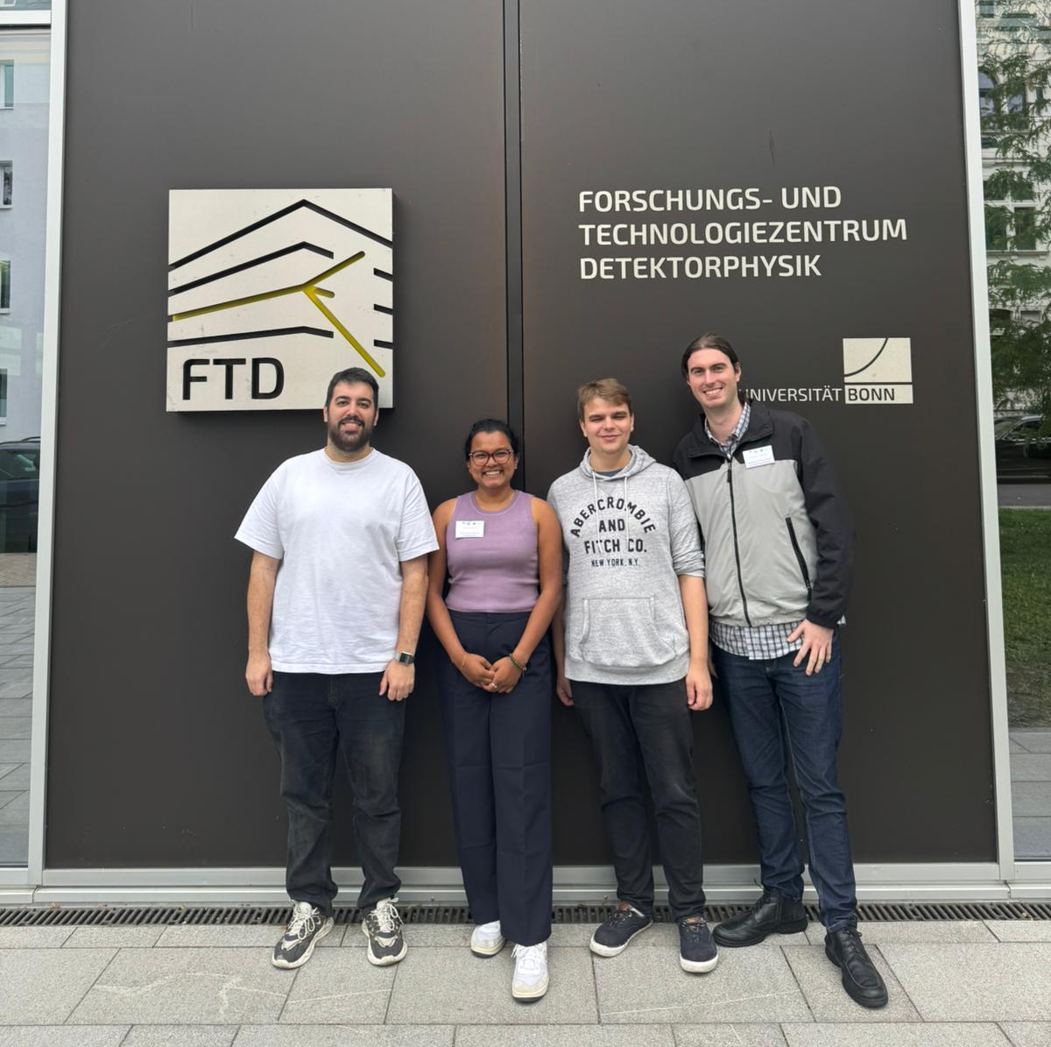
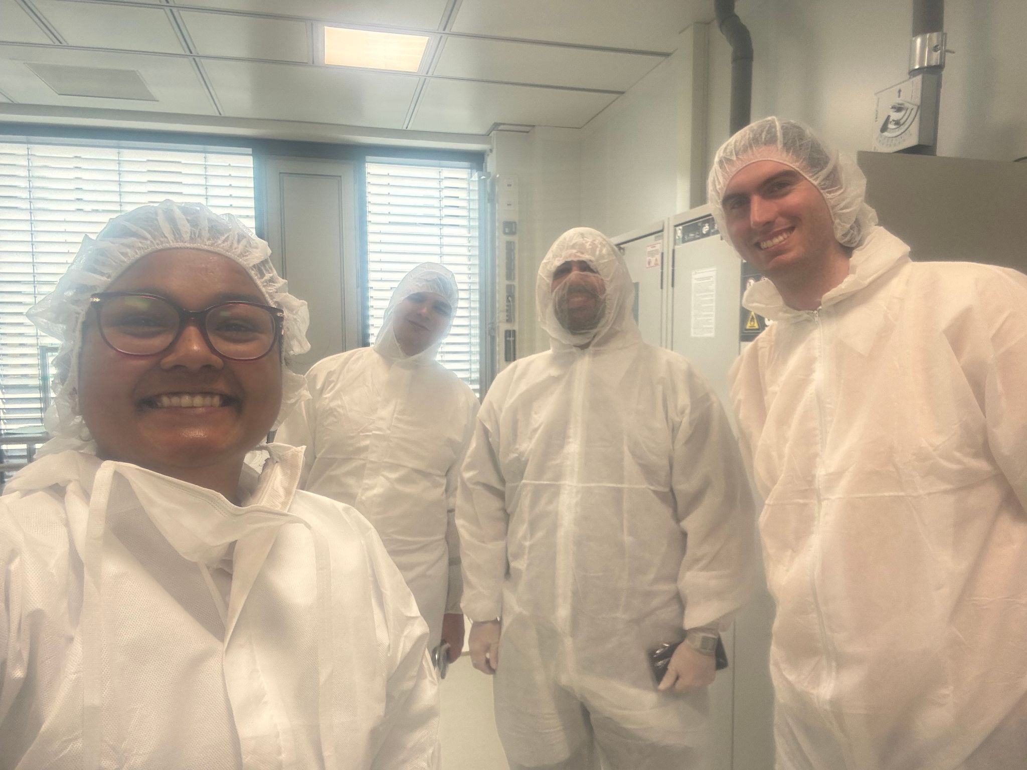
Neutron Detectors
Thank you
Big shout out to the organisers for this exciting and insightful experience
‹#›
Notes:
‹#›

