Slide 1
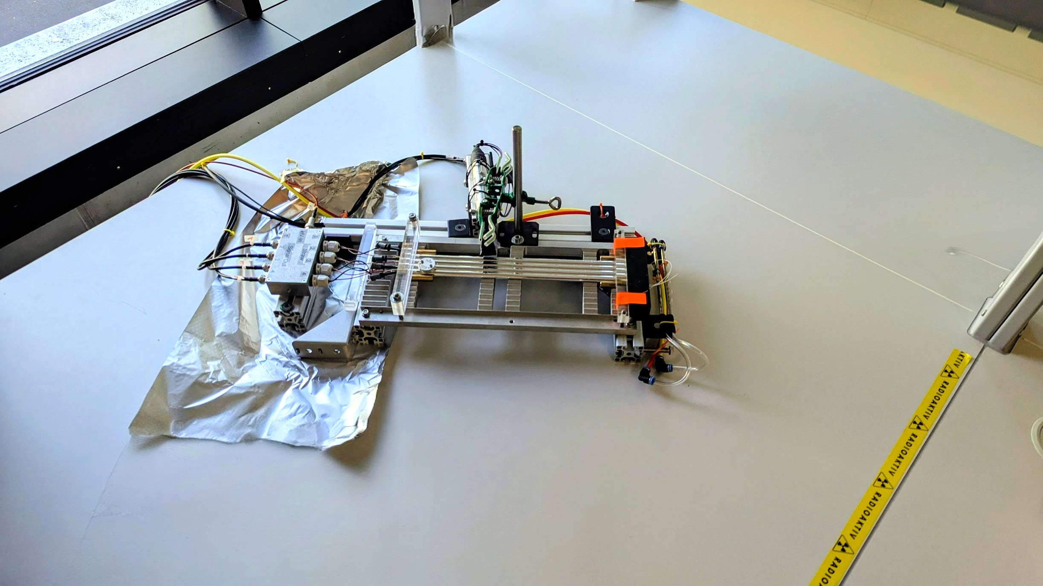
LAB 6: Straw Tube Characterization and Drift Tube Characterization
Kacper Chmiel, Roma Tre
Annabelle Cyster, UoY
Linda Eliasson, KTH
Saba Imtiaz, INAF
Daniel Klee, RWTH
Notes:
give a 5-10min report

Slide 2
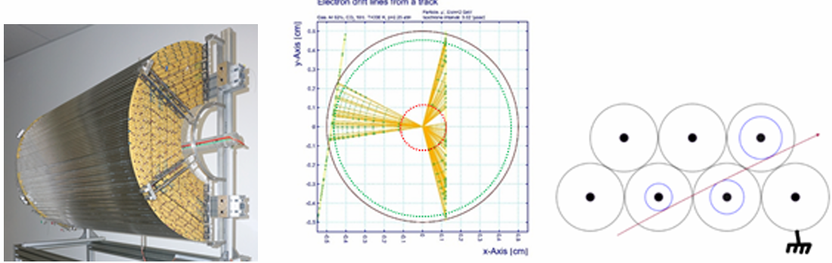
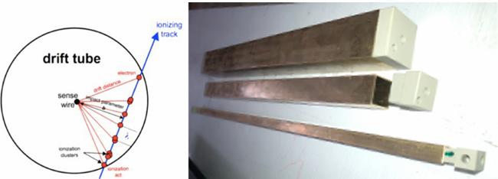
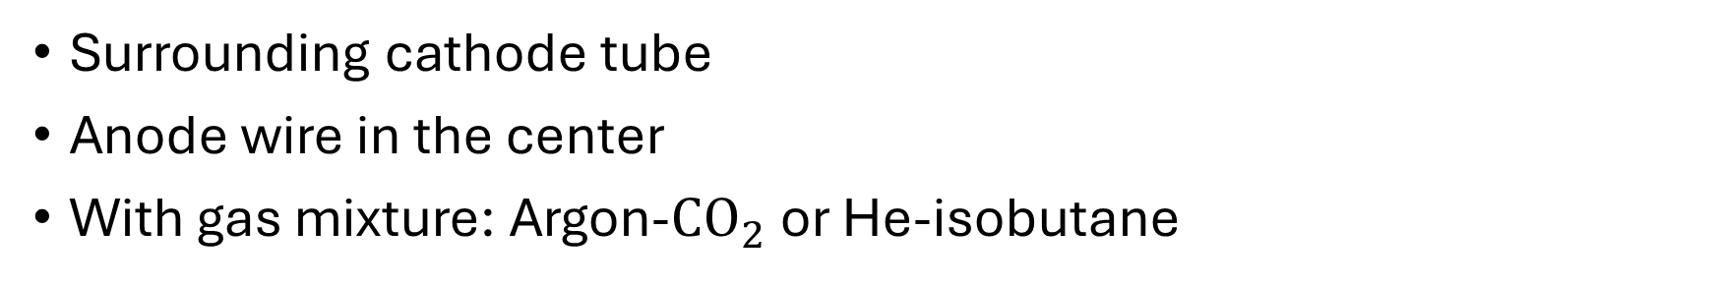
Introduction
Surrounding cathode tube
Anode wire in the center
With gas mixture: Argon-${CO}_{2}$ or He-isobutane
Straw Tubes:
Used for tracking
Drift Tubes:
Used for tracking
[Lab book]

Slide 3
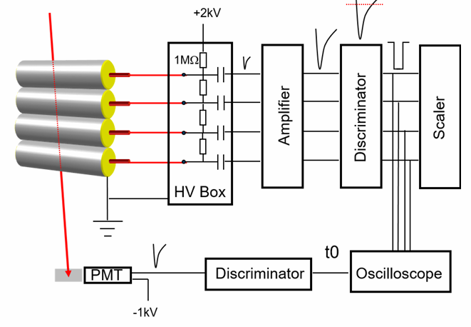
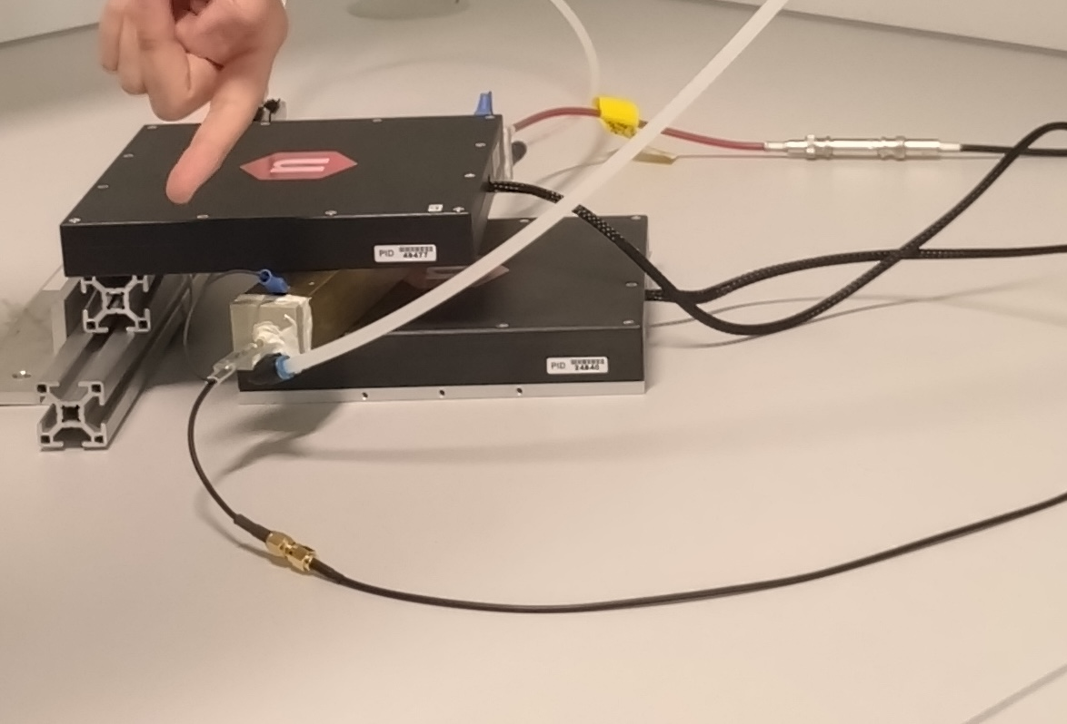
What we did
Straw Tubes:
Inspect single straw
Investigate straw signal
Optical inspection
Drift Tubes:
Characterization of drift tubes
Gain measurement
[Lab book]
Notes:
introduce the lab activity, show what you did during the lab exercise

Slide 4
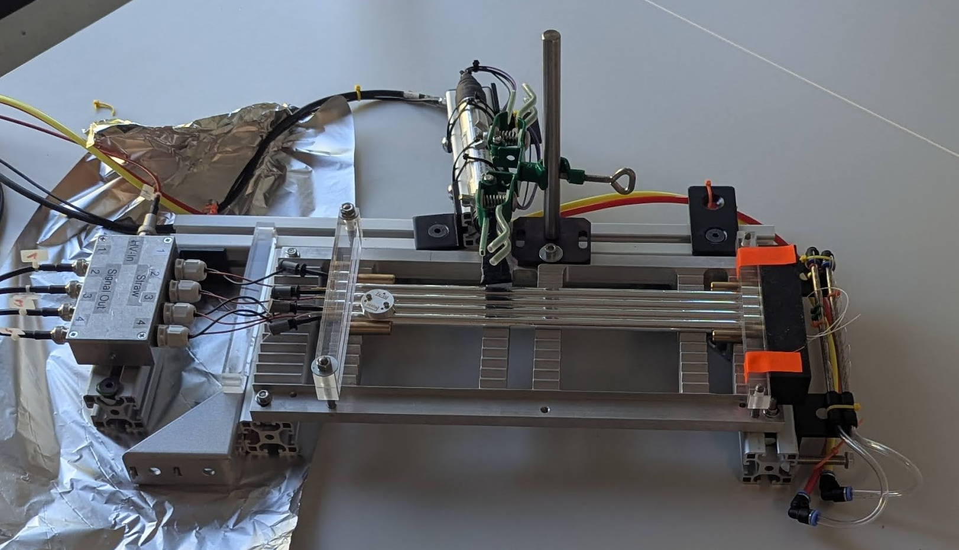
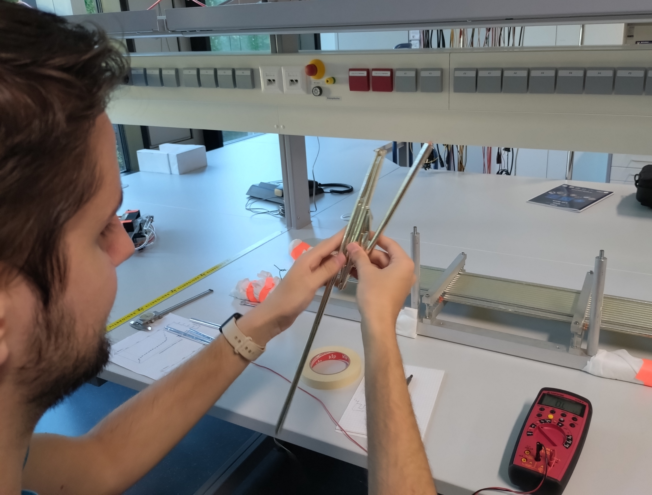
Straw Tubes
Counting events between 2050V and 2290V
Measure the resistance of the tubes after bending them
HV Box
Fe-55 Source
Straws
Notes:
Bending them to see how durable they are, resistance didn’t change because the wire didn’t break

Slide 5
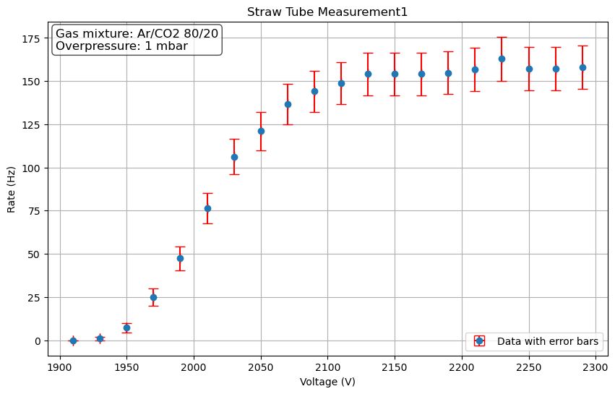
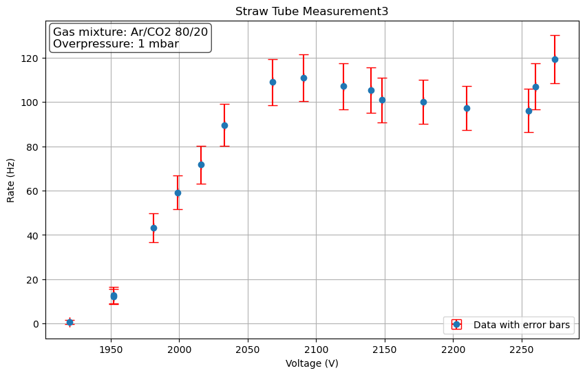
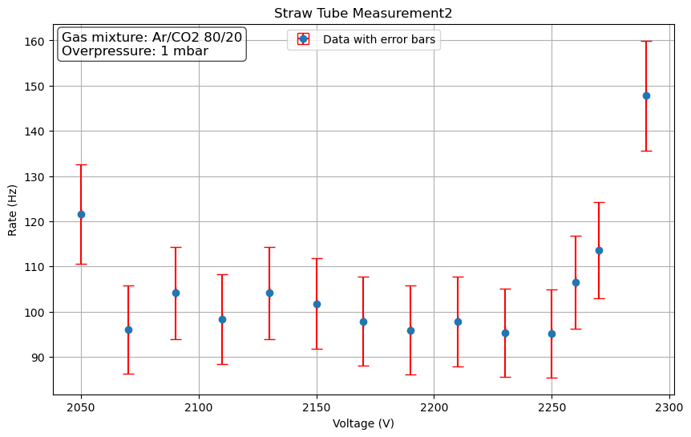
Straw Tubes - Results
Plateau region
UV release

Slide 6
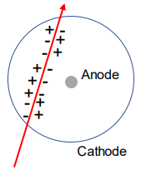
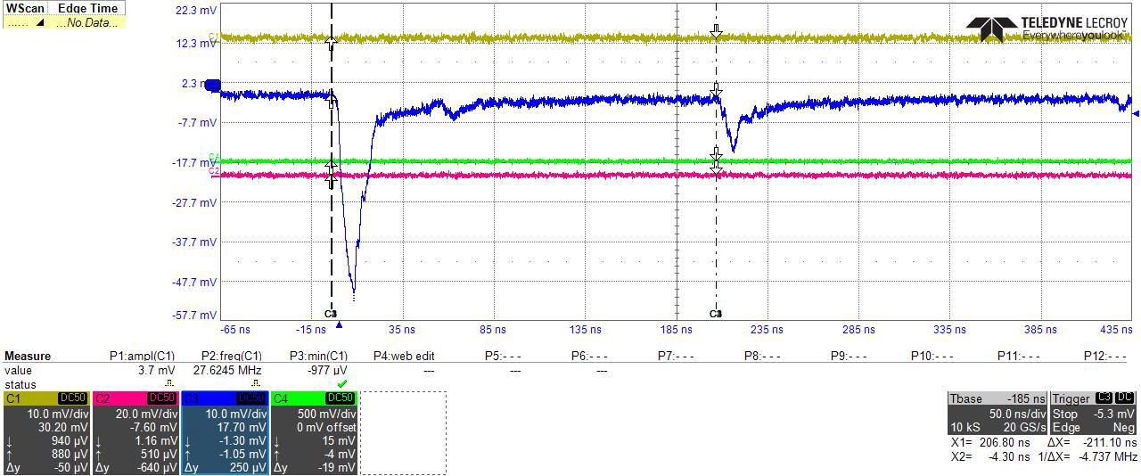
Straw Tubes - Results
The UV release is also visible in the signal on the oscilloscope
Pulse from UV emission offset by constant distance
Photoeffect at cathode => same drift time
Maximum drift time
UV Photon
Notes:
UV photons are only released close to the wire, since there the electrons are accelerated the most

Slide 7
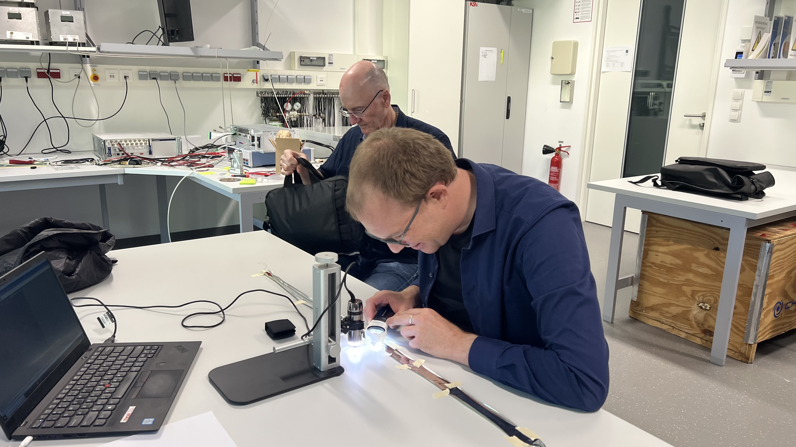
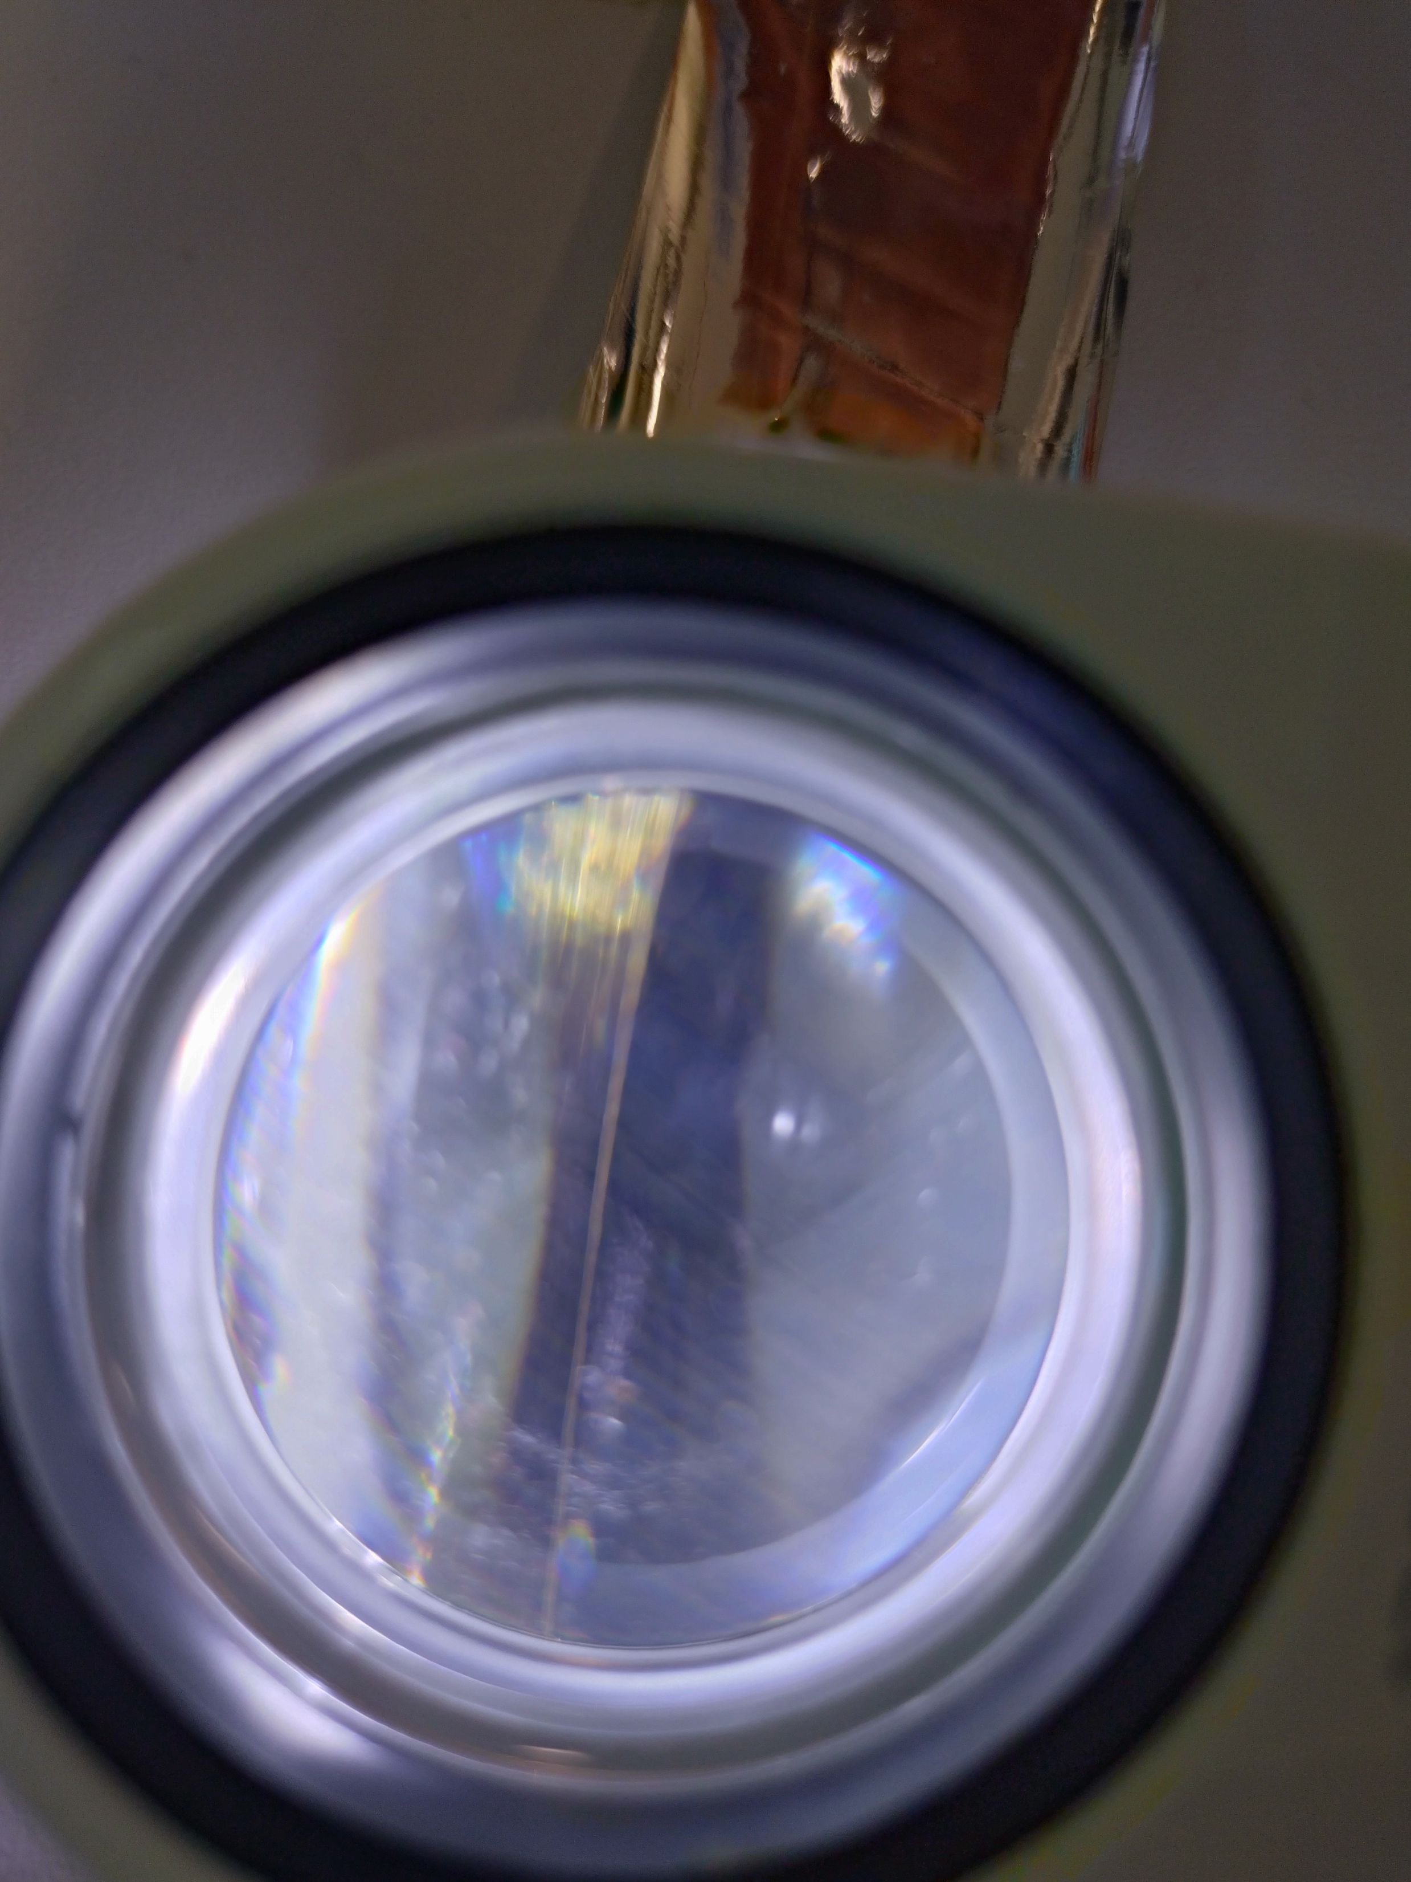
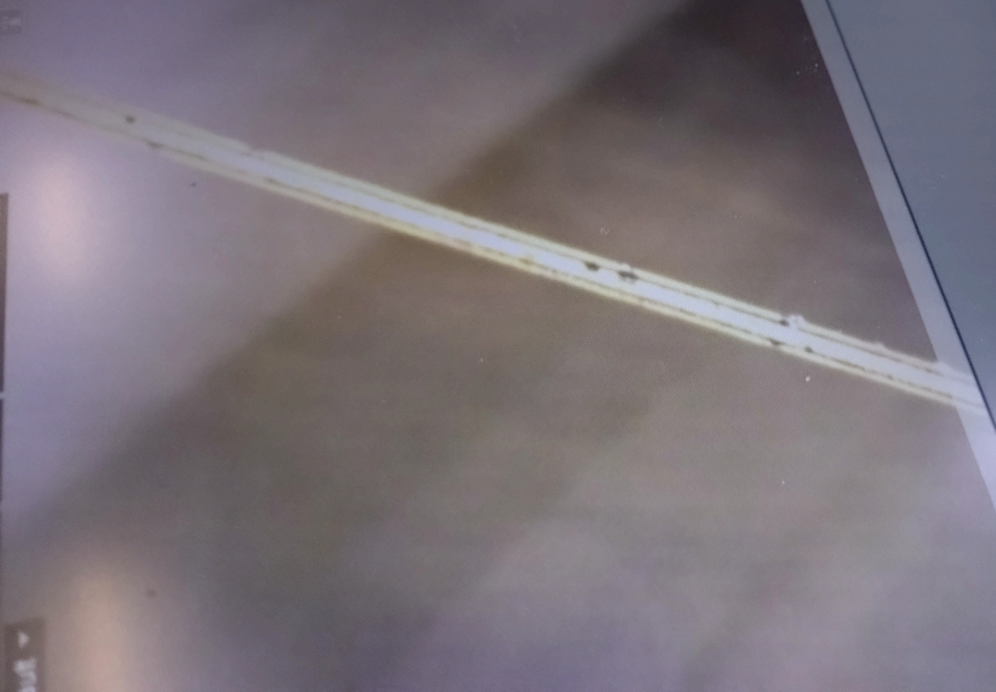
Straw Tubes
Optical inspection
Spots on the ⌀ ~ 20µm wire
Notes:
Optical inspection was done by professionals ;)

Slide 8
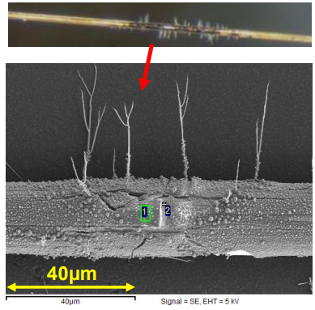
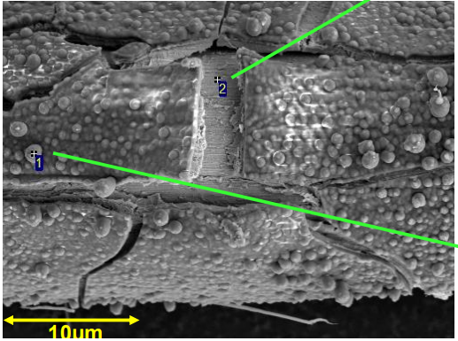
Straw Tubes - Results
Explanation of spots: Ageing effects
Delamination of gold plating
Silicate deposits

Slide 9
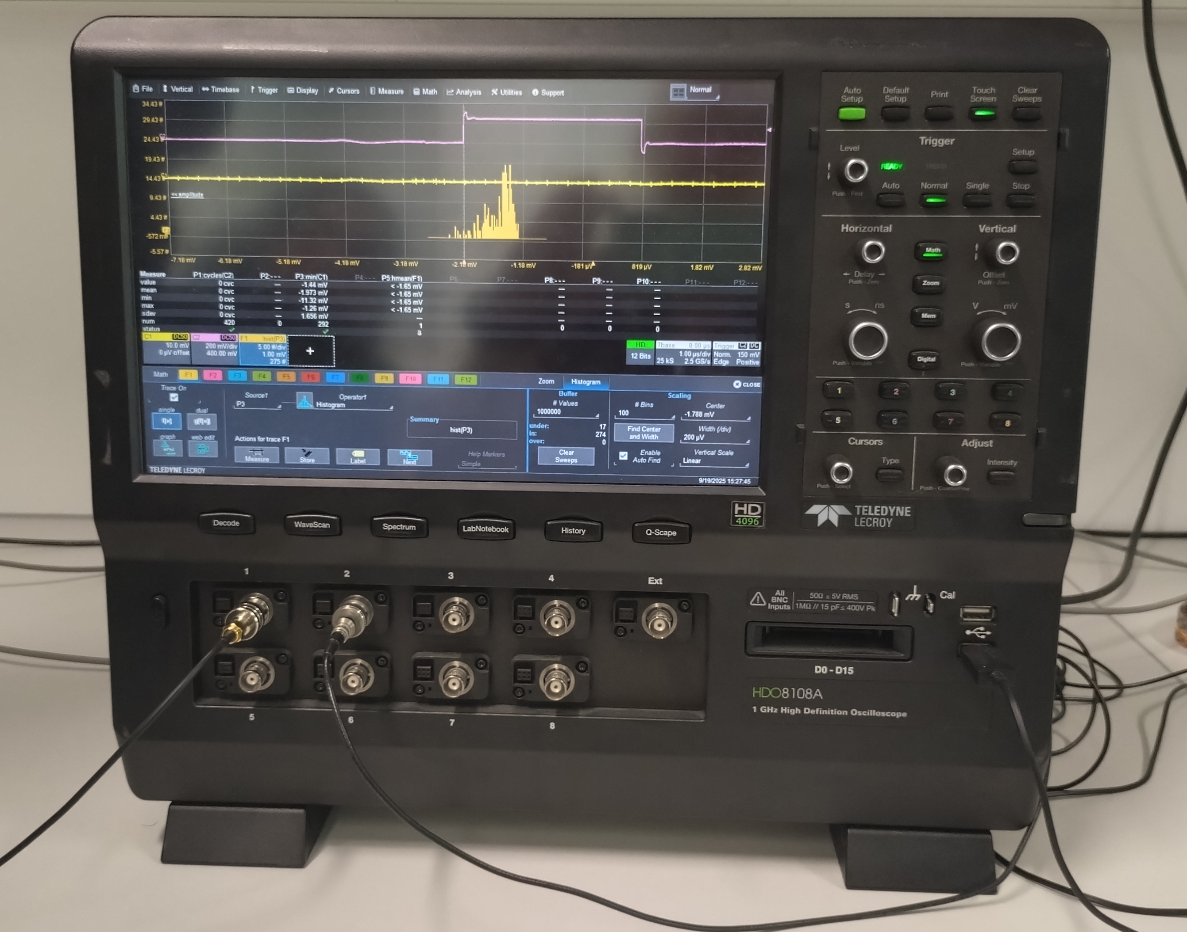
Drift tubes
Objective of the lab
Learn basic principle of drift tubes
Use the oscilloscope to study drift tube signal.
Observe parameters such as amplitude , noise
Find optimal HV from the tube efficiency
Measure gas gain at optimal HV.

Slide 10
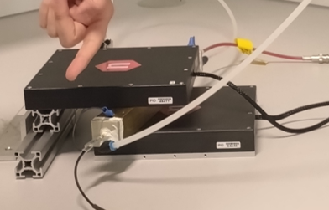
Drift tubes – Experimental setup
Drift tube "1a":
30 cm long, squared brass tube with 3x3 cm2 external cross section
Gas: He-Isobutane (90%-10%) at atm pressure
Anode: Gold plated Tungsten wire
Two plastic scintillators coupled to SiPMs + controller
for coincidence from scintillators and trigger for oscilloscope
Power supply
Provide positive voltage
Oscilloscope
Scintillator
Drift tube
Scintillator

Slide 11
Drift tubes – What we did
Set threshold to discriminate noise
Should be ≥ 3× RMS
Based on measurements of RMS: set to 3 mV
Found optimal HV
Measured efficiency = (tube counts)/(scintillator coincidence counts) for different HV
Use HV with "good" efficiency (well within proportinal regime, but not near streamer regime)
Used this HV to measure gas gain
Acquire signal amplitude spectrum and deduce average signal amplitude
Calculate average charge using average signal and effective capacitance of the tube at working point HV.
Calculate gain by using pre-known average number of electrons/clusters in the gas mixture

Slide 12
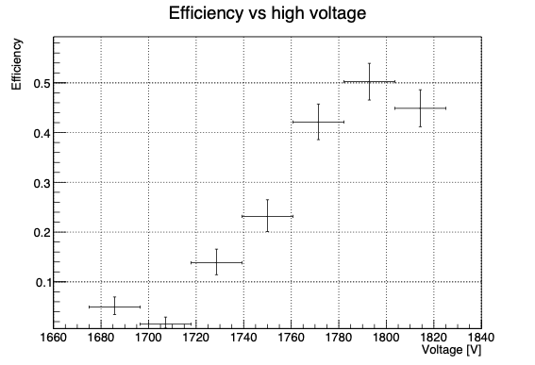
Drift tube - Results
Highest efficiency at 1790 - 1815 V.
Chose 1750 to ensure that we are in the proportional region
Next step determine the gain:
Average amplitude of the signal was recorded by oscilloscope.

Slide 13
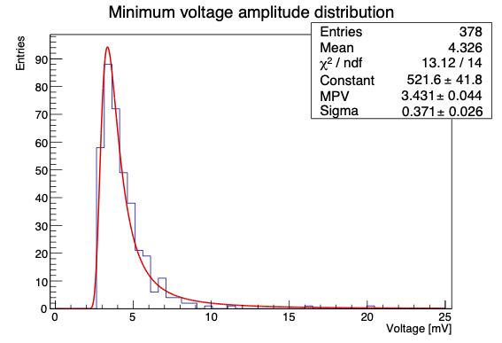
Drift tube - Results
Next step determine the gain:
Average amplitude of the signal was recorded by oscilloscope.
Average from fitting a Landau* to the spectrum: 4.326 mV -> Gain 95 600
Uncertainty
Due to statistics: ~2%
Others due to i.e. geometry, impedance estimate of the tube etc. to be added
*Landau distribution with a max limit

Slide 14
Drift tube - Results
Is 10^5 a "good gain"?
Preferably a bit higher
Optimal HV higher than 1.75 kV?
Not necessarily – risk for streamer discharge

Slide 15
Thank you for listening! Questions?
Notes:
give a 5-10min report

Slide 16




Backup slide: Drift tube – gain calculation
Number of electrons/ cluster in the gas mixture
Average signal amplitude
Effective capacitance
Effective half side size of the squared tube
Radius anode wire
Reflection coefficient
Impedance tube
Tube length
Measured average signal amplitude
Impedance oscilloscope

Slide 17
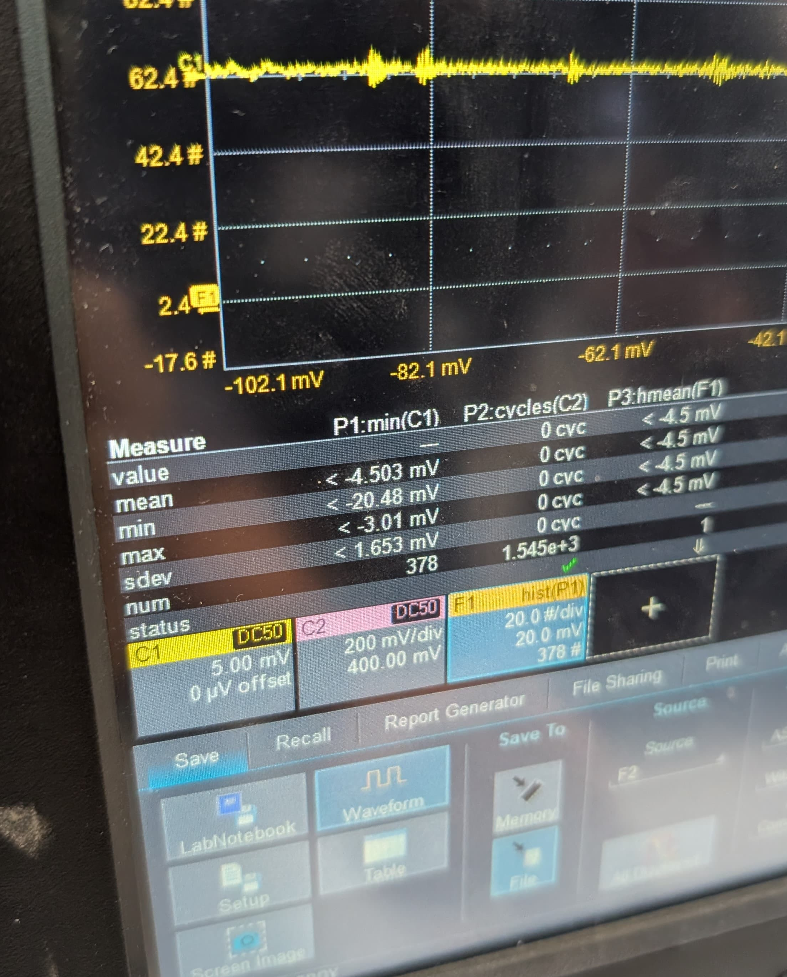
Backup slide: Drift tube – oscilloscope reading
"Underflow condition" - lowest part of wf below ADC range -> cutoff of pulse

