Slide 1
Working Group 7: Common test facilities
Test beam update and plans for
the μRGroove detector
On behalf of USTC MPGD Group
6th DRD1 collaboration meeting, 09/10/2025

Slide 2
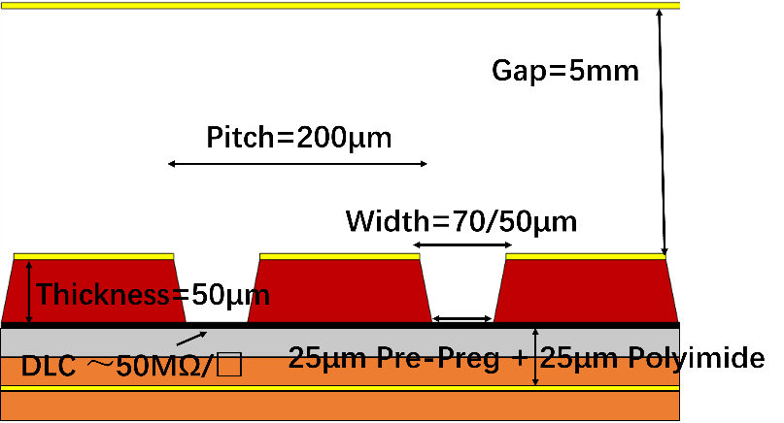
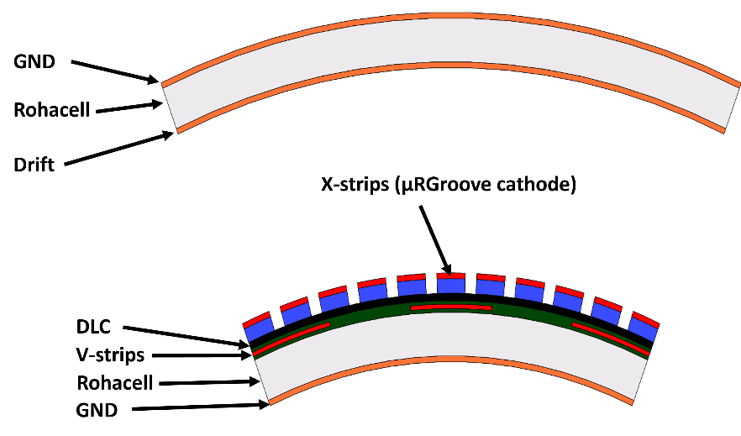
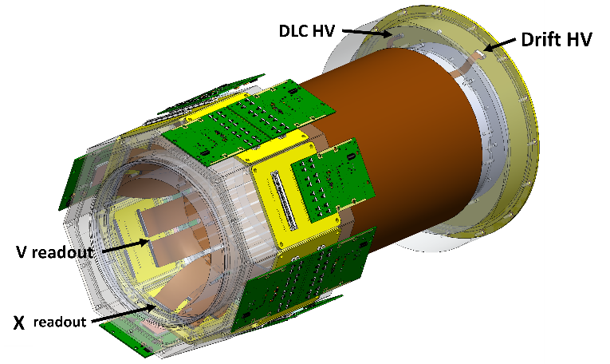
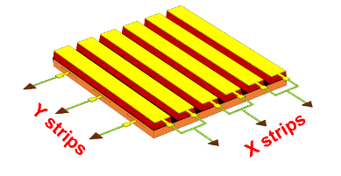
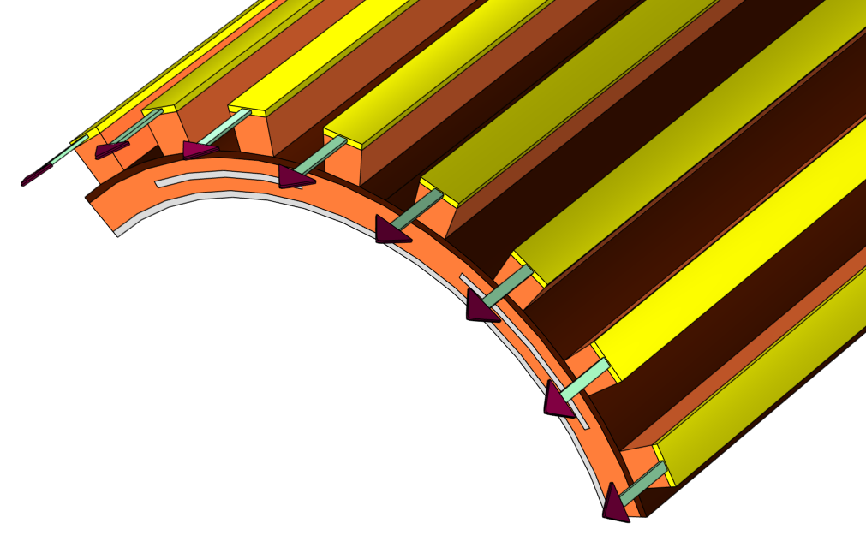
Micro-Resistive Groove detector
Planar μRGroove
cylindrical μRGroove
Completed the design, fabrication, and preliminary beam test of planar μRGrooves with dimensions of 10cm×10cm, 50cm×50cm, and 100cm×50cm.
Completed the design, fabrication, and beam test (including beam test in a magnetic field) of the cylindrical μRGroove prototype.
In November this year, detailed tests will be conducted on various planar μRGrooves, covering new structures and new setups.
Siqi, 5th DRD1 : Preliminary results of 50cmX50cm μRGroove
Siqi, Development of μRGroove detector
Qixuan, 6th DRD1 Performance of c-uRGroove in magnetic field

Slide 3
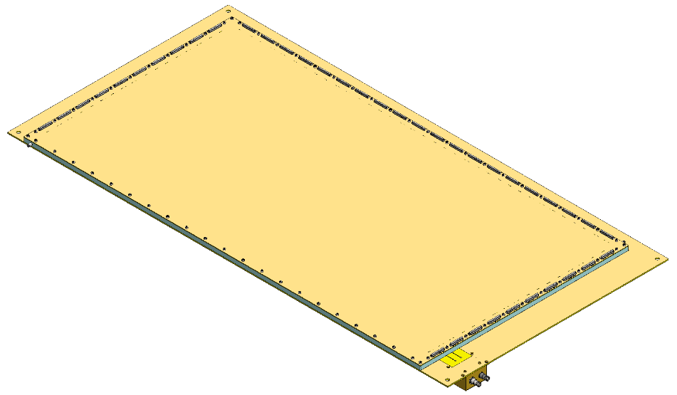
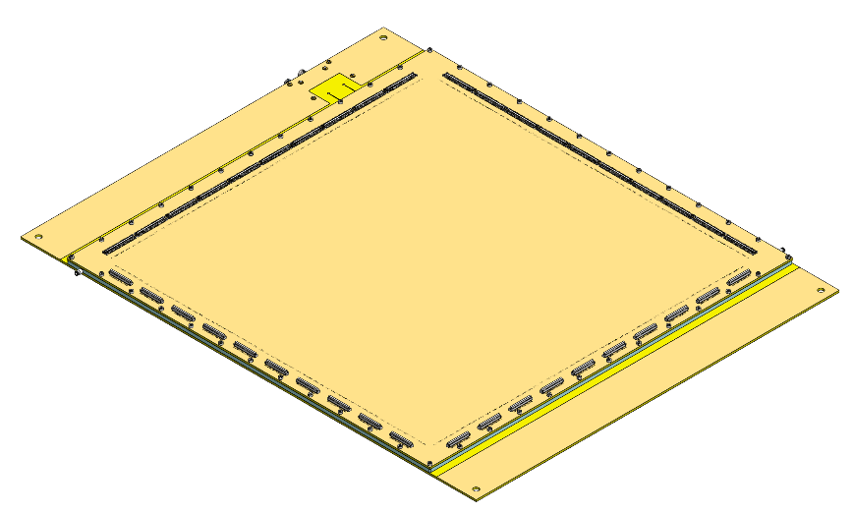
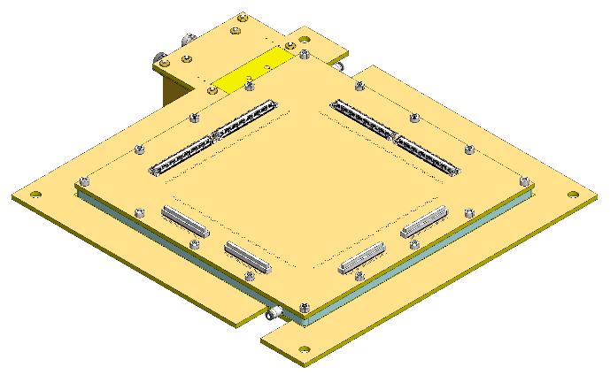
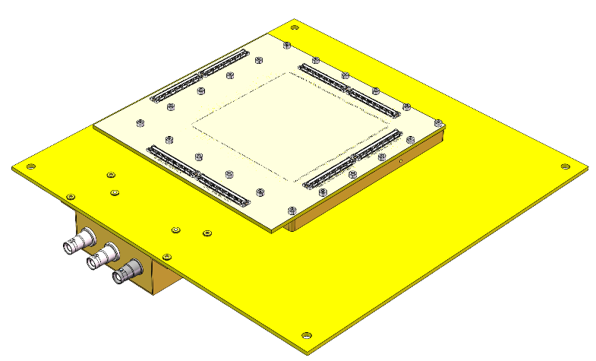
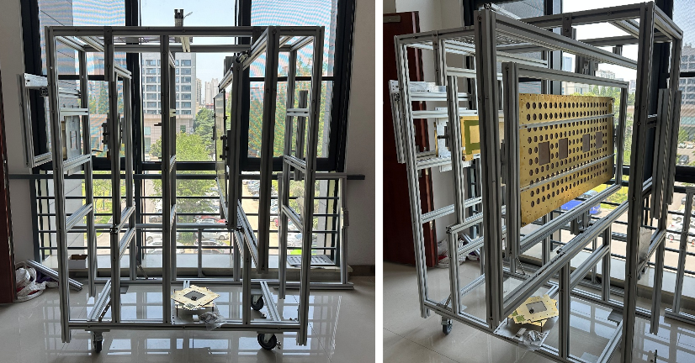
The μRGroove detector for testing
4 mechanical frames, including 5 different μRGroove detectors：
Test1：100cm ×50cm μRGroove
Test2：50cm ×50cm μRGroove
Test3：10cm ×10cm μRGroove、10cm × 10cm small pitch μRGroove
Test4：10cm × 10cm 75μm-APICAL μRGroove
Test1
Test2
Test3
Test4

Slide 4
Test content
Test1
Test2
Test1：100cm ×50cm μRGroove
Ar/CF₄/CO₂(45/40/15):
High-count-rate pion test
μTPC test with tilt angle
Test2：50cm ×50cm μRGroove
Ar/CF₄/CO₂(45/40/15): CC&μTPC
Ar/iso-C₄H₁₀(90/10):
High drift electric field (5kV/cm) for smaller Lorentz angle.
Tilt at a small angle (5-6°) to simulate the Lorentz angle under 1Tesla, and verify the resolution of the CC or new algorithm

Slide 5
Test content
Test3
Test4
Test3：10cm ×10cm μRGroove Tracker
Ar/CF₄/CO₂(45/40/15): CC&μTPC
Test3：10cm ×10cm small pitch μRGroove
Ar/CF₄/CO₂(45/40/15): CC&μTPC
Test4：10cm ×10cm 75μm-APICAL μRGroove
Ar/CF₄/CO₂(45/40/15): CC&μTPC

Slide 6
Summary
Test different planar μRGrooves with different sizes and structures.
Two gases are required: Ar/CF₄/CO₂ (45/40/15) and Ar/iso-C₄H₁₀ (90/10). The latter is a flammable gas, and a matching iron box has been fabricated
Prioritize the testing of large-area detectors, especially under high-count-rate and high drift field.
For the μTPC, the test angles can be adjusted according to beam time, and it is sufficient to cover the range of 0-30°.
Thanks

