Slide 1
Steve Biagi’s Contributions to Modeling
Low Temperature Plasmas (LTPs)
Leanne Pitchford
LAPLACE, Univ. Toulouse III and CNRS, emeritus
pitchford@laplace.univ-tlse.fr
Steve Biagi Memorial session, October 2025, DRD1 collaboration meeting, Warsaw

Slide 2
Outline
1) Low-temperature plasmas
2) Data needs for modeling LTPs
3) The LXCat platform
The take-aways I would like you to have from this talk :
1) The LTP community has benefited tremendously from access to Steve Biagi’s compilations of electron/neutral scattering cross sections. These are the best data of their kind available today.
2) Some, but not all, of Steve’s data are available on LXCat. I hope we can work together to get more of his data on LXCat.

Slide 3
Low Temperature Plasmas (LTPs)
The properties of plasmas are so remarkable (electrical conductivity, light emission, self-organization, extraordinary chemical activity..) that "plasma" is considered the 4th state of matter.
Most of the visible universe is in the plasma state. However, most of the plasmas on earth are LTPs, created by man for technical purposes.
In contrast to "fusion" plasmas, charged particles in LTPs interact with the neutral background gas and surfaces, as well as with each other.
This talk will focus on collisional, non-thermal LTPs, where « T_{electron} » >> T_{ion} ≈T_{g} , with « T_{electron} » ~ 1 to 10 eV, and where the degree of ionization is << 10⁻³.
Much (but not all!) of the fundamental physics in LTPs is well established and much of the research in LTPs is now concerned with the comprehension, development, and optimization of specific plasma configurations for technical applications.

Slide 4
Technologies based on LTPs – a few examples
Electrical energy
PLASMA
Radiant energy
Source of photons
Chemical energy
Source of reactive species
Lamps
Lighting
UV sources for sterlization
Visualisation
Plasma display panels
Lasers
Surface processing
Microelectronics
Functionalization of surfaces
Volume processes
Chemical conversion
Kinetic energy
Source of charged particles
Ion sources
Satellte propulsion
Ion sources for ITER
Elemental analysis of solids
Electron beams
X-ray sources
Switches, current interrupters
Flow control

Slide 5

Generation of LTPs
LTPs can be generated most simply by applying a voltage (> V_{b}) beween two electrodes, separated by a gas gap.
cathode
anode
V
Neutral gas, N

Slide 6
Models of LTPs
INPUT: gas composition and pressure; geometry; circuit; …..
Model
OUTPUT: E, n_{e}, n_{ions}, T_{g}, species densities,.. as functions of r and t

Slide 7

A closer look……
electron
electron
cathode
anode
V
Neutral gas, N

Slide 8
Electrons (very small mass) are easier to accelerate by electric fields than are ions.
What happens when an energetic electron collides with an N₂ molecule?
elastic collisions : e + N₂=> e + N₂ excitation : e + N₂ => e + N₂* ionization : e + N₂ => e + e + N₂⁺
The probability for a collision to happen depends on the electron energy. That is, cross sections depend on electron energy.
electron
molecules

Slide 9
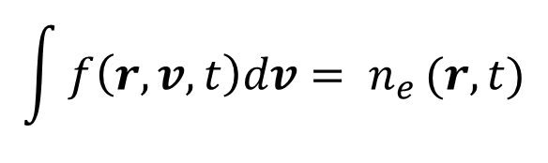
Boltzmann equation for electrons
f (r,v,t) = electron velocity distribution function
transport in r
collision operator
a = -eE/m
transport in v
$$\int{f\left(r,v,t\right)dv= n_{e}}(r,t)$$
where
- Electron transport & rate coefficients are integrals over f(r,v,t)
- E/N is an important parameter.
9

Slide 10
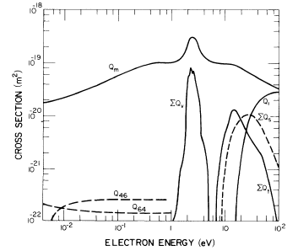
Example : electron collisions with nitrogen molecules

Slide 11
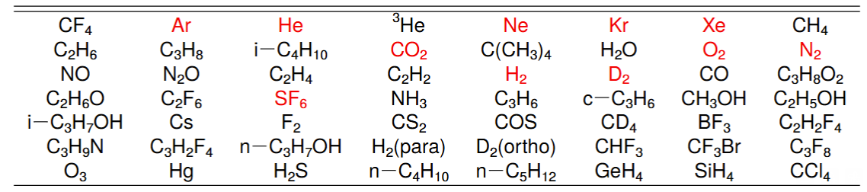
MAGBOLTZ – a Fortran code, written by Steve Biagi in 1999 and regularly updated
MAGBOLTZ solves the Boltzmann equation for electrons using a Monte Carlo technique with E,B fields at arbitrary angles.
MAGBOLTZ includes Biagi’s detailed compilations of electron-neutral scattering cross sections for 56 (!!) different atomic and molecular gases:
Such compilations require extensive knowledge of theory, existing measurements with error bars,...
The set of cross sections for each gas, when used in a Boltzmann solver, yields transport and rate coefficients consistent with measurements, which can be very accurate.
.
Thanks, Marnik!

Slide 12
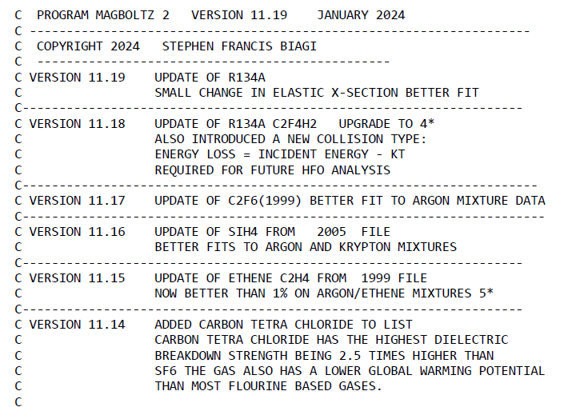
Most recent version
of MAGBOLTZ
Version 11.19: > 100 000 lines of Fortran code on 1443 pages
Cross sections for each of gas species are hardwired into MAGBOLTZ.

Slide 13
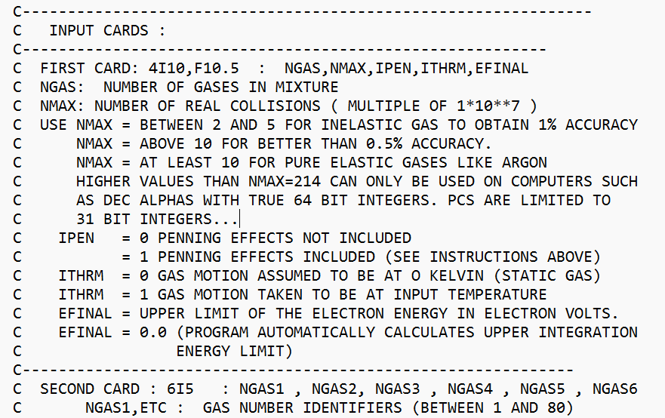
MAGBOLTZ input parameters

Slide 14
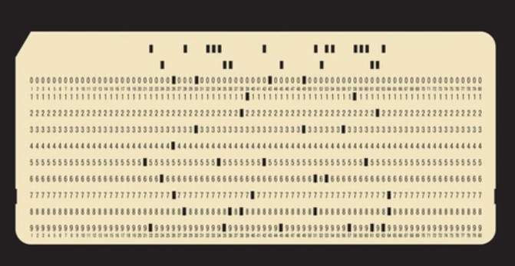
MAGBOLTZ input parameters
IBM 80-column, punched card

Slide 15
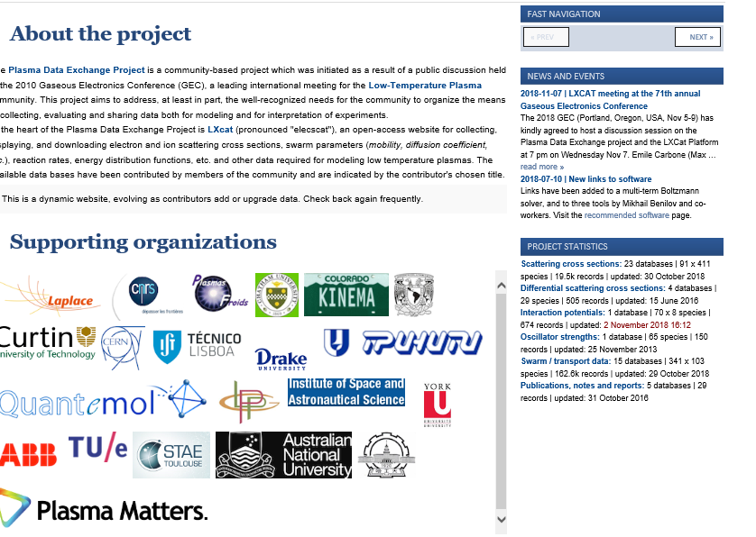
The LXCat platform (initiated at LAPLACE in 2009)
LXCat is a web-based, community-wide project for the curation of
data needed in modeling low-temperature plasmas
Electron + neutral
cross sections / oscillator strengths/ swarm parameters
LXCat
ELECtron (and ion) SCATtering
Ion + neutral
cross sections / interaction potentials / swarm parameters
Plasma-surface interactions
Plasma chemistry
Radiation

Slide 16
Availability of data before 2009
Most people working in the area of modeling LTPs had their own databases, suitable for use in their own codes.
Some on-line compilations of numerical data for electron/neutral scattering cross sections were available, but in different formats, different units, with more or less detail, and of variable accuracy.
People have been generally willing to share their data.
In 2010, the Gaseous Electronics Conference agreed to host a Plasma Data Exchange Project which was largely based on LXCat. In this context we organized 3 workshops at GEC 2011, 2012 and 2013.

Slide 17
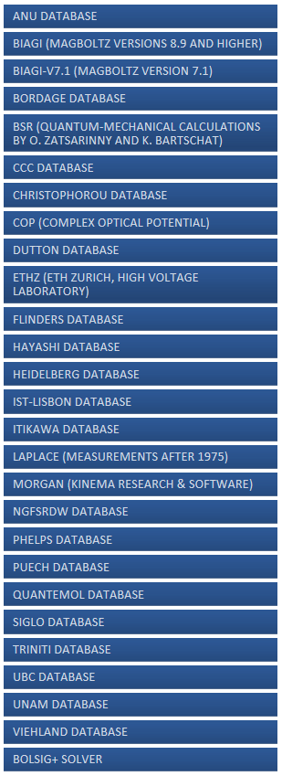
LXCat structure – on-line tools
www.lxcat.net
Contributors
Approximately 65 volunteers – both data contributors as well as the support teams - from 17 countries have contributed to this project.
Individual databases
On-line tools
Tech support
Users
LXCat review articles
S Pancheshnyi et al., Chem. Phys. 398 148 (2012)
LC Pitchford, et al., Plasma Processes and Polymers, 14 1600098 (2017)
E Carbone, et al., Atoms 9 (1), 16 (2021).

Slide 18
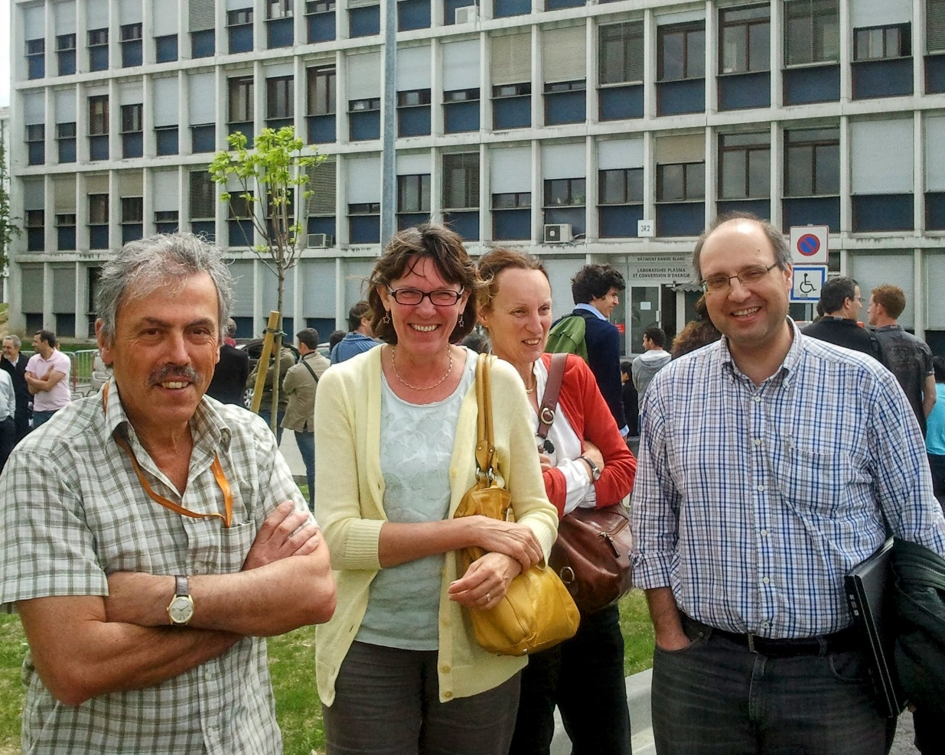
Steve Biagi, one of the first contributors to LXCat, and Luis Alves (IST-Lisbon database) visited Toulouse in 2011 to prepare for the workshop on LXCat at the upcoming Gaseous Electronics Conference. The focus of the workshop was comparisons of data for rare gases on different databases.
Steve Biagi (UK), Leanne Pitchford, Mairie-Claude Bordage, and Luis Alves

Slide 19
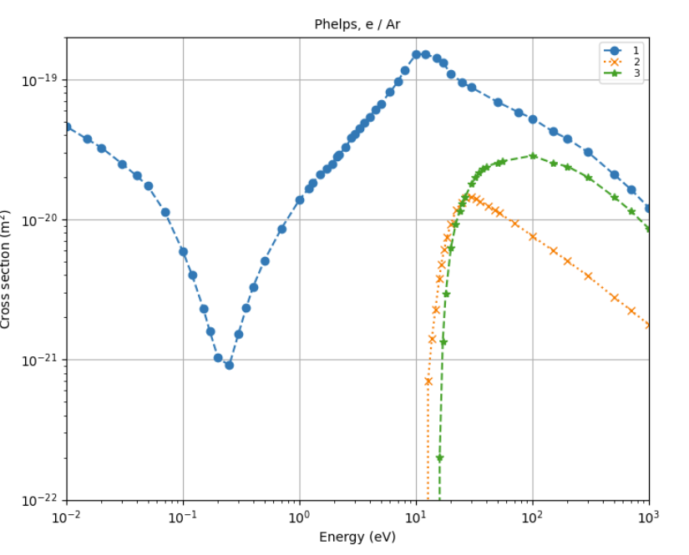
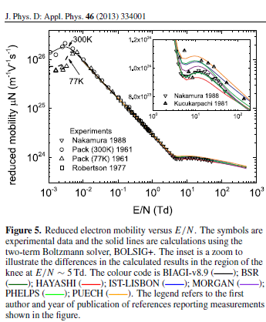
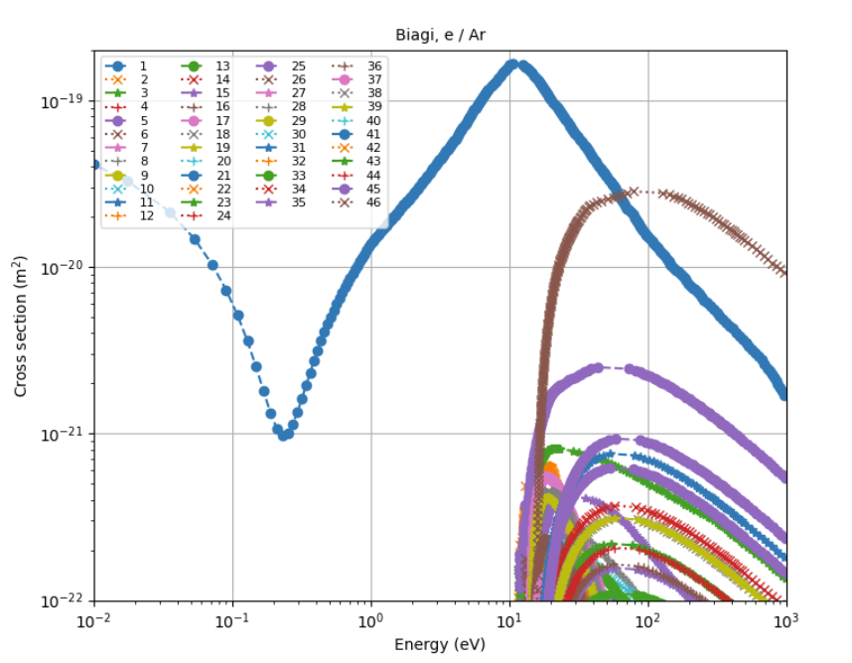
Datasets for e/Ar from two different databases
Comparisons of calculated reduced mobility in Argon
Phelps
1 excitation
levels
Biagi
44 excitation
levels
See similar comparisons for He, Ne, Kr, Xe, N₂, O₂, H₂, D₂, CO₂ available on the LXCat site.

Slide 20
What data are available on LXCat today?
for electrons
23 databases containing electron/neutral scattering cross sections*
1 database containing optical oscillator strengths for 65 species
5 databases containing differential scattering data
12 databases containing swarm/transport data
for ions
2 databases containing ion/neutral scattering cross sections
1 database with interaction potentials
3 databases containing swarm/transport data
* The Biagi data are the most downloaded.

Slide 21
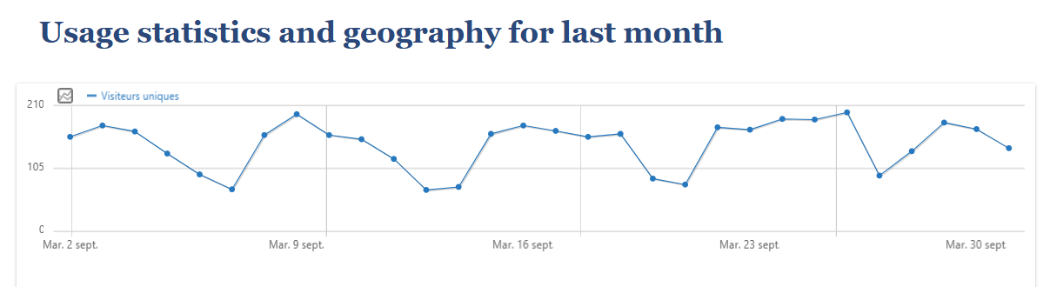
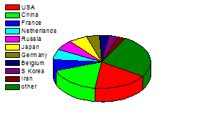
Some LXCat statistics
210
Unique visitors per day during September 2025
105
0
8 Sept 2025
15 Sept 2025
22 Sept 2025
29 Sept 2025
Geographical distribution of visitors to LXCat (2019)
The formal by-laws for the project are available on the LXCat site.
The non-profit organization, « Data for Modeling Plasmas » (DMP), was established in France in 2015.

Slide 22

Remembering Steve, a colleague and a friend, and his wife, Marie — together again, and fondly remembered.
Cinque Terre, Italy, 2015

