Slide 1
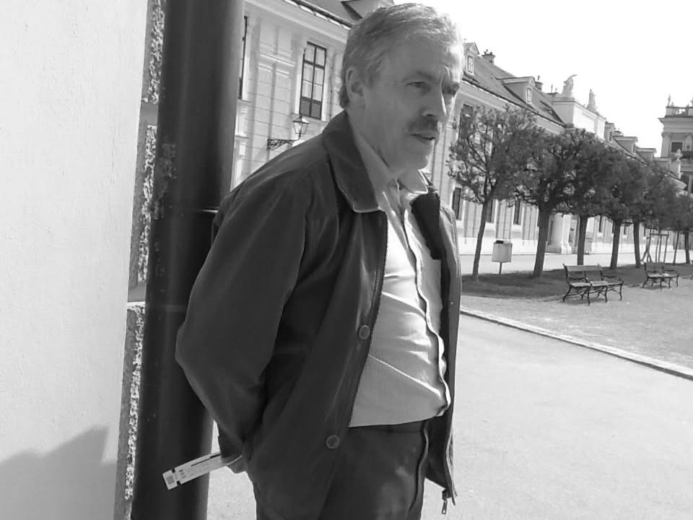
Stephen Francis Biagi
Renfrew
23.03.1949 - Glasgow 14.08.2025

Slide 2
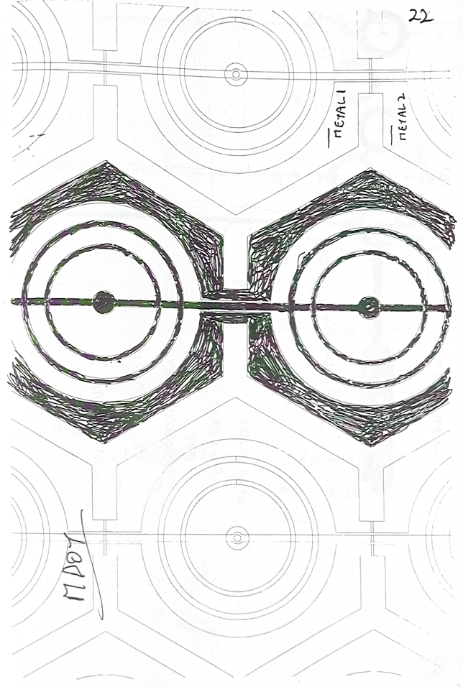
Stephen Francis Biagi
23.03.1949 - 14.08.2025

Slide 3
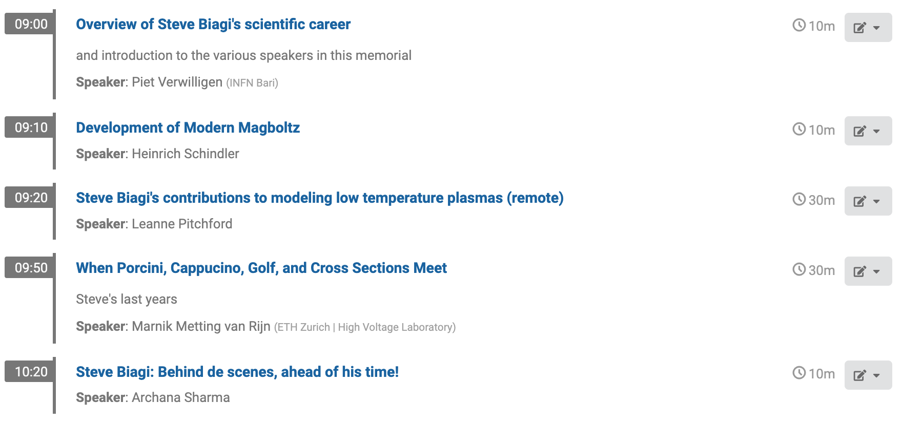
Steve Biagi’s Memorial session

Slide 4







Literature Analysis Steve’s Affiliations
Year of publications as indicator for periods in Steve’s professional life
1974
1976
1981
1986
2005
2017
2025
Rutherford Appleton Laboratory Didcot
University of London Queen Mary College
University Manchester
University of Liverpool
Uludag University Bursa
retired
retired
Reconstructed with the help of Mirella Biagi:
1970
1974
1979
1982
2005
2025
Rutherford Appleton Laboratory Didcot
CERN (Affiliated with QMC London)
University Manchester
University of Liverpool
Glasgow

Slide 5
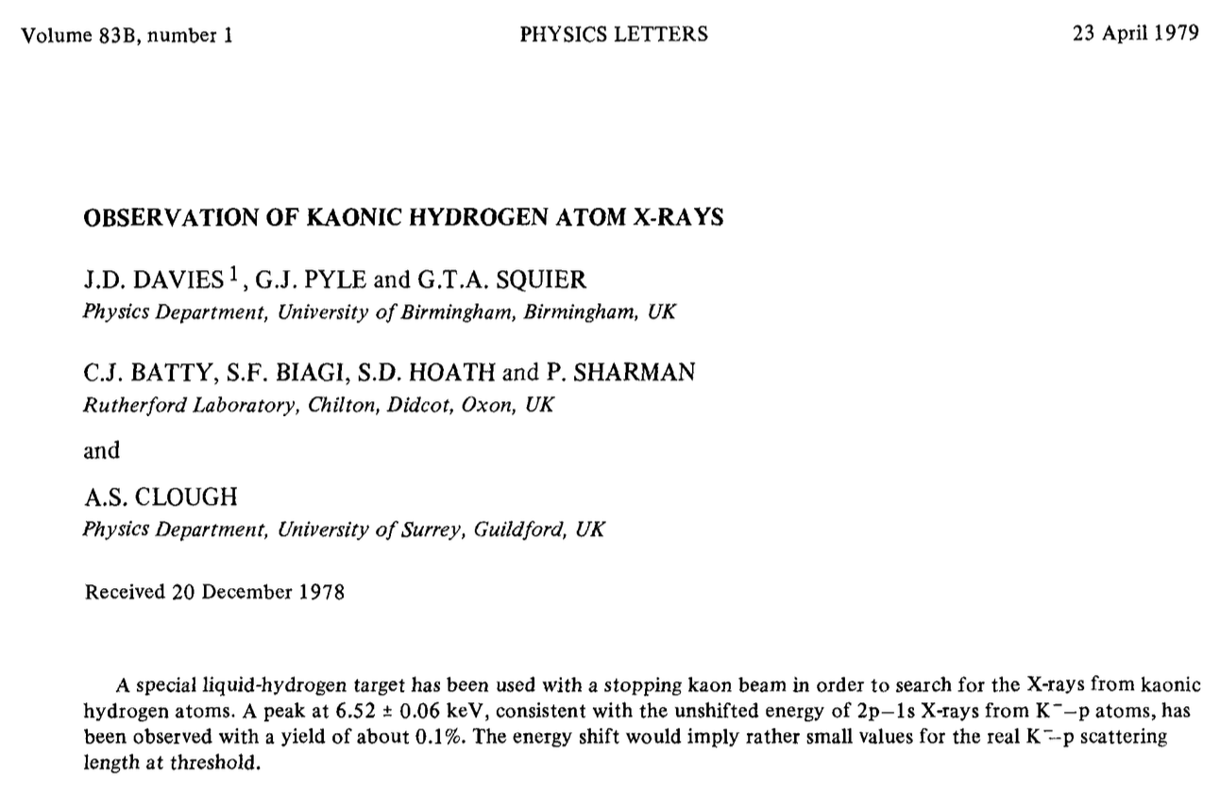
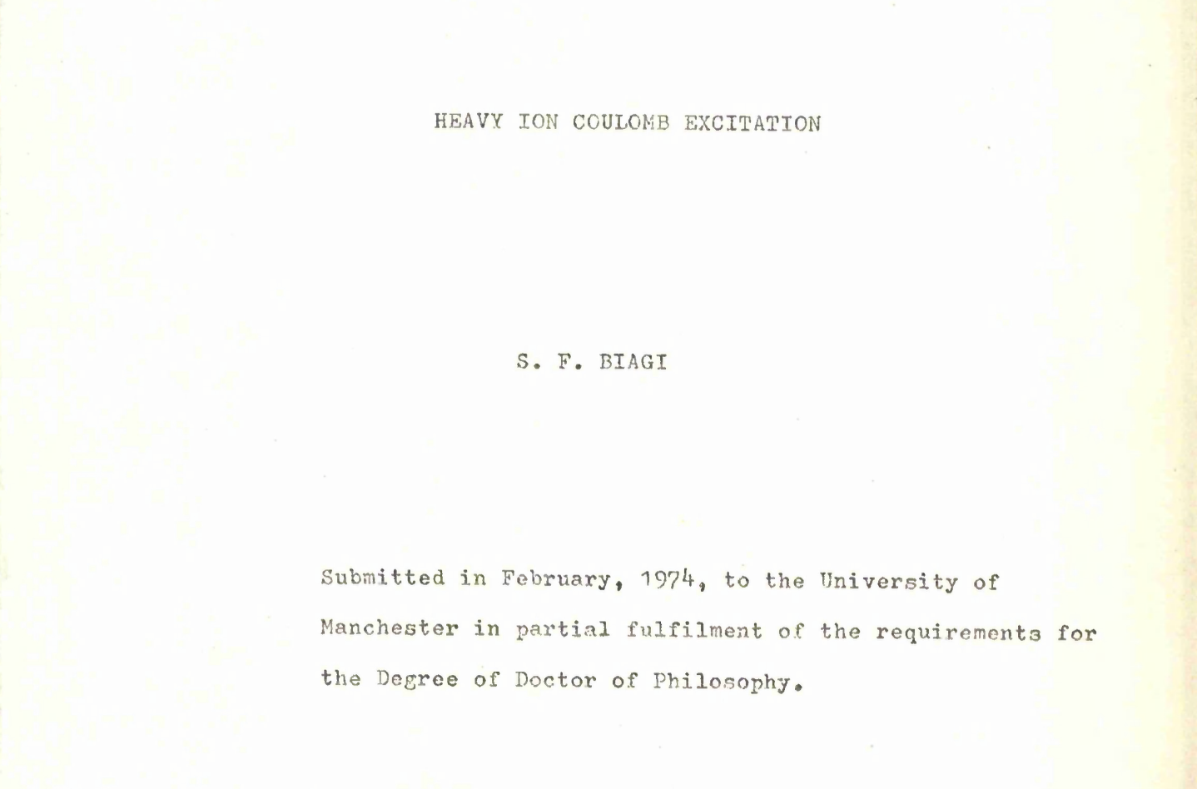
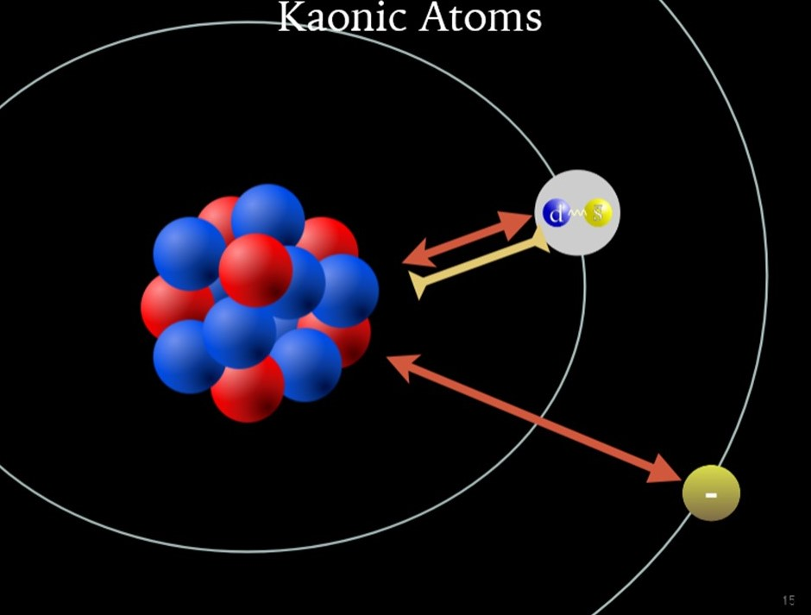
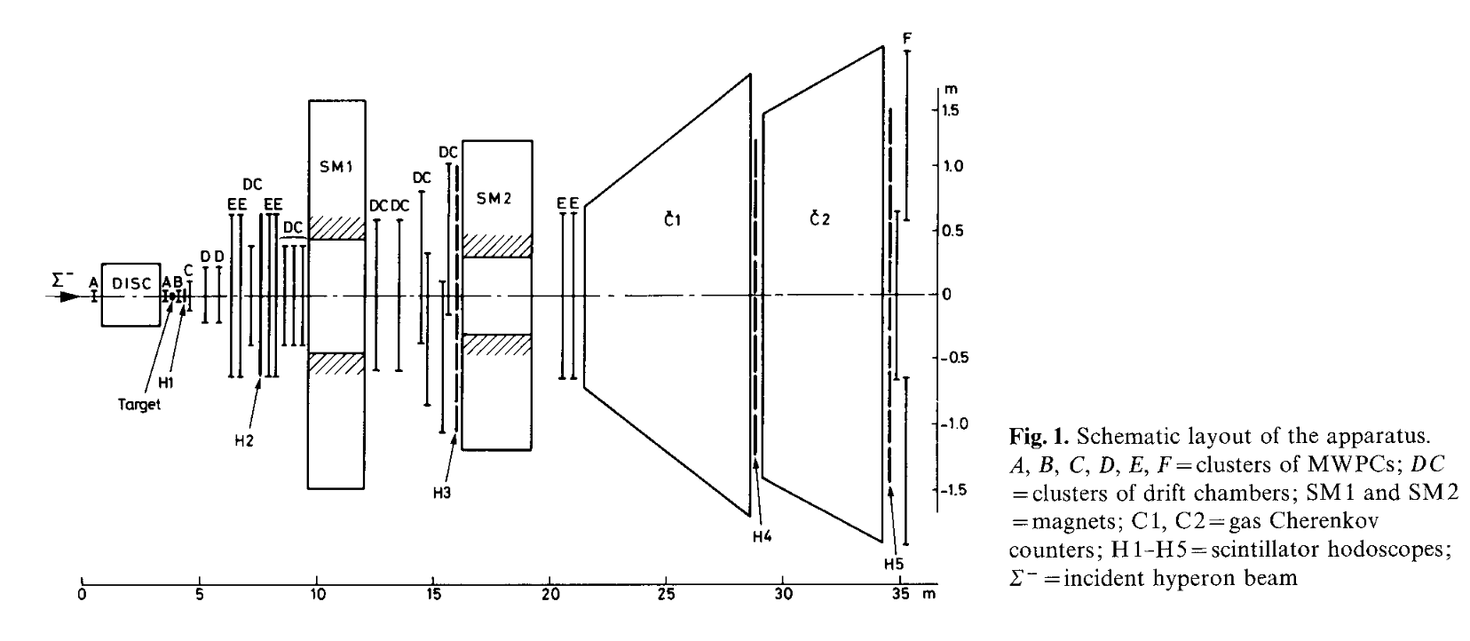
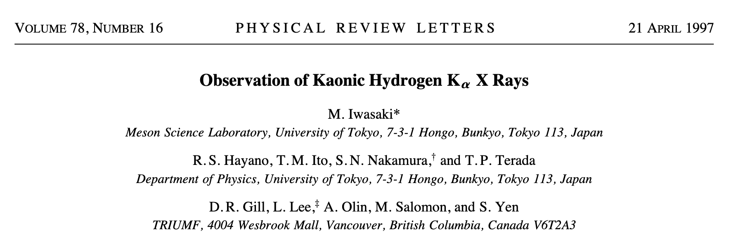

1970
1974
1979
1982
2005
2025
Rutherford Appleton Laboratory Didcot
CERN (Affiliated with QMC London)
University Manchester
University of Liverpool
Glasgow
Heavy Ion Coulomb excitation
1979
PhD 1974
X-rays from Kaonic Atoms
Rutherford Lab
Queen Mary College WA62 Exp CERN
Charged Hyperon beam at CERN SPS
Spectrometer full of MWPCs &DCs

Slide 6


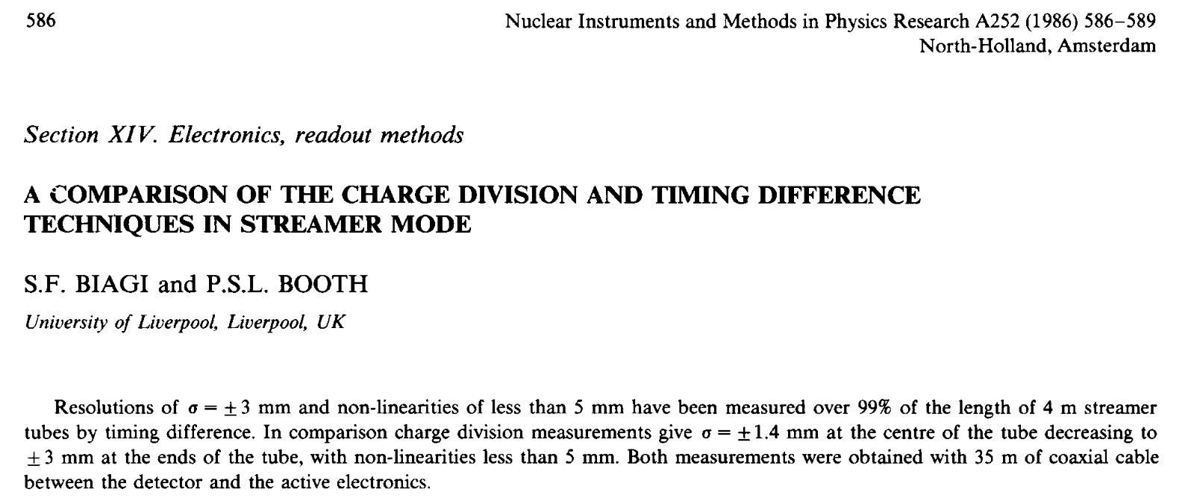
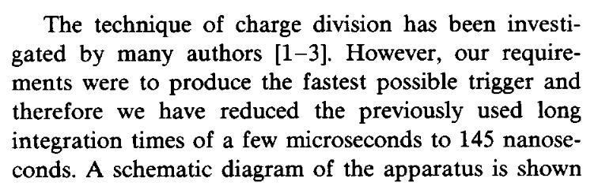
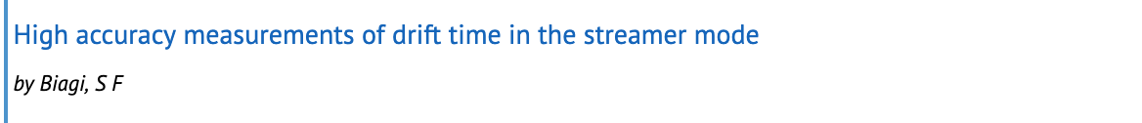
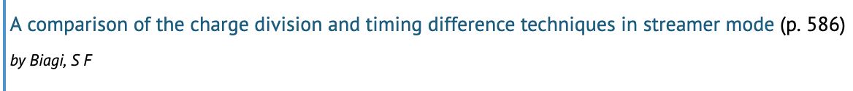
1970
1974
1979
1982
2005
2025
Rutherford Appleton Laboratory Didcot
CERN (Affiliated with QMC London)
University Manchester
University of Liverpool
Glasgow
First publications of Steve at University of Liverpool are on the operation of Streamer Tubes for Delphi Exp
Two talks at 4th Vienna Wire Chamber Conference in 1986

Slide 7
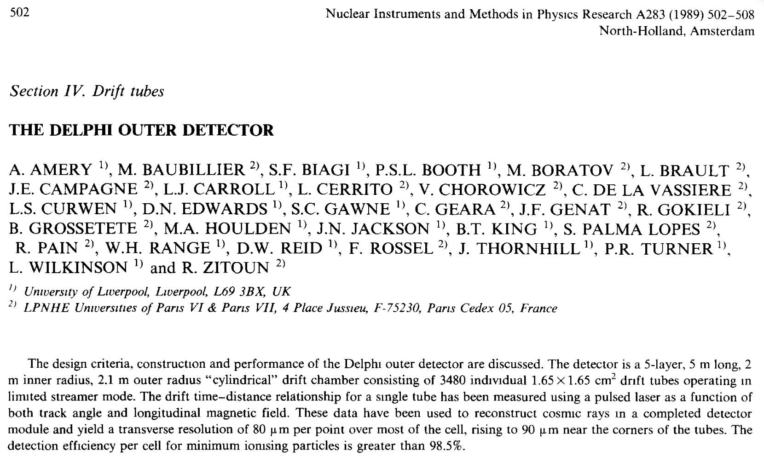
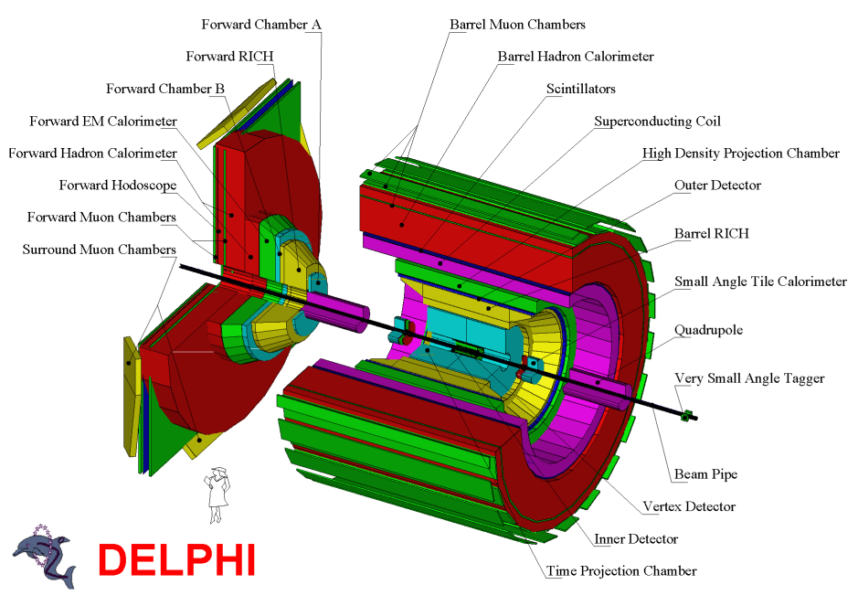
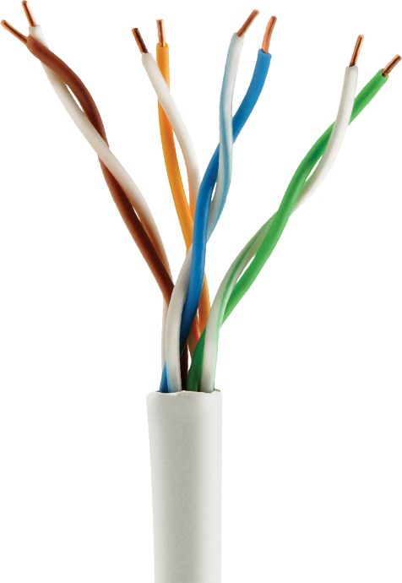
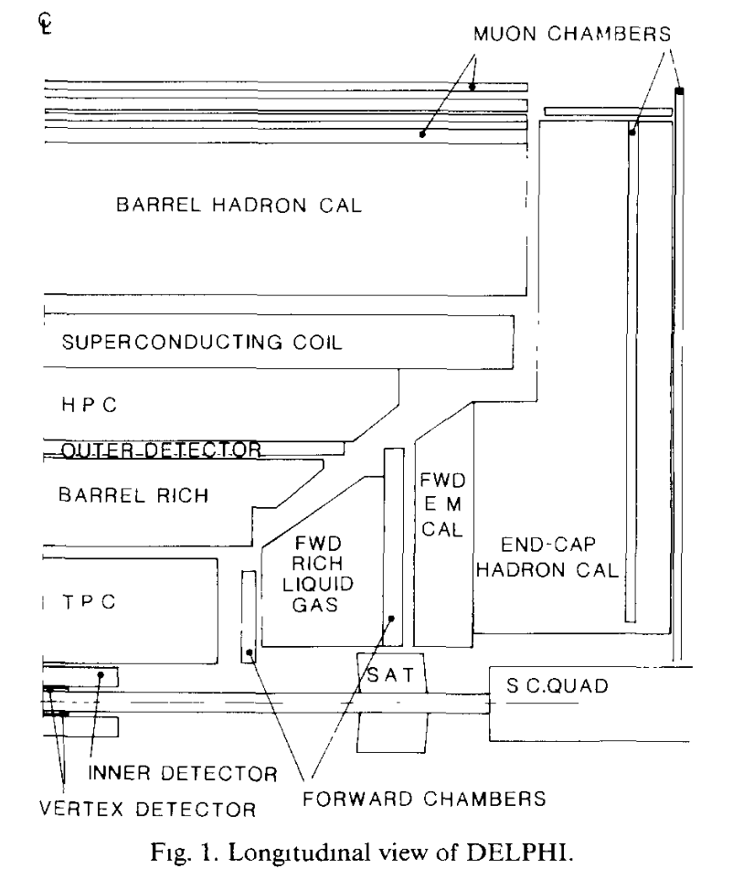
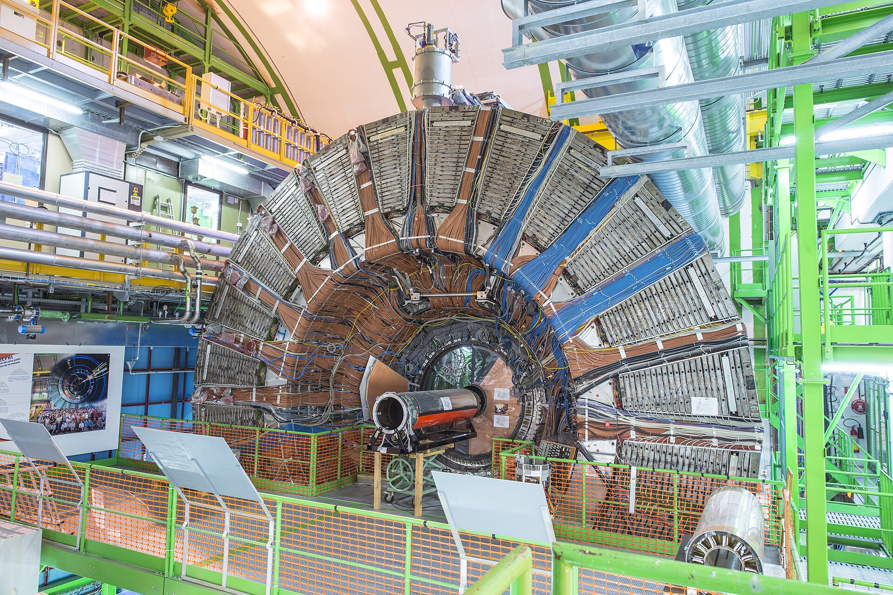
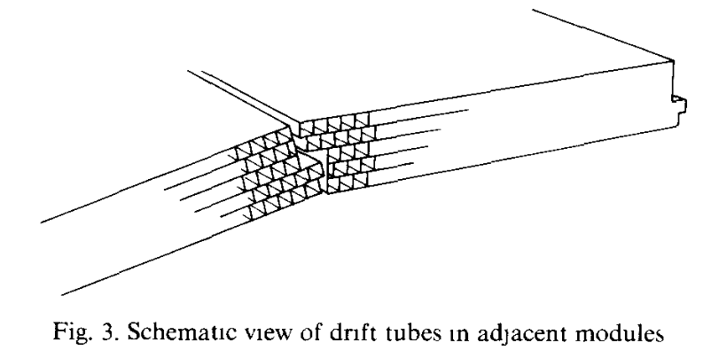

Slide 8

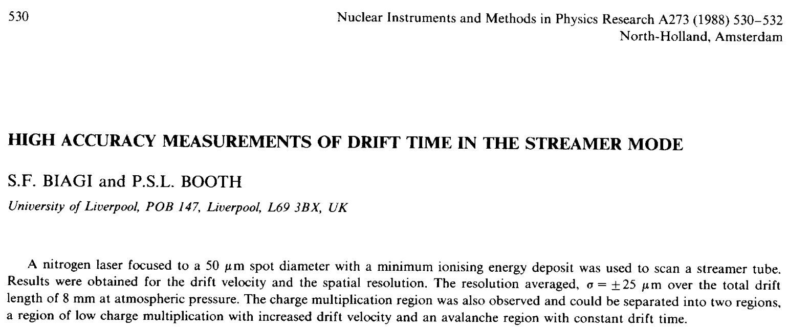
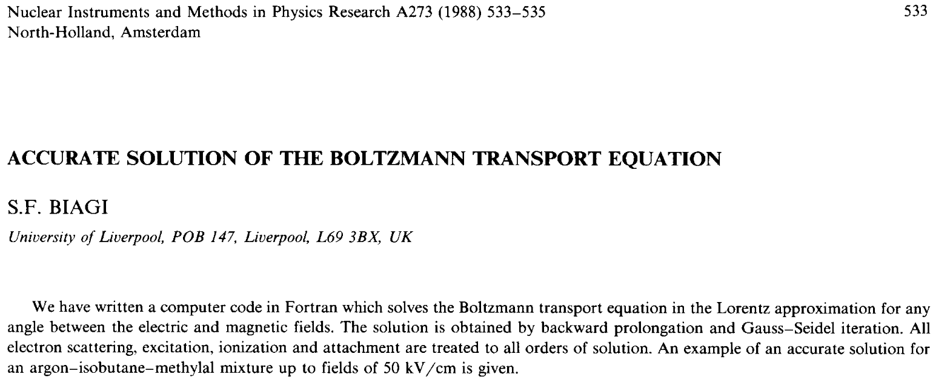
1970
1974
1979
1982
2005
2025
Rutherford Appleton Laboratory Didcot
CERN (Affiliated with QMC London)
University Manchester
University of Liverpool
Glasgow
First publications of Steve at University of Liverpool are on the operation of Streamer Tubes for Delphi Exp
Two talks at 4th Vienna Wire Chamber Conference in 1986
Two talks at 1st Position Sensitive Detectors Conference in 1987

Slide 9
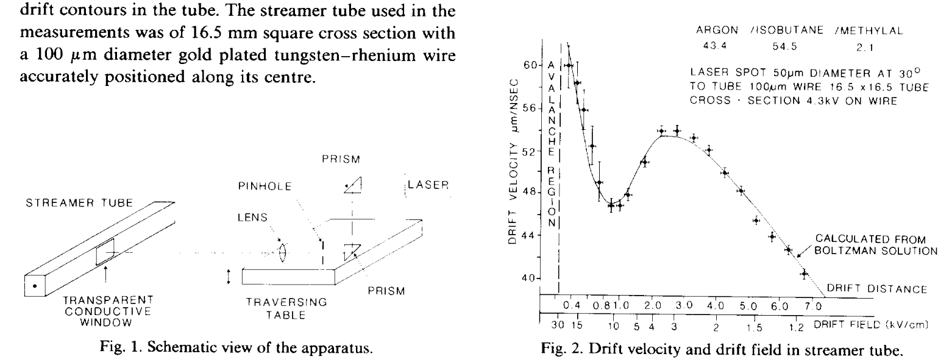
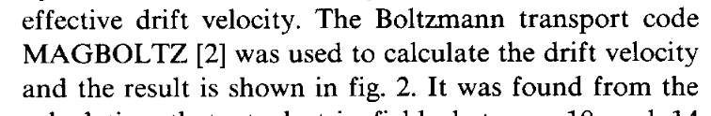
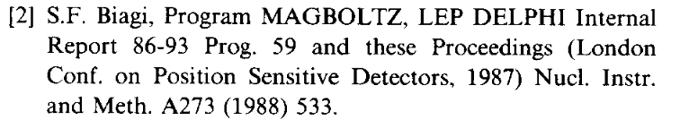

Slide 10
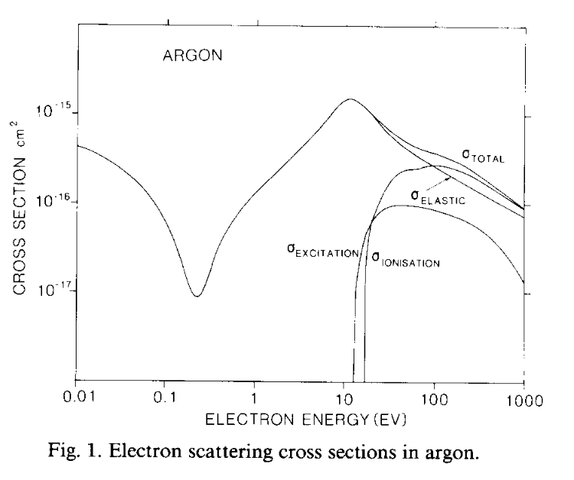
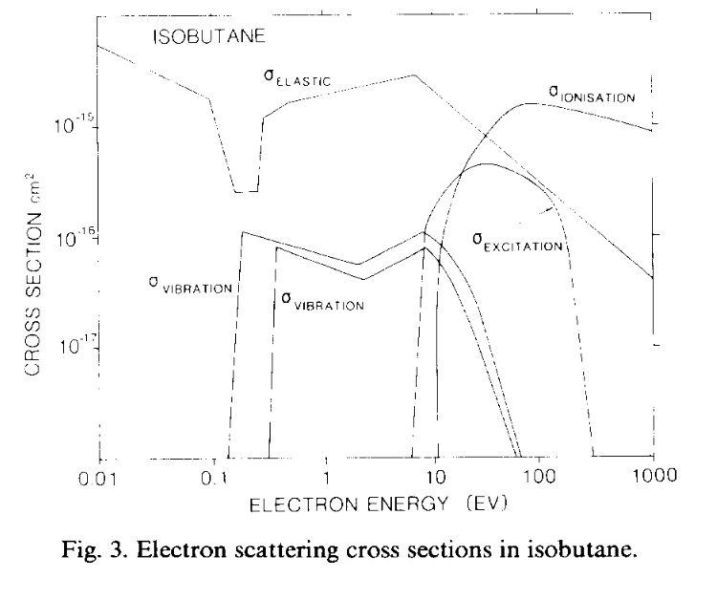
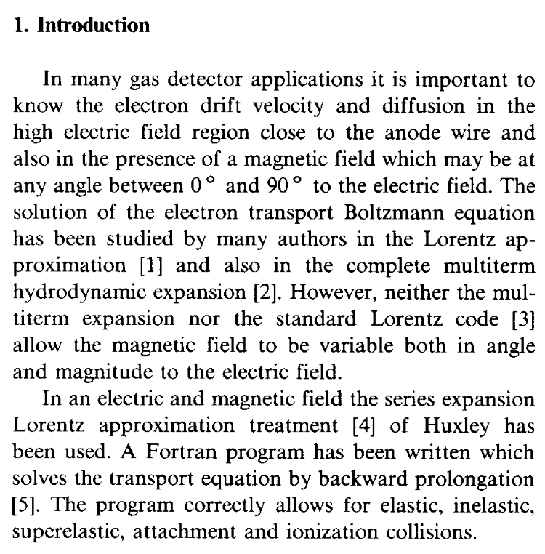
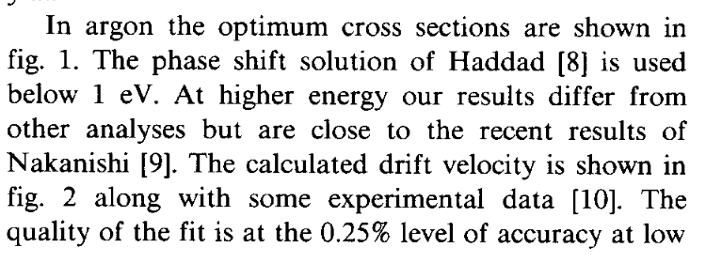
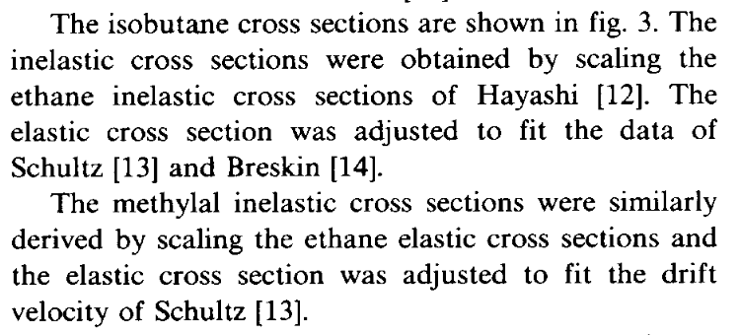
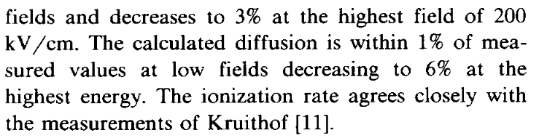

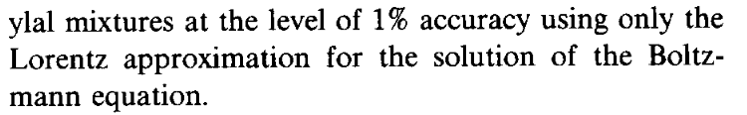
42 citations

Slide 11
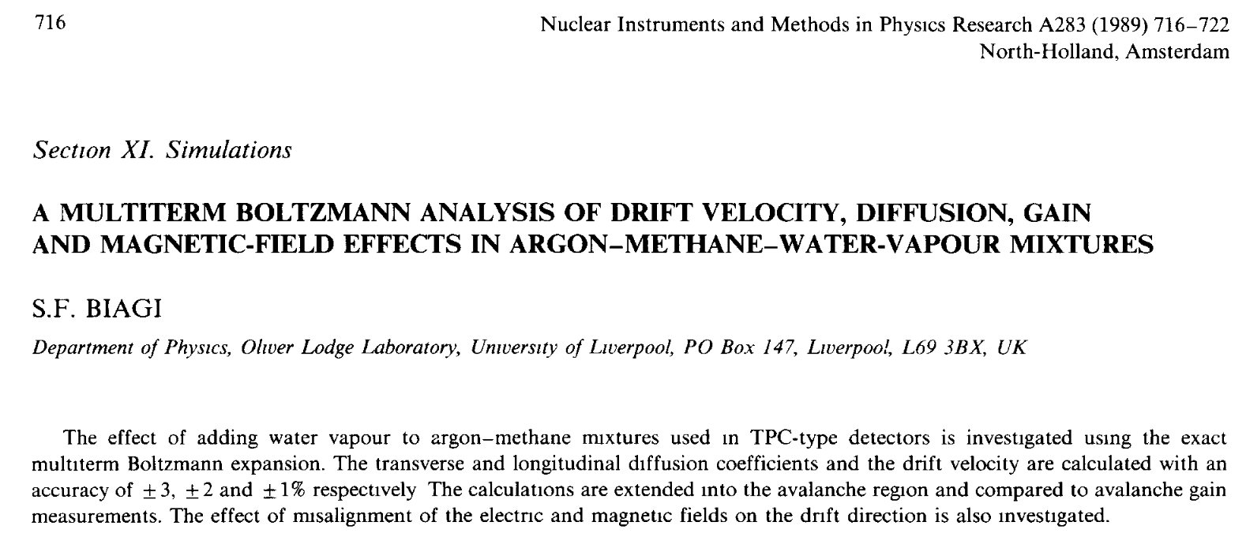
1970
1974
1979
1982
2005
2025
Rutherford Appleton Laboratory Didcot
CERN (Affiliated with QMC London)
University Manchester
University of Liverpool
Glasgow
First publications of Steve at University of Liverpool are on the operation of Streamer Tubes for Delphi Exp
Two talks at 4th Vienna Wire Chamber Conference in 1986
Two talks at 1st Position Sensitive Detectors Conference in 1987
One talk at 5th Vienna Wire Chamber Conference in 1988

Slide 12
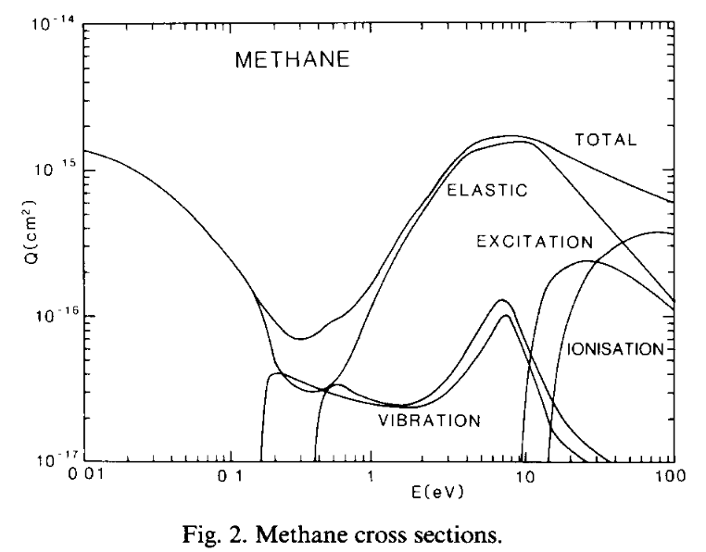
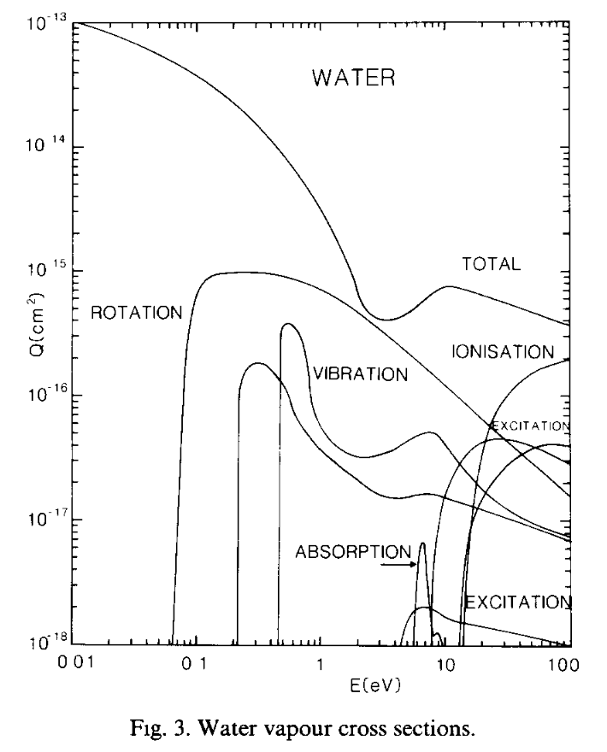
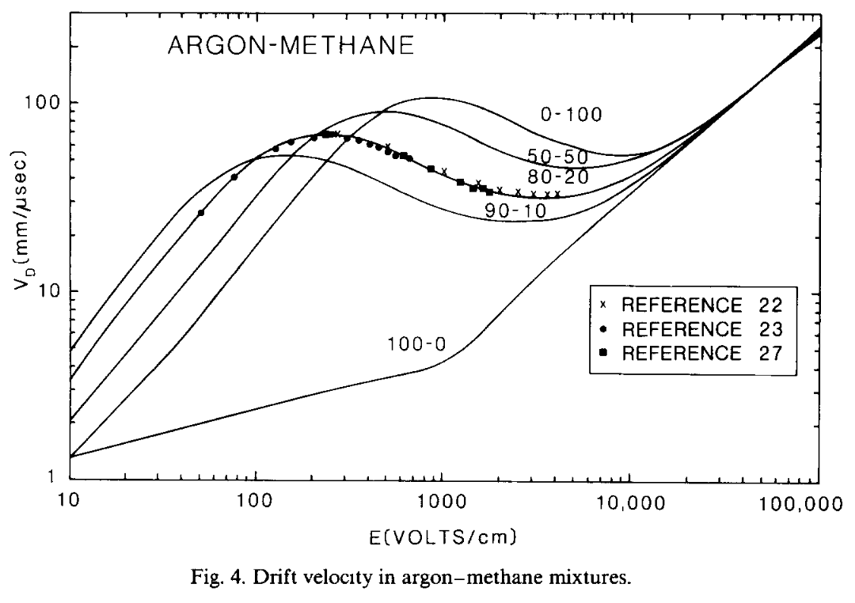
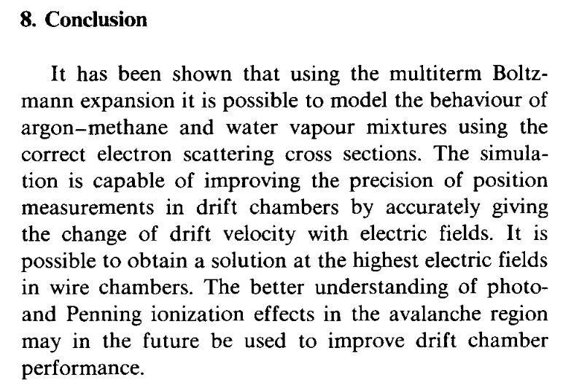
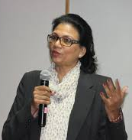
117 citations
Contribution by Archana Sharma Steve Biagi: Behind the scenes, ahead of his time!

Slide 13
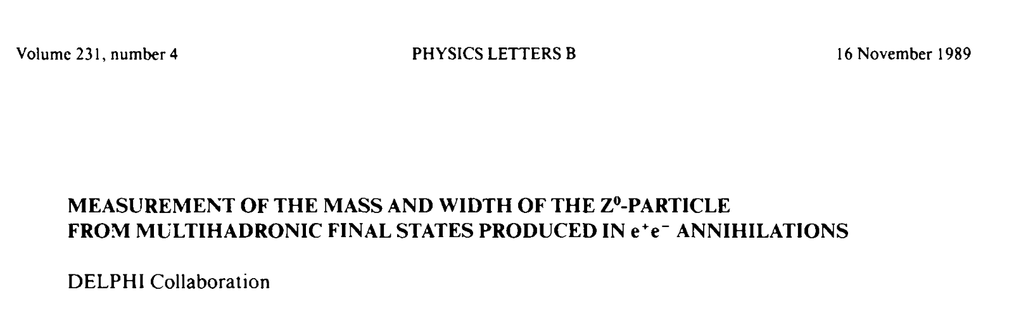
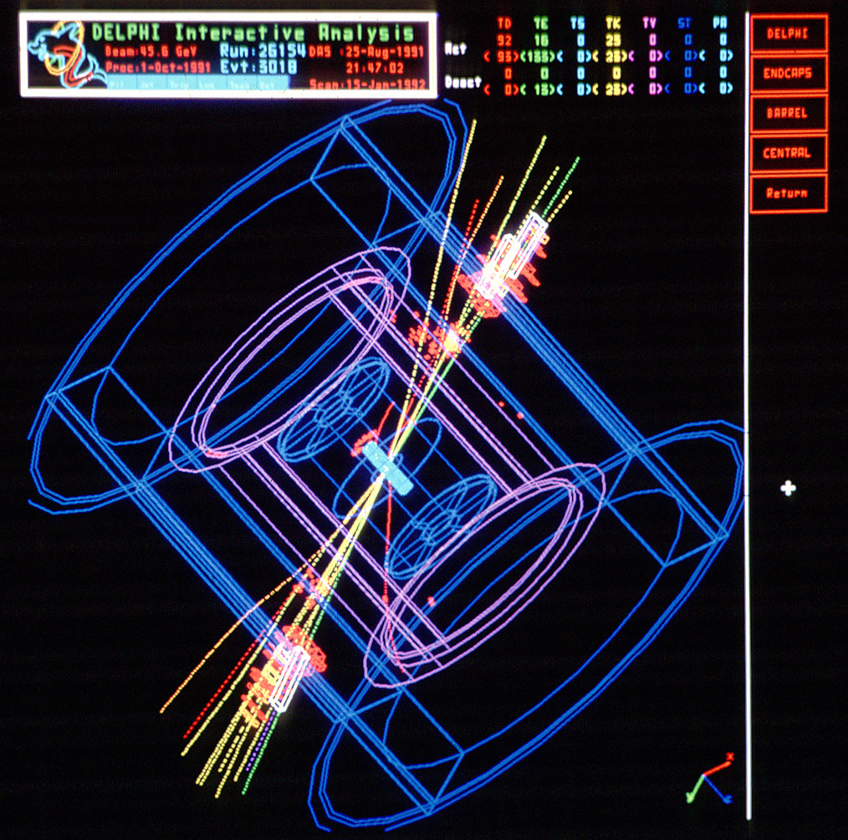
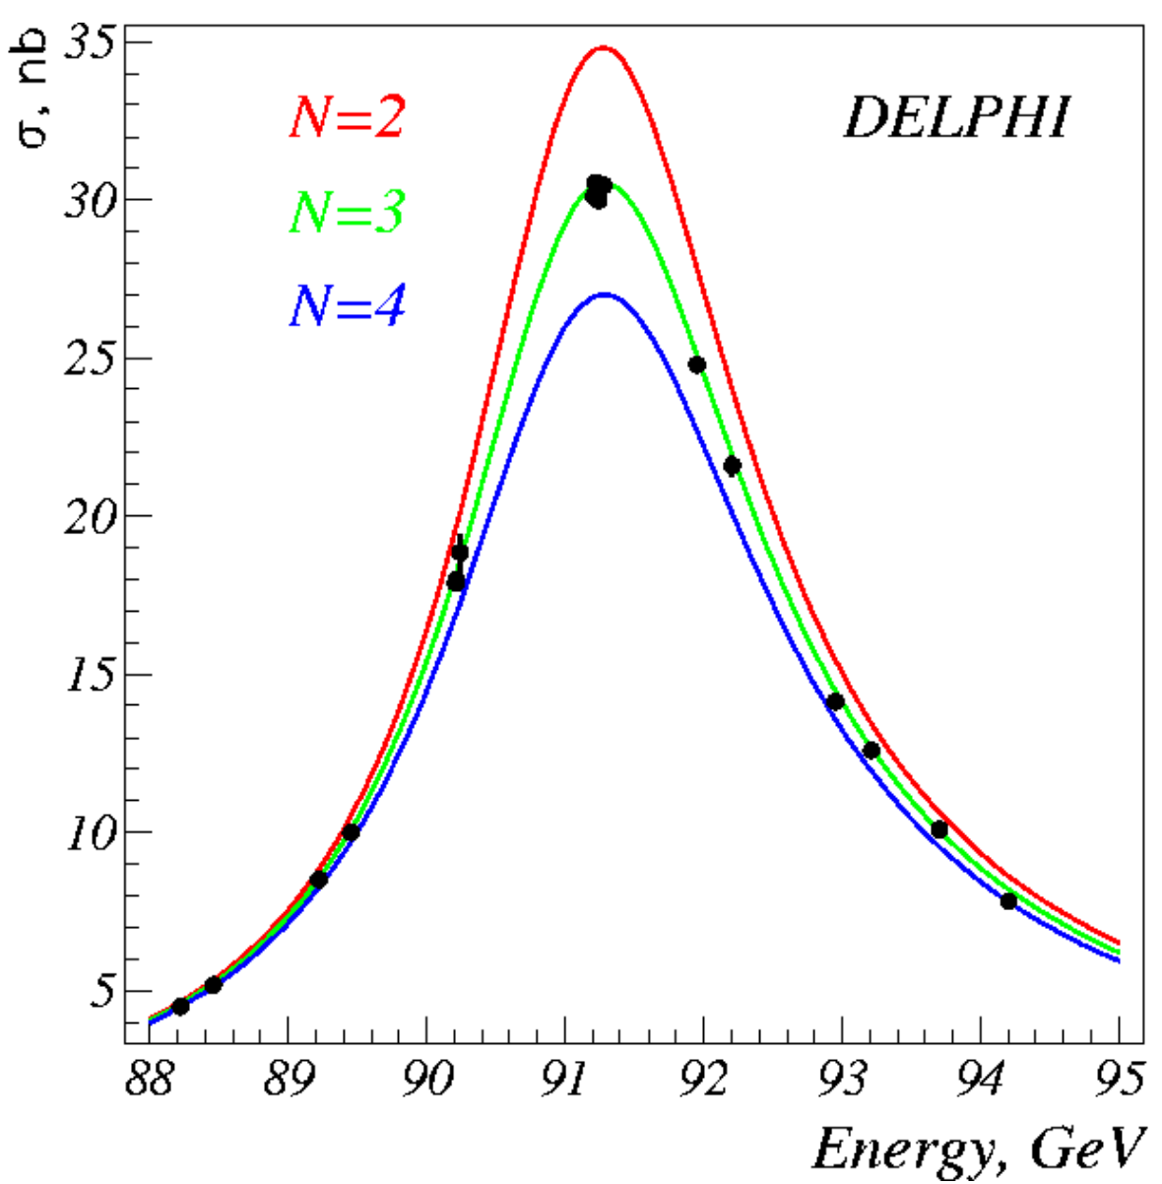
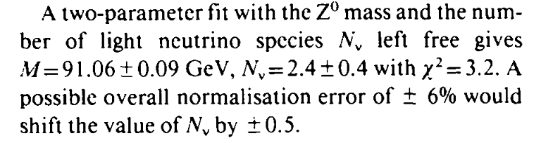
231 citations
Steve has 24 publications with the Delphi Collaboration, from 1989 to 1992

Slide 14
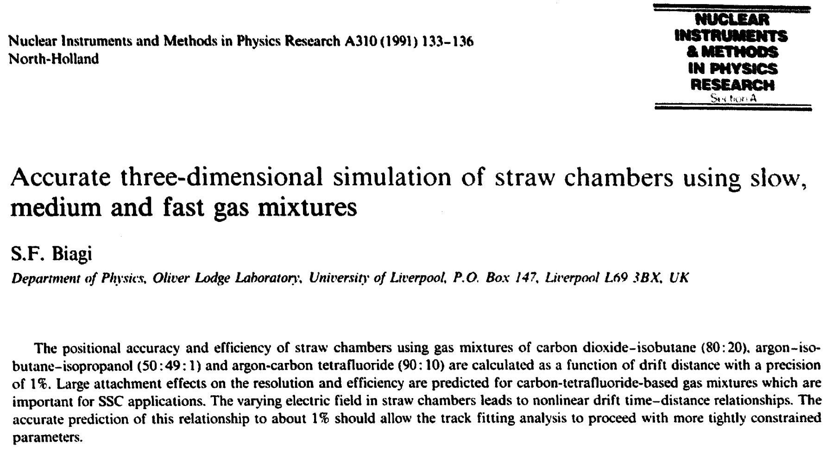
1970
1974
1979
1982
2005
2025
Rutherford Appleton Laboratory Didcot
CERN (Affiliated with QMC London)
University Manchester
University of Liverpool
Glasgow
First publications of Steve at University of Liverpool are on the operation of Streamer Tubes for Delphi Exp
Two talks at 4th Vienna Wire Chamber Conference in 1986
Two talks at 1st Position Sensitive Detectors Conference in 1987
One talk at 5th Vienna Wire Chamber Conference in 1988
Another talk at 2nd Position Sensitive Detectors Conference in 1990

Slide 15
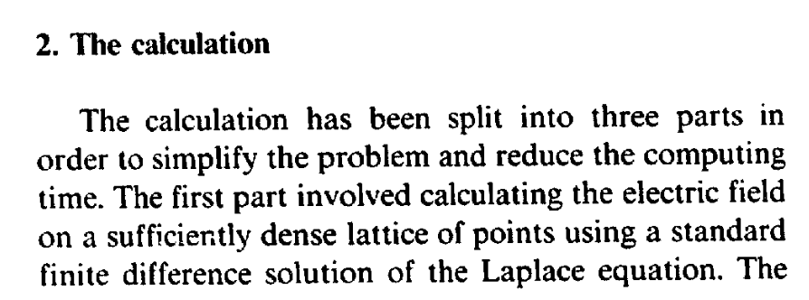
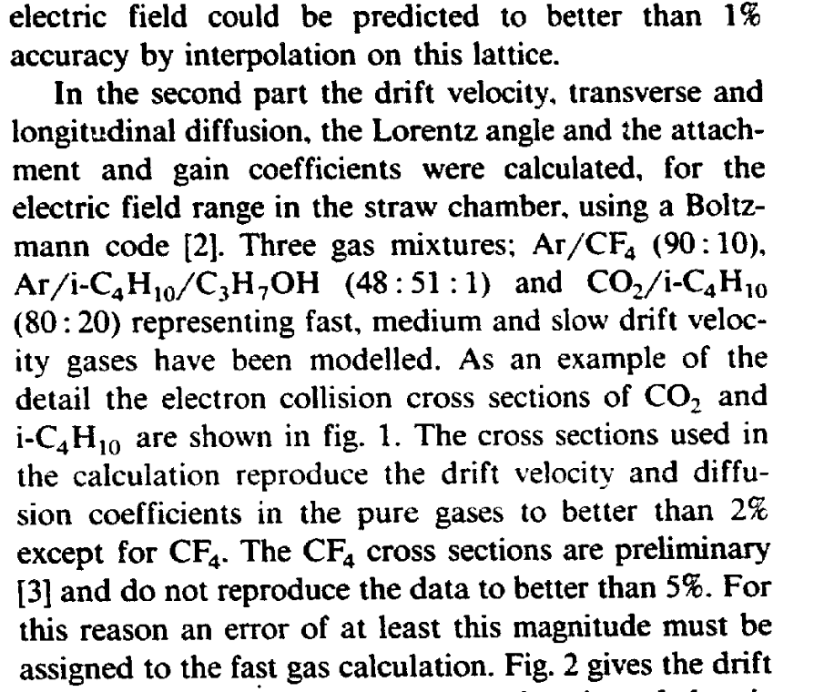
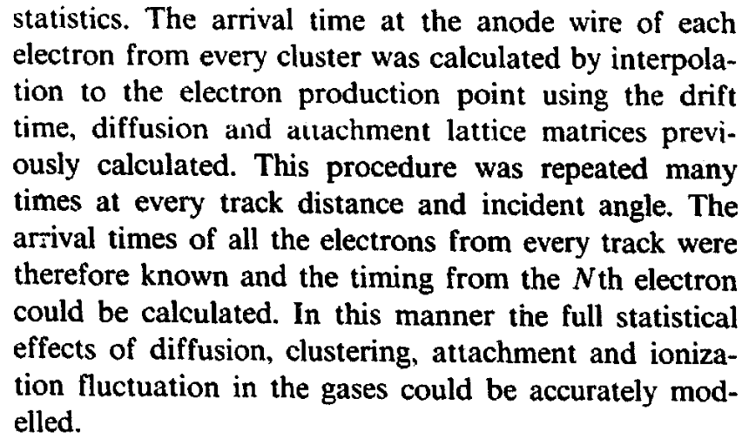
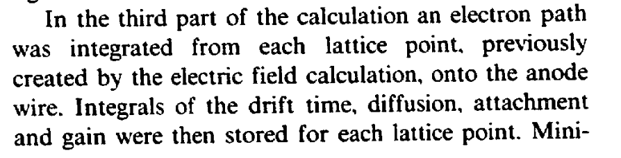
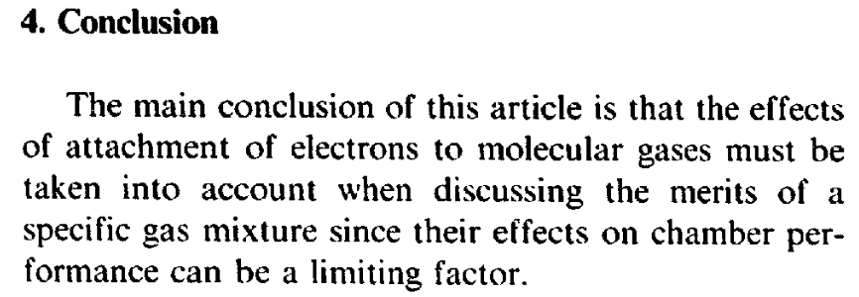
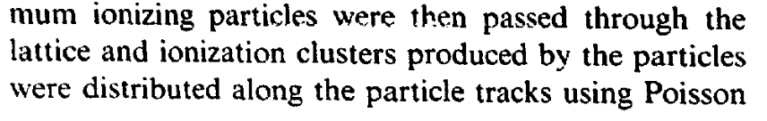
14 citations
Largely forgotten
Last cited 2003
Note: possibility to use Finite Element method solutions in Garfield was first presented by Rob Veenhof at 8th Vienna Wire Chamber Conference 1998

Slide 16
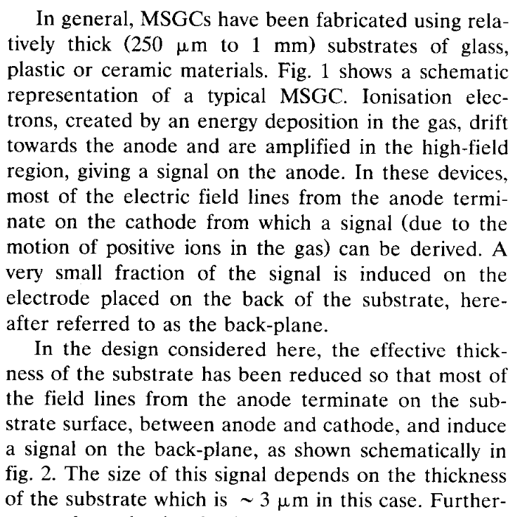
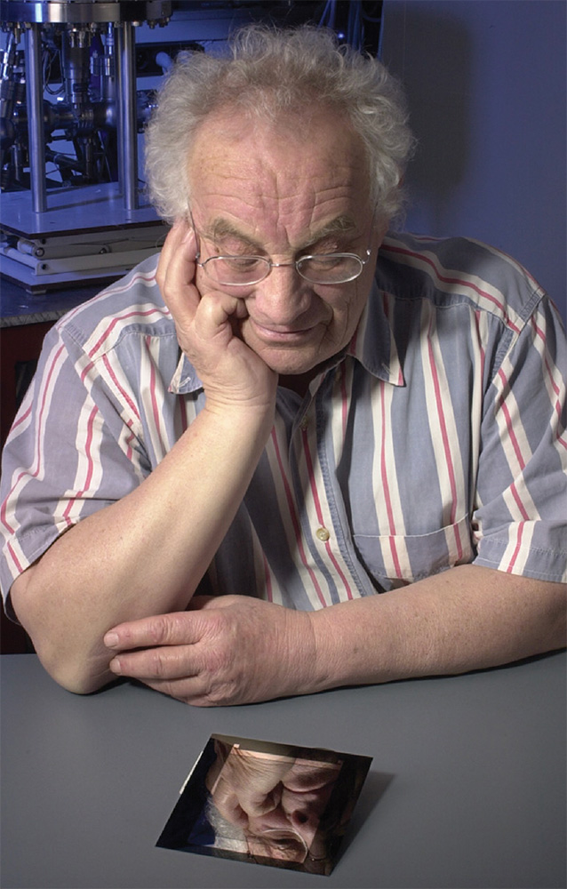
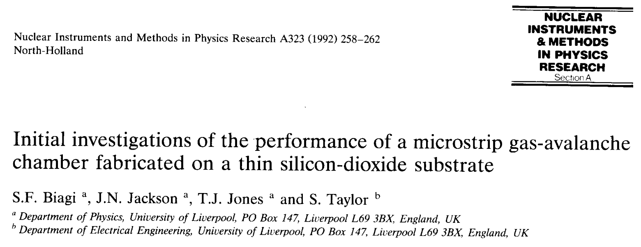

1970
1974
1979
1982
2005
2025
Rutherford Appleton Laboratory Didcot
CERN (Affiliated with QMC London)
University Manchester
University of Liverpool
Glasgow
What happened next?
Oed invented the Micro-Strip Gaseous Chamber in 1988
Detector R&D for “wireless chambers” for SCC and LHC
Another talk at the 6th Vienna Wire Chamber Conference 1992

Slide 17









1982
2005
2025
University of Liverpool
Glasgow
Microdot
MSGC

Slide 18








What happened to the Microdot?

Slide 19




What happened to the Microdot?
Steve presented to the LHCb week in Amsterdam in 1999 the Microdot detector as a possible inner tracker (alternative to MSGC, GEM+MSGC and Silicon.
However Silicon detectors were chosen for the Inner Detector, and Steve and the Liverpool group will join the LHCb VELO project

Slide 20





What happened to the Microdot?

Slide 21






Development of Garfield 1984 – 1998 - …
Computer program to simulate drift chambers written by Rob Veenhof
Initially:
calculate (2D) Electric Field & Potential
Calculate and plot drift lines
Simulate the signal
Continuous updates through the years
1998: Announcement of new Magboltz program for which an interface will be written:

Slide 22





1982
2005
2025
University of Liverpool
Glasgow
Contribution by Heinrich Schindler The development of Modern Magboltz

Slide 23





Birth of the LXCAT database 2007
Contribution by Leanne Pitchford Steve Biagi’s contribution to modelling Low Temperature Plasmas

Slide 24





RD51 Collaboration 2008
RD51 Collaboration
2008: birth RD51 Collaboration + 2009: First MPGD Conference
WG4 Modelling of physics processes and Software Tools
Decision to develop C++ version of Garfield
Further development of Magboltz cross sections
Detailed Ar* levels necessary to investigate Penning effect: Ar* + B -> Ar + B⁺ + e⁻
LXCAT – Biagi-v8.9 (2010)
Sahin & Veenhof – JINST 2010 5 P05002

Slide 25





And much more …
Simulation of Electroluminescence
4 papers in 2011 – 2018
C.A.B Oliveira (Aveiro) + LIP + Steve + …
Interfacing GEANT4, Garfield & Degrad
Dorothea & co 2019
Measurement of R134a & HFO1234ze
Marnik & Dario (ETH Zurich)
Contribution by Marnik Metting van Rijn When Porcini, Cappucino, Golf and Cross Sections meet

Slide 26


CERN Instagram 14.08.2025 CERN Relay race June 1980

Slide 27

Thanks to Mirella Biagi for all help with reconstructing Steve’s history and for all the nice pictures

Slide 28





Charged Particle Transport Boltzmann equation
The Boltzmann equation describes the evolution of the distribution function f (energy or velocity distribution) in 6D phase-space: $f(x,v)$ is function of position and velocity
$\frac{∂f}{∂t}+v∙∇f+\frac{e}{m}\left(E+v×B\right)$ $∙∇f$ = 0
$$S=k log⁡W$$
Boltzmann eqn = 0 in case of no collisions – else equal to collision term
1935: solution by expansion of f with Legendre polynoms $f\left(x,v\right)=f0\left(x,v\right)+\frac{ε}{v}f1\left(x,v\right)$ With $f0$ the random distribution and $f1$ the electron drift
Steve Biagi 1988-89, E & B-fields with 3-term expansion
From 1960: numerical solutions with first computers
Skullerud – Null-collision tech. 1968
Fraser & Mathieson 1986, E-fields
Steve Biagi 1998-99, E & B-fields with monte-carlo techns
Backup

