Slide 1
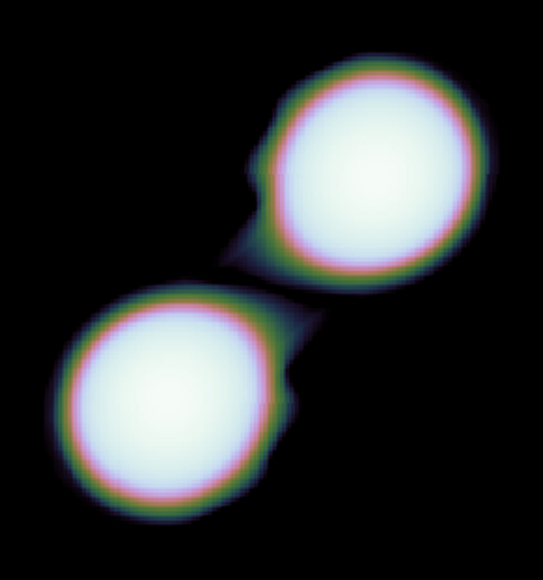
Spritz: Binary Neutron Star Merger Simulations with Microphysical Equation of State
Fatemeh Hossein-NouR, INFN at Milano-Bicocca University

Slide 2
Spritz: Features
Adopts high resolution shock capturing methods to solve GRMHD equations using HLLE Riemann solver and 5th order reconstruction method.
Built on the Einstein Toolkit infrastructure
Physics implemented: Microphysics and magnetic field
Neutrino transport: Leakage approximation
Magnetic field: vector potential evolution using generalized Lorenz gauge
Publicly available on Zenodo: https://zenodo.org/record/4350072
For implementation of numerical methods, check out papers:
Cipolletta et al. 2020, CQG 37, 135010 Cipolletta et al. 2021, CQG 38, 085021
Kalinani et al. 2022, PRD 105, 103031
Tabulated EOS and neutrino leakage successfully tested for single NS. Currently, the code is being tested for BNS merger.

Slide 3
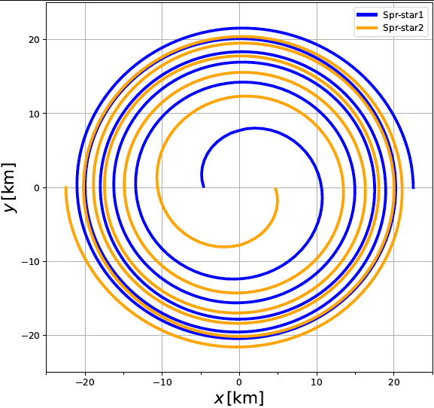
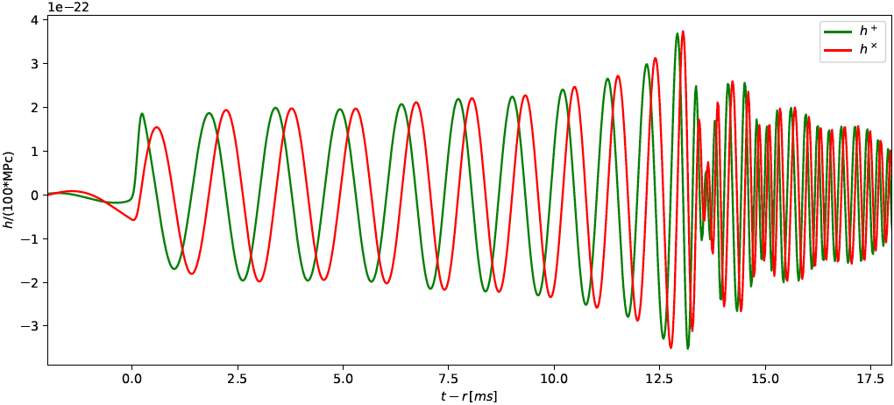
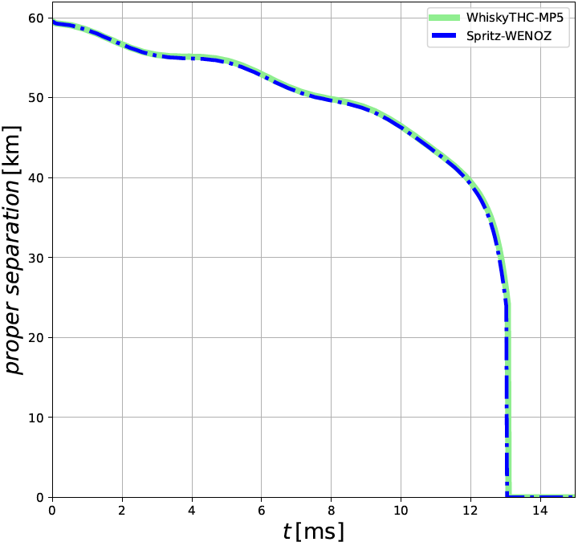
Equal mass BNS: M_{b}= 1.63 M☉
Initial coordinate separation between the centers: 45 km
Bombaci-Logoteta EOS, Initial data: Slice constant temperature T=0.01 MeV
Resolution for finest grid dx = 0.20 M☉
Magnetized case: B_{max} at initial time = 3 x 10¹⁶ G
Orbital evolution is compared with WhiskyTHC code

Slide 4
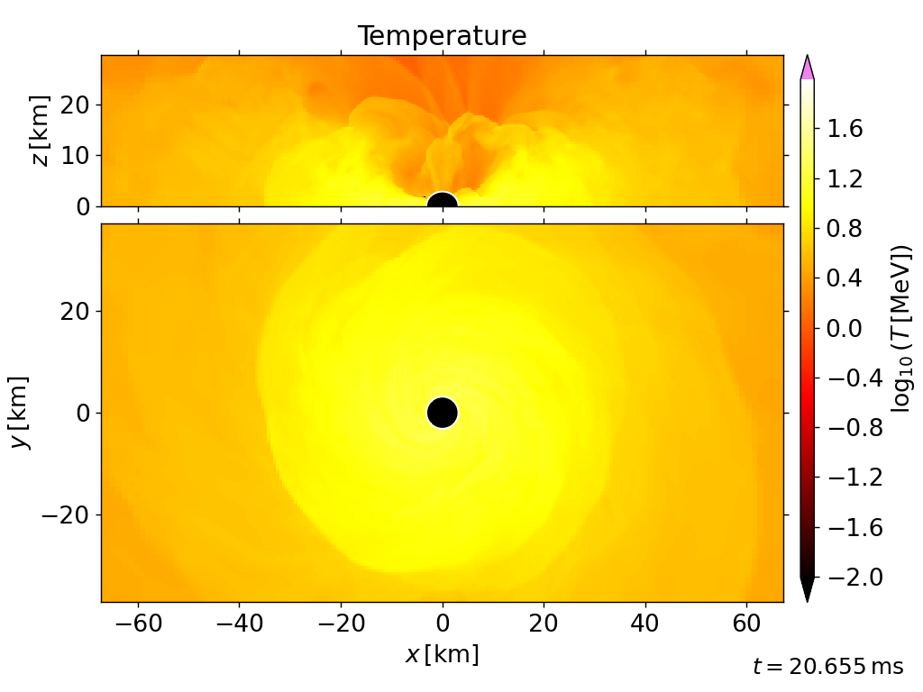
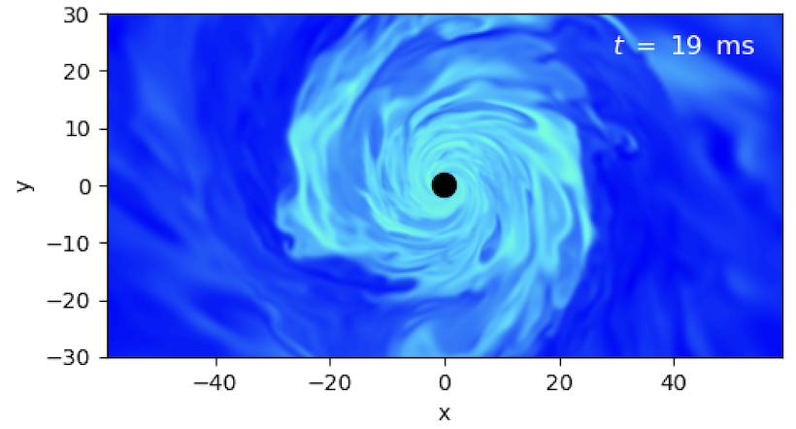
Hydro evolution for non-magnetized case
electron fraction
Apparent horizon is formed ~5 ms after the merger, HMNS collapse to BH

Slide 5
Current Status and Future Plans
So far…
Non-magnetized case: Successful in inspiral, merger and postmerger phases (delayed collapse of HMNS to BH as expected).
Currently working on the magnetized case
For Future:
Extend magnetic field outside the neutron star
Extend EOS table for low density atmosphere treatment ⍴~r⁻⁶ for large scale simulation
Add more advanced neutrino treatment (M1)

