Slide 1
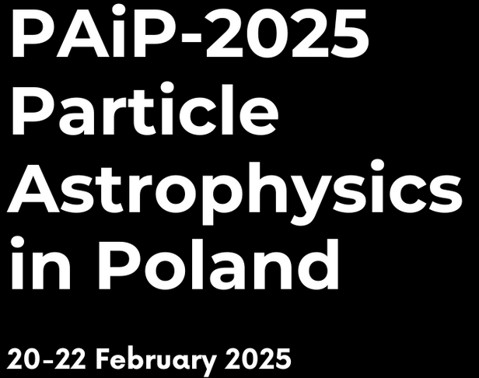
PARTICLE ASTROPHYSICS* IN POLAND
Community Discussion
Leszek Roszkowski
AstroCeNT, CAMK PAN and NCBJ
PAP, aka astroparticle physics (APP)

Slide 2
Points for discussion:
PAiP community
  meetings every other year
  …
APPEC
  news
  surveys of the community
  PAiP report
  EUCAPT (theorists)
Astrocent and new opportunities for PAiP
  joint activities planned
  more ideas welcome
need more action
  National Council for Particle Astrophysics (Krajowa Rada Astrofizyki Cząstek)
other news:
  community email list (under construction): paiplist@gmail.com
  webpage?
  Initiative to build in Poland underground laboratory
AOB?

Slide 3
Points for discussion:
PAiP community
  meetings every other year
  …
APPEC
  news
  surveys of the community
  PAiP report
  EUCAPT (theorists))
Astrocent and new opportunities for PAiP
  joint activities planned
  more ideas welcome
need more action
  National Council for Particle Astrophysics (Krajowa Rada Astrofizyki Cząstek)
other news:
  community email list (under construction): paiplist@gmail.com
  webpage?
  Initiative to build in Poland underground laboratory
AOB?

Slide 4
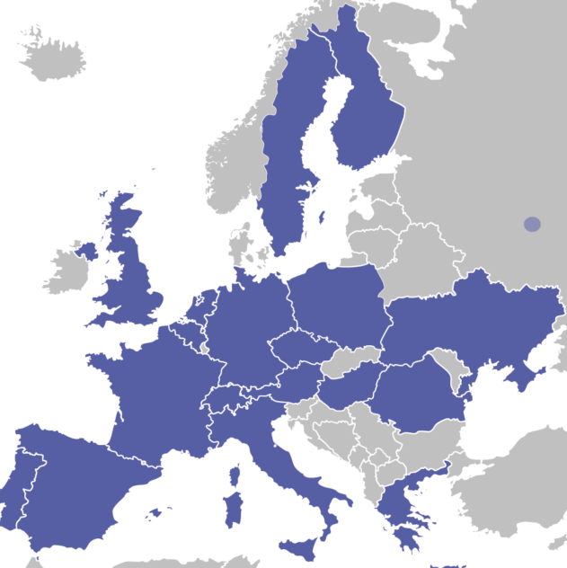
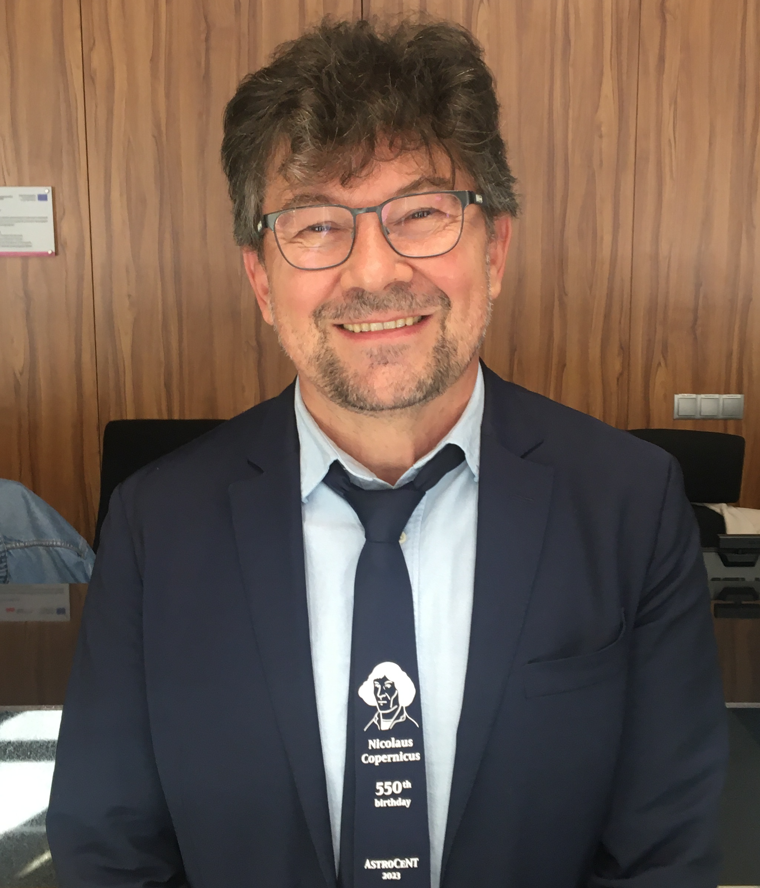
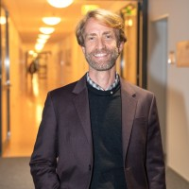
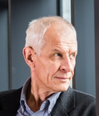
APPEC: Astroparticle Physics European Consortium
cooperation and coordination
common strategy
10-year roadmaps
  next one in prep (2027-36)
2019: Poland rejoined
Dec. 2024: deputy chair from Poland
chair:
Carlos
Peña Garay
(Spain)
Marcin Kuźniak: member of SAC
Masayuki Wada: replacement for LR
deputy:
Antoine
Kouchner
(France)
deputy:
Leszek
Roszkowski
(Poland)

Slide 5
Community surveys
and roadmaps

Slide 6
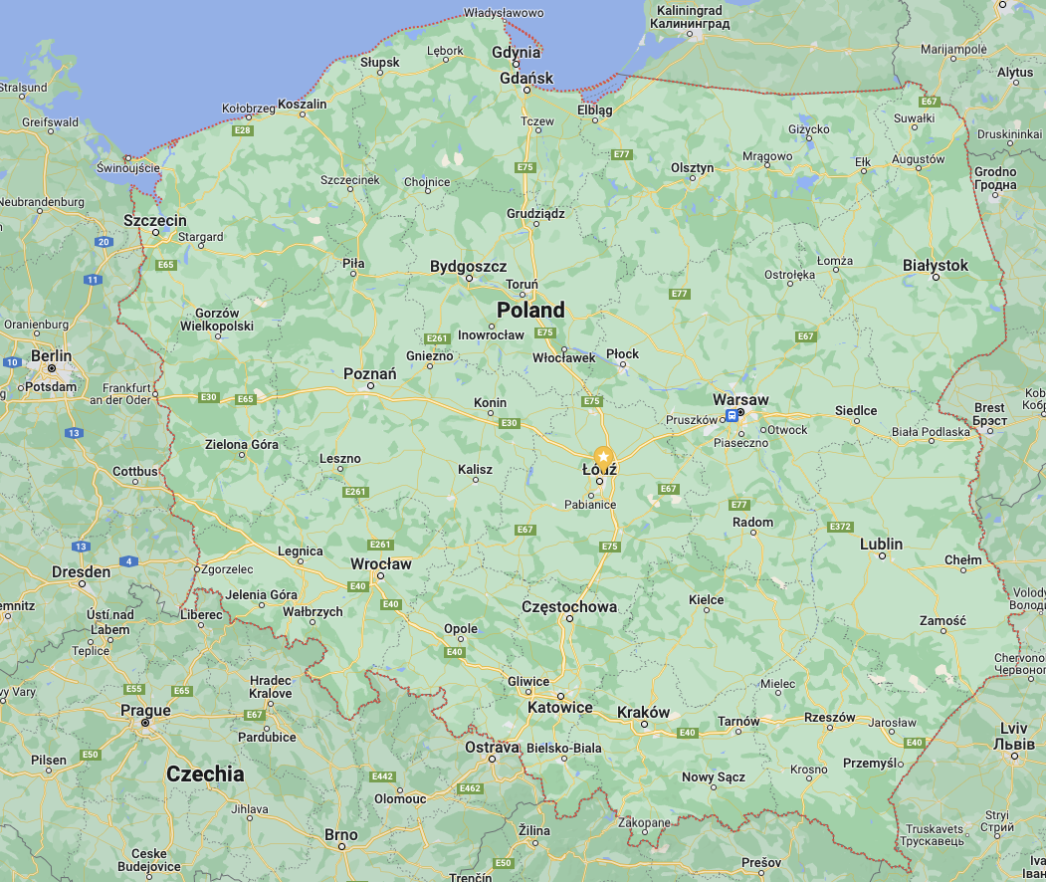
Astroparticle physics in Poland
Survey of 2023/24
List of institutions involved in Astro/cosmo:
Jagiellonian University, Kraków (UJ)
Institute of Nuclear Physics Polish Academy of Sciences, Kraków (IFJ PAN)
Nicolaus Copernicus Astronomical Center Polish Academy of Sciences,
Warszawa (CAMK PAN)
AstroCeNT - Particle Astrophysics Science and Technology Centre (AC)
  (autonomous centre at CAMK PAN)
National Centre for Nuclear Research, Otwock (NCBJ)
Space Research Centre Polish Academy of Sciences, Warszawa (CBK PAN)
University of Warsaw, Warszawa (UW)
Warsaw University of Technology, Warszawa (PW)
AGH University of Science and Technology, Kraków (AGH)
Academic Computer Centre Cyfronet AGH, Kraków (Cyfronet)
University of Silesia, Katowice (US)
University of Lodz, Łódź (UŁ)
Nicolaus Copernicus University, Toruń (UMK)
University of Bialystok, Białystok (UwB)
University of Zielona Gora, Zielona Góra (UZ)
Jan Kochanowski University, Kielce (JKU)

Slide 7
APP in Poland – main activities
``Core” and related to APP:
Gravitational waves
Dark matter
Neutrinos
Cosmic rays
Gamma ray astronomy
X-rays
CMB
Dark energy
Observational cosmology
0nu2beta
APP theory
Plus, other related:
astronomy
astrophysics
collider and non-collider physics
…

Slide 8
APP in Poland – main activities
Core APP:
Gravitational waves
LIGO-Virgo-Kagra: large consortium: AO UW, NCBJ, IM PAN, CAMK, AC
Einstein Telescope: AO UW, CAMK, AC
LISA: AO UW
TORES: NCBJ
WERA: UJ
Polgraw Consortium
Dark matter
DarkSide: AC, UJ
DEAP-3600: AC
Major growth since 2019, when Astrocent started.
Neutrinos
Hyper-Kamiokande: large consortium of 9 institutions:
NCBJ, U Silesia, IFJ, WUT, UW, Uwr, AGH, UJ, CAMK, AC
(Super-Kamiokande)
KM3Net: NCBJ, UJ, AC (observer), since 2020
GRAND: UW
Lake Baikal: IFJ PAN – terminated 2022
PONE:IFJ PAN
T2K: NCBJ
Borexino
DUNE
Neutrino Platform@CERN

Slide 9
Cosmic rays
Pierre Auger: IFJ
CREDO: IFJ
JEM-EUSO: NCBJ
GRAND: UW
Gamma ray astronomy
CTA: Polish CTA Consortium of 13: UJ, NCBJ, …
SST-1M: Polish CTA Consortium (currently active: UJ, IFJ, CAMK, AGH, UW, UwB, CBK)
H.E.S.S: 5 institutions: CAMK, UJ, IFJ, UW, UMK
POLAR-2: NCBJ, IFJ
MAGIC: UŁ
HAWC: IFJ
X-rays
  Athena: CAMK
POLAR-2 - gamma-ray spectrometer to be launched
on the Chinese space station (Tiangong-2 Space Lab)

Slide 10
CMB
PLANCK: NCBJ
(LiteBird: AO UW)
Dark energy/observational cosmology
Vera Rubin Observatory (LSST): NCBJ, UW, UWr, UJ, UMK, CAMK, CFT
VIPERS: NCBJ, UJ, JKU
0nu2beta
LEGEND: UJ
GERDA: UJ
VIPERS: VIMOS Public Extragalactic Redshift Survey
APP theory
diverse range of activities and interests by many groups:
dark matter: AC, NCBJ, UW, …
GWs: NCBJ, UW, CAMK, …
Neutrinos: UW, UWr, NCBJ, …
Early Universe: UW, AC, NCBJ, …
New physics: UW, AC, NCBJ,

Slide 11
Update of the survey & report
as part of preparations for APPEC’s next roadmap, prepare
our community survey and report
report: some 10 pages, to prepare over the next 6 months

Slide 12
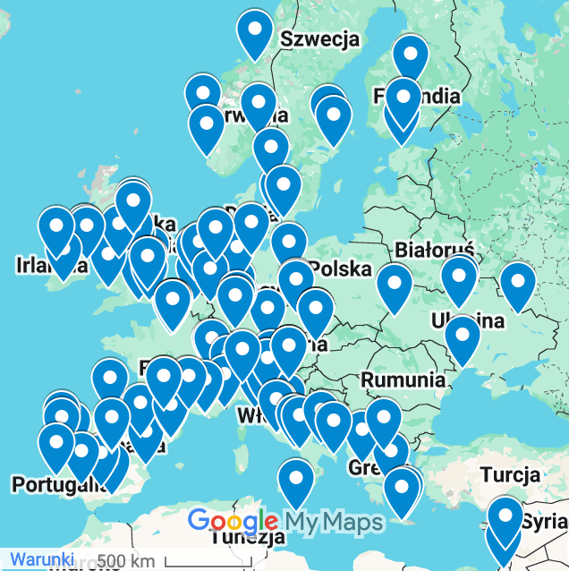
EUCAPT: The European Consortium for Astroparticle Theory
https://www.eucapt.org/
(EuCAPT) aims to bring together the European community
of theoretical astroparticle physicists and cosmologists.
Our goals are:
to increase the exchange of ideas and knowledge;
to coordinate scientific and training activities;
to help scientists attract adequate resources for their projects;
to promote a stimulating, fair and open environment in which young scientists can thrive.
next deadline to apply to join: May 2025
https://www.eucapt.org/joining
institutions with more than 20 active members
(or groups of institutions with more than 20 members in total)

Slide 13
Points for discussion:
PAiP community
  meetings every other year
  …
APPEC
  news
  surveys of the community
  PAiP report
  EUCAPT (theorists))
Astrocent and new opportunities for PAiP
  joint activities planned
  more ideas?welcome
need more action
  National Council for Particle Astrophysics (Krajowa Rada Astrofizyki Cząstek)
other news:
  community email list (under construction): paiplist@gmail.com
  webpage?
  Initiative to build in Poland underground laboratory
AOB?

Slide 14
1 January 2025 – 31 December 2030, 15 MEuro (EC) + 15 MEuro (co-funding: Ministry + FNP)
Teaming for Excellence project Astrocent Plus
prime objective: transform ASTROCENT
into a new interdisciplinary institute
Consortium Members: | Country
Nicolaus Copernicus Astronomical Centre Polish Academy of Sciences (NCAC) – initial coordinator | Poland
Łukasiewicz Center (LC) | Poland
Centre National De La Recherche Scientifique (CNRS) | France
Universite Paris Cite (UPC) -- Affiliated Partner | France
Gran Sasso Science Institute (GSSI) | Italy
Deutsches Elektronen-Synchrotron Desy (DESY) | Germany
Arthur B. McDonald Canadian Astroparticle Physics Research Institute (MI) -- Associated Partner | Canada

Slide 15
Astrocent Plus and the PAiP community
Objective 5: Young researcher education and training
  grow new generations of professionals, train juniors and seniors
Objective 6: Raising interest in APP and ensuing benefits
  communication and outreach: educate the general public
  and target groups

Slide 16
Points for discussion:
PAiP community
  meetings every other year
  …
APPEC
  news
  surveys of the community
  PAiP report
  EUCAPT (theorists))
Astrocent and new opportunities for PAiP
  joint activities planned
  more ideas?welcome
need more action
  National Council for Particle Astrophysics (Krajowa Rada Astrofizyki Cząstek))
other news:
  community email list (under construction): paiplist@gmail.com
  webpage?
  Initiative to build in Poland underground laboratory
AOB?

Slide 17
Points for discussion:
PAiP community
  meetings every other year
  …
APPEC
  news
  surveys of the community
  PAiP report
  EUCAPT (theorists))
Astrocent and new opportunities for PAiP
  joint activities planned
  more ideas?welcome
need more action
  National Council for Particle Astrophysics (Krajowa Rada Astrofizyki Cząstek))
other news:
  community email list (under construction): paiplist@gmail.com
  webpage?
  Initiative to build in Poland underground laboratory
AOB?

Slide 18
Thank you

Slide 20

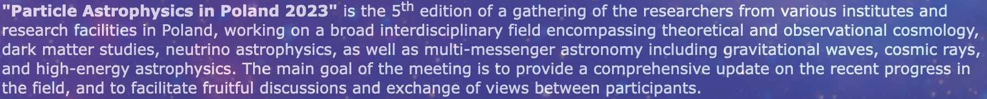
Points for discussion:
PAiP community meetings
Big thanks to Łukasz Stawarz and the whole LOC!
Who are we in PAP community?
Interdisciplinary: from particle physics
to astronomy, (classical) astrophysics,
cosmology, nuclear physics, geophysics, …
Keep biennial frequency? Or make it annual?
Next meeting?
  2025? Which quarter of the year?
  Or Autumn/Winter 2024?
Multimessenger: explore the Universe
through as many windows as one can
Where? Warsaw? Any volunteers?

Slide 21
Points for discussion:
PAiP community meetings
Big thanks to Łukasz Stawarz and the whole LOC!
Who are we in PAP community?
Interdisciplinary: from particle physics
to astronomy, (classical) astrophysics,
cosmology, nuclear physics, geophysics, …
Keep biennial frequency? Or make it annual?
Next meeting?
  2025? Which quarter of the year?
  Or Autumn/Winter 2024?
Multimessenger: explore the Universe
through as many windows as one can
Where? Warsaw? Any volunteers?

Slide 22
APPEC General Assembly to visit Poland in late June
Prepare report on our community, activities, plans
  Working group:
    Łukasz Stawarz
    Jacek Niemiec
    Ewa Rondio
    Dorota Rosińska
    Krzysztof Turzyński
    Leszek Roszkowski
  Will be contacting you and collecting info
  Report to be ready by the end of May

Slide 23
Some news
Fall 2019: Poland re-joined APPEC

Slide 24
multimessenger

