Slide 1
Recent Results on Particle Acceleration at Non-relativistic Shocks
Oleh Kobzar
Astronomical Observatory of the Jagiellonian University, Department of High Energy Astrophysics
PAiP-2025 conference ”Particle Astrophysics in Poland”
Warsaw, 20 – 22 February 2025

Slide 2
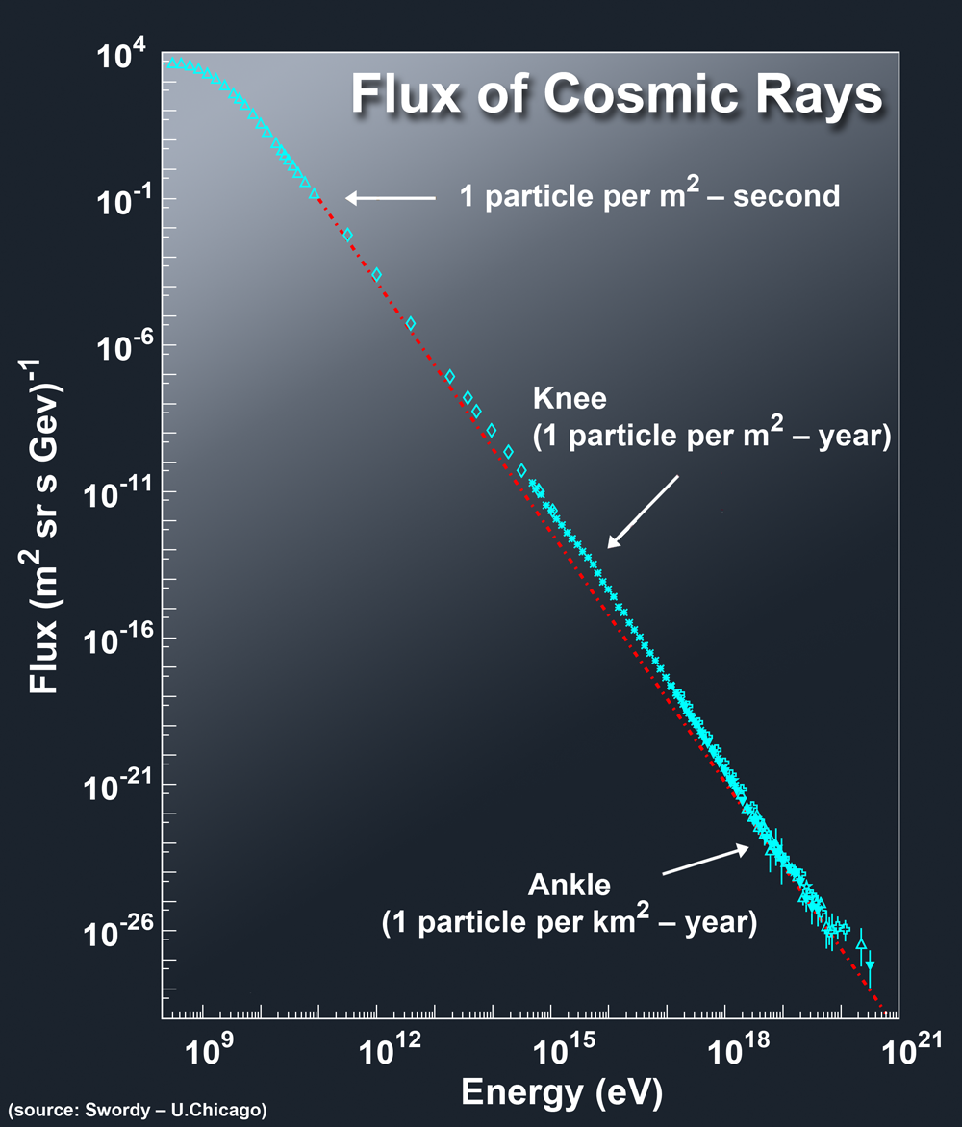
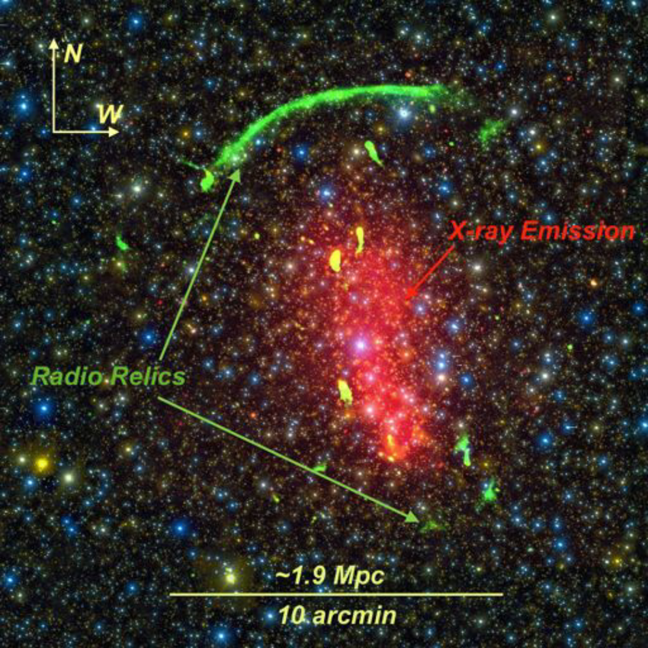
Astrophysical aspects related with particle acceleration
Acceleration is a cornerstone problem in astrophysics
High-energy emission (X-ray, γ)
Radio synchrotron emission
Generated by relativistic particles
Cosmic Rays
including UHECR with energies up to $E∼{10}^{20} \text{eV}$

Slide 3
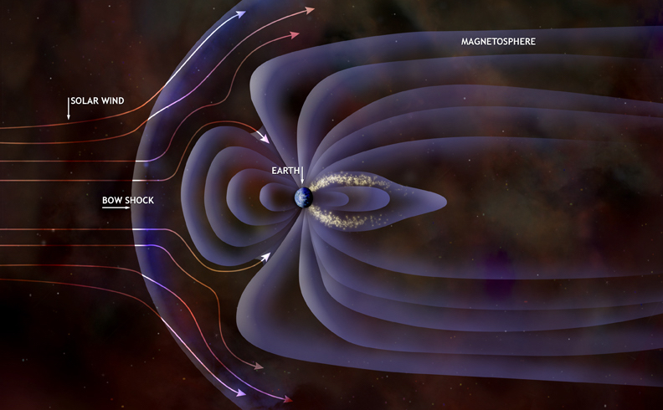
Shock waves on various scales
Earth’s bow shock
Solar flare shocks
Solar wind termination shock
Supernova remnant (SNR) shocks
Active galactic nuclei (AGN) shocks
Large-scale shocks in the galaxy clusters: - turbulence shocks - infall shocks - merger shocks

Slide 4
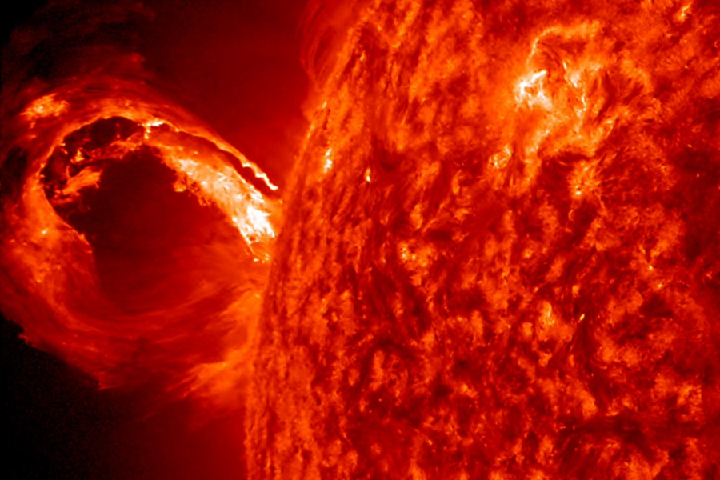
Shock waves on various scales
Earth’s bow shock
Solar flare shocks
Solar wind termination shock
Supernova remnant (SNR) shocks
Active galactic nuclei (AGN) shocks
Large-scale shocks in the galaxy clusters: - turbulence shocks - infall shocks - merger shocks

Slide 5
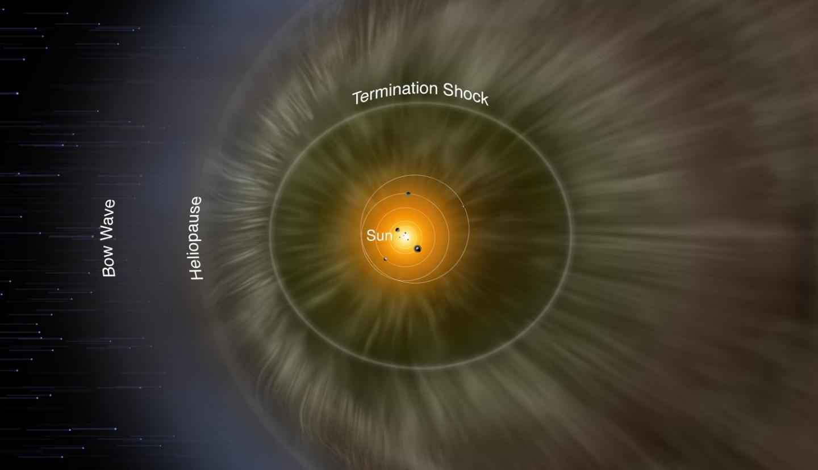
Shock waves on various scales
Earth’s bow shock
Solar flare shocks
Solar wind termination shock
Supernova remnant (SNR) shocks
Active galactic nuclei (AGN) shocks
Large-scale shocks in the galaxy clusters: - turbulence shocks - infall shocks - merger shocks

Slide 6
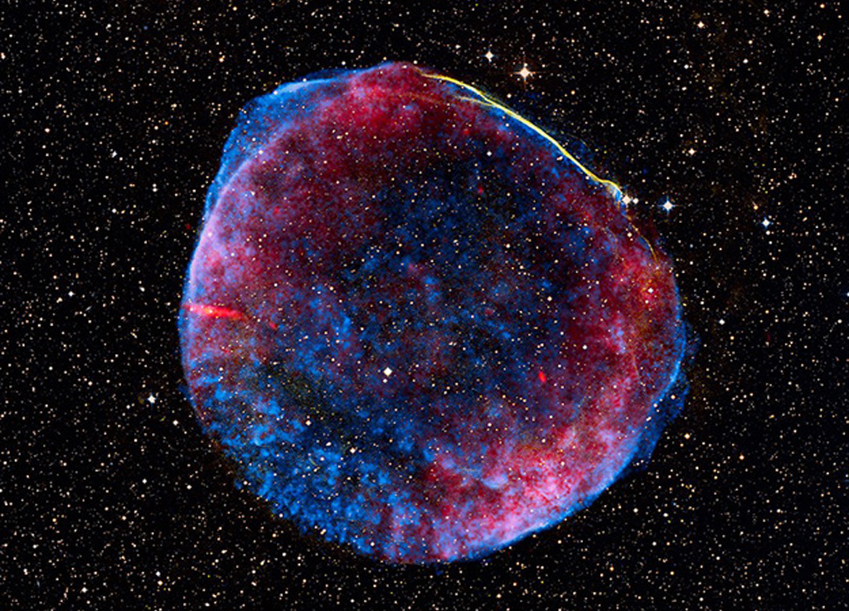
Shock waves on various scales
Earth’s bow shock
Solar flare shocks
Solar wind termination shock
Supernova remnant (SNR) shocks
Active galactic nuclei (AGN) shocks
Large-scale shocks in the galaxy clusters: - turbulence shocks - infall shocks - merger shocks
White – optical
Blue – X-ray
Red – radio

Slide 7
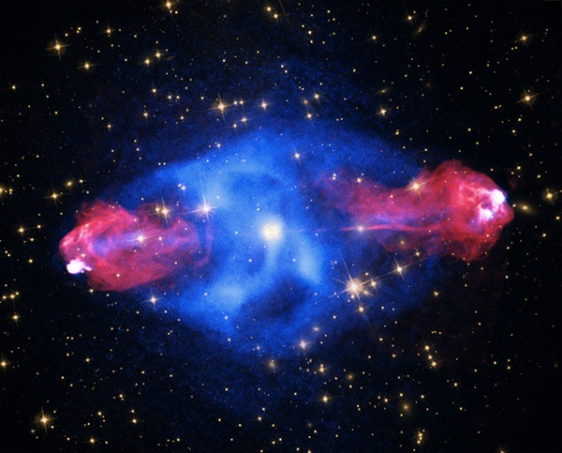
Shock waves on various scales
Earth’s bow shock
Solar flare shocks
Solar wind termination shock
Supernova remnant (SNR) shocks
Active galactic nuclei (AGN) shocks
Large-scale shocks in the galaxy clusters: - turbulence shocks - infall shocks - merger shocks
White – optical
Blue – X-ray
Red – radio

Slide 8
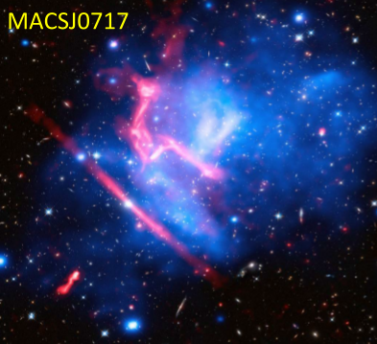
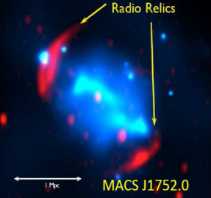
Shock waves on various scales
Earth’s bow shock
Solar flare shocks
Solar wind termination shock
Supernova remnant (SNR) shocks
Active galactic nuclei (AGN) shocks
Large-scale shocks in the galaxy clusters: - turbulence shocks - infall shocks - merger shocks
Mpc-scale
Signatures of the astrophysical shocks: X-ray and radio synchrotron emission.
Indication of the electron acceleration.
UHECR sources – ???
White – optical
Blue – X-ray
Red – radio

Slide 9
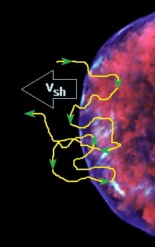
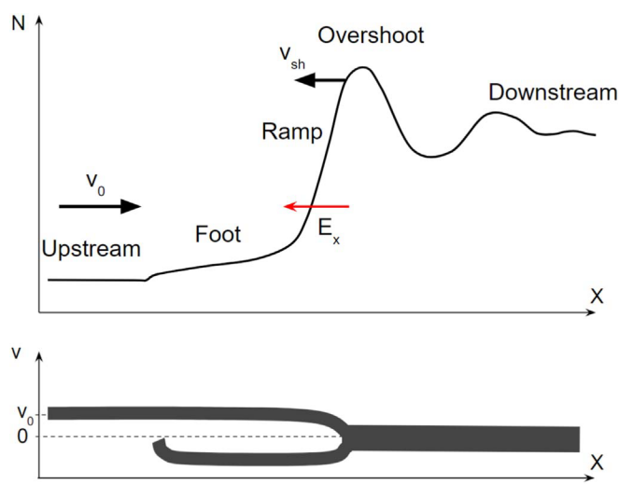
Astrophysical shock structure and particle acceleration
Perpendicular shock structure
Top: The particle number density profile.
The shock transition consists of a foot, a ramp, and an overshoot.
$E_{x}$ is the shock potential.
Bottom: The x-component of the ion velocity.
Diffusive Shock Acceleration (DSA) can produce most energetic particles, eg. Galactic CRs with energies up to $E∼{10}^{15} \text{eV}$ accelerated at SNR shocks.
Necessary conditions:
EM turbulence both downstream and upstream of the shock
Particle gyro-radius > thickness of the shock transition.
The injection is required: to be involved in DSA particle should have momentum $p≳\left(3−5\right)p_{\text{i}\text{,}\text{th}}$
$$\frac{dN(E)}{dE}∼E^{−α}$$
$$α≳2$$
The injection problem:
Pre-acceleration is required for particles to be involved in DSA. This is especially critical for electrons.
9

Slide 10
Numerical methods applied in shock physics
Application of analytic methods is limited because of strong nonlinearity of a system.
Magneto-Hydro-Dynamic
(MHD simulations) Plasma is treated as continuum
Individual particles are not resolved
Appropriate for:
Study of global system dynamics
and large-scale structures
(shock waves, magnetic turbulence etc.)
Kinetic simulations (Particle-In-Cell) Individual particles are followed
(electrons and ions) Macroscopic parameters are derived from distributions of microscopic ones
Appropriate for:
Study of plasma microphysics,
including the processes of particle acceleration
10

Slide 11
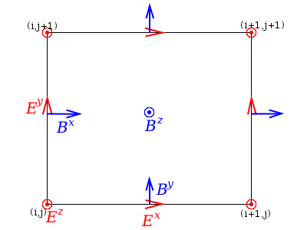
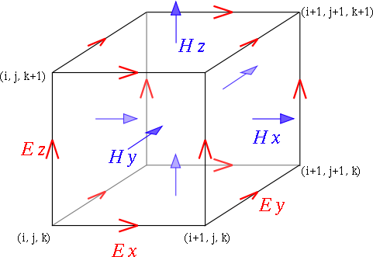
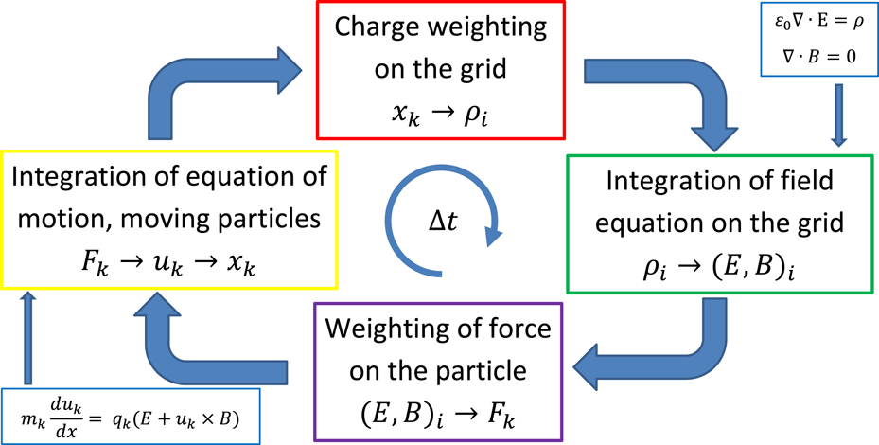
PIC-simulation method
EM fields are defined for grid elements.
Particles motion is continuous in space with finite time steps.
Super-computer clusters are used for PIC-simulations.

Slide 12
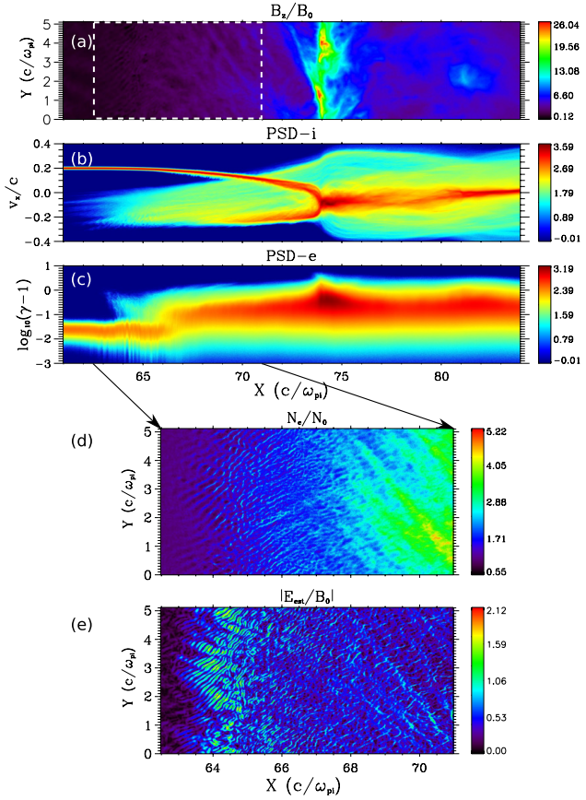
Electron acceleration at (quasi-)perpendicular SNR shocks
Shock Drift Acceleration (SDA)
Electrons undergo the |B|-gradient drift in the shock transition region.
Acceleration is due to motional E field:
$$Δγ=\frac{−e}{mc^{2}}\int{E_{z}dz}≈\frac{−e}{mc^{2}}E_{z}^{up}Δz$$
Shock Surfing Acceleration (SSA)
If shock Mach number is high enough $M_{A}≥(1+α){\left(\frac{m_{i}}{m_{e}}\right)}^{\frac{2}{3}}$
Electrostatic waves are generated ahead of shock due to the Buneman instability.
Electrons are trapped by the electrostatic potential and accelerated in the same way.
Figs. by Matsumoto, Amano & Hoshino (ApJ 2012)

Slide 13
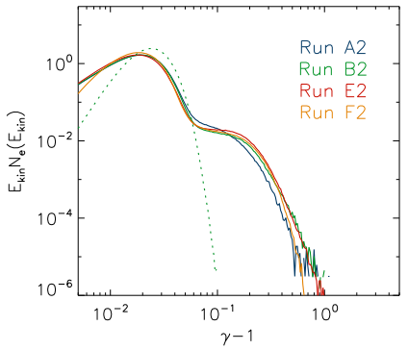
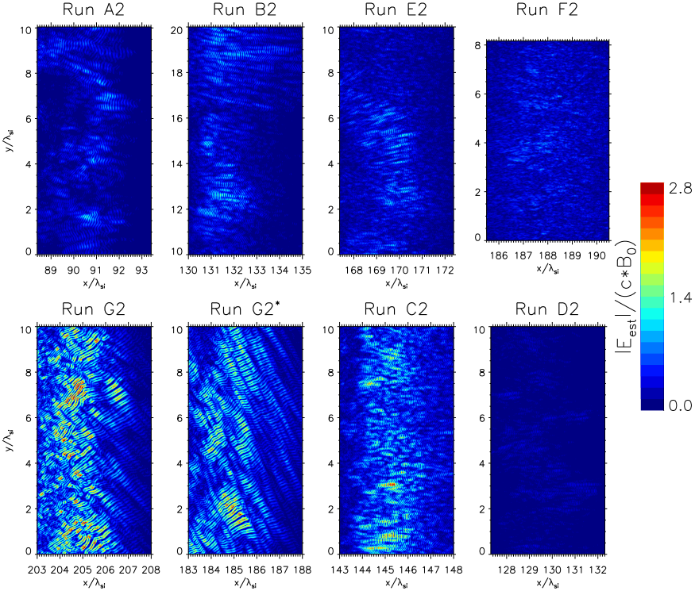
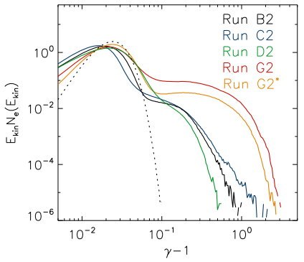
Electron acceleration at (quasi-)perpendicular SNR shocks
Role of the Buneman instability for SSA
Figs. by Bohdan et al. (ApJ 2019)

Slide 14
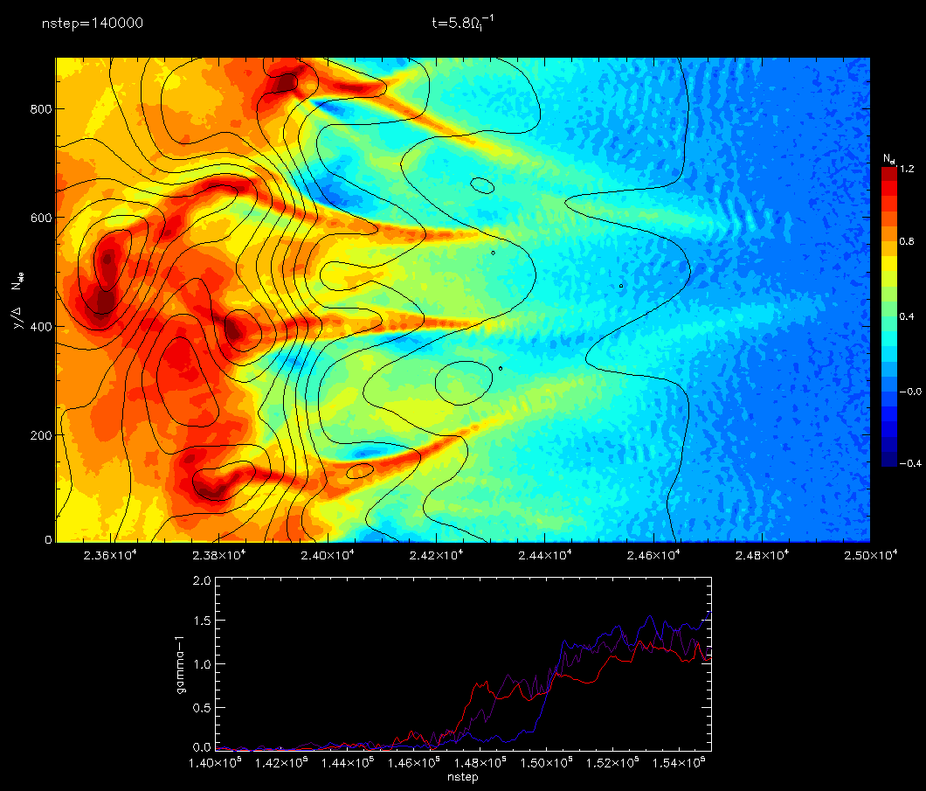
Electron acceleration at (quasi-)perpendicular SNR shocks
SSA accompanied by acceleration at the magnetic reconnection regions
Ion Weibel instability results in the strong magnetic turbulence in the transition region.
Filaments with magnetic islands arise.
Electrons are accelerated at the reconnection X-points.

Slide 15
Electron acceleration at shocks in galaxy clusters
Mpc-scale merger shocks in galaxy clusters:
Propagate in hot weakly magnetized plasma with high plasma beta $β≫1$.
Have low Mach numbers $M≲4$.
Physical conditions are not appropriate for SSA or Buneman instability.
X-ray and synchrotron radio emission indicate the electron acceleration to non-thermal energies.
Series of recent studies showed the important role of SDA or stochastic SDA (SSDA) processes for electron acceleration at such physical conditions.
SSDA is a kind of SDA process accompanied by the elastic pitch-angle scattering of electrons by the magnetic turbulence.

Slide 16
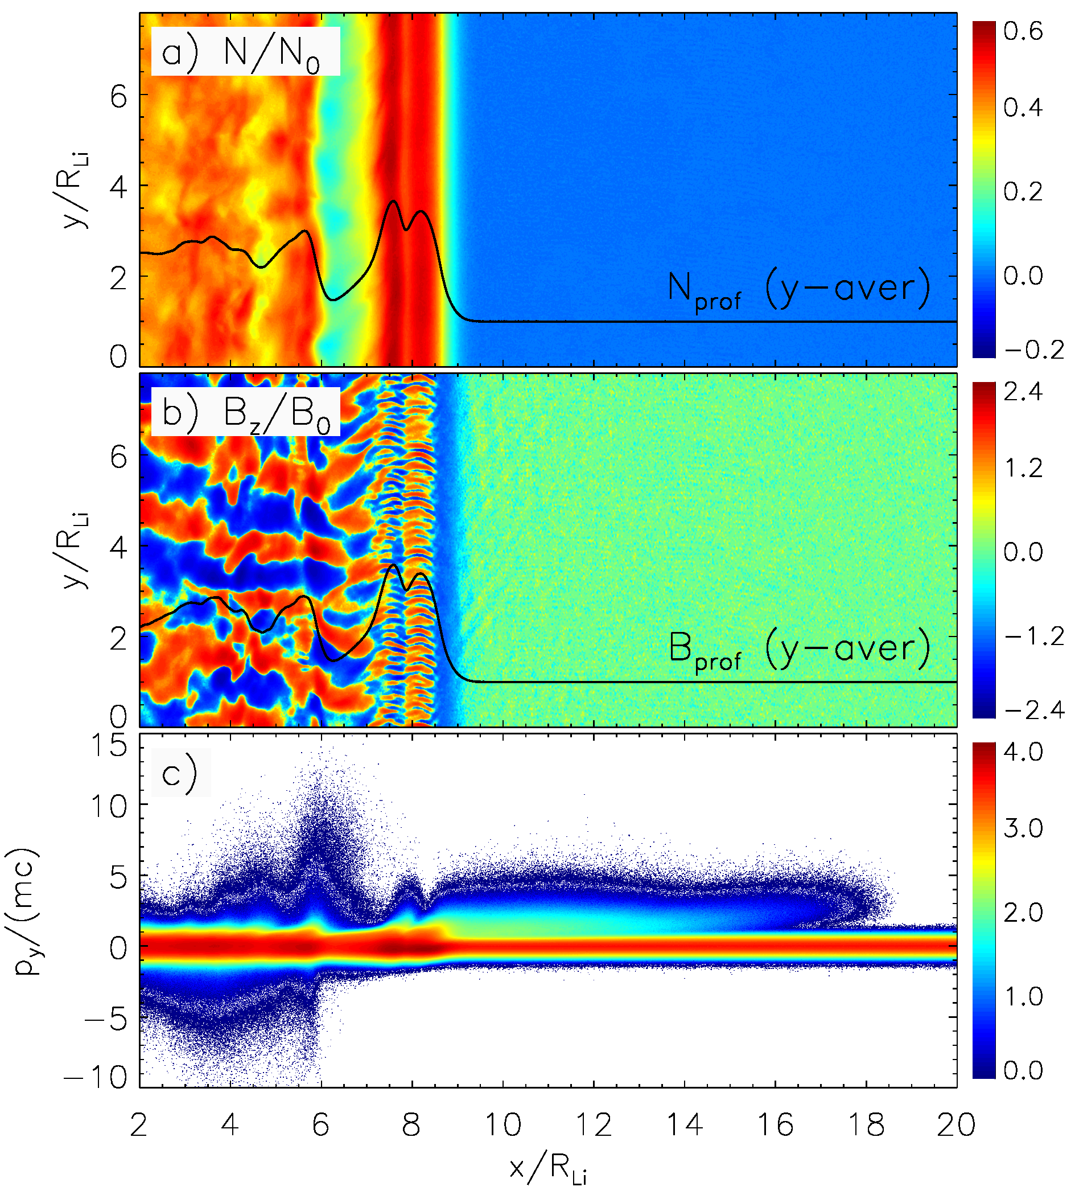
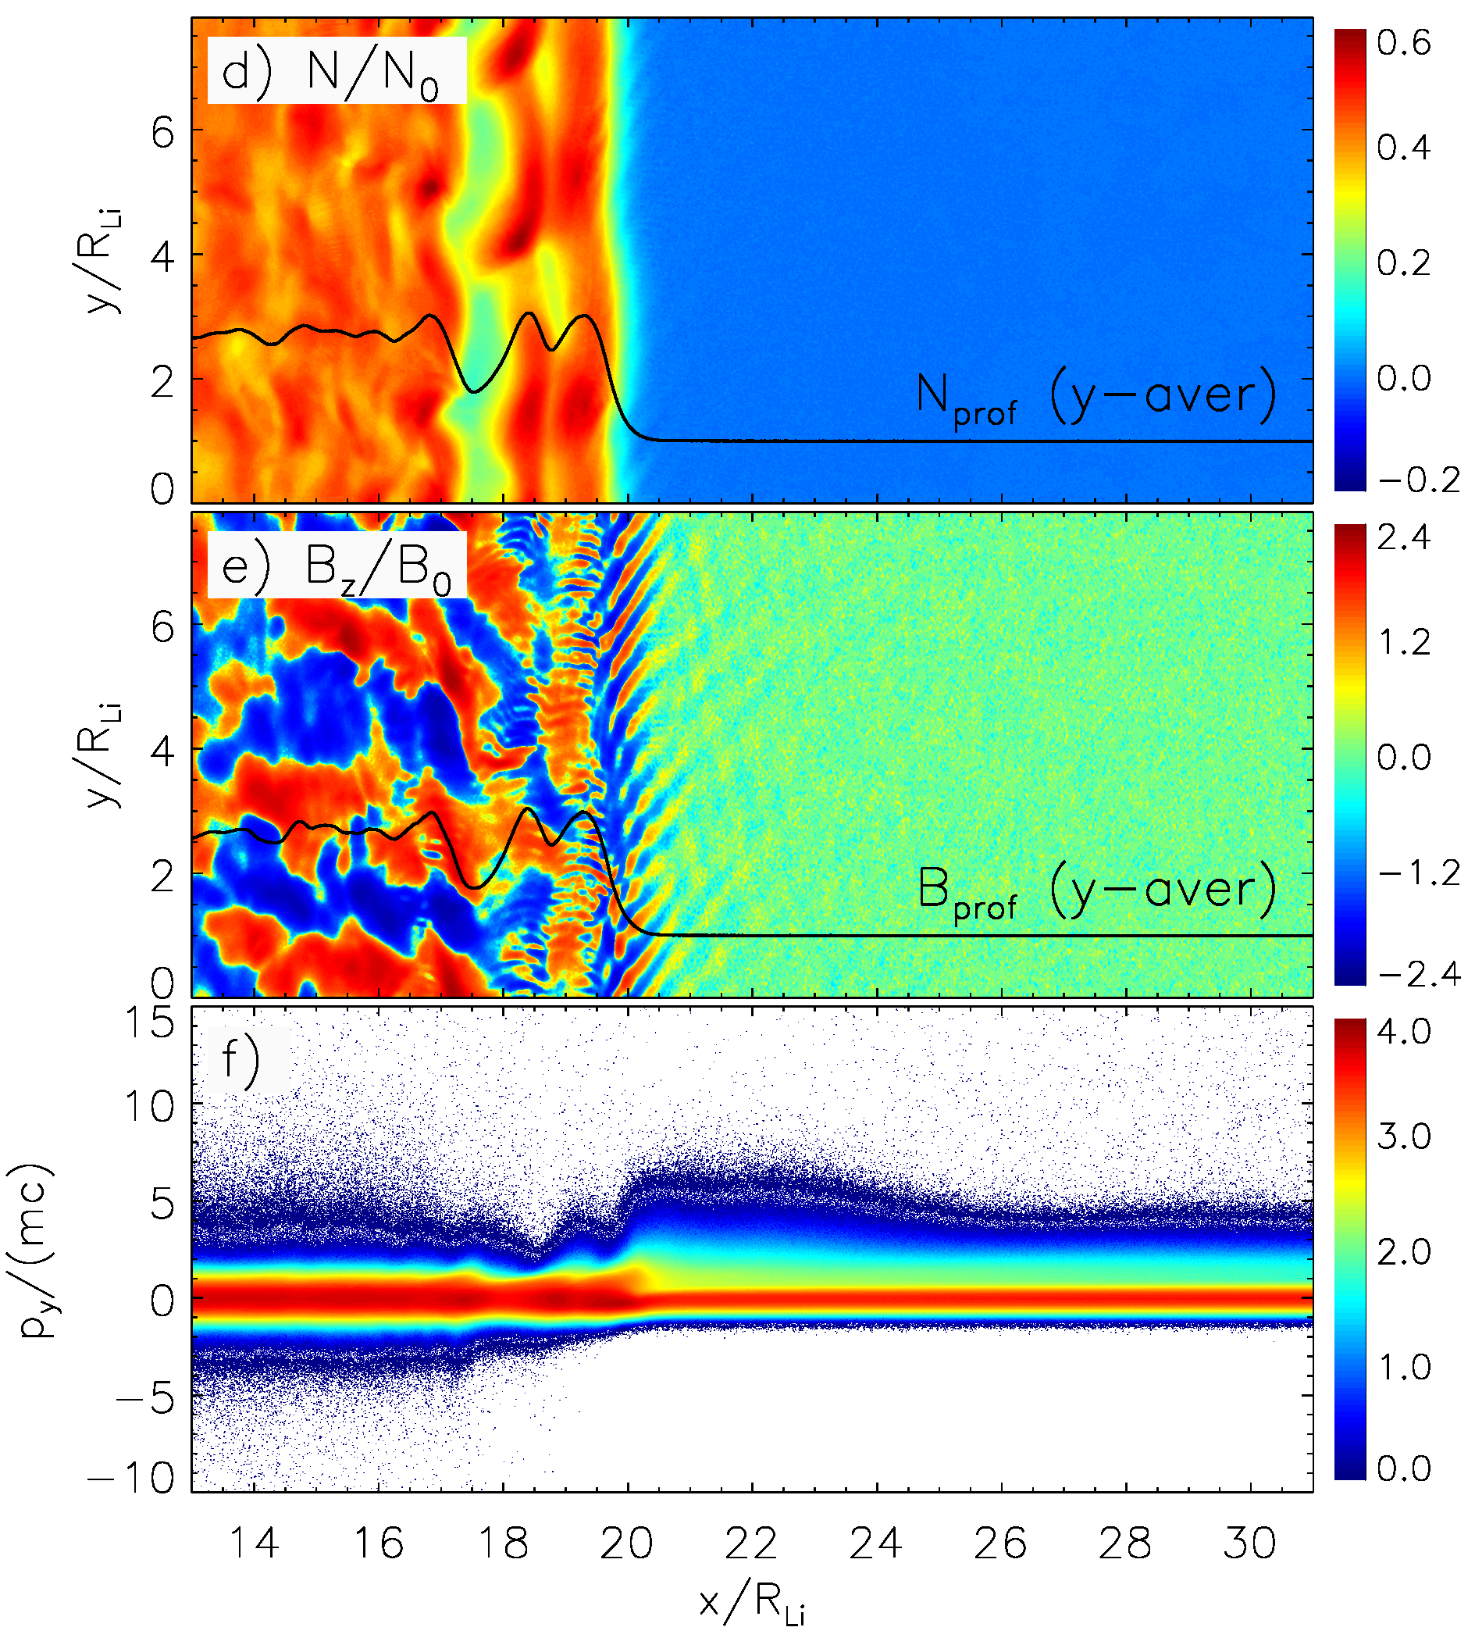
Electron acceleration at shocks in galaxy clusters
Shock parameters
3
Quasi-perpendicular.
Sonic Mach number $M=3$.
Plasma temperature $T=5∙{10}^{8} \text{K}$ (43 keV).
Plasma beta $β=5$.
3
Wave modes
2
1
Electron whistlers.
Magnetic waves due to oblique mode of electron firehose instability (EFI), or EFI-waves.
Shock rippling modes due to Alfven ion cyclotron (AIC) instability.

Slide 17
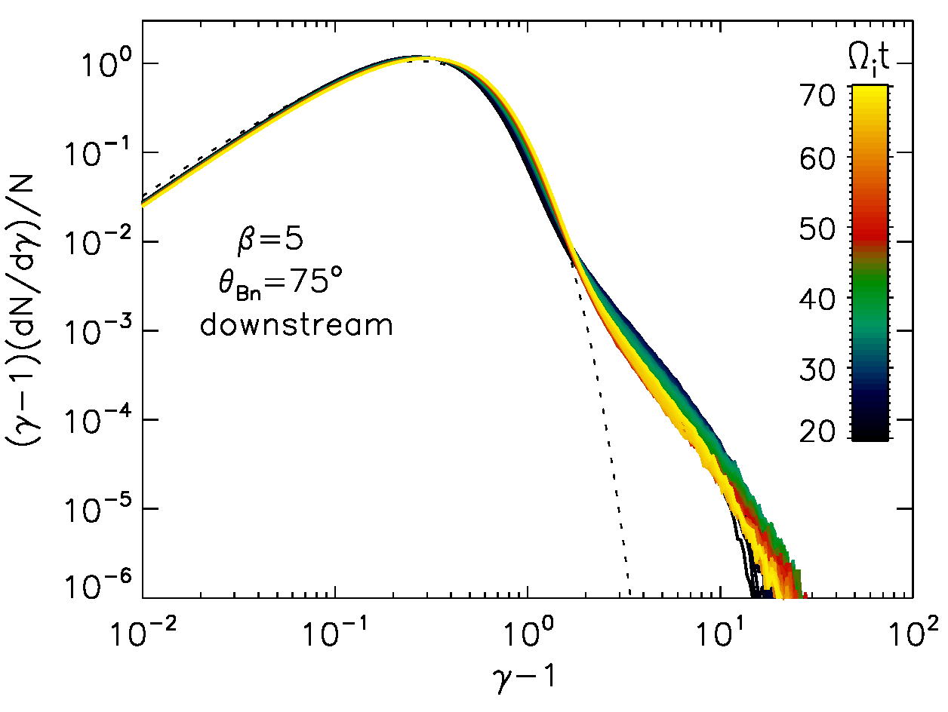
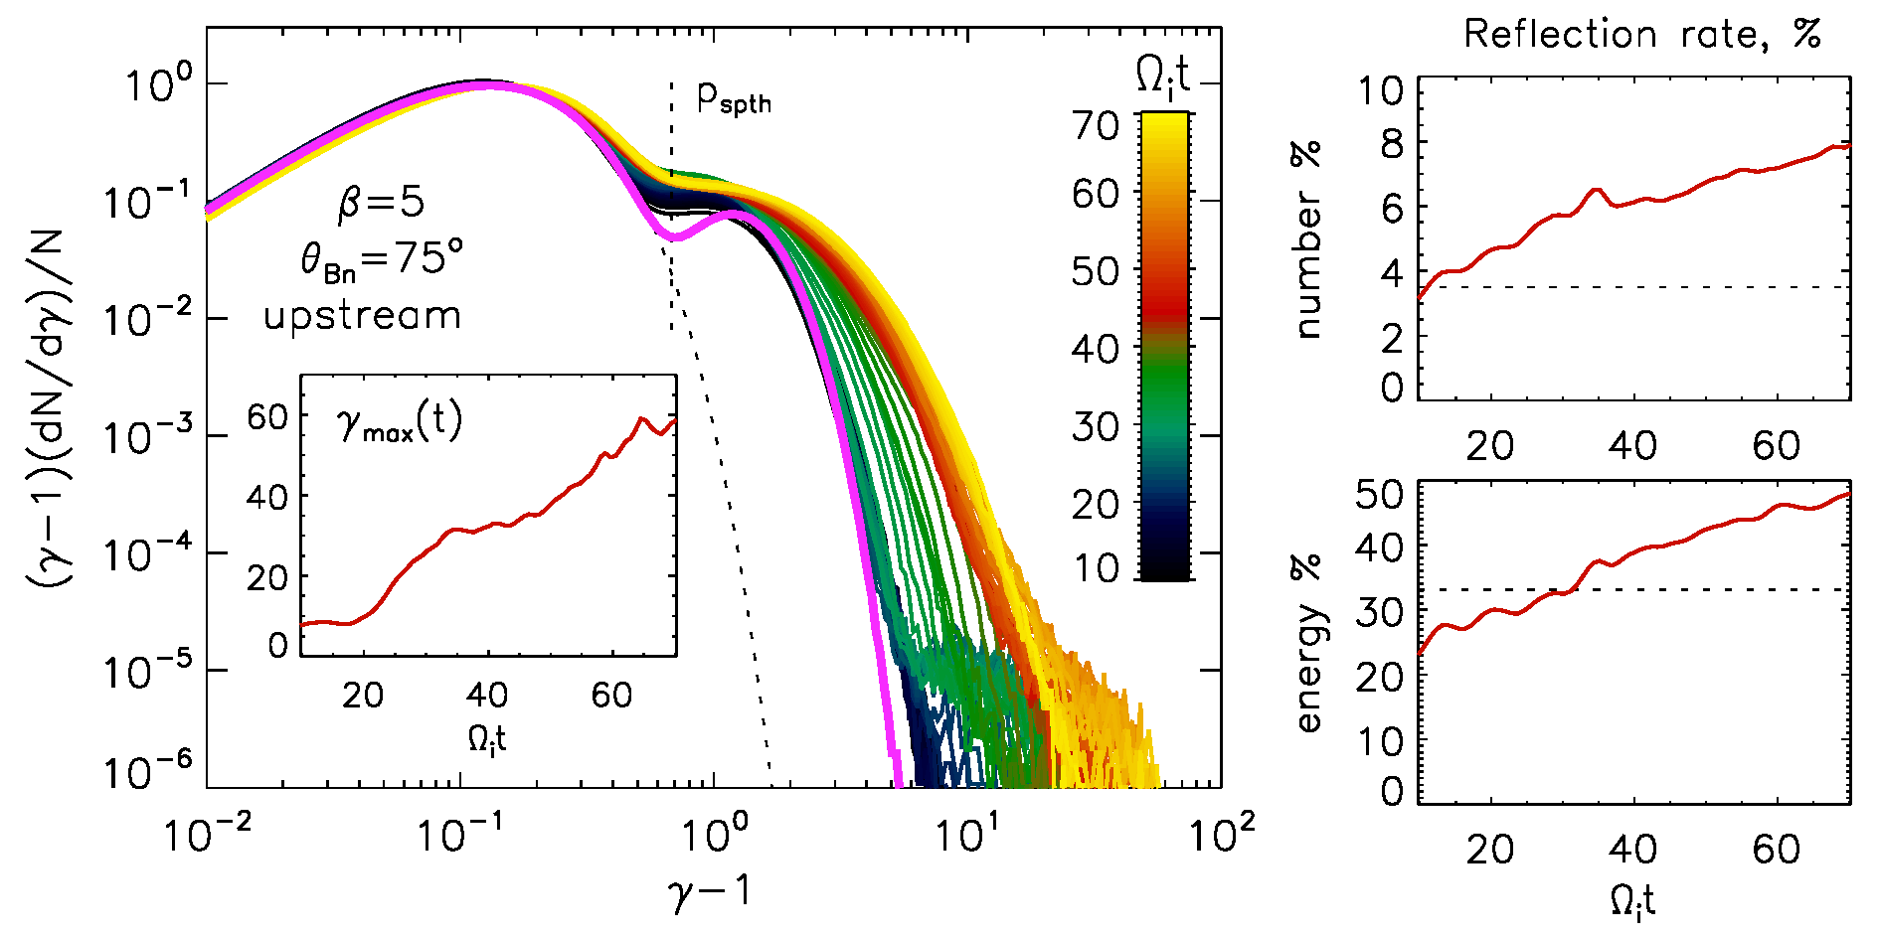
Electron acceleration at shocks in galaxy clusters
Evolution of the electron energy distributions
Electron kinetic energies reach the values much higher than SDA theory prediction.
The dominating process is SSDA.
This correlates with appearance of the shock rippling.

Slide 18
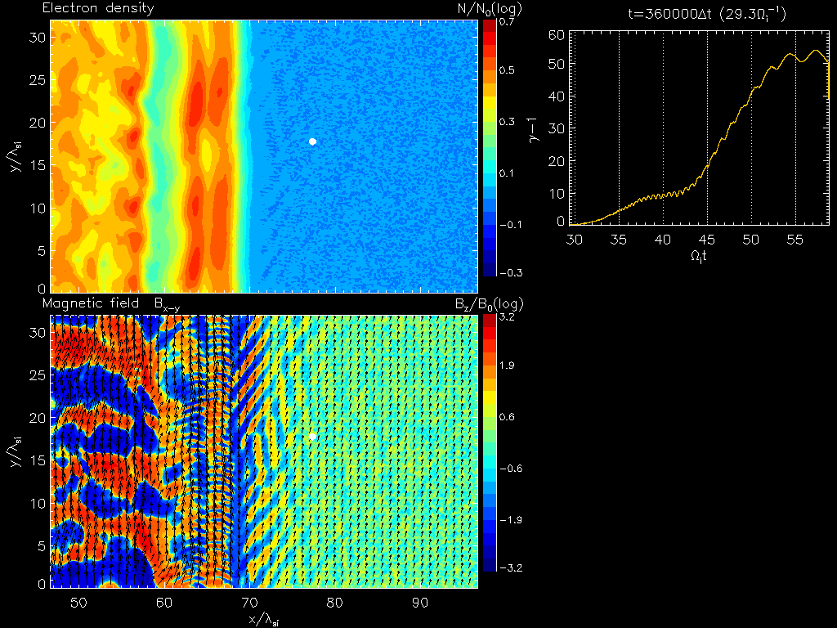
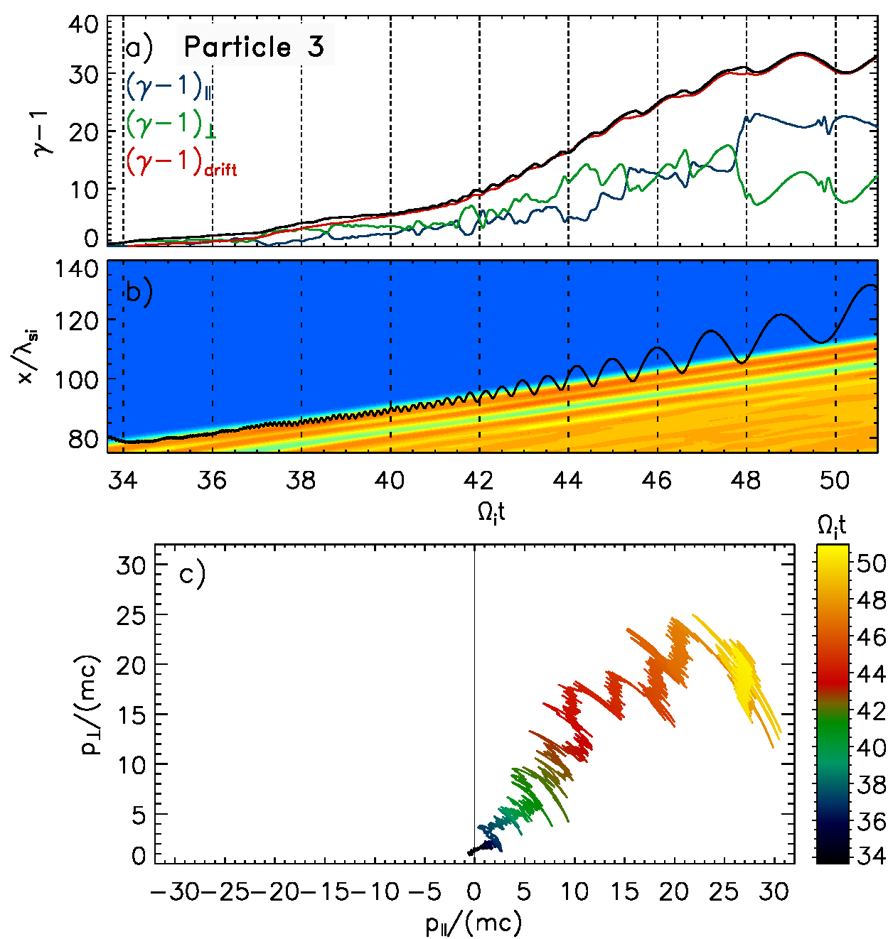
Electron acceleration at shocks in galaxy clusters
SSDA process

Slide 19
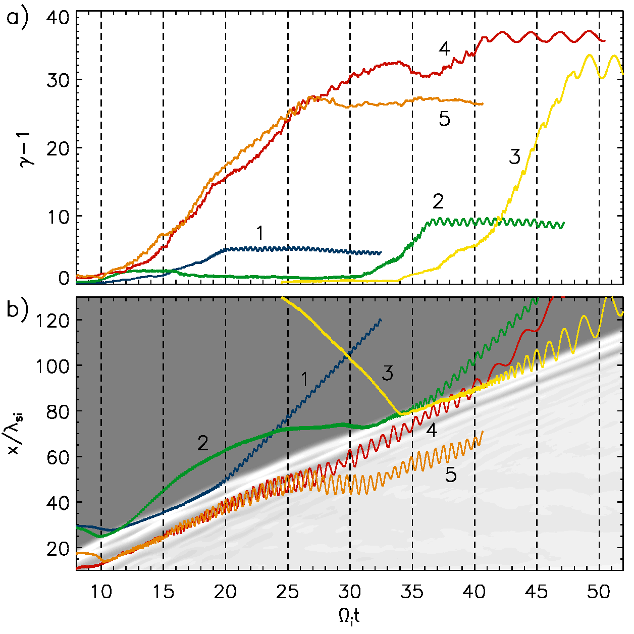
Electron acceleration at shocks in galaxy clusters
Possible types of the electron acceleration at the rippled shock
Single-cycle SDA process − regular.
Double-cycle SDA process − rare, second cycle occurs at rippled shock.
The SSDA process − typical for rippled shock.
Accelerated via SSDA in the undershoot and scattered to the upstream.
Accelerated via SSDA in the undershoot and scattered to the downstream.
Conclusion:
The dominant acceleration mechanism is SSDA.
Circumstance:
Gradual increase of the turbulence scale: whistlers → EFI-waves → rippling modes.

Slide 20
Summary
Shock waves in cosmic plasma can accelerate particles to high energies through 1-st order Fermi mechanism – Diffusive Shock Acceleration (DSA).
(Quasi-)parallel shocks are more efficient for ion acceleration, while
(quasi-)perpendicular shocks are more efficient for electron acceleration.
Pre-acceleration (injection) is necessary for particles to be involved in DSA.
Shock Surfing Acceleration (SSA) and Shock Drift Acceleration (SDA) can be the plausible pre-acceleration mechanisms for the following injection to DSA.
Plasma instabilities are crucially important for the efficiency of pre-acceleration.
Particle-wave interaction with magnetic turbulence through pitch-angle scattering results in stochastic SDA (SSDA).
The SSDA process is found to be much more efficient than regular SDA, and it is potentially able to give the particle energy enough for injection to DSA.

Slide 21
Thank You!

