Slide 1
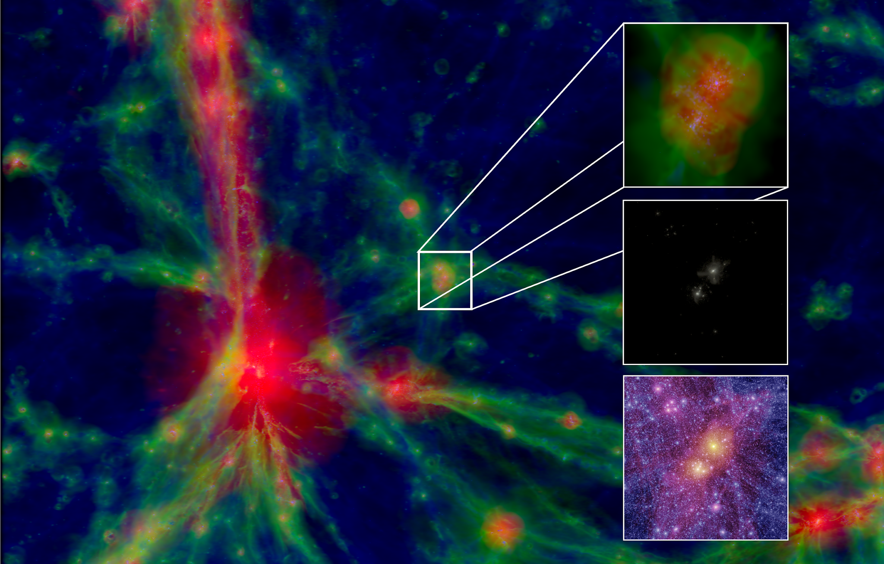
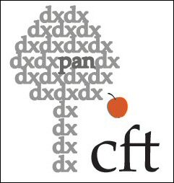
Cosmic web or cosmic variance? The impact on the large-scale environment on various dark matter observables
Wojtek Hellwing
Center for Theoretical Physics PAS
Feven
Markos-Hunde
Oliver Newton
Maciej Bilicki
Credit: EAGLE simulation & The VIRGO consortium

Slide 2
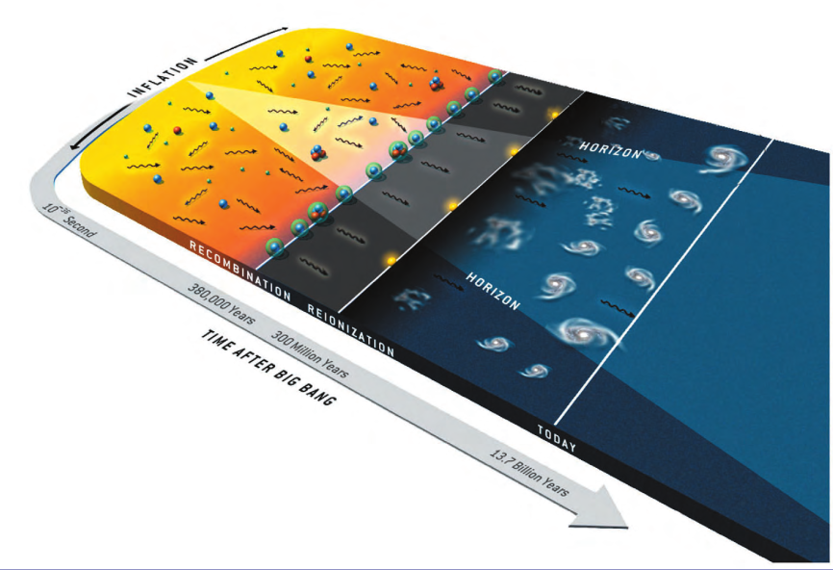
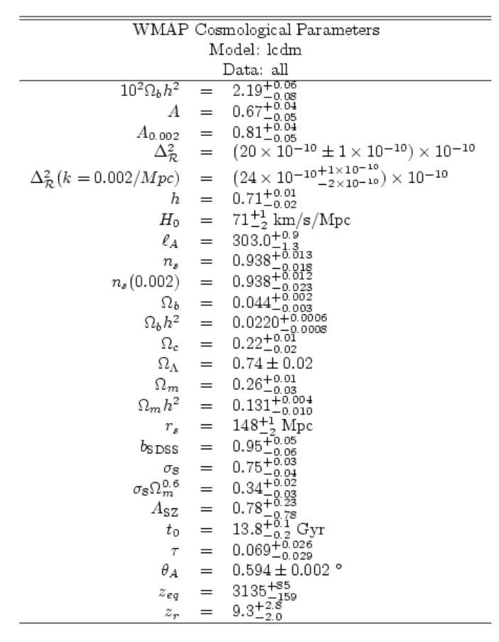
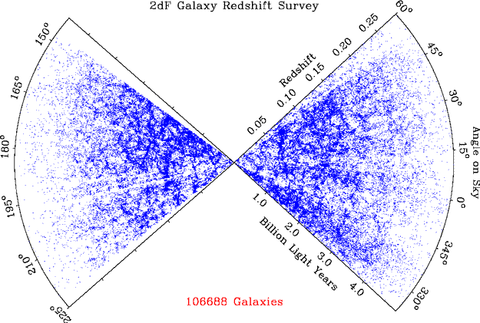
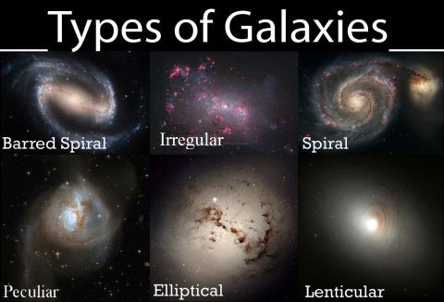
From smooth background to specks
Non-relativistic (remnant) gravitating Dark Matter?
The initial conditions of the Universe can be summarized on a single sheet of
paper, yet thousands of books cannot fully describe the complex structures
we see today… Why?
Gravitational instability!

Slide 3
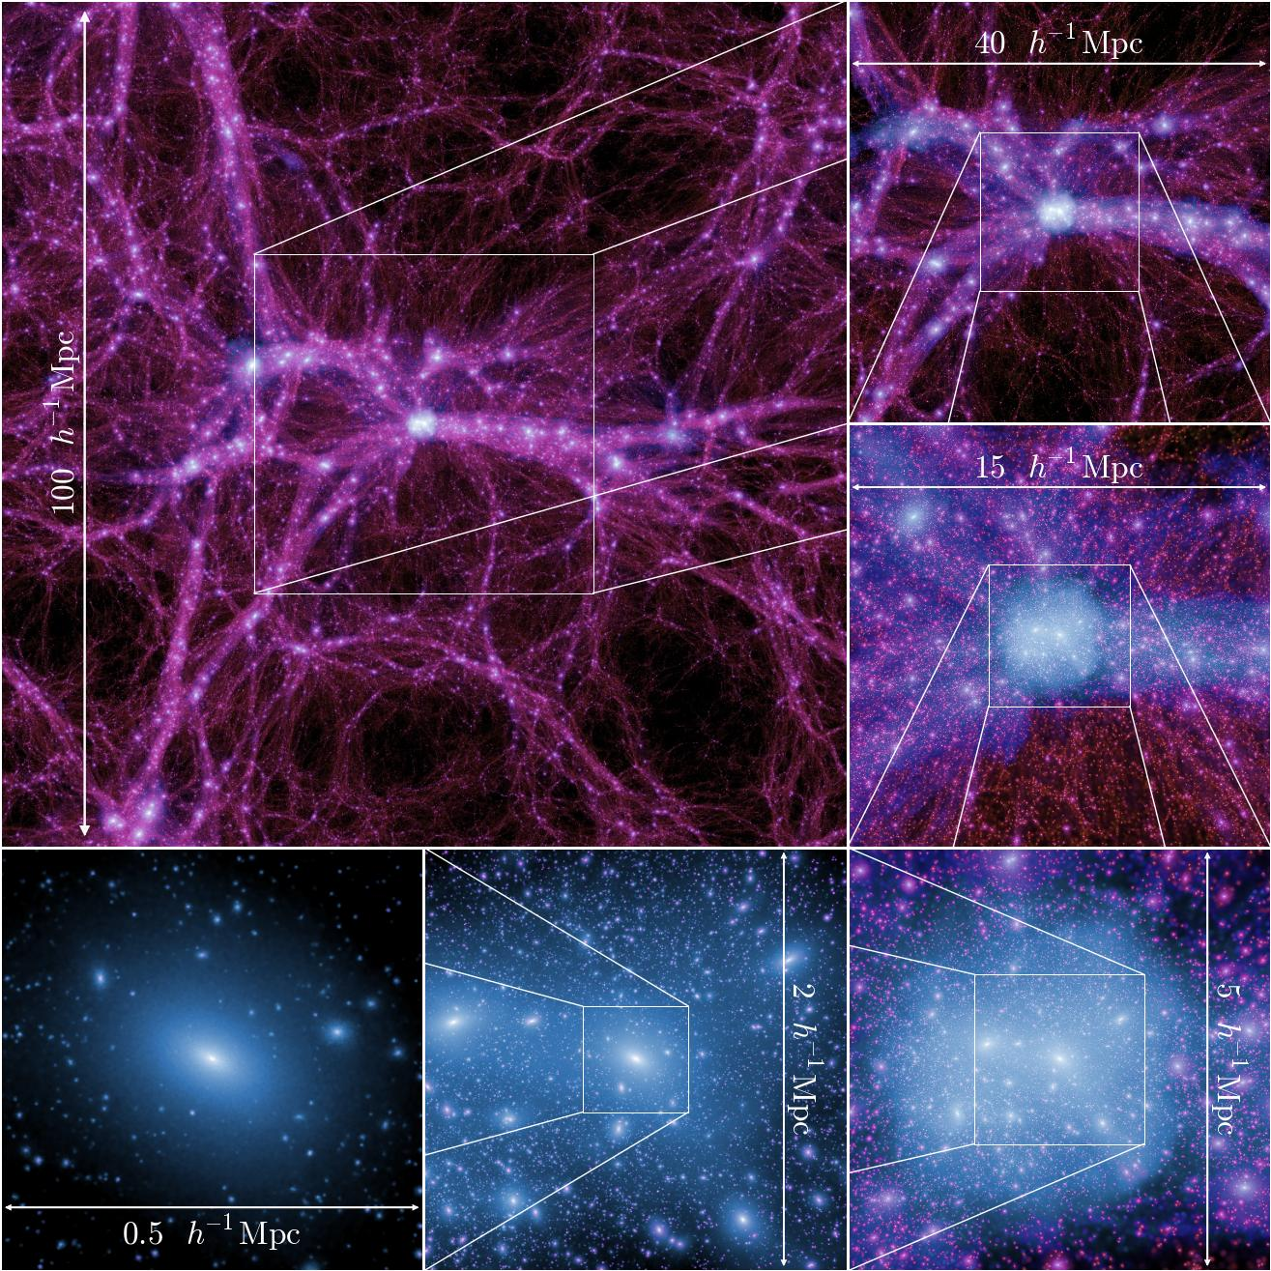
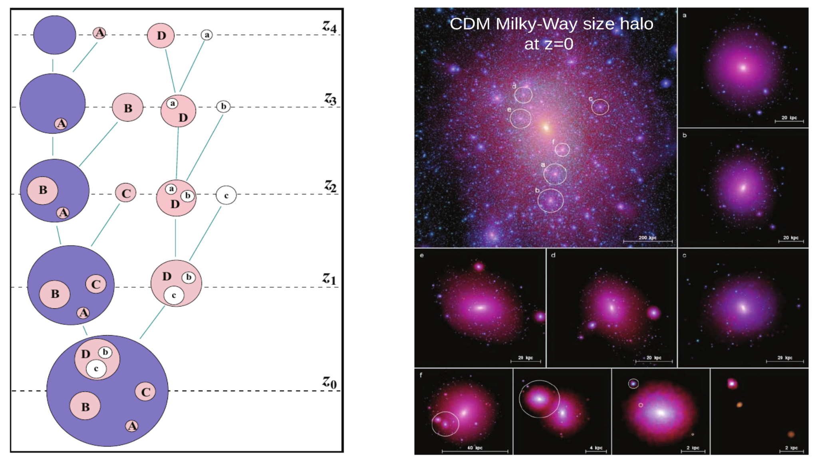
Non-relativistic DM:
- scale-free initial P(k);
- bottom-up (hierarchical) structure assembly
DM haloes are self-similar
Boylan-Kolchin et al. 2009
Springel et al. 2008

Slide 4
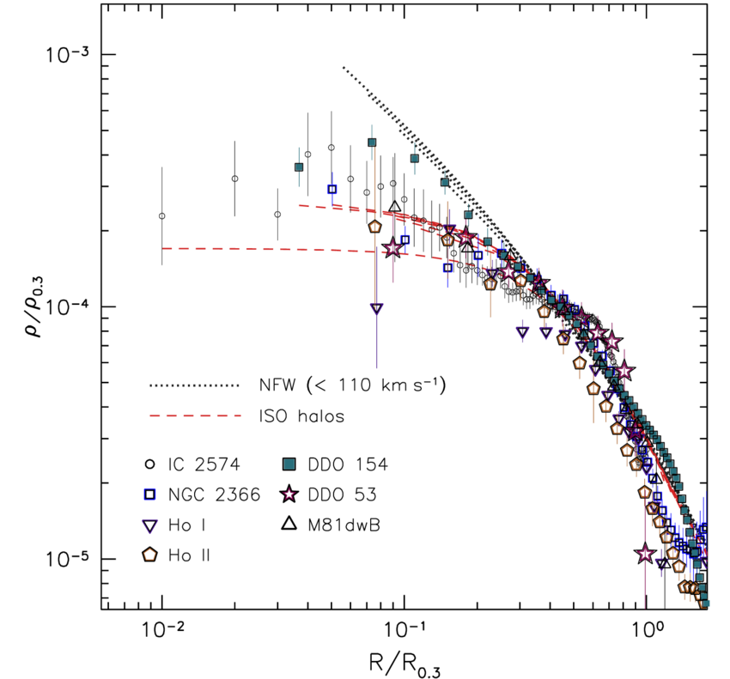
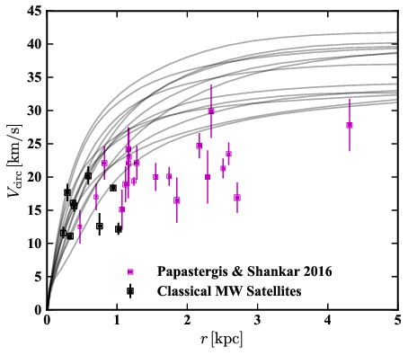
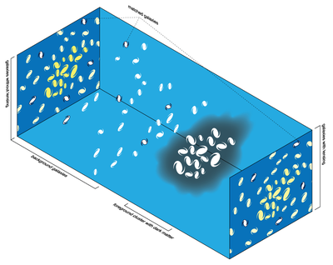
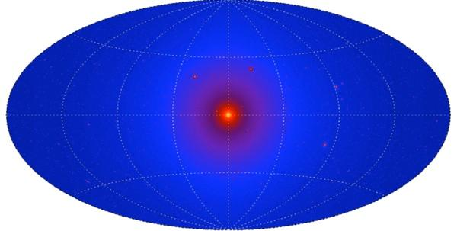
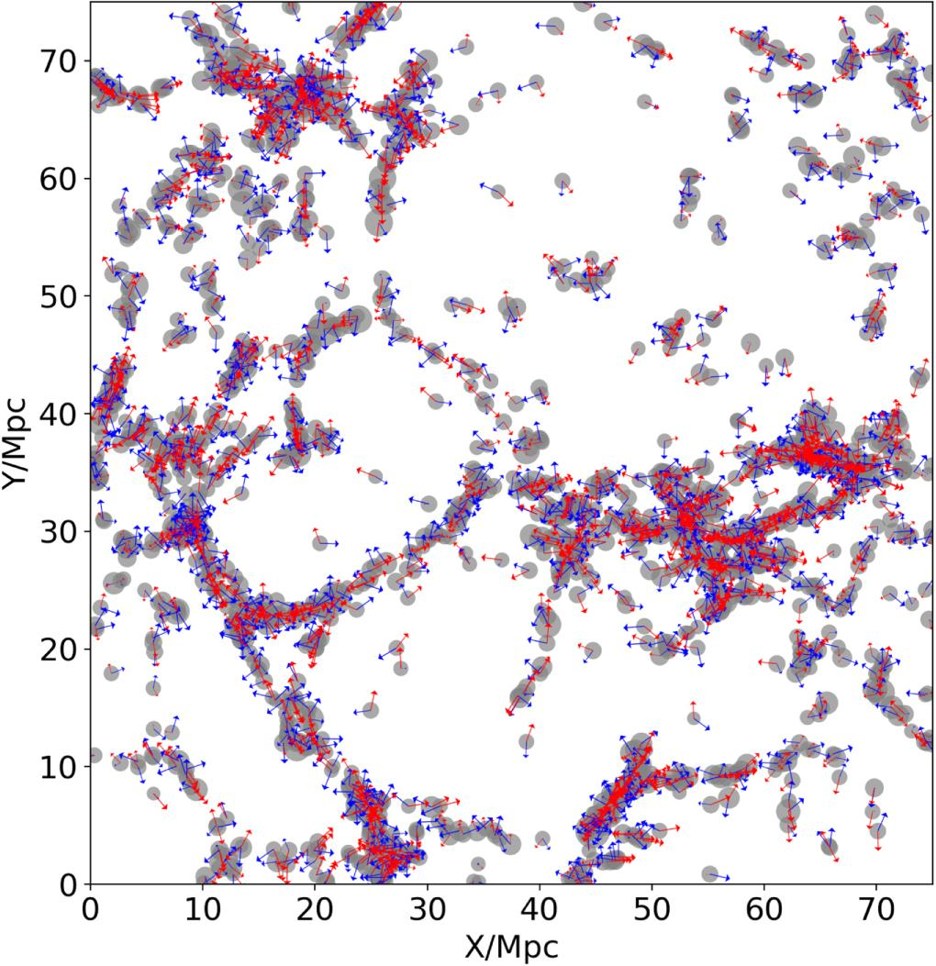
PROMISE: I will show you that the Cosmic Web matters dearly if you want to lower the systematic errors!
Resolving and assessing internal DM halo (and subhalo)
properties is important for number of reasons:
internal halo/galaxy kinematics
(core-cusp, too big to fail)
density profiles
(γ-rays annihilation signal, X-ray decay, strong lensing)
shapes
(weak lensing, intrinsic alignments)
spins
(LSS alignment, TTT)

Slide 5
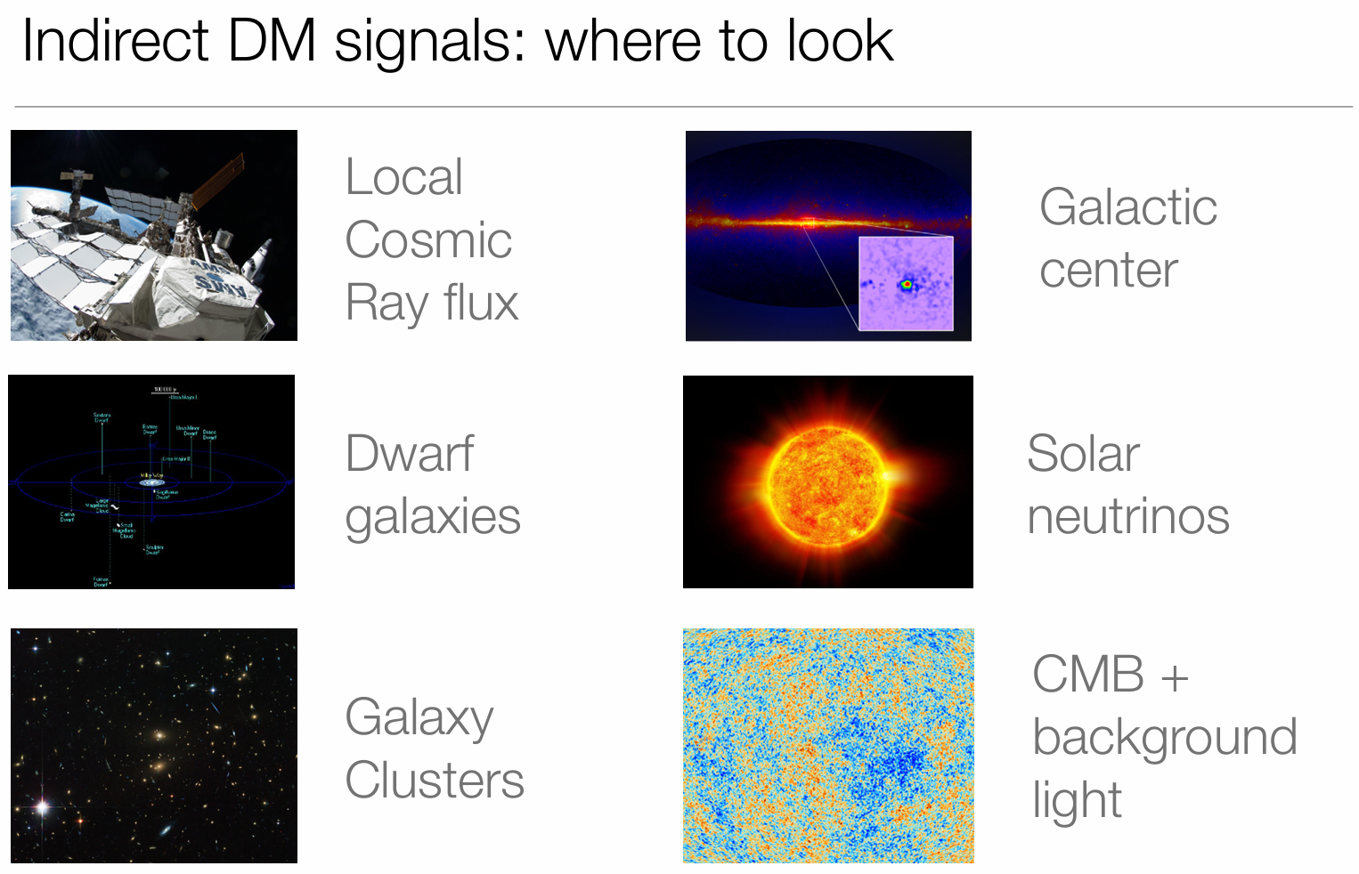
Courtesy: Aaron Vincent

Slide 6
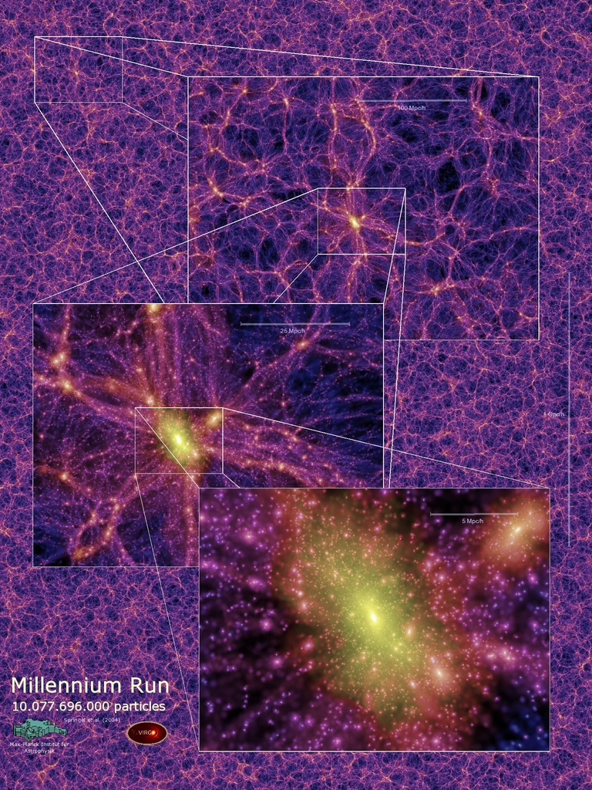
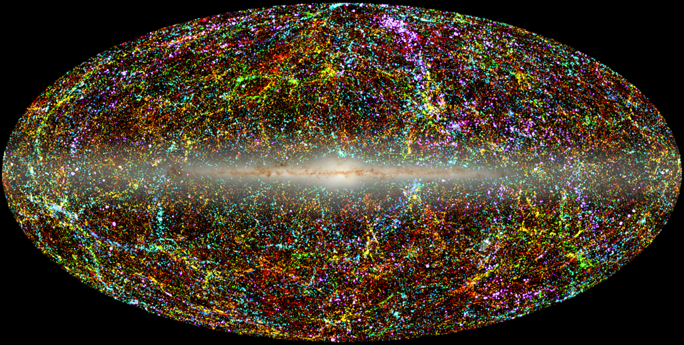
What is the Cosmic Web?
2MASS all sky (J. Huchra 2002)
Complex Web is a pattern
emerges on Scales from ~1Mpc to 100s Mpc
in which matter, gas and galaxies aggregate
poses 4 main distinct “features”: compact nodes (galaxy clusters) connected via elongated filaments between which flattened sheets stretch, wrapping around empty voids.

Slide 7
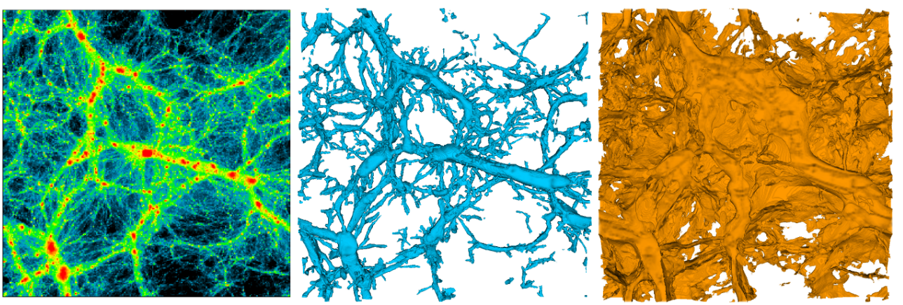
How to identify the Cosmic Web elements?
Standard answer:
use eigenvalues of density/velocity field Hessian matrix.
Pros: easy and straightforward
Cons: user dependent (scale and threshold), require fine tuning

Slide 9
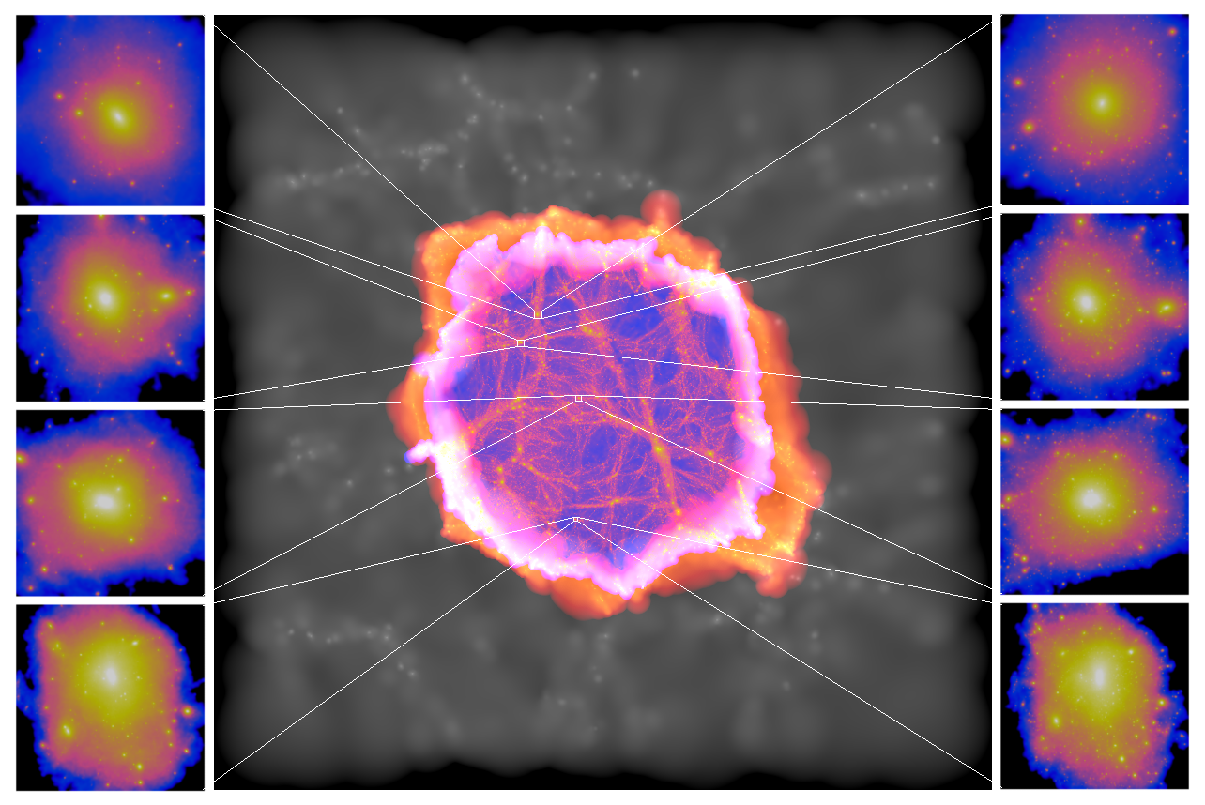
Copernicus Complexio: zoom-in simulation suite
Mass resolution: 1.35x10⁵M☉/h
Force resolution:
ε=230 pc/h
high-res volume:
~2.2x10⁴(Mpc/h)³
Bose, WH, et al. 2016

Slide 10
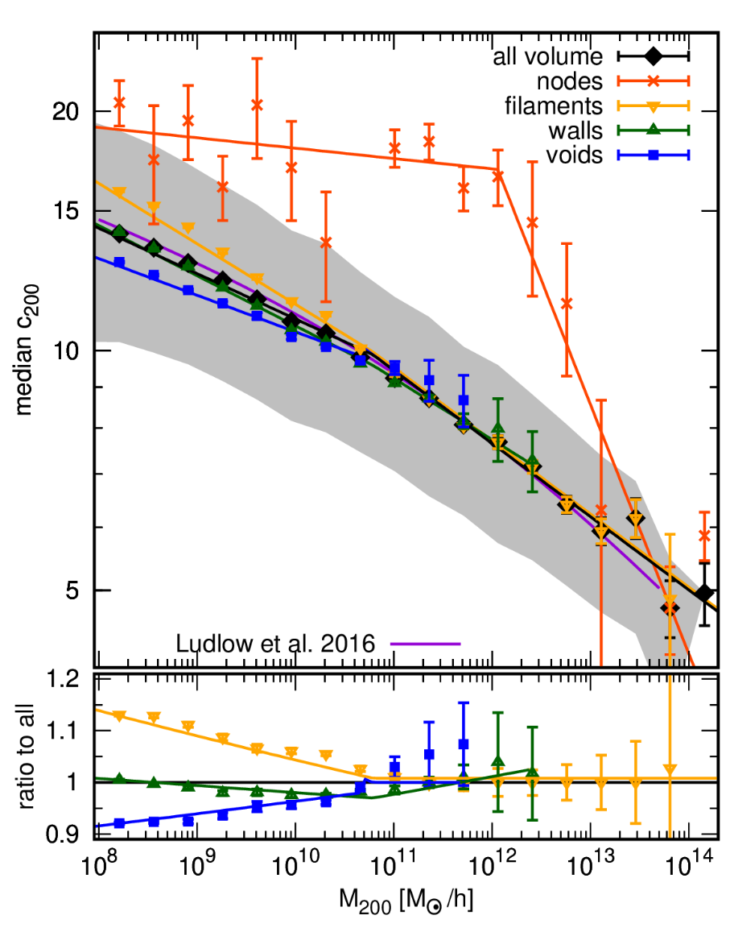
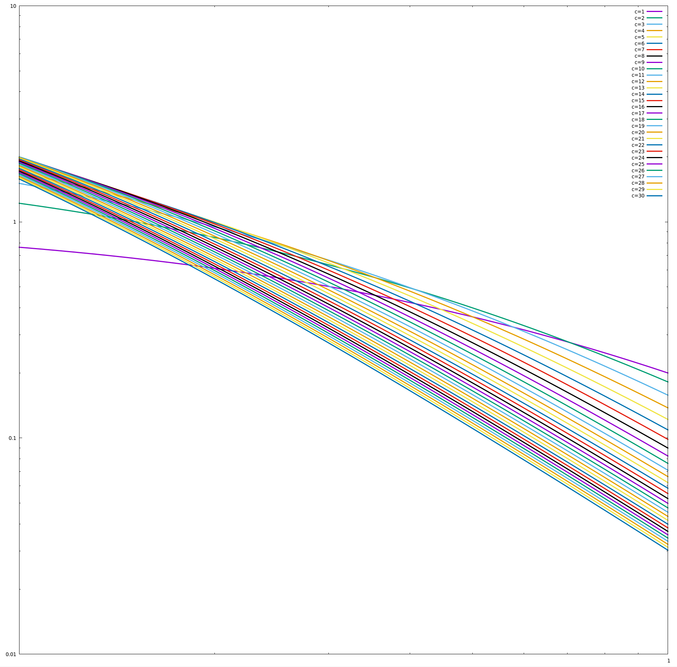
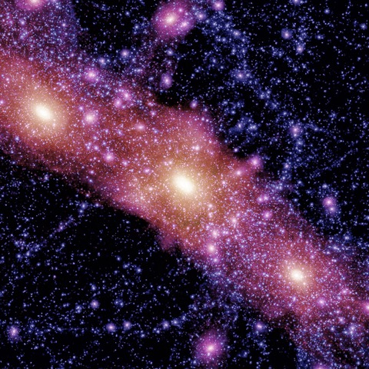
Concentration-mass: first look
density
Hellwing et al. 2021
radius

Slide 11
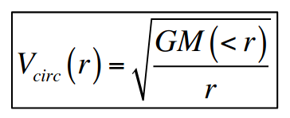
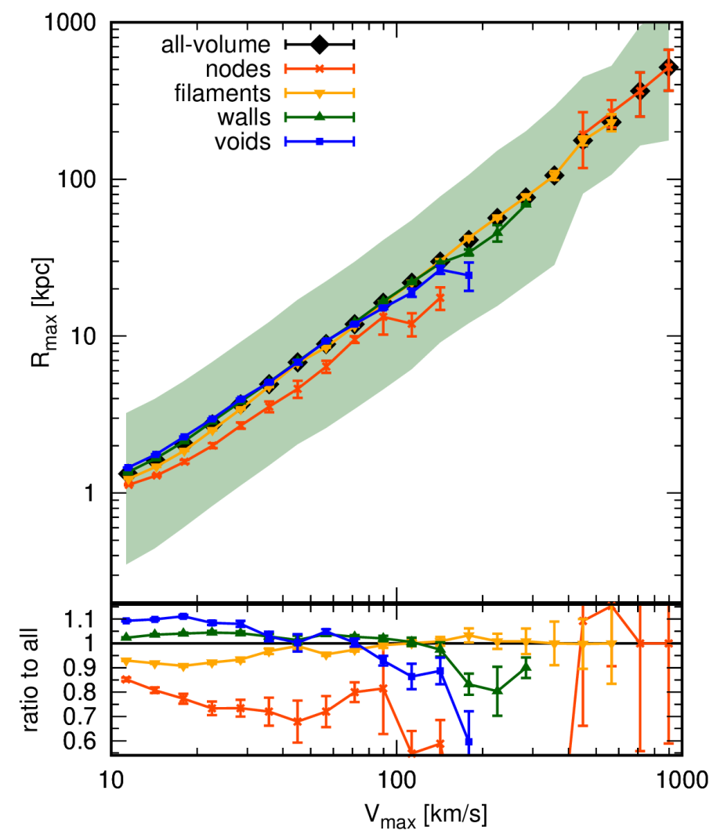
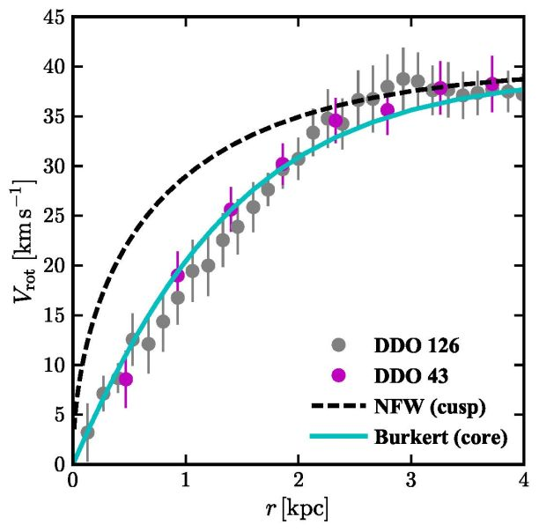
Concentration-mass: vmax-rmax
?
Hellwing et al. 2021

Slide 12
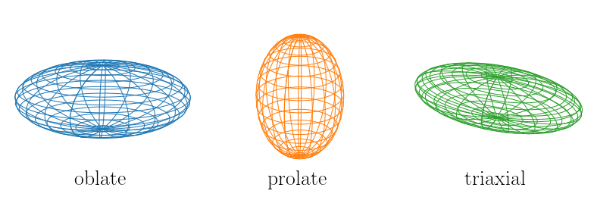
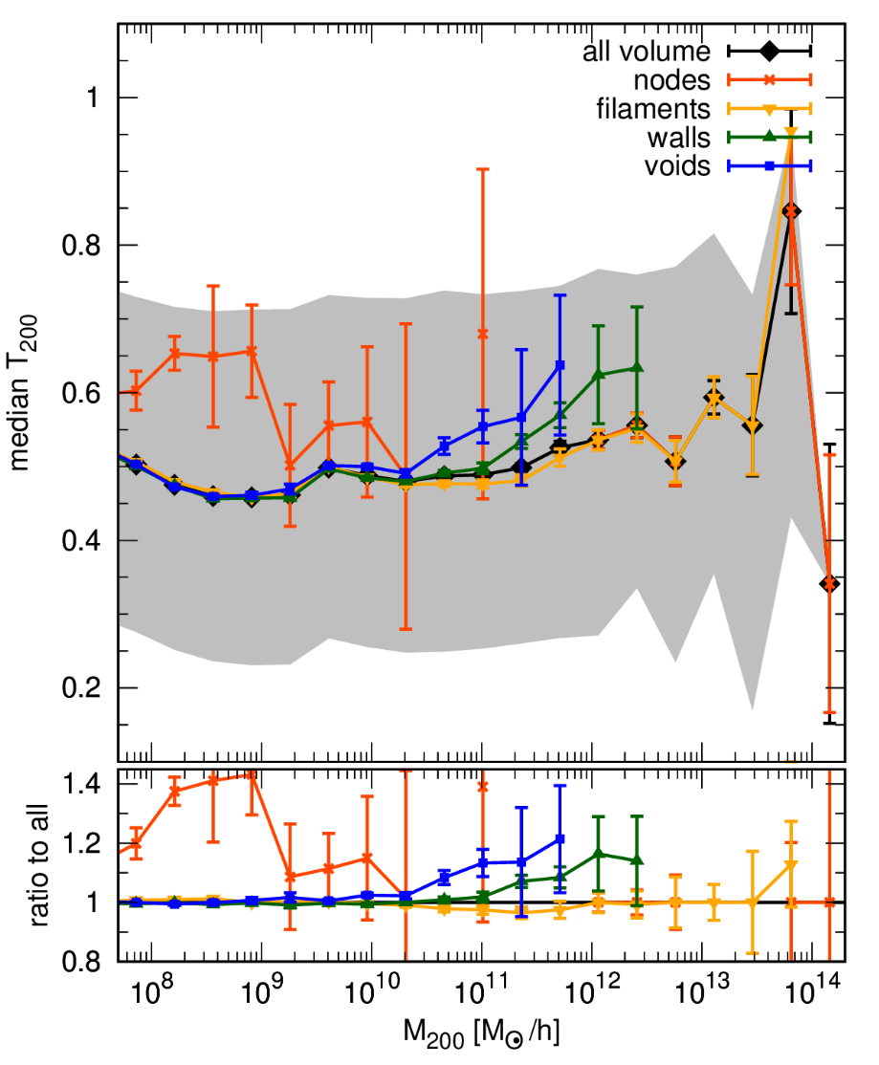
Shape-web effect has a different nature though…

Slide 13
Bonus track: subhaloes (means satellites!)
MW satellites would reside in DM subhaloes. The numbers and properties of those we can predict from simulations.
cold dark matter
Project() in development with my PhD student: Feven Marcos-Hunde
Bose, Hellwing, et al. 2016

Slide 14
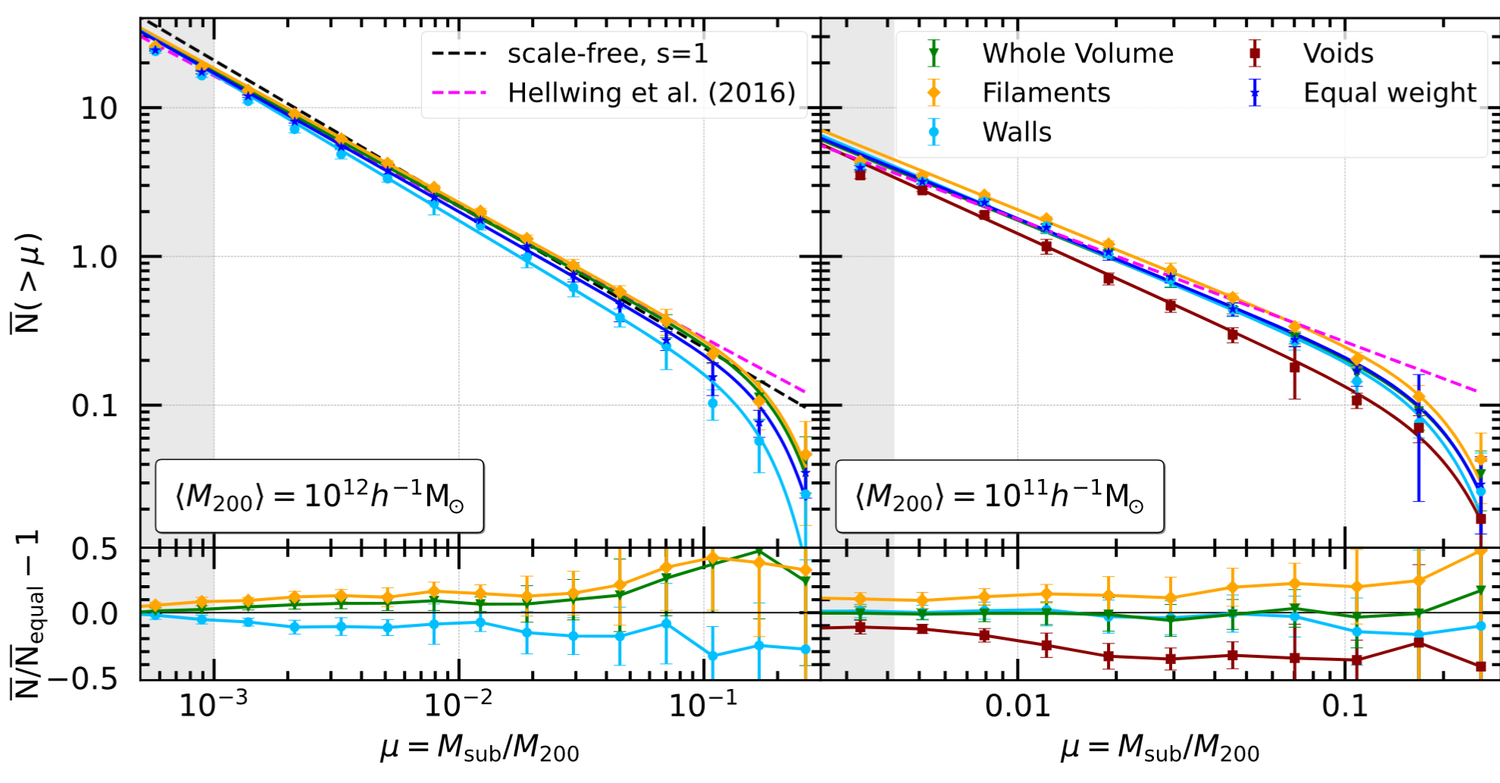
subhaloes in the cosmic web (abundance)
Hunde et al. (arXiv:2409.09226, submitted to A&A)

Slide 15
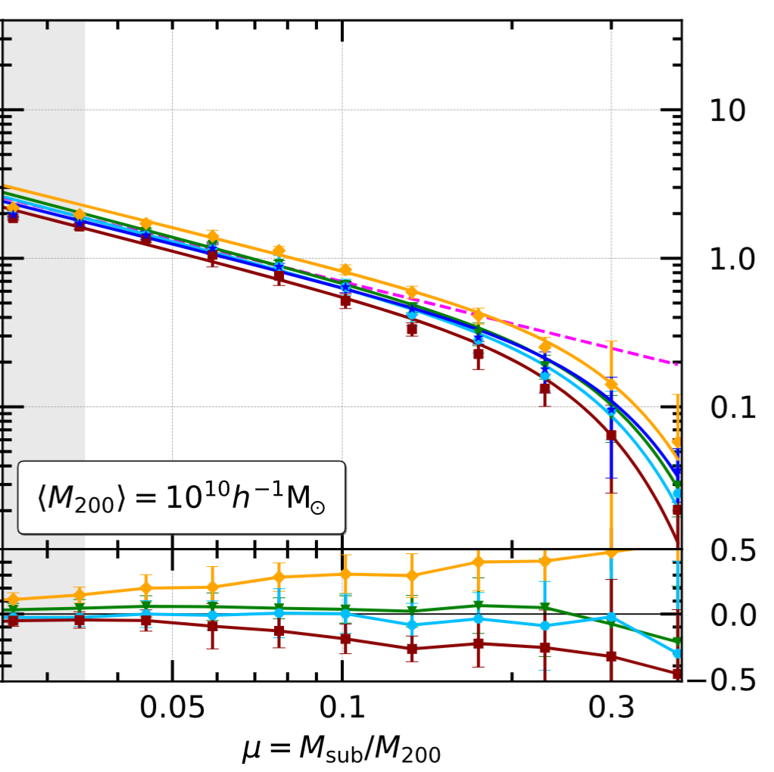
subhaloes in the cosmic web (abundance)
Hunde et al. (arXiv:2409.09226, submitted to A&A)

Slide 16
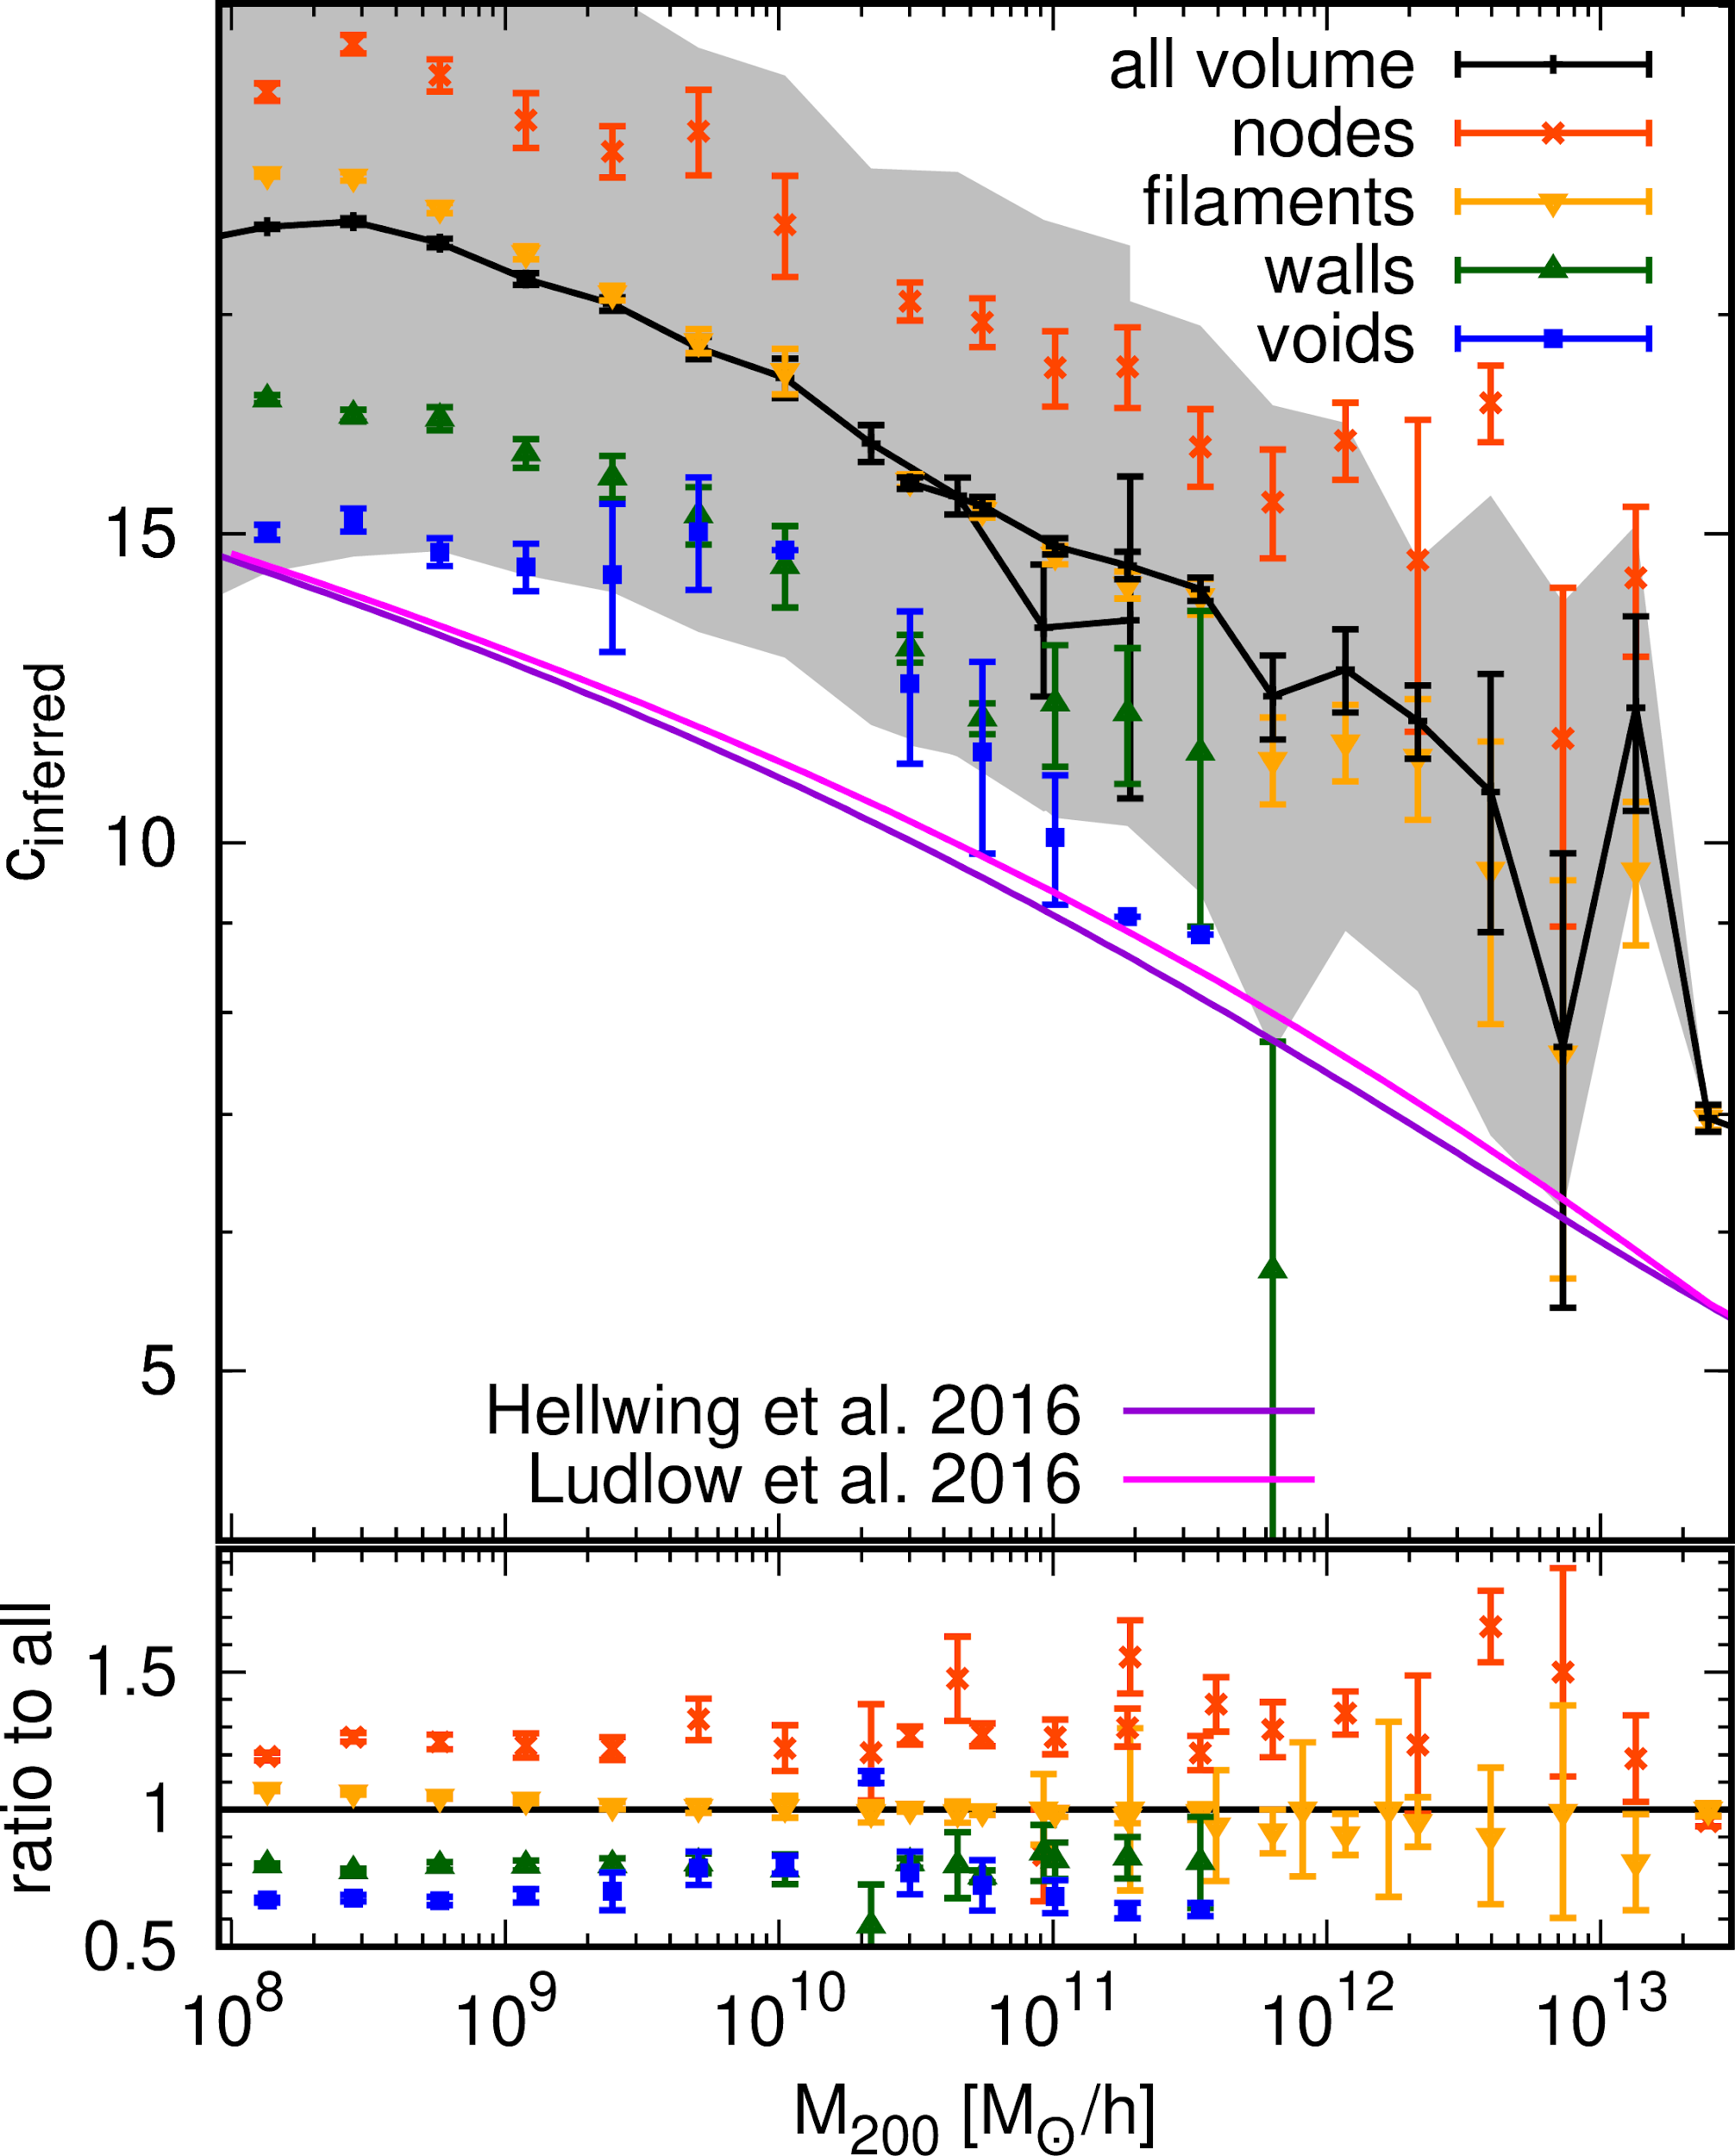
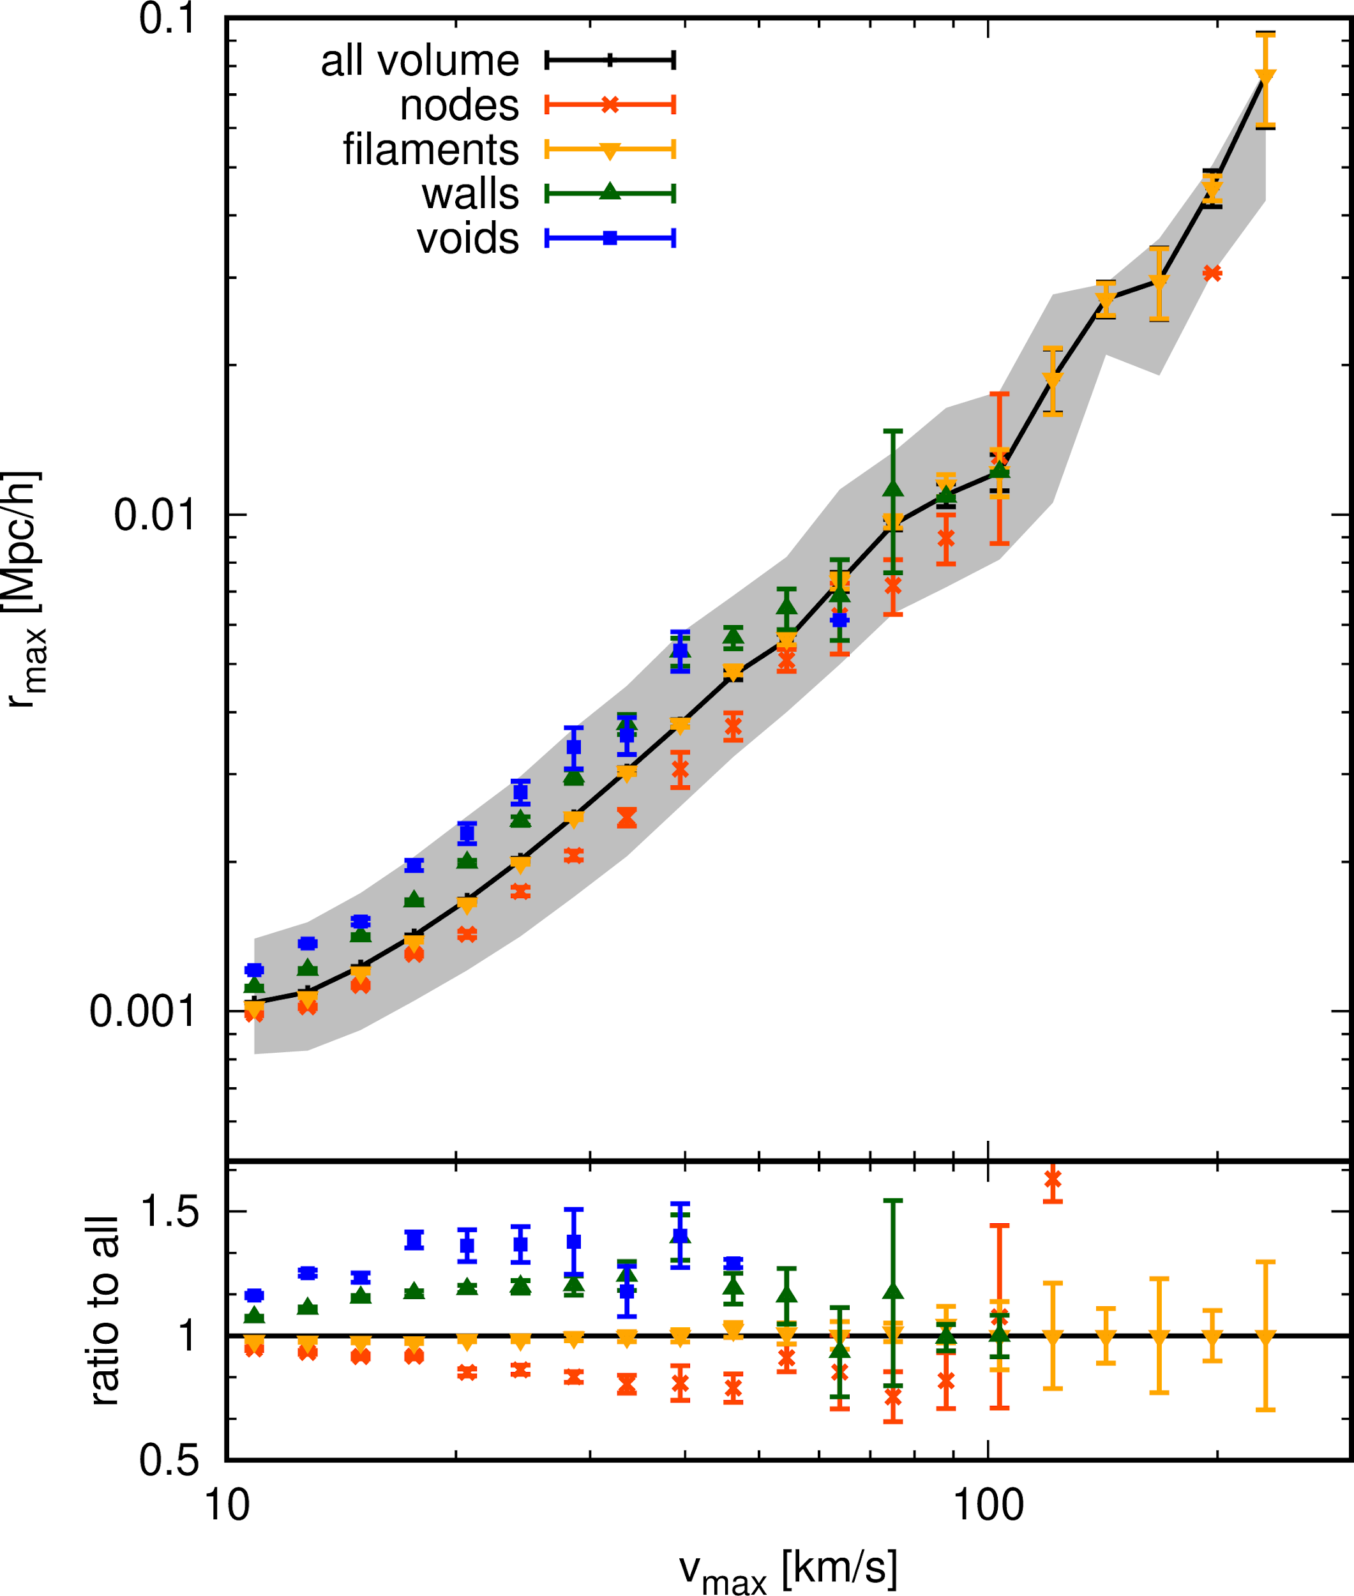
Satellites - subhaloes (compact vs loose)

Slide 17
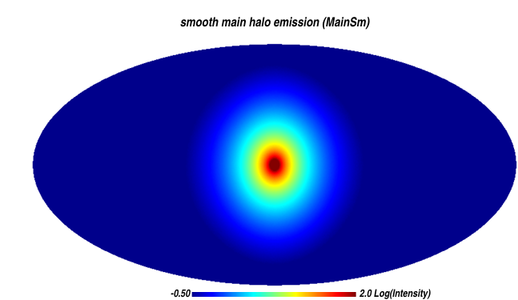
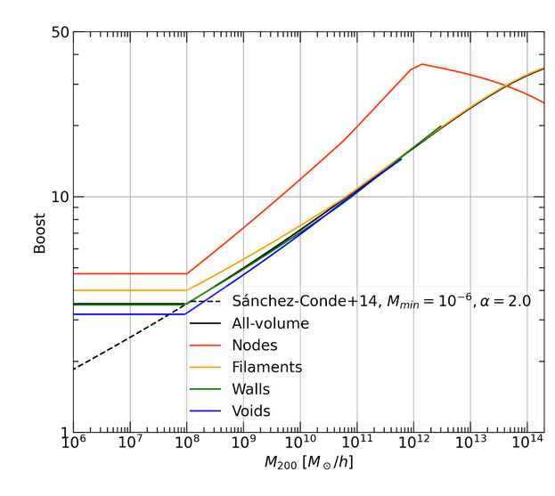
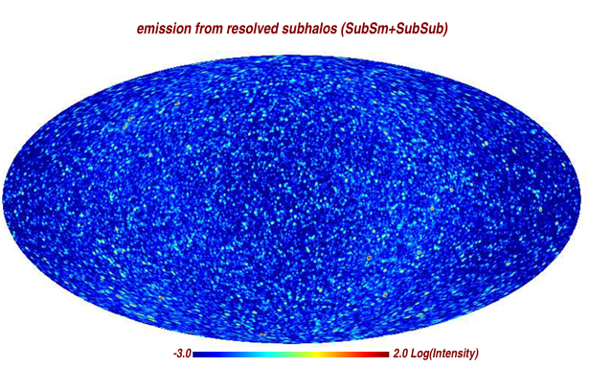
Example - effect on the ૪-ray annihilation radiation boost factors from MW substructure
Springel et al. 2008
Markos-Hunde et al. (in prep)

Slide 18
Conclusions:
DM haloes are sensitive to their environment (nature vs nurture)
Big massive haloes resemble ‘island universes’
Environment dependence moderate medians and variance of intrinsic properties
DM haloes and subhaloes self-similarity is broken by CWEB
Your (our) cosmic neighbourhood really matters!

Slide 20
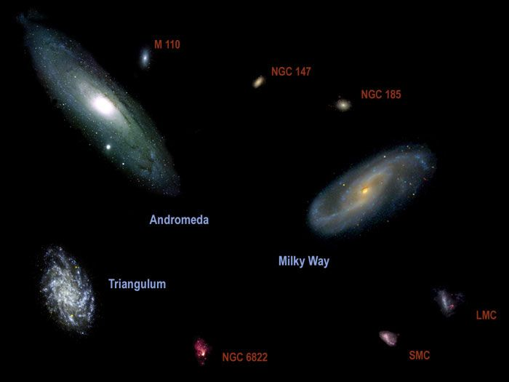
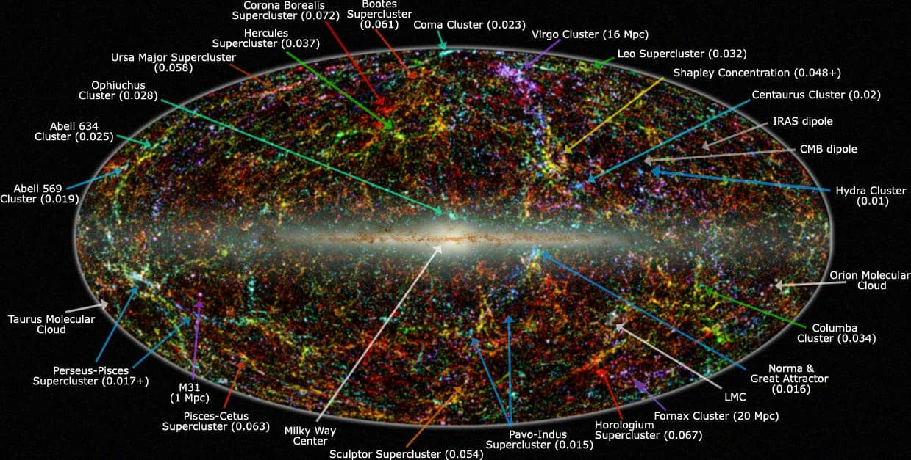
Is the Cosmic Web a useful concept?
clear manifestation in controlled environment (i.e. simulations)
multitude definitions, identification algorithms (i.e. lack of consensus in the community on common properties)
seen in observed galaxy distribution, but hard to segment and analyse (RSD and selection effects)
if we can split observed galaxies/LSS into clear CWEB segments, what will we learn?
Can adjusting for CWEB environment help to control/reduce some systematics/cosmic variance? For what observables?

Slide 21
So, why (or when and where) Cosmic Web matters?
Some ideas about this to provoke discussion:
so-claimed LCDM problems (too big to fail, missing satellites, plane of satellites, core-cusp?)
DM signal modelling (annihilation from subhaloes, dark subhaloes count)
local galaxy/satellite statistics
spin, shape alignment
velocity fields statistics (local non-Gaussian cosmic variance)
reconstructions (what we can learn from them?)
distance ladder and H₀ tension
more?

