Slide 1
Numerical Simulations of Black Hole Jets
CAMK Annual Meeting
23 JAN 2025
Wen Xuan Sia
Supervisor: Dr. Krzysztof Nalewajko
Collaborator: Dr. Oliver Porth

Slide 2
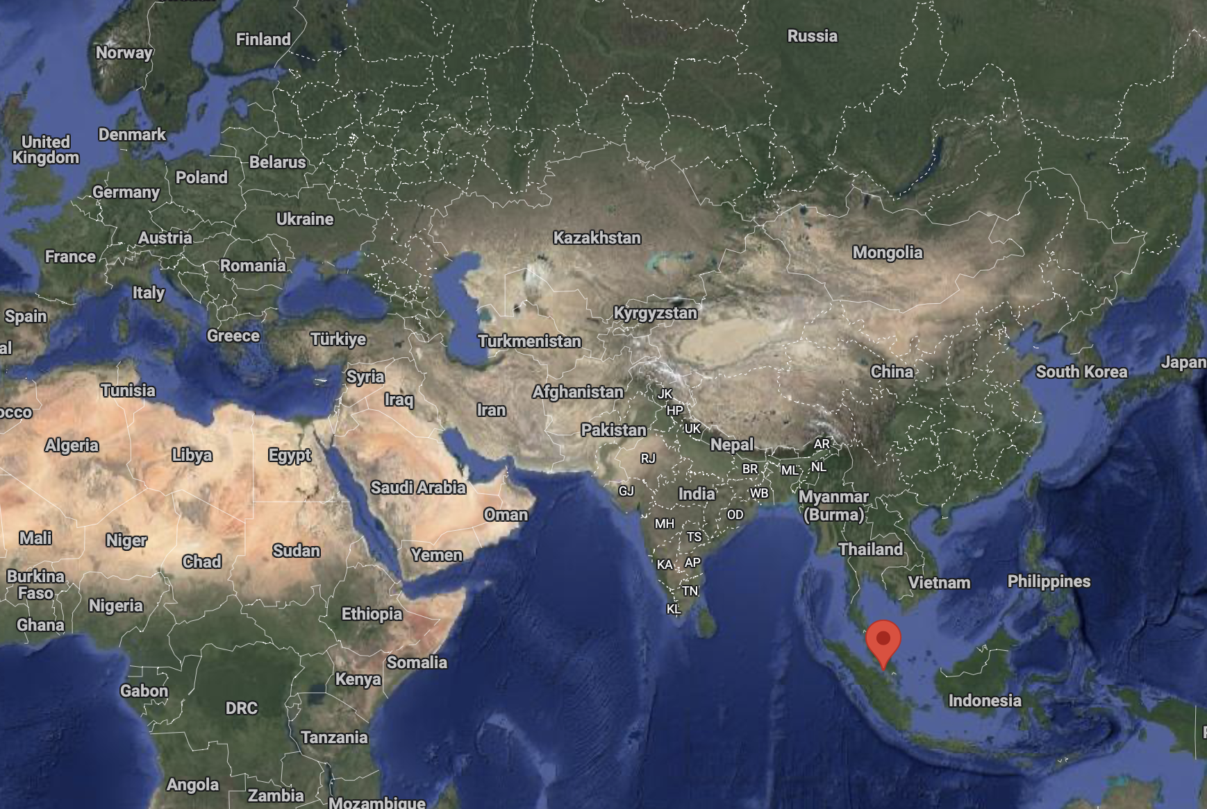
My country: Malaysia

Slide 3
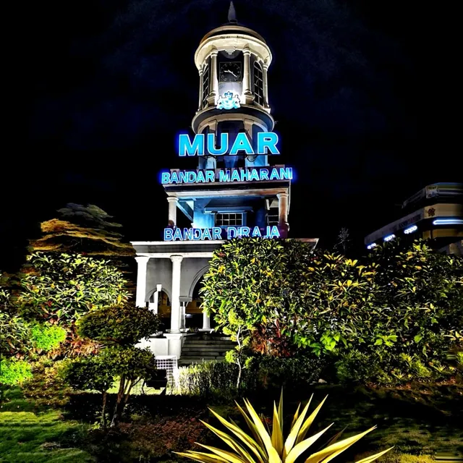
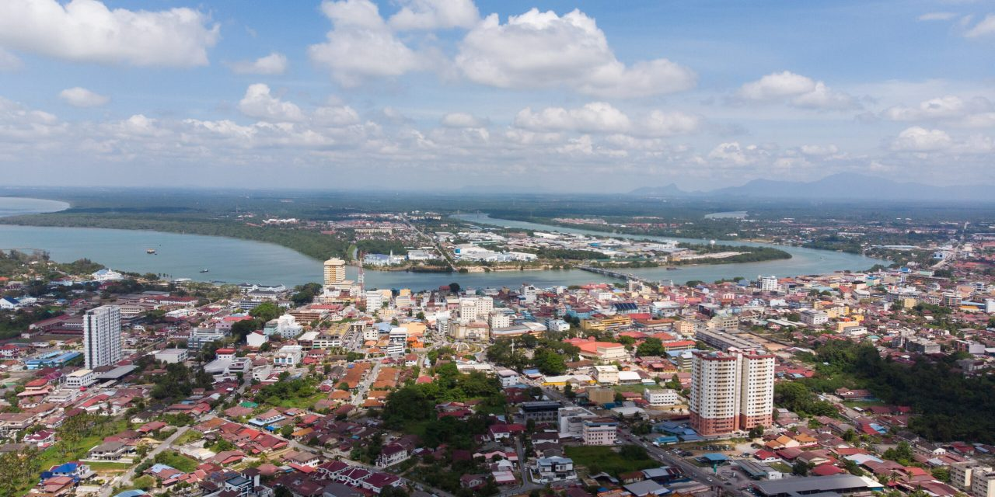
Hometown: Muar

Slide 4
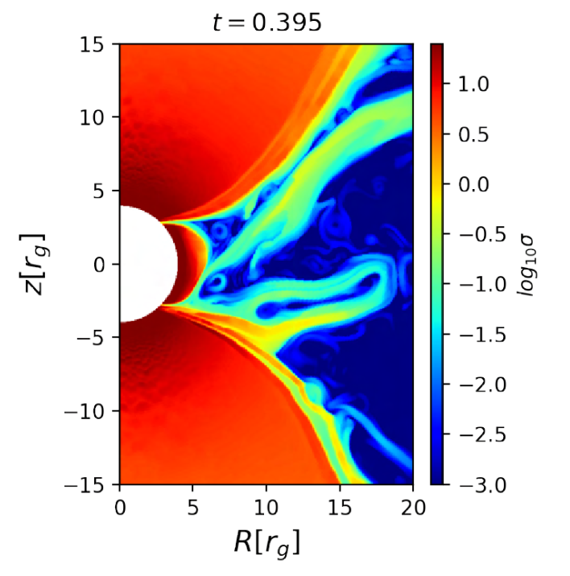
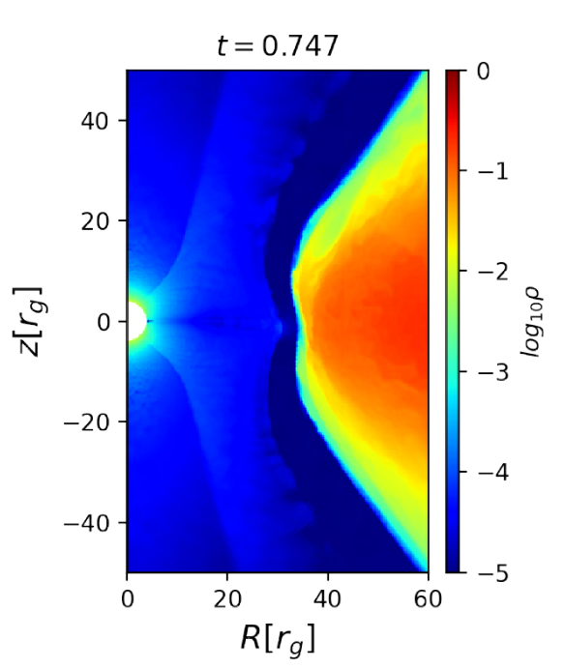
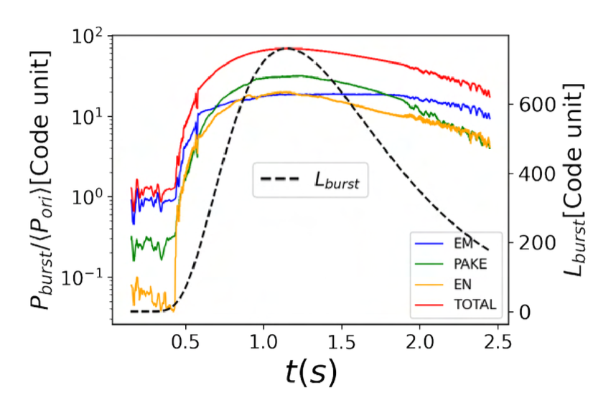
Master thesis: Modelling thermonuclear burst using GRMHD simulations with BHAC
Supervisor: Dr. Oliver Porth
Formation of magnetosphere (at roughly $∼0.25s$ after the burst has ignited) for boundary layer accreting neutron star
Jet power increases by roughly $∼80$ times as the disk retreats

Slide 5
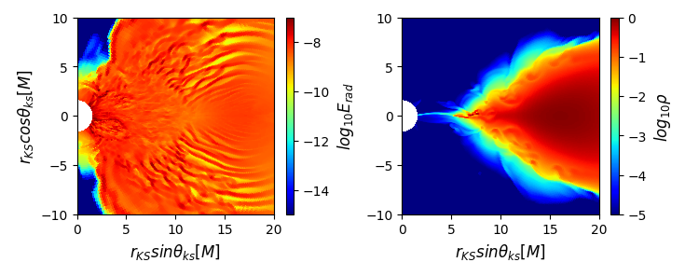
M1 Radiation Module for BHAC In collaboration with Dr. Oliver Porth
Resolution study of a beam of light at the photon ring.
Preliminary test run on an accreting non-spinning black hole

Slide 6
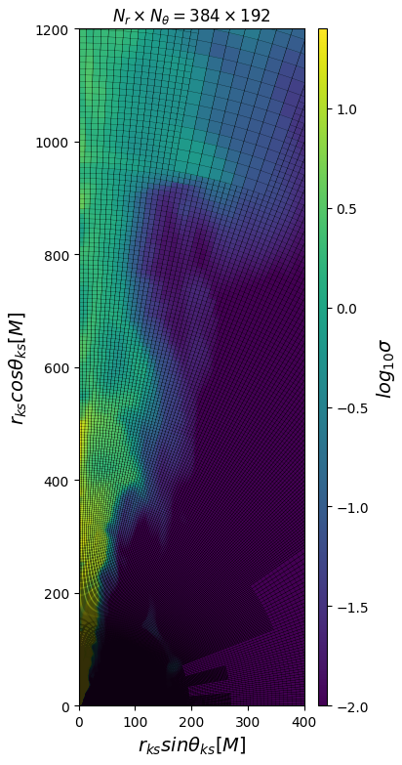
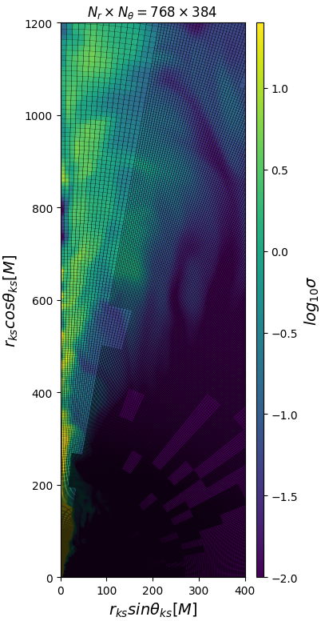
Resolution study of FM torus
Performed using BHAC
1 level of AMR

Slide 7
2024 Summary
Performed GRMHD simulations to study thermonuclear burst on a neutron star (Master thesis project).
Building/debugging M1 radiation module for Black Hole Accretion Code (BHAC).
Performed resolution study for a standard Fishbone-Moncrief (FM) torus.

