Slide 1
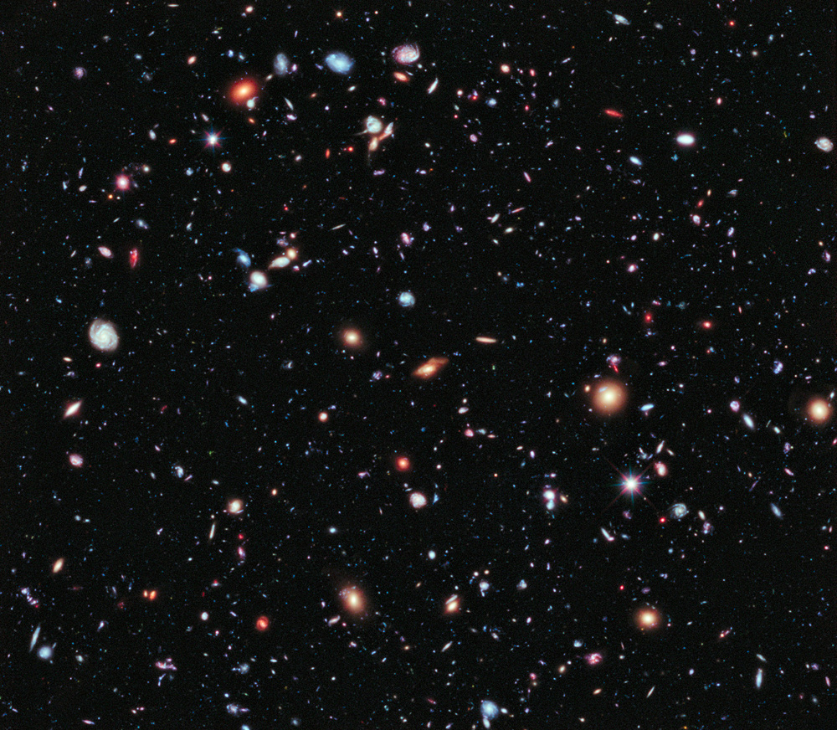
Introduction to Cosmology
Marek Demianski
University of Warsaw

Slide 2
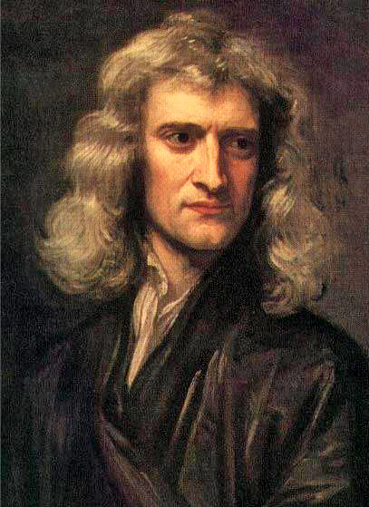
Isaac Newton
1642 - 1727

Slide 3
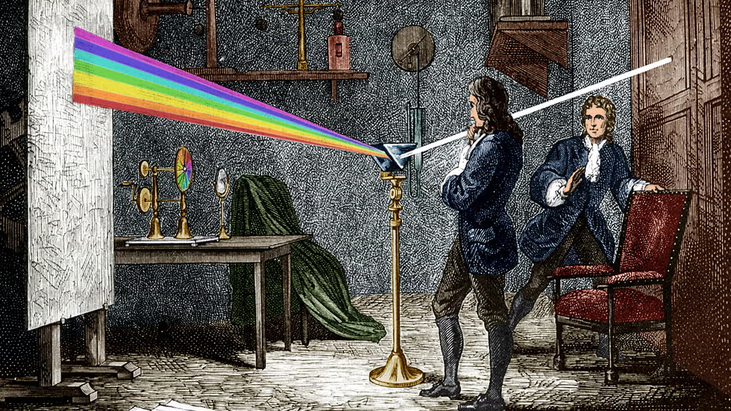

Slide 4
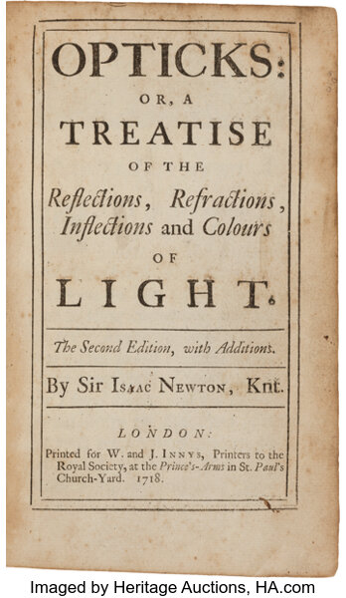
Light is a stream
of particles

Slide 5
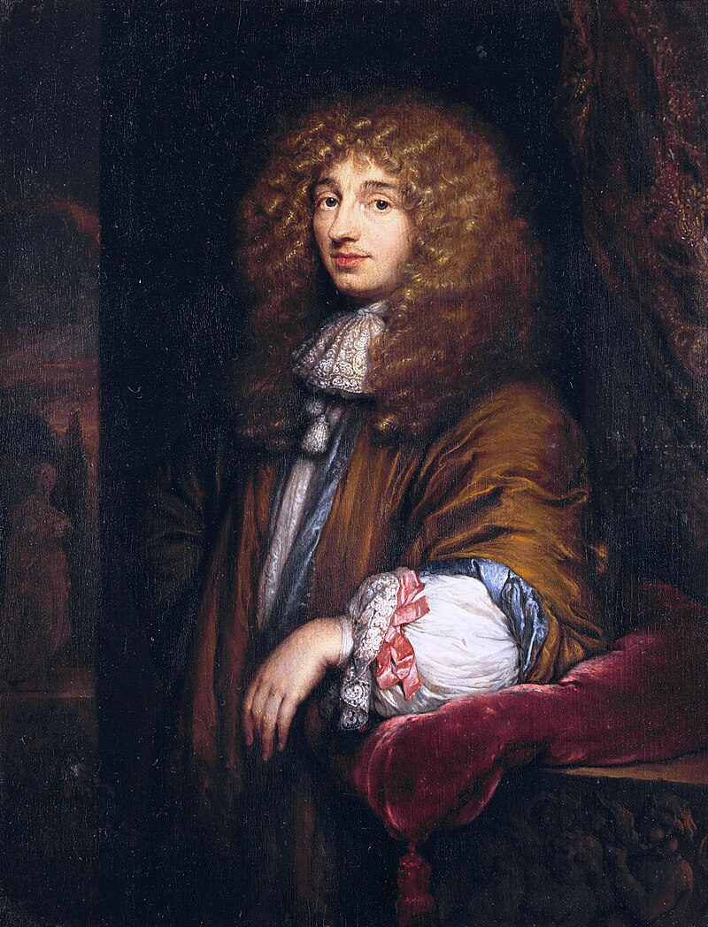
Christiaan
Huygens
1629 - 1695
Light is a wave

Slide 6

water waves
water waves

Slide 7
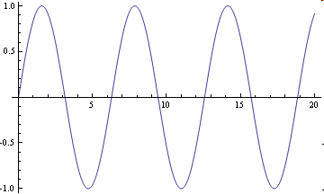
Simple wave
λ
A
A - amplitude
λ – wavelength

Slide 8
Characteristics of a wave
Wavelength - λ
Frequency - f
Period – P = 1/f
Velocity c = λ/P = λf

Slide 9
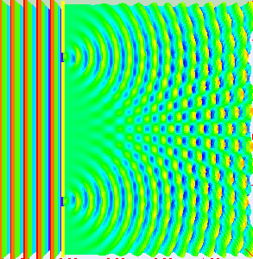
Young’s double-slit experiment

Slide 10
Young’s double-slit experiment (1801)
Light passes through two apertures. You can think of these two apertures as two light sources.
Young showed that light from these sources produces an interference pattern (recall the animation with the interference of water waves).
So, Young showed that light is a wave!

Slide 11
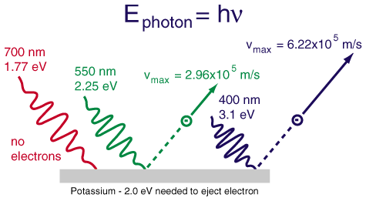
The Photoelectric Effect
No matter how many photons impinge on the surface,
no electrons will be ejected unless E_{photon} ≥ E_{min}
http://hyperphysics.phy-astr.gsu.edu/hbase/imgmod2/pelec.gif

Slide 12
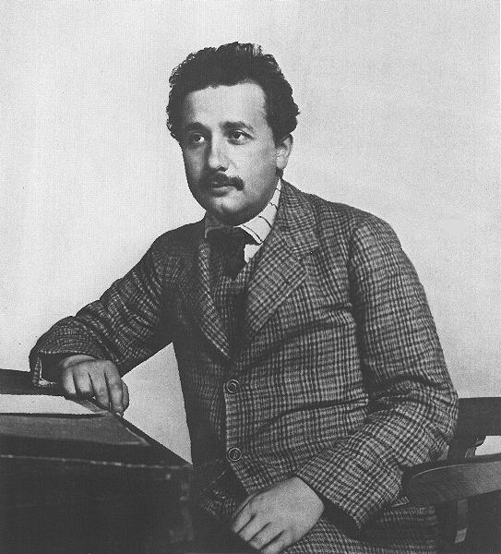
Light is
a stream
of particles
(photons)
Nobel Prize
1921

Slide 13
So what is light ?
Sometimes light appears as a wave
and sometimes as a stream of photons

Slide 14
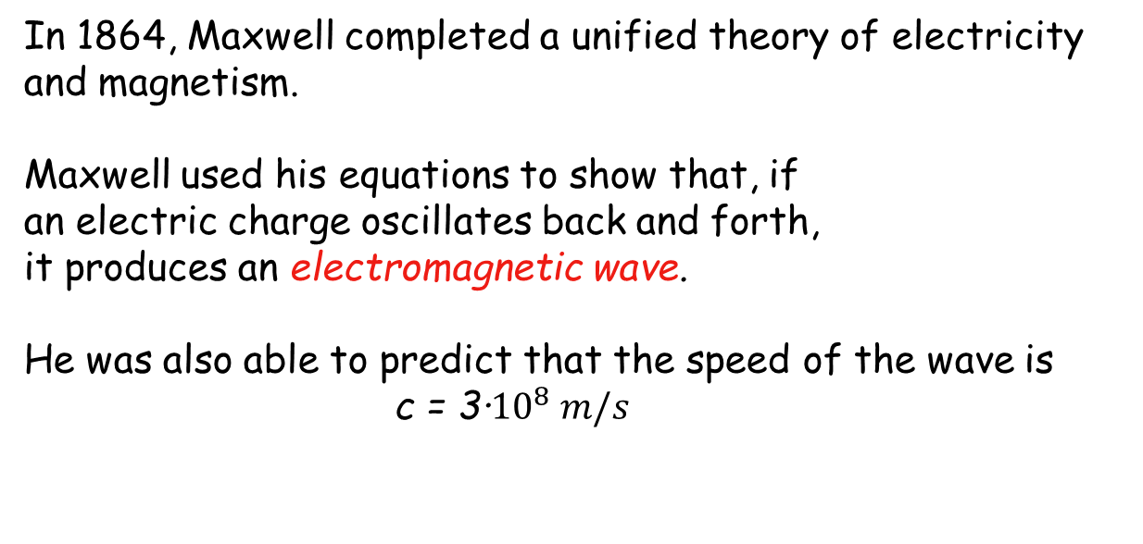
What kind of wave is light?
In 1864, Maxwell completed a unified theory of electricity and magnetism.
Maxwell used his equations to show that, if
an electric charge oscillates back and forth,
it produces an electromagnetic wave.
He was also able to predict that the speed of the wave is
c = 3∙${10}^{8} m/s$
This speed agreed well with the measured value of the speed of light!
His conclusion: light IS an electromagnetic wave!

Slide 15
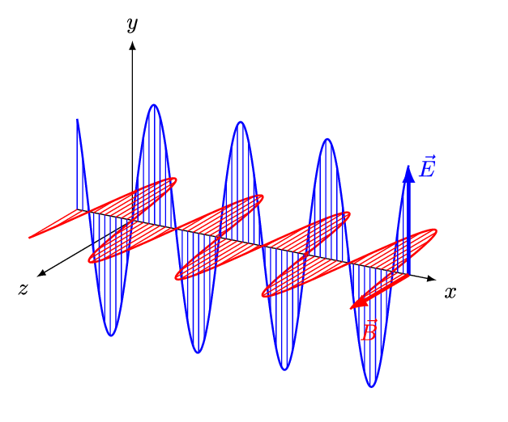
Light is an electromagnetic wave
It can propagate in vacuum!

Slide 16
Basic properties of light
Light is an electromagnetic wave !
Light can propagate in vacuum !
The speed of light does not depend on the relative motion of the source of light and an observer.
Light is a stream of particles (photons)!
E_{photon}=h·ν
h – Planck constant

Slide 17
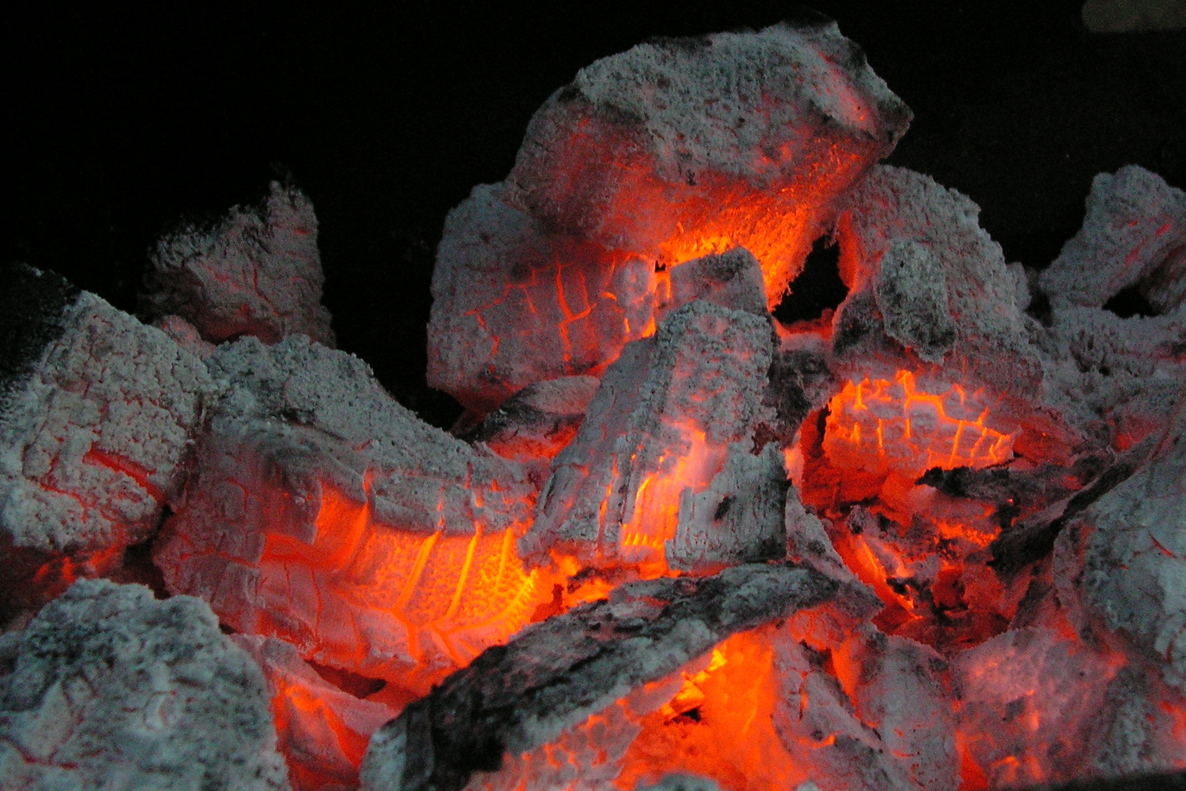
Color depends on temperature
http://en.wikipedia.org/wiki/File:Embers_01.JPG

Slide 18
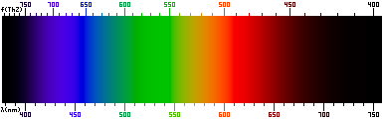
Colors and the Spectrum
But what governs the distribution of light across the
spectrum and the color we perceive?

Slide 19

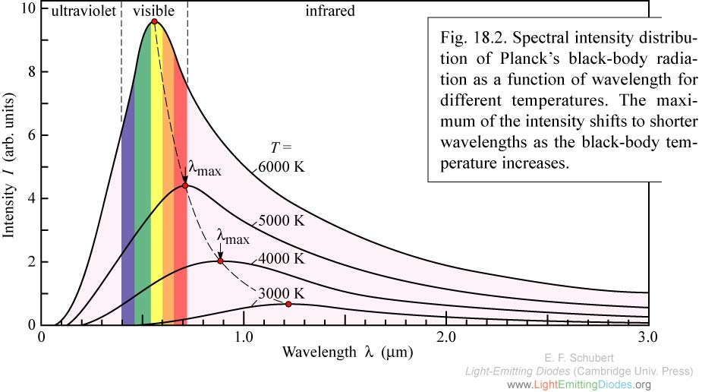
Max Planck to the Rescue!
research-in-germany.de
h = Planck’s cst k = Boltzmann’s cst c = speed of light

Slide 20
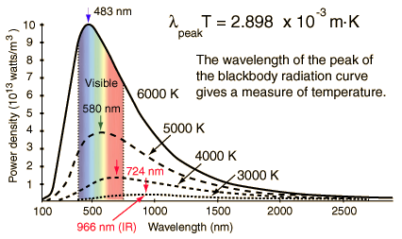

Two Additional Useful Relations
Wien’s Law
The Stefan-Boltzmann law
Says: integral under Planck curve equals
Says: wavelength of peak emission is
where derivative of Planck curve is zero, and is given by:
λ_{max} ·T = 2.898·10⁶ nm·K
the total power emitted per unit area of a blackbody:
$E_{ν}$ = $I_{ν}$
Both laws can be used to derive the surface temperature of a star! How…?

Slide 21
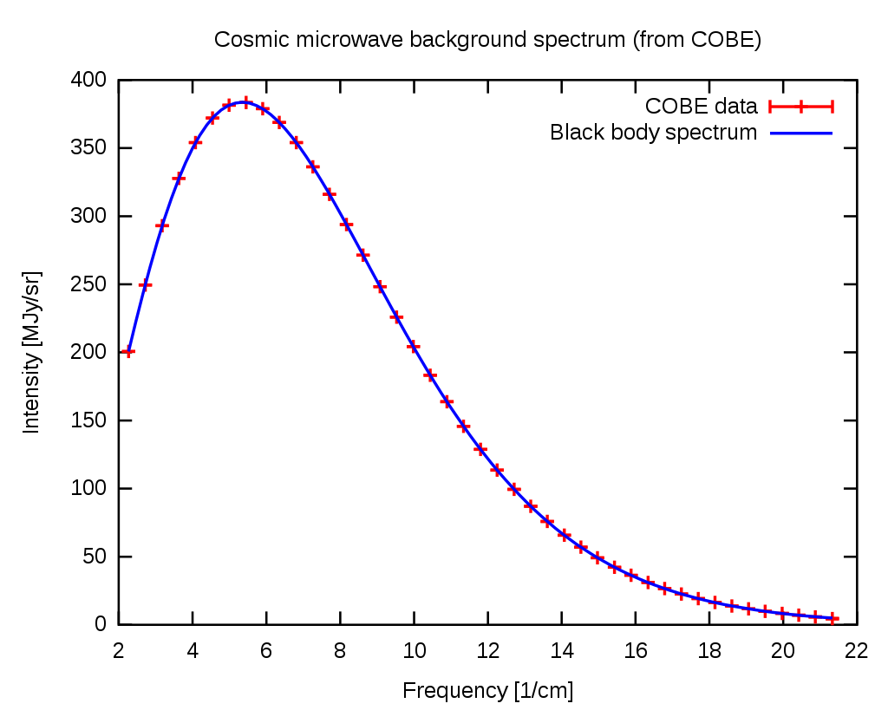
T= 2.72548 +/- 0.00057 K

Slide 22

Stellar Luminosity = total power (E/sec)
Stefan-Boltzmann Law describes E/sec per unit area
=σT⁴
Luminosity = total power from entire surface area (4πR*²):
L = 4πR*²σT⁴
= 5.67x10⁻⁸ W m⁻² K⁻⁴
L= 4π ∙ (7x10⁸)² ∙ 5.67∙10⁻⁸ ∙ (5800)⁴
Example: R=7∙10⁸ m
T=5800 K
= 3.95 ∙ 10²⁶ W( = J/s)
= 1 Solar Luminosity (L)

Slide 23
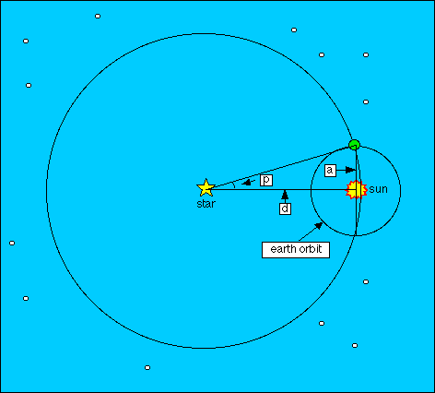
Distances to Stars:
The Principle of Parallax
a=1AU = 1.49 10^11 m d=distance to star in AU p=parallax angle*
sin p ≈ tan p ≈ p_{rad} = 1/d_{AU}
But parallaxes are ^{tiny} !
Let’s express them in arcsec (’’):
p_{rad} = p’’/206265 = 1/d_{AU}
Let’s define a new unit: parsec (pc)
1 pc = 206265 AU
So:
➔
and
*In practice, we make measurements 6 months
apart, so total angular shift is 2p.

Slide 24
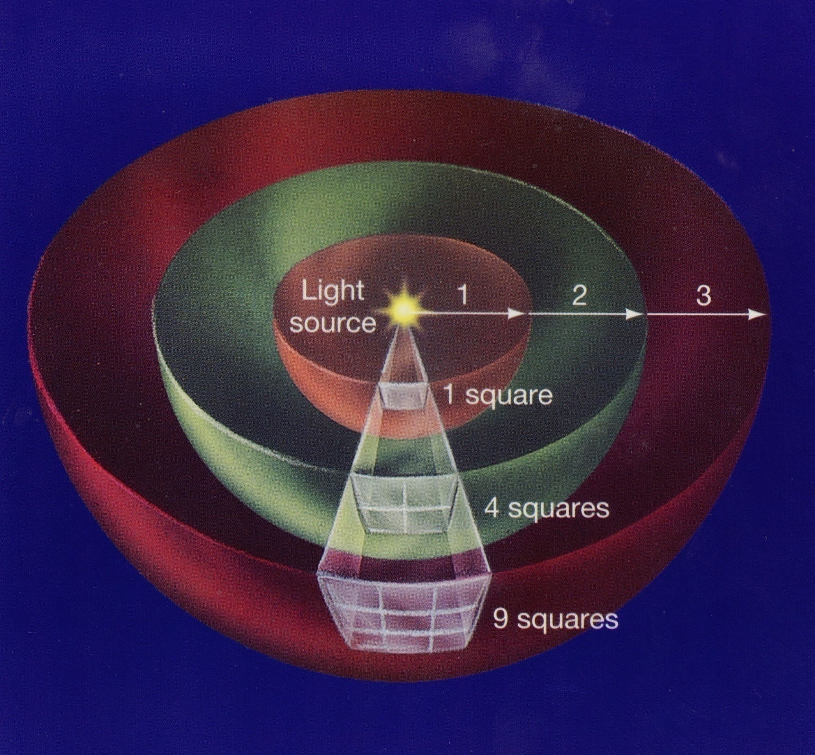
Inverse square law: Flux declines as 1/d²
Flux= energy received per unit area per unit time e.g. W m⁻²
At larger d, the same
total amount of light
is spread more thinly;
less falls on each area:
L
distance, d
adapted from: www.uta.edu/ physics/ main/ faculty/ rubins/
Recall: L = Luminosity = total power output from star (≠F(d)

Slide 25
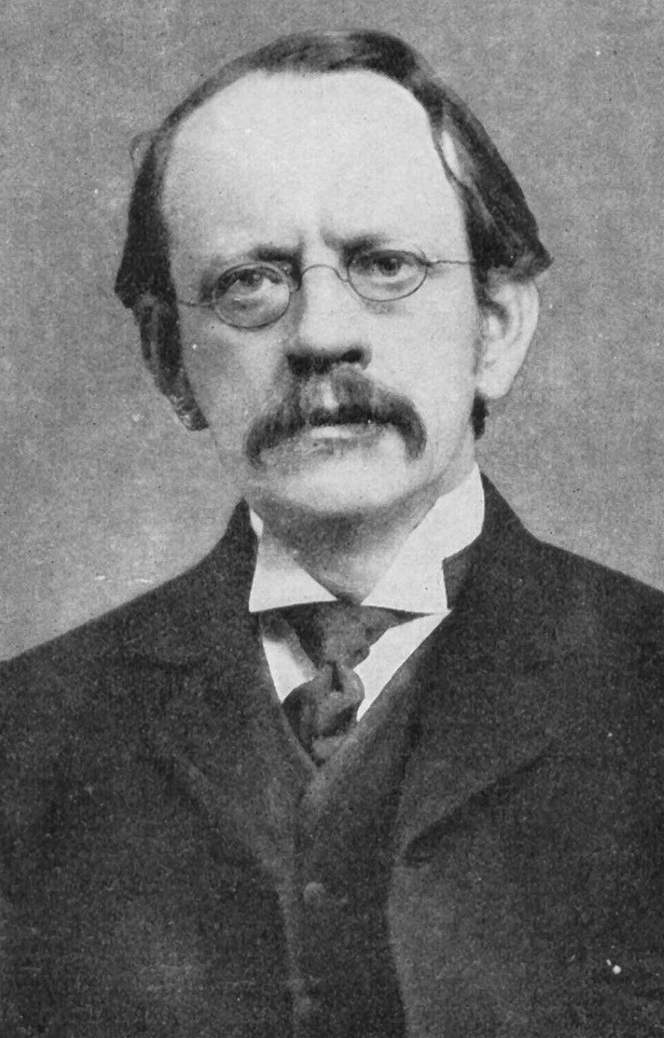
J J Thomson

Slide 26
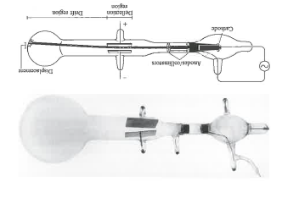
Electrons carry charge and have mass

Slide 27
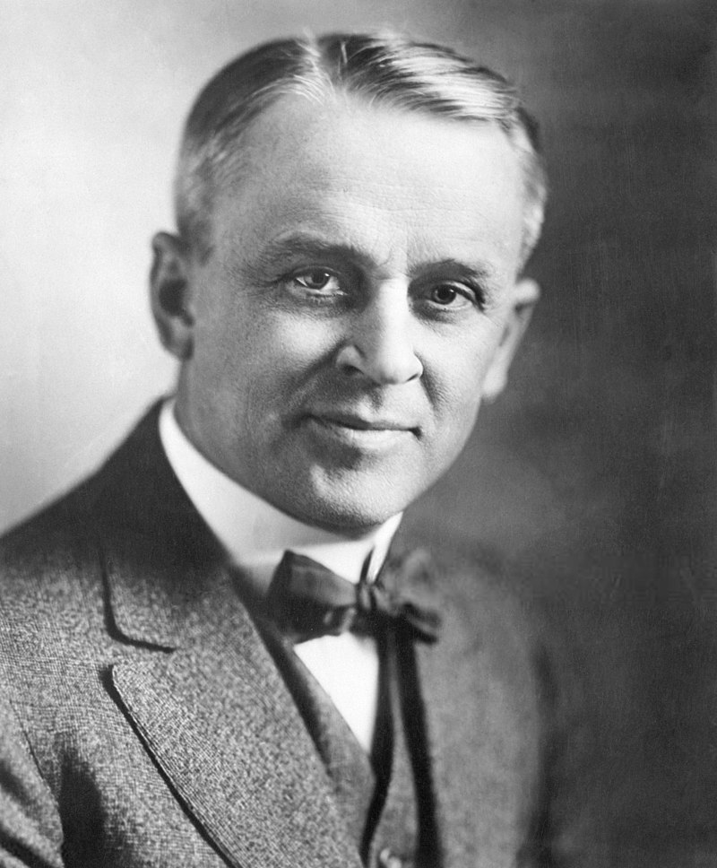
Robert A Millikan

Slide 28
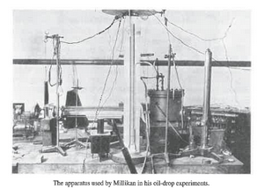
Millikan measured charge of an electron

Slide 29
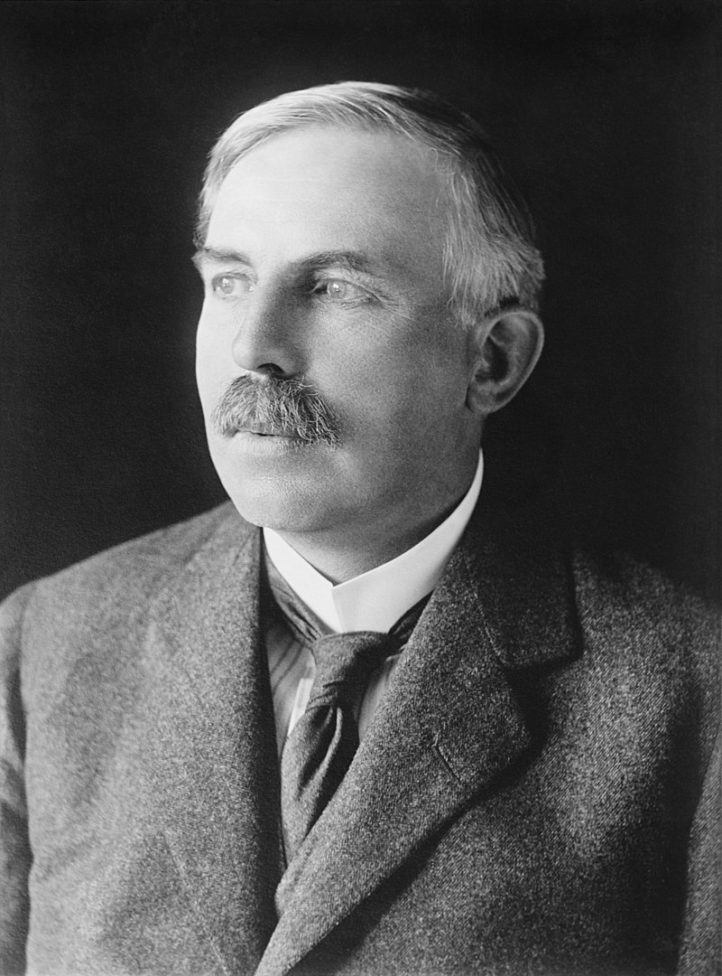
Ernest Rutherford

Slide 30
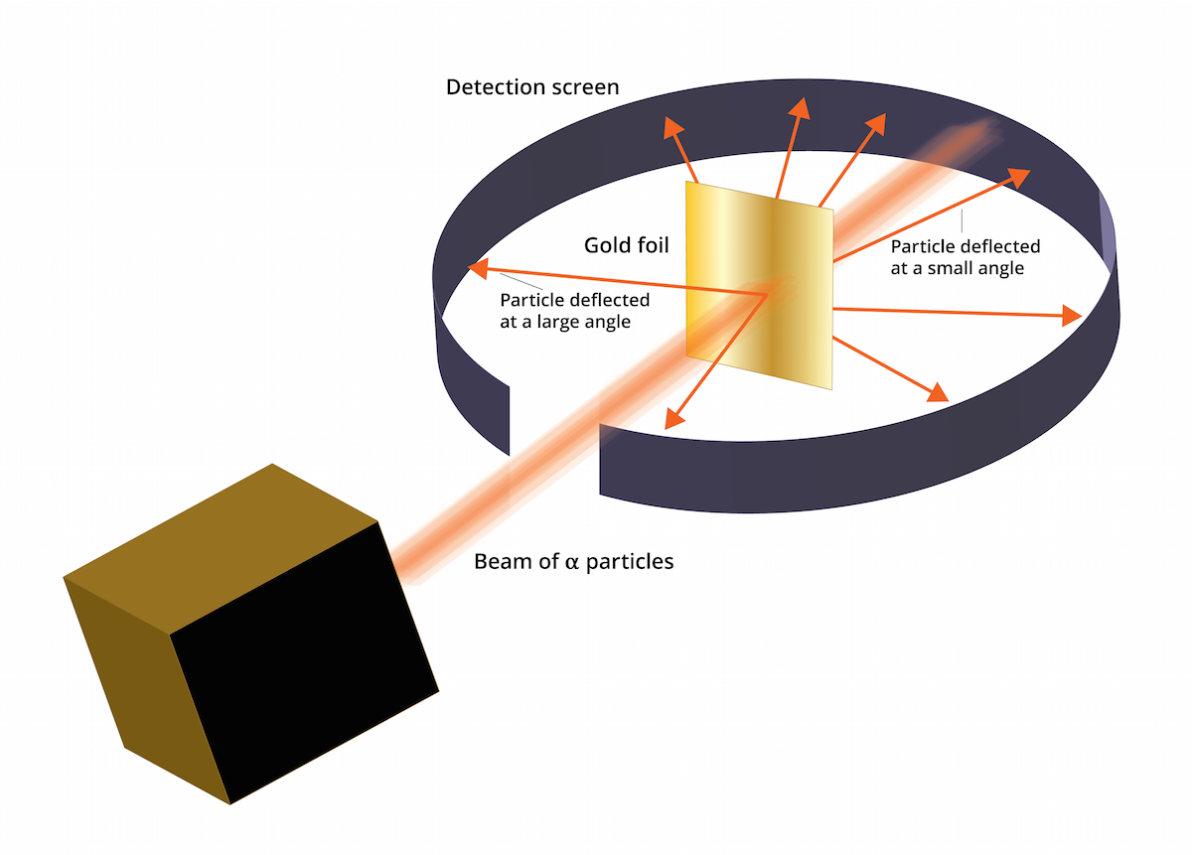
The Rutherford experiment (1911)

Slide 31

Spectrum of hydrogen gas

Slide 32
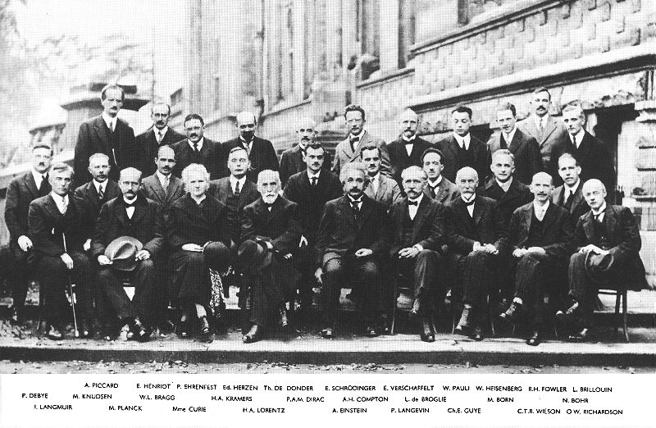

Slide 33
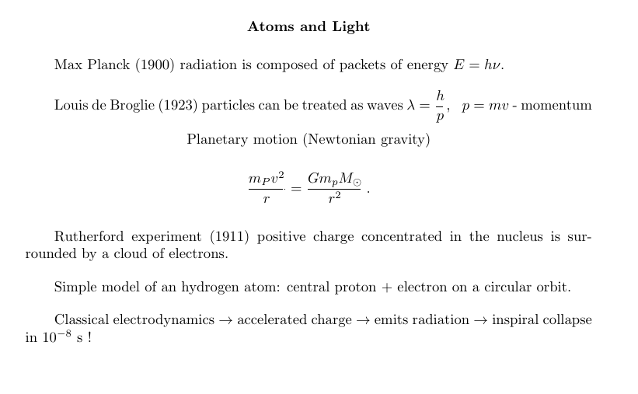

Slide 34
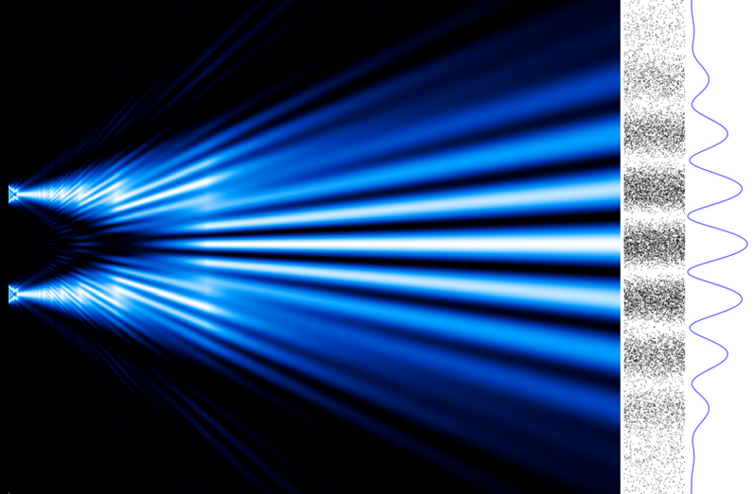
Double slit experiment with electrons de Broglie λ = $\frac{h}{p}$

Slide 35
Bohr model of an atom

Slide 36
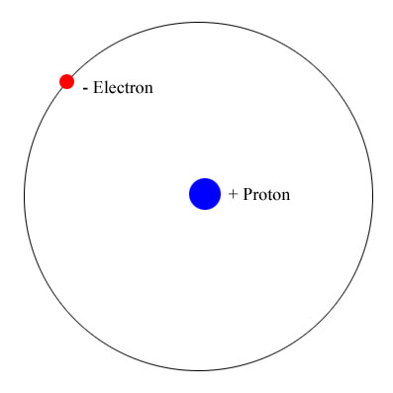
The hydrogen atom

Slide 37
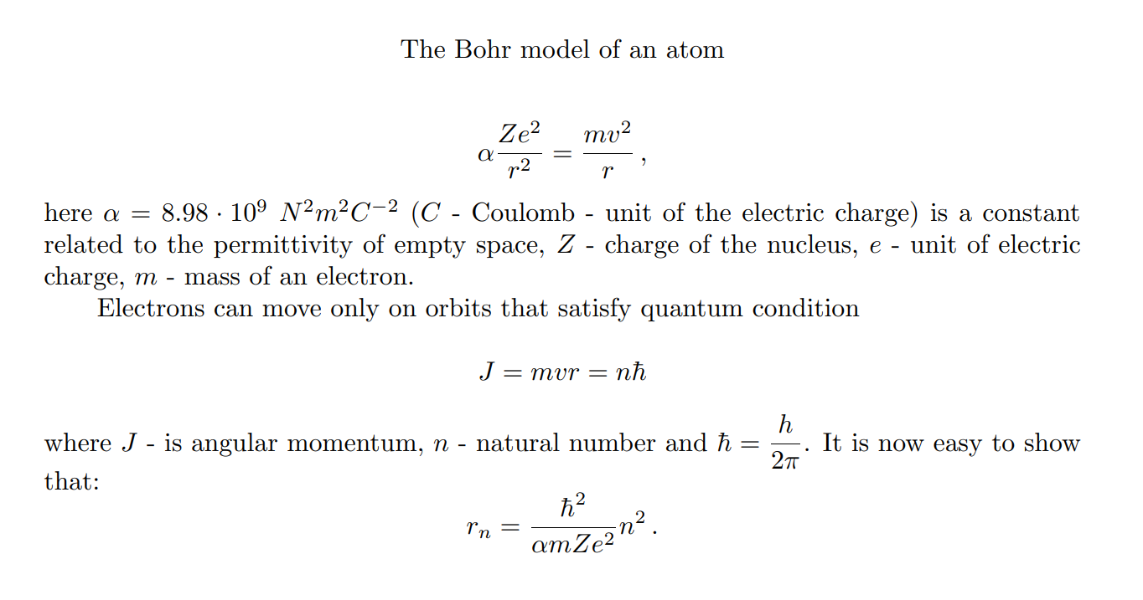

Slide 38
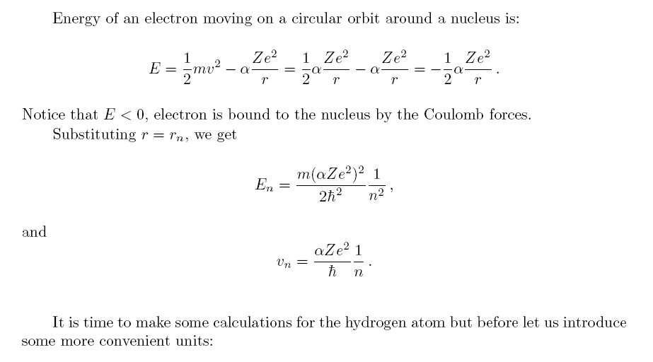

Slide 39
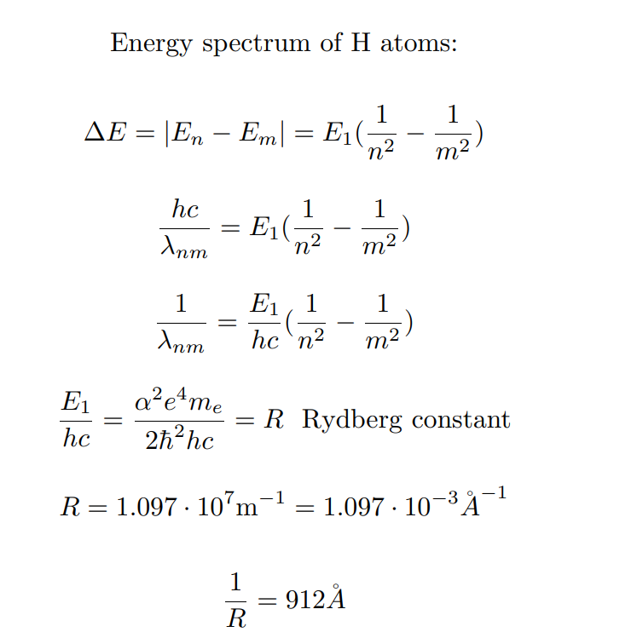

Slide 41

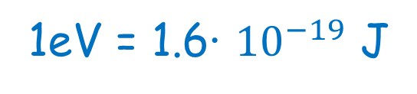


Units
Angstrom (Å) = ${10}^{−8}$ cm or ${10}^{−10}$m = 0.1 nm
Nanometer =${10}^{−9}$m
Picometer = ${10}^{−12 }$m
Femtometer = ${10}^{−15}$ m
1eV = 1.6∙ ${10}^{−19}$ J

Slide 42
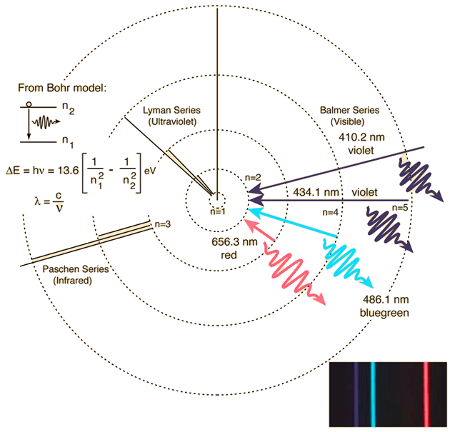

Slide 43
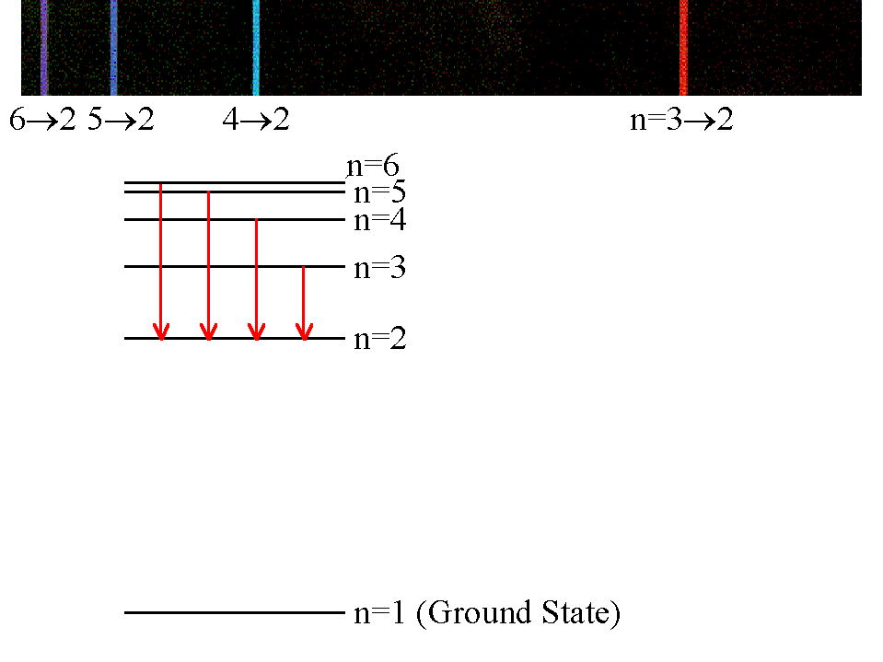
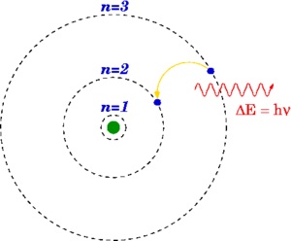
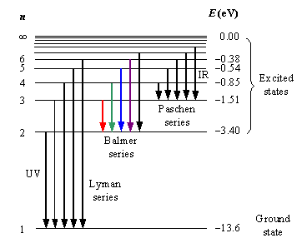

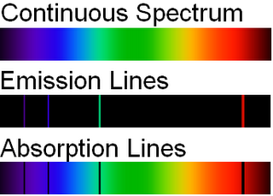
Every atom (and ion) has a distinctive fingerprint…
=
=hc/λ₃₂
H
http://socphysics.blogspot.com/2010/08/bohr-model-of-atom.html
http://astronomy.nju.edu.cn/~lixd/GA/AT4/AT404/IMAGES/AACHCLS0.JPG

Slide 44
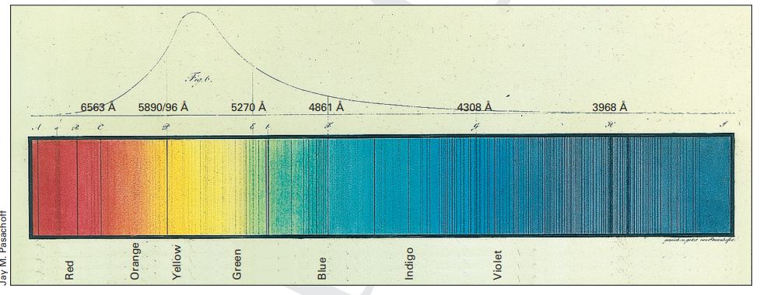
Fraunhofer spectral lines
Spectrum of the Sun (1814)

Slide 45
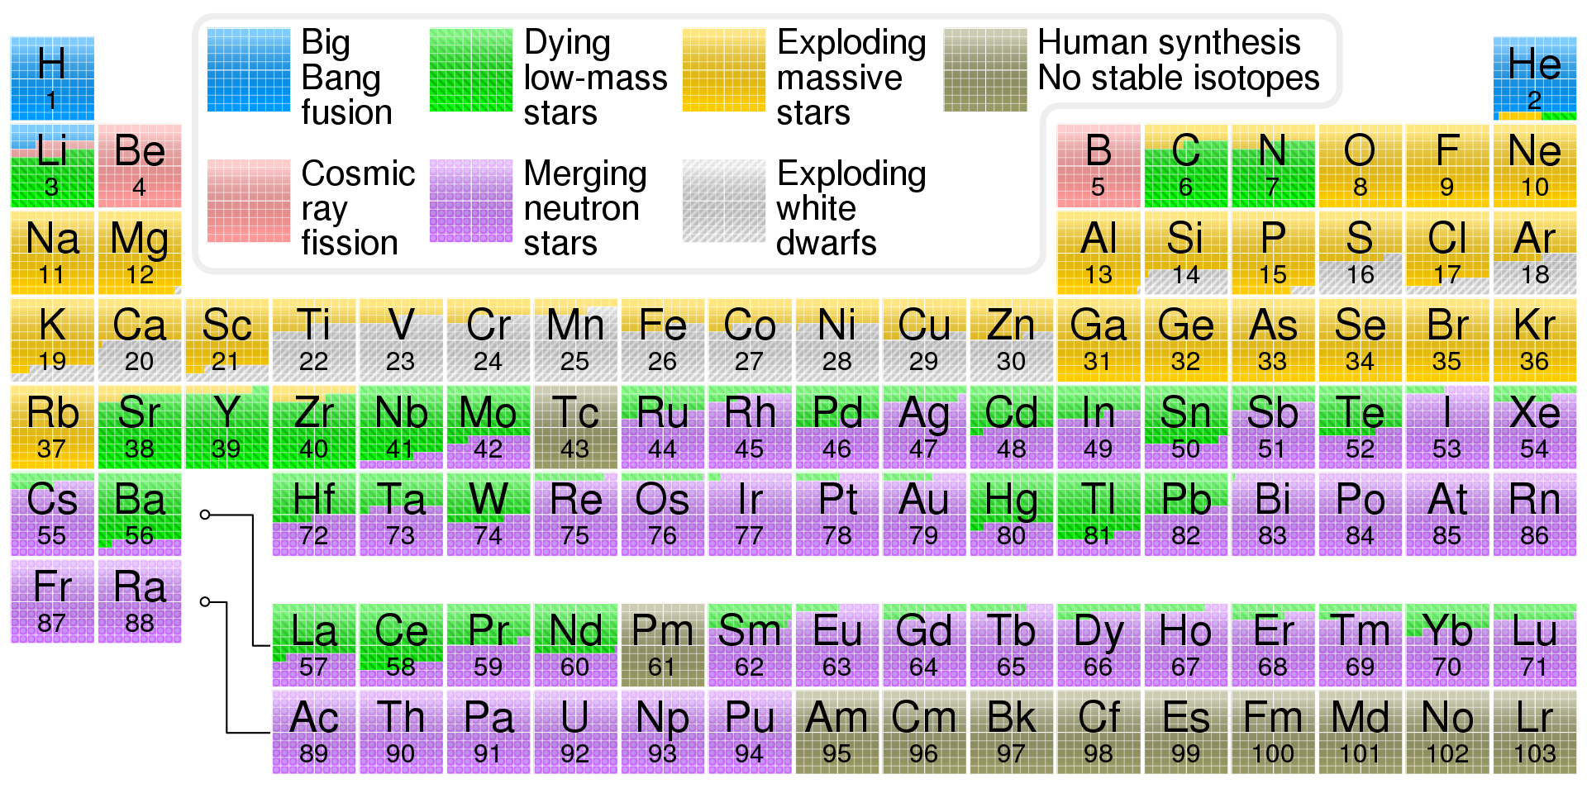

Slide 46
Chemical
composition
of the Sun

