Slide 1
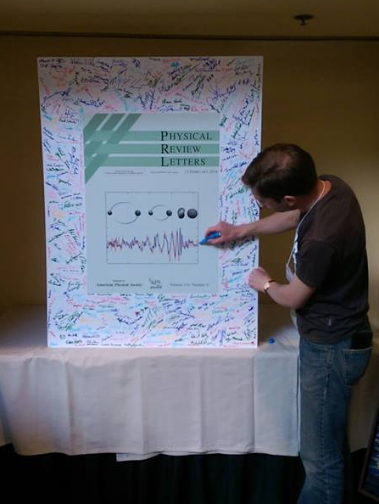
Observations of compact binary mergers via GW
Thomas Dent IGFAE, University of Santiago de Compostela Sep 6, 2019
Astrophysics with GW detections, Warsaw

Slide 2
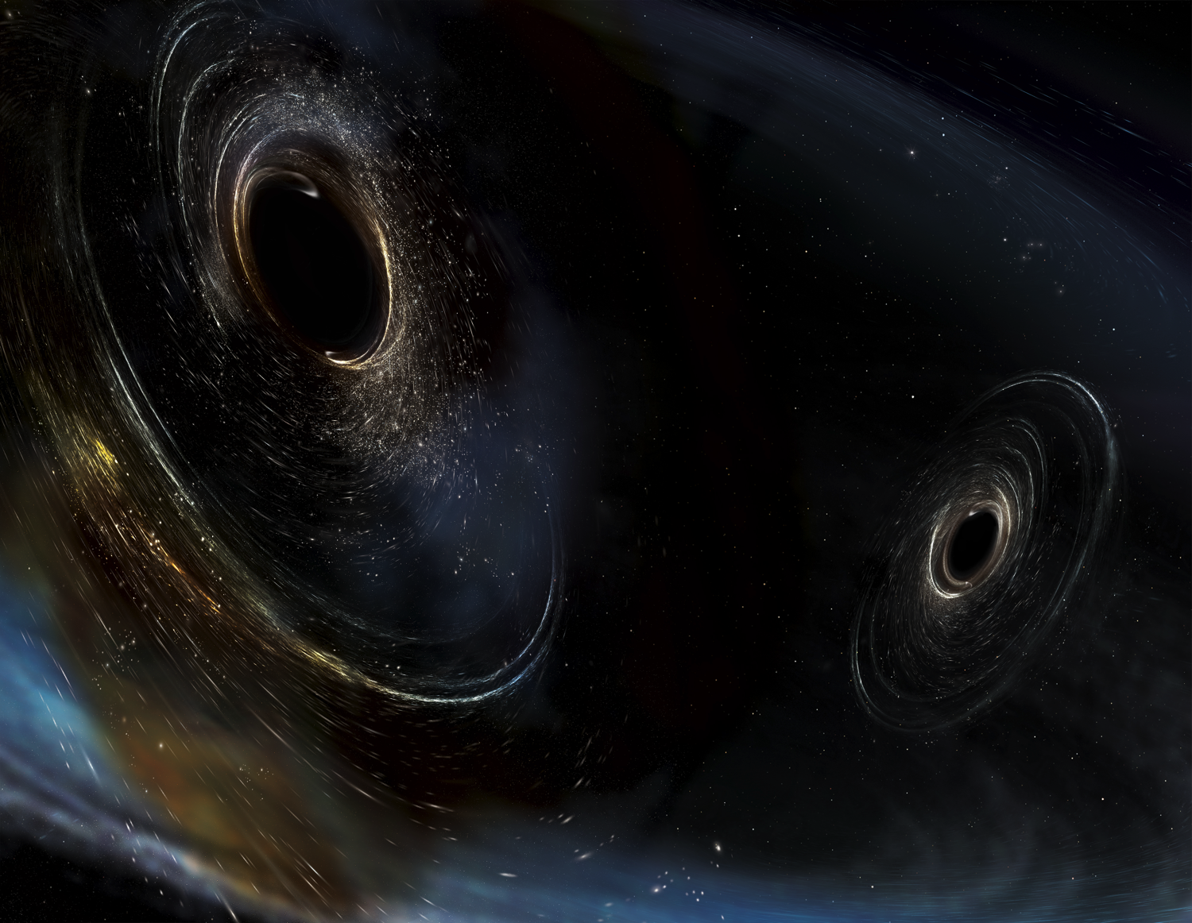
Plan of the talk
Gravitational wave basics and compact binary merger sources
GW detectors and sensitivity
LIGO-Virgo observations in O1 and O2 runs
Status of O3 run
Image Credit: Aurore Simonnet/SSU

Slide 3
How to ‘see’ GW
Tidal effect on spatially separated test particles
Can extract energy (imagine a spring connecting particles)
Measure variations in distance or travel time
Strain

Slide 4
Broad spectrum of GW
ff
NASA / I. Thorpe

Slide 5
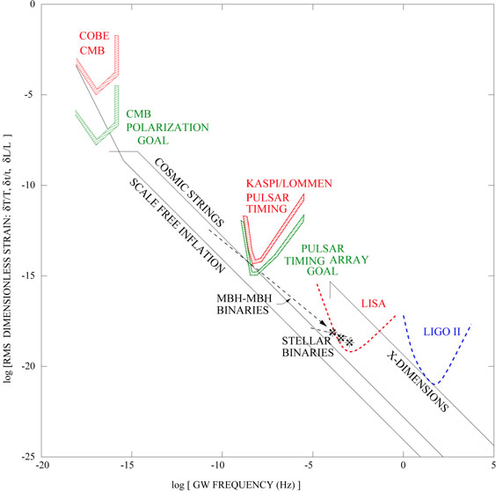
GW strain spectrum
Backer, Jaffe & Lommen

Slide 6
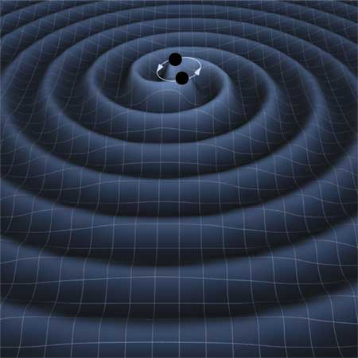
Compact Binary Sources & Detectability

Slide 7
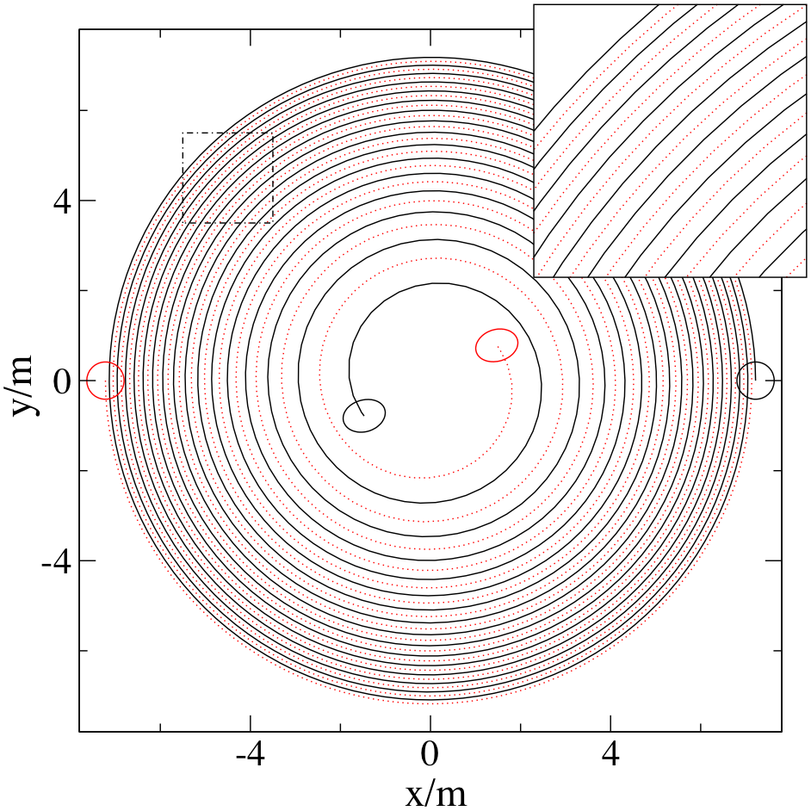
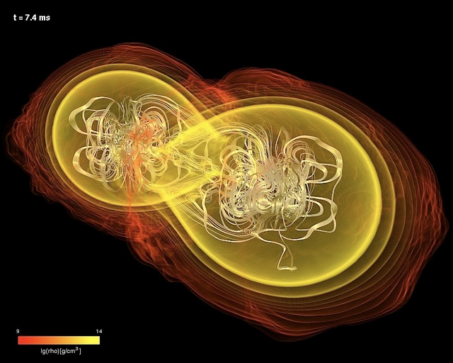
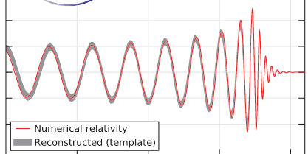
Compact binary mergers
Binaries of NS / BH emit GW due to orbital motion
Orbit decays due to GW emission
Objects eventually collide / merge
Waveform predicted in GR given NS, BH masses/spins

Slide 8
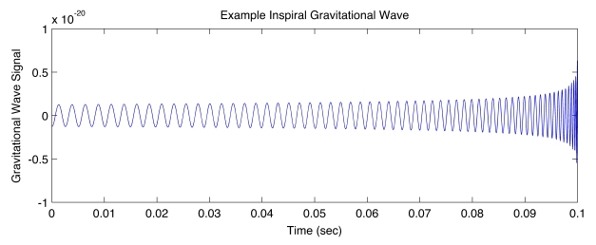
A binary inspiral chirp
Image: A. Stuver, LIGO

Slide 9
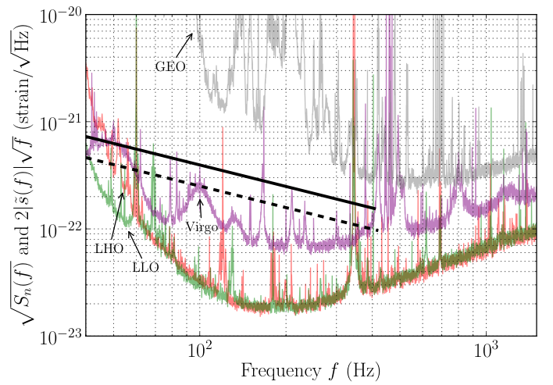
Frequency dependence
Frequency domain
chirp
as f increases,
PostNewtonian phase corrections increase
(5,6)M☉ BBH inspirals vs. detector noises “Blind hardware injection”
http://www.ligo.org/science/GW100916/

Slide 10
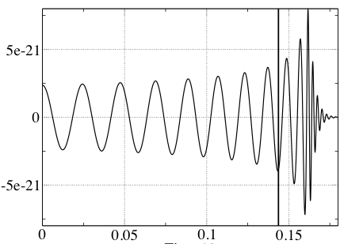
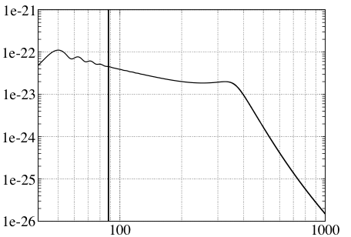
Waveforms with merger/ringdown
Highly nonlinear & difficult problem
Combine numerical (‘NR’) and analytic techniques
25+25 M☉ “EOBNR” waveform Used in search for binaries with black hole(s) : m₁+m₂ > 4 M☉
h(t)
h(f)
t (s)
f (Hz)
Abadie et al. arXiv:1102.3781

Slide 11
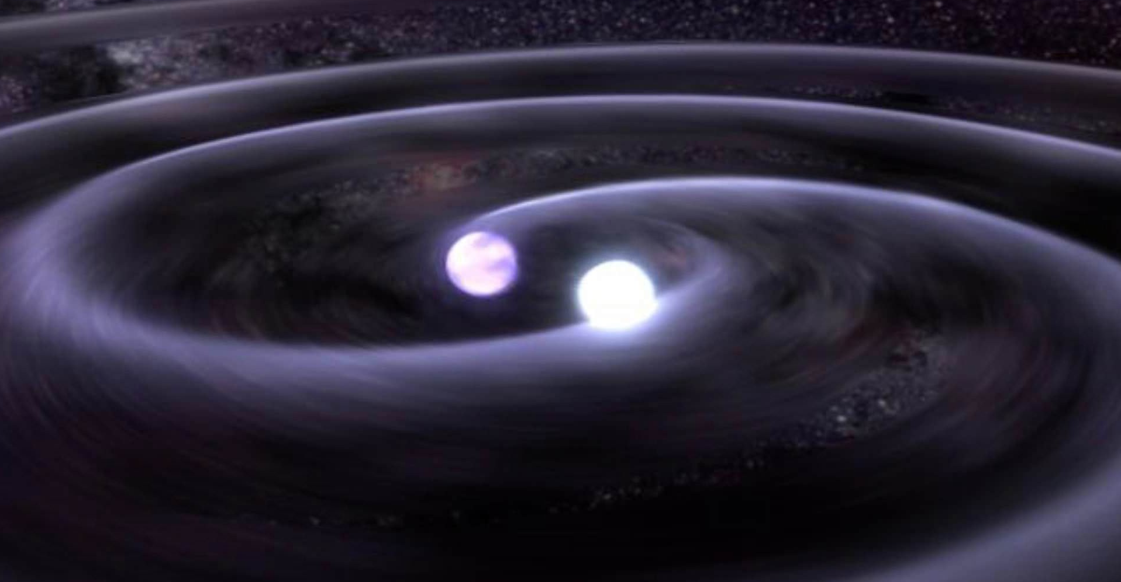
GW are really small !
Closest known NS are 10² − 10³ pc away (scale of Galaxy ~10⁴ kpc)
Most efficient GW emitters : compact binaries eg binary NS

Slide 12
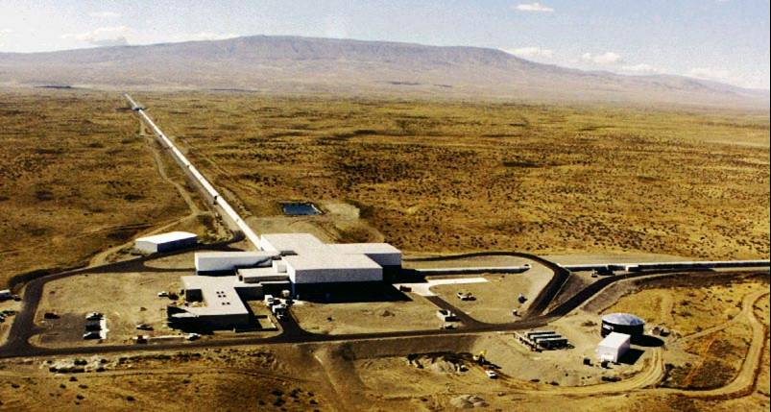
Ground-based GW Detectors

Slide 13
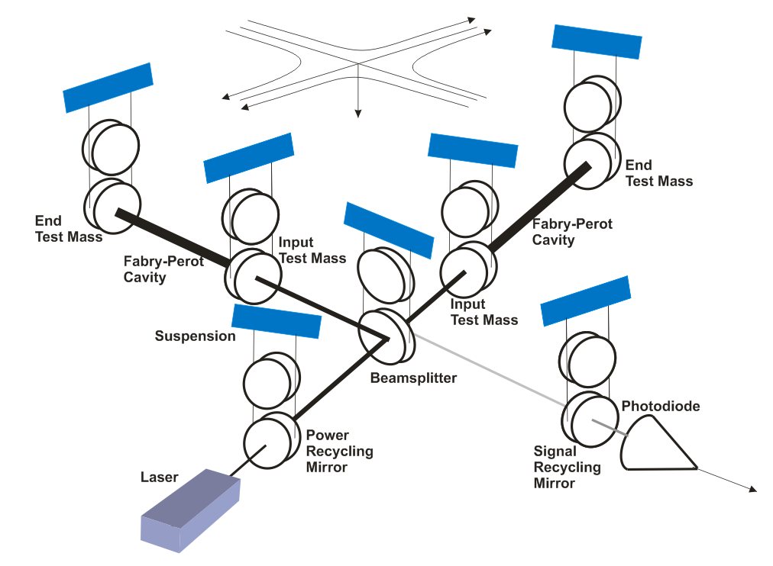
Laser interferometric detection
Michelson interferometer : end mirrors free to move along arms
Differential length change δ(L_{x} − L_{y}) = h(t)·L ⇒ time of flight difference ⇒ relative phase difference @ beam splitter ⇒ transmitted intensity variation @ PhotoDiode
PhotoDiode

Slide 14
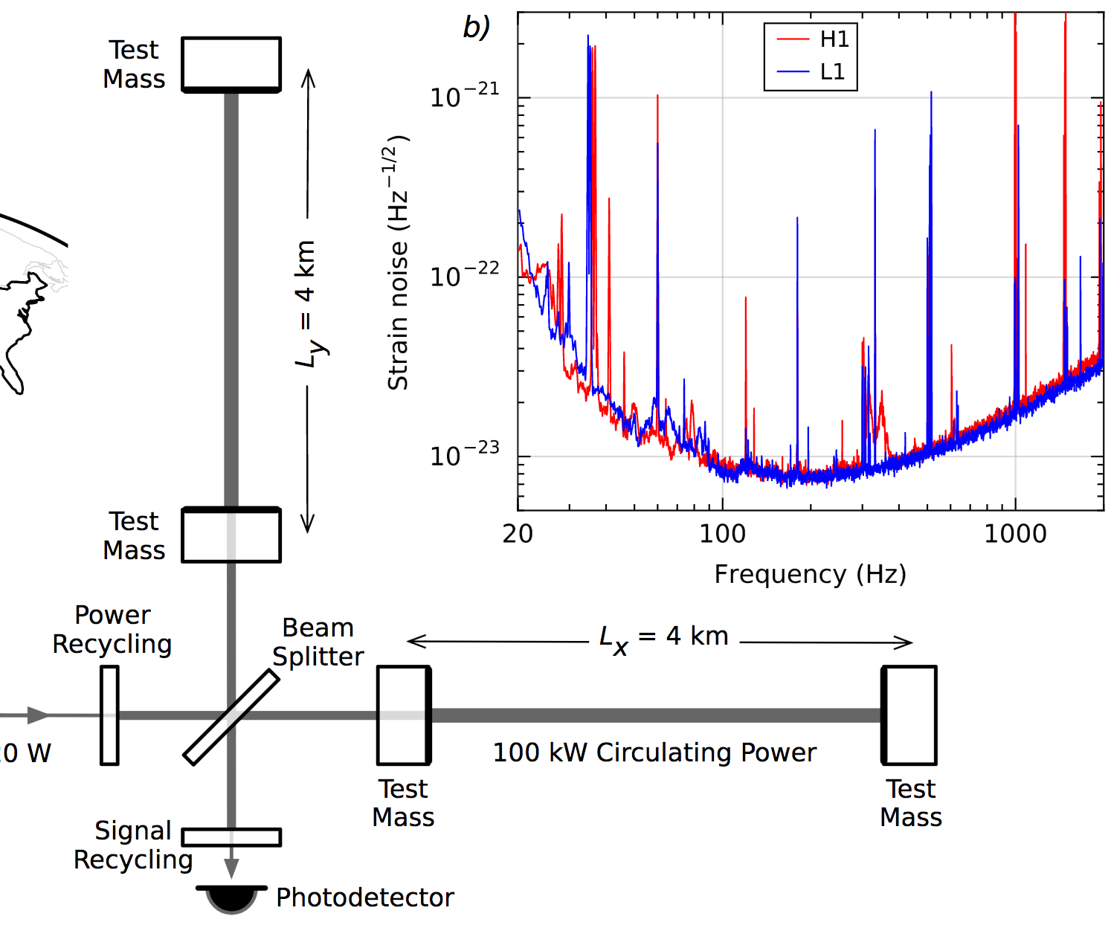
Getting down to <𝟣e–𝟤𝟥
Enhance the signal
Long arms
High power ultra-stable laser
Power recycling (factor ~𝟥𝟧)
Resonant arm cavities (factor ~𝟥𝟢𝟢)
Signal recycling
LVC, PRL 116 061102 (2016)

Slide 15
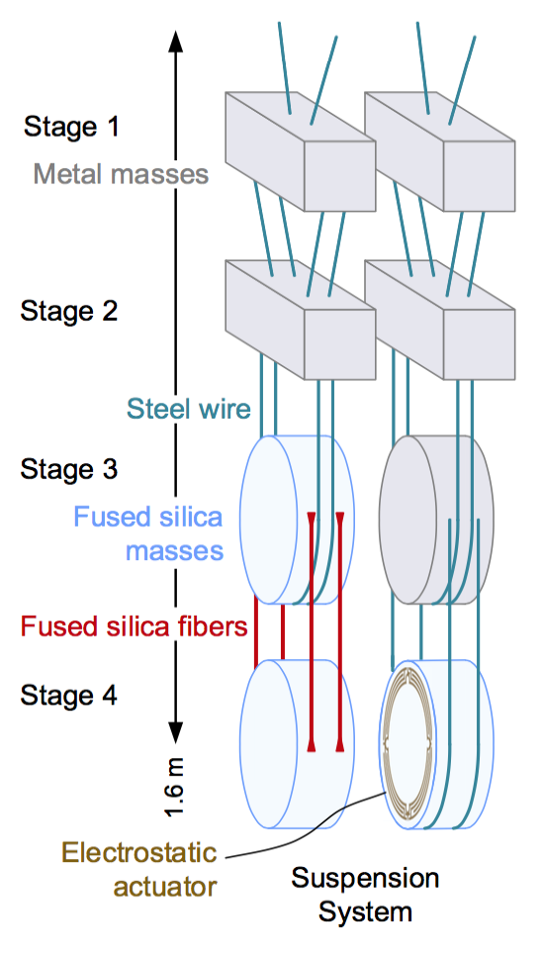
Getting down to <𝟣e–𝟤𝟥
Reduce seismic noise
Active seismic isolation
Quadruple pendulum suspension
~𝟣𝟢 orders of magnitude suppression of displacement noise above 𝟣𝟢Hz
Reduce quantum noise
Inject non-classical ‘squeezed’ states of photon field

Slide 16
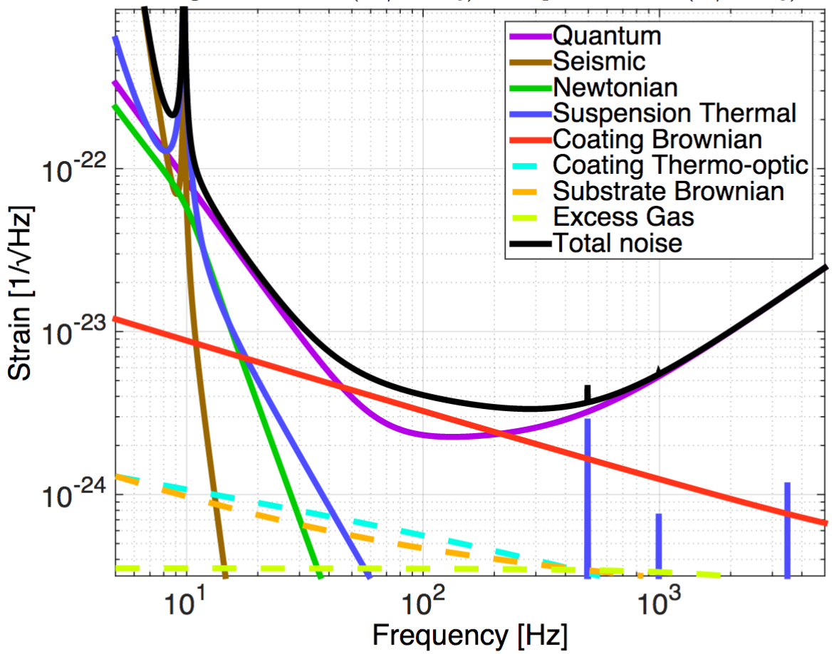
Precision Interferometry = Understanding Measurement Noises
Fundamental Noises:
Displacement Noises
→ ΔL(f)
Seismic noise
Radiation Pressure
Thermal noise
Suspensions
Optics
II. Sensing Noises
→ Δt_{photon}(f)
Shot Noise
Residual Gas
Technical Noises:
Advanced LIGO Design Noise Budget
→ Hundreds of them…
https://dcc.ligo.org/LIGO-T1800044/public

Slide 17
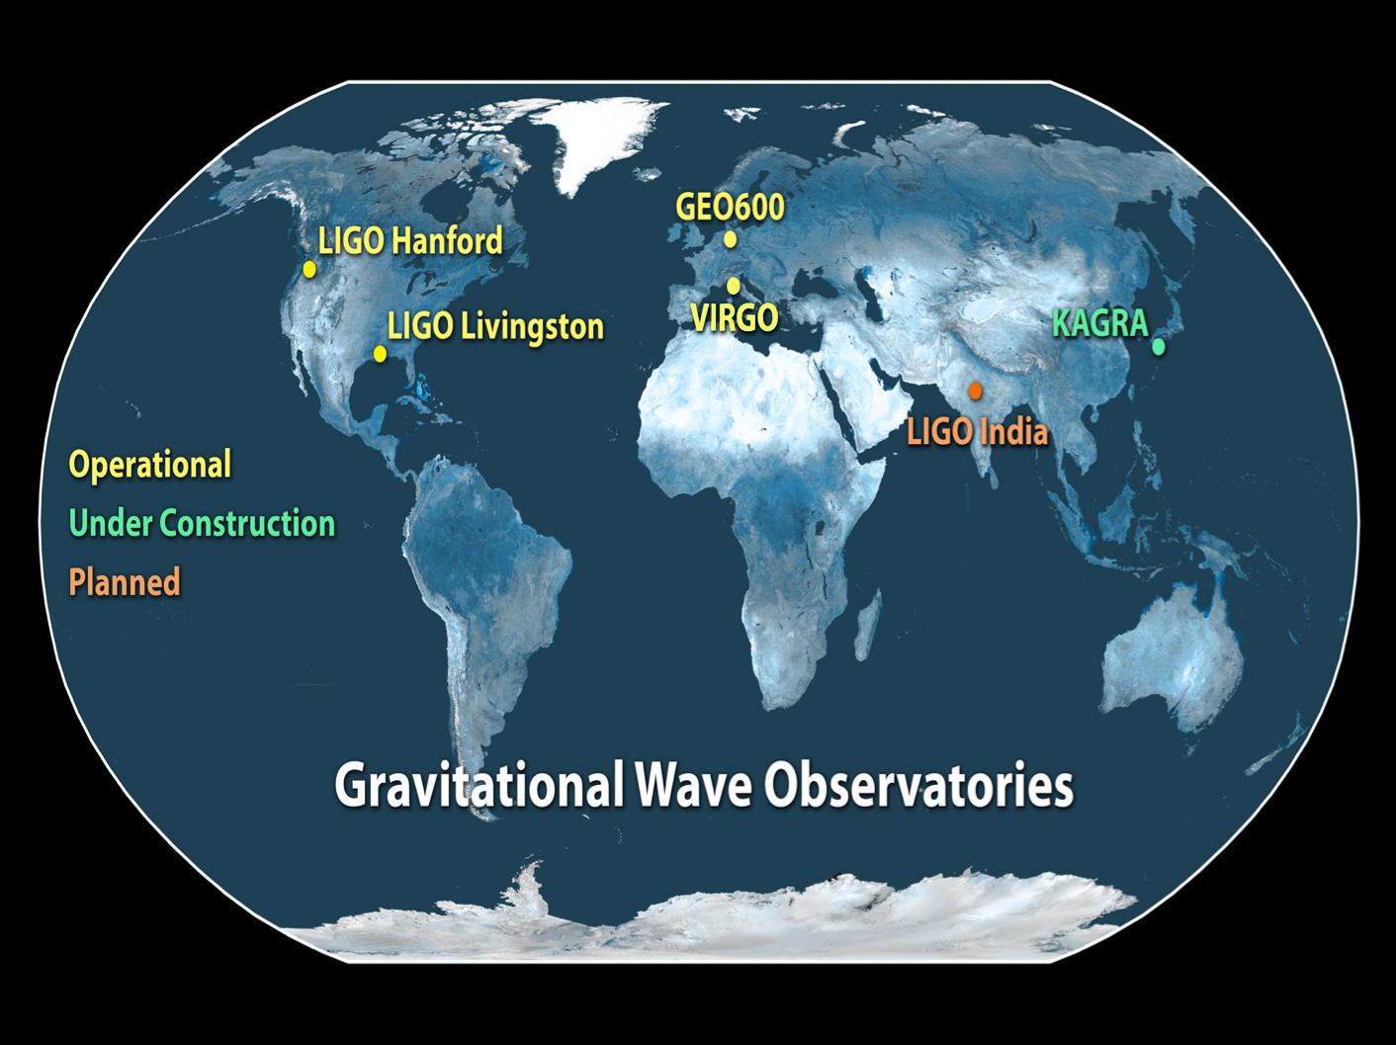
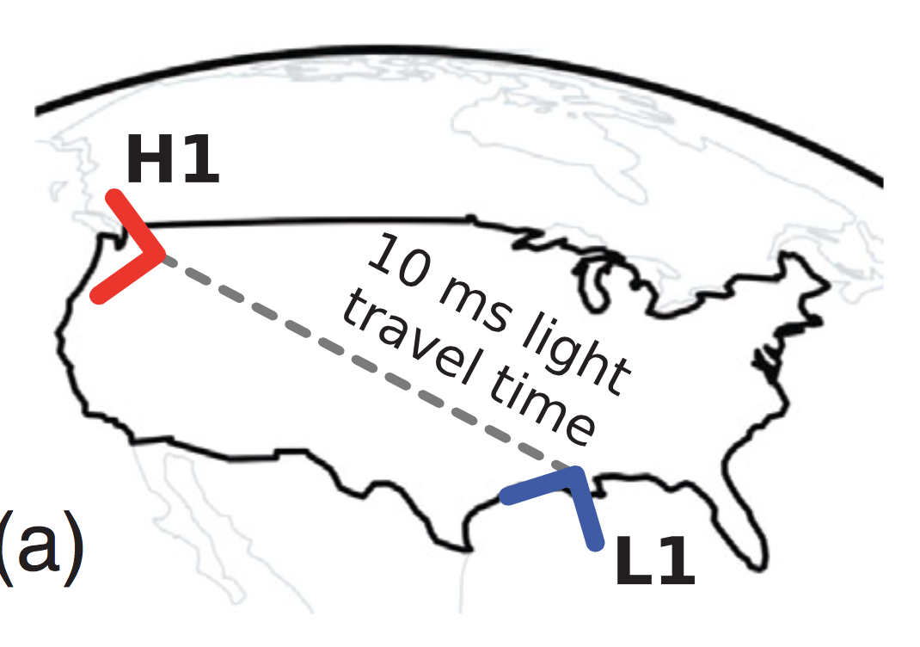
A global network
Detection rate, sky coverage, network duty cycle
Greater accuracy on source parameters
distance, sky location, GW polarization / orbit inclination ...

Slide 18
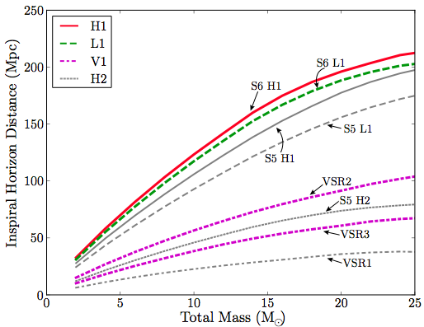
Horizon distance
Farthest distance D where a merger could produce a given expected SNR 𝜌 (e.g. =8)
D depends on binary masses & detector noise spectrum
−
LVC, arXiv:1111.7314

Slide 19
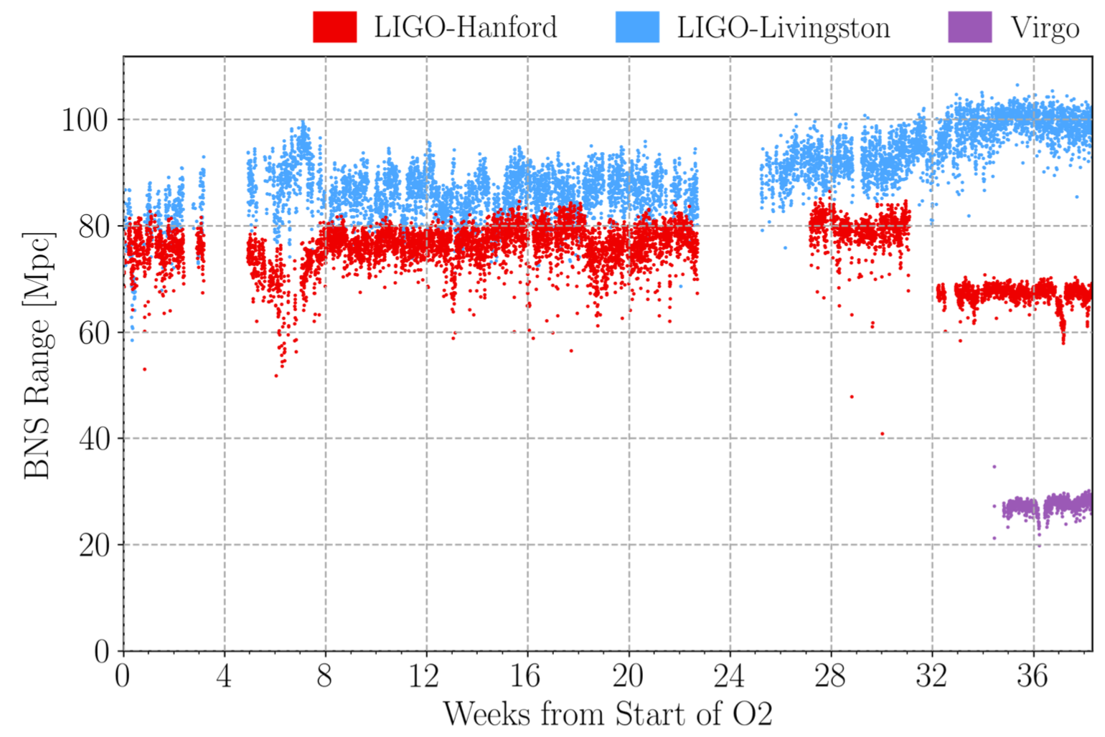
BNS range as figure of merit
‘Range’ : distance at which (1.4,1.4)M☉ source is detectable, averaged over 𝜄 and sky location
Sensitive volume
LVC, arXiv:1811.12907

Slide 20
THE DISCOVERY : BINARY BLACK HOLE MERGERS

Slide 21
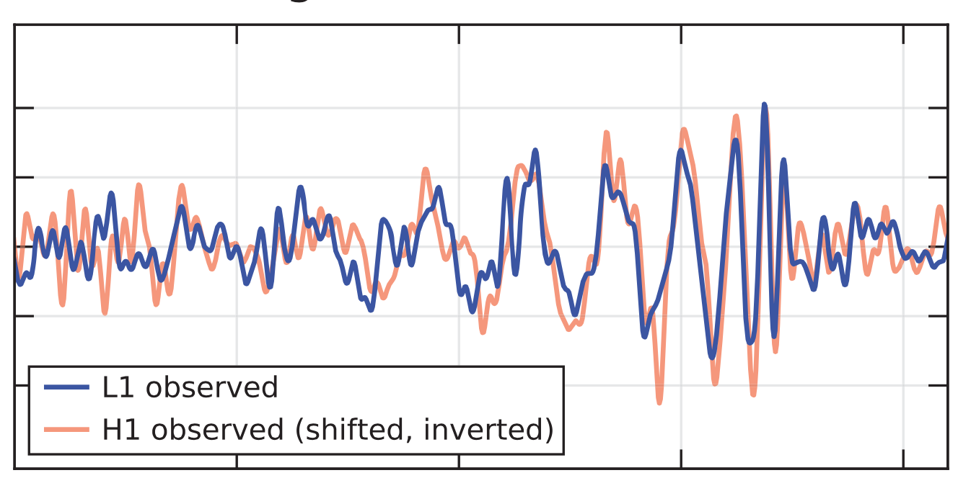
14 September 2015, 09:50:45 UTC
Strain (𝟣𝟢^{−𝟤𝟣})
Time (s)
Data band-passed & notch filtered
H1 relative sign flip & time delay
LVC, arXiv:1602.03837

Slide 22
‘The sound of gravity’

Slide 23
Black hole merger signal

Slide 24
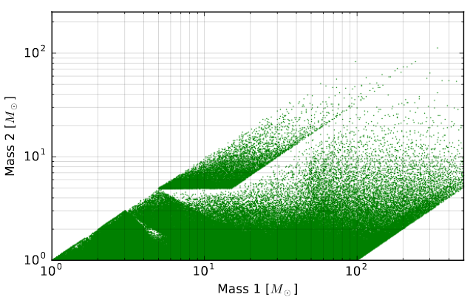
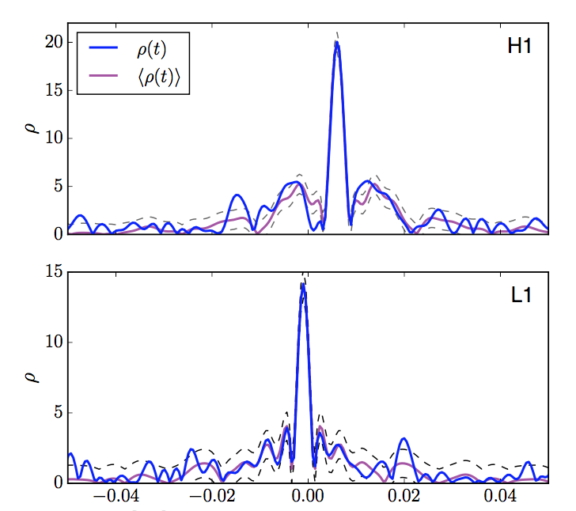
Detection of binary merger signal
Correlate h(t) data with 400,000+ ‘templates’
Binary mergers with total mass 2 − 500 M☉
Spins aligned with orbital ang momentum
Templates fitted to PostNewtonian & NumericalRelativity calculations
Impose consistency between detectors
SNR vs time /s (best fit template)
LVC, arXiv:1602.03839

Slide 26
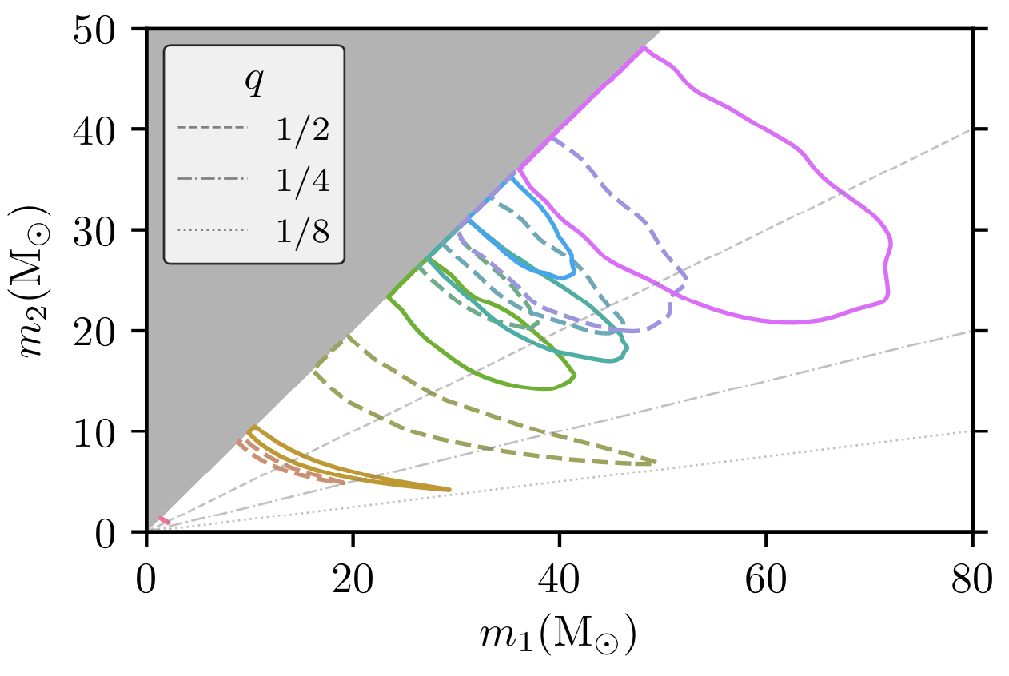
Masses of merging BH
LVC, arXiv:1811.12907

Slide 27
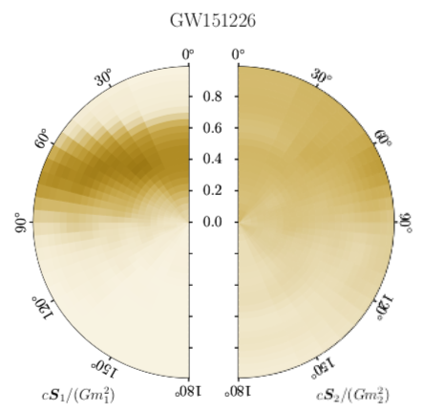
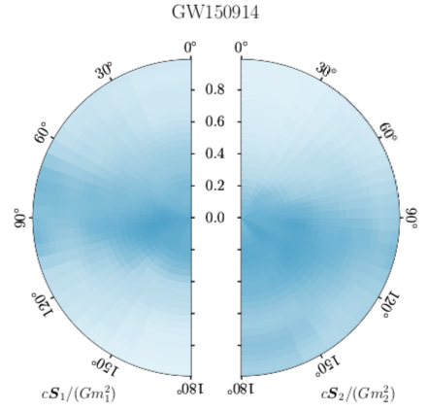
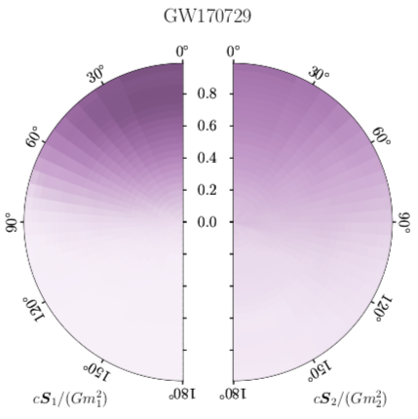
BH component spins
Typically very large uncertainties on S_{1,2}
Spin magnitudes smaller than maximum allowed by GR

Slide 28
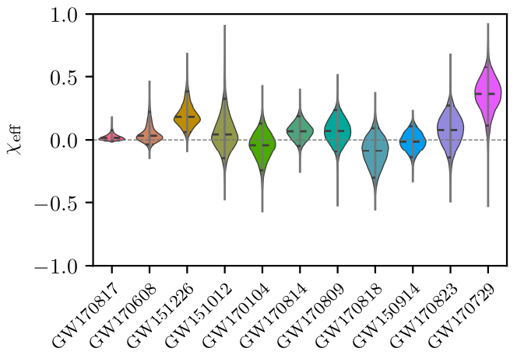
Binary ‘effective spin’
Best measured combination of component spins

Slide 29
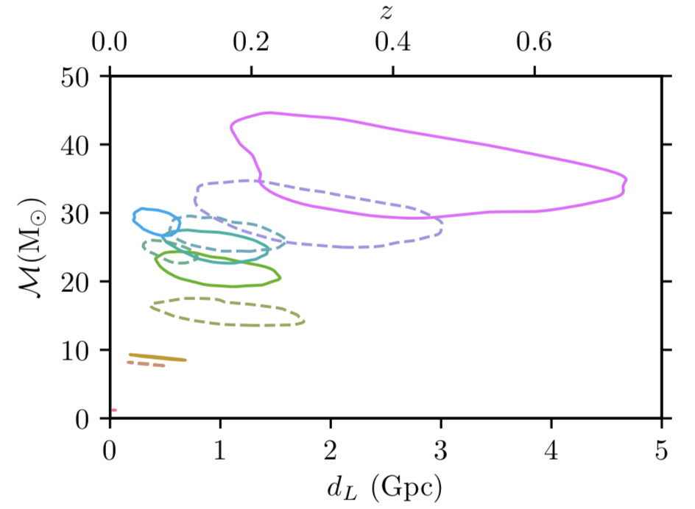
Distance to sources
Large uncertainties driven by orbital inclination 𝜄
Redshift effect on observed mass 𝘩(m₁, m₂ ; 𝑧) ∝ 𝘩(m₁(1+𝑧), m₂(1+𝑧) ; 𝑧=0)

Slide 30
BH merger rate and mass distribution
Prediction from 2010 : 0.1, 5, 300 /Gpc³ /y (low, realistic, high)
Mass distribution of merging BH : nearly flat up to 40-45 M☉
LVC, arXiv:1811.12940

Slide 31
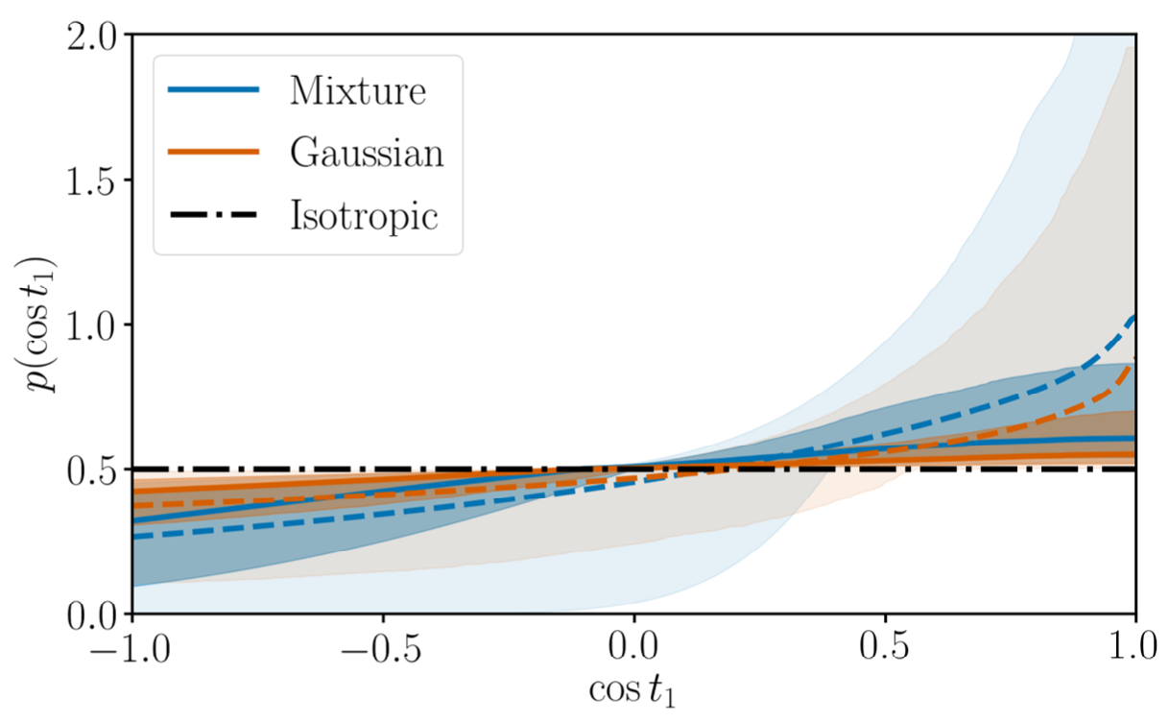
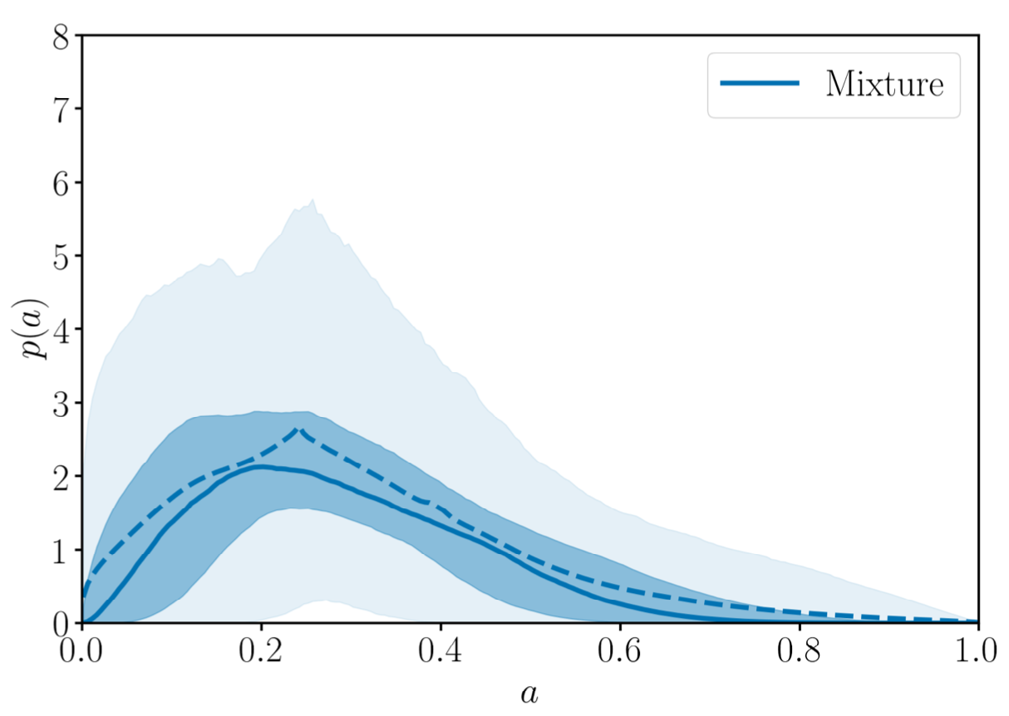
Weak constraints on BH spins
Tilt of primary spin (angle relative to orbital ang.mom.)
Magnitude

Slide 32
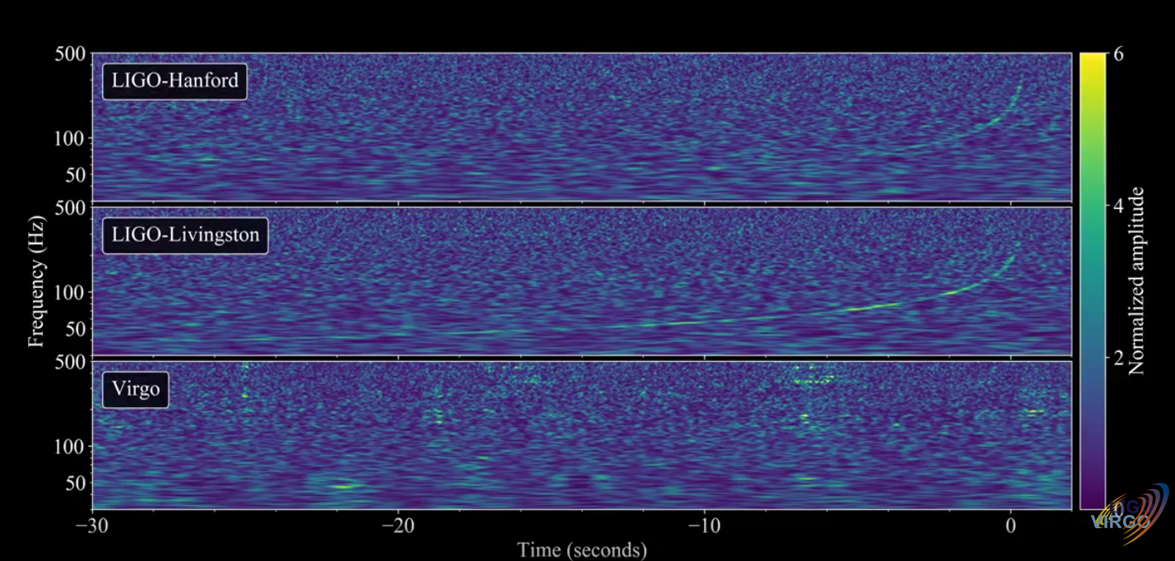
17th August, 2017
https://www.youtube.com/watch?v=aWX-BY-A9CY

Slide 33
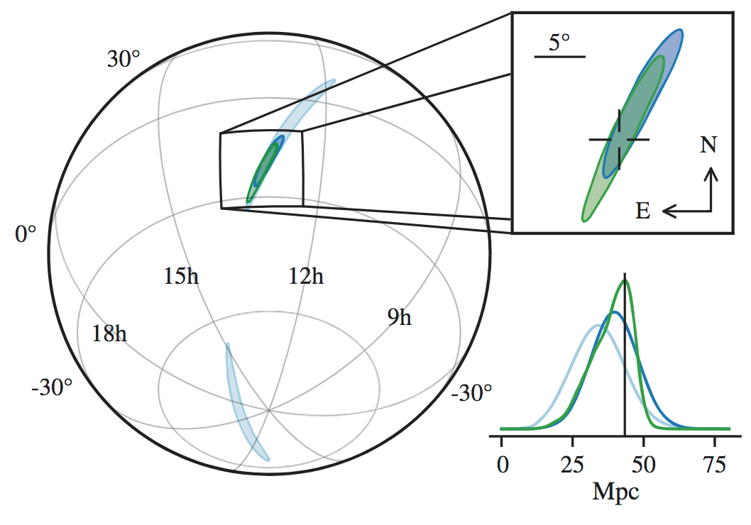
GW170817 on the sky
Map issued after few hours
3-detector sky area ~ 30 deg²
LVC, arXiv:1710.05832

Slide 34
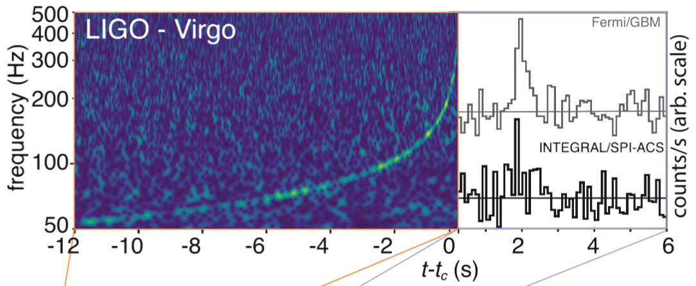
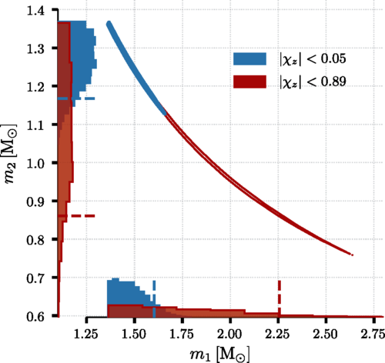
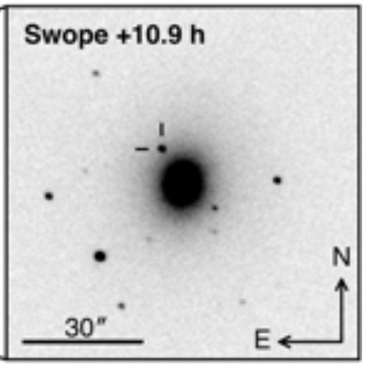
A few science results
Speed of gravity = speed of light
BinaryNeutronStar mergers create many heavy elements (‘kilonova’)
BNS masses consistent with Galactic binaries
Amplitude of GW ⇒ distance estimate Host galaxy ID ⇒ redshift Independent estimate of Hubble constant !

Slide 35
NS tidal deformability
NS in (static) tidal field will develop a nonzero quadrupole moment
Λ : dimensionless deformability
Affects evolution of orbit and GW emission when NS approach close to each other
Leading contribution to GW phase prop. to

Slide 36
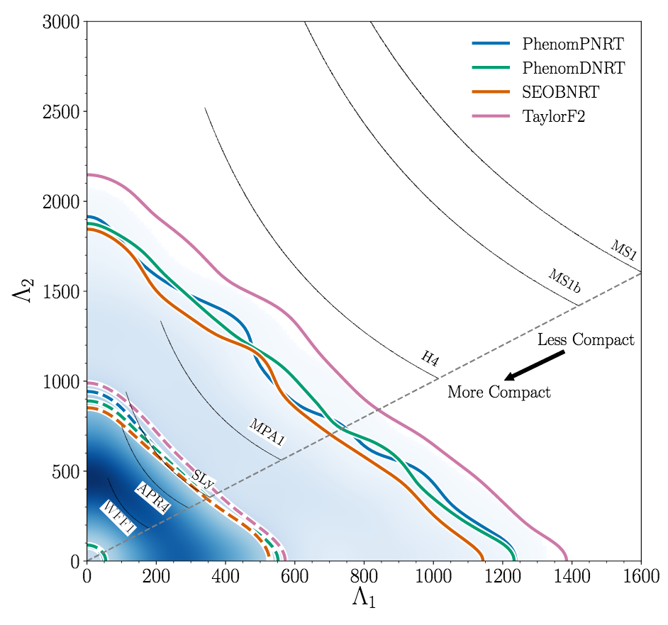
Bounds for ‘independent’ Λ’s
low spins assumed
LVC, arXiv:1805.11579

Slide 37
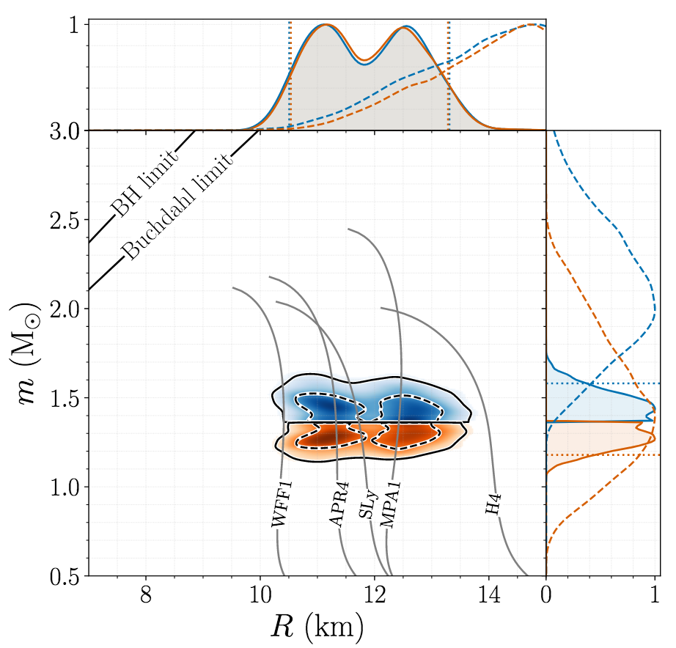
NS mass and radius
For parameterized EOS find (& numerically identical constraint for R₂)
LVC, arXiv:1805.11581

Slide 38
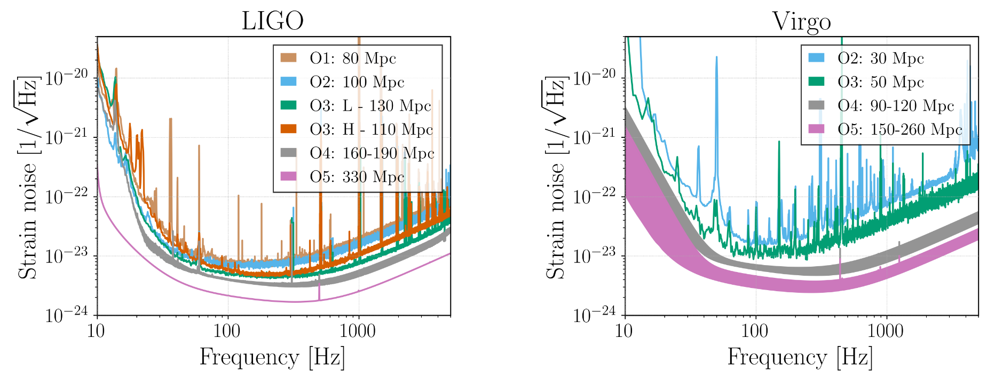
Upcoming science runs
O3 run started April 2019, duration ~1 year
Advanced design sensitivity (‘O4’) by 2021-22
Projections from LIGO-P1200087 Living Rev. Relativity vol.19 (2016) 1

Slide 39
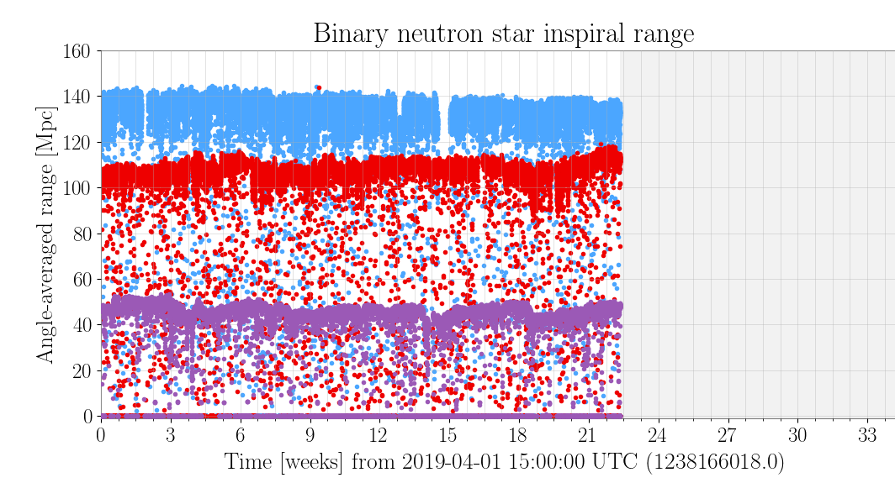
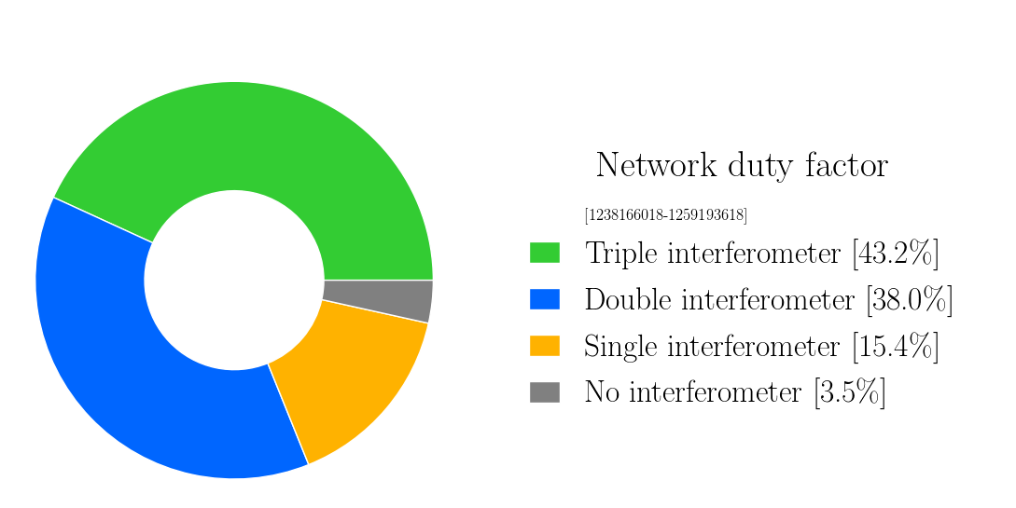
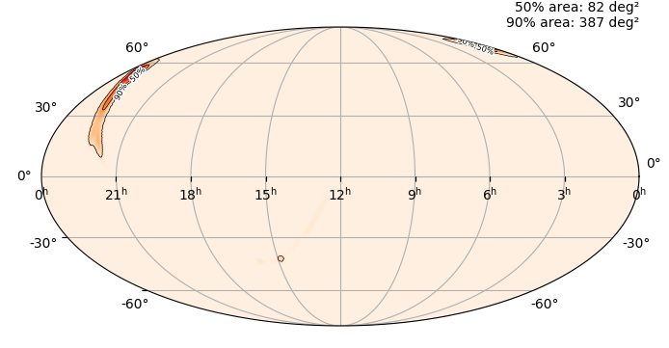
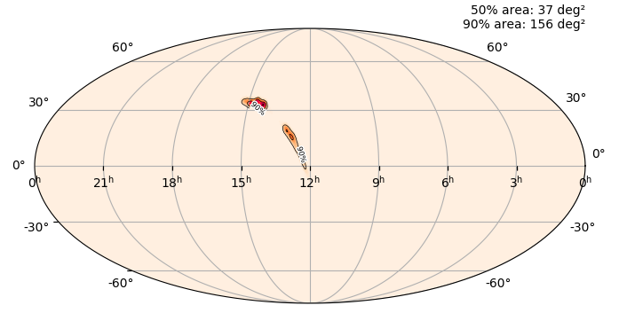
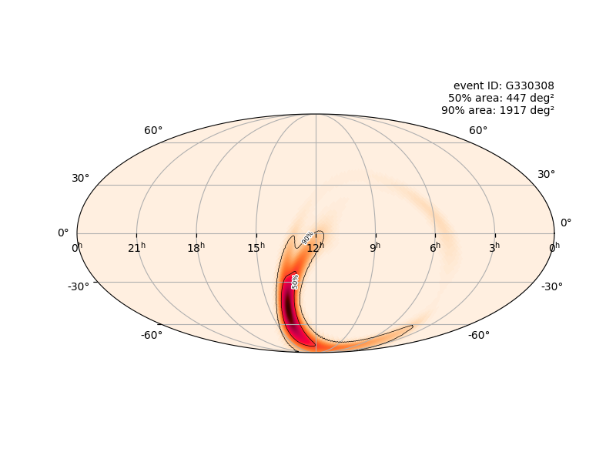
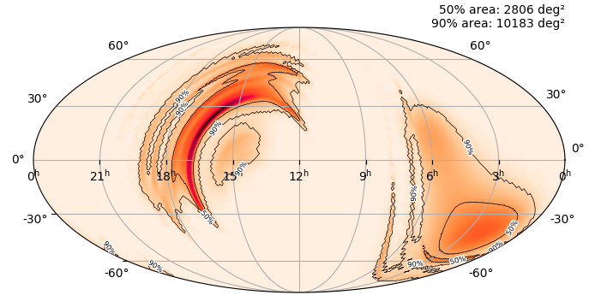
Latest News : O3 observing run
In progress since April 1st , HLV network
Public alerts for significant candidate events
sky map, distance, probabilistic classification of source

Slide 40
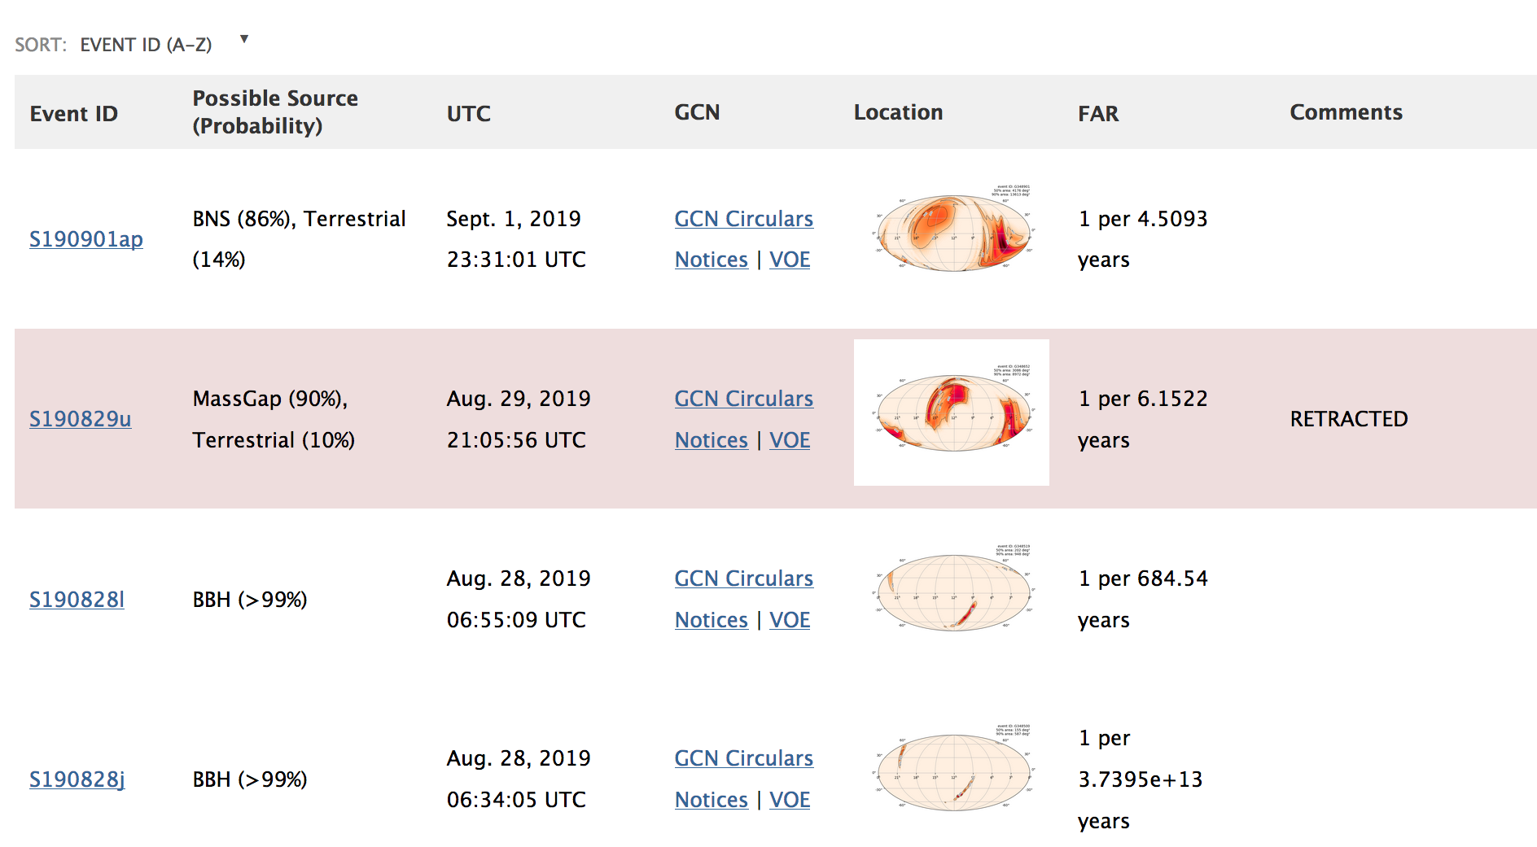
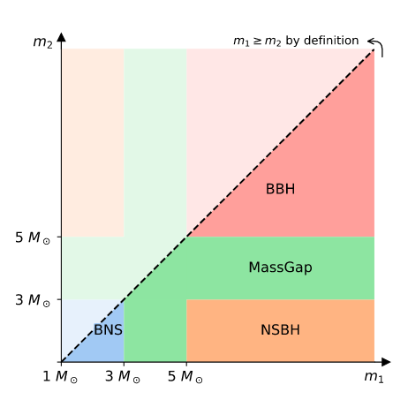
O3 public alert page
https://gracedb.ligo.org/superevents/public/O3/

Slide 41
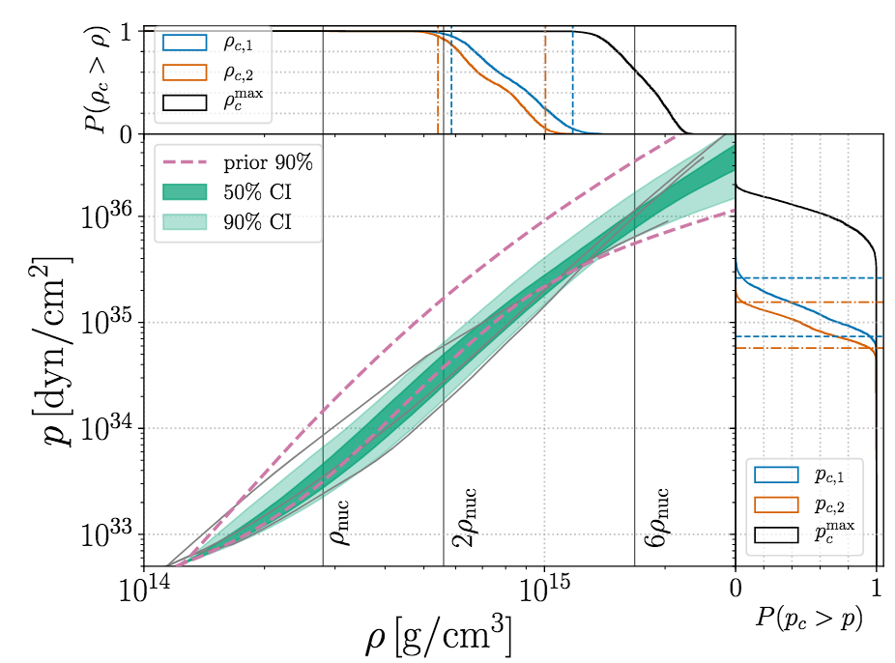
Parameterized EOS bounds
‘Spectral model’ of NS energy & density as functions of pressure (Lindblom et al.)
polynomials in 𝑝 imposing physical constraints
must allow 𝑚 ≥ 1.97 M☉
LVC, arXiv:1805.11581

